Slide 1
8. An appraisal of Josiah’s reformation 23:24-27
24 Moreover, Josiah removed the mediums and the spiritists and the teraphim and the idols and all the abominations that were seen in the land of Judah and in Jerusalem, that he might confirm the words of the law which were written in the book that Hilkiah the priest found in the house of the LORD.
25 And before him there was no king like him who turned to the LORD with all his heart and with all his soul and with all his might, according to all the law of Moses; nor did any like him arise after him.
26 However, the LORD did not turn from the fierceness of His great wrath with which His anger burned against Judah, because of all the provocations with which Manasseh had provoked Him.
27 And the LORD said, "I will remove Judah also from My sight, as I have removed Israel. And I will cast off Jerusalem, this city which I have chosen, and the temple of which I said, ‘My name shall be there.’"

Slide 2
III. The Dying Days of Judah II Kings 23:28—25:30

Slide 3
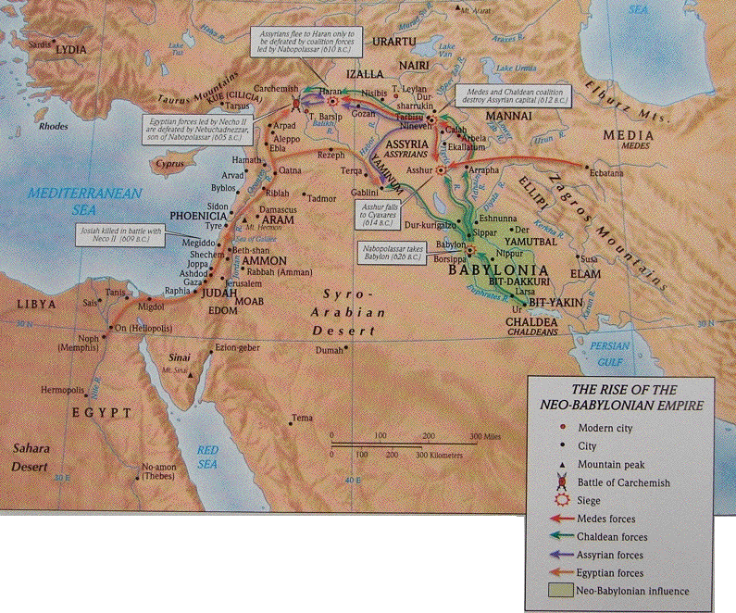

Slide 4
A. The death and burial of Josiah 23:28-30
28 Now the rest of the acts of Josiah and all that he did, are they not written in the Book of the Chronicles of the Kings of Judah?

Slide 5
Neco II 610-595 killed Josiah when he met him at Megiddo. Tried to prop up Assyrian empire as buffer against Babylon

Slide 6
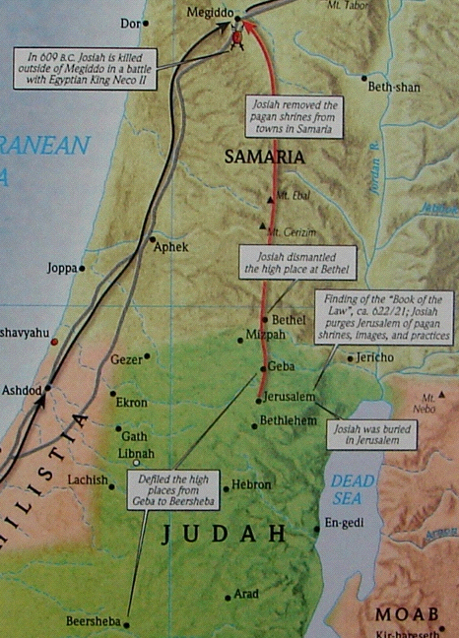
29 In his days Pharaoh Neco king of Egypt went up to the king of Assyria to the river Euphrates. And King Josiah went to meet him, and when Pharaoh Neco saw him he killed him at Megiddo.
30 And his servants drove his body in a chariot from Megiddo, and brought him to Jerusalem and buried him in his own tomb. Then the people of the land took Jehoahaz the son of Josiah and anointed him and made him king in place of his father.

Slide 7
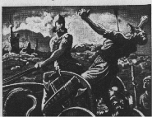
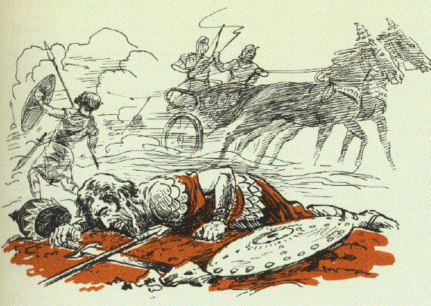
Death of Josiah 2 C 35:21-25
21 But Neco sent messengers to him, saying, "What have we to do with each other, O King of Judah? I am not coming against you today but against the house with which I am at war, and God has ordered me to hurry. Stop for your own sake from interfering with God who is with me, that He may not destroy you."
22 However, Josiah would not turn away from him, but disguised himself in order to make war with him; nor did he listen to the words of Neco from the mouth of God, but came to make war on the plain of Megiddo.
23 And the archers shot King Josiah, and the king said to his servants, "Take me away, for I am badly wounded."

Slide 8
24 So his servants took him out of the chariot and carried him in the second chariot which he had, and brought him to Jerusalem where he died and was buried in the tombs of his fathers. And all Judah and Jerusalem mourned for Josiah.
25 Then Jeremiah chanted a lament for Josiah. And all the male and female singers speak about Josiah in their lamentations to this day. And they made them an ordinance in Israel; behold, they are also written in the Lamentations.

Slide 9
B. The reign and removal of Jehoahaz 23:31-35
31 Jehoahaz was twenty-three years old when he became king, and he reigned three months in Jerusalem; and his mother’s name was Hamutal [huh-myoo’tuhl] the daughter of Jeremiah of Libnah.
32 And he did evil in the sight of the LORD, according to all that his fathers had done.
33 And Pharaoh Neco imprisoned him at Riblah in the land of Hamath, that he might not reign in Jerusalem; and he imposed on the land a fine of one hundred talents of silver and a talent of gold.

Slide 10
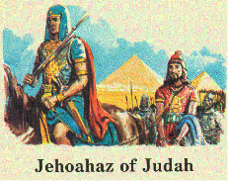
34 And Pharaoh Neco made Eliakim the son of Josiah king in the place of Josiah his father, and changed his name to Jehoiakim. But he took Jehoahaz away and brought him to Egypt, and he died there.
35 So Jehoiakim gave the silver and gold to Pharaoh, but he taxed the land in order to give the money at the command of Pharaoh. He exacted the silver and gold from the people of the land, each according to his valuation, to give it to Pharaoh Neco.

Slide 11
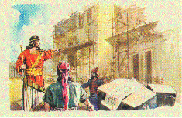
C. The reign and rebellion of Jehoiakim 23:36—24:7
36 Jehoiakim was twenty-five years old when he became king, and he reigned eleven years in Jerusalem; and his mother’s name was Zebidah [zeb’uh-digh’uh] the daughter of Pedaiah [pi-day’yuh] of Rumah.
* 609-597 B.C.
37 And he did evil in the sight of the LORD, according to all that his fathers had done.
* Built a fancy palace while the nation was poor Jer. 22:13-14
* A tyrant - bigot, arrogant, irreverent
* Killed Uriah the prophet Jer. 26:21
* Persecuted Jeremiah (predicted the destruction of temple, Jer. 7, 26)

Slide 12
The Babylonian Chronicle records events in ancient Babylon dating from about 750 BC to 280 BC. This tablet is part of that chronicle and records events from 605-594 BC including Nebuchadnezzar II's campaigns in the west, where Jerusalem is. It also records the defeat of the Assyrians and the fall of the Assyrian Empire and the rising threat of Egypt. It records the Battle of Carchemish where Nebuchadnezzar II of Babylon defeated Pharoah Necho of Egypt in 605 BC. It records Nebuchadnezzar's rise to power, it records the removing of Jehoiachin, king of Judah and inserting Zedekiah as king in his place, as recorded in Scripture, and it records the capture of Jerusalem on the 16th of March, 598 BC. The discovery of this part of the Babylonian Chronicle is important in the study of Biblical Archaeology because it contains several events mentioned in the Bible that correspond exactly.

Slide 13
Hananiah the son of Azariah (Azzur) Jeremiah 28
Seraiah son of Neriah, Jer 51:59
Malchiah the son of the king Jer 3
Seal of Baruch (Berekyahu) son of Neriah the scribe = Jeremiah's secretary

Slide 14
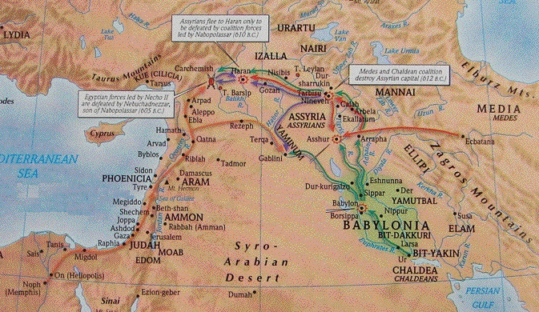
* Babylon defeats Egyptians at Carchemish, June 605
Hostages (Daniel and friends) and treasures are sent to Babylon
* Nabopolassar died, August 16, 605
* Nebuchadnezzar crowned king, Sept. 6, 605
* In the fourth regnal year of Jehoiakim: Oct. 7, 605
* Nebuchadnezzar’s first regnal year, April 2, 604
Jeremiah’s prophecy Jer. 25:1
Jeremiah predicted that Babylon would capture Judah

Slide 15
* In the fourth regnal year of Jehoiakim: Oct. 7, 605
* Nebuchadnezzar’s first regnal year, April 2, 604
Jeremiah’s prophecy Jer. 25:1 Predicted that Babylon would capture Judah

Slide 16
C. The reign and rebellion of Jehoiakim 23:36—24:7
1 In his days Nebuchadnezzar king of Babylon came up, and Jehoiakim became his servant for three years; then he turned and rebelled against him.
2 C 36:6, 7
6 Nebuchadnezzar king of Babylon came up against him and bound him with bronze chains to take him to Babylon.
7 Nebuchadnezzar also brought some of the articles of the house of the LORD to Babylon and put them in his temple at Babylon.
* Jehoiakim became a vassal of Nebuchadnezzar, Sept. 26, 604
* 2 C 36:6 Jehoiakim bound for Babylon
Nebuchadnezzar must have changed his mind
Jehoiakim served the king of Babylon 3 years

Slide 17
C. The reign & rebellion of Jehoiakim 23:36—24:7
1 In his days Nebuchadnezzar king of Babylon came up, and Jehoiakim became his servant for three years; then he turned and rebelled against him.
* Jehoiakim cut and burned Jeremiah’s book, Jer. 36, Dec. 603
* Nebuchadnezzar tries to invade Egypt, but is turned back, Mar. 30, 601
* Jehoiakim rebels: Sept. 22, 601

Slide 18
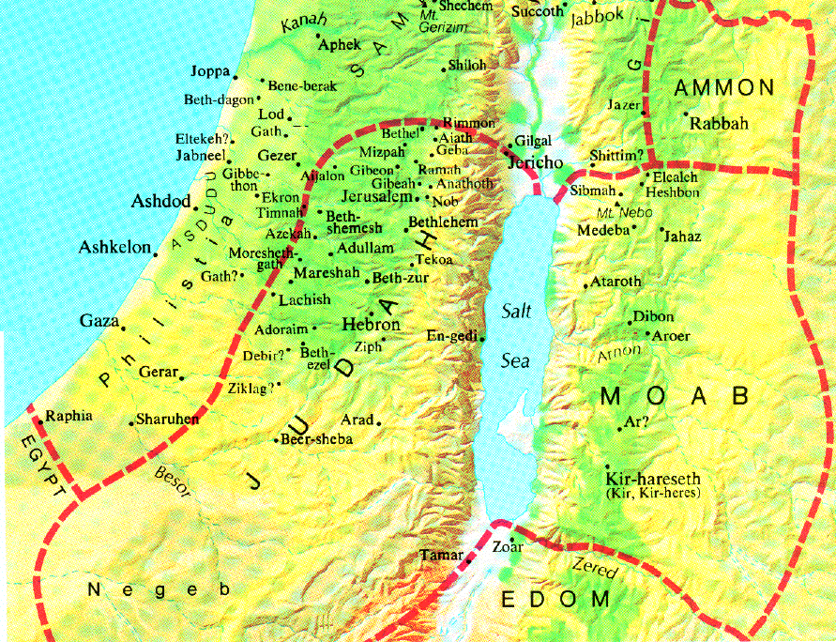
C. The reign & rebellion of Jehoiakim 23:36—24:7
2 And the LORD sent against him bands of Chaldeans, bands of Arameans, bands of Moabites, and bands of Ammonites. So He sent them against Judah to destroy it, according to the word of the LORD, which He had spoken through His servants the prophets.
Rural people seek refuge in Jerusalem Jer. 35:11

Slide 19
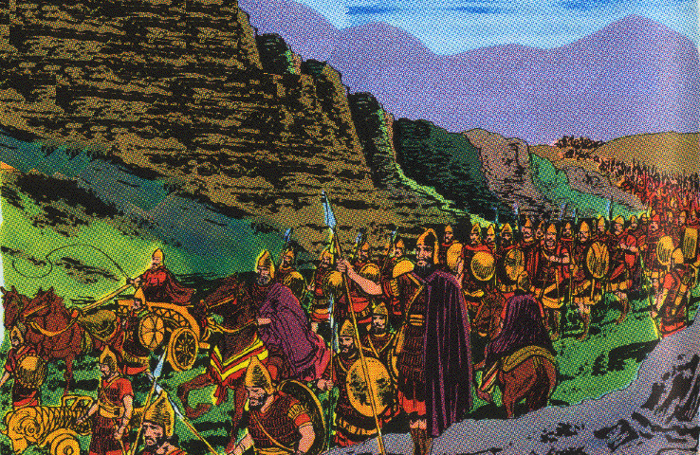
C. The reign & rebellion of Jehoiakim 23:36—24:7
* Babylonian army rebuilt, Mar. 19, 600
* Nebuchadnezzar marches against Palestine, Nov. 599
* Nebuchadnezzar returns to Babylon, Mar. 598
* Nebuchadnezzar begins seventh regnal year: Mar. 27, 598 3,023 Jews exiled to Babylon, Jer. 52:28
* Nebuchadnezzar come to Palestine, Dec. 598

Slide 20
C. The reign & rebellion of Jehoiakim 23:36—24:7
3 Surely at the command of the LORD it came upon Judah, to remove them from His sight because of the sins of Manasseh, according to all that he had done,
4 and also for the innocent blood which he shed, for he filled Jerusalem with innocent blood; and the LORD would not forgive.

Slide 21
C. The reign & rebellion of Jehoiakim 23:36—24:7
5 Now the rest of the acts of Jehoiakim and all that he did, are they not written in the Book of the Chronicles of the Kings of Judah?
6 So Jehoiakim slept with his fathers, and Jehoiachin his son became king in his place.
* Jehoiakim died, Dec. 6, 598
* Burial of a donkey, Jer. 22:18, 19
7 And the king of Egypt did not come out of his land again, for the king of Babylon had taken all that belonged to the king of Egypt from the brook of Egypt to the river Euphrates.

Slide 22
D. The reign & deportation of Jehoiachin 24:8-17
8 Jehoiachin was eighteen years old when he became king, and he reigned three months in Jerusalem; and his mother’s name was Nehushta [ni-hoosh’tuh] the daughter of Elnathan of Jerusalem.
(Jehoiachin, or Jeconiah, or Coniah = Jehovah will establish or Jehovah establishes)
His mother is mentioned in Jer. 22:26; 29:2
9 And he did evil in the sight of the LORD, according to all that his father had done.
No repentance or reform Jer. 22:28, 29; Ezek. 19:5-7

Slide 23
D. The reign and deportation of Jehoiachin 24:8-17
10 At that time the servants of Nebuchadnezzar king of Babylon went up to Jerusalem, and the city came under siege.
11 And Nebuchadnezzar the king of Babylon came to the city, while his servants were besieging it.
12 And Jehoiachin the king of Judah went out to the king of Babylon, he and his mother and his servants and his captains and his officials. So the king of Babylon took him captive in the eighth year of his reign.
Jehoiachin and the other leaders surrender to Nebuchadnezzar: March 16, 597

Slide 24
D. The reign and deportation of Jehoiachin 24:8-17
13 And he carried out from there all the treasures of the house of the LORD, and the treasures of the king’s house, and cut in pieces all the vessels of gold which Solomon king of Israel had made in the temple of the LORD, just as the LORD had said. Isa. 39:6; Jer. 15:13; 17:3
14 Then he led away into exile all Jerusalem and all the captains and all the mighty men of valor, ten thousand captives, and all the craftsmen and the smiths. None remained except the poorest people of the land.

Slide 25
D. The reign and deportation of Jehoiachin 24:8-17
15 So he led Jehoiachin away into exile to Babylon; also the king’s mother and the king’s wives and his officials and the leading men of the land, he led away into exile from Jerusalem to Babylon.
16 And all the men of valor, seven thousand, and the craftsmen and the smiths, one thousand, all strong and fit for war, and these the king of Babylon brought into exile to Babylon.
17 Then the king of Babylon made his uncle Mattaniah, king in his place, and changed his name to Zedekiah.

Slide 26
E. The revolt and punishment of Zedekiah 24:18—25:7
18 Zedekiah was twenty-one years old when he became king, and he reigned eleven years in Jerusalem; and his mother’s name was Hamutal the daughter of Jeremiah of Libnah.
19 And he did evil in the sight of the LORD, according to all that Jehoiakim had done.
He let the people continue in their abominations
[2 C 36:14 Furthermore, all the officials of the priests and the people were very unfaithful following all the abominations of the nations; and they defiled the house of the LORD which He had sanctified in Jerusalem.]
He ignored the prophets
He was dependent on politics and not God
594 - A new Pharaoh in Egypt and plans by Judah, Edom, Moab, Ammon, Tyre, and Sidon to rebel Jer. 27:3-ff
Zedekiah summoned to Babylon to reaffirm his allegiance Jer. 51:59 ff

Slide 27
E. The revolt and punishment of Zedekiah 24:18—25:7
* Hananiah’s false prophesy, Sept. 593 Jer. 28:1-4
* Ezekiel’s temple vision, Sept. 17, 592 Ezek. 8:1
* Ezekiel’s address to the elders, Aug. 14, 591 Ezek. 20:1
* 588 - Pharaoh Hophra crowned & encourages nations to revolt

Slide 28
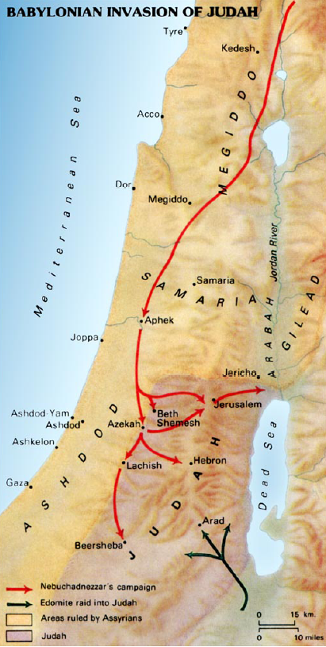
E. The revolt and punishment of Zedekiah 24:18—25:7
20 For through the anger of the LORD this came about in Jerusalem and Judah until He cast them out from His presence. And Zedekiah rebelled against the king of Babylon.
* His stupidity was part of God’s plan to cast them out
* Tyre and Ammon join Judah
* Zedekiah sends ambassadors to Egypt Ezek. 17:15

Slide 29
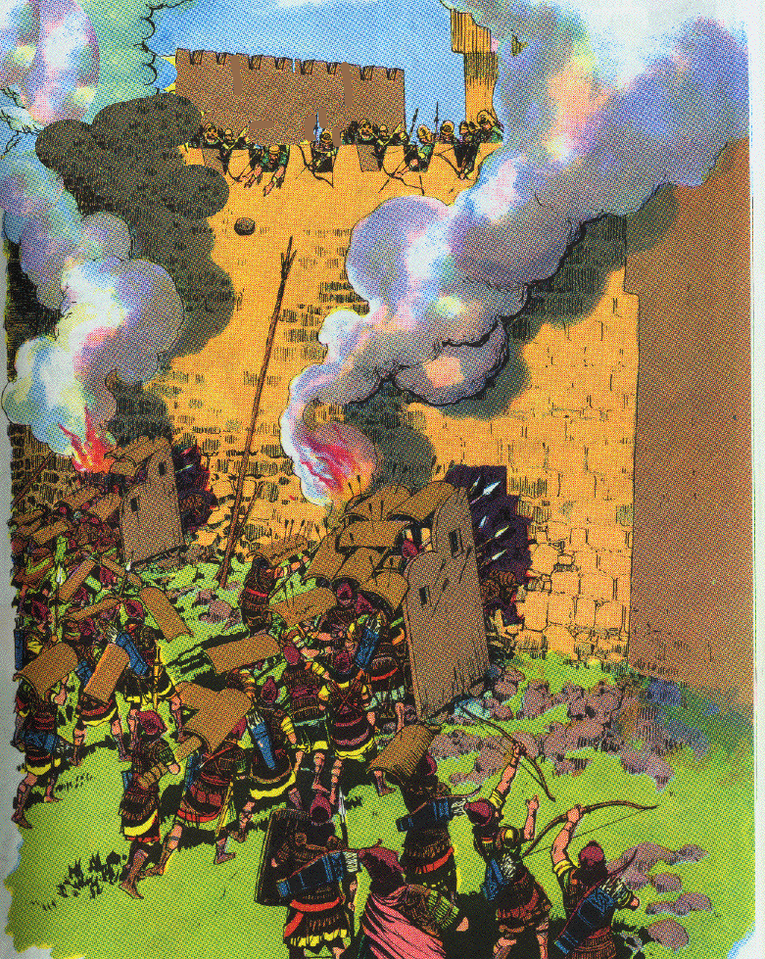
E. The revolt and punishment of Zedekiah 24:18—25:7
25:1 ¶ Now it came about in the ninth year of his reign, on the tenth day of the tenth month, that Nebuchadnezzar king of Babylon came, he and all his army, against Jerusalem, camped against it, and built a siege wall all around it.
* The siege of Jerusalem begins, Jan. 15, 588 Jer. 39:1; 52:4; Ezek. 24:1

Slide 30
E. The revolt and punishment of Zedekiah 24:18—25:7
2 So the city was under siege until the eleventh year of King Zedekiah.
3 On the ninth day of the fourth month the famine was so severe in the city that there was no food for the people of the land.
* 588 summer - Egyptian army marched toward Jerusalem.
Siege temporarily lifted. Jer. 37:5; Ezek. 17:17
Jeremiah attempted to go to Benjamin, Jer. 37:12
Jeremiah put in prison, Jer. 32:1
June 21, Ezekiel’s message to Egypt, Ezek. 31:1
* Siege resumed and a famine begins, Jer. 21:7, 9; Lam. 2:12
Pestilence follows the famine, Jer. 21:6, 7
The city is reduced to the last extremity, Lam. 4:10

Slide 31
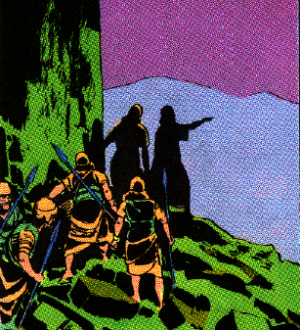
E. The revolt and punishment of Zedekiah 24:18—25:7
4 Then the city was broken into, and all the men of war fled by night by way of the gate between the two walls beside the king’s garden, though the Chaldeans were all around the city. And they went by way of the Arabah.
July 18, 586 the wall is breached
5 But the army of the Chaldeans pursued the king and overtook him in the plains of Jericho and all his army was scattered from him.

Slide 32
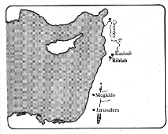

Slide 33
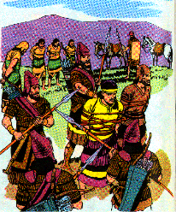
E. The revolt and punishment of Zedekiah 24:18—25:7
6 Then they captured the king and brought him to the king of Babylon at Riblah, and he passed sentence on him.

Slide 34
E. The revolt and punishment of Zedekiah 24:18—25:7
7 And they slaughtered the sons of Zedekiah before his eyes, then put out the eyes of Zedekiah and bound him with bronze fetters and brought him to Babylon.

Slide 35
F. Destruction of Jerusalem & deportation of the Jews 25:8-17
The situation had no remedy 2 Chron. 36:15-16
15 And the LORD, the God of their fathers, sent word to them again and again by His messengers, because He had compassion on His people and on His dwelling place;
16 but they continually mocked the messengers of God, despised His words and scoffed at His prophets, until the wrath of the LORD arose against His people, until there was no remedy.

Slide 36
F. Destruction of Jerusalem & deportation of the Jews 25:8-17
8 ¶ Now on the seventh day of the fifth month, which was the nineteenth year of King Nebuchadnezzar, king of Babylon, Nebuzaradan the captain of the guard, a servant of the king of Babylon, came to Jerusalem.
Aug. 12, 586, Nebuzaradan arrived and on the Aug. 15 entered the city
Nebuzaradan arrived a month after the walls were breached
He arrived on the seventh day of the month & enter the city on the tenth
Jer. 52:12 Now on the tenth day of the fifth month, which was the nineteenth year of King Nebuchadnezzar, king of Babylon, Nebuzaradan the captain of the bodyguard, who was in the service of the king of Babylon, came to Jerusalem.

Slide 37
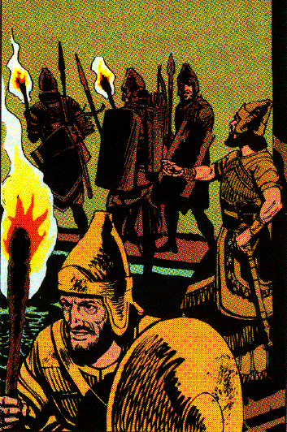
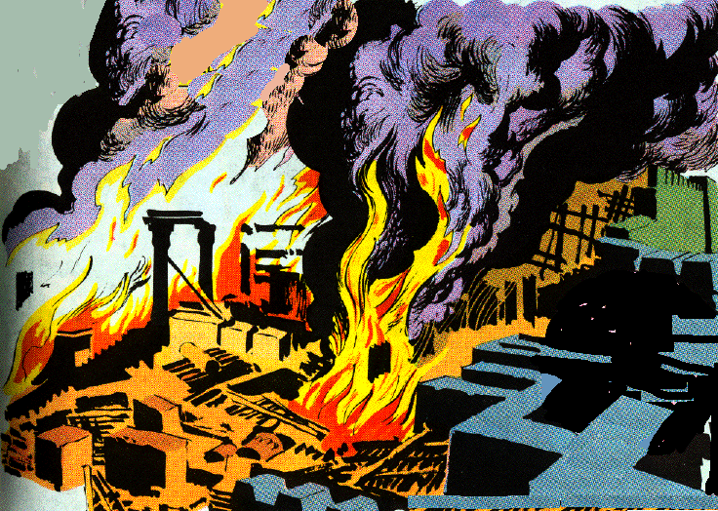
F. Destruction of Jerusalem & deportation of the Jews 25:8-17
9 And he burned the house of the LORD, the king’s house, and all the houses of Jerusalem; even every great house he burned with fire.
10 So all the army of the Chaldeans who were with the captain of the guard broke down the walls around Jerusalem.

Slide 38
Destruction of the Temple & Jerusalem
A den of robbers Isa. 56:7; Jer. 7:11 "Has this house, which is called by My name, become a den of robbers in your sight? Behold, I, even I, have seen it," declares the LORD.
God’s glory departed Ezek. 11:22, 23 Then the cherubim lifted up their wings with the wheels beside them, and the glory of the God of Israel hovered over them. And the glory of the LORD went up from the midst of the city, and stood over the mountain which is east of the city.
Evil doers had trusted in the temple like an idol Jer. 7:4 "Do not trust in deceptive words, saying, ‘This is the temple of the LORD, the temple of the LORD, the temple of the LORD.’
Like the bronze serpent it needed to be destroyed II K 18:4

Slide 39
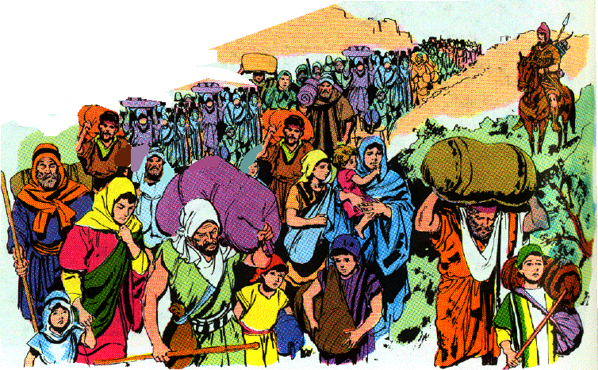
F. Destruction of Jerusalem & deportation of the Jews 25:8-17
11 Then the rest of the people who were left in the city and the deserters who had deserted to the king of Babylon and the rest of the multitude, Nebuzaradan the captain of the guard carried away into exile.
12 But the captain of the guard left some of the poorest of the land to be vinedressers and plowmen.

Slide 40
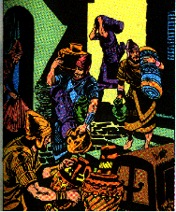
F. Destruction of Jerusalem & deportation of the Jews 25:8-17
13 Now the bronze pillars which were in the house of the LORD, and the stands and the bronze sea which were in the house of the LORD, the Chaldeans broke in pieces and carried the bronze to Babylon.
14 And they took away the pots, the shovels, the snuffers, the spoons, and all the bronze vessels which were used in temple service.
15 The captain of the guard also took away the firepans and the basins, what was fine gold and what was fine silver.

Slide 41
F. Destruction of Jerusalem & deportation of the Jews 25:8-17
16 The two pillars, the one sea, and the stands which Solomon had made for the house of the LORD--the bronze of all these vessels was beyond weight.
17 The height of the one pillar was eighteen cubits, and a bronze capital was on it; the height of the capital was three cubits, with a network and pomegranates on the capital all around, all of bronze. And the second pillar was like these with network.

Slide 42
G. The Aftermath of the fall of Jerusalem 25:18-30
1. The execution of Jewish leaders 18-21
18 Then the captain of the guard took Seraiah the chief priest and Zephaniah the second priest, with the three officers of the temple.
19 And from the city he took one official who was overseer of the men of war, and five of the king’s advisers who were found in the city; and the scribe of the captain of the army, who mustered the people of the land; and sixty men of the people of the land who were found in the city.

Slide 43
G. The Aftermath of the fall of Jerusalem 25:18-30
20 And Nebuzaradan the captain of the guard took them and brought them to the king of Babylon at Riblah.
21 Then the king of Babylon struck them down and put them to death at Riblah in the land of Hamath. So Judah was led away into exile from its land.

Slide 44
G. The Aftermath of the fall of Jerusalem 25:18-30
22 ¶ Now as for the people who were left in the land of Judah, whom Nebuchadnezzar king of Babylon had left, he appointed Gedaliah the son of Ahikam, the son of Shaphan over them.

Slide 45
G. The Aftermath of the fall of Jerusalem 25:18-30
23 When all the captains of the forces, they and their men, heard that the king of Babylon had appointed Gedaliah governor, they came to Gedaliah to Mizpah, namely, Ishmael the son of Nethaniah, and Johanan the son of Kareah, and Seraiah the son of Tanhumeth the Netophathite, and Jaazaniah the son of the Maacathite, they and their men.
a) Ishamael later murdered Gedaliah
b) Johanan later led remnant to Egypt
c) Seraiah from the town of Netophah near Bethlehem
d) Jaazaniah (Jezaniah in Jer. 42:1) came from Syrian region of Maachah
24 And Gedaliah swore to them and their men and said to them, "Do not be afraid of the servants of the Chaldeans; live in the land and serve the king of Babylon, and it will be well with you."

Slide 46
G. The Aftermath of the fall of Jerusalem 25:18-30
25 But it came about in the seventh month, that Ishmael the son of Nethaniah, the son of Elishama, of the royal family, came with ten men and struck Gedaliah down so that he died along with the Jews and the Chaldeans who were with him at Mizpah.
Sept 585? (The year is not certain)the Babylonians did come to land until 582)
Ishmael was used by Baalis of Ammon Jer. 40:14
Gedaliah had been warned about the treacherous plot but would not listen Jer. 40:13, 14 Now Johanan the son of Kareah and all the commanders of the forces that were in the field came to Gedaliah at Mizpah, and said to him, "Are you well aware that Baalis the king of the sons of Ammon has sent Ishmael the son of Nethaniah to take your life?" But Gedaliah the son of Ahikam did not believe them.

Slide 47
G. The Aftermath of the fall of Jerusalem 25:18-30
25 But it came about in the seventh month, that Ishmael the son of Nethaniah, the son of Elishama, of the royal family, came with ten men and struck Gedaliah down so that he died along with the Jews and the Chaldeans who were with him at Mizpah.
Gedaliah entertained Ishmael and his ten cutthroats with hospitality Jer. 41:1 Now it came about in the seventh month that Ishmael the son of Nethaniah, the son of Elishama, of the royal family and one of the chief officers of the king, along with ten men, came to Mizpah to Gedaliah the son of Ahikam. While they were eating bread together there in Mizpah,

Slide 48
G. The Aftermath of the fall of Jerusalem 25:18-30
25 But it came about in the seventh month, that Ishmael the son of Nethaniah, the son of Elishama, of the royal family, came with ten men and struck Gedaliah down so that he died along with the Jews and the Chaldeans who were with him at Mizpah.
Throughout the exile, the Jews commemorated the assassination of Gedaliah Zech. 7:5; 8:19 "Thus says the LORD of hosts, ‘The fast of the fourth, the fast of the fifth, the fast of the seventh, and the fast of the tenth months will become joy, gladness, and cheerful feasts for the house of Judah; so love truth and peace.’
Seventy innocent pilgrims were also murdered by the group that day Jer. 41:4-9
Captive were taken by Ishmael from Mizpah and rescued by Johanan and others Jer. 41:10-16

Slide 49
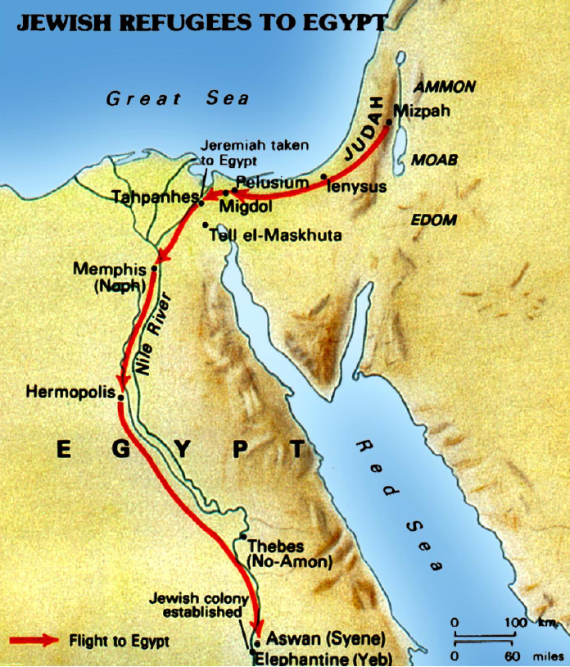
G. The Aftermath of the fall of Jerusalem 25:18-30
26 Then all the people, both small and great, and the captains of the forces arose and went to Egypt; for they were afraid of the Chaldeans.
Johanan and the other feared Babylonian retaliation and lead the remnant to Egypt against the prophesying of Jeremiah, Jer. 41:17—42:22

Slide 50
G. The Aftermath of the fall of Jerusalem 25:18-30
27 Now it came about in the thirty-seventh year of the exile of Jehoiachin king of Judah, in the twelfth month, on the twenty-seventh day of the month, that Evil-merodach king of Babylon, in the year that he became king, released Jehoiachin king of Judah from prison;
28 and he spoke kindly to him and set his throne above the throne of the kings who were with him in Babylon.
Evil-Merodach succeeded Nebuchadnezzar Oct. 7, 562
Jehoiachin released from prison in the thirty seventh year of captivity Jer. 52:31 Apr. 2, 561
He was 55 years old upon his release - God’s mercy is seen in this
Daniel and others may used their influence
The king being seated on throne enhanced the dignity of Evil-Merodach

Slide 51
G. The Aftermath of the fall of Jerusalem 25:18-30
29 And Jehoiachin changed his prison clothes, and had his meals in the king’s presence regularly all the days of his life;
30 and for his allowance, a regular allowance was given him by the king, a portion for each day, all the days of his life.
He was supplied with garments & daily food allowance for his family
Documents have been found in Babylon that show the food allowance for Jehoiachin and his five sons
This release & elevation of Jehoiachin encouraged the Jews that they would return to Judah as God had promised

Slide 52
Rations for Jehoiachin
This is one of the clay tablets that reveal the presence of the Judean royal house as prisoners in Babylon. They were excavated from an arched building near the Ishtar Gate of ancient Babylon. The cuneiform texts, which are dated between 595 and 570 B.C., contain lists of rations of barley and oil issued to the captive princes and artisans, including "Yaukin, king of the land of Yahud." This is a direct reference to Jehoiachin, and some of the other tablets also mentioned his 5 sons who accompanied him to Babylon. (Staatliche Museum, Berlin).

Slide 53
Encouragement from Jeremiah
1. Israel as people were indestructible 30:11; 29:11
2. 70 years 16:18; 25:11,12
3. New Exodus from Babylon 16:14-f
4. Restoration for Israel and Judah 30:10
5. Messiah the ideal king, new city 25:5, 6; 30:9
6. Spiritual city, 33:11, 16
7. New covenant 31:33-f; 32:39-f; 33:8
8. God would dwell among people 3:16-f
9. Faith & obedience will bring the Gentiles into the New Israel 3:17; 16:19; 12:16

Slide 54
The Faithful Remnant
Isa. 1:9; 17:6-8; 24:14-16; Ezek. 6:8-10; Zeph. 3:11-13
A. Captivity to last seventy years Jer. 25:12; 29:10; II C 36:22
B. Cyrus’ proclamation Isa. 44:24—45:7 539 B.C.
C. Zerubbabel and Joshua lead the first return 536 B.C.
Ezra 1-5 Altar restored, foundation of temple laid
D. Haggai & Zechariah encourage the work to continue 520 B.C.
E. Temple finished 516 B.C.
F. Ezra returns with second group 458 B.C.
G. Nehemiah returns & restores the walls of Jerusalem 446 B.C.
H. A second spiritual remnant Isa. 11:11-12; Rom. 15:12; Rom. 9:27, 28, 29; 11:5

Slide 55
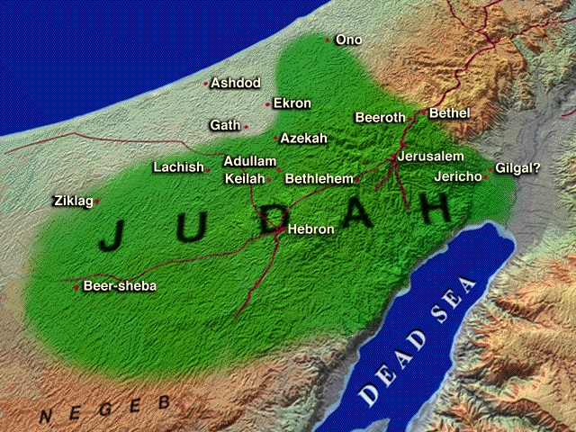

Slide 56
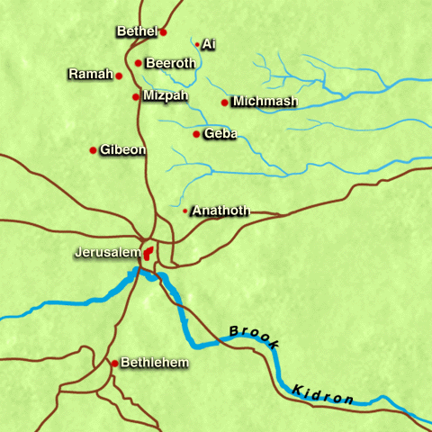

Slide 57
