Slide 2
Deacons
N.T. church - a group of men set apart to do a special work
Mentioned by name in only two passages Phil. 1:1 Paul and Timothy, bond-servants of Christ Jesus, to all the saints in Christ Jesus who are in Philippi, including the overseers and deacons:
1 Tim. 3:8, 12
8 Deacons likewise must be men of dignity, not double-tongued, or addicted to much wine or fond of sordid gain,
12 Let deacons be husbands of only one wife, and good managers of their children and their own households.

Slide 3
I. THE MEANING OF THE WORD DEACON

Slide 4
Deacon - diakonos
BAG - servant, helper, or minister
Thayer - one who executes the commands of another, especially of a minister; a servant, attendant, minister
Vine - generally speaking, to be distinguished from doulos, a bondservant, slave; diakonos views a servant in relationship to his work; doulos views him in relationship to his master.
The New International Dictionary of the Christian Church: means 'servant,' with an emphasis on usefulness rather than inferiority

Slide 5
Deacon - diakonos
Special sense - a particular class of servants - deacons
Phil. 1:1 Paul and Timothy, bond-servants of Christ Jesus, to all the saints in Christ Jesus who are in Philippi, including the overseers and deacons:
1 Tim. 3:8, 12 8 Deacons likewise must be men of dignity, not double-tongued, or addicted to much wine or fond of sordid gain, 12 Let deacons be husbands of only one wife, and good managers of their children and their own households.
A deacon is an qualified & authorized servant.
Other Christians may do similar work.
A deacon does the work with special authority.
The office (work) of deacons

Slide 6
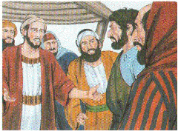
Earliest Account of Their Work
Acts 6:1-6
1 Now at this time while the disciples were increasing in number, a complaint arose on the part of the Hellenistic Jews against the native Hebrews, because their widows were being overlooked in the daily serving of food.

Slide 7
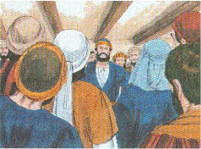
Earliest Account of Their Work
Acts 6:1-6
2 And the twelve summoned the congregation of the disciples and said, "It is not desirable for us to neglect the word of God in order to serve tables.
3 "But select from among you, brethren, seven men of good reputation, full of the Spirit and of wisdom, whom we may put in charge of this task.
4 "But we will devote ourselves to prayer, and to the ministry of the word."
Apostles needed to devote their time to teaching
Seven men appointed to care for the material needs

Slide 8
Earliest Account of Their Work
Acts 6:1-6
2 And the twelve summoned the congregation of the disciples and said, "It is not desirable for us to neglect the word of God in order to serve tables.
3 "But select from among you, brethren, seven men of good reputation, full of the Spirit and of wisdom, whom we may put in charge of this task.
4 "But we will devote ourselves to prayer, and to the ministry of the word."
Congregation to select men to take care of this need
Apostles nor elders can do all that needs to be done
They need helpers - Moses & Jethro Ex. 18:14-26

Slide 9
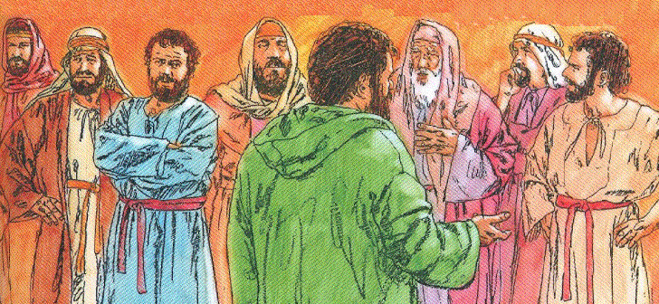
Earliest Account of Their Work
Acts 6:1-6
1 Now at this time while the disciples were increasing in number, a complaint arose on the part of the Hellenistic Jews against the native Hebrews, because their widows were being overlooked in the daily serving of food.
2 And the twelve summoned the congregation of the disciples and said, "It is not desirable for us to neglect the word of God in order to serve tables.
Noun diakonos - not used in this text
Related noun, diakonia, is used vs. 1
The verb diakoneō, to serve vs. 2

Slide 10
Learn The Work Of Deacons
diakonos - a servant or minister
Overseers & servants - placed side by side Phil. 1:1; 1 Tim. 3:1, 8
Deacons do not oversee - they serve
A certain amount of oversight in any work assigned
Example of Acts 6 - deacons appointed to serve in areas other than prayer & the ministry of the word
They are special servants of the elders and the church

Slide 11
Learn The Work Of Deacons
Served tables, provided the needs of the widows Acts 6
The qualifications provide some clues as to their work

Slide 12
The Qualification of Deacons
1 Timothy 3:8-13
8 Deacons likewise must be men of dignity, not double-tongued, or addicted to much wine or fond of sordid gain,
9 but holding to the mystery of the faith with a clear conscience.
Men of dignity - semnos - worthy of respect or honor, noble, dignified, serious, poise & self-respect; stateliness & reserve in deportment & appearance, aware of his influence & reputation
Not double-tongued - dilogos - double-faced, insincere; saying one thing with one person, another with another (with the intent to deceive) - speak the truth always in a straightforward way

Slide 13
The Qualification of Deacons
1 Timothy 3:8-13
8 Deacons likewise must be men of dignity, not double-tongued, or addicted to much wine or fond of sordid gain,
9 but holding to the mystery of the faith with a clear conscience.
Not addicted to much wine - not beside wine, not sitting at wine, not with wine; a man who has to drink should not be appointed
KJV, ASV, NKJV - not given to much wine
NIV - not indulging in much wine NEB - not given to excessive drinking
RWP - Not holding the mind on much wine - leads to over-indulgence
Wine: grape juice, some alcoholic wine weakened by water, some drugged wines, etc.
Grape juice - No glutton
Alcoholic - condemning excess does not mean that a little is o.k.
excess of riot, incessant lying, etc...
Non-drinker with self-control - (Bible principles: be sober, not drunk)

Slide 14
The Qualification of Deacons
1 Timothy 3:8-13
8 Deacons likewise must be men of dignity, not double-tongued, or addicted to much wine or fond of sordid gain,
9 but holding to the mystery of the faith with a clear conscience.
Not fond of sordid gain - aischrokerdēs - base gain; greedy for dishonest gain
Balaam Num. 22; 2 Pet. 2:15
Gehazi 2 Kings 5
Judas Iscariot Mt. 26:15
Achan Josh. 6:18, 19; 7:21
When money is the price of wrong, it is filthy
When gain is sought where none is due, it is filthy
When the desire of just gains is excessive, it ceases to be clean
Achan

Slide 15
The Qualification of Deacons
1 Timothy 3:8-13
8 Deacons likewise must be men of dignity, not double-tongued, or addicted to much wine or fond of sordid gain,
9 but holding to the mystery of the faith with a clear conscience.
Holding to the mystery of the faith with a clear conscience
Holding to the truth sincerely
Nothing about them being able to teach
Both Stephen & Philip did teach - not an essential part of their work as deacons

Slide 16
The Qualification of Deacons
1 Timothy 3:8-13
10 And let these also first be tested; then let them serve as deacons if they are beyond reproach.
Let these also first be tested
Put to the test, examined, proved
Examine their life & work prior to appointment
Indicates some time for maturing
Beyond reproach - aneglētos - that cannot be called in account, unreprovable, unaccused, blameless; irreproachable; implies not merely acquittal, but the absence of even a charge or accusation against a person
No man is absolutely blameless - A relative sense - not shown an unrighteous or ungodly man
Has a good reputation & deserves it

Slide 17
The Qualification of Deacons
1 Timothy 3:8-13
12 Let deacons be husbands of only one wife, and good managers of their children and their own households.
Husbands of only one wife - a married man - rules out a single man as well as a polygamist
Good managers of their children & their own households
Must exercise the headship in his own home
managers - ruling - proistemi - to rule; to be over, to superintend, preside over, direct, discipline, administrator, delegate
Nothing said about the children being "believers"

Slide 18
qualifications mentioned in Acts 6:1-6
3 "But select from among you, brethren, seven men of good reputation, full of the Spirit and of wisdom, whom we may put in charge of this task.
Good reputation - congregation must have full confidence to entrust its work & resources to them
Reputation must be established before his appointment
Good report both inside & outside the church
Full of the Spirit - the fruits of a holy life
"fruit of the Spirit" Gal. 5:22, 23
Led by the Spirit Rom. 8:14

Slide 19
qualifications mentioned in Acts 6:3, 5
3 "But select from among you, brethren, seven men of good reputation, full of the Spirit and of wisdom, whom we may put in charge of this task.
Full of wisdom - practical good sense which enables men to manage complicated business affairs with satisfaction
Stephen was full of faith Acts 6:5 And the statement found approval with the whole congregation; and they chose Stephen, a man full of faith and of the Holy Spirit, and Philip, Prochorus, Nicanor, Timon, Parmenas and Nicolas, a proselyte from Antioch.
The man who does not meet God’s standard cannot be a deacon
For a pure church & effective work we must have qualified men

Slide 20
ADDITIONAL FACTS ABOUT THE WORK
Based on the qualifications
Not double-tongued - dealing with various people in need
Not given to much wine - Wine was part of the hospitality
Not fond of sordid gain - likely to be handling the church's money as they care for the needy

Slide 21
ADDITIONAL FACTS ABOUT THE WORK
Not his work to preach, although some did (Philip, Stephen)
Not to rule or oversee the congregation
Not to organize & promote schemes & organizations unknown in the New Testament
To attend to the secular necessities of the church
Prime purpose - to care for the sick & needy of the congregation - to relieve the elders & preachers from "serving tables" so they may attend to the spiritual needs of the church

Slide 22
ADDITIONAL FACTS ABOUT THE WORK
Many other special tasks which need to be performed
The church & the elders need men they can depend to look after many of the affairs of the church
Might include: care of the building, securing supplies for the building & for classes, serving as treasurer, preparation for baptizing, etc.
Specific duties are assigned by the elders

Slide 23
THE REWARD OF FAITHFUL SERVICE
1 Tim. 3:13 For those who have served well as deacons obtain for themselves a high standing and great confidence in the faith that is in Christ Jesus.
Obtain a high (or good) standing
In the eyes of the church & with God
A great work Mt. 20:26 It is not so among you, but whoever wishes to become great among you shall be your servant,
Confidence in the faith
Grow in their faith as a result of the good work they do
Eternal joys & rewards will be great

Slide 24
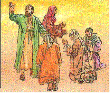
SELECTION & APPOINTMENT OF DEACONS
Acts 6:5, 6
5 And the statement found approval with the whole congregation; and they chose Stephen, a man full of faith and of the Holy Spirit, and Philip, Prochorus, Nicanor, Timon, Parmenas and Nicolas, a proselyte from Antioch.
6 And these they brought before the apostles; and after praying, they laid their hands on them.
No specific procedure set forth in N.T.
The only example in N.T. Acts 6
The group of believers selected from among them men who met the qualifications set forth

Slide 25
CONCLUSION
Many things for the welfare of a church need to be done
Wise elders assign these tasks to qualified men
This leaves the elders free to tend, feed & watch the flock
Sometimes preachers spend their time doing deacon work
Men who cannot preach are robbed of opportunities to serve & grow
God's plan for church organization is best
Let us follow it

Slide 26
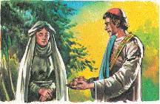
Duties of Church To The Deacons
Recognize as qualified & faithful & willing servants
See as good examples
Esteem for their work
Cooperate with them to fullest of our ability
Give appreciation & thanks for their labor & time
Show love for our elders & deacons

