Slide 1
The Kingdom or Church Was Established
On The First Pentecost After the Resurrection of Christ

Slide 2
50 Days

Slide 3
The Church in Purpose, Prophesy, Preparation & Establishment
Eternal Purpose ➯
Eph. 3:10-11
About 725 BC ➯
Isaiah 2:1-4
About 600 BC ➯
Daniel 2
AD 26-30 ➯
Matt. 3:1, 2
Mark 1:14, 15
Matt. 6:9-10
Matt. 16:18
Mk. 9:1
Luke 10:9,10
Luke 22:18
AD 30
The Beginning
(see Acts 11:15)
Acts 2
Church
(Kingdom)
In Existence
Pentecost
Acts 2:1-47
AD 62
Colossians 1:13
AD 63
Hebrews 12:28
AD 96
Revelation 1:9
➯
✞
Luke 24:44-49
Acts 1:6-8
➯
➯
Church Established
in Jerusalem

Slide 4
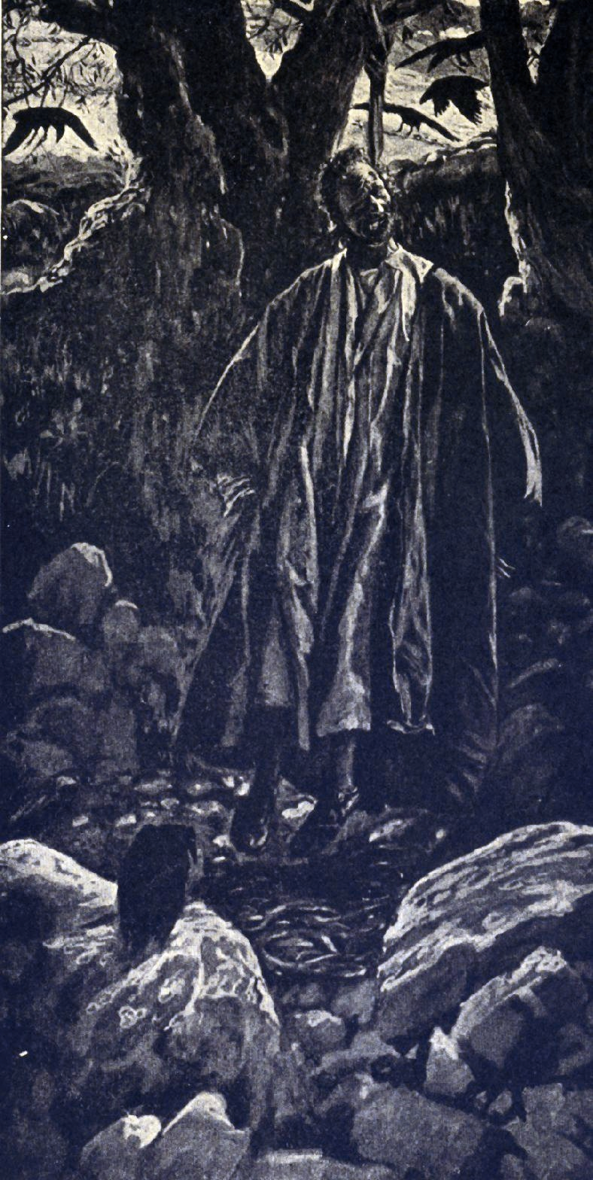
When would the kingdom come?
The kingdom came after the death of Judas Mk. 9:1 And He was saying to them, "Truly I say to you, there are some of those who are standing here who shall not taste death until they see the kingdom of God after it has come with power."
Ascension
Acts 1:9-12
Pentecost
Holy Spirit
Power
Kingdom
Matt. 14:1, 2
Matt. 16:18
Mk. 9:1
40 days
10 days
Death of John
“I will build My church” (Kingdom)
“see the kingdom of God after it has come with power”
Resurrection
Rom. 1:4
Heb. 2:14, 15
1 Cor. 15:23
Acts 2:1-41
church begins
Buried
Isa. 53:9

Slide 5
When would the kingdom come?
Come with Power Luke 24:49 "And behold, I am sending forth the promise of My Father upon you; but you are to stay in the city until you are clothed with power from on high."
Acts 1:8 but you shall receive power when the Holy Spirit has come upon you; and you shall be My witnesses both in Jerusalem, and in all Judea and Samaria, and even to the remotest part of the earth. "
Ascension
Acts 1:9-12
Pentecost
Holy Spirit
Power
Kingdom
Matt. 14:1, 2
Matt. 16:18
Mk. 9:1
40 days
10 days
Death of John
“see the kingdom of God after it has come with power”
Resurrection
Rom. 1:4
Heb. 2:14, 15
1 Cor. 15:23
Acts 2:1-41
church begins
“I will build My church” (Kingdom)
Buried
Isa. 53:9

Slide 6
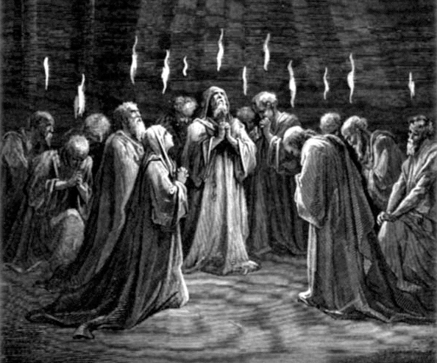
Came With Power On Pentecost
Power came on Pentecost Acts 2:1-4 And when the day of Pentecost had come, they were all together in one place. And suddenly there came from heaven a noise like a violent, rushing wind, and it filled the whole house where they were sitting. And there appeared to them tongues as of fire distributing themselves, and they rested on each one of them. And they were all filled with the Holy Spirit and began to speak with other tongues, as the Spirit was giving them utterance.

Slide 7
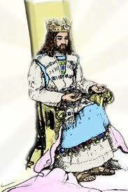
Christ’s Kingdom & Glory came together
Was not glorified during His personal ministry John 7:39 But this He spoke of the Spirit, whom those who believed in Him were to receive; for the Spirit was not yet given, because Jesus was not yet glorified.
Glory
Ascended
Buried & Raise

Slide 8
Christ’s Kingdom & Glory came together
He enter glory & His kingdom at the same time Matt. 20:20, 21 Then the mother of the sons of Zebedee came to Him with her sons, bowing down, and making a request of Him. And He said to her, "What do you wish?" She said to Him, "Command that in Your kingdom these two sons of mine may sit, one on Your right and one on Your left."
Mk. 10:35-37 And James and John, the two sons of Zebedee, came up to Him, saying to Him, "Teacher, we want You to do for us whatever we ask of You." And He said to them, "What do you want Me to do for you?" And they said to Him, "Grant that we may sit in Your glory, one on Your right, and one on Your left."

Slide 9
Christ’s Kingdom & Glory came together
He entered into glory after His death Luke 24:26 "Was it not necessary for the Christ to suffer these things and to enter into His glory?"

Slide 10
Christ’s Kingdom & Glory came together
He entered into glory when He went to the Father
Dan. 7:13, 14 "I kept looking in the night visions, And behold, with the clouds of heaven One like a Son of Man was coming, And He came up to the Ancient of Days And was presented before Him. "And to Him was given dominion, Glory and a kingdom, That all the peoples, nations, and men of every language Might serve Him. His dominion is an everlasting dominion Which will not pass away; And His kingdom is one Which will not be destroyed.

Slide 11
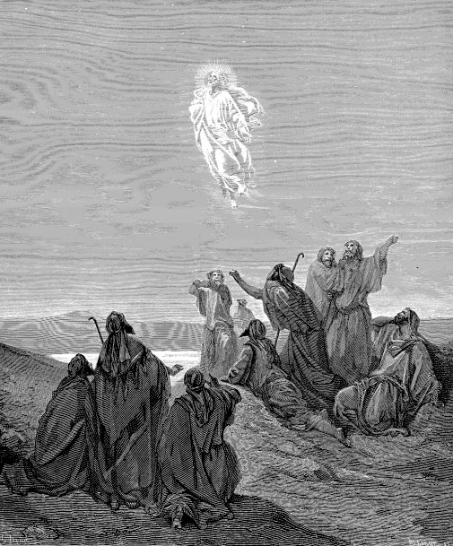
went to the Father at ascension - Crowned
Acts 1:9 And after He had said these things, He was lifted up while they were looking on, and a cloud received Him out of their sight.
1 Tim. 3:16 And by common confession great is the mystery of godliness: He who was revealed in the flesh, Was vindicated in the Spirit, Beheld by angels, Proclaimed among the nations, Believed on in the world, Taken up in glory.
Heb. 2:9 But we do see Him who has been made for a little while lower than the angels, namely, Jesus, because of the suffering of death crowned with glory and honor, that by the grace of God He might taste death for everyone.

Slide 12
The kingdom was not established
during Jesus’ ministry
Nobleman had to go & receive Kingdom Lk. 19:11-12 And while they were listening to these things, He went on to tell a parable, because He was near Jerusalem, and they supposed that the kingdom of God was going to appear immediately. He said therefore, "A certain nobleman went to a distant country to receive a kingdom for himself, and then return.

Slide 13
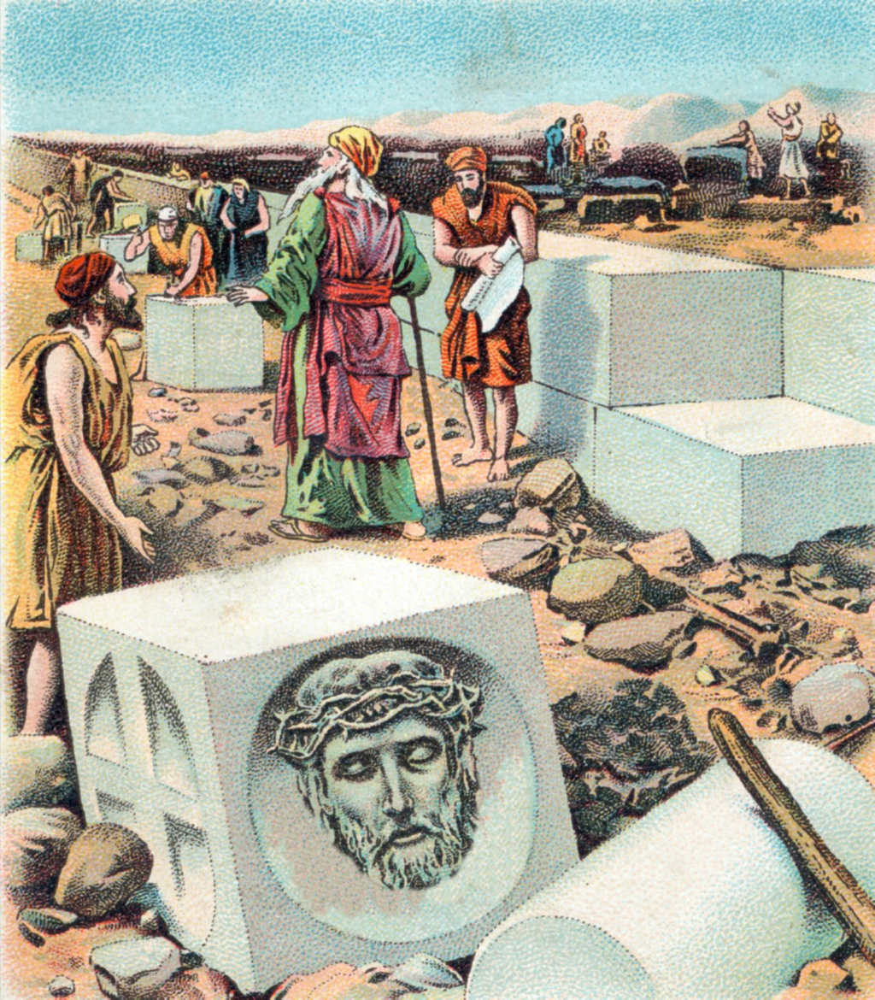
The kingdom was not established
during Jesus’ ministry
Foundation rejected before the temple would be built Matt. 12:6 "But I say to you, that something greater than the temple is here.
Matt. 21:42 Jesus said to them, "Did you never read in the Scriptures, 'The stone which the builders rejected, This became the chief corner stone; This came about from the Lord, And it is marvelous in our eyes'?

Slide 14
The kingdom was not established
during Jesus’ ministry
Not to drink the fruit of the vine until the kingdom Lk. 22:18 for I say to you, I will not drink of the fruit of the vine from now on until the kingdom of God comes. "
Waiting for the Kingdom Luke 23:51 (he had not consented to their plan and action), a man from Arimathea, a city of the Jews, who was waiting for the kingdom of God;
Took away the 1st to establish the 2nd Heb. 10:9 then He said, "Behold, I have come to do Thy will." He takes away the first in order to establish the second.

Slide 15
The Church or Kingdom is in existence
Kingdom appointed to Apostles Lk. 22:29 and just as My Father has granted Me a kingdom, I grant you
We receive a kingdom Heb. 12:28 Therefore, since we receive a kingdom which cannot be shaken, let us show gratitude, by which we may offer to God an acceptable service with reverence and awe;

Slide 16
The Church or Kingdom is in existence
Lord’s supper or table in the Kingdom until He comes Lk. 22:29, 30 and just as My Father has granted Me a kingdom, I grant you that you may eat and drink at My table in My kingdom, and you will sit on thrones judging the twelve tribes of Israel.
1 Cor. 11:26 For as often as you eat this bread and drink the cup, you proclaim the Lord's death until He comes.
1 Cor. 10:21-22 You cannot drink the cup of the Lord and the cup of demons; you cannot partake of the table of the Lord and the table of demons. Or do we provoke the Lord to jealousy? We are not stronger than He, are we?

Slide 17
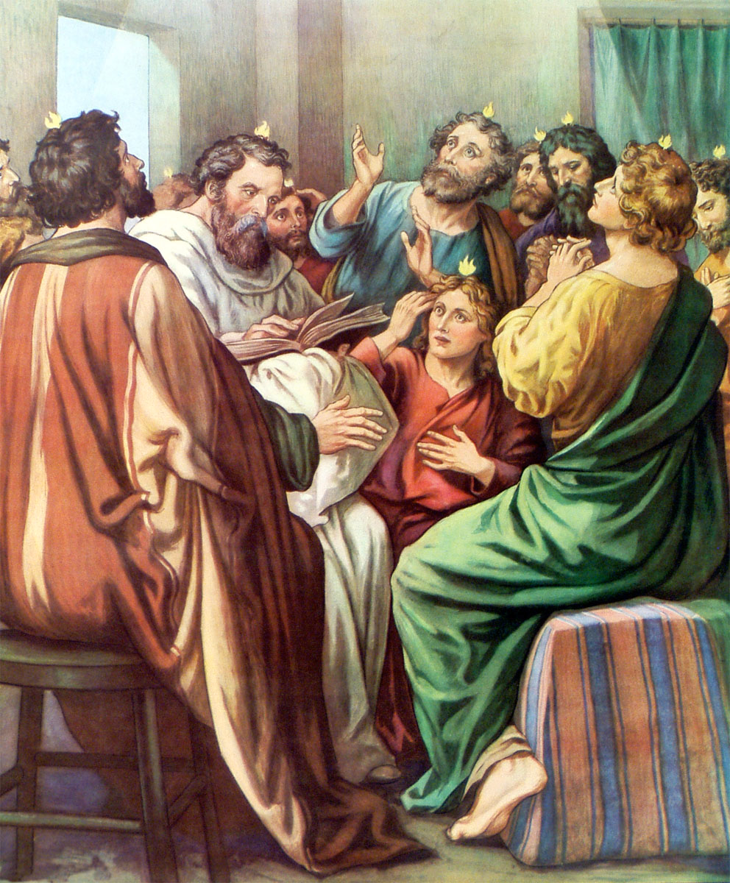
The Church or Kingdom is in existence
Apostles given to the church after the ascension Eph. 4:10, 11 He who descended is Himself also He who ascended far above all the heavens, that He might fill all things.) And He gave some as apostles, and some as prophets, and some as evangelists, and some as pastors and teachers,
Apostles given the highest authority 1 Cor. 12:28 And God has appointed in the church, first apostles, second prophets, third teachers, then miracles, then gifts of healings, helps, administrations, various kinds of tongues.

Slide 18
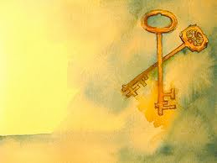
The Church or Kingdom is in existence
Peter used the keys on Pentecost Matt. 16:18, 19 "And I also say to you that you are Peter, and upon this rock I will build My church; and the gates of Hades shall not overpower it. "I will give you the keys of the kingdom of heaven; and whatever you shall bind on earth shall be bound in heaven, and whatever you shall loose on earth shall be loosed in heaven."

Slide 19
The Church or Kingdom is in existence
We must confess Jesus as Lord or king 1 Tim. 6:13 I charge you in the presence of God, who gives life to all things, and of Christ Jesus, who testified the good confession before Pontius Pilate,
Luke 23:3 And Pilate asked Him, saying, "Are You the King of the Jews?" And He answered him and said, "It is as you say."

Slide 20
The Church or Kingdom is in existence
Jesus is now King of Kings Rev. 17:14 "These will wage war against the Lamb, and the Lamb will overcome them, because He is Lord of lords and King of kings, and those who are with Him are the called and chosen and faithful."
Rev. 1:5, 6 and from Jesus Christ, the faithful witness, the first-born of the dead, and the ruler of the kings of the earth. To Him who loves us, and released us from our sins by His blood, and He has made us to be a kingdom, priests to His God and Father; to Him be the glory and the dominion forever and ever. Amen.

Slide 21
Christ is the king & Has A kingdom
Persecuted for teaching another king Acts 17:6-7 And when they did not find them, they began dragging Jason and some brethren before the city authorities, shouting, "These men who have upset the world have come here also; and Jason has welcomed them, and they all act contrary to the decrees of Caesar, saying that there is another king, Jesus. "
Translated into the kingdom Col. 1:13, 14 For He delivered us from the domain of darkness, and transferred us to the kingdom of His beloved Son, in whom we have redemption, the forgiveness of sins.

Slide 22
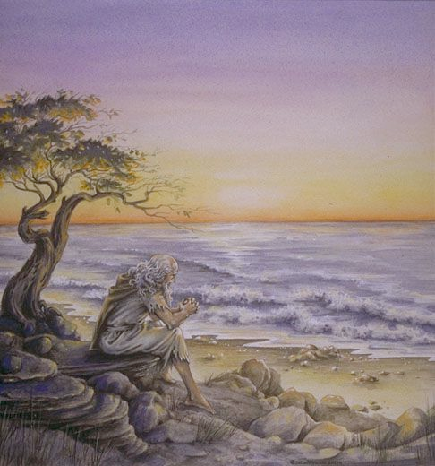
All Christians are partakers in the Kingdom Now
John was a partaker of the kingdom Rev. 1:9 I, John, your brother and fellow partaker in the tribulation and kingdom and perseverance which are in Jesus, was on the island called Patmos, because of the word of God and the testimony of Jesus.

Slide 23
Jesus is now a priest upon His throne
Zech. 6:13 "Yes, it is He who will build the temple of the Lord, and He who will bear the honor and sit and rule on His throne. Thus, He will be a priest on His throne, and the counsel of peace will be between the two offices." '
Priest now Heb. 8:4 Now if He were on earth, He would not be a priest at all, since there are those who offer the gifts according to the Law;
A High Priest Heb. 4:14 Since then we have a great high priest who has passed through the heavens, Jesus the Son of God, let us hold fast our confession.

Slide 24
Jesus is now a priest upon His throne
After the order of Melchizedek Heb. 7:17 For it is witnessed of Him, "Thou art a priest forever According to the order of Melchizedek."
King & Priest Heb. 7:1 For this Melchizedek, king of Salem, priest of the Most High God, who met Abraham as he was returning from the slaughter of the kings and blessed him,

Slide 25
The church is a Spiritual nation
1 Pet. 2:9 But you are a chosen race, a royal priesthood, a holy nation, a people for God's own possession, that you may proclaim the excellencies of Him who has called you out of darkness into His marvelous light;
James 2:8 If, however, you are fulfilling the royal law, according to the Scripture, " You shall love your neighbor as yourself," you are doing well.
Rom. 14:17 for the kingdom of God is not eating and drinking, but righteousness and peace and joy in the Holy Spirit.

Slide 26
In the kingdom & waiting for
the eternal kingdom
Eternal Kingdom 2 Pet. 1:10, 11 Therefore, brethren, be all the more diligent to make certain about His calling and choosing you; for as long as you practice these things, you will never stumble; for in this way the entrance into the eternal kingdom of our Lord and Savior Jesus Christ will be abundantly supplied to you.
The Kingdom glorified, freed from pain Acts 14:22 strengthening the souls of the disciples, encouraging them to continue in the faith, and saying, "Through many tribulations we must enter the kingdom of God.”

Slide 27
Heirs of the Kingdom
Saved now Eph. 2:5 even when we were dead in our transgressions, made us alive together with Christ (by grace you have been saved),
Heirs of salvation Heb. 1:14 Are they not all ministering spirits, sent out to render service for the sake of those who will inherit salvation?

Slide 28
Heirs of the Kingdom
Eternal salvation Mark 10:29, 30 Jesus said, "Truly I say to you, there is no one who has left house or brothers or sisters or mother or father or children or farms, for My sake and for the gospel's sake, but that he shall receive a hundred times as much now in the present age, houses and brothers and sisters and mothers and children and farms, along with persecutions; and in the age to come, eternal life.

Slide 29
Heirs of the Kingdom
We receive grace Eph. 3:7 of which I was made a minister, according to the gift of God's grace which was given to me according to the working of His power.
2 Cor. 6:1 And working together with Him, we also urge you not to receive the grace of God in vain--
Heirs of grace 1 Pet. 1:9 obtaining as the outcome of your faith the salvation of your souls.
In the kingdom Col. 1:13
Heirs of the eternal kingdom

Slide 30
THE CHURCH OR KINGDOM WAS ESTABLISHED ON PENTECOST
The prophets had the church in mind when foretelling the coming of the kingdom
The reign of christ & the establishment of the church fulfills all o.T. kingdom prophecies
church & kingdom describe god’s people from different viewpoints
The kingdom was set up in the 1st century
The future reign of christ on earth is false

