Slide 1
Centralization In Church Government

Slide 2
Catholicism in Protestantism
Many doctrines & practices of the Protestant churches
No Scriptural basis
Souvenirs of the Catholic Church
Infant church membership
Sprinkling for baptism
Formalism in worship
Instrumental music in worship
Centralization in church government

Slide 3
Roman Catholic Hierarchy
Founded on a hierarchy
Systematic arrangement of higher & lower ranks of the clergy
Not a society where all the members are equal
Two distinct groups:
the teaching church “hierarchy" - clergy
the taught church - laity
A double hierarchy:
Orders: founded on the right to administer the sacraments
Jurisdiction: founded on the right of teaching & ruling

Slide 4
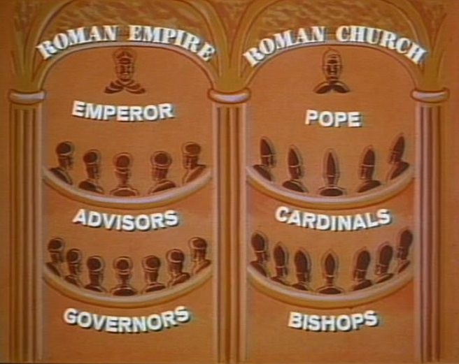
Head of the hierarchy of jurisdiction
Pope
Universal jurisdiction over both clergy & laity
Elected by two‑thirds of the votes of the cardinals
Upon election becomes the bishop of Rome
Claims the fulness of power from Christ

Slide 5
Catholic Bishops
Chosen by the pope or some political government
Hold their jurisdiction from the pope
Share with pope the fulness of the priestly function
Power to teach & govern is limited to their dioceses

Slide 6
Catholic Priests
Members of the teaching church
Not allowed to make laws for their parishioners
Only to apply laws conveyed by the pope & the bishops

Slide 7
Catholic church government is not based on the New testament
A gradual development
Reach its climax after hundreds of years
Based largely upon the political hierarchy of pagan Rome

Slide 8
Protestants Have Borrowed
Protestants revolted against much that is objectionable
Borrowed centralization of church government
Martin Luther maintained the “order of the clergy”
King Henry VIII - No recognition of Pope - kept episcopal hierachy
No higher source than the apostate church

Slide 9
many other churches
Some have no hierarchal order of the clergy
Borrowed in principle from the centralized organization
Synods, conferences, conventions, associations, federations
Ecumenical, national & regional councils
Human ideas of church polity & government

Slide 10
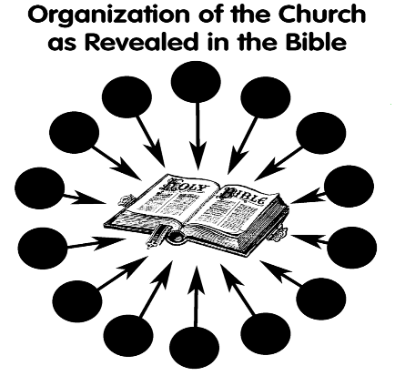
The New Testament Order
Congregational independence & autonomy
The word "church" in the New Testament
Two primary senses: Universal & Local

Slide 11
Church: Two Senses
Universal Church
Local Church
In both heaven & earth Eph.3:15
Lord "adds" members Acts 2:47
Entered by baptism 1 Cor. 12:13
All saints are here Gal. 3:27
None but the saved 2 Tim. 2:19
One Shepherd only Matt. 23:8
Assembled figuratively Heb.12:23
Satan can't prevail against Matt.16:18
Earthly, limited Phil. 1:1
We "join" ourselves to Acts 9:26
Agreement fellow-saints 3 Jn.10
Certain saints here 1 Cor. 1:2
Some "not of us" here 1 Jn. 2:19
Lesser Shepherds here 1 Pet.5:2
Literally assemble 1 Cor. 14:23
Can and does prevail Rev. 2:5
A RELATIONSHIP OF
SAINTS WITH GOD
A RELATIONSHIP OF
SAINTS WITH SAINTS

Slide 13
Church used in Universal Sense
Matt. 16:18 “And I also say to you that you are Peter, and upon this rock I will build My church; and the gates of Hades shall not overpower it.”
Eph. 1:22, 23 “And He put all things in subjection under His feet, and gave Him as head over all things to the church, which is His body, the fulness of Him who fills all in all.”
Eph. 5:25, 26 “Husbands, love your wives, just as Christ also loved the church and gave Himself up for her; that He might sanctify her, having cleansed her by the washing of water with the word,”

Slide 14
Church used in Universal Sense
Christ is the head
Col. 1:18 He is also head of the body, the church; and He is the beginning, the first-born from the dead; so that He Himself might come to have first place in everything.
Eph. 1:22 And He put all things in subjection under His feet, and gave Him as head over all things to the church,
Eph. 5:24 But as the church is subject to Christ, so also the wives ought to be to their husbands in everything.
Christ the only head
Christ - Head
Church - Body

Slide 15
Church used in Universal Sense
All Christians are members of his body 1 Cor. 12:12, 20, 27
12 For even as the body is one and yet has many members, and all the members of the body, though they are many, are one body, so also is Christ.
20 But now there are many members, but one body.
27 Now you are Christ’s body, and individually members of it.
Head & body - the only organization
No hierarchy, no arch‑bishops, no cardinals, no pope, no councils, no conferences, no synods

Slide 16
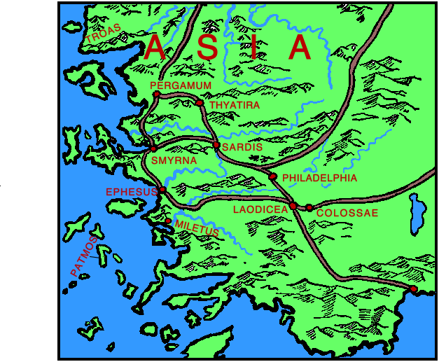
Church used in Local Sense
The local, or congregational, sense
1 Cor. 1:2 to the church of God which is at Corinth, to those who have been sanctified in Christ Jesus, saints by calling, with all who in every place call upon the name of our Lord Jesus Christ, their Lord and ours:
Rev. 1:4 John to the seven churches that are in Asia: Grace to you and peace, from Him who is and who was and who is to come; and from the seven Spirits who are before His throne;
Not different sects or denominations
Different assemblies of the same church

Slide 17
The order of church government, within the local congregations
We see their autonomy
All subject to the same head, Christ
Following & preaching the same word
Maintained complete congregational independence
Within the church universal there was no unit greater nor smaller than the local congregation

Slide 18
The order of church government, within the local congregations
Acts 11:22, 26, 28, 29
22 And the news about them reached the ears of the church at Jerusalem, and they sent Barnabas off to Antioch.
26 and when he had found him, he brought him to Antioch. And it came about that for an entire year they met with the church, and taught considerable numbers; and the disciples were first called Christians in Antioch.
28 And one of them named Agabus stood up and began to indicate by the Spirit that there would certainly be a great famine all over the world. And this took place in the reign of Claudius.
29 And in the proportion that any of the disciples had means, each of them determined to send a contribution for the relief of the brethren living in Judea.

Slide 19
Church - local, congregational sense
Acts 20:17 And from Miletus he sent to Ephesus and called to him the elders of the church.
1 Cor. 1:2 to the church of God which is at Corinth, to those who have been sanctified in Christ Jesus, saints by calling, with all who in every place call upon the name of our Lord Jesus Christ, their Lord and ours:
1 Thess. 1:1 Paul and Silvanus and Timothy to the church of the Thessalonians in God the Father and the Lord Jesus Christ: Grace to you and peace.

Slide 20
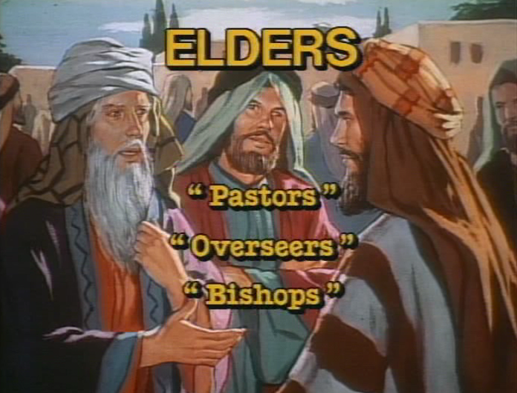
Within the local congregation
Elders - Overseers - Shepherds
Spiritual oversight of their own flock
A plurality of elders, or bishops, in every congregation
Acts 14:23 And when they had appointed elders for them in every church, having prayed with fasting, they commended them to the Lord in whom they had believed.
Titus 1:5 For this reason I left you in Crete, that you might set in order what remains, and appoint elders in every city as I directed you,

Slide 21
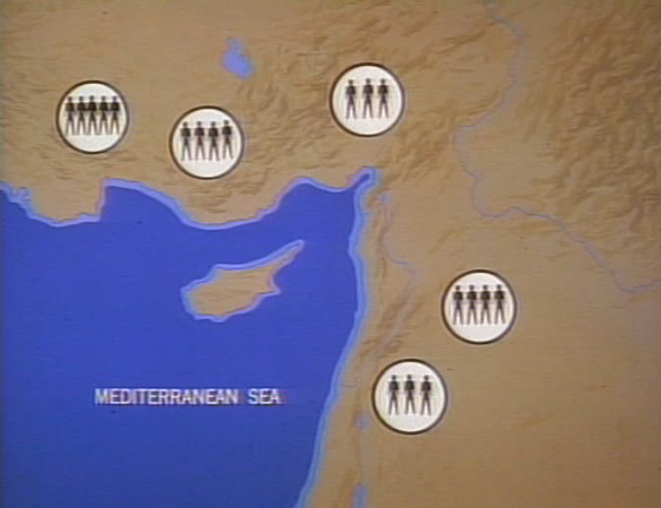
Within the local congregation
Elders - Overseers - Shepherds
No jurisdiction outside their own congregation
Amenable only to Christ, the Chief Shepherd
Diocesan bishops developed many years after the N.T.

Slide 22
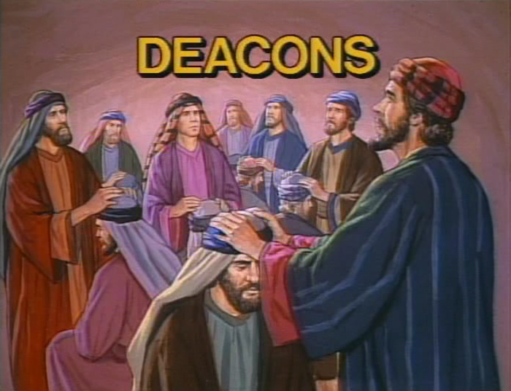
Within the local congregation
deacons - Servants
Worked under the oversight of their bishops
Phil. 1:1 Paul and Timothy, bond-servants of Christ Jesus, to all the saints in Christ Jesus who are in Philippi, including the overseers and deacons:
1 Tim. 3:8‑10 Deacons likewise must be men of dignity, not double-tongued, or addicted to much wine or fond of sordid gain, but holding to the mystery of the faith with a clear conscience. And let these also first be tested; then let them serve as deacons if they are beyond reproach.

Slide 23
Within the local congregation
All Members Obey Leaders
All the members taught to obey Heb. 13:17 Obey your leaders, and submit to them; for they keep watch over your souls, as those who will give an account. Let them do this with joy and not with grief, for this would be unprofitable for you.

Slide 24
Within the local congregation
Evangelists - Preachers - Ministers
No jurisdictional authority: no official power
Only the power of teaching
Subject to the elders of any local church where they might be laboring 2 Tim. 4:5; 1 Tim. 1:3‑7; 4:14; 5:19, 20

Slide 25
New Testament church organization
Beautiful simplicity
Human wisdom dictated a complicated ecclesiastical machinery
Divine wisdom ordained simplicity
Human wisdom calls for federation & centralization
Divine wisdom teaches congregational independence & autonomy
2 Tim. 1:13 … hold to the pattern of sound words
1 Cor. 4:6 … not to go beyond what is written
Rom. 10:17 faith comes by hearing
Heb. 11:6 without faith it is impossible to please God

Slide 26
centralized church government is Not Expedient
Cannot be justified saying it works better, therefore right
Must first be lawful - authorized to be expedient
Not to do evil that good may come Rom. 3:8 And why not say (as we are slanderously reported and as some affirm that we say), “Let us do evil that good may come”? Their condemnation is just.
Rebellion against Christ, the head Eph. 1:22 And He put all things in subjection under His feet, and gave Him as head over all things to the church,

Slide 27
centralized church government the first step toward apostasy
The stronghold of error in Catholicism & Protestantism
With congregational independence, one church may go astray from the faith, but it does not necessarily drag others with it.
Churches banded together all drift into error together
Error entrenched in a super‑organization - dangerous & difficult to overthrow
Eph. 6:12 For our struggle is not against flesh and blood, but against the rulers, against the powers, against the world forces of this darkness, against the spiritual forces of wickedness in the heavenly places.

Slide 28
Pray that God’s Simple plan with be restored & preserved
Danger - the desire of men to do "great things"
Forgetting the power & simplicity
“speaking the utterances of God." 1 Pet. 4:11
Respect congregational autonomy
Every church is a "golden lampstand" Rev. 1:20
Every congregation is precious in the sight of God
Let it not be despised & overawed by its stronger sisters

