Slide 1
II. The Last Great Reformation 21:1—23:27
Manasseh - Josiah

Slide 2
The Judean Period: Overview
722-586 BC
722
686
640
609
605
586
Judah
Independent
Hezekiah
Assyrian
Domination
Manasseh
Amon
Judah
Independent
Josiah
Babylonian
Domination
Jehoiakim
Jehoiachin
Zedakiah
Egyptian
Domination
Jehoahaz
Jehoiakim

Slide 3
A. The apostasy and repentance of Manasseh 21:1-18

Slide 4
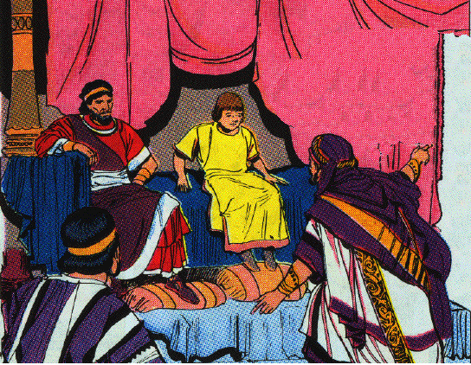
1. Introduction to the Reign of Manasseh 1-9
1 Manasseh was twelve years old when he became king, and he reigned fifty-five years in Jerusalem; and his mother’s name was Hephzibah.
2 And he did evil in the sight of the LORD, according to the abominations of the nations whom the LORD dispossessed before the sons of Israel.

Slide 5
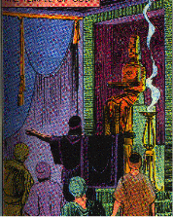
3 For he rebuilt the high places which Hezekiah his father had destroyed; and he erected altars for Baal and made an Asherah, as Ahab king of Israel had done, and worshiped all the host of heaven and served them.
4 And he built altars in the house of the LORD, of which the LORD had said, "In Jerusalem I will put My name."
5 For he built altars for all the host of heaven in the two courts of the house of the LORD.

Slide 6
1. Introduction to the Reign of Manasseh 1-9
6 And he made his son pass through the fire, practiced witchcraft and used divination, and dealt with mediums and spiritists. He did much evil in the sight of the LORD provoking Him to anger.
7 Then he set the carved image of Asherah that he had made, in the house of which the LORD said to David and to his son Solomon, "In this house and in Jerusalem, which I have chosen from all the tribes of Israel, I will put My name forever.

Slide 7
1. Introduction to the Reign of Manasseh 1-9
8 "And I will not make the feet of Israel wander anymore from the land which I gave their fathers, if only they will observe to do according to all that I have commanded them, and according to all the law that My servant Moses commanded them."
9 But they did not listen, and Manasseh seduced them to do evil more than the nations whom the LORD destroyed before the sons of Israel.

Slide 8
2. The prophetic promouncement against Jerusalem 10-15
10 ¶ Now the LORD spoke through His servants the prophets, saying,
11 "Because Manasseh king of Judah has done these abominations, having done wickedly more than all the Amorites did who were before him, and has also made Judah sin with his idols;
12 therefore thus says the LORD, the God of Israel, ‘Behold, I am bringing such calamity on Jerusalem and Judah, that whoever hears of it, both his ears shall tingle.
13 ‘And I will stretch over Jerusalem the line of Samaria and the plummet of the house of Ahab, and I will wipe Jerusalem as one wipes a dish, wiping it and turning it upside down.
14 ‘And I will abandon the remnant of My inheritance and deliver them into the hand of their enemies, and they shall become as plunder and spoil to all their enemies;
15 because they have done evil in My sight, and have been provoking Me to anger, since the day their fathers came from Egypt, even to this day.’"

Slide 9
3. Conclusion of the reign of Manasseh 16-18
16 Moreover, Manasseh shed very much innocent blood until he had filled Jerusalem from one end to another; besides his sin with which he made Judah sin, in doing evil in the sight of the LORD.
17 Now the rest of the acts of Manasseh and all that he did and his sin which he committed, are they not written in the Book of the Chronicles of the Kings of Judah?
18 And Manasseh slept with his fathers and was buried in the garden of his own house, in the garden of Uzza, and Amon his son became king in his place.
Heb. 11:37 They were stoned, they were sawn in two, they were tempted, they were put to death with the sword; they went about in sheepskins, in goatskins, being destitute, afflicted, ill-treated

Slide 10
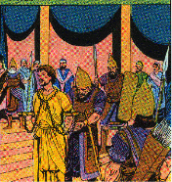
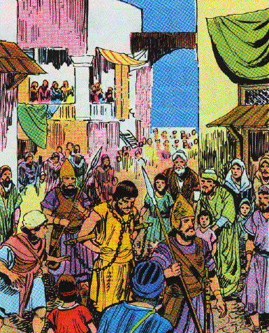
Additional material 2 Chron. 33:11-17
Manasseh’s captivity, repentance & restoration
11 ¶ Therefore the LORD brought the commanders of the army of the king of Assyria against them, and they captured Manasseh with hooks, bound him with bronze chains, and took him to Babylon.

Slide 11
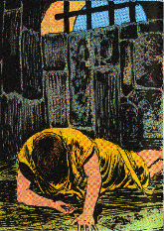
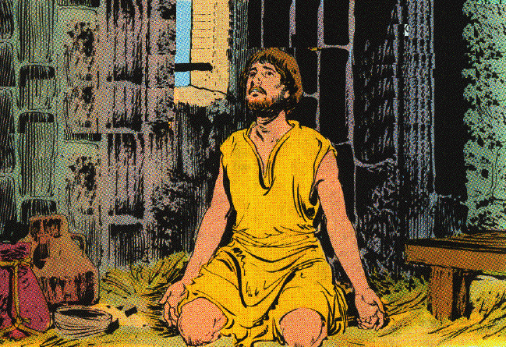
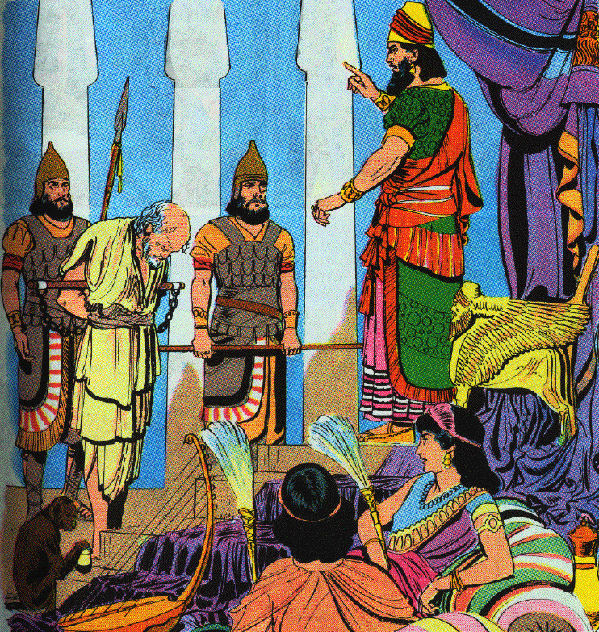
12 And when he was in distress, he entreated the LORD his God and humbled himself greatly before the God of his fathers.
13 When he prayed to Him, He was moved by his entreaty and heard his supplication, and brought him again to Jerusalem to his kingdom. Then Manasseh knew that the LORD was God.

Slide 12
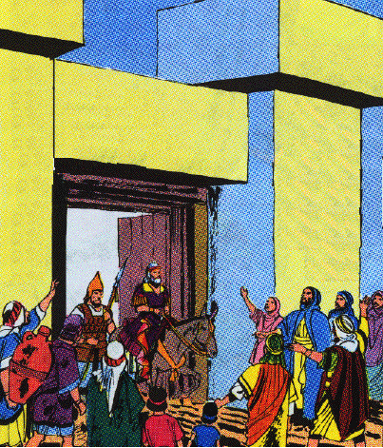
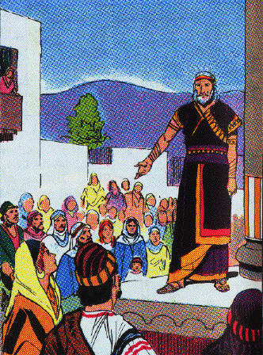
Manasseh’s acts after his restoration
14 Now after this he built the outer wall of the city of David on the west side of Gihon, in the valley, even to the entrance of the Fish Gate; and he encircled the Ophel with it and made it very high. Then he put army commanders in all the fortified cities of Judah.

Slide 13
Manasseh’s acts after his restoration
15 He also removed the foreign gods and the idol from the house of the LORD, as well as all the altars which he had built on the mountain of the house of the LORD and in Jerusalem, and he threw them outside the city.
16 And he set up the altar of the LORD and sacrificed peace offerings and thank offerings on it; and he ordered Judah to serve the LORD God of Israel.
Spiritual condition of the people
17 Nevertheless the people still sacrificed in the high places, although only to the LORD their God.

Slide 14
B. The accession and assassination of Amon
2 K 21:19-26

Slide 15
Accession & character of Amon
19 Amon was twenty-two years old when he became king, and he reigned two years in Jerusalem; and his mother’s name was Meshullemeth the daughter of Haruz of Jotbah.
20 And he did evil in the sight of the LORD, as Manasseh his father had done.
21 For he walked in all the way that his father had walked, and served the idols that his father had served and worshiped them.
22 So he forsook the LORD, the God of his fathers, and did not walk in the way of the LORD.

Slide 16
Death of Amon
23 And the servants of Amon conspired against him and killed the king in his own house.
24 Then the people of the land killed all those who had conspired against King Amon, and the people of the land made Josiah his son king in his place.
25 Now the rest of the acts of Amon which he did, are they not written in the Book of the Chronicles of the Kings of Judah?
26 And he was buried in his grave in the garden of Uzza, and Josiah his son became king in his place.

Slide 17
C. The reign and reformation of Josiah 21:1—23:27

Slide 18
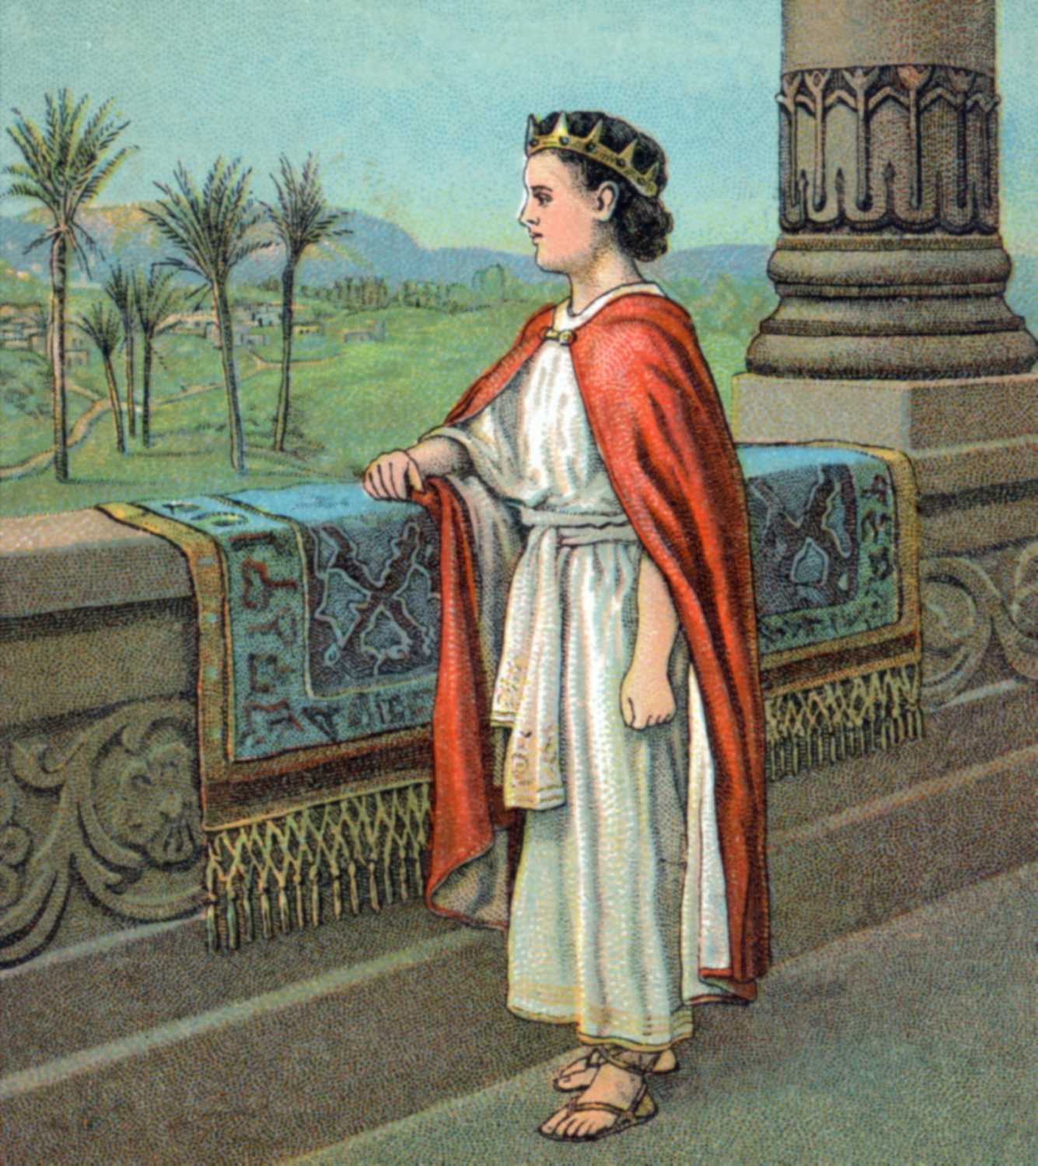
1. Introduction to the reign of Josiah 22:1-2
1 Josiah was eight years old when he became king, and he reigned thirty-one years in Jerusalem; and his mother’s name was Jedidah the daughter of Adaiah of Bozkath.
2 And he did right in the sight of the LORD and walked in all the way of his father David, nor did he turn aside to the right or to the left.

Slide 19
Josiah’s early reformation 2 C 34:3-7
3 For in the eighth year of his reign while he was still a youth, he began to seek the God of his father David; and in the twelfth year he began to purge Judah and Jerusalem of the high places, the Asherim, the carved images, and the molten images.
4 And they tore down the altars of the Baals in his presence, and the incense altars that were high above them he chopped down; also the Asherim, the carved images, and the molten images he broke in pieces and ground to powder and scattered it on the graves of those who had sacrificed to them.
5 Then he burned the bones of the priests on their altars, and purged Judah and Jerusalem.

Slide 20
Josiah’s early reformation 2 C 34:3-7
6 And in the cities of Manasseh, Ephraim, Simeon, even as far as Naphtali, in their surrounding ruins,
7 he also tore down the altars and beat the Asherim and the carved images into powder, and chopped down all the incense altars throughout the land of Israel. Then he returned to Jerusalem.

Slide 21
The Reign Of Good King Josiah
640-609 BC
640
632
628
627
621
609
Begins Reign at Age 8
Begins to Seek the LORD
2 C 34:3
Purged the Land
2 C 34:3-5
Jeremiah Called
Jer. 1:1
Lost Scroll Found
2 K 22
Expansion of the Kingdom
Killed at Megiddo

Slide 22
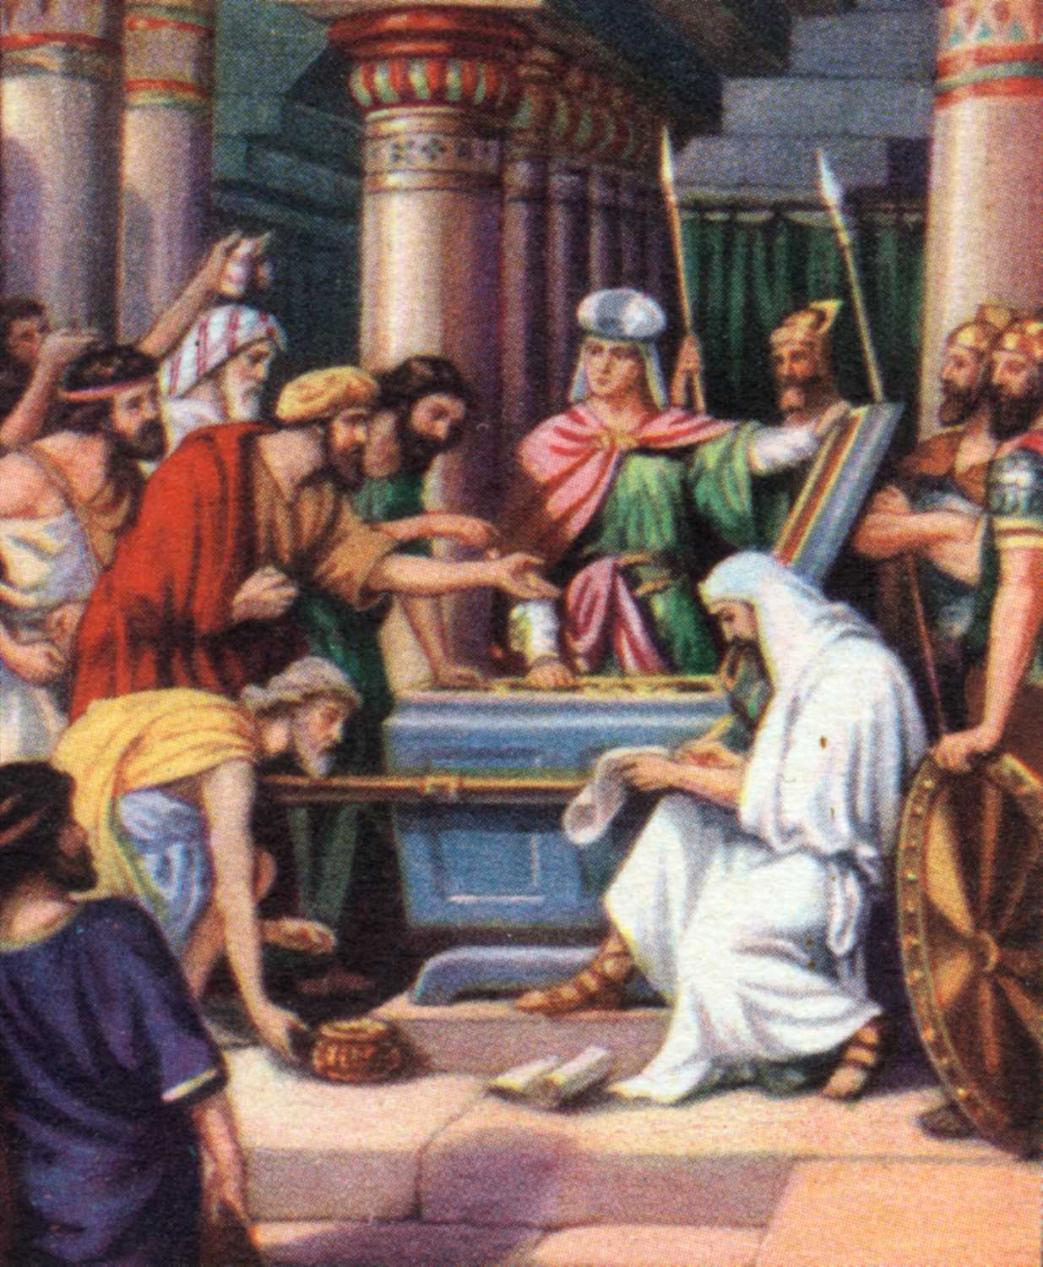
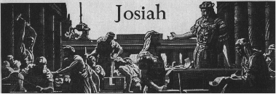
2. The temple repair 2 K 22:3-7
3 Now it came about in the eighteenth year of King Josiah that the king sent Shaphan, the son of Azaliah [az uh LIGH uh] the son of Meshullam the scribe, to the house of the LORD saying,
4 "Go up to Hilkiah the high priest that he may count the money brought in to the house of the LORD which the doorkeepers have gathered from the people.

Slide 23
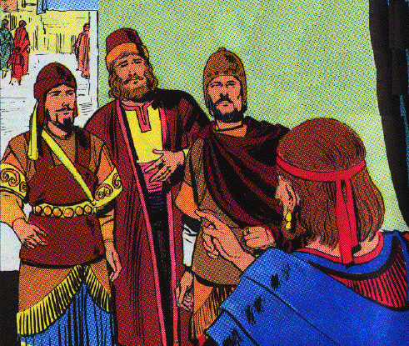
5 "And let them deliver it into the hand of the workmen who have the oversight of the house of the LORD, and let them give it to the workmen who are in the house of the LORD to repair the damages of the house,
6 to the carpenters and the builders and the masons and for buying timber and hewn stone to repair the house.
7 "Only no accounting shall be made with them for the money delivered into their hands, for they deal faithfully."

Slide 24
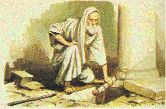
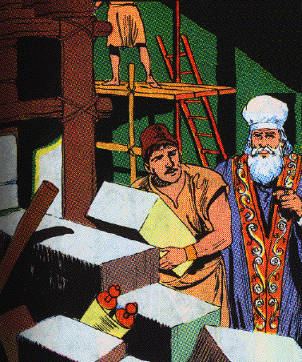
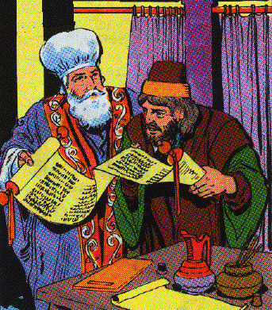
3. Book of the Law found 2 K 22:8
8 Then Hilkiah the high priest said to Shaphan the scribe, "I have found the book of the law in the house of the LORD." And Hilkiah gave the book to Shaphan who read it.

Slide 25
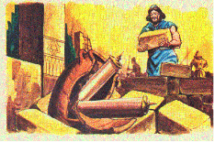
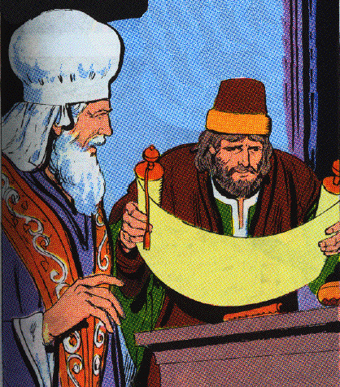
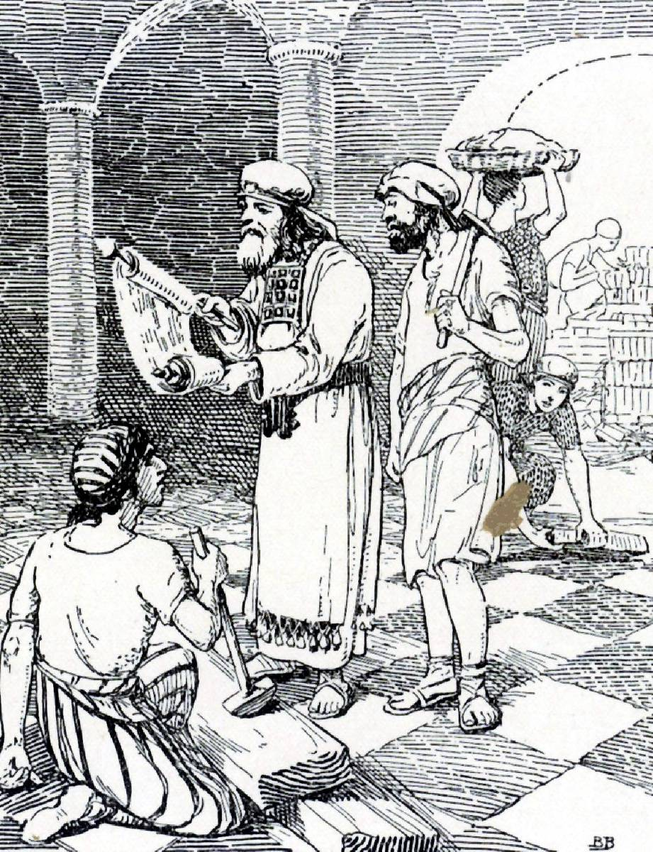
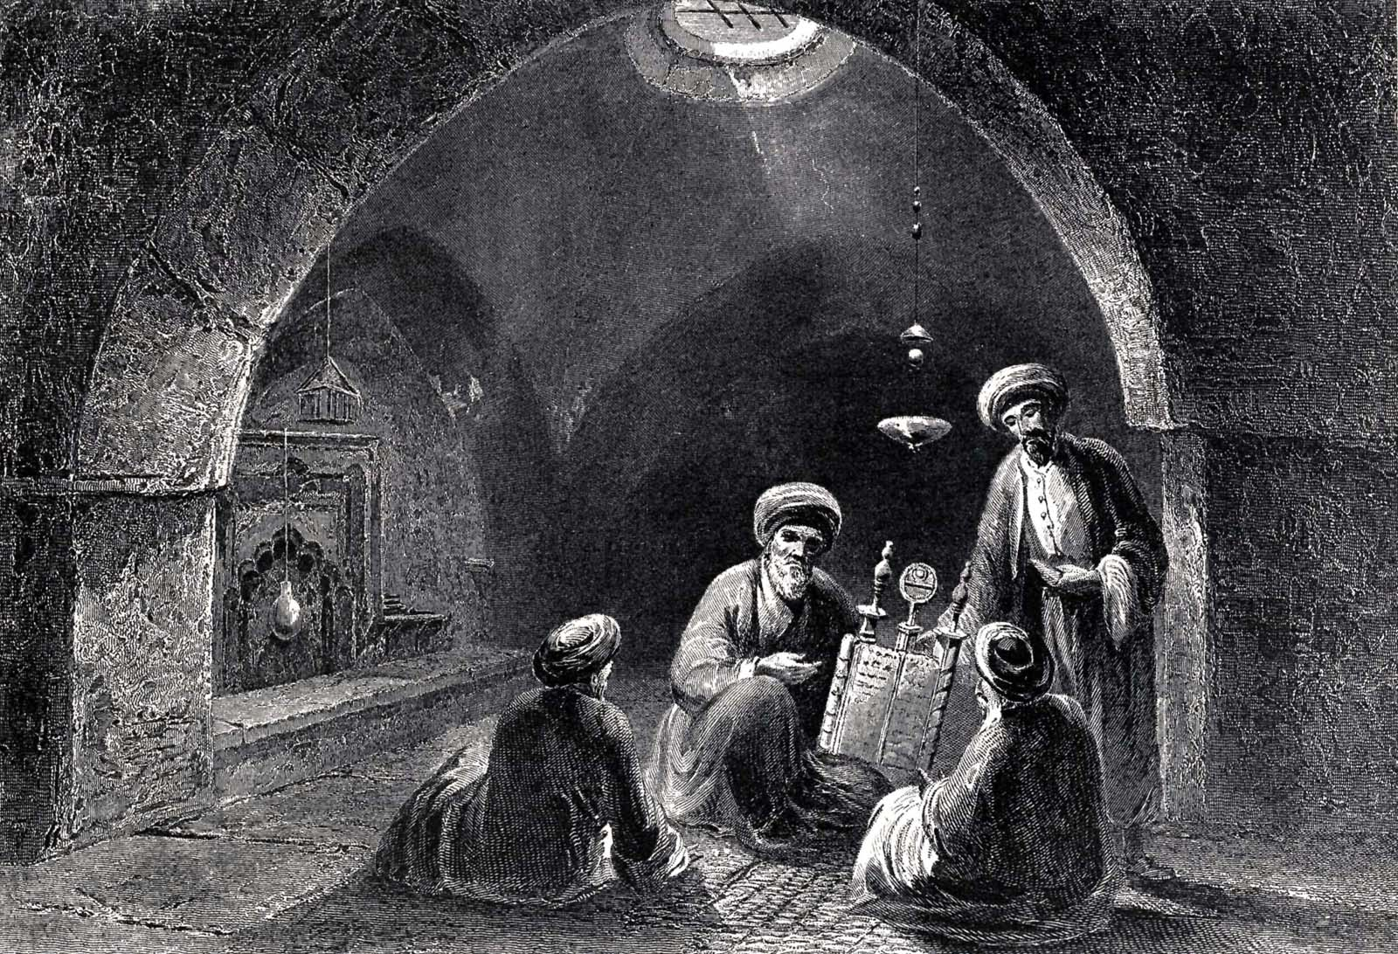
2 C 34:14, 15
14 When they were bringing out the money which had been brought into the house of the LORD, Hilkiah the priest found the book of the law of the LORD given by Moses.
15 And Hilkiah responded and said to Shaphan the scribe, "I have found the book of the law in the house of the LORD." And Hilkiah gave the book to Shaphan.

Slide 26
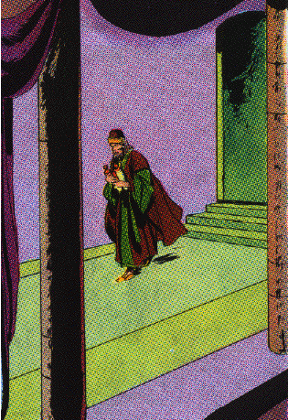
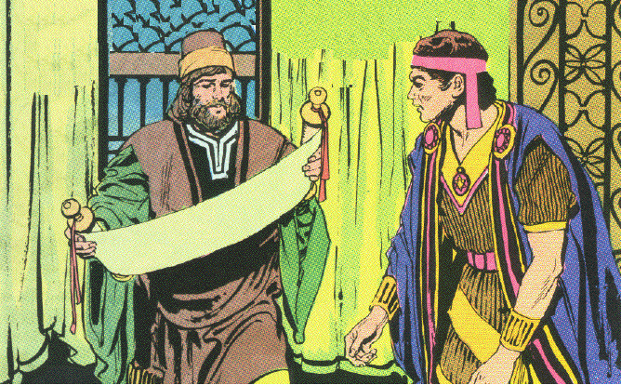
4. Effect of the discovery on Josiah 2 K 22:9-13
9 And Shaphan the scribe came to the king and brought back word to the king and said, "Your servants have emptied out the money that was found in the house, and have delivered it into the hand of the workmen who have the oversight of the house of the LORD."
10 Moreover, Shaphan the scribe told the king saying, "Hilkiah the priest has given me a book." And Shaphan read it in the presence of the king.

Slide 27
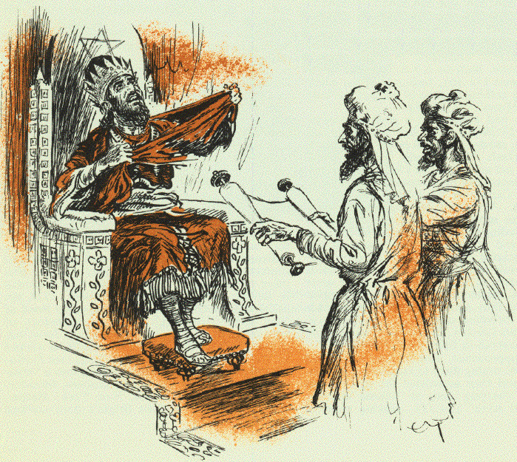
11 And it came about when the king heard the words of the book of the law, that he tore his clothes.
12 Then the king commanded Hilkiah the priest, Ahikam the son of Shaphan, Achbor the son of Micaiah, Shaphan the scribe, and Asaiah [uh ZAY uh] the king’s servant saying,
13 "Go, inquire of the LORD for me and the people and all Judah concerning the words of this book that has been found, for great is the wrath of the LORD that burns against us, because our fathers have not listened to the words of this book, to do according to all that is written concerning us."

Slide 28
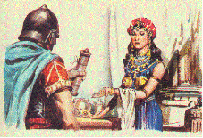
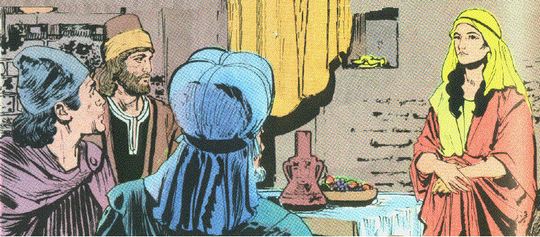
5. Words of Huldah the prophetess 2 K 22:14-20
14 So Hilkiah the priest, Ahikam, Achbor, Shaphan, and Asaiah went to Huldah the prophetess, the wife of Shallum the son of Tikvah, the son of Harhas, keeper of the wardrobe (now she lived in Jerusalem in the Second Quarter); and they spoke to her.

Slide 29
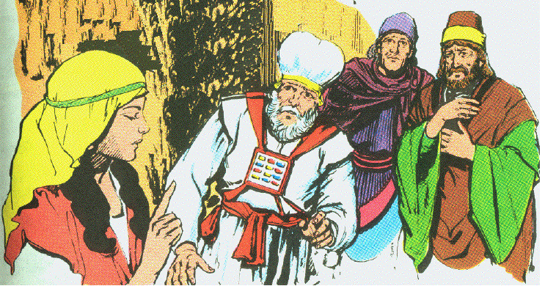
15 And she said to them, "Thus says the LORD God of Israel, ‘Tell the man who sent you to me,
16 thus says the LORD, "Behold, I bring evil on this place and on its inhabitants, even all the words of the book which the king of Judah has read.
17 "Because they have forsaken Me and have burned incense to other gods that they might provoke Me to anger with all the work of their hands, therefore My wrath burns against this place, and it shall not be quenched."’

Slide 30
18 "But to the king of Judah who sent you to inquire of the LORD thus shall you say to him, ‘Thus says the LORD God of Israel," Regarding the words which you have heard,
19 because your heart was tender and you humbled yourself before the LORD when you heard what I spoke against this place and against its inhabitants that they should become a desolation and a curse, and you have torn your clothes and wept before Me, I truly have heard you, "declares the LORD.
20 "Therefore, behold, I will gather you to your fathers, and you shall be gathered to your grave in peace, neither shall your eyes see all the evil which I will bring on this place."’" So they brought back word to the king.

Slide 31
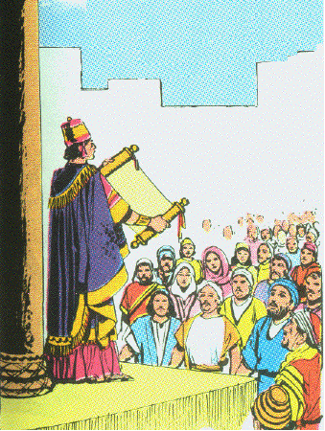
6. Reading the book of the Law & making a covenant 2 K 23:1-3
1 Then the king sent, and they gathered to him all the elders of Judah and of Jerusalem.
2 And the king went up to the house of the LORD and all the men of Judah and all the inhabitants of Jerusalem with him, and the priests and the prophets and all the people, both small and great; and he read in their hearing all the words of the book of the covenant, which was found in the house of the LORD.
3 And the king stood by the pillar and made a covenant before the LORD, to walk after the LORD, and to keep His commandments and His testimonies and His statutes with all his heart and all his soul, to carry out the words of this covenant that were written in this book. And all the people entered into the covenant.

Slide 32
7. Intensification of reform 2 K 23:4-23

Slide 33
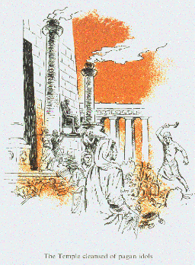
a. The cleansing of the Temple 23:4-7
4 Then the king commanded Hilkiah the high priest and the priests of the second order and the doorkeepers, to bring out of the temple of the LORD all the vessels that were made for Baal, for Asherah, and for all the host of heaven; and he burned them outside Jerusalem in the fields of the Kidron, and carried their ashes to Bethel.

Slide 34
5 And he did away with the idolatrous priests whom the kings of Judah had appointed to burn incense in the high places in the cities of Judah and in the surrounding area of Jerusalem, also those who burned incense to Baal, to the sun and to the moon and to the constellations and to all the host of heaven.
6 And he brought out the Asherah from the house of the LORD outside Jerusalem to the brook Kidron, and burned it at the brook Kidron, and ground it to dust, and threw its dust on the graves of the common people.
7 He also broke down the houses of the male cult prostitutes which were in the house of the LORD, where the women were weaving hangings for the Asherah.

Slide 35
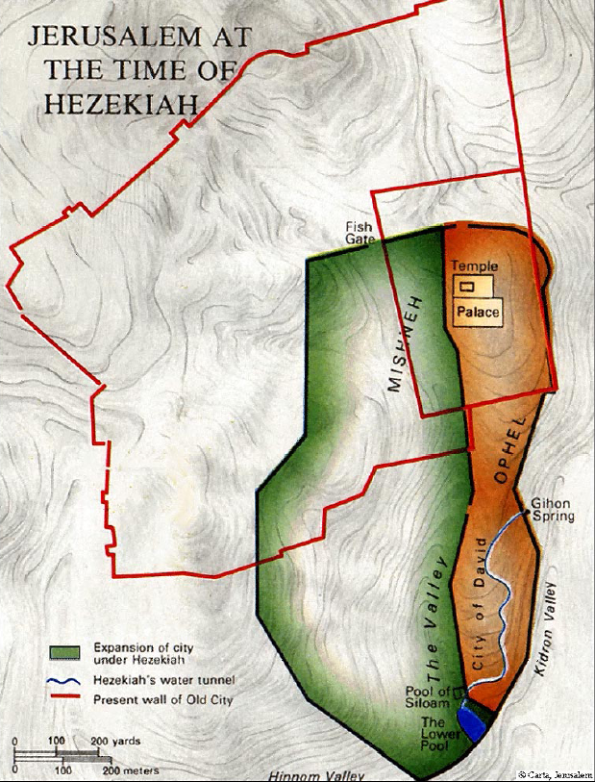

Slide 36
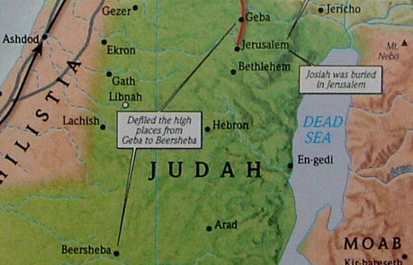
b. The reforms in Jerusalem and Judah 23:8-14
8 Then he brought all the priests from the cities of Judah, and defiled the high places where the priests had burned incense, from Geba to Beersheba; and he broke down the high places of the gates which were at the entrance of the gate of Joshua the governor of the city, which were on one’s left at the city gate.
9 Nevertheless the priests of the high places did not go up to the altar of the LORD in Jerusalem, but they ate unleavened bread among their brothers.

Slide 37
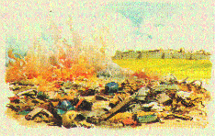
10 He also defiled Topheth, which is in the valley of the son of Hinnom, that no man might make his son or his daughter pass through the fire for Molech.

Slide 38
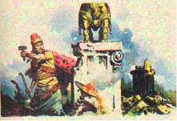
11 And he did away with the horses which the kings of Judah had given to the sun, at the entrance of the house of the LORD, by the chamber of Nathan-melech the official, which was in the precincts; and he burned the chariots of the sun with fire.
12 And the altars which were on the roof, the upper chamber of Ahaz, which the kings of Judah had made, and the altars which Manasseh had made in the two courts of the house of the LORD, the king broke down; and he smashed them there, and threw their dust into the brook Kidron.
13 And the high places which were before Jerusalem, which were on the right of the mount of destruction which Solomon the king of Israel had built for Ashtoreth the abomination of the Sidonians, and for Chemosh the abomination of Moab, and for Milcom the abomination of the sons of Ammon, the king defiled.
14 And he broke in pieces the sacred pillars and cut down the Asherim and filled their places with human bones.

Slide 39
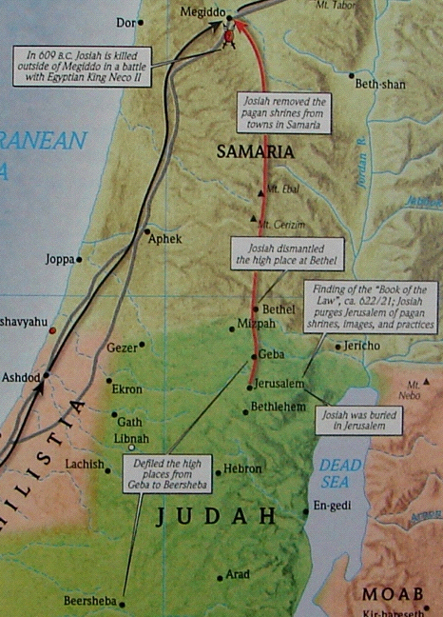
c. Fulfilled prophecy of the man of God 23:15-20
15 Furthermore, the altar that was at Bethel and the high place which Jeroboam the son of Nebat, who made Israel sin, had made, even that altar and the high place he broke down. Then he demolished its stones, ground them to dust, and burned the Asherah.

Slide 40
16 Now when Josiah turned, he saw the graves that were there on the mountain, and he sent and took the bones from the graves and burned them on the altar and defiled it according to the word of the LORD which the man of God proclaimed, who proclaimed these things.
17 Then he said, "What is this monument that I see?" And the men of the city told him, "It is the grave of the man of God who came from Judah and proclaimed these things which you have done against the altar of Bethel."

Slide 41
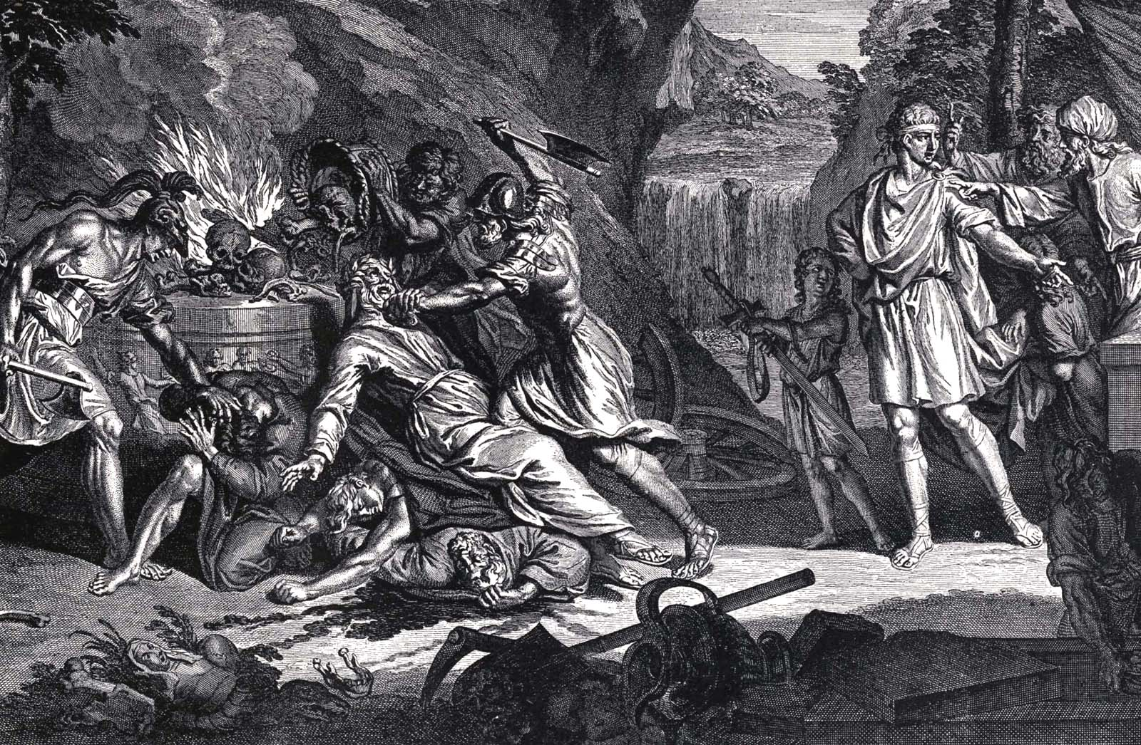
18 And he said, "Let him alone; let no one disturb his bones." So they left his bones undisturbed with the bones of the prophet who came from Samaria.
19 And Josiah also removed all the houses of the high places which were in the cities of Samaria, which the kings of Israel had made provoking the LORD; and he did to them just as he had done in Bethel.
20 And all the priests of the high places who were there he slaughtered on the altars and burned human bones on them; then he returned to Jerusalem.

Slide 42
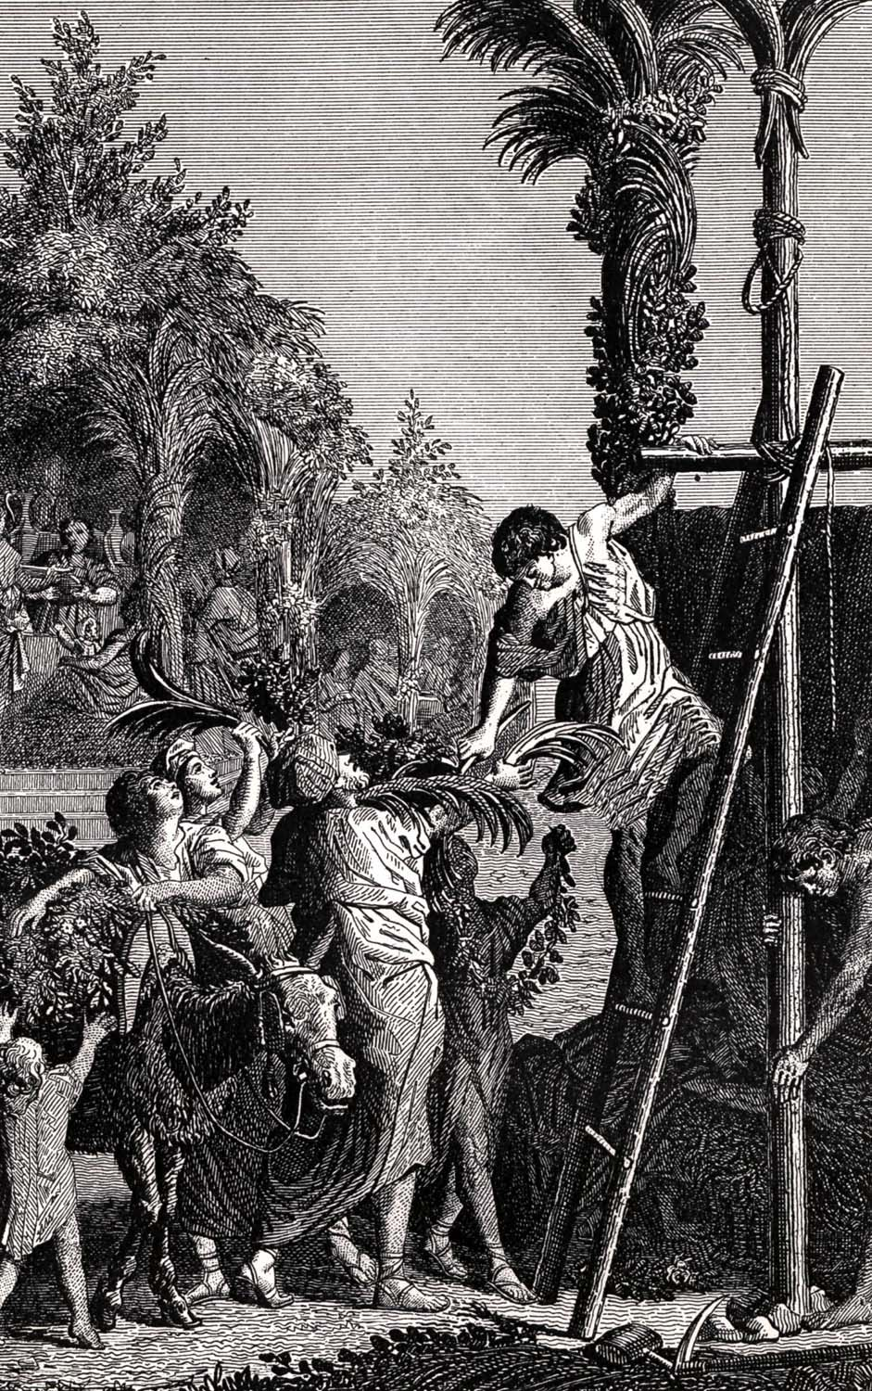
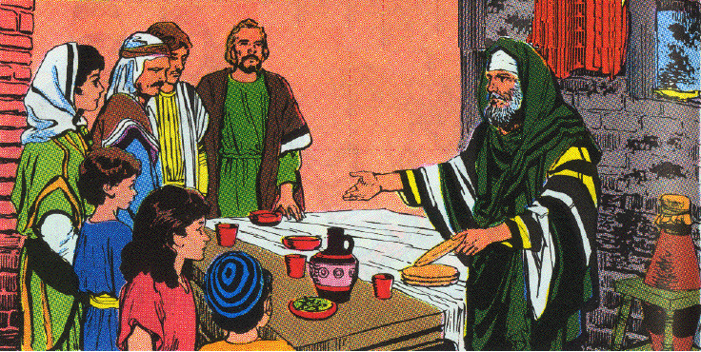
d. Keeping the Passover 23:21-23; cf. 2 C 35:1-19
21 Then the king commanded all the people saying, "Celebrate the Passover to the LORD your God as it is written in this book of the covenant."
22 Surely such a Passover had not been celebrated from the days of the judges who judged Israel, nor in all the days of the kings of Israel and of the kings of Judah.
23 But in the eighteenth year of King Josiah, this Passover was observed to the LORD in Jerusalem.

Slide 43
8. An appraisal of Josiah’s reformation 23:24-27
24 Moreover, Josiah removed the mediums and the spiritists and the teraphim and the idols and all the abominations that were seen in the land of Judah and in Jerusalem, that he might confirm the words of the law which were written in the book that Hilkiah the priest found in the house of the LORD.
25 And before him there was no king like him who turned to the LORD with all his heart and with all his soul and with all his might, according to all the law of Moses; nor did any like him arise after him.
26 However, the LORD did not turn from the fierceness of His great wrath with which His anger burned against Judah, because of all the provocations with which Manasseh had provoked Him.
27 And the LORD said, "I will remove Judah also from My sight, as I have removed Israel. And I will cast off Jerusalem, this city which I have chosen, and the temple of which I said, ‘My name shall be there.’"

Slide 44
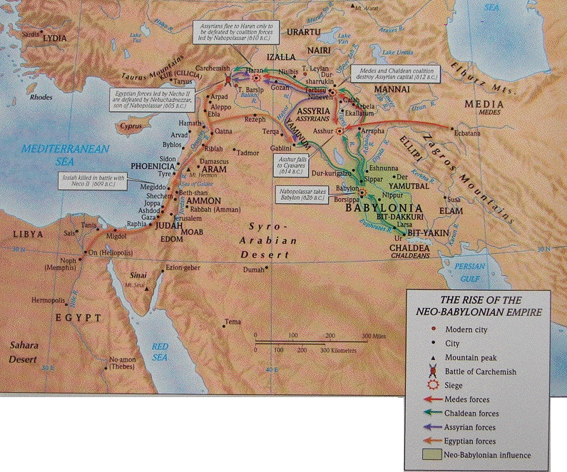

Slide 45
