Slide 1
THE GOOD SHEPHERD
John 10:1-21

Slide 2
The Later Judean Ministry
From Tabernacles to Dedication, Oct. — Dec. 29 AD Jn. 7:11—10:21; Lk. 10:1—13:21; Jn. 10:22-42
Feast of Tabernacles & woman taken in adultery Jn. 7:11—8:11 Jerusalem, Oct. 29 AD
After the feast - in Jerusalem - Sermon on the light of the world - Messianic claims met by attempts to stone Jesus Jn. 8:12-59
The healing of the man born blind, Jn. 9
The Good Shepherd - Jerusalem Jn. 10:1-21
Teaching in Judea: Mission of 70, Good Samaritan, Prayer, Further Controversies, Fear of men vs. trust in God, Warning concerning judgment day Lk. 10:1—13:21
Feast of Dedication - Jerusalem - Dec. Jn. 10:22-42

Slide 3
Sermon’s Two Divisions
The Good Shepherd & the Sheep 10:1-6
The Good Shepherd & the Hirelings 10:7-18
The aftermath of the sermon 10:19-21
Two key words - shepherd & door

Slide 4
Sheep Folds
1 “Truly, truly, I say to you, he who does not enter by the door into the fold of the sheep, but climbs up some other way, he is a thief and a robber.
To protect sheep from wild animals & robbers or wandering off
A solid wall
Long branches of thorns placed on top
Deterred a wolf from surmounting the wall

Slide 5
Thief & Robber
1 “Truly, truly, I say to you, he who does not enter by the door into the fold of the sheep, but climbs up some other way, he is a thief and a robber.
One with good purposes would enter by the door
Climbing over barrier - evil purposes
Stole the sheep - used deception & violence
O.T. speaks of false shepherds Ezek. 34:1-6; Jer. 33:1-6; Zech. 11:4-11
Jesus came the proper & appointed way
Pharisees cast out the blindman - tried to gain control by violence & intimidation
Parable explains & application vv. 7-18

Slide 6
The Shepherd - The door
2 “But he who enters by the door is a shepherd of the sheep.
3 “To him the doorkeeper opens, and the sheep hear his voice, and he calls his own sheep by name and leads them out.
Christ is the true Shepherd & God’s way for man's redemption
The promised good shepherd Jer. 23:1-5
Christ is the door & shepherd
the doorkeeper - part of imagery or God

Slide 7
The Sheep
2 “But he who enters by the door is a shepherd of the sheep.
3 “To him the doorkeeper opens, and the sheep hear his voice, and he calls his own sheep by name and leads them out.
Honest hearts, like the blindman, recognize His voice
Sheep know His voice & habits - Christ’s word
Shepherd know each sheep by name
Cares for His sheep individually
Knows your name & the hairs of your head Matt. 10:29-30 Are not two sparrows sold for a cent? And yet not one of them will fall to the ground apart from your Father. But the very hairs of your head are all numbered.

Slide 8
The Comradeship
4 “When he puts forth all his own, he goes ahead of them, and the sheep follow him because they know his voice.
5 “A stranger they simply will not follow, but will flee from him, because they do not know the voice of strangers.”
The shepherd leads them to the best pastures
He will meet the dangers first
Jesus leads us to heaven
The sheep trustingly follow
Know shepherd’s voice - trust & obey
Will not follow a stranger
The voice of Jesus is revealed in the word, Heb. 1:1-3; 2:1-4

Slide 9
True & False Leaders
6 This figure of speech Jesus spoke to them, but they did not understand what those things were which He had been saying to them.
7 So Jesus said to them again, “Truly, truly, I say to you, I am the door of the sheep.
8 “All who came before Me are thieves and robbers, but the sheep did not hear them.
figure of speech - paroimia - wayside saying, simile or allegory
Both the door & the shepherd
The Door, only one - way of salvation
Pharisees - false leadership, false teachers - led the nation astray by materialistic hopes, hypocrisy & perversion of the Scripture
false Christs - sought to lead the nation into fatal rebellions
Christ’s authority - unique & final & supreme

Slide 10
Precious Promises
9 “I am the door; if anyone enters through Me, he will be saved, and will go in and out and find pasture.
10 “The thief comes only to steal and kill and destroy; I came that they may have life, and have it abundantly.
to go in and out - follow ordinary procedure of daily living
Enter by the door: salvation, liberty & nutrition
Saved from danger - forgiveness & release from bondage to Satan
Liberty - choose your service field for personal gifts to glorify God
Nutrition - spiritual food & blessings for the soul
The church has a tender Shepherd
false teachers - selfish, harmful
life abundant - overflowing, never-ceasing

Slide 11
Perfect Self-sacrifice
11 “I am the good shepherd; the good shepherd lays down His life for the sheep.
the good shepherd - not a good shepherd - unique
Greek - literally, "the shepherd the good one"
good - halos - beautiful; excellent in nature, well-adapted to its end: competent, able, such as one ought to be
Above all other shepherds, good or bad.
Even faithful shepherds (teachers) are weak & imperfect
Christ claims the confidence & admiration of all
Gives His life to save sheep - robbers, wolves, lions, bears
for - hoper - on behalf of, on behalf of - substitutionary death Jn. 15:13; 1 Jn. 3:16; Matt. 20:28

Slide 12
the Hired hand
12 “He who is a hired hand, and not a shepherd, who is not the owner of the sheep, sees the wolf coming, and leaves the sheep and flees, and the wolf snatches them and scatters them.
13 “He flees because he is a hired hand and is not concerned about the sheep.
Works for pay (wages) - chief consideration - not the sheep - think only care for his own well-being & selfish ends
chief priests & Pharisees - pretended shepherds - selfish interests
Leaves sheep to be scattered & killed
wolves - destroyers - Satan & his servants
Individuals & organizations prey on people by religion
Many will not defend the truth against false teachers & godless philosophies & denominationalism

Slide 13
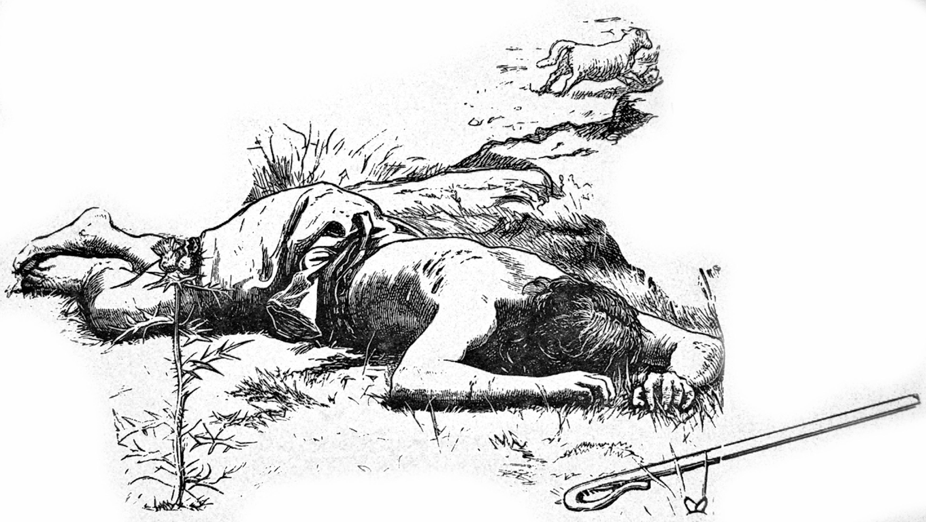
Relationship to His Flock
14 “I am the good shepherd, and I know My own and My own know Me,
15 even as the Father knows Me and I know the Father; and I lay down My life for the sheep.
Contrast between Jesus vs. the hireling
Happy relationship of mutual regard & understanding
Like what exists between the Father& the Son
Fellowship of understanding, love & regard
Lays down His life for the sheep
Made human to do this for us
Gave up physical life so we might have spiritual life in Him

Slide 14
Other sheep
16 “I have other sheep, which are not of this fold; I must bring them also, and they will hear My voice; and they will become one flock with one shepherd.
other sheep - not of the Jewish fold - the Gentiles
Came to establish a world-wide system for honest men of all nations to seek & find salvation, Jn. 3:16; Matt. 8:11; Lk. 13:28
Anticipated & predicted in the O.T. Isa. 42:6; 49:6; Mic. 4: 1-5
Not another fold or body - other sheep merged
Jew & Gentile disciples become one flock, one church Eph. 4:4-6
His sheep, by anticipation - people who would willingly receive him when the gospel was preached to them, Acts 18:10

Slide 15
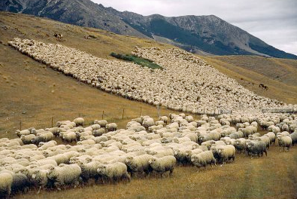
Other sheep
16 “I have other sheep, which are not of this fold; I must bring them also, and they will hear My voice; and they will become one flock with one shepherd.
Christ died for all men - all races or nationalities
All are called to salvation - those who hear are saved
God sent his Son to save the world Jn. 3:16, 17
Gave knowledge of life & salvation to Samaritans Jn. 4:39-42
Great Commission - to all the world & every creature Matt. 28:18-20; Mk. 16:15, 16
Invitation extends to all humanity: Matt. 11:28; Rev. 22:17

Slide 16
The Shepherd Dies for His Sheep
17 “For this reason the Father loves Me, because I lay down My life so that I may take it again.
18 “No one has taken it away from Me, but I lay it down on My own initiative. I have authority to lay it down, and I have authority to take it up again. This commandment I received from My Father.”
The Father loves His Son - will gladly give up His life for His followers
Valid sacrifice - willing offering, out of love Heb. 9:14
His resurrection was as much a part Rom. 4:25
Laid it down as a sacrifice for world’s sins 1 Pet. 2:24
Took it up again - triumphant over death, sin & Satan

Slide 17
The Shepherd Dies for His Sheep
17 “For this reason the Father loves Me, because I lay down My life so that I may take it again.
18 “No one has taken it away from Me, but I lay it down on My own initiative. I have authority to lay it down, and I have authority to take it up again. This commandment I received from My Father.”
No one could take his life away - could have delivered Himself
Not forced to leave heaven or suffer by wicked men
Did all voluntarily to fulfill the Father’s will to save men
Gave His life at the command of God
To accomplish atonement
Freely submitted out of love for the Father

Slide 18
Divided Counsel
19 A division occurred again among the Jews because of these words.
20 Many of them were saying, “He has a demon and is insane. Why do you listen to Him?”
Differences arose among the leaders
Some were influenced by the Lord's words to believe in Him
Some more conscientious & honest & open-minded
Division about Jesus not unusual Jn. 9:16; 10:19, 24, 41; 11:41; 12:19, 29, 42
Those who opposed Him more vocal
Quick to minimize any effect on the multitude by those defending Jesus

Slide 19
Attempt to undermine His Reputation
19 A division occurred again among the Jews because of these words.
20 Many of them were saying, “He has a demon and is insane. Why do you listen to Him?”
many - most still opposed - more hardened
Repeated Jn. 8:48 - demon possessed - a madman
Try to explain the healing of the blind man Matt. 12:24
Try to destroy His influence - unable to refute teaching
Common device against good & great men
An effective instrument of the devil

Slide 20
Miracles impossible for a demon
21 Others were saying, “These are not the sayings of one demon-possessed. A demon cannot open the eyes of the blind, can he?”
Defenders of Jesus were not deceived
Jesus’ saying were not those of a demon or insane man
His teachings were irrefutable
Power to heal a blind man was not possible for a demon - never do good
The unbelieving Jews could not answer it
Quick to point out what Jesus was not
Did not acknowledge Him for what He is
Let us confess Him as Lord & Savior

