Slide 1
Veneration of Saints, Images & Relics
Bible vs. Catholicism

Slide 2
I. Do Catholics Worship Saints?
Some will deny they worship Mary, saints, images or relics
Practice says otherwise

Slide 3
Procession of the Holy Blood Bruges, Belgium
Bruges - brūēzh
Once a year - 10th of May
Supposed blood caught at the foot of the cross
Found by Crusaders
People bow down before it & venerate

Slide 4
the Church of the Sacred Heart in Paris
Statues of Joseph holding Christ-child
Statue of the Virgin
Peter holding keys
Toes have been kissed off

Slide 5
Shire of the Virgin Banneux
Little girl supposedly saw Mary
Request a chapel be built
Blessed a fountain
Pilgrims worship on their knees
Wash themselves with blessed waters

Slide 6
"the good old God of Tancremont"
supposed to have been found by a farmer in a field
Caused 40 days of rain
Cannot be painted
Easier to pray before it

Slide 7
The Authorities Say They Do
Outline of Dogmatic Theology, volume II (Pages 220, 223, 225), by Bernard Bartmann, a papal prelate in Rome
"'The Saints who live with Christ offer the prayers of the faithful to God, and it is good and useful intercession.' It is with these words that the Council of Trent takes the defense of the ancient practice of worshipping the saints in the church & declares that those who refuse the worship of the saints & declare it foolish have an impious thought . . .

Slide 8
The Authorities Say They Do
Outline of Dogmatic Theology, volume II (Pages 220, 223, 225), by Bernard Bartmann, a papal prelate in Rome
"'It is likewise permissible & useful to honor the relics of the saints ...
The Council of Trent pronounced itself in favor of their worship in these words, 'Likewise the holy bodies of the martyred saints and of other saints who lived with Christ, and who were living members of Christ and temples of the Holy Spirit, and who will be raised by him and glorified by life eternal, should be honored by the faithful' . . .
The church has likewise protected the worship of images against attacks and has declared it permissible and useful."

Slide 9
The Authorities Say They Do
Boulenger's Catholic Doctrine, part Two, entitled "Morals." Vol. II, pp. 28‑31)
“It is good and useful to invoke the servants of God . . .
to venerate their relics and their images; but the faithful should have especially a filial devotion with regard to the blessed Virgin Mary. . .
Public worship can be given only to the servants of God who have been declared saints and blessed by the authority of the Church. To the canonized saints is due a worship of 'dulia,' a worship which may be rendered to them everywhere and by no matter what act of 'dulia.' This worship cannot be rendered to the blessed except in the places where the Holy See permits it and in the manner which it concedes."

Slide 10
The Authorities Say They Do
Boulenger's Catholic Doctrine, part Two, entitled "Morals." Vol. II, pp. 30, 31)
“We honor the relics, because they are (1) the remains of our glorious brethren, consequently, worthy of our respect; and (2) the instruments which God has used to accord innumerable favors. It is fitting to remark that if the remains were not those of the saint whom one wishes to honor, there would be no idolatry, in view of the fact that the homage should not stop with the relic, but should go, in the last analysis, to the saint who is the object of our worship . . . "

Slide 11
The Authorities Say They Do
Boulenger's Catholic Doctrine, part Two, entitled "Morals." Vol. II, pp. 30, 31)
“Let us render to the Holy Virgin, to the angels and the saints the worship which belongs to them. Let there always be a crucifix in our home, to give us a lesson and a model, and the image of the Virgin to preach to us confidence and virtue. Let us not separate, in our devotion, the Mother from the Son; it is by Mary that one goes to Jesus and that one is more certain to obtain the graces of which one has need."

Slide 12
Titles For Mary
Table of contents - Alphonsus Liguori’s 30 volume works
"Mary is the star of the sea, the star of the morning, the moon, the dawn, the sun ...
the lily among thorns, the flower of the root of Jesse...
the olive of mercy, the mystic rose, the nard of the holy canticles, the closed garden and the shaded fountain, the dove of Noah . . .
Noah's ark, the ark of the covenant, the mercy seat, the column of fire in the desert, the royal road which leads to the Savior, the mountain of David, the tower of David ...
the mirror of righteousness, the ladder of heaven, the key and the door of heaven, the throne of mercy, the new Eve ...
the divine shepherdess."

Slide 13
Mary’s Prerogatives
Alphonsus Liguori
"The holy Virgin is the daughter of God the Father, the Mother of God the Son, the bride of the Holy Spirit. She is full of grace. She is preferred of all the saints and of all the angels. She is exempt from sin. She brought back the victory over the infernal serpent. She was our mother the day of the incarnation of the Word. She had the use of reason from the time of her conception . . . She is the queen of the martyrs," etc.

Slide 14
Mary’s Her Powers
Alphonsus Liguori
"Mary is preferred of God above all the saints and angels together. She is the queen of the world, the queen of the saints. Her intercession is necessary for us. She is the restorer of the human family, the mediatrix of men. She received at Calvary the title of mother of the church and the mother of all men. She is a lovable and a loving mother. She is the mother of penitent sinners, the mother of orphans. Her credit before God is all‑powerful."

Slide 15
Mary Placed On Equality With Christ
Alphonsus Liguori
"Jesus Christ is the center of grace and Mary is the circumference by which grace comes to us. Mary is the treasury of divine grace. She wants to protect us. She is a compassionate and powerful advocate for us. Mary is our hope, the hope of sinners,"

Slide 16
Communion of the Saints
Three states of the church in Catholicism
church militant - on earth
church triumphant - in heaven with Christ
suffering church - those in purgatory
community of interest & of prayers
pray for those in purgatory
pray to those in heaven

Slide 17
Communion of the Saints
Boulenger Vol. I pp. 227, 228
"Communion of the faithful of the earth with the saints in Heaven and the souls in Purgatory:
(a) With the elect. The faithful of the church militant render to the saints of heaven a worship of honor; they celebrate piously their feasts, venerate their relies; they pray to them and ask them to intercede for them before God . . .
In consideration of the praises which we address to them, the saints interest themselves in our salvation, offer to God our prayers and obtain for us the grace that we solicit. The saints intercede also for the souls in Purgatory.

Slide 18
Communion of the Saints
Boulenger Catholic Doctrine Vol. I pp. 227, 228
(b) With the souls in Purgatory. The Church militant considers as a duty of charity and often of thanksgiving the relieving of the pains of the souls in Purgatory and the shortening of their stay there. For this, she uses prayer and good works: alms, penance, indulgences and especially the holy sacrifice of the mass."

Slide 19
Communion of the Saints
Doctrine supporting the worship of saints, images & relics
Closer to God
Intercede for men
Help those in purgatory
Relics & images honor them

Slide 20
Doctrines Admittedly Unscriptural
Doctrines are not in the Bible
Catholic authorities frankly admit it
Boulenger Catholic Doctrine Vol. I p. 223
"The dogma of the Communion of the Saints, the formula for which was not introduced into the (Symbol of the Apostles until quite late, likely near the 5th Century, has its foundation in numerous texts of the New Testament."
Uses texts for praying for Paul & other Christians Eph. 6:19; 1 Thess. 2:1, 2

Slide 21
Doctrines Admittedly Unscriptural
Bartmann: Outline of Dogmatic Theology, Vol. II
"One can hardly cite direct attestation from the Scriptures concerning the worship of the saints." (p. 221)
"The Scripture cannot be allegated to demonstrate the worship of relics." (p. 224).
"In the New Testament one does not find any allusion to an image‑worship."
These doctrine are wrong because they are not in the Bible

Slide 22
Doctrines Antagonistic to Scripture
One mediator 1 Tim. 2:5 For there is one God, and one mediator also between God and men, the man Christ Jesus,
Jesus Christ
Son of God Jn. 3:17 For God did not send the Son into the world to judge the world, but that the world should be saved through Him.
Son of man Matt. 9:6 "But in order that you may know that the Son of Man has authority on earth to forgive sins" --then He *said to the paralytic--"Rise, take up your bed, and go home."
Lives to make intercession Heb. 7:25 Hence, also, He is able to save forever those who draw near to God through Him, since He always lives to make intercession for them.

Slide 23
Through & In the Name of Christ
Pray through Christ to the Father
Jn. 14:13, 14 "And whatever you ask in My name, that will I do, that the Father may be glorified in the Son. If you ask Me anything in My name, I will do it.
Jn. 16:23 "And in that day you will ask Me no question. Truly, truly, I say to you, if you shall ask the Father for anything, He will give it to you in My name.
In the name of Christ Col. 3:17 And whatever you do in word or deed, do all in the name of the Lord Jesus, giving thanks through Him to God the Father.
Not Mary, nor saints, nor relic, nor image

Slide 24
Idolatry
First commandment Ex. 20:3 "You shall have no other gods before Me.
Second commandment Ex. 20:4-6 "You shall not make for yourself an idol, or any likeness of what is in heaven above or on the earth beneath or in the water under the earth. "You shall not worship them or serve them; for I, the LORD your God, am a jealous God, visiting the iniquity of the fathers on the children, on the third and the fourth generations of those who hate Me, but showing lovingkindness to thousands, to those who love Me and keep My commandments.
Catholics omit the second commandment
They split the tenth commandment to make 10
1 John 5:21 Little children, guard yourselves from idols.

Slide 25
Distinctions Made by Catholics in Types of Worship
“Latria” highest form - due to God, Christ, Holy Spirit.
“Hyperdulia” due to Mary
“Dulia” lowest form - due saints, images, relics.
All these are worship
Average Catholic knows no difference

Slide 26
Not Simply Helps
Catholic logic - images - relics only helps to bring us nearer to God & the saints
Crucifix - nailed up
When passed - cross sign made - bow head - tip hat

Slide 27
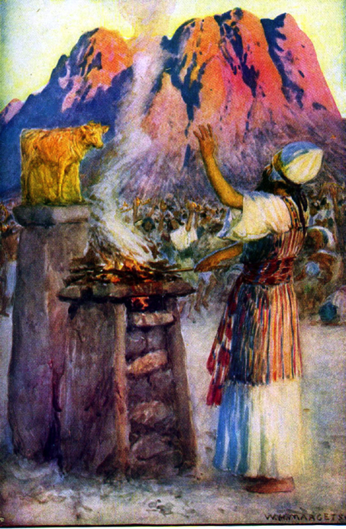
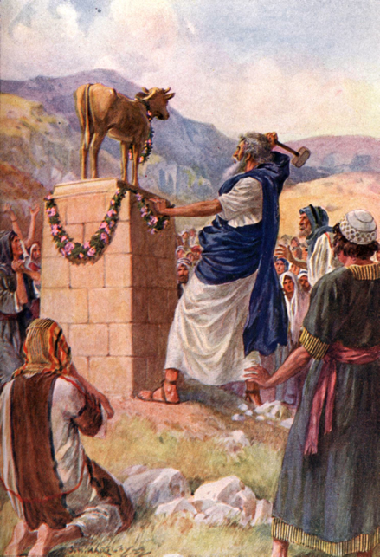
Golden Calf - only a Help?
Ex. 32:4 And he took this from their hand, and fashioned it with a graving tool, and made it into a molten calf; and they said, "This is your god, O Israel, who brought you up from the land of Egypt."
I Cor. 10:7 And do not be idolaters, as some of them were; as it is written, "THE PEOPLE SAT DOWN TO EAT AND DRINK, AND STOOD UP TO PLAY."

Slide 28
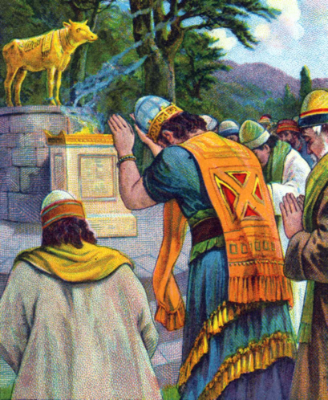
Jeroboam’s calf - only a Help?
I Kings 12:28 So the king consulted, and made two golden calves, and he said to them, "It is too much for you to go up to Jerusalem; behold your gods, O Israel, that brought you up from the land of Egypt."
Hos. 8:4 They have set up kings, but not by Me; They have appointed princes, but I did not know it. With their silver and gold they have made idols for themselves, That they might be cut off.
Hos. 8:6 For from Israel is even this! A craftsman made it, so it is not God; Surely the calf of Samaria will be broken to pieces.

Slide 29
Crucifix is a sign of the wrong kind of faith
Faith - not sight 2 Cor. 5:7 for we walk by faith, not by sight--
Their faith needs sight

Slide 30
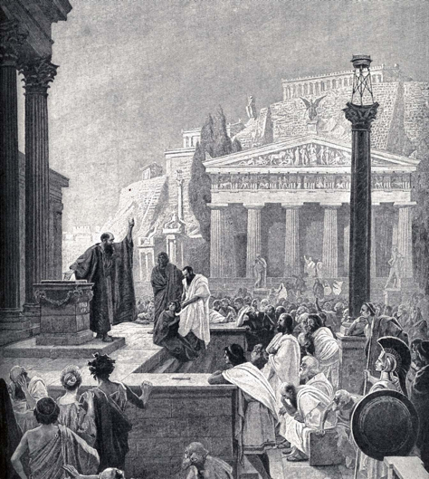
Paul In Athens
Athenians meant to worship God through idols
All idolatry intends to worship something beyond the stone, word, metal
Desires to worship his concept of a god represented.
Acts 17:22-31

Slide 31
Spirit & Truth Worship
John 4:24 "God is spirit, and those who worship Him must worship in spirit and truth."
Only acceptable worship today
Worship from the heart with faith & love
No need for a crutch

