Slide 1
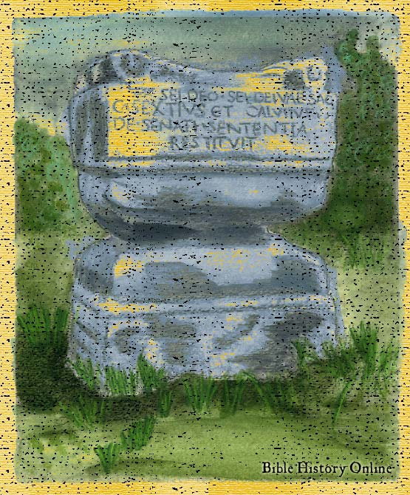
The Unknown God

Slide 2
The Unknown God
Acts 17:16-34
Athenians were very religious, but not for the right reasons
Athenians had many gods, but no creator
Notes:
Read : Hebrews 13:1-2
Question – Who is Hebrews 13 talking about?...... Abraham and Lot
Read Genisis 18 :1-8 and Gen 19:1-4
? How did they Show Hospitality

Slide 3
The Unknown God
People would rather worship a god they did not know than a god they know
An unknown god holds no one accountable
Their god has convinced them he is true
Notes:
Read : Hebrews 13:1-2
Question – Who is Hebrews 13 talking about?...... Abraham and Lot
Read Genisis 18 :1-8 and Gen 19:1-4
? How did they Show Hospitality

Slide 4
The Unknown God
Evolution
Agnosticism
Vain Idols (Sports, Television, Entertainment)
Notes:
Read : Hebrews 13:1-2
Question – Who is Hebrews 13 talking about?...... Abraham and Lot
Read Genisis 18 :1-8 and Gen 19:1-4
? How did they Show Hospitality

Slide 5
The Unknown God
The Athenians wanted to hear Paul….
….Not for the right reasons
Interesting but not important
Notes:
Read : Hebrews 13:1-2
Question – Who is Hebrews 13 talking about?...... Abraham and Lot
Read Genisis 18 :1-8 and Gen 19:1-4
? How did they Show Hospitality

Slide 6
The Known God
The Creator God
Genesis 1:1-5
In the beginning was the Word, and the Word was with God, and the Word was God. John 1:1
Notes:
Read : Hebrews 13:1-2
Question – Who is Hebrews 13 talking about?...... Abraham and Lot
Read Genisis 18 :1-8 and Gen 19:1-4
? How did they Show Hospitality

Slide 7
The Known God
The Loving God
I John 4:7-12
"For God so loved the world that He gave His only begotten Son, that whoever believes in Him should not perish but have everlasting life. John 3:16
Notes:
Read : Hebrews 13:1-2
Question – Who is Hebrews 13 talking about?...... Abraham and Lot
Read Genisis 18 :1-8 and Gen 19:1-4
? How did they Show Hospitality

Slide 8
The Known God
The Honest God
"God is not a man, that He should lie, Nor a son of man, that He should repent. Has He said, and will He not do? Or has He spoken, and will He not make it good?
Number 23:19
Notes:
Read : Hebrews 13:1-2
Question – Who is Hebrews 13 talking about?...... Abraham and Lot
Read Genisis 18 :1-8 and Gen 19:1-4
? How did they Show Hospitality

