Slide 1
3. Repopulation of Samaria 17:24-41

Slide 2
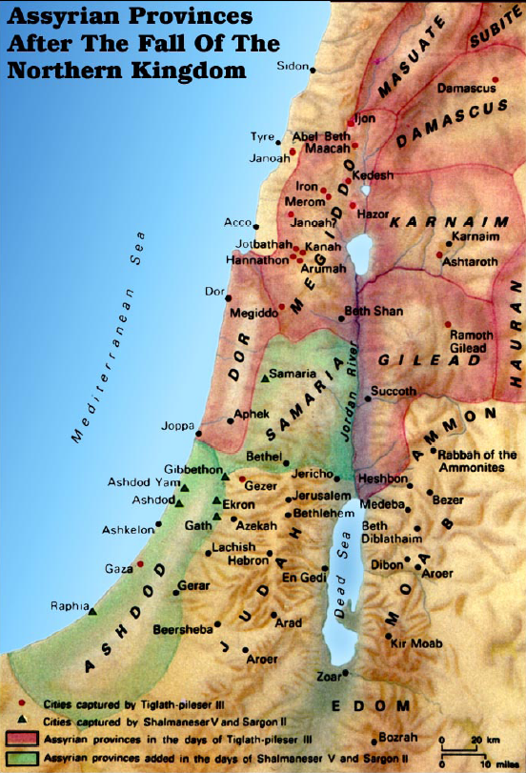

Slide 3
a. The peoples brought to inhabit Samaria 17:24
24 And the king of Assyria brought men from Babylon and from Cuthah and from Avva and from Hamath and Sephar-vaim, and settled them in the cities of Samaria in place of the sons of Israel. So they possessed Samaria and lived in its cities.

Slide 4
b. The plague of the lions 17:25, 26
25 And it came about at the beginning of their living there, that they did not fear the LORD; therefore the LORD sent lions among them which killed some of them.
26 So they spoke to the king of Assyria, saying, "The nations whom you have carried away into exile in the cities of Samaria do not know the custom of the god of the land; so he has sent lions among them, and behold, they kill them because they do not know the custom of the god of the land."

Slide 5
c. The mixed character of the Samaritans’ religion 17:27-41
27 Then the king of Assyria commanded, saying, "Take there one of the priests whom you carried away into exile, and let him go and live there; and let him teach them the custom of the god of the land."
28 So one of the priests whom they had carried away into exile from Samaria came and lived at Bethel, and taught them how they should fear the LORD.
29 But every nation still made gods of its own and put them in the houses of the high places which the people of Samaria had made, every nation in their cities in which they lived.

Slide 6
c. The mixed character of the Samaritans’ religion 17:27-41
30 And the men of Babylon made Succoth-benoth, the men of Cuth made Nergal, the men of Hamath made Ashima,
31 and the Avvites made Nibhaz and Tartak; and the Sepharvites burned their children in the fire to Adrammelech and Anammelech the gods of Sepharvaim.
32 They also feared the LORD and appointed from among themselves priests of the high places, who acted for them in the houses of the high places.
33 They feared the LORD and served their own gods according to the custom of the nations from among whom they had been carried away into exile.

Slide 7
c. The mixed character of the Samaritans’ religion 17:27-41
34 To this day they do according to the earlier customs: they do not fear the LORD, nor do they follow their statutes or their ordinances or the law, or the commandments which the LORD commanded the sons of Jacob, whom He named Israel;
35 with whom the LORD made a covenant and commanded them, saying, "You shall not fear other gods, nor bow down yourselves to them nor serve them nor sacrifice to them.

Slide 8
c. The mixed character of the Samaritans’ religion 17:27-41
36 "But the LORD, who brought you up from the land of Egypt with great power and with an outstretched arm, Him you shall fear, and to Him you shall bow yourselves down, and to Him you shall sacrifice.
37 "And the statutes and the ordinances and the law and the commandment, which He wrote for you, you shall observe to do forever; and you shall not fear other gods.
38 "And the covenant that I have made with you, you shall not forget, nor shall you fear other gods.
39 "But the LORD your God you shall fear; and He will deliver you from the hand of all your enemies."

Slide 9
c. The mixed character of the Samaritans’ religion 17:27-41
40 However, they did not listen, but they did according to their earlier custom.
41 So while these nations feared the LORD, they also served their idols; their children likewise and their grandchildren, as their fathers did, so they do to this day.

Slide 10
The Struggle For Independence 2 Kings 18:1—20:21

Slide 11
A. General Intro. to the Reign of Hezekiah 18:1-12
1. Hezekiah’s accession to the throne 1, 2
1 Now it came about in the third year of Hoshea, the son of Elah king of Israel, that Hezekiah the son of Ahaz king of Judah became king.
2 He was twenty-five years old when he became king, and he reigned twenty-nine years in Jerusalem; and his mother’s name was Abi the daughter of Zechariah.

Slide 12
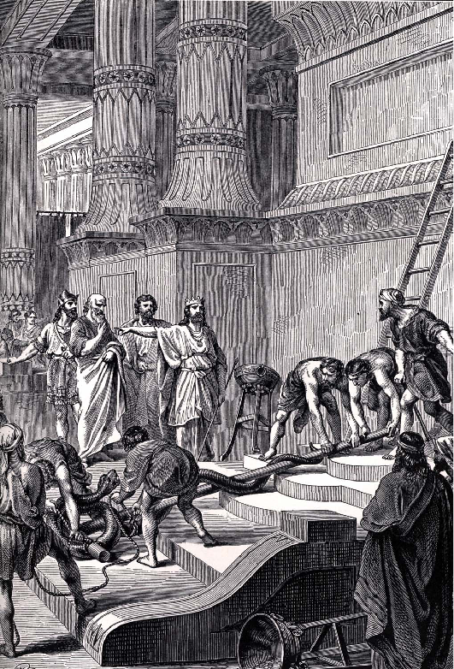
2. Character of Hezekiah 3-7a
3 And he did right in the sight of the LORD, according to all that his father David had done.
4 He removed the high places and broke down the sacred pillars and cut down the Asherah. He also broke in pieces the bronze serpent that Moses had made, for until those days the sons of Israel burned incense to it; and it was called Nehushtan.

Slide 13
2. Character of Hezekiah 3-7a
5 He trusted in the LORD, the God of Israel; so that after him there was none like him among all the kings of Judah, nor among those who were before him.
6 For he clung to the LORD; he did not depart from following Him, but kept His commandments, which the LORD had commanded Moses.
7a And the LORD was with him; wherever he went he prospered.

Slide 14
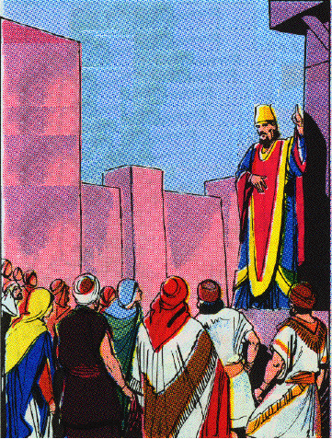
3. Orders the cleansing of the temple 2 C 29:3-11
3 In the first year of his reign, in the first month, he opened the doors of the house of the LORD and repaired them.
4 And he brought in the priests and the Levites, and gathered them into the square on the east.
5 Then he said to them, "Listen to me, O Levites. Consecrate yourselves now, and consecrate the house of the LORD, the God of your fathers, and carry the uncleanness out from the holy place.
6 "For our fathers have been unfaithful and have done evil in the sight of the LORD our God, and have forsaken Him and turned their faces away from the dwelling place of the LORD, and have turned their backs.

Slide 15
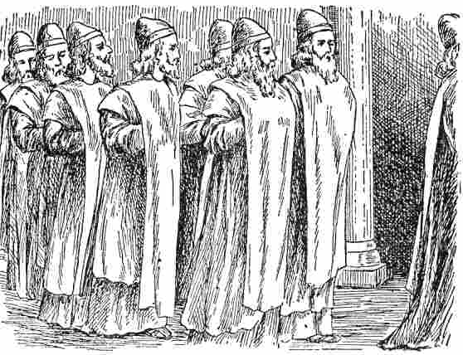
7 "They have also shut the doors of the porch and put out the lamps, and have not burned incense or offered burnt offerings in the holy place to the God of Israel.
8 "Therefore the wrath of the LORD was against Judah and Jerusalem, and He has made them an object of terror, of horror, and of hissing, as you see with your own eyes.
9 "For behold, our fathers have fallen by the sword, and our sons and our daughters and our wives are in captivity for this.
10 "Now it is in my heart to make a covenant with the LORD God of Israel, that His burning anger may turn away from us.
11 "My sons, do not be negligent now, for the LORD has chosen you to stand before Him, to minister to Him, and to be His ministers and burn incense."

Slide 16
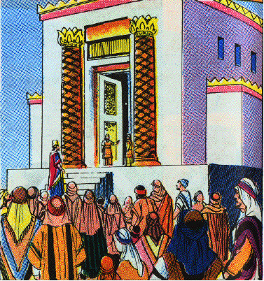
4. Reconsecration of the temple & people 2 C 29:20-36
5. Preparation for the Passover 2 C 30:1-12
6. Keeping the Passover 2 C 30:13-22
7. Feast kept for another seven day 2 C 30:23-27
8. Further religious reforms 2 C 31:2-21
a. Priest resume their functions
b. Tithes and offerings brought in
c. Surprising amounts come in
20 And thus Hezekiah did throughout all Judah; and he did what was good, right, and true before the LORD his God.
21 And every work which he began in the service of the house of God in law and in commandment, seeking his God, he did with all his heart and prospered.

Slide 17
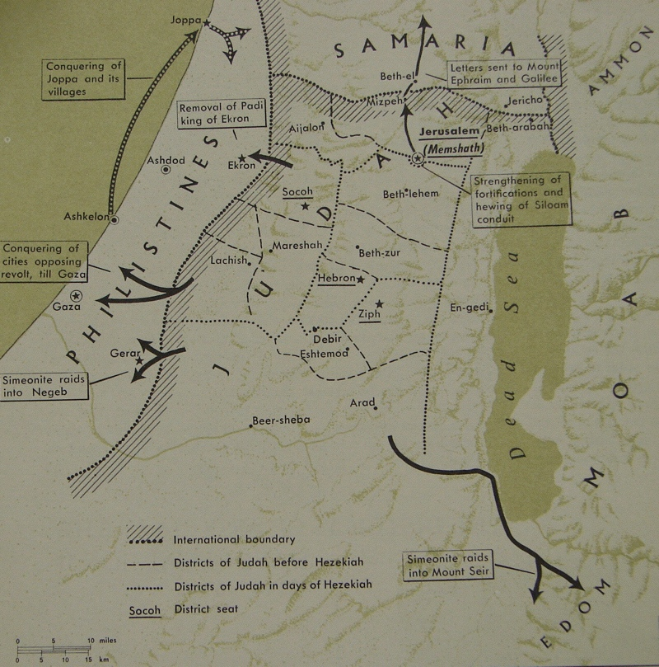
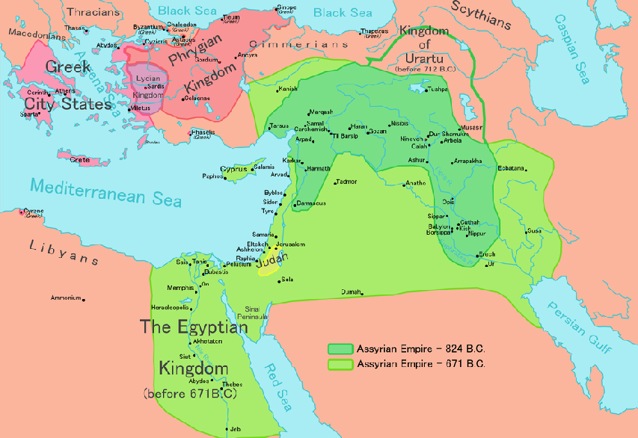
9. Hezekiah throw off the Assyrian yoke 2 K 18:7b
7b And he rebelled against the king of Assyria and did not serve him.
10. Successful Philistine Campaign 2 K 18:8
8 He defeated the Philistines as far as Gaza and its territory, from watchtower to fortified city.

Slide 18
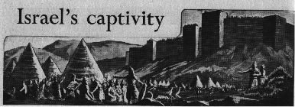
11. Samaria Besieged, captured & Israel carried away 2 K 18:9-12
9 Now it came about in the fourth year of King Hezekiah, which was the seventh year of Hoshea son of Elah king of Israel, that Shalmaneser king of Assyria came up against Samaria and besieged it.
10 And at the end of three years they captured it; in the sixth year of Hezekiah, which was the ninth year of Hoshea king of Israel, Samaria was captured.

Slide 19
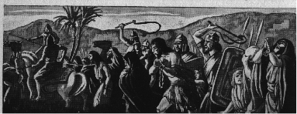
11 Then the king of Assyria carried Israel away into exile to Assyria, and put them in Halah and on the Habor, the river of Gozan, and in the cities of the Medes,
12 because they did not obey the voice of the LORD their God, but transgressed His covenant, even all that Moses the servant of the LORD commanded; they would neither listen, nor do it.

Slide 20
B. A Political Crisis: The Assyrian Invasion of 701 B.C.
2 Kings 18:13—19:37

Slide 21
1. Hezekiah’s payment of tribute to Sennacherib 2 K 18:13-16
13 Now in the fourteenth year of King Hezekiah, Sennacherib king of Assyria came up against all the fortified cities of Judah and seized them.
14 Then Hezekiah king of Judah sent to the king of Assyria at Lachish, saying, "I have done wrong. Withdraw from me; whatever you impose on me I will bear." So the king of Assyria required of Hezekiah king of Judah three hundred talents of silver and thirty talents of gold.

Slide 22
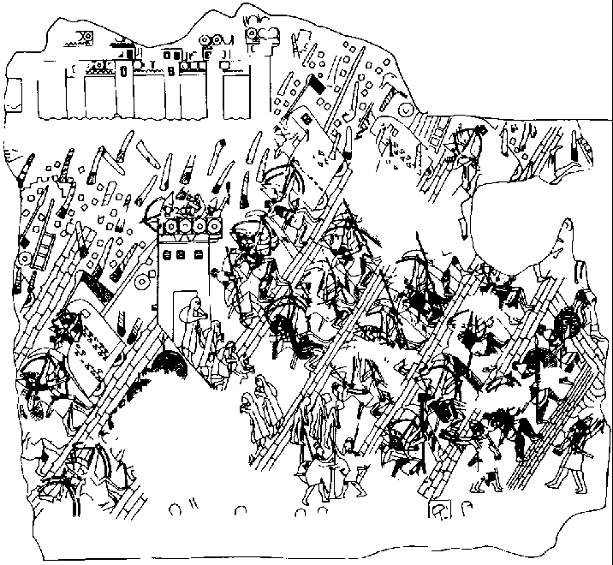
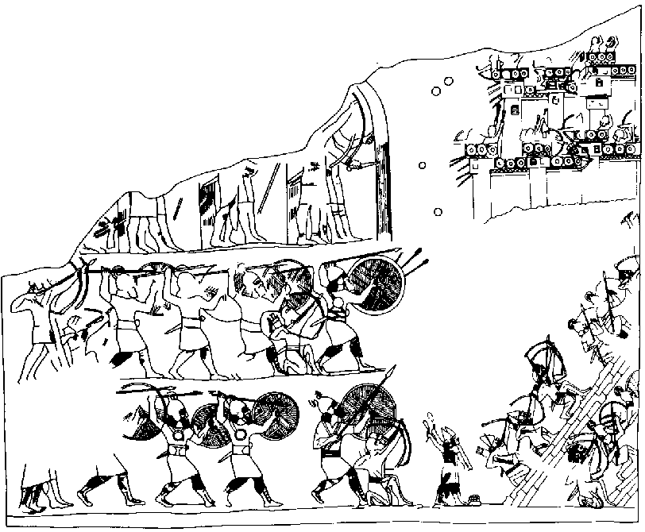
15 And Hezekiah gave him all the silver which was found in the house of the LORD, and in the treasuries of the king’s house.
16 At that time Hezekiah cut off the gold from the doors of the temple of the LORD, and from the doorposts which Hezekiah king of Judah had overlaid, and gave it to the king of Assyria.

Slide 23
The Sennacherib Prism
The cuneiform text on this clay prism (ca. 690 B.C.) documents the spread of the Assyrian Empire, including Sennacherib's campaigns against the Neo-Hittite states in Turkey and Sidon (Lebannon), and siege of jerusalem, then under the rule of hezekiah.

Slide 24
2. Sennacherib’s initial surrender demands 18:17—19:7

Slide 25
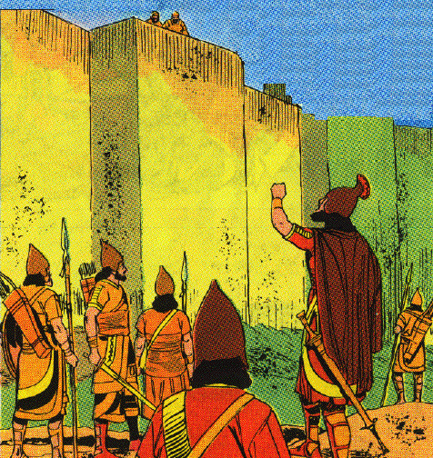
a. The Arrogant assyrian demands 2 K 18:17-37
17 ¶ Then the king of Assyria sent Tartan and Rab-saris and Rabshakeh from Lachish to King Hezekiah with a large army to Jerusalem. So they went up and came to Jerusalem. And when they went up, they came and stood by the conduit of the upper pool, which is on the highway of the fuller’s field.
18 When they called to the king, Eliakim the son of Hilkiah, who was over the household, and Shebnah the scribe and Joah the son of Asaph the recorder, came out to them.
19 Then Rabshakeh said to them, "Say now to Hezekiah, ‘Thus says the great king, the king of Assyria," What is this confidence that you have?
20 "You say (but they are only empty words), ‘I have counsel and strength for the war.’ Now on whom do you rely, that you have rebelled against me?

Slide 26
21 "Now behold, you rely on the staff of this crushed reed, even on Egypt; on which if a man leans, it will go into his hand and pierce it. So is Pharaoh king of Egypt to all who rely on him.
22 "But if you say to me, ‘We trust in the LORD our God,’ is it not He whose high places and whose altars Hezekiah has taken away, and has said to Judah and to Jerusalem, ‘You shall worship before this altar in Jerusalem’?
23 "Now therefore, come, make a bargain with my master the king of Assyria, and I will give you two thousand horses, if you are able on your part to set riders on them.
24 "How then can you repulse one official of the least of my master’s servants, and rely on Egypt for chariots and for horsemen?
25 "Have I now come up without the LORD’S approval against this place to destroy it? The LORD said to me, ‘Go up against this land and destroy it.’"’"

Slide 27
26 Then Eliakim the son of Hilkiah, and Shebnah and Joah, said to Rabshakeh, "Speak now to your servants in Aramaic, for we understand it; and do not speak with us in Judean, in the hearing of the people who are on the wall."
27 But Rabshakeh said to them, "Has my master sent me only to your master and to you to speak these words, and not to the men who sit on the wall, doomed to eat their own dung and drink their own urine with you?"
28 Then Rabshakeh stood and cried with a loud voice in Judean, saying, "Hear the word of the great king, the king of Assyria.
29 "Thus says the king, ‘Do not let Hezekiah deceive you, for he will not be able to deliver you from my hand;
30 nor let Hezekiah make you trust in the LORD, saying, "The LORD will surely deliver us, and this city shall not be given into the hand of the king of Assyria."

Slide 28
31 ‘Do not listen to Hezekiah, for thus says the king of Assyria, "Make your peace with me and come out to me, and eat each of his vine and each of his fig tree and drink each of the waters of his own cistern,
32 until I come and take you away to a land like your own land, a land of grain and new wine, a land of bread and vineyards, a land of olive trees and honey, that you may live and not die. "But do not listen to Hezekiah, when he misleads you, saying, "The LORD will deliver us."

Slide 29
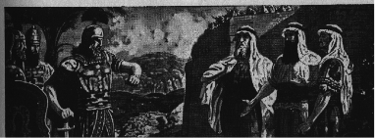
33 ‘Has any one of the gods of the nations delivered his land from the hand of the king of Assyria?
34 ‘Where are the gods of Hamath and Arpad? Where are the gods of Sepharvaim, Hena and Ivvah? Have they delivered Samaria from my hand?
35 ‘Who among all the gods of the lands have delivered their land from my hand, that the LORD should deliver Jerusalem from my hand?’"

Slide 30
36 But the people were silent and answered him not a word, for the king’s commandment was, "Do not answer him."
37 Then Eliakim the son of Hilkiah, who was over the household, and Shebna the scribe and Joah the son of Asaph, the recorder, came to Hezekiah with their clothes torn and told him the words of Rabshakeh.

Slide 31
b. The announcement of Isaiah the prophet 19:1-7
1 And when King Hezekiah heard it, he tore his clothes, covered himself with sackcloth and entered the house of the LORD.
2 Then he sent Eliakim who was over the household with Shebna the scribe and the elders of the priests, covered with sackcloth, to Isaiah the prophet the son of Amoz.
3 And they said to him, "Thus says Hezekiah, ‘This day is a day of distress, rebuke, and rejection; for children have come to birth, and there is no strength to deliver.
4 ‘Perhaps the LORD your God will hear all the words of Rabshakeh, whom his master the king of Assyria has sent to reproach the living God, and will rebuke the words which the LORD your God has heard. Therefore, offer a prayer for the remnant that is left.’"

Slide 32
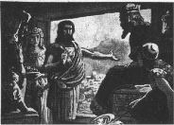
5 So the servants of King Hezekiah came to Isaiah.
6 And Isaiah said to them, "Thus you shall say to your master, ‘Thus says the LORD, "Do not be afraid because of the words that you have heard, with which the servants of the king of Assyria have blasphemed Me.
7 "Behold, I will put a spirit in him so that he shall hear a rumor and return to his own land. And I will make him fall by the sword in his own land."’"

Slide 33
3. Sennacherib’s second surrender demands 19:8-34

Slide 34
a. The letter of Sennacherib 19:8-13
8 Then Rabshakeh returned and found the king of Assyria fighting against Libnah, for he had heard that the king had left Lachish.
9 When he heard them say concerning Tirhakah king of Cush, "Behold, he has come out to fight against you," he sent messengers again to Hezekiah saying,
10 "Thus you shall say to Hezekiah king of Judah, ‘Do not let your God in whom you trust deceive you saying, "Jerusalem shall not be given into the hand of the king of Assyria."
11 ‘Behold, you have heard what the kings of Assyria have done to all the lands, destroying them completely. So will you be spared?
12 ‘Did the gods of those nations which my fathers destroyed deliver them, even Gozan and Haran and Rezeph and the sons of Eden who were in Telassar?
13 ‘Where is the king of Hamath, the king of Arpad, the king of the city of Sepharvaim, and of Hena and Ivvah?’"

Slide 35
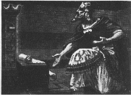
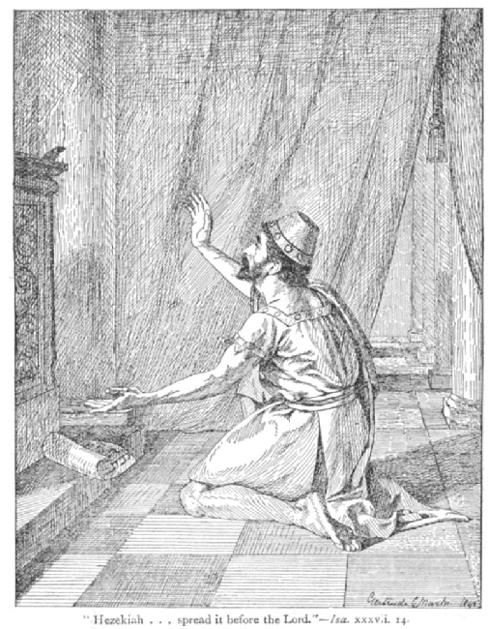
b. Prayer of Hezekiah 19:14-19
14 Then Hezekiah took the letter from the hand of the messengers and read it, and he went up to the house of the LORD and spread it out before the LORD.
15 And Hezekiah prayed before the LORD and said, "O LORD, the God of Israel, who art enthroned above the cherubim, Thou art the God, Thou alone, of all the kingdoms of the earth. Thou hast made heaven and earth.

Slide 36
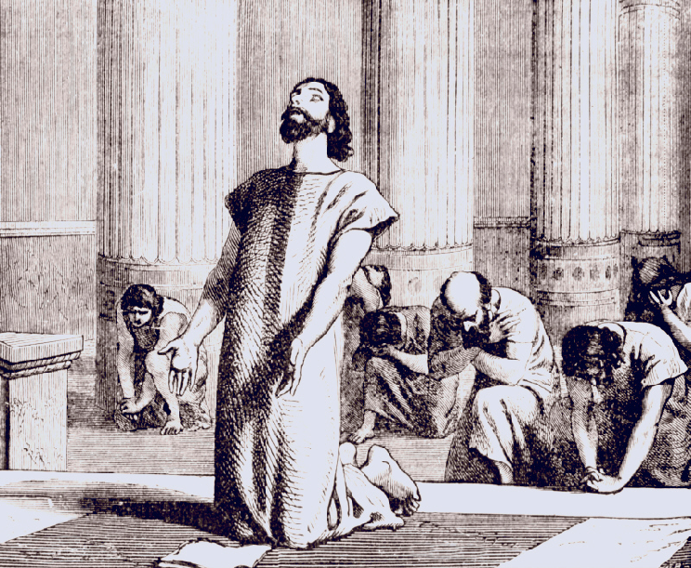
16 "Incline Thine ear, O LORD, and hear; open Thine eyes, O LORD, and see; and listen to the words of Sennacherib, which he has sent to reproach the living God.
17 "Truly, O LORD, the kings of Assyria have devastated the nations and their lands
18 and have cast their gods into the fire, for they were not gods but the work of men’s hands, wood and stone. So they have destroyed them.
19 "And now, O LORD our God, I pray, deliver us from his hand that all the kingdoms of the earth may know that Thou alone, O LORD, art God."

Slide 37
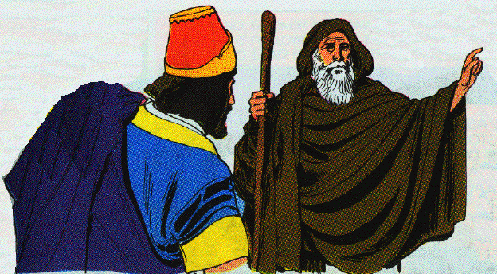
c. The oracle of Isaiah 19:20-34
20 ¶ Then Isaiah the son of Amoz sent to Hezekiah saying, "Thus says the LORD, the God of Israel, ‘Because you have prayed to Me about Sennacherib king of Assyria, I have heard you.’
21 "This is the word that the LORD has spoken against him: ‘She has despised you and mocked you, The virgin daughter of Zion; She has shaken her head behind you, The daughter of Jerusalem!
22 ‘Whom have you reproached and blasphemed? And against whom have you raised your voice, And haughtily lifted up your eyes? Against the Holy One of Israel!

Slide 38
23 ‘Through your messengers you have reproached the Lord, And you have said, "With my many chariots I came up to the heights of the mountains, To the remotest parts of Lebanon; And I cut down its tall cedars and its choice cypresses. And I entered its farthest lodging place, its thickest forest.
24 "I dug wells and drank foreign waters, And with the sole of my feet I dried up All the rivers of Egypt."
25 ‘Have you not heard? Long ago I did it; From ancient times I planned it. Now I have brought it to pass, That you should turn fortified cities into ruinous heaps.

Slide 39
26 ‘Therefore their inhabitants were short of strength, They were dismayed and put to shame; They were as the vegetation of the field and as the green herb, As grass on the housetops is scorched before it is grown up.
27 ‘But I know your sitting down, And your going out and your coming in, And your raging against Me.
28 ‘Because of your raging against Me, And because your arrogance has come up to My ears, Therefore I will put My hook in your nose, And My bridle in your lips, And I will turn you back by the way which you came.

Slide 40
29 ‘Then this shall be the sign for you: you shall eat this year what grows of itself, in the second year what springs from the same, and in the third year sow, reap, plant vineyards, and eat their fruit.
30 ‘And the surviving remnant of the house of Judah shall again take root downward and bear fruit upward.
31 ‘For out of Jerusalem shall go forth a remnant, and out of Mount Zion survivors. The zeal of the LORD shall perform this.
32 ‘Therefore thus says the LORD concerning the king of Assyria, "He shall not come to this city or shoot an arrow there; neither shall he come before it with a shield, nor throw up a mound against it.
33 "By the way that he came, by the same he shall return, and he shall not come to this city,"’ declares the LORD.
34 ‘For I will defend this city to save it for My own sake and for My servant David’s sake.’"

Slide 41
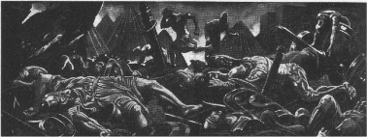
4. The deliverance of Judah 19:35-37
35 Then it happened that night that the angel of the LORD went out, and struck 185,000 in the camp of the Assyrians; and when men rose early in the morning, behold, all of them were dead.

Slide 42
4. The deliverance of Judah 19:35-37
35 Then it happened that night that the angel of the LORD went out, and struck 185,000 in the camp of the Assyrians; and when men rose early in the morning, behold, all of them were dead.

Slide 43
36 So Sennacherib king of Assyria departed and returned home, and lived at Nineveh.
37 And it came about as he was worshiping in the house of Nisroch his god, that Adrammelech and Sharezer killed him with the sword; and they escaped into the land of Ararat. And Esarhaddon his son became king in his place.

Slide 44
C. Hezekiah’s Personal Crisis 20:1-19

Slide 45
1. Hezekiah’s serious sickness & miraculous recovery 20:1-11
1 In those days Hezekiah became mortally ill. And Isaiah the prophet the son of Amoz came to him and said to him, "Thus says the LORD, ‘Set your house in order, for you shall die and not live.’"
2 Then he turned his face to the wall, and prayed to the LORD, saying,
3 "Remember now, O LORD, I beseech Thee, how I have walked before Thee in truth and with a whole heart, and have done what is good in Thy sight." And Hezekiah wept bitterly.

Slide 46
4 And it came about before Isaiah had gone out of the middle court, that the word of the LORD came to him, saying,
5 "Return and say to Hezekiah the leader of My people, ‘Thus says the LORD, the God of your father David," I have heard your prayer, I have seen your tears; behold, I will heal you. On the third day you shall go up to the house of the LORD.
6 "And I will add fifteen years to your life, and I will deliver you and this city from the hand of the king of Assyria; and I will defend this city for My own sake and for My servant David’s sake."’"
7 Then Isaiah said, "Take a cake of figs." And they took and laid it on the boil, and he recovered.

Slide 47
9 And Isaiah said, "This shall be the sign to you from the LORD, that the LORD will do the thing that He has spoken: shall the shadow go forward ten steps or go back ten steps?"
10 So Hezekiah answered, "It is easy for the shadow to decline ten steps; no, but let the shadow turn backward ten steps."
11 And Isaiah the prophet cried to the LORD, and He brought the shadow on the stairway back ten steps by which it had gone down on the stairway of Ahaz.

Slide 48
2. Hezekiah’s foolish showing of his treasury & rebuke 20:12-19
12 At that time Berodach-baladan a son of Baladan, king of Babylon, sent letters and a present to Hezekiah, for he heard that Hezekiah had been sick.
13 And Hezekiah listened to them, and showed them all his treasure house, the silver and the gold and the spices and the precious oil and the house of his armor and all that was found in his treasuries. There was nothing in his house, nor in all his dominion, that Hezekiah did not show them.

Slide 49
14 Then Isaiah the prophet came to King Hezekiah and said to him, "What did these men say, and from where have they come to you?" And Hezekiah said, "They have come from a far country, from Babylon."
15 And he said, "What have they seen in your house?" So Hezekiah answered, "They have seen all that is in my house; there is nothing among my treasuries that I have not shown them."

Slide 50
16 Then Isaiah said to Hezekiah, "Hear the word of the LORD.
17 ‘Behold, the days are coming when all that is in your house, and all that your fathers have laid up in store to this day shall be carried to Babylon; nothing shall be left,’ says the LORD.
18 ‘And some of your sons who shall issue from you, whom you shall beget, shall be taken away; and they shall become officials in the palace of the king of Babylon.’"
19 Then Hezekiah said to Isaiah, "The word of the LORD which you have spoken is good." For he thought, "Is it not so, if there shall be peace and truth in my days?"

Slide 51
3. Hezekiah’s acts & death 20:20-21
20 Now the rest of the acts of Hezekiah and all his might, and how he made the pool and the conduit, and brought water into the city, are they not written in the Book of the Chronicles of the Kings of Judah?
21 So Hezekiah slept with his fathers, and Manasseh his son became king in his place.

Slide 53
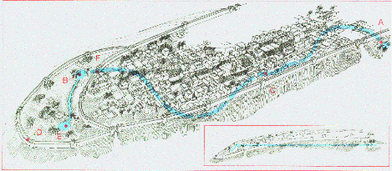

Slide 55
The Tunnel
A 1750-foot (530m) tunnel carved during the reign of Hezekiah to bring water from one side of the city to the other, Hezekiah's Tunnel together with the 6th c. tunnel of Euphalios in Greece are considered the greatest works of water engineering technology in the pre-Classical period. Had it followed a straight line, the length would have been 1070 ft (335m) or 40% shorter.

Slide 56
The Construction
2 Kings 20:20 "As for the other events of Hezekiah’s reign, all his achievements and how he made the pool and the tunnel by which he brought water into the city..."
2 Chron. 32:30 "It was Hezekiah who blocked the upper outlet of the Gihon spring and channeled the water down to the west side of the City of David."

Slide 57
The Meeting Point
Why is the tunnel S-shaped?
R. A. S. Macalister said the tunnel was a "pathetically helpless piece of engineering."
Henry Sulley in 1929 first suggested that Hezekiah’s tunnel followed a natural crack in the rock.
Dan Gill argues that the two crews of diggers followed a natural karstic dissolution channel.

Slide 58
The Location of the Siloam Inscription
“[...when] (the tunnel) was driven through. And this was the way in which it was cut through: While [...] (were) still [...] axe(s), each man toward his fellow, and while there were still three cubits to be cut through, [there was heard] the voice of a man calling to his fellows, for there was an overlap in the rock on the right [and on the left]. And when the tunnel was driven through, the quarrymen hewed (the rock), each man toward his fellow, axe against axe; and the water flowed from the spring toward the reservoir for 1200 cubits, and the height of the rock above the head(s) of the quarrymen was 100 cubits.”

Slide 59
King Hezekiah owned at least 2 seals shown below. Both inscriptions say, "(Seal) of Hezekiah, (son of) Ahaz, King (of) Judah" (לחזקיהו אחז מלך יהדה); however, the one with downward wings was written from top to bottom (with the word "Ahaz" divided) while the one with upward wings was written from bottom to top. Both of these types were stamped on unprovenanced clay bullae that sealed papyrus documents (which probably disintegrated a long time ago).

