Slide 1
XIII. The Great Assyrian Conqueror II Kings 15:8—17:41

Slide 2
Divided Monarchy: Homage Phase
(Sisters Parting)
750-722 B.C.
Pekahiah
Menahem
Hoshea
Pekah
742
740
750
739
735
732
728
722
Uzziah’s Last Days
Jotham
Ahaz
Hezekiah’s
Co-regent
Ahaz Co-regent
743

Slide 3
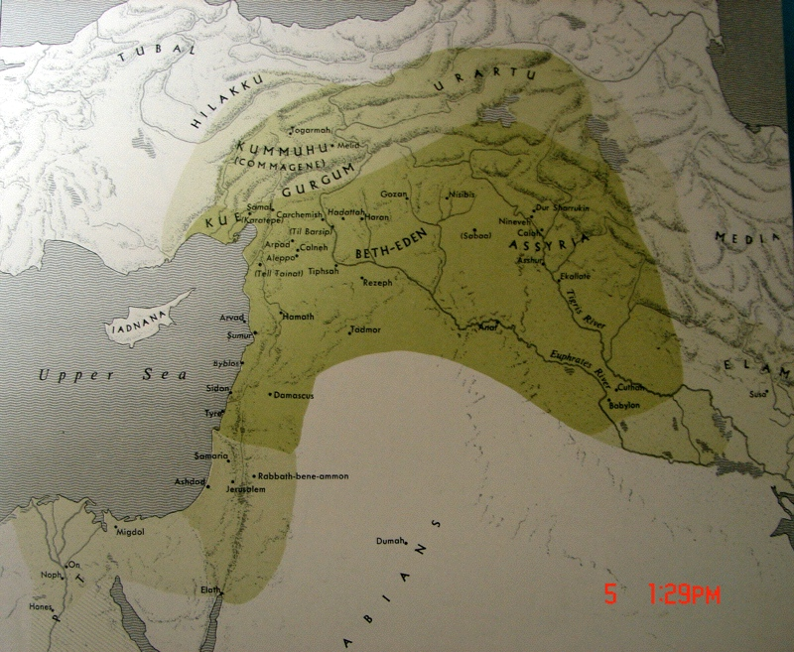
Rise of Assyria
Shalmaneser III
Tiglath-pileser III
Esarhaddon
Asshurbanipal

Slide 4
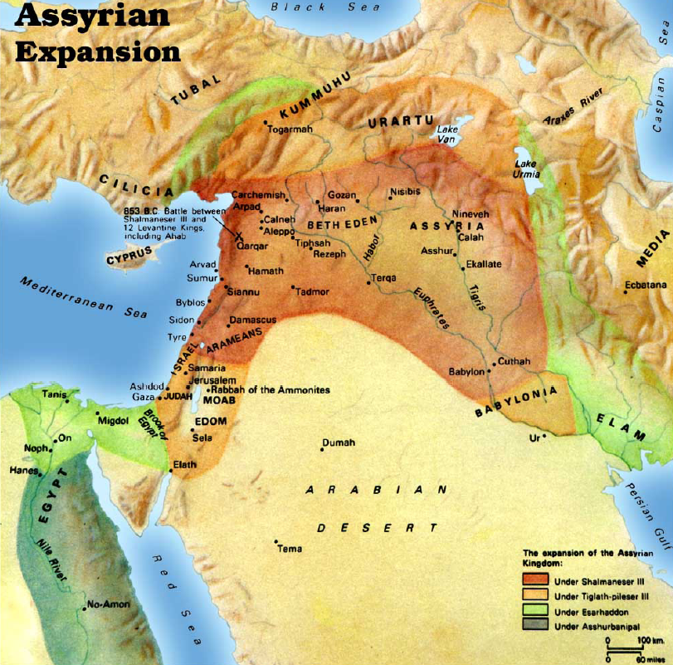

Slide 5
A. Israel Submits to Assyria 15:8-31

Slide 6
Israel
753
Jeroboam II 41 yrs.
Jehoash 16 yrs.
Zech.
Shallum
790
Judah
767
750
Uzziah (Azariah) 52 yrs.
Amaziah 29 yrs.
Divided Monarchy: Heyday Phase
(Sisters Growing)
790-750 BC

Slide 7
1. The six-month reign of Zechariah 15:8-12
8 In the thirty-eighth year of Azariah king of Judah, Zechariah the son of Jeroboam became king over Israel in Samaria for six months.
9 And he did evil in the sight of the LORD, as his fathers had done; he did not depart from the sins of Jeroboam the son of Nebat, which he made Israel sin.
10 Then Shallum the son of Jabesh conspired against him and struck him before the people and killed him, and reigned in his place.
11 Now the rest of the acts of Zechariah, behold they are written in the Book of the Chronicles of the Kings of Israel.
12 This is the word of the LORD which He spoke to Jehu, saying, "Your sons to the fourth generation shall sit on the throne of Israel." And so it was.
Hos. 1:4; Amos 7:9

Slide 8
2. The one month reign of Shallum 15:13-15
13 Shallum son of Jabesh became king in the thirty-ninth year of Uzziah king of Judah, and he reigned one month in Samaria.
14 Then Menahem son of Gadi went up from Tirzah and came to Samaria, and struck Shallum son of Jabesh in Samaria, and killed him and became king in his place.
15 Now the rest of the acts of Shallum and his conspiracy which he made, behold they are written in the Book of the Chronicles of the Kings of Israel.

Slide 9
3. Menahem submits to Assyria 15:16-22
16 Then Menahem struck Tiphsah and all who were in it and its borders from Tirzah, because they did not open to him, therefore he struck it; and he ripped up all its women who were with child.
17 In the thirty-ninth year of Azariah king of Judah, Menahem son of Gadi became king over Israel and reigned ten years in Samaria.
18 And he did evil in the sight of the LORD; he did not depart all his days from the sins of Jeroboam the son of Nebat, which he made Israel sin.

Slide 10
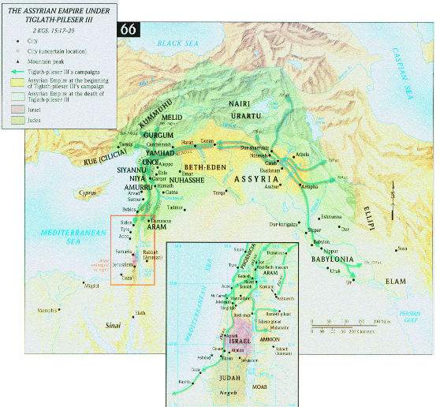

Slide 12
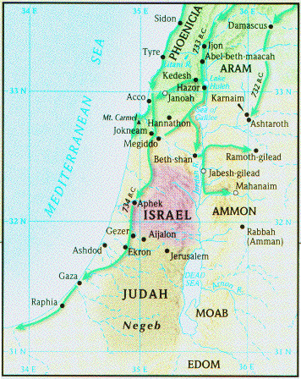
3. Menahem submits to Assyria 15:16-22
19 Pul, king of Assyria, came against the land, and Menahem gave Pul a thousand talents of silver so that his hand might be with him to strengthen the kingdom under his rule. (738 B.C.)

Slide 13
3. Menahem submits to Assyria 15:16-22
20 Then Menahem exacted the money from Israel, even from all the mighty men of wealth, from each man fifty shekels of silver to pay the king of Assyria. So the king of Assyria returned and did not remain there in the land.

Slide 14
3. Menahem submits to Assyria 15:16-22
21 Now the rest of the acts of Menahem and all that he did, are they not written in the Book of the Chronicles of the Kings of Israel?
22 And Menahem slept with his fathers, and Pekahiah his son became king in his place.
Pekahiah
Menahem
Hoshea
Pekah
742
740
750
739
735
732
728
722
Uzziah’s Last Days
Jotham
Ahaz
Hezekiah’s
Co-regent
Ahaz Co-regent
743

Slide 15
4. The two-year reign of Pekahiah 15:23-26
23 In the fiftieth year of Azariah king of Judah, Pekahiah son of Menahem became king over Israel in Samaria, and reigned two years.
24 And he did evil in the sight of the LORD; he did not depart from the sins of Jeroboam son of Nebat, which he made Israel sin.
25 Then Pekah son of Remaliah, his officer, conspired against him and struck him in Samaria, in the castle of the king’s house with Argob and Arieh (air’ee-uh); and with him were fifty men of the Gileadites, and he killed him and became king in his place.
26 Now the rest of the acts of Pekahiah and all that he did, behold they are written in the Book of the Chronicles of the Kings of Israel.

Slide 16
5. Pekah, the great nationalist 15:27-31
27 In the fifty-second year of Azariah king of Judah, Pekah son of Remaliah became king over Israel in Samaria, and reigned twenty years.
28 And he did evil in the sight of the LORD; he did not depart from the sins of Jeroboam son of Nebat, which he made Israel sin.

Slide 17
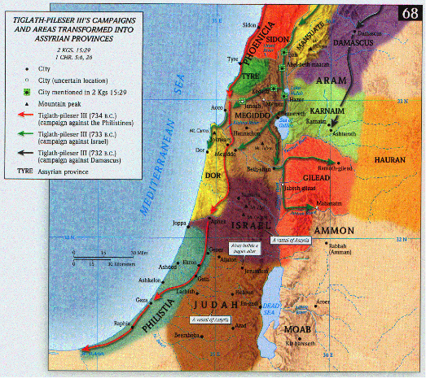
29 In the days of Pekah king of Israel, Tiglath-pileser king of Assyria came and captured Ijon and Abel-beth-maacah and Janoah and Kedesh and Hazor and Gilead and Galilee, all the land of Naphtali; and he carried them captive to Assyria.

Slide 18
30 And Hoshea the son of Elah made a conspiracy against Pekah the son of Remaliah, and struck him and put him to death and became king in his place, in the twentieth year of Jotham the son of Uzziah.
31 Now the rest of the acts of Pekah and all that he did, behold, they are written in the Book of the Chronicles of the Kings of Israel.

Slide 19
B. Judah Submits to Assyria 15:32—16:20

Slide 20
Divided Monarchy: Homage Phase
(Sisters Parting)
750-722 B.C.
Pekahiah
Menahem
Hoshea
Pekah
742
740
750
739
735
732
728
722
Uzziah’s Last Days
Jotham
Ahaz
Hezekiah’s
Co-regent
Ahaz Co-regent
743

Slide 21
1. The reign of Jotham 15:32-38
32 ¶ In the second year of Pekah the son of Remaliah king of Israel, Jotham the son of Uzziah king of Judah became king.
33 He was twenty-five years old when he became king, and he reigned sixteen years in Jerusalem; and his mother’s name was Jerusha the daughter of Zadok.
34 And he did what was right in the sight of the LORD; he did according to all that his father Uzziah had done.
35 Only the high places were not taken away; the people still sacrificed and burned incense on the high places. He built the upper gate of the house of the LORD.

Slide 22
Jotham’s building 2 C 27:3, 4
3 He built the upper gate of the house of the LORD, and he built extensively the wall of Ophel.
4 Moreover, he built cities in the hill country of Judah, and he built fortresses and towers on the wooded hills.

Slide 23
Subjugation of the Ammonites 2 C 27:5, 6
5 He fought also with the king of the Ammonites and prevailed over them so that the Ammonites gave him during that year one hundred talents of silver, ten thousand kors of wheat and ten thousand of barley. The Ammonites also paid him this amount in the second and in the third year.
6 So Jotham became mighty because he ordered his ways before the LORD his God.

Slide 24
1. The reign of Jotham 15:32-38
36 Now the rest of the acts of Jotham and all that he did, are they not written in the Book of the Chronicles of the Kings of Judah?
37 In those days the LORD began to send Rezin king of Aram and Pekah the son of Remaliah against Judah.
38 And Jotham slept with his fathers, and he was buried with his fathers in the city of David his father; and Ahaz his son became king in his place.

Slide 25
2. The Reign of Ahaz 16:1-20

Slide 26
Divided Monarchy: Homage Phase
(Sisters Parting)
750-722 B.C.
Pekahiah
Menahem
Hoshea
Pekah
742
740
750
739
735
732
728
722
Uzziah’s Last Days
Jotham
Ahaz
Hezekiah’s
Co-regent
Ahaz Co-regent
743

Slide 27
a. Introduction to the reign of Ahaz 16:1-4
1 In the seventeenth year of Pekah the son of Remaliah, Ahaz the son of Jotham, king of Judah, became king.
2 Ahaz was twenty years old when he became king, and he reigned sixteen years in Jerusalem; and he did not do what was right in the sight of the LORD his God, as his father David had done.
3 But he walked in the way of the kings of Israel, and even made his son pass through the fire, according to the abominations of the nations whom the LORD had driven out from before the sons of Israel.
4 And he sacrificed and burned incense on the high places and on the hills and under every green tree.
The inscription reads, “Belonging to Ahaz (son of) Jehotam, King of Judah.” Dated to the 8th century BCE, this is the first seal impression of a Hebrew king ever found.

Slide 28
Sins of Ahaz 2 C 27:3, 4
2 But he walked in the ways of the kings of Israel; he also made molten images for the Baals.
3 Moreover, he burned incense in the valley of Ben-hinnom, and burned his sons in fire, according to the abominations of the nations whom the LORD had driven out before the sons of Israel.
4 And he sacrificed and burned incense on the high places, on the hills, and under every green tree.

Slide 29
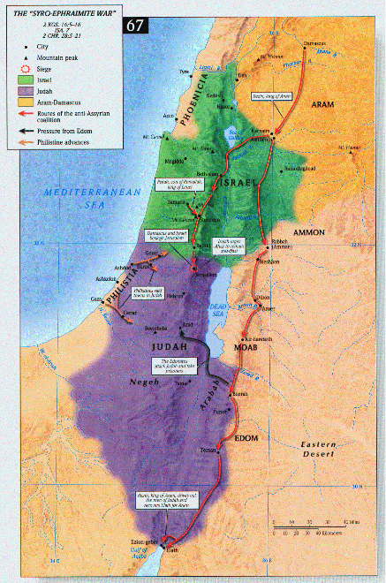
b. The Syro-Israelite invasion of Judah 16:5-9
5 Then Rezin king of Aram and Pekah son of Remaliah, king of Israel, came up to Jerusalem to wage war; and they besieged Ahaz, but could not overcome him.
6 At that time Rezin king of Aram recovered Elath for Aram, and cleared the Judeans out of Elath entirely; and the Arameans came to Elath, and have lived there to this day.

Slide 30
Complete defeat 2 C 28:5-8
5 Wherefore, the LORD his God delivered him into the hand of the king of Aram; and they defeated him and carried away from him a great number of captives, and brought them to Damascus. And he was also delivered into the hand of the king of Israel, who inflicted him with heavy casualties.

Slide 31
Complete defeat 2 C 28:5-8
6 ¶ For Pekah the son of Remaliah slew in Judah 120,000 in one day, all valiant men, because they had forsaken the LORD God of their fathers.
7 And Zichri, a mighty man of Ephraim, slew Maaseiah the king’s son, and Azrikam the ruler of the house and Elkanah the second to the king.
8 And the sons of Israel carried away captive of their brethren 200,000 women, sons, and daughters; and took also a great deal of spoil from them, and they brought the spoil to Samaria.

Slide 32
Losses to Philistines & Edomities 2 C 28:17-19
17 For again the Edomites had come and attacked Judah, and carried away captives.

Slide 33
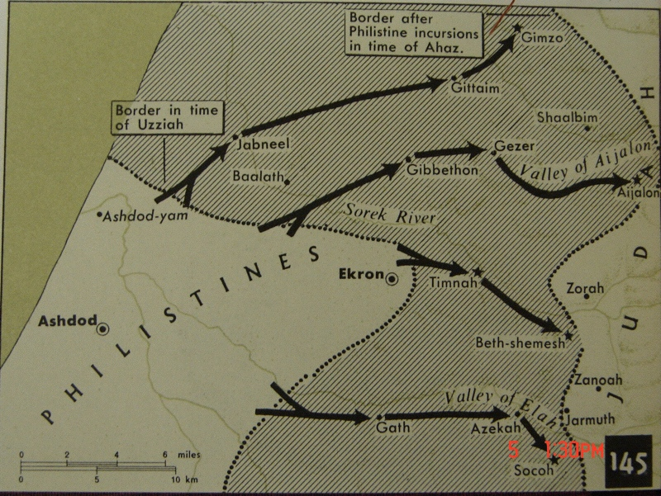
Losses to Philistines & Edomities 2 C 28:17-19
18 The Philistines also had invaded the cities of the lowland and of the Negev of Judah, and had taken Beth-shemesh, Aijalon, Gederoth, and Soco with its villages, Timnah with its villages, and Gimzo with its villages, and they settled there.
19 For the LORD humbled Judah because of Ahaz king of Israel, for he had brought about a lack of restraint in Judah and was very unfaithful to the LORD.

Slide 34
b. The Syro-Israelite invasion of Judah 16:5-9
See Isaiah 7
7 So Ahaz sent messengers to Tiglath-pileser king of Assyria, saying, "I am your servant and your son; come up and deliver me from the hand of the king of Aram, and from the hand of the king of Israel, who are rising up against me." (735 B.C.)
8 And Ahaz took the silver and gold that was found in the house of the LORD and in the treasuries of the king’s house, and sent a present to the king of Assyria.
9 So the king of Assyria listened to him; and the king of Assyria went up against Damascus and captured it, and carried the people of it away into exile to Kir, and put Rezin to death. (733-732 B.C.) Amos 1:4, 5

Slide 35
c. Temple alterations by Ahaz 16:10-18
10 Now King Ahaz went to Damascus to meet Tiglath-pileser king of Assyria, and saw the altar which was at Damascus; and King Ahaz sent to Urijah the priest the pattern of the altar and its model, according to all its workmanship.
11 So Urijah the priest built an altar; according to all that King Ahaz had sent from Damascus, thus Urijah the priest made it, before the coming of King Ahaz from Damascus.

Slide 36
c. Temple alterations by Ahaz 16:10-18
12 And when the king came from Damascus, the king saw the altar; then the king approached the altar and went up to it,
13 and burned his burnt offering and his meal offering, and poured his libation and sprinkled the blood of his peace offerings on the altar.
14 And the bronze altar, which was before the LORD, he brought from the front of the house, from between his altar and the house of the LORD, and he put it on the north side of his altar.

Slide 37
c. Temple alterations by Ahaz 16:10-18
15 Then King Ahaz commanded Urijah the priest, saying, "Upon the great altar burn the morning burnt offering and the evening meal offering and the king’s burnt offering and his meal offering, with the burnt offering of all the people of the land and their meal offering and their libations; and sprinkle on it all the blood of the burnt offering and all the blood of the sacrifice. But the bronze altar shall be for me to inquire by."
16 So Urijah the priest did according to all that King Ahaz commanded.

Slide 38
c. Temple alterations by Ahaz 16:10-18
17 Then King Ahaz cut off the borders of the stands, and removed the laver from them; he also took down the sea from the bronze oxen which were under it, and put it on a pavement of stone.
18 And the covered way for the sabbath which they had built in the house, and the outer entry of the king, he removed from the house of the LORD because of the king of Assyria.

Slide 39
Shut up the Temple & worship idols 2 C 28:24, 25
24 Moreover, when Ahaz gathered together the utensils of the house of God, he cut the utensils of the house of God in pieces; and he closed the doors of the house of the LORD, and made altars for himself in every corner of Jerusalem.
25 And in every city of Judah he made high places to burn incense to other gods, and provoked the LORD, the God of his fathers, to anger.

Slide 40
d. The death of Ahaz 16:19-20
19 Now the rest of the acts of Ahaz which he did, are they not written in the Book of the Chronicles of the Kings of Judah?
20 So Ahaz slept with his fathers, and was buried with his fathers in the city of David; and his son Hezekiah reigned in his place.
2 C 28:27 So Ahaz slept with his fathers, and they buried him in the city, in Jerusalem, for they did not bring him into the tombs of the kings of Israel; and Hezekiah his son reigned in his place.

Slide 41
C. The Assyrian Destruction of Israel
and the Deportation of the Ten Tribes 17:1-41

Slide 42
1. Hoshea: The last king of Israel 17:1-6
1 In the twelfth year of Ahaz king of Judah, Hoshea the son of Elah became king over Israel in Samaria, and reigned nine years.
2 And he did evil in the sight of the LORD, only not as the kings of Israel who were before him.
3 Shalmaneser king of Assyria came up against him, and Hoshea became his servant and paid him tribute.
Pekahiah
Menahem
Hoshea
Pekah
742
740
750
739
735
732
728
722
Uzziah’s Last Days
Jotham
Ahaz
Hezekiah’s
Co-regent
Ahaz Co-regent
743

Slide 43
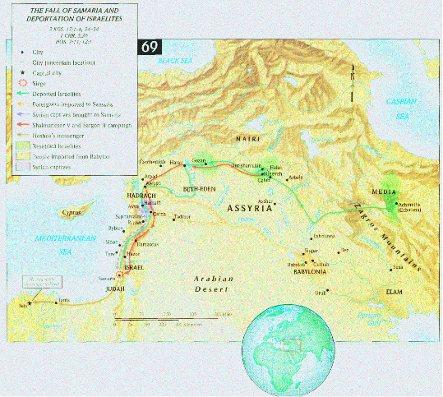

Slide 44
1. Hoshea: The last king of Israel 17:1-6
4 But the king of Assyria found conspiracy in Hoshea, who had sent messengers to So king of Egypt and had offered no tribute to the king of Assyria, as he had done year by year; so the king of Assyria shut him up and bound him in prison.
5 Then the king of Assyria invaded the whole land and went up to Samaria and besieged it three years.
6 In the ninth year of Hoshea, the king of Assyria captured Samaria and carried Israel away into exile to Assyria, and settled them in Halah and Habor, on the river of Gozan, and in the cities of the Medes.

Slide 45
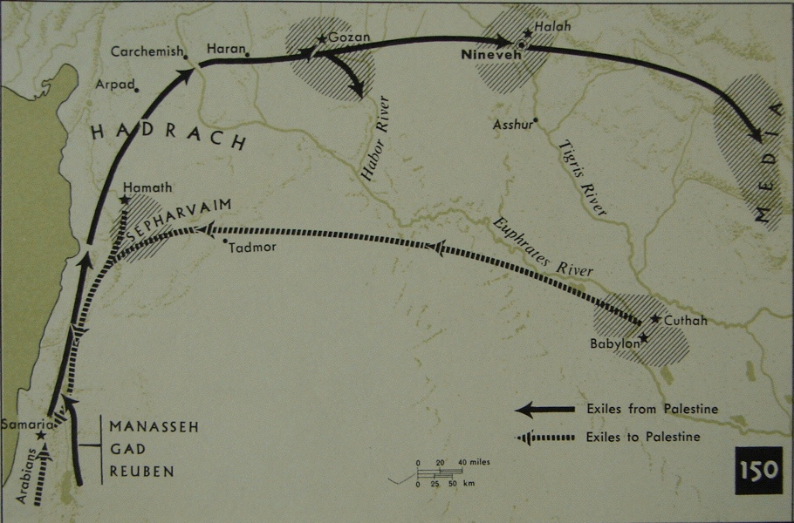

Slide 46
2. Explanation of the captivity of Israel 17:7-23

Slide 47
a. General statement of Israel’s wickedness 17:7-12
7 Now this came about, because the sons of Israel had sinned against the LORD their God, who had brought them up from the land of Egypt from under the hand of Pharaoh, king of Egypt, and they had feared other gods
8 and walked in the customs of the nations whom the LORD had driven out before the sons of Israel, and in the customs of the kings of Israel which they had introduced.

Slide 48
a. General statement of Israel’s wickedness 17:7-12
9 And the sons of Israel did things secretly which were not right, against the LORD their God. Moreover, they built for themselves high places in all their towns, from watchtower to fortified city.
10 And they set for themselves sacred pillars and Asherim on every high hill and under every green tree,
11 and there they burned incense on all the high places as the nations did which the LORD had carried away to exile before them; and they did evil things provoking the LORD.
12 And they served idols, concerning which the LORD had said to them, "You shall not do this thing."

Slide 49
b. They did not take heed to God’s warnings 17:13-15
13 Yet the LORD warned Israel and Judah, through all His prophets and every seer, saying, "Turn from your evil ways and keep My commandments, My statutes according to all the law which I commanded your fathers, and which I sent to you through My servants the prophets."
14 However, they did not listen, but stiffened their neck like their fathers, who did not believe in the LORD their God.
15 And they rejected His statutes and His covenant which He made with their fathers, and His warnings with which He warned them. And they followed vanity and became vain, and went after the nations which surrounded them, concerning which the LORD had commanded them not to do like them.

Slide 50
c. Further examples of how they rejected God 17:16-18
16 And they forsook all the commandments of the LORD their God and made for themselves molten images, even two calves, and made an Asherah and worshiped all the host of heaven and served Baal.
17 Then they made their sons and their daughters pass through the fire, and practiced divination and enchantments, and sold themselves to do evil in the sight of the LORD, provoking Him.
18 So the LORD was very angry with Israel, and removed them from His sight; none was left except the tribe of Judah.

Slide 51
d. God rejected Judah & Israel because of their sins 17:19-23
19 Also Judah did not keep the commandments of the LORD their God, but walked in the customs which Israel had introduced.
20 And the LORD rejected all the descendants of Israel and afflicted them and gave them into the hand of plunderers, until He had cast them out of His sight.
21 When He had torn Israel from the house of David, they made Jeroboam the son of Nebat king. Then Jeroboam drove Israel away from following the LORD, and made them commit a great sin.
22 And the sons of Israel walked in all the sins of Jeroboam which he did; they did not depart from them,
23 until the LORD removed Israel from His sight, as He spoke through all His servants the prophets. So Israel was carried away into exile from their own land to Assyria until this day.

Slide 52
3. Repopulation of Samaria 17:24-41

Slide 53
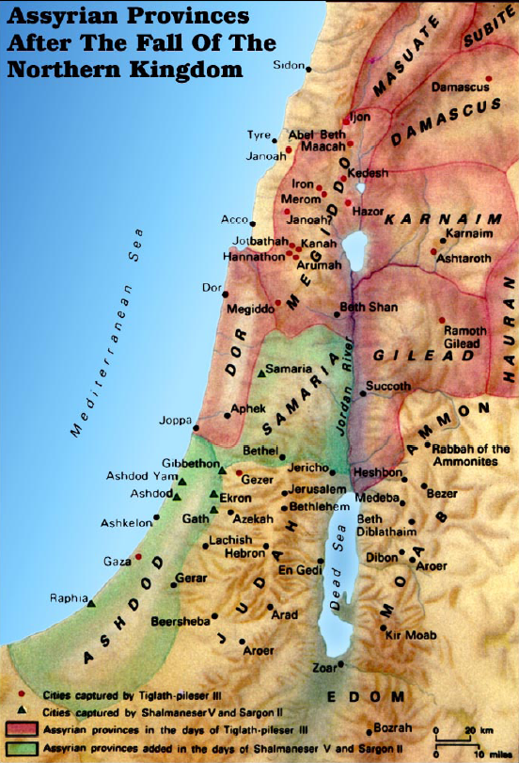

Slide 54
a. The peoples brought to inhabit Samaria 17:24
24 And the king of Assyria brought men from Babylon and from Cuthah and from Avva and from Hamath and Sephar-vaim, and settled them in the cities of Samaria in place of the sons of Israel. So they possessed Samaria and lived in its cities.

Slide 55
b. The plague of the lions 17:25, 26
25 And it came about at the beginning of their living there, that they did not fear the LORD; therefore the LORD sent lions among them which killed some of them.
26 So they spoke to the king of Assyria, saying, "The nations whom you have carried away into exile in the cities of Samaria do not know the custom of the god of the land; so he has sent lions among them, and behold, they kill them because they do not know the custom of the god of the land."

Slide 56
c. The mixed character of the Samaritans’ religion 17:27-41
27 Then the king of Assyria commanded, saying, "Take there one of the priests whom you carried away into exile, and let him go and live there; and let him teach them the custom of the god of the land."
28 So one of the priests whom they had carried away into exile from Samaria came and lived at Bethel, and taught them how they should fear the LORD.
29 But every nation still made gods of its own and put them in the houses of the high places which the people of Samaria had made, every nation in their cities in which they lived.

Slide 57
c. The mixed character of the Samaritans’ religion 17:27-41
30 And the men of Babylon made Succoth-benoth, the men of Cuth made Nergal, the men of Hamath made Ashima,
31 and the Avvites made Nibhaz and Tartak; and the Sepharvites burned their children in the fire to Adrammelech and Anammelech the gods of Sepharvaim.
32 They also feared the LORD and appointed from among themselves priests of the high places, who acted for them in the houses of the high places.
33 They feared the LORD and served their own gods according to the custom of the nations from among whom they had been carried away into exile.

Slide 58
c. The mixed character of the Samaritans’ religion 17:27-41
34 To this day they do according to the earlier customs: they do not fear the LORD, nor do they follow their statutes or their ordinances or the law, or the commandments which the LORD commanded the sons of Jacob, whom He named Israel;
35 with whom the LORD made a covenant and commanded them, saying, "You shall not fear other gods, nor bow down yourselves to them nor serve them nor sacrifice to them.

Slide 59
c. The mixed character of the Samaritans’ religion 17:27-41
36 "But the LORD, who brought you up from the land of Egypt with great power and with an outstretched arm, Him you shall fear, and to Him you shall bow yourselves down, and to Him you shall sacrifice.
37 "And the statutes and the ordinances and the law and the commandment, which He wrote for you, you shall observe to do forever; and you shall not fear other gods.
38 "And the covenant that I have made with you, you shall not forget, nor shall you fear other gods.
39 "But the LORD your God you shall fear; and He will deliver you from the hand of all your enemies."

Slide 60
c. The mixed character of the Samaritans’ religion 17:27-41
40 However, they did not listen, but they did according to their earlier custom.
41 So while these nations feared the LORD, they also served their idols; their children likewise and their grandchildren, as their fathers did, so they do to this day.

