Slide 1
The Golden Rule
Matt. 7:12
Therefore whatever you want others to do for you, do so for them, for this is the Law and the Prophets.

Slide 2
The Golden Rule
Most famous statement Highest point of righteousness toward men
Equity & justice in dealing with others
Brevity shows divine wisdom
Gospel - spirit of God's law
Rom. 3:31 Do we then nullify the Law through faith? May it never be! On the contrary, we establish the Law.

Slide 3
The Golden Rule
Not a new principle of life
One sentence summary of all the moral & ethical teachings of the Law & the prophets
Other teachers taught the same truths
The Bible - all truth
Men can quote all the great teachers of all time
Jesus of Nazareth said it all

Slide 4
The Golden Rule
No real parallel to this rule of life
Every organization must have a rule - a catch all statement
3 rules of life with metallic names

Slide 5
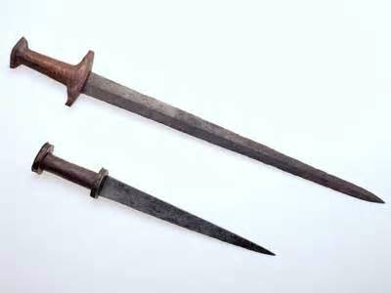
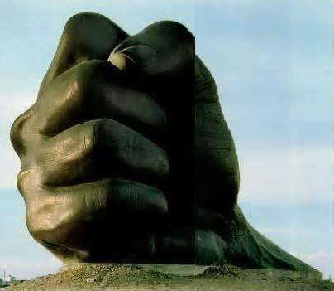
The Iron Rule:
“I have the power, I will have my way.”
Might makes right.

Slide 6
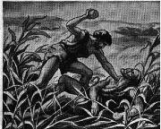
The Rule of Cain
“Do unto others before they do unto you.”

Slide 7
Crime
All cruelty & crime grows out of this rule
“Man's inhumanity to man makes countless thousands mourn” - Robert Burns
Great New York city blackout
“civilization went out when the lights went out.”
All cruelty & crime grows out of this rule
“Man's inhumanity to man makes countless thousands mourn”
“civilization went out when the lights went out.”
Great New York city blackout
“civilization went out when the lights went out.”
All cruelty & crime grows out of this rule

Slide 8
The Iron Rule
Obtain desires by the sorrows of others
Evolution - Survival of the fittest
Romans - Nazis - Soviets
Many parents, husbands, employers, & policemen

Slide 9
The Silver Rule:
“Do nothing to others that you would not have them do to you.”

Slide 10
The Silver Rule
Jews, Greeks, Romans, Confucius, & O.T.
Negative rule
Does not demand anything positive
Only what government demands
Forbids setting fire, but does not demand you help one out

Slide 11
What Does This Rule Produce?
Isolationist attitudes
Cold husband or wife
A snob or unfriendly person
Possibly a righteous man, but not a good man

Slide 12
Not the Rule For Christians
Selfish and does not help the helpless
Gal. 6:2 Bear one another's burdens, and thus fulfill the law of Christ.

Slide 13
The Golden Rule:
Whatever you want others to do for you, do so for them

Slide 14
The Golden Rule
Matt. 7:12 Therefore whatever you want others to do for you, do so for them, for this is the Law and the Prophets.
Therefore - Look back to 7:7-11
Prerequisite for answered prayer
Actions that should follow answered prayer

Slide 15
Matt. 7:12 Therefore whatever you want others to do for you, do so for them, for this is the Law and the Prophets.
Doing good shows gratitude toward God
Acts as we want God to deal with us
Prayer + conscientiously performing duties + perseverance
What others need from us; we need from God Eph. 6:8 knowing that whatever good thing each one does, this he will receive back from the Lord, whether slave or free.
Demands faith in God as a rewarder

Slide 16
Its Excellence & Value
Matt. 7:12 ...whatever you want others to do for you, do so for them...
A rule for emergencies - “the portable law”
Ready for any emergency
Ready at any moment to act toward our neighbor
Ready when there is no time to ask advice
A natural & logical law, (clear, fair)

Slide 17
Its Excellence & Value
Matt. 7:12 ...whatever you want others to do for you, do so for them...
Applies self love to others
Jealous for the other’s good name
Put yourself in his place
Prevents the false & injurious statements
Cautious about receiving evil reports

Slide 18
Its Excellence & Value
Matt. 7:12 ...whatever you want others to do for you, do so for them...
Applies self love to others
Makes self-love the handmaid of justice & charity
Motivates to action
Makes careless treatment of others more evil
Ex. 22:21 "And you shall not wrong a stranger or oppress him, for you were strangers in the land of Egypt.

Slide 19
Summarizes the Law & Prophets
Matt. 7:12 Therefore whatever you want others to do for you, do so for them, for this is the Law and the Prophets.
The Law is good - fulfilled by love
Rom. 13:8, 9 Owe nothing to anyone except to love one another; for he who loves his neighbor has fulfilled the law. For this, "You shall not commit adultery, You shall not murder, You shall not steal, You shall not covet," and if there is any other commandment, it is summed up in this saying, " You shall love your neighbor as yourself."

Slide 20
Apply It To All
Feeling kindly is useless without action
Every relationship - not limited to friends
Criminals, sinners (hate the sin but not the sinner)
Clerks, Waitresses, Highway workers
People you will never see again
Even to animals Prov. 12:10 A righteous man has regard for the life of his beast, But the compassion of the wicked is cruel.

Slide 21
Applies to Forgiveness
Col. 3:13 bearing with one another, and forgiving each other, whoever has a complaint against anyone; just as the Lord forgave you, so also should you.
Matt. 6:15 "But if you do not forgive men, then your Father will not forgive your transgressions.

Slide 22
The Golden Rule Result in Peace
Peace in the family
Problems solved
Husband & wife
Parents & children
Brothers & sisters
Personal problems in the church

Slide 23
Invitation
Non-Christian use their own strength
Cannot save yourself - need regenerated Tit. 3:3-5 For we also once were foolish ourselves, disobedient, deceived, enslaved to various lusts and pleasures, spending our life in malice and envy, hateful, hating one another.
But when the kindness of God our Savior and His love for mankind appeared, He saved us, not on the basis of deeds which we have done in righteousness, but according to His mercy, by the washing of regeneration and renewing by the Holy Spirit,

