Slide 1
THE JOURNEY
Colossians 3:2 (NASB)
Set your mind on the things above, not on the things that are on earth.

Slide 2
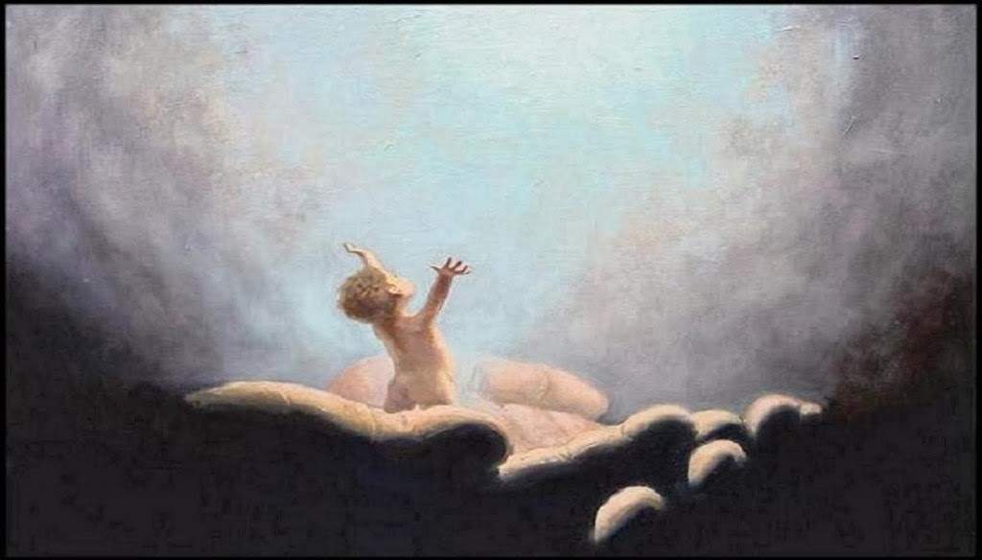
Our Created Life
Fearfully and Wonderfully Created [Psalm 139:14]
70, Maybe 80-Year Lifespan [Psalm 90:10]

Slide 3
Not a Long Time Then What Should We Pursue?
Happiness? No, not So Much
Holiness? Yes, Definitely
Hebrews 12:14
1 Peter 1:15

Slide 4
Just What Is Happiness
Worldly Happiness and Holiness
Worldly Happiness
Pleasurable, Satisfying Physically
Short-term Pleasures
Flesh, Eyes, and/or Pride
1 John 2:16

Slide 5
What about Holiness?
Spiritually Pure, Virtuous
Devoutness, Piousness, etc.
Antonyms (Opposites) Include Depravity, Evilness, Sinfulness, Wickedness, etc.

Slide 6
Putting Things into Perspective How Do We Apply This Knowledge?
Jesus Is Preparing a Wonderful Place for Us in Eternity
John 14:2
Sing Anywhere Is “Home” (pg. 680)

Slide 7
We’re Included in a Potentially Deadly Battle
First, We Must Dwell upon the Earth
A Deadly Battle Rages
Good vs. Evil
Satan Constantly Seeks to Destroy Us (1 Peter 5:8)
Either Build Godly Character or Process Our Souls for Destruction

Slide 8
Live for Jesus, not Self
Fantasy Island Life Style
Live in Happy, Carefree Manner
Disregard God’s Desires for Us
Disneyesque Surrealism
Self-Centered
With Misery and Devastation
Ecclesiastes 7:2 & 5

Slide 9
We All Have an Achilles Heal
We Live in a Blessed, Wealthy Nation
Surrounded by Horrid, Sinful Things
Satan Strikes Us in Vulnerable Areas (Achilles Heel)
Satan Dangles the Carrot of “Happiness” before Us

Slide 10
Attain Happiness and Holiness in the Lord
Paradoxical?
Life of Holiness and Service that Glorifies God Happiness
Experience Purpose, Meaning, and Fulfillment
Isaiah 58:10,11

Slide 11
The Conclusion Is Near What Are You Thinking and How Do You Feel?
We Have only a Short Number of Years to Dwell upon the Earth
We Are to Pursue Godly Holiness
We Are to Find Happiness in the Lord
Jesus Is Preparing a Wonderful Eternal Dwelling Place for Us
We’re Embroiled in an Ongoing Good vs. Evil Battle
Satan Constantly Seeks to Destroy Our Souls
We Can Please God and Achieve Happiness
SING “We Shall Stand before the Throne” (pg. 509)

