Slide 1
XII. The Kingdoms at High Tide
2 Kings 13:10—15:7
In 802 B.C. the Assyrian King Adadnirari III (AH dad-nih-RAH rih ) attacked Damascus and inflicted serious casualties on Ben-hadad II.
At this point, Israel began to recover lost territories and emerge from submission to Damascus.

Slide 2
Israel
753
Jeroboam II 41 yrs.
Jehoash 16 yrs.
Zech.
Shallum
790
Judah
767
750
Uzziah (Azariah) 52 yrs.
Amaziah 29 yrs.
Divided Monarchy: Heyday Phase
(Sisters Growing)
790-750 BC

Slide 3
A. The Period of Recovery 13:10—14:22
A period of transition from humiliation to greatness.
These two kings gradually recover territory from Syria.

Slide 4
1. The reign of Jehoash in Israel 13:10-13
10 In the thirty-seventh year of Joash king of Judah, Jehoash the son of Jehoahaz, became king over Israel in Samaria, and reigned sixteen years.
11 And he did evil in the sight of the LORD; he did not turn away from all the sins of Jeroboam the son of Nebat, with which he made Israel sin, but he walked in them.
12 Now the rest of the acts of Joash and all that he did and his might with which he fought against Amaziah king of Judah, are they not written in the Book of the Chronicles of the Kings of Israel?
13 So Joash slept with his fathers, and Jeroboam sat on his throne; and Joash was buried in Samaria with the kings of Israel.

Slide 5
2. The final prediction of Elisha 13:14-25

Slide 6
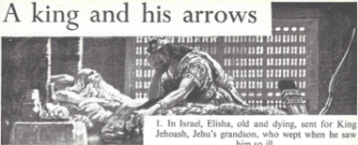
a. Elisha ordered King Jehoash to perform symbolic acts 13:14-19
14 When Elisha became sick with the illness of which he was to die, Joash the king of Israel came down to him and wept over him and said, "My father, my father, the chariots of Israel and its horsemen!"
Joash & Elisha

Slide 7
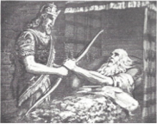
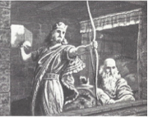
a. Elisha ordered King Jehoash to perform symbolic acts 13:14-19
15 And Elisha said to him, "Take a bow and arrows." So he took a bow and arrows.
16 Then he said to the king of Israel, "Put your hand on the bow." And he put his hand on it, then Elisha laid his hands on the king’s hands.
17 And he said, "Open the window toward the east," and he opened it. Then Elisha said, "Shoot!" And he shot. And he said, "The LORD’S arrow of victory, even the arrow of victory over Aram; for you shall defeat the Arameans at Aphek until you have destroyed them."

Slide 8
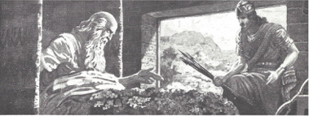
a. Elisha ordered King Jehoash to perform symbolic acts 13:14-19
18 Then he said, "Take the arrows," and he took them. And he said to the king of Israel, "Strike the ground," and he struck it three times and stopped.
19 So the man of God was angry with him and said, "You should have struck five or six times, then you would have struck Aram until you would have destroyed it. But now you shall strike Aram only three times."

Slide 9
Lessons
1. Elisha was going to be missed
2. Elisha died without complaint
3. Elisha showed perseverance & got up from his deathbed to prophesy
4. God can deliver in trouble
5. God employs human agency in his deliverances
6. The human agent could succeed only with the help of God (Elisha put his hands on the king’s hands)
7. Lack of faith leads to low expectations & feeble effort
8. God is displeased that we do not ask more of Him

Slide 10
b. Elisha’s power manifested even after his death 13:20-21
20 And Elisha died, and they buried him. Now the bands of the Moabites would invade the land in the spring of the year.
21 And as they were burying a man, behold, they saw a marauding band; and they cast the man into the grave of Elisha. And when the man touched the bones of Elisha he revived and stood up on his feet.

Slide 11
Lessons
1. God confirms His approval of the prophet
2. The faithful are encourage that God still works after his death
3. God’s life giving power to resurrect is seen again
4. No excuse for relic worship - it did not happen again, his bone were not on display
5. The Lord Jesus has greater power in His death

Slide 12
c. How Elisha’s final prophecy was fulfilled 13:22-25
22 Now Hazael king of Aram had oppressed Israel all the days of Jehoahaz.
23 But the LORD was gracious to them and had compassion on them and turned to them because of His covenant with Abraham, Isaac, and Jacob, and would not destroy them or cast them from His presence until now.

Slide 13
c. How Elisha’s final prophecy was fulfilled 13:22-25
24 When Hazael king of Aram died, Ben-hadad his son became king in his place.
25 Then Jehoash the son of Jehoahaz took again from the hand of Ben-hadad the son of Hazael the cities which he had taken in war from the hand of Jehoahaz his father. Three times Joash defeated him and recovered the cities of Israel.

Slide 14
Lessons
1. God is patient with the descendants of the righteous
2. God delivers them for His promise and Name’s sake
3. God is unwilling to quickly destroy His people

Slide 15
3. The reign of Amaziah in Judah 14:1-22

Slide 16
Israel
753
Jeroboam II 41 yrs.
Jehoash 16 yrs.
Zech.
Shallum
790
Judah
767
750
Uzziah (Azariah) 52 yrs.
Amaziah 29 yrs.
Divided Monarchy: Heyday Phase
(Sisters Growing)
790-750 BC

Slide 17
a. Amaziah’s hopeful beginning 14:1-6
1 In the second year of Joash son of Joahaz king of Israel, Amaziah the son of Joash king of Judah became king.
2 He was twenty-five years old when he became king, and he reigned twenty-nine years in Jerusalem. And his mother’s name was Jehoaddin of Jerusalem.
3 And he did right in the sight of the LORD, yet not like David his father; he did according to all that Joash his father had done.
4 Only the high places were not taken away; the people still sacrificed and burned incense on the high places.

Slide 18
a. Amaziah’s hopeful beginning 14:1-6
5 Now it came about, as soon as the kingdom was firmly in his hand, that he killed his servants who had slain the king his father.
6 But the sons of the slayers he did not put to death, according to what is written in the book of the law of Moses, as the LORD commanded, saying, "The fathers shall not be put to death for the sons, nor the sons be put to death for the fathers; but each shall be put to death for his own sin.” Deut. 24:16

Slide 19
Amaziah plans an expedition against Edom 2 C 25:5
5 Moreover, Amaziah assembled Judah and appointed them according to their fathers’ households under commanders of thousands and commanders of hundreds throughout Judah and Benjamin; and he took a census of those from twenty years old and upward, and found them to be 300,000 choice men, able to go to war and handle spear and shield.

Slide 20
Amaziah hires 100,000 mercenaries out of Israel, but subsequently dismisses them 2 C 25:6-10
6 He hired also 100,000 valiant warriors out of Israel for one hundred talents of silver.
7 But a man of God came to him saying, "O king, do not let the army of Israel go with you, for the LORD is not with Israel nor with any of the sons of Ephraim.
8 "But if you do go, do it, be strong for the battle; yet God will bring you down before the enemy, for God has power to help and to bring down."
9 And Amaziah said to the man of God, "But what shall we do for the hundred talents which I have given to the troops of Israel?" And the man of God answered, "The LORD has much more to give you than this."
10 Then Amaziah dismissed them, the troops which came to him from Ephraim, to go home; so their anger burned against Judah and they returned home in fierce anger.

Slide 21
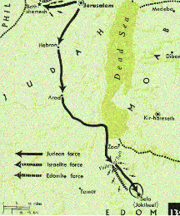
b. Amaziah’s success in Edom 2 K 14:7; 2 C 25:11, 12
7 He killed of Edom in the Valley of Salt 10,000 and took Sela by war, and named it Joktheel to this day.
2 C 25:11, 12 Now Amaziah strengthened himself, and led his people forth, and went to the Valley of Salt, and struck down 10,000 of the sons of Seir. The sons of Judah also captured 10,000 alive and brought them to the top of the cliff, and threw them down from the top of the cliff so that they were all dashed to pieces.

Slide 22
c. Amaziah’s disastrous defeat 14:8-14
8 Then Amaziah sent messengers to Jehoash, the son of Jehoahaz son of Jehu, king of Israel, saying, "Come, let us face each other."
9 And Jehoash king of Israel sent to Amaziah king of Judah, saying, "The thorn bush which was in Lebanon sent to the cedar which was in Lebanon, saying, ‘Give your daughter to my son in marriage.’ But there passed by a wild beast that was in Lebanon, and trampled the thorn bush.
10 "You have indeed defeated Edom, and your heart has become proud. Enjoy your glory and stay at home; for why should you provoke trouble so that you, even you, should fall, and Judah with you?"

Slide 23
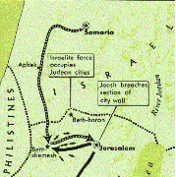
c. Amaziah’s disastrous defeat 14:8-14
11 But Amaziah would not listen. So Jehoash king of Israel went up; and he and Amaziah king of Judah faced each other at Beth-shemesh, which belongs to Judah.
12 And Judah was defeated by Israel, and they fled each to his tent.
13 Then Jehoash king of Israel captured Amaziah king of Judah, the son of Jehoash the son of Ahaziah, at Beth-shemesh, and came to Jerusalem and tore down the wall of Jerusalem from the Gate of Ephraim to the Corner Gate, 400 cubits.
14 And he took all the gold and silver and all the utensils which were found in the house of the LORD, and in the treasuries of the king’s house, the hostages also, and returned to Samaria.

Slide 24
Lessons
1. God punishes a wicked man by his own wickedness & by other wicked men
2. His war was not sanctioned by God

Slide 25
d. The Death of Jehoash 14:15-16
15 Now the rest of the acts of Jehoash which he did, and his might and how he fought with Amaziah king of Judah, are they not written in the Book of the Chronicles of the Kings of Israel?
16 So Jehoash slept with his fathers and was buried in Samaria with the kings of Israel; and Jeroboam his son became king in his place.

Slide 26
e. The Last 15 Years of Amaziah’s Reign 14:17, 18
17 And Amaziah the son of Joash king of Judah lived fifteen years after the death of Jehoash son of Jehoahaz king of Israel.
18 Now the rest of the acts of Amaziah, are they not written in the Book of the Chronicles of the Kings of Judah?

Slide 27
f. Amaziah’s treacherous death 14:19, 20
2 C 25:27 And from the time that Amaziah turned away from following the LORD they conspired against him in Jerusalem, and he fled to Lachish; but they sent after him to Lachish and killed him there.
19 And they conspired against him in Jerusalem, and he fled to Lachish; but they sent after him to Lachish and killed him there.
20 Then they brought him on horses and he was buried at Jerusalem with his fathers in the city of David.

Slide 28
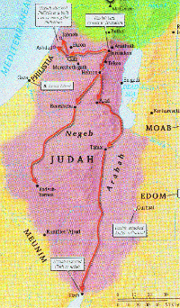
g. Azariah (Uzziah) ascends the throne 14:21, 22
21 And all the people of Judah took Azariah, who was sixteen years old, and made him king in the place of his father Amaziah.
22 He built Elath and restored it to Judah, after the king slept with his fathers.

Slide 29
B. The Heyday Period of Israel and Judah 14:23—15:7
About 800 B.C. the Assyrians withdrew to their own territory where they remained politically dormant until 745 B.C.
Made it possible for Israel & Judah to become the dominate powers in the region
The great wealth of the nations in these days & the worldliness & cruelties of the people are described & condemned by Amos & Hosea
Jonah was also active during this period of time

Slide 30
Israel
753
Jeroboam II 41 yrs.
Jehoash 16 yrs.
Zech.
Shallum
790
Judah
767
750
Uzziah (Azariah) 52 yrs.
Amaziah 29 yrs.
Divided Monarchy: Heyday Phase
(Sisters Growing)
790-750 BC

Slide 31
1. The reign of Jeroboam II in Israel 14:23-27
His accession
23 In the fifteenth year of Amaziah the son of Joash king of Judah, Jeroboam the son of Joash king of Israel became king in Samaria, and reigned forty-one years.
His character
24 And he did evil in the sight of the LORD; he did not depart from all the sins of Jeroboam the son of Nebat, which he made Israel sin.

Slide 32
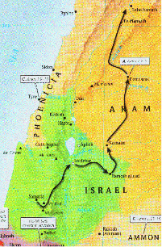
1. The reign of Jeroboam II in Israel 14:23-27
The Lord saved Israel by his hand
25 He restored the border of Israel from the entrance of Hamath as far as the Sea of the Arabah, according to the word of the LORD, the God of Israel, which He spoke through His servant Jonah the son of Amittai, the prophet, who was of Gath-hepher.
26 For the LORD saw the affliction of Israel, which was very bitter; for there was neither bond nor free, nor was there any helper for Israel.

Slide 33
1. The reign of Jeroboam II in Israel 14:23-27
27 And the LORD did not say that He would blot out the name of Israel from under heaven, but He saved them by the hand of Jeroboam the son of Joash.

Slide 34
2. Death of Jeroboam II 14:28-29
28 Now the rest of the acts of Jeroboam and all that he did and his might, how he fought and how he recovered for Israel, Damascus and Hamath, which had belonged to Judah, are they not written in the Book of the Chronicles of the Kings of Israel?
29 And Jeroboam slept with his fathers, even with the kings of Israel, and Zechariah his son became king in his place.

Slide 35
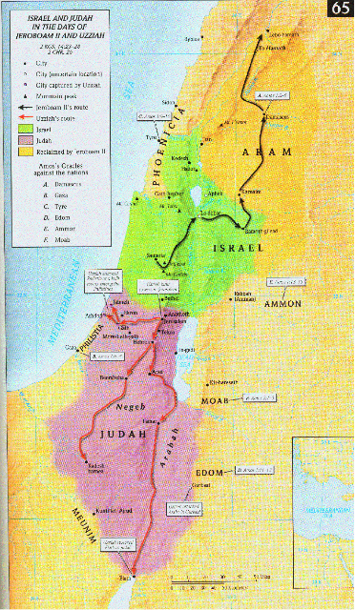
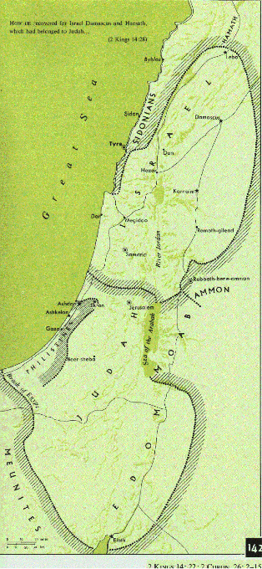

Slide 36
3. The reign of Azariah (Uzziah) in Judah 15:1-4
Accession to the throne
1 ¶ In the twenty-seventh year of Jeroboam king of Israel, Azariah son of Amaziah king of Judah became king.
2 He was sixteen years old when he became king, and he reigned fifty-two years in Jerusalem; and his mother’s name was Jecoliah of Jerusalem.

Slide 37
3. The reign of Azariah (Uzziah) in Judah 15:1-4
Character
3 And he did right in the sight of the LORD, according to all that his father Amaziah had done.
Spiritual condition of the kingdom
4 Only the high places were not taken away; the people still sacrificed and burned incense on the high places.
Positive influence of a prophet name Zechariah
2 Chron. 26:5 He continued to seek God in the days of Zechariah, who had understanding through the vision of God; and as long as he sought the LORD, God prospered him.

Slide 38
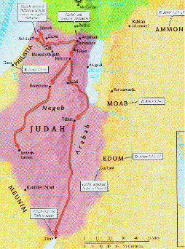
4. Uzziah’s success in war 2 C 26:6-8
6 Now he went out and warred against the Philistines, and broke down the wall of Gath and the wall of Jabneh and the wall of Ashdod; and he built cities in the area of Ashdod and among the Philistines.
7 And God helped him against the Philistines, and against the Arabians who lived in Gur-baal, and the Meunites.
8 The Ammonites also gave tribute to Uzziah, and his fame extended to the border of Egypt, for he became very strong.

Slide 39
5. Uzziah’s Building & husbandry 2 C 26:9,10
9 Moreover, Uzziah built towers in Jerusalem at the Corner Gate and at the Valley Gate and at the corner buttress and fortified them.
10 And he built towers in the wilderness and hewed many cisterns, for he had much livestock, both in the lowland and in the plain. He also had plowmen and vinedressers in the hill country and the fertile fields, for he loved the soil.

Slide 40
6. Uzziah’s army & fame 2 C 26:11-15
11 Moreover, Uzziah had an army ready for battle, which entered combat by divisions, according to the number of their muster, prepared by Jeiel the scribe and Maaseiah the official, under the direction of Hananiah, one of the king’s officers.
12 The total number of the heads of the households, of valiant warriors, was 2,600.
13 And under their direction was an elite army of 307,500, who could wage war with great power, to help the king against the enemy.
14 Moreover, Uzziah prepared for all the army shields, spears, helmets, body armor, bows and sling stones.

Slide 41
6. Uzziah’s army & fame 2 C 26:11-15
15 And in Jerusalem he made engines of war invented by skillful men to be on the towers and on the corners, for the purpose of shooting arrows and great stones. Hence his fame spread afar, for he was marvelously helped until he was strong.

Slide 42
7. Uzziah’s sin & punishment 2 C 26:16-20
16 But when he became strong, his heart was so proud that he acted corruptly, and he was unfaithful to the LORD his God, for he entered the temple of the LORD to burn incense on the altar of incense.
17 Then Azariah the priest entered after him and with him eighty priests of the LORD, valiant men.
18 And they opposed Uzziah the king and said to him, "It is not for you, Uzziah, to burn incense to the LORD, but for the priests, the sons of Aaron who are consecrated to burn incense. Get out of the sanctuary, for you have been unfaithful, and will have no honor from the LORD God."

Slide 43
7. Uzziah’s sin & punishment 2 C 26:16-20
19 But Uzziah, with a censer in his hand for burning incense, was enraged; and while he was enraged with the priests, the leprosy broke out on his forehead before the priests in the house of the LORD, beside the altar of incense.

Slide 44
7. Uzziah’s sin & punishment 2 C 26:16-20
20 And Azariah the chief priest and all the priests looked at him, and behold, he was leprous on his forehead; and they hurried him out of there, and he himself also hastened to get out because the LORD had smitten him.

Slide 45
8. Uzziah’s punishment & end 2 K 15:5-7
Spiritual condition of the kingdom
5 And the LORD struck the king, so that he was a leper to the day of his death. And he lived in a separate house, while Jotham the king’s son was over the household, judging the people of the land.
6 Now the rest of the acts of Azariah and all that he did, are they not written in the Book of the Chronicles of the Kings of Judah?
7 And Azariah slept with his fathers, and they buried him with his fathers in the city of David, and Jotham his son became king in his place.

Slide 46
Lessons
1. His way to prosperity
a. Feared & sought God
b. Followed a good man’s influence
c. He was diligent in business
2. His path from prosperity to shame
a. Prosperity lead to pride
b. Pride lead to presumption
3. Compare earthly prosperity with eternity
4. Compare earthly honor with being children of God

Slide 47
Divided Monarchy: Homage Phase
(Sisters Parting)
750-722 B.C.
Pekahiah
Menahem
Hoshea
Pekah
742
740
750
739
735
732
728
722
Uzziah’s Last Days
Jotham
Ahaz
Hezekiah’s
Co-regent
Ahaz Co-regent
743

Slide 48
XIII. The Great Assyrian Conqueror II Kings 15:8—17:41

Slide 49
Divided Monarchy: Homage Phase
(Sisters Parting)
750-722 B.C.
Pekahiah
Menahem
Hoshea
Pekah
742
740
750
739
735
732
728
722
Uzziah’s Last Days
Jotham
Ahaz
Hezekiah’s
Co-regent
Ahaz Co-regent
743

Slide 50
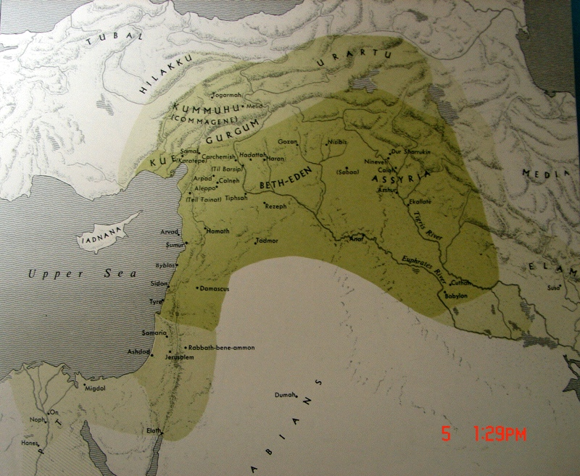
Rise of Assyria
Shalmaneser III
Tiglath-pileser III
Esarhaddon
Asshurbanipal

Slide 51
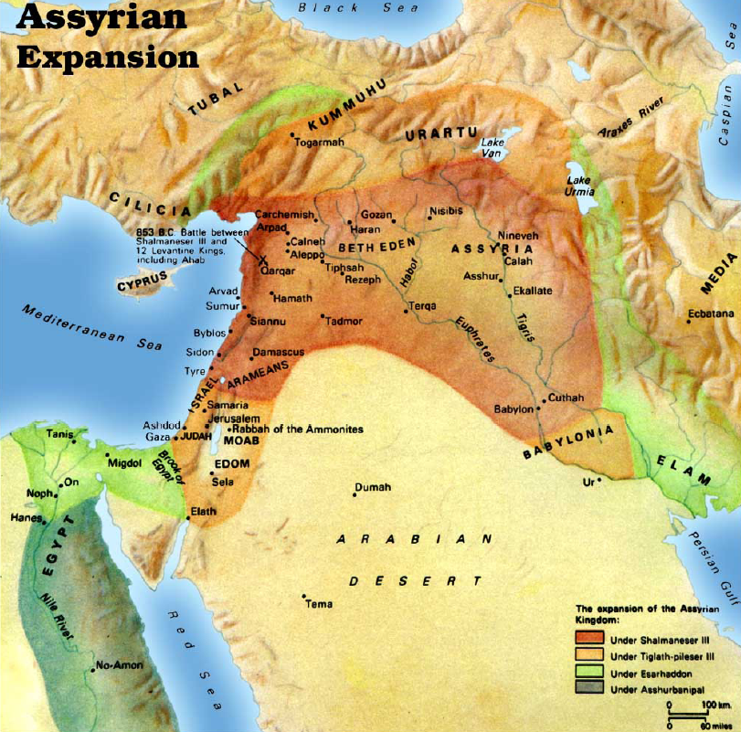

Slide 52
A. Israel Submits to Assyria 15:8-31

Slide 53
Israel
753
Jeroboam II 41 yrs.
Jehoash 16 yrs.
Zech.
Shallum
790
Judah
767
750
Uzziah (Azariah) 52 yrs.
Amaziah 29 yrs.
Divided Monarchy: Heyday Phase
(Sisters Growing)
790-750 BC

Slide 54
1. The six-month reign of Zechariah 15:8-12
8 In the thirty-eighth year of Azariah king of Judah, Zechariah the son of Jeroboam became king over Israel in Samaria for six months.
9 And he did evil in the sight of the LORD, as his fathers had done; he did not depart from the sins of Jeroboam the son of Nebat, which he made Israel sin.
10 Then Shallum the son of Jabesh conspired against him and struck him before the people and killed him, and reigned in his place.
11 Now the rest of the acts of Zechariah, behold they are written in the Book of the Chronicles of the Kings of Israel.
12 This is the word of the LORD which He spoke to Jehu, saying, "Your sons to the fourth generation shall sit on the throne of Israel." And so it was.

Slide 55
2. The one month reign of Shallum 15:13-15
13 Shallum son of Jabesh became king in the thirty-ninth year of Uzziah king of Judah, and he reigned one month in Samaria.
14 Then Menahem son of Gadi went up from Tirzah and came to Samaria, and struck Shallum son of Jabesh in Samaria, and killed him and became king in his place.
15 Now the rest of the acts of Shallum and his conspiracy which he made, behold they are written in the Book of the Chronicles of the Kings of Israel.

Slide 56
3. Menahem submits to Assyria 15:16-22
16 Then Menahem struck Tiphsah and all who were in it and its borders from Tirzah, because they did not open to him, therefore he struck it; and he ripped up all its women who were with child.
17 In the thirty-ninth year of Azariah king of Judah, Menahem son of Gadi became king over Israel and reigned ten years in Samaria.
18 And he did evil in the sight of the LORD; he did not depart all his days from the sins of Jeroboam the son of Nebat, which he made Israel sin.

Slide 57
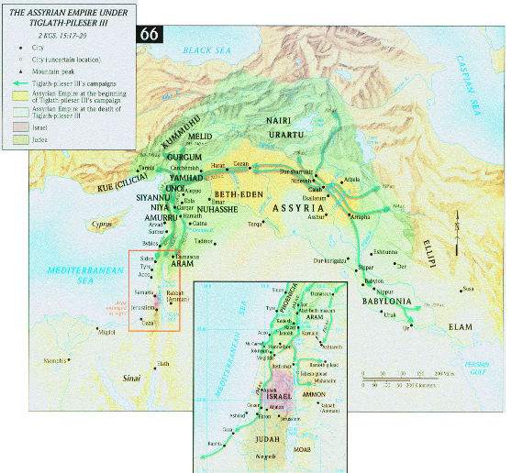

Slide 58
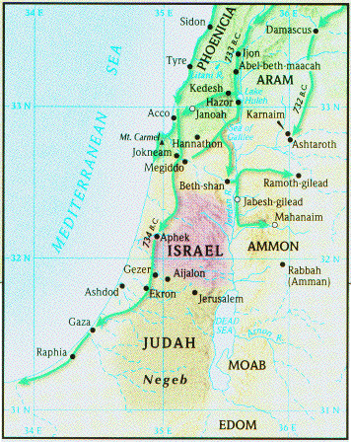
3. Menahem submits to Assyria 15:16-22
19 Pul, king of Assyria, came against the land, and Menahem gave Pul a thousand talents of silver so that his hand might be with him to strengthen the kingdom under his rule. (738 B.C.)
20 Then Menahem exacted the money from Israel, even from all the mighty men of wealth, from each man fifty shekels of silver to pay the king of Assyria. So the king of Assyria returned and did not remain there in the land.

Slide 59
3. Menahem submits to Assyria 15:16-22
21 Now the rest of the acts of Menahem and all that he did, are they not written in the Book of the Chronicles of the Kings of Israel?
22 And Menahem slept with his fathers, and Pekahiah his son became king in his place.

Slide 60
4. The two-year reign of Pekahiah 15:23-26
23 In the fiftieth year of Azariah king of Judah, Pekahiah son of Menahem became king over Israel in Samaria, and reigned two years.
24 And he did evil in the sight of the LORD; he did not depart from the sins of Jeroboam son of Nebat, which he made Israel sin.
25 Then Pekah son of Remaliah, his officer, conspired against him and struck him in Samaria, in the castle of the king’s house with Argob and Arieh (air’ee-uhl); and with him were fifty men of the Gileadites, and he killed him and became king in his place.
26 Now the rest of the acts of Pekahiah and all that he did, behold they are written in the Book of the Chronicles of the Kings of Israel.

Slide 61
5. Pekah, the great nationalist 15:27-31
27 In the fifty-second year of Azariah king of Judah, Pekah son of Remaliah became king over Israel in Samaria, and reigned twenty years.
28 And he did evil in the sight of the LORD; he did not depart from the sins of Jeroboam son of Nebat, which he made Israel sin.

Slide 62
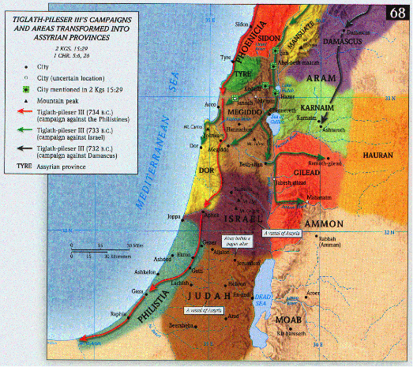
29 In the days of Pekah king of Israel, Tiglath-pileser king of Assyria came and captured Ijon and Abel-beth-maacah and Janoah and Kedesh and Hazor and Gilead and Galilee, all the land of Naphtali; and he carried them captive to Assyria.

Slide 63
30 And Hoshea the son of Elah made a conspiracy against Pekah the son of Remaliah, and struck him and put him to death and became king in his place, in the twentieth year of Jotham the son of Uzziah.
31 Now the rest of the acts of Pekah and all that he did, behold, they are written in the Book of the Chronicles of the Kings of Israel.

