Slide 1
3. Jehu and Jehonadab 10:15-17
15 Now when he had departed from there, he met Jehonadab the son of Rechab coming to meet him; and he greeted him and said to him, "Is your heart right, as my heart is with your heart?" And Jehonadab answered, "It is." Jehu said, "If it is, give me your hand." And he gave him his hand, and he took him up to him into the chariot.
16 And he said, "Come with me and see my zeal for the LORD." So he made him ride in his chariot.
17 And when he came to Samaria, he killed all who remained to Ahab in Samaria, until he had destroyed him, according to the word of the LORD, which He spoke to Elijah.

Slide 2
4. Jehu deceitfully gathers and slays the Baal worshipers 10:18-27
a. He commands all Baal worships to worship with him 18, 19
18 Then Jehu gathered all the people and said to them, "Ahab served Baal a little; Jehu will serve him much.
19 "And now, summon all the prophets of Baal, all his worshipers and all his priests; let no one be missing, for I have a great sacrifice for Baal; whoever is missing shall not live." But Jehu did it in cunning, in order that he might destroy the worshipers of Baal.

Slide 3
4. Jehu deceitfully gathers and slays the Baal worshipers 10:18-27
b. Jehu commands a solemn assembly for Baal 20-22
20 And Jehu said, "Sanctify a solemn assembly for Baal." And they proclaimed it.
21 Then Jehu sent throughout Israel and all the worshipers of Baal came, so that there was not a man left who did not come. And when they went into the house of Baal, the house of Baal was filled from one end to the other.
c. No servants of the LORD allowed 23
22 And he said to the one who was in charge of the wardrobe, "Bring out garments for all the worshipers of Baal." So he brought out garments for them.

Slide 4
4. Jehu deceitfully gathers and slays the Baal worshipers 10:18-27
d. 80 soldiers appointed to slay the Baal worshipers 24
24 Then they went in to offer sacrifices and burnt offerings. Now Jehu had stationed for himself eighty men outside, and he had said, "The one who permits any of the men whom I bring into your hands to escape, shall give up his life in exchange."

Slide 5
4. Jehu deceitfully gathers and slays the Baal worshipers 10:18-27
e. All worshipers killed, sacred pillars and house destroyed 25-28
25 Then it came about, as soon as he had finished offering the burnt offering, that Jehu said to the guard and to the royal officers, "Go in, kill them; let none come out." And they killed them with the edge of the sword; and the guard and the royal officers threw them out, and went to the inner room of the house of Baal.

Slide 6
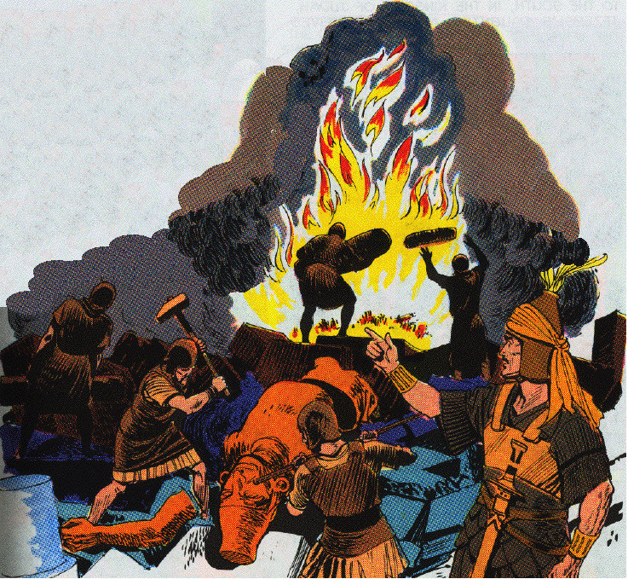
4. Jehu deceitfully gathers and slays the Baal worshipers 10:18-27
26 And they brought out the sacred pillars of the house of Baal, and burned them.

Slide 7
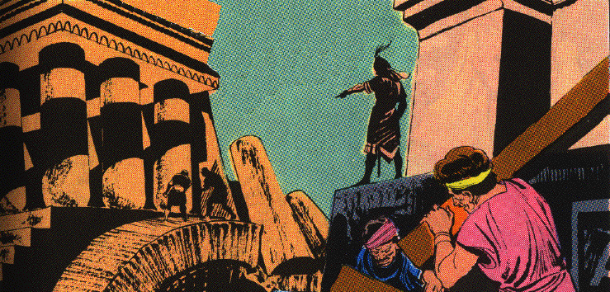
4. Jehu deceitfully gathers and slays the Baal worshipers 10:18-27
27 They also broke down the sacred pillar of Baal and broke down the house of Baal, and made it a latrine to this day.
28 Thus Jehu eradicated Baal out of Israel.
Toilet from Lacish found in a Baal Shrine. Credit: CBN/Israel Antiquities Authority

Slide 8
XI. The Kingdoms At Low Ebb 2 Kings 10:29—13:9

Slide 9
A. Reign of Jehu in Israel 10:29-36
29 However, as for the sins of Jeroboam the son of Nebat, which he made Israel sin, from these Jehu did not depart, even the golden calves that were at Bethel and that were at Dan.
30 And the LORD said to Jehu, "Because you have done well in executing what is right in My eyes, and have done to the house of Ahab according to all that was in My heart, your sons of the fourth generation shall sit on the throne of Israel."
31 But Jehu was not careful to walk in the law of the LORD, the God of Israel, with all his heart; he did not depart from the sins of Jeroboam, which he made Israel sin.

Slide 10
A. Reign of Jehu in Israel 10:29-36
32 In those days the LORD began to cut off portions from Israel; and Hazael defeated them throughout the territory of Israel:
33 from the Jordan eastward, all the land of Gilead, the Gadites and the Reubenites and the Manassites, from Aroer, which is by the valley of the Arnon, even Gilead and Bashan.

Slide 11
A. Reign of Jehu in Israel 10:29-36
34 Now the rest of the acts of Jehu and all that he did and all his might, are they not written in the Book of the Chronicles of the Kings of Israel?
The tribute of Jehu, son of Omri: I received from him silver, gold, a golden bowl, a golden vase with pointed bottom, golden tumblers, golden buckets, tin, a staff for a king [and] spears.
The Black Obelisk of Shalmaneser III

Slide 12
A. Reign of Jehu in Israel 10:29-36
35 And Jehu slept with his fathers, and they buried him in Samaria. And Jehoahaz his son became king in his place.
36 Now the time which Jehu reigned over Israel in Samaria was twenty-eight years.

Slide 13
B. Reign of Athaliah in Judah 11:1-20
(Turmoil in Judah)

Slide 14
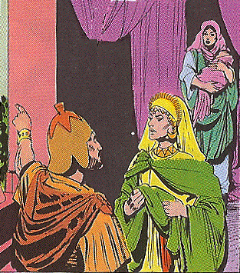
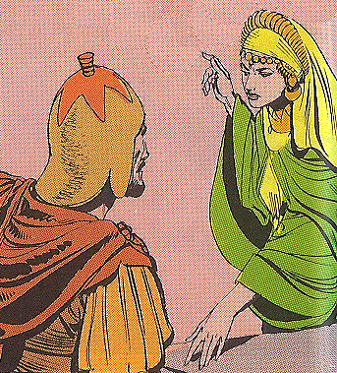
1. The usurpation of Athaliah 11:1-3
1 When Athaliah the mother of Ahaziah saw that her son was dead, she rose and destroyed all the royal offspring.

Slide 15
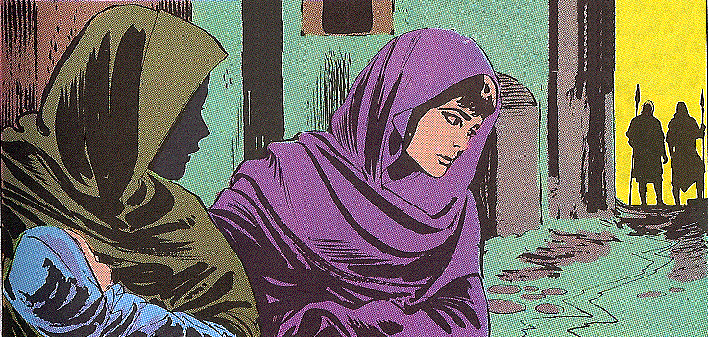
1. The usurpation of Athaliah 11:1-3
2 But Jehosheba [jih HAHSH ih buh], the daughter of King Joram, sister of Ahaziah, took Joash the son of Ahaziah and stole him from among the king’s sons who were being put to death, and placed him and his nurse in the bedroom. So they hid him from Athaliah, and he was not put to death.

Slide 16
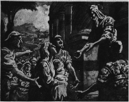
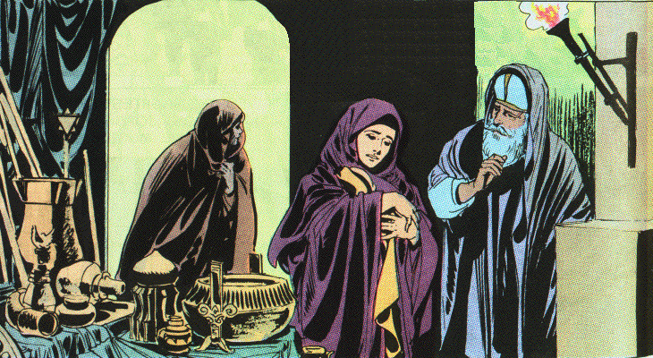
1. The usurpation of Athaliah 11:1-3
3 So he was hidden with her in the house of the LORD six years, while Athaliah was reigning over the land.

Slide 17
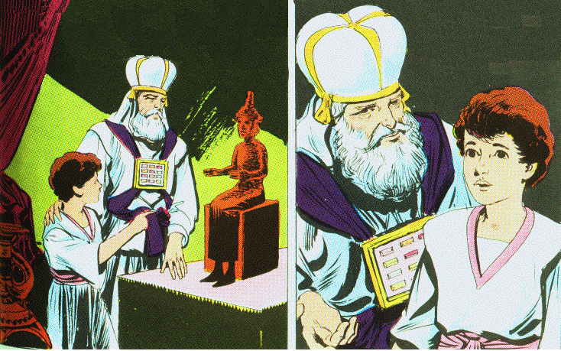
Rescue of Joash 2 C 22:11, 12
11 But Jehoshabeath [jee hoh SHAB ih ath] the king’s daughter took Joash the son of Ahaziah, and stole him from among the king’s sons who were being put to death, and placed him and his nurse in the bedroom. So Jehoshabeath, the daughter of King Jehoram, the wife of Jehoiada the priest (for she was the sister of Ahaziah), hid him from Athaliah so that she would not put him to death.
12 And he was hidden with them in the house of God six years while Athaliah reigned over the land.

Slide 18
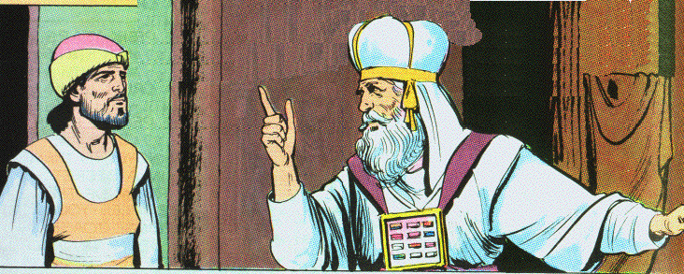
2. The coronation of Joash 11: 4-12
[Jehoiada summons five captains of the royal guard 2 C 23:1]

Slide 19
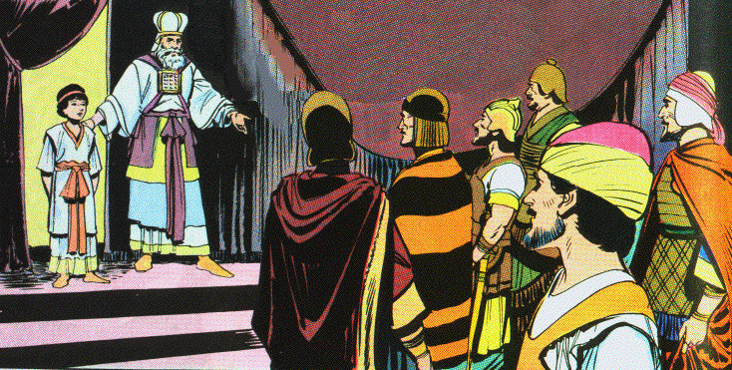
2. The coronation of Joash 11:4-12
4 Now in the seventh year Jehoiada sent and brought the captains of hundreds of the Carites and of the guard, and brought them to him in the house of the LORD. Then he made a covenant with them and put them under oath in the house of the LORD, and showed them the king’s son.

Slide 20
2. The coronation of Joash 11: 4-12
A strong force of Levites is secretly gather from throughout Judah 2 C 23:4-7
5 And he commanded them, saying, "This is the thing that you shall do: one third of you, who come in on the sabbath and keep watch over the king’s house
6 (one third also shall be at the gate Sur, and one third at the gate behind the guards), shall keep watch over the house for defense.
7 "And two parts of you, even all who go out on the sabbath, shall also keep watch over the house of the LORD for the king.
8 "Then you shall surround the king, each with his weapons in his hand; and whoever comes within the ranks shall be put to death. And be with the king when he goes out and when he comes in."

Slide 21
2. The coronation of Joash 11: 4-12
9 So the captains of hundreds did according to all that Jehoiada the priest commanded. And each one of them took his men who were to come in on the sabbath, with those who were to go out on the sabbath, and came to Jehoiada the priest.
10 And the priest gave to the captains of hundreds the spears and shields that had been King David’s, which were in the house of the LORD.

Slide 22
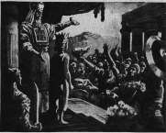
2. The coronation of Joash 11: 4-12
11 And the guards stood each with his weapons in his hand, from the right side of the house to the left side of the house, by the altar and by the house, around the king.
12 Then he brought the king’s son out and put the crown on him, and gave him the testimony; and they made him king and anointed him, and they clapped their hands and said, "Long live the king!"

Slide 23
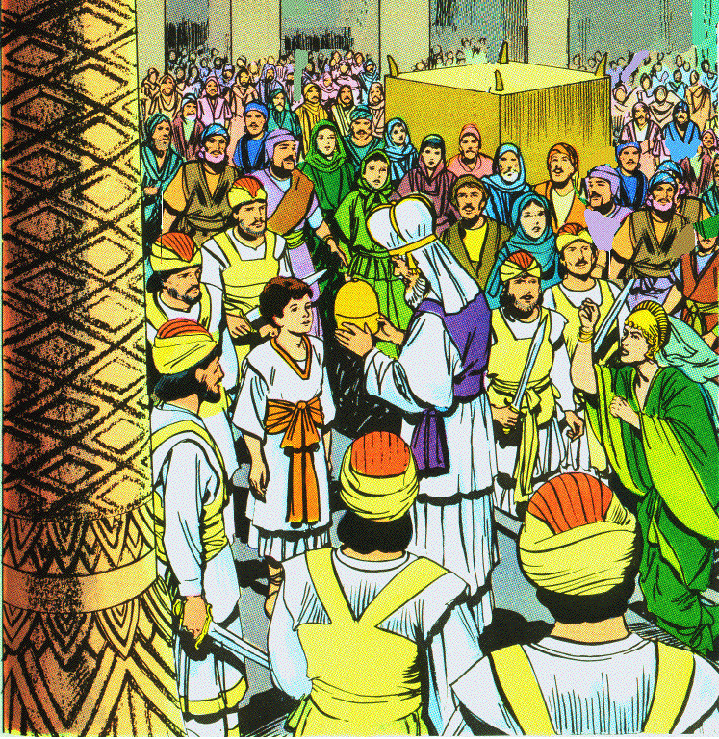
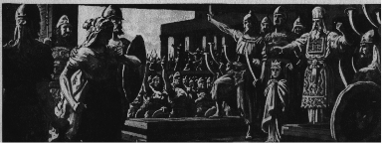
2. The coronation of Joash 11: 4-12
13 When Athaliah heard the noise of the guard and of the people, she came to the people in the house of the LORD.
14 And she looked and behold, the king was standing by the pillar, according to the custom, with the captains and the trumpeters beside the king; and all the people of the land rejoiced and blew trumpets. Then Athaliah tore her clothes and cried, "Treason! Treason!"

Slide 24
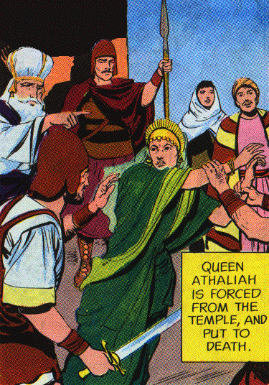
3. The death of Athaliah 11:13-16
15 And Jehoiada the priest commanded the captains of hundreds who were appointed over the army, and said to them, "Bring her out between the ranks, and whoever follows her put to death with the sword." For the priest said, "Let her not be put to death in the house of the LORD."
16 So they seized her, and when she arrived at the horses’ entrance of the king’s house, she was put to death there.

Slide 25
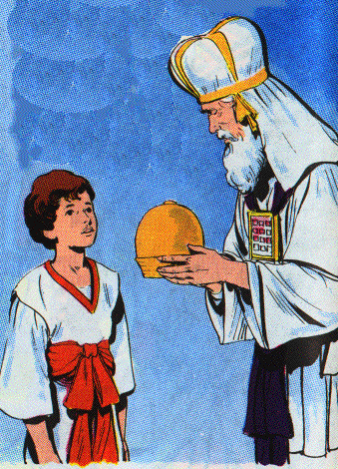
4. Enthronement of another descendant of David 11:17-20
17 Then Jehoiada made a covenant between the LORD and the king and the people, that they should be the LORD’S people, also between the king and the people.

Slide 26
4. Enthronement of another descendant of David 11:17-20
18 And all the people of the land went to the house of Baal, and tore it down; his altars and his images they broke in pieces thoroughly, and killed Mattan the priest of Baal before the altars. And the priest appointed officers over the house of the LORD.
[2 C 23:18 Moreover, Jehoiada placed the offices of the house of the LORD under the authority of the Levitical priests, whom David had assigned over the house of the LORD, to offer the burnt offerings of the LORD, as it is written in the law of Moses--with rejoicing and singing according to the order of David.]
19 And he took the captains of hundreds and the Carites and the guards and all the people of the land; and they brought the king down from the house of the LORD, and came by the way of the gate of the guards to the king’s house. And he sat on the throne of the kings.
20 So all the people of the land rejoiced and the city was quiet. For they had put Athaliah to death with the sword at the king’s house.

Slide 27
C. Reign of Joash in Judah 11:21—12:21

Slide 28
1. Introduction to the reign of Joash 11:21—12:3
21 Jehoash was seven years old when he became king.
12:1 In the seventh year of Jehu, Jehoash became king, and he reigned forty years in Jerusalem; and his mother’s name was Zibiah [ZIB ee-uh] of Beersheba.
2 And Jehoash did right in the sight of the LORD all his days in which Jehoiada the priest instructed him.
3 Only the high places were not taken away; the people still sacrificed and burned incense on the high places.
2 C 24:3 And Jehoiada took two wives for him, and he became the father of sons and daughters.

Slide 29
2. Repair of the Temple 12:4-16
4 Then Jehoash said to the priests, "All the money of the sacred things which is brought into the house of the LORD, in current money, both the money of each man’s assessment and all the money which any man’s heart prompts him to bring into the house of the LORD,
5 let the priests take it for themselves, each from his acquaintance; and they shall repair the damages of the house wherever any damage may be found.

Slide 30
2. Repair of the Temple 12:4-16
6 But it came about that in the twenty-third year of King Jehoash the priests had not repaired the damages of the house.
7 Then King Jehoash called for Jehoiada the priest, and for the other priests and said to them, "Why do you not repair the damages of the house? Now therefore take no more money from your acquaintances, but pay it for the damages of the house."
8 So the priests agreed that they should take no more money from the people, nor repair the damages of the house.

Slide 31
2. Repair of the Temple 12:4-16
9 But Jehoiada the priest took a chest and bored a hole in its lid, and put it beside the altar, on the right side as one comes into the house of the LORD; and the priests who guarded the threshold put in it all the money which was brought into the house of the LORD.
10 And when they saw that there was much money in the chest, the king’s scribe and the high priest came up and tied it in bags and counted the money which was found in the house of the LORD.

Slide 32
2. Repair of the Temple 12:4-16
11 And they gave the money which was weighed out into the hands of those who did the work, who had the oversight of the house of the LORD; and they paid it out to the carpenters and the builders, who worked on the house of the LORD;
12 and to the masons and the stonecutters, and for buying timber and hewn stone to repair the damages to the house of the LORD, and for all that was laid out for the house to repair it.

Slide 33
2. Repair of the Temple 12:4-16
13 But there were not made for the house of the LORD silver cups, snuffers, bowls, trumpets, any vessels of gold, or vessels of silver from the money which was brought into the house of the LORD;
14 for they gave that to those who did the work, and with it they repaired the house of the LORD.
15 Moreover, they did not require an accounting from the men into whose hand they gave the money to pay to those who did the work, for they dealt faithfully.
16 The money from the guilt offerings and the money from the sin offerings, was not brought into the house of the LORD; it was for the priests.
2 C 24:14 And when they had finished, they brought the rest of the money before the king and Jehoiada; and it was made into utensils for the house of the LORD, utensils for the service and the burnt offering, and pans and utensils of gold and silver. And they offered burnt offerings in the house of the LORD continually all the days of Jehoiada.

Slide 34
The death of Jehoiada 2 C 24:15, 16
15 Now when Jehoiada reached a ripe old age he died; he was one hundred and thirty years old at his death.
16 And they buried him in the city of David among the kings, because he had done well in Israel and to God and His house.

Slide 35
The Sins of Joash 2 C 24:17-19
17 But after the death of Jehoiada the officials of Judah came and bowed down to the king, and the king listened to them.
18 And they abandoned the house of the LORD, the God of their fathers, and served the Asherim and the idols; so wrath came upon Judah and Jerusalem for this their guilt.
19 Yet He sent prophets to them to bring them back to the LORD; though they testified against them, they would not listen.

Slide 36
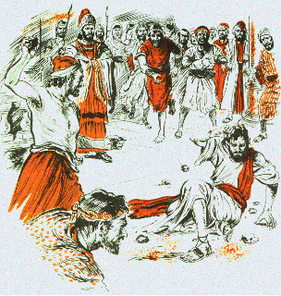
The Stoning of Zechariah 2 C 24:20-22
20 Then the Spirit of God came on Zechariah the son of Jehoiada the priest; and he stood above the people and said to them, "Thus God has said, ‘Why do you transgress the commandments of the LORD and do not prosper? Because you have forsaken the LORD, He has also forsaken you.’"
21 So they conspired against him and at the command of the king they stoned him to death in the court of the house of the LORD.
22 Thus Joash the king did not remember the kindness which his father Jehoiada had shown him, but he murdered his son. And as he died he said, "May the LORD see and avenge!"

Slide 37
The reverses of Judah 2 C 24:23, 24
23 Now it came about at the turn of the year that the army of the Arameans came up against him; and they came to Judah and Jerusalem, destroyed all the officials of the people from among the people, and sent all their spoil to the king of Damascus.
24 Indeed the army of the Arameans came with a small number of men; yet the LORD delivered a very great army into their hands, because they had forsaken the LORD, the God of their fathers. Thus they executed judgment on Joash.

Slide 38
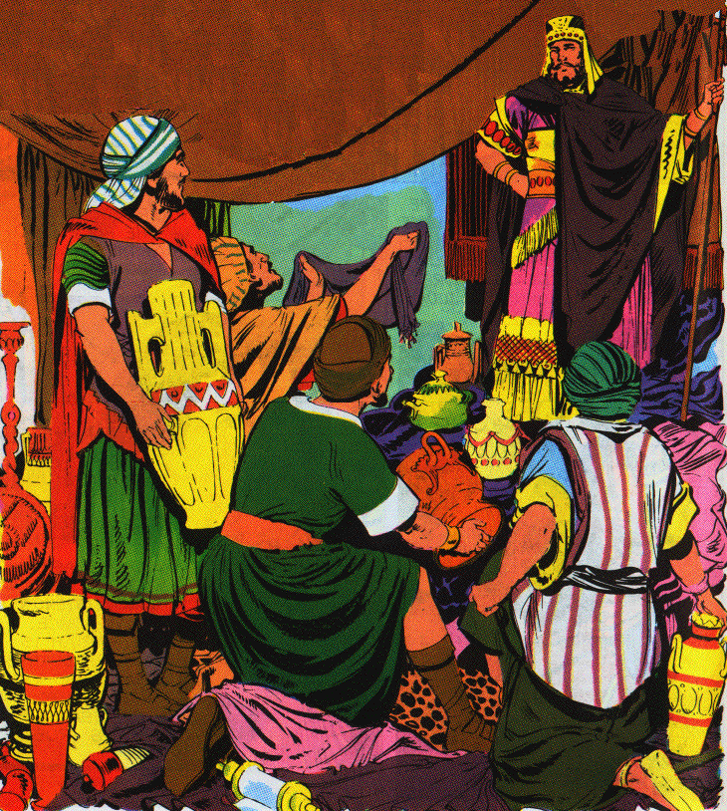
3. The invasion of Hazael 12:17-18
17 Then Hazael king of Aram went up and fought against Gath and captured it, and Hazael set his face to go up to Jerusalem.
18 And Jehoash king of Judah took all the sacred things that Jehoshaphat and Jehoram and Ahaziah, his fathers, kings of Judah, had dedicated, and his own sacred things and all the gold that was found among the treasuries of the house of the LORD and of the king’s house, and sent them to Hazael king of Aram. Then he went away from Jerusalem.

Slide 39
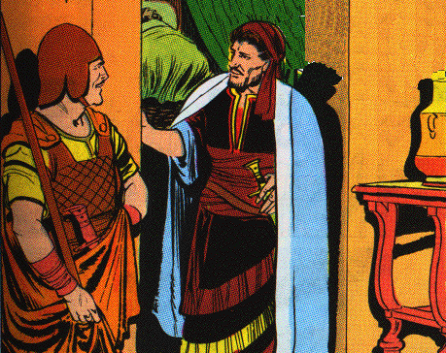
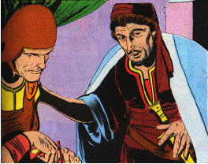
4. The assassination of Joash 12:19-21
19 Now the rest of the acts of Joash and all that he did, are they not written in the Book of the Chronicles of the Kings of Judah?
20 And his servants arose and made a conspiracy, and struck down Joash at the house of Millo as he was going down to Silla.
21 For Jozacar the son of Shimeath, and Jehozabad the son of Shomer, his servants, struck him, and he died; and they buried him with his fathers in the city of David, and Amaziah his son became king in his place.

Slide 40
The death of Joash 2 C 24:25-27
25 And when they had departed from him (for they left him very sick), his own servants conspired against him because of the blood of the son of Jehoiada the priest, and murdered him on his bed. So he died, and they buried him in the city of David, but they did not bury him in the tombs of the kings.
26 Now these are those who conspired against him: Zabad the son of Shimeath the Ammonitess, and Jehozabad the son of Shimrith the Moabitess.
27 As to his sons and the many oracles against him and the rebuilding of the house of God, behold, they are written in the treatise of the Book of the Kings. Then Amaziah his son became king in his place.

Slide 41
Hazael of Aram
Ben-hadad
Israel
814
798
Jehu 28 yrs.
Jehoahaz 17 yrs.
Jehoash
16 yrs.
841
790
796
Athaliah 6 yrs.
Joash 40 yrs.
Amaziah 41 yrs.
835
Divided Monarchy: Humiliation Phase
(Sisters Bowing)
841-790 BC

Slide 42
D. Reign of Jehoahaz in Israel 13:1-9
1 In the twenty-third year of Joash the son of Ahaziah, king of Judah, Jehoahaz the son of Jehu became king over Israel at Samaria, and he reigned seventeen years.
2 And he did evil in the sight of the LORD, and followed the sins of Jeroboam the son of Nebat, with which he made Israel sin; he did not turn from them.
3 So the anger of the LORD was kindled against Israel, and He gave them continually into the hand of Hazael king of Aram, and into the hand of Ben-hadad the son of Hazael.
4 Then Jehoahaz entreated the favor of the LORD, and the LORD listened to him; for He saw the oppression of Israel, how the king of Aram oppressed them.
5 And the LORD gave Israel a deliverer, so that they escaped from under the hand of the Arameans; and the sons of Israel lived in their tents as formerly.

Slide 43
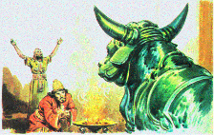
D. Reign of Jehoahaz in Israel 13:1-9
6 Nevertheless they did not turn away from the sins of the house of Jeroboam, with which he made Israel sin, but walked in them; and the Asherah also remained standing in Samaria.
7 For he left to Jehoahaz of the army not more than fifty horsemen and ten chariots and 10,000 footmen, for the king of Aram had destroyed them and made them like the dust at threshing.
8 Now the rest of the acts of Jehoahaz, and all that he did and his might, are they not written in the Book of the Chronicles of the Kings of Israel?
9 And Jehoahaz slept with his fathers, and they buried him in Samaria; and Joash his son became king in his place.

Slide 44
XII. The Kingdoms at High Tide
II Kings 13:10—15:7
In 802 B.C. the Assyrian King Adadnirari III (AH dad-nih-RAH rih ) attacked Damascus and inflicted serious casualties on Ben-hadad II.
At this point, Israel began to recover lost territories and emerge from submission to Damascus.

Slide 45
Israel
753
Jeroboam II 41 yrs.
Jehoash 16 yrs.
Zech.
Shallum
790
Judah
767
750
Uzziah (Azariah) 52 yrs.
Amaziah 29 yrs.
Divided Monarchy: Heyday Phase
(Sisters Growing)
790-750 BC

Slide 46
A. The Period of Recovery 13:10—14:22
A period of transition from humiliation to greatness.
These two kings gradually recover territory from Syria.

Slide 47
1. The reign of Jehoash in Israel 13:10-13
10 In the thirty-seventh year of Joash king of Judah, Jehoash the son of Jehoahaz, became king over Israel in Samaria, and reigned sixteen years.
11 And he did evil in the sight of the LORD; he did not turn away from all the sins of Jeroboam the son of Nebat, with which he made Israel sin, but he walked in them.
12 Now the rest of the acts of Joash and all that he did and his might with which he fought against Amaziah king of Judah, are they not written in the Book of the Chronicles of the Kings of Israel?
13 So Joash slept with his fathers, and Jeroboam sat on his throne; and Joash was buried in Samaria with the kings of Israel.

Slide 48
2. The final prediction of Elisha 13:14-25

Slide 49
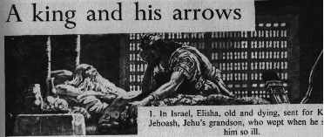
a. Elisha ordered King Jehoash to perform symbolic acts 13:14-19
14 When Elisha became sick with the illness of which he was to die, Joash the king of Israel came down to him and wept over him and said, "My father, my father, the chariots of Israel and its horsemen!"
Joash & Elisha

Slide 50
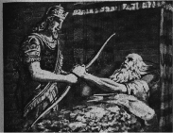
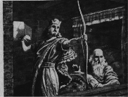
a. Elisha ordered King Jehoash to perform symbolic acts 13:14-19
15 And Elisha said to him, "Take a bow and arrows." So he took a bow and arrows.
16 Then he said to the king of Israel, "Put your hand on the bow." And he put his hand on it, then Elisha laid his hands on the king’s hands.
17 And he said, "Open the window toward the east," and he opened it. Then Elisha said, "Shoot!" And he shot. And he said, "The LORD’S arrow of victory, even the arrow of victory over Aram; for you shall defeat the Arameans at Aphek until you have destroyed them."

Slide 51
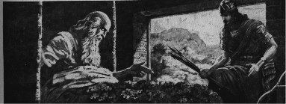
a. Elisha ordered King Jehoash to perform symbolic acts 13:14-19
18 Then he said, "Take the arrows," and he took them. And he said to the king of Israel, "Strike the ground," and he struck it three times and stopped.
19 So the man of God was angry with him and said, "You should have struck five or six times, then you would have struck Aram until you would have destroyed it. But now you shall strike Aram only three times."

Slide 52
Lessons
1. Elisha was going to be missed
2. Elisha died without complaint
3. Elisha showed perseverance & got up from his deathbed to prophesy
4. God can deliver in trouble
5. God employs human agency in his deliverances
6. The human agent could succeed only with the help of God (Elisha put his hands on the king’s hands)
7. Lack of faith leads to low expectations & feeble effort
8. God is displeased that we do not ask more of Him

Slide 53
b. Elisha’s power manifested even after his death 13:20-21
20 And Elisha died, and they buried him. Now the bands of the Moabites would invade the land in the spring of the year.
21 And as they were burying a man, behold, they saw a marauding band; and they cast the man into the grave of Elisha. And when the man touched the bones of Elisha he revived and stood up on his feet.

Slide 54
Lessons
1. God confirms His approval of the prophet
2. The faithful are encourage that God still works after his death
3. God’s life giving power to resurrect is seen again
4. No excuse for relic worship - it did not happen again, his bone were not on display
5. The Lord Jesus has greater power in His death

Slide 55
c. How Elisha’s final prophecy was fulfilled 13:22-25
22 Now Hazael king of Aram had oppressed Israel all the days of Jehoahaz.
23 But the LORD was gracious to them and had compassion on them and turned to them because of His covenant with Abraham, Isaac, and Jacob, and would not destroy them or cast them from His presence until now.

Slide 56
c. How Elisha’s final prophecy was fulfilled 13:22-25
24 When Hazael king of Aram died, Ben-hadad his son became king in his place.
25 Then Jehoash the son of Jehoahaz took again from the hand of Ben-hadad the son of Hazael the cities which he had taken in war from the hand of Jehoahaz his father. Three times Joash defeated him and recovered the cities of Israel.

Slide 57
Lessons
1. God is patient with the descendants of the righteous
2. God delivers them for His promise and Name’s sake
3. God is unwilling to quickly destroy His people

