Slide 1
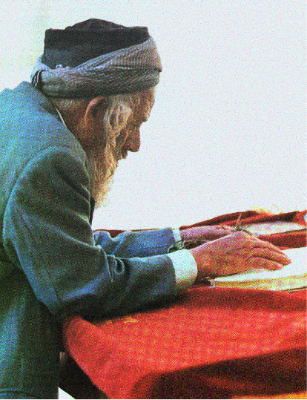
The Bible - The Book
A miracle to be seen today

Slide 2
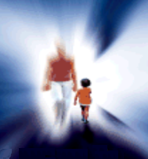
For The Soul & Spiritual Things
Gather to deal with things perpetual & eternal
Thing’s eternal - of the soul
Time - Timely - God - Judgment
Spiritual things - must trust God
Jer. 10:23 know, O LORD, that a man's way is not in himself; Nor is it in a man who walks to direct his steps.
Ps. 119:105 Thy word is a lamp to my feet, And a light to my path.

Slide 3
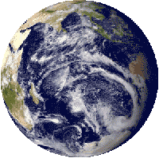
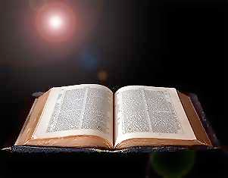
Alone claims to reveal the truth
Origin of man, world
Destiny
Principles regulate duties to self, neighbor, God

Slide 4
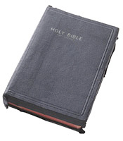
Worthy of consideration - Magnitude of its claims
Revelation from God
Worthy of God
Character
Subject matter: Creation of universe & man
Style: simple - adapted to babes

Slide 5
Explains the state of man
Highest creation
Sin - curse
Suffering and weakness
Longing
Capacity for a higher state

Slide 6
Profitable & Adequate
2 Tim. 3:16, 17 All Scripture is inspired by God and profitable for teaching, for reproof, for correction, for training in righteousness; that the man of God may be adequate, equipped for every good work.
Every spiritual need
Made adequate for every work
Everything pertaining to life & godliness 2 Peter 1:3

Slide 7
Sole rule of faith & practice
No other religious authority
No supplement needed
Creeds & manuals of faith not needed
Every need anticipated

Slide 8
Taught us all we know of spiritual & eternal things
Heaven - Hell
Holy Spirit
Jesus Christ
Angels
Life beyond

Slide 9
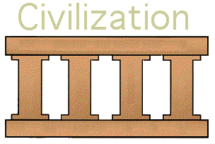
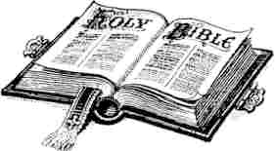
Study The Importance of the Bible
As A Book
Faith, confidence & respect for as word of God
The Foundation of our Country & Civilization
Foundation shaking because of loss of respect

Slide 10
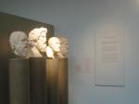
Among the Oldest Books
Yet, Still Relevant
Records events from creation to end of 1st century
Events before pyramids
David’s Psalms - before Greek poets wrote of Trojan War
Most books before public library in Athens
Isaiah - Malachi before Socrates, Plato, Aristotle

Slide 11
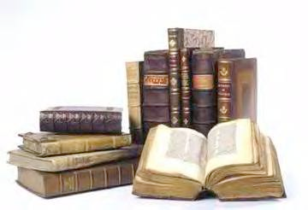
Holy Spirit has not inspired a book in 2,000 years
Just as applicable today
Does not become obsolete
Text books - Science books
Bible relevant as ages pass

Slide 12
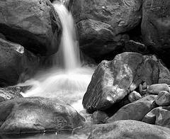
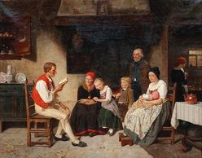
Like a mountain spring
All our fathers, grandfathers & great-grand fathers quenched their thirst
Refreshes just the same

Slide 13
Still Relevant
Treats most sublime problems
No new thoughts added to its statements
Human progress cannot overtake it
Wisdom waiting for each generation
Josiah, Luther, Campbell, you, me

Slide 14
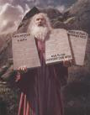
Uniqueness of Its Composition
Written over 1,500 year period
1520 B.C.
Moses
750 B.C.
Isaiah
432 B.C.
Malachi
30 A.D.
Cross
96 A.D.
Revelation

Slide 15
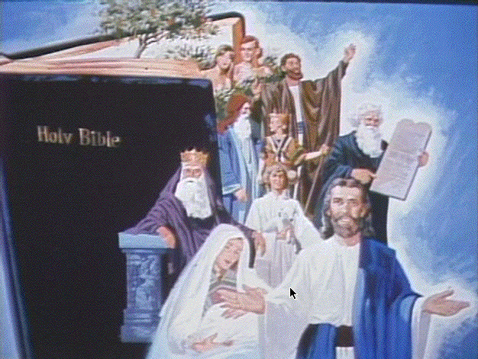
Written by 40 authors
1. Moses - a political leader - shepherd
2. Peter - fisherman
3. Amos - herdsman
4. Joshua - a military general
5. Nehemiah - cupbearer - governor
6. Daniel - prime minister
7. Luke - a doctor
8. Solomon - a king
9. Matthew - a tax collector
10. Paul - a rabbi

Slide 16
Written in different places & times
1. Moses in wilderness
2. Jeremiah in a dungeon
3. Daniel on a hillside and in a palace
4. Paul inside prison wall
5. Luke while traveling
6. John on the isle of Patmos
7. Times of war (David) and peace (Solomon)

Slide 17
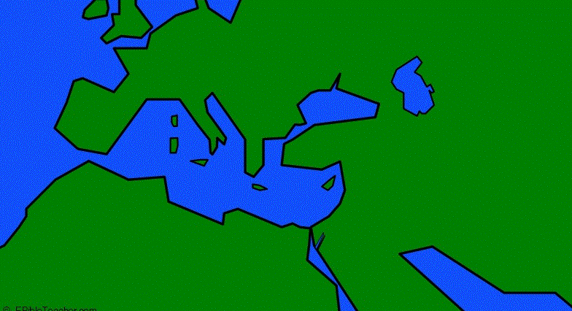
Written:
During different moods: joy, sorrow, despair
On different continents: Asia, Africa, Europe
In three languages: Hebrew, Aramaic, Greek
Europe
Asia
Africa

Slide 18
Hundreds of controversial subjects
Prophecy, morality, theology
Harmony - How?
Ancient surroundings - slaves, battled for survival, small country
No contradiction or discrepancies
Jews - not a literary people - gave us the Bible

Slide 19
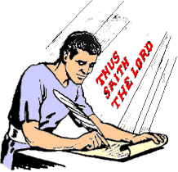
How Do We Account For It?
Found in every nation
Challenges the sincerest thoughts of the best
One purpose - One God guided them

Slide 20
Grew Like An Organism
Its Parts (Books) Are Interdependent
Each book complete in itself
No one complete apart from whole
Each necessary
Secular history fix their dates

Slide 21
Old Testament Books
Genesis ⇒ meaningless without fulfillment
Exodus ⇔ Deut. - need what proceeds & follows
Joshua ⇔ Esther - different authors - same as above
One Mind planned, guided all
Psalms ⇔ Malachi need History
Limbs of prophetic tree
Unity ⇒ written over a 1000 years

Slide 22
New Testament Books
Gospels - different authors, times - complementary
Matthew, Mark - Galilean ministry
Luke, John - Perean & Judean ministry
Gospels incomplete without Acts
Acts needs Letters
Letters have not context without Acts
Saints discouraged without Revelation

Slide 23
Old Testament not Complete without New
Unfulfilled
N.T. outgrowth, supplement, complement
Jesus Christ fulfillment
John 5:46-47 "For if you believed Moses, you would believe Me; for he wrote of Me. "But if you do not believe his writings, how will you believe My words?"
Luke 24:27 And beginning with Moses and with all the prophets, He explained to them the things concerning Himself in all the Scriptures.

Slide 24
Old & New Testament Are Mutually Dependent
Genesis ⇔ Revelation
Stop could not be made at any point
Incompleteness of story without all

Slide 26
The Bible - The Book
A miracle to be seen today

Slide 27
It Speaks As From God
It Speaks With Absolute Authority

Slide 28
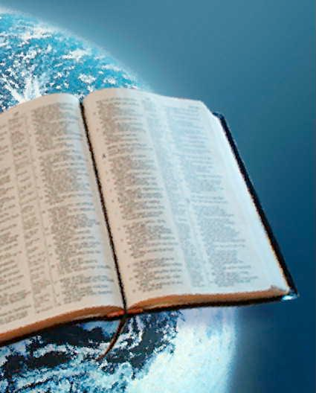
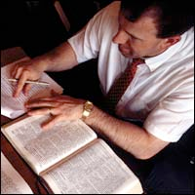
Never Speaks of Things as Probable or Possible
Positive of future as of past
Condition only made concerning man’s course
Absolute certainty of past & future

Slide 29
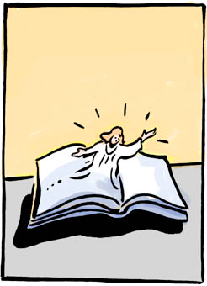
Expresses Truth Without Reasoning or Philosophizing
Announces principles of right or wrong
Based on God’s authority
Matt. 7:28, 29 The result was that when Jesus had finished these words, the multitudes were amazed at His teaching; for He was teaching them as one having authority, and not as their scribes.
2 Pet. 1:21 for no prophecy was ever made by an act of human will, but men moved by the Holy Spirit spoke from God.

Slide 30
Claims Authority & Dominion Over Man
Contrary to our rebellious disposition
Proposes to hold us accountable
Does not ask what we prefer
Superhuman authority - “You shall” “You shall not”
Governs all - kings, parents, masters, rich
Limits & holds in check our liberties

Slide 31
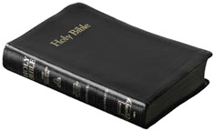
Absolutely Impartial
Does not eulogize good or abuse enemies
Tells the facts
Uncolored by human feelings or prejudice
History of 4000 years - many authors
Impartiality unifies its style

Slide 32
Unchangeable Purpose
Unbroken chain of warnings, testimonies & exhortation - Obey God
Harmony of thought beyond comprehension
Greatest miracle - the Bible itself
Its existence is a guarantee & explanation of all its truths & miracles

Slide 33
Style worthy of its claims of Divine origin
Aim is Godlike
Contents in perfect harmony
Not a trivial or irrelevant thought
Designed to bring men into submission to God’s authority and judge every deed

Slide 34
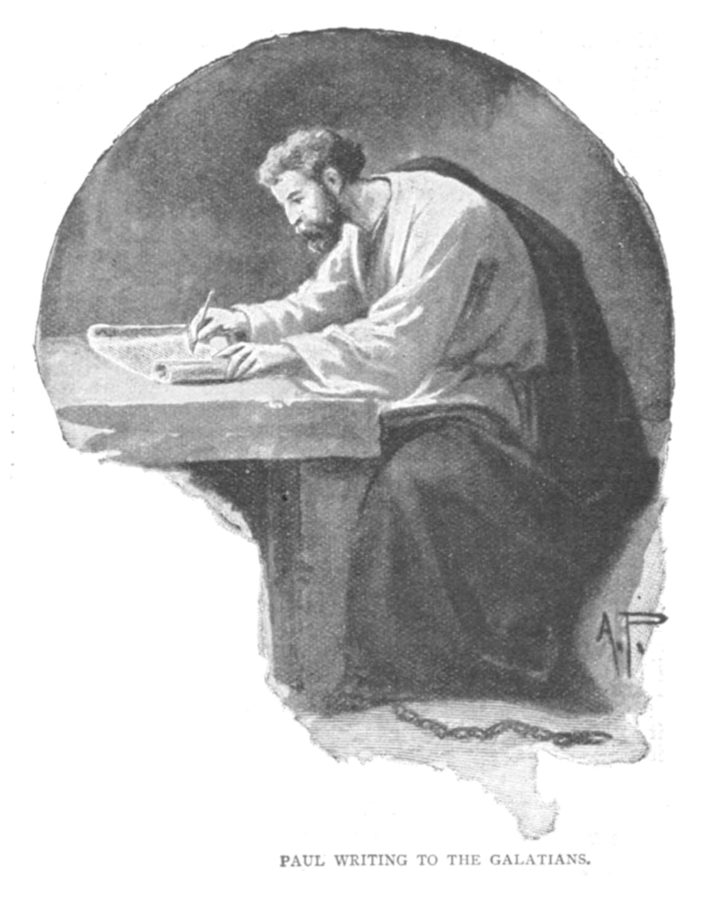
Moral Character - Godlike
Human writers - no sign of self-seeking
Plain & simple facts
Purest morality
Writers did not always understand their words

Slide 35
Always Accurate
Not a book of science - dependable & reliable
No violation of true scientific principle
Rules of hygiene - harmony with knowledge of germs
Histories confirmed

Slide 36
No Book Hated Like Bible
Others dislike, ignored, passed away
Devil hates it
Draws an appalling picture of man
Enemies seek to rid the world of this portrait
They keep up the fight

Slide 37
Portrait of Mankind
Gen. 6:5 Then the LORD saw that the wickedness of man was great on the earth, and that every intent of the thoughts of his heart was only evil continually.
Rom. 1:29-31 being filled with all unrighteousness, wickedness, greed, evil; full of envy, murder, strife, deceit, malice; they are gossips, slanderers, haters of God, insolent, arrogant, boastful, inventors of evil, disobedient to parents, without understanding, untrustworthy, unloving, unmerciful;

Slide 38
Portrait of Mankind
Eph. 2:1-3 And you were dead in your trespasses and sins, in which you formerly walked according to the course of this world, according to the prince of the power of the air, of the spirit that is now working in the sons of disobedience. Among them we too all formerly lived in the lusts of our flesh, indulging the desires of the flesh and of the mind, and were by nature children of wrath, even as the rest.

Slide 39
Portrait of Mankind
Eph. 2:11, 12 Therefore remember, that formerly you, the Gentiles in the flesh, who are called "Uncircumcision" by the so-called "Circumcision," which is performed in the flesh by human hands-- remember that you were at that time separate from Christ, excluded from the commonwealth of Israel, and strangers to the covenants of promise, having no hope and without God in the world.

Slide 40
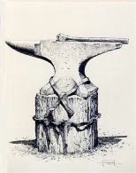
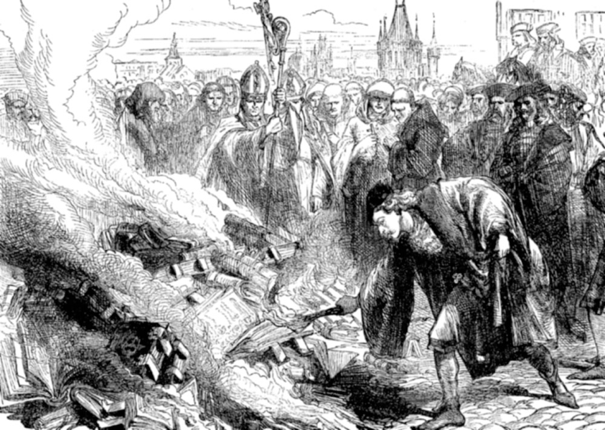
Survival Through Persecution
Anvil - many hammer worn out
Many efforts to destroy
Physical force - Romans, Catholics, Communist
Learned - ridicule

Slide 41
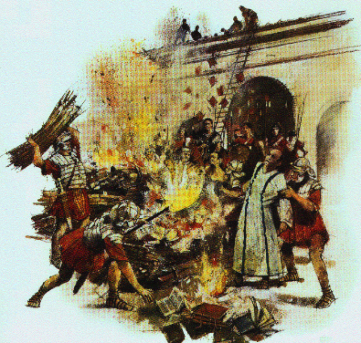
Survival Through Persecution
Diocletian 303 A.D.
Ordered all churches razed, Bible burned
25 yrs. later Constantine order 50 Bible copied at government expense

Slide 42
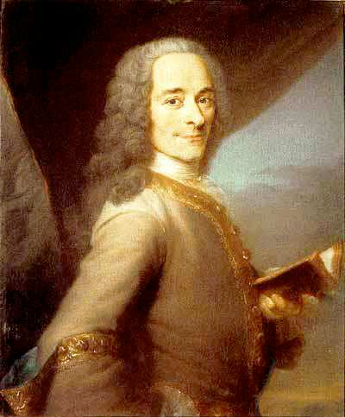
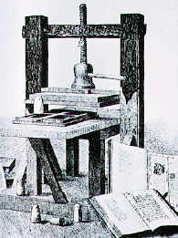
Survival Through Persecution
Voltaire: 1694-1778
“It took twelve men to write it up, but he would show it took only one man to write it down.”
By the close of the century no Bibles on earth
After his death Geneva Bible Society used his press & house to produce Bibles

Slide 43
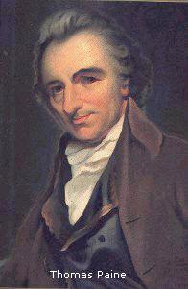
Survival Through Persecution
Tom Paine 1737-1809
The Age of Reason
50 years - Bible only in museums
His book almost forgotten
Tens of Million of Bible every year

Slide 44
Survival Through Persecution
Word of God - Eternal - Cannot be destroyed
Heb. 4:12 For the word of God is living and active and sharper than any two-edged sword, and piercing as far as the division of soul and spirit, of both joints and marrow, and able to judge the thoughts and intentions of the heart.
1 Pet. 1:23-25 for you have been born again not of seed which is perishable but imperishable, that is, through the living and abiding word of God. For, " All flesh is like grass, And all its glory like the flower of grass. The grass withers, And the flower falls off, But the word of the Lord abides forever." And this is the word which was preached to you.

Slide 45
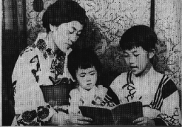
Its Translation
Translated without losing its power
Works of men often do not translate

Slide 46
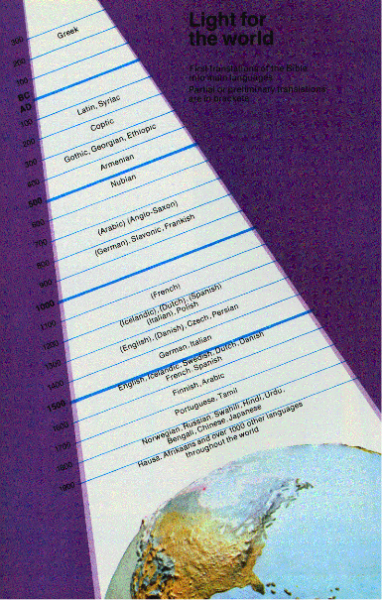
Its Translation
Translated into 1280 languages
We read it without thinking
Penned in Hebrew and Greek

Slide 47
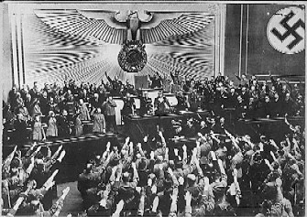
Challenges Men To Judge It By Its Fruit
The only uplifting power among nations
Without it man has sunk
Ignorance, sin, degradation (physical, moral, social)
Paganism Rom. 1:18-31
Jewish history
Before the flood

Slide 48
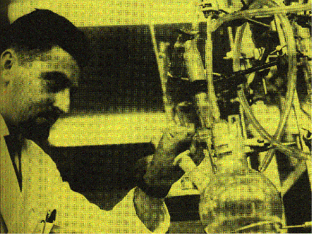
Challenges Men To Judge It By Its Fruit
Nursing Mother of Science
Foundation truths of science
Law giver - laws
Does not contradict established truth
Advancements in science, manufacturing, husbandry

Slide 49
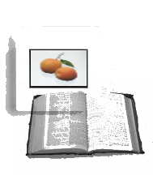
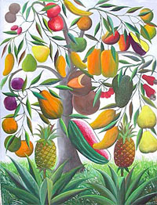
Challenges Men To Judge It By Its Fruit
Foundation of human laws
Government
Human rights
Morals

Slide 50
Challenges Men To Judge It By Its Fruit
Exaltation of women
Part of man - complement
Weaker, more sensitive
Honor and cherish
Chivalry
Center of family
Trainer of children

Slide 51
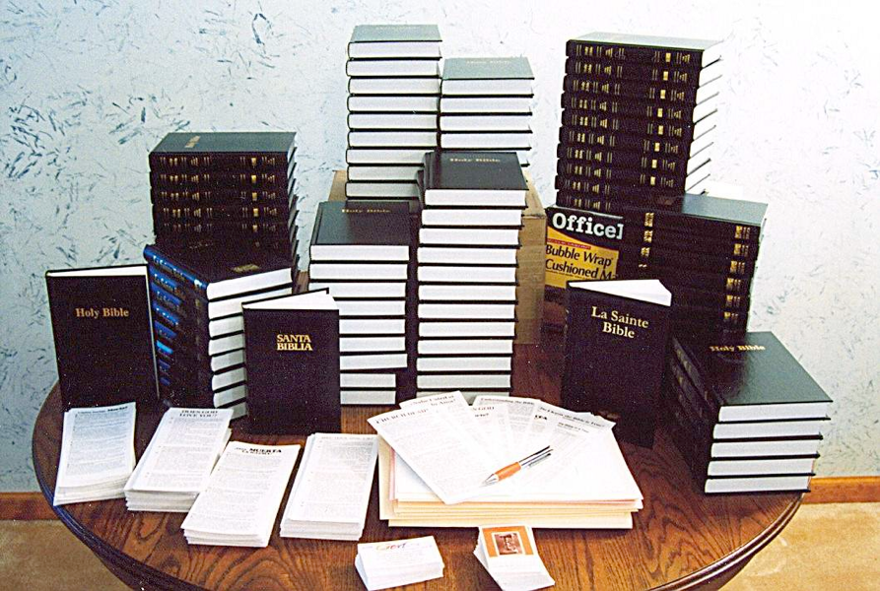
Unlike Any Other Book
It lives
Let a man write its equal
Most prominent & influential
No equal in Greece, Rome, England, America

Slide 52
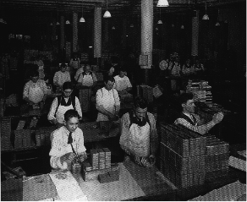
Unlike Any Other Book
Book of World Records
Most published

Slide 53
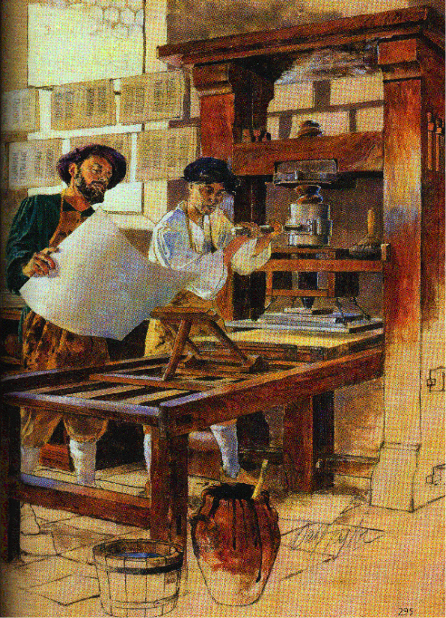
Unlike Any Other Book
Book of World Records
First printed

Slide 54
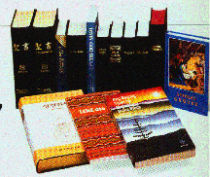
Unlike Any Other Book
Book of World Records
Most Translated

Slide 55
Unlike Any Other Book
Book of World Records
Longest telegram

Slide 56
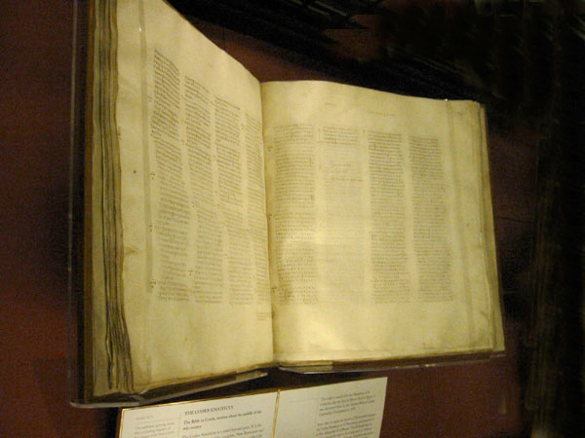
Unlike Any Other Book
Book of World Records
Most expensive
Sinaiticus
$510,000

Slide 57
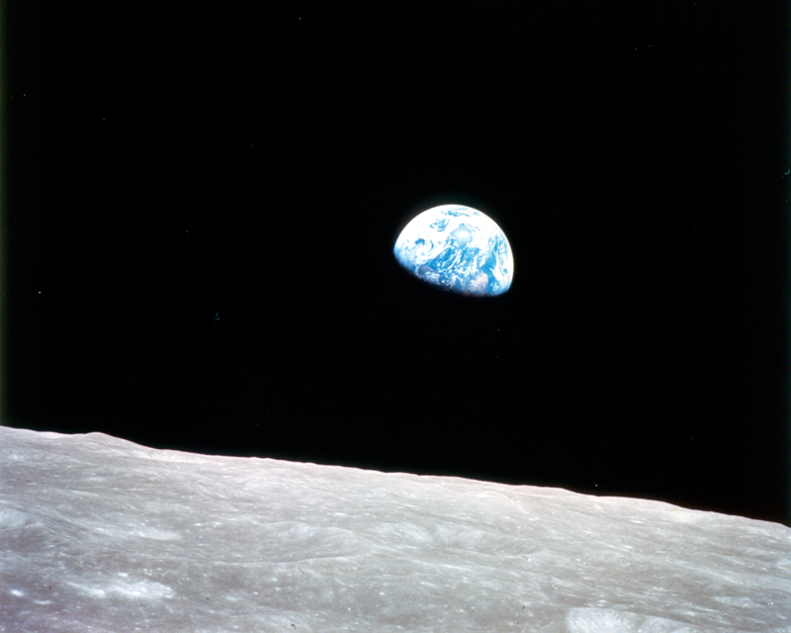
Unlike Any Other Book
Book of World Records
First read in space

Slide 58
Written For Every Person
Appeals to common characteristics & impulses
Belongs to all classes & condition of life
Humble & contrite - given hope
Challenges all to live up to best thoughts

Slide 59
Miracle of the Ages
More widely read & respected
In spite of attacks - pagans, infidels, philosophers, pseudo-scientist
It stands

Slide 60
Changes Since Written
Egypt - passed under rule of many nations
Work of Greek orators, poets, painter, sculptors
Imperial Rome’s rule
Tyre, Sidon, Spain, napoleon, England, Germany, have dominated and declined
The Bible stands

Slide 61
The Bible Stands
Defying waves of infidelity
Giving comfort & hope
Pointing To the Lord Jesus Christ
Mariners north star
Every Christian’s compass

Slide 62
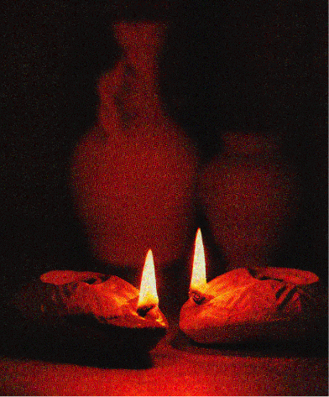
Lamp For Our Feet
2 Pet. 1:19 And so we have the prophetic word made more sure, to which you do well to pay attention as to a lamp shining in a dark place, until the day dawns and the morning star arises in your hearts.

