Slide 1
C. Miraculous cleansing of the Aramean general Naaman
5:1-19

Slide 2
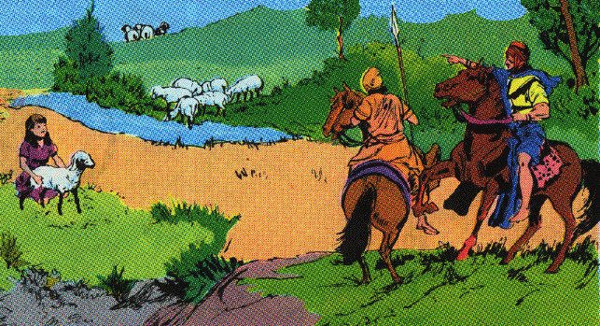
1. Naaman’s condition 1-7
1 Now Naaman, captain of the army of the king of Aram, was a great man with his master, and highly respected, because by him the LORD had given victory to Aram. The man was also a valiant warrior, but he was a leper.
2 Now the Arameans had gone out in bands, and had taken captive a little girl from the land of Israel; and she waited on Naaman’s wife.

Slide 3
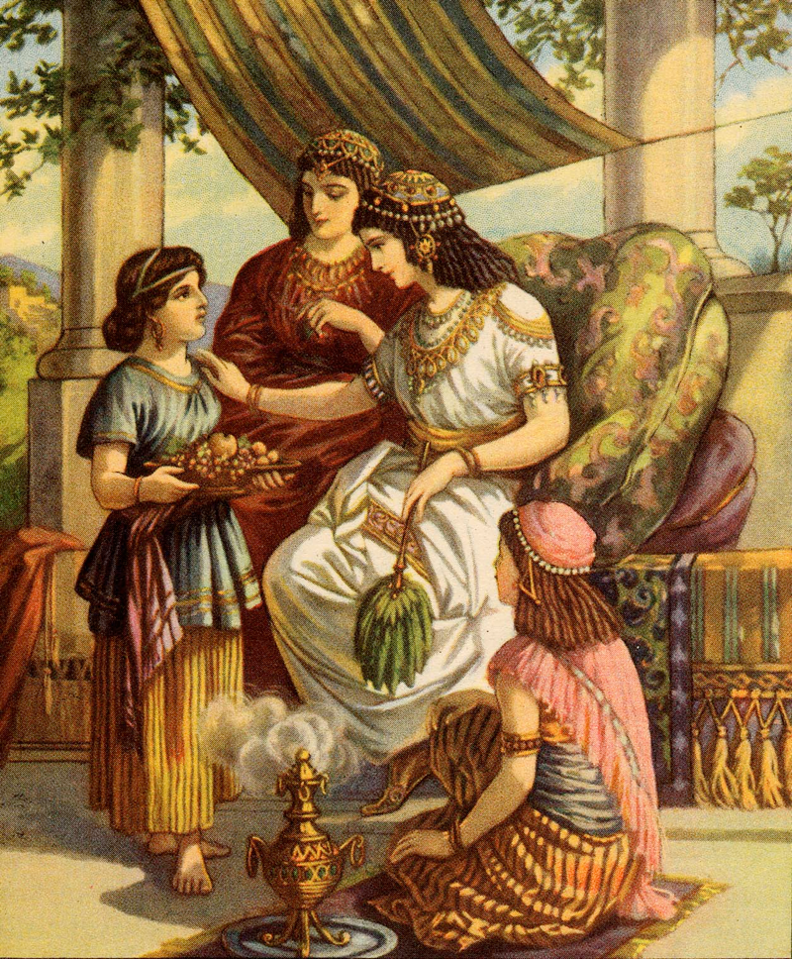
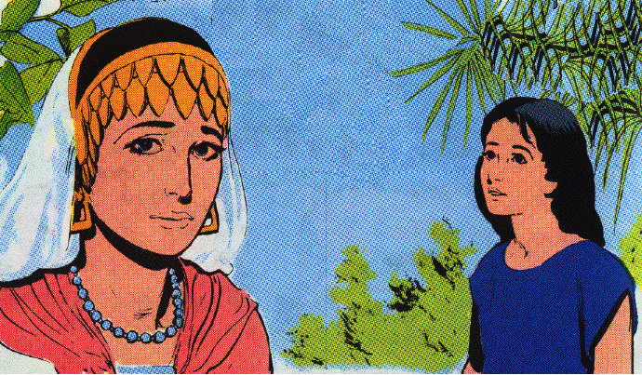
1. Naaman’s condition 1-7
3 And she said to her mistress, "I wish that my master were with the prophet who is in Samaria! Then he would cure him of his leprosy."

Slide 4
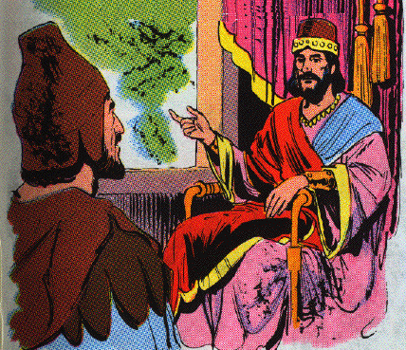
1. Naaman’s condition 1-7
4 And Naaman went in and told his master, saying, "Thus and thus spoke the girl who is from the land of Israel."
5 Then the king of Aram said, "Go now, and I will send a letter to the king of Israel." And he departed and took with him ten talents of silver and six thousand shekels of gold and ten changes of clothes.

Slide 5
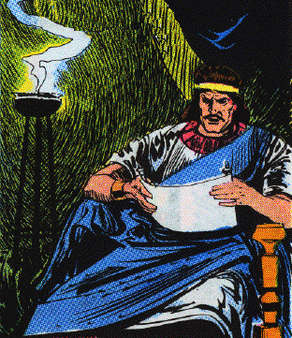
1. Naaman’s condition 1-7
6 And he brought the letter to the king of Israel, saying, "And now as this letter comes to you, behold, I have sent Naaman my servant to you, that you may cure him of his leprosy."

Slide 6
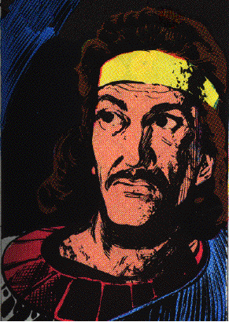
1. Naaman’s condition 1-7
7 And it came about when the king of Israel read the letter, that he tore his clothes and said, "Am I God, to kill and to make alive, that this man is sending word to me to cure a man of his leprosy? But consider now, and see how he is seeking a quarrel against me."

Slide 7
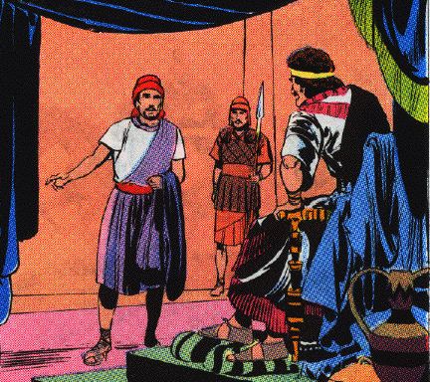
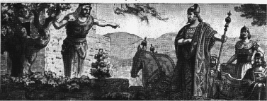
2. Naaman’s cleansing 8-14
8 And it happened when Elisha the man of God heard that the king of Israel had torn his clothes, that he sent word to the king, saying, "Why have you torn your clothes? Now let him come to me, and he shall know that there is a prophet in Israel."

Slide 8
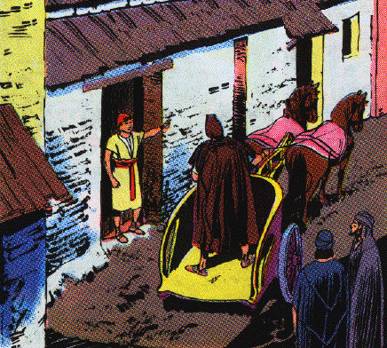
2. Naaman’s cleansing 8-14
9 So Naaman came with his horses and his chariots, and stood at the doorway of the house of Elisha.
10 And Elisha sent a messenger to him, saying, "Go and wash in the Jordan seven times, and your flesh shall be restored to you and you shall be clean."

Slide 9
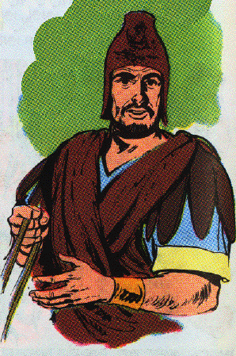
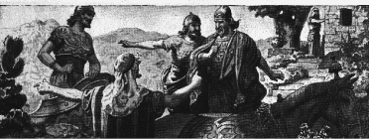
2. Naaman’s cleansing 8-14
11 But Naaman was furious and went away and said, "Behold, I thought, ‘He will surely come out to me, and stand and call on the name of the LORD his God, and wave his hand over the place, and cure the leper.’
12 "Are not Abanah and Pharpar, the rivers of Damascus, better than all the waters of Israel? Could I not wash in them and be clean?" So he turned and went away in a rage.

Slide 10
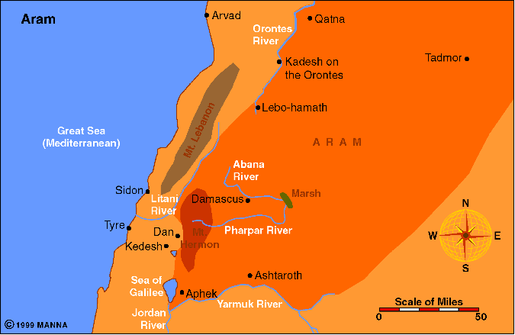

Slide 11
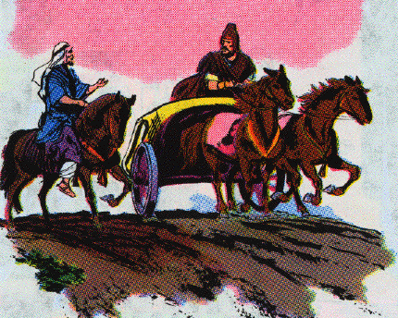
2. Naaman’s cleansing 8-14
13 Then his servants came near and spoke to him and said, "My father, had the prophet told you to do some great thing, would you not have done it? How much more then, when he says to you, ‘Wash, and be clean’?"

Slide 12
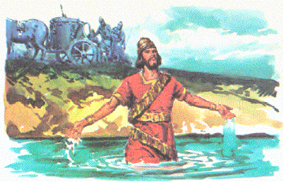
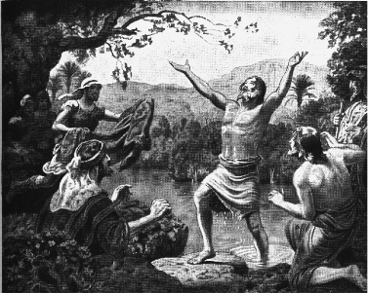
2. Naaman’s cleansing 8-14
14 So he went down and dipped himself seven times in the Jordan, according to the word of the man of God; and his flesh was restored like the flesh of a little child, and he was clean.

Slide 13
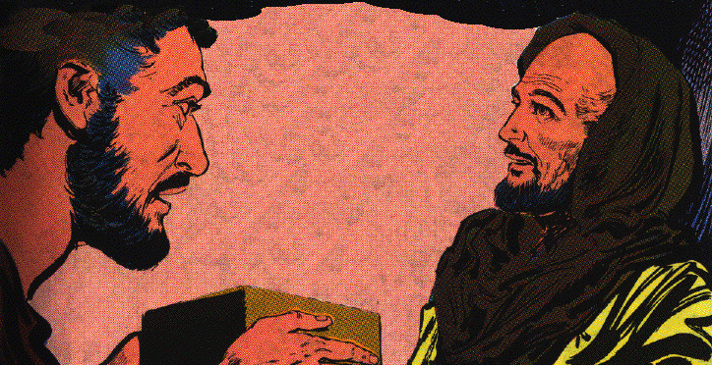
3. Naaman’s conversion 15-19
15 When he returned to the man of God with all his company, and came and stood before him, he said, "Behold now, I know that there is no God in all the earth, but in Israel; so please take a present from your servant now."
16 But he said, "As the LORD lives, before whom I stand, I will take nothing." And he urged him to take it, but he refused.

Slide 14
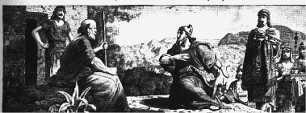
3. Naaman’s conversion 15-19
17 And Naaman said, "If not, please let your servant at least be given two mules’ load of earth; for your servant will no more offer burnt offering nor will he sacrifice to other gods, but to the LORD.
18 "In this matter may the LORD pardon your servant: when my master goes into the house of Rimmon to worship there, and he leans on my hand and I bow myself in the house of Rimmon, when I bow myself in the house of Rimmon, the LORD pardon your servant in this matter."
19 And he said to him, "Go in peace." So he departed from him some distance.

Slide 15
D. A judicial miracles against Gehazi 5:20-27
20 But Gehazi [gih HAY zigh], the servant of Elisha the man of God, thought, "Behold, my master has spared this Naaman the Aramean, by not receiving from his hands what he brought. As the LORD lives, I will run after him and take something from him."
21 So Gehazi pursued Naaman. When Naaman saw one running after him, he came down from the chariot to meet him and said, "Is all well?"
22 And he said, "All is well. My master has sent me, saying, ‘Behold, just now two young men of the sons of the prophets have come to me from the hill country of Ephraim. Please give them a talent of silver and two changes of clothes.’"
23 And Naaman said, "Be pleased to take two talents." And he urged him, and bound two talents of silver in two bags with two changes of clothes, and gave them to two of his servants; and they carried them before him.

Slide 16
D. A judicial miracles against Gehazi 5:20-27
24 When he came to the hill, he took them from their hand and deposited them in the house, and he sent the men away, and they departed.
25 But he went in and stood before his master. And Elisha said to him, "Where have you been, Gehazi?" And he said, "Your servant went nowhere."
26 Then he said to him, "Did not my heart go with you, when the man turned from his chariot to meet you? Is it a time to receive money and to receive clothes and olive groves and vineyards and sheep and oxen and male and female servants?

Slide 17
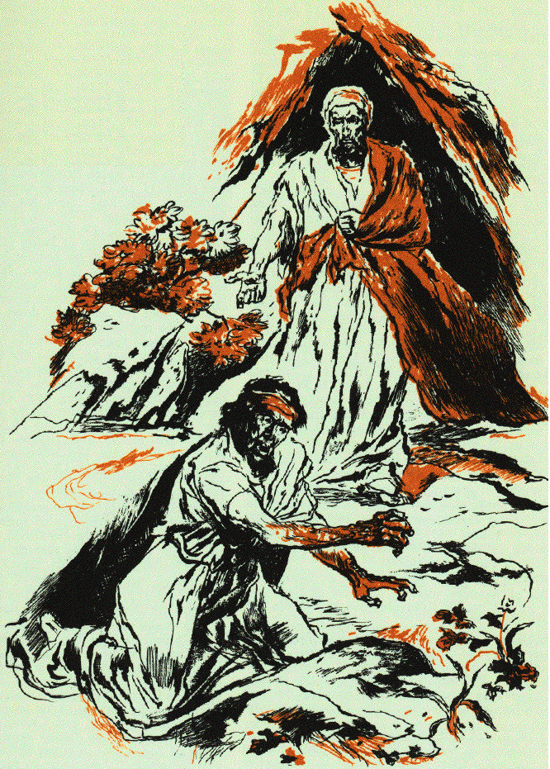
D. A judicial miracles against Gehazi 5:20-27
27 "Therefore, the leprosy of Naaman shall cleave to you and to your descendants forever." So he went out from his presence a leper as white as snow.

Slide 18
E. Miraculous levitation of the axe head 6:1-7
1 Now the sons of the prophets said to Elisha, "Behold now, the place before you where we are living is too limited for us.
2 "Please let us go to the Jordan, and each of us take from there a beam, and let us make a place there for ourselves where we may live." So he said, "Go."
3 Then one said, "Please be willing to go with your servants." And he answered, "I shall go."
4 So he went with them; and when they came to the Jordan, they cut down trees.

Slide 19
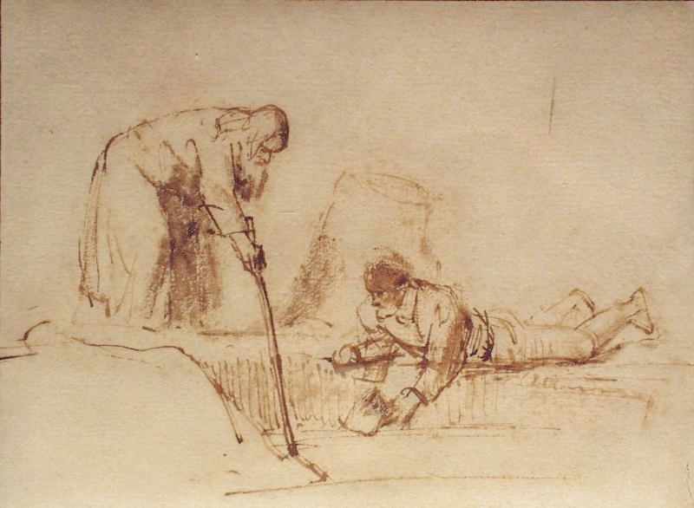
E. Miraculous levitation of the axe head 6:1-7
5 But as one was felling a beam, the axe head fell into the water; and he cried out and said, "Alas, my master! For it was borrowed."
6 Then the man of God said, "Where did it fall?" And when he showed him the place, he cut off a stick, and threw it in there, and made the iron float.
7 And he said, "Take it up for yourself." So he put out his hand and took it.

Slide 20
X. Elisha and the Syrians 2 Kings 6:8—8:29

Slide 21
A. Elisha’s patriotic miracles 6:8-23

Slide 22
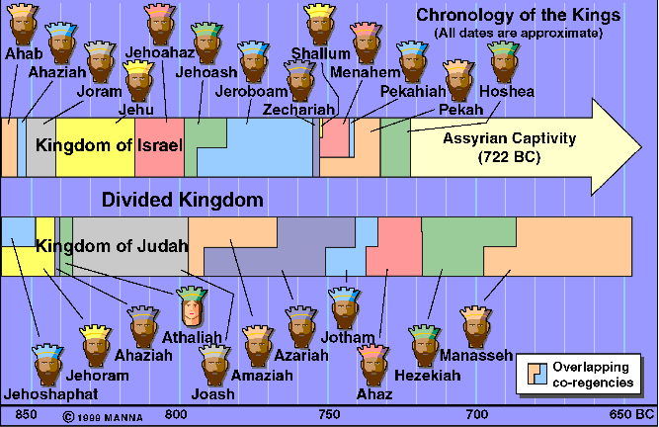

Slide 23
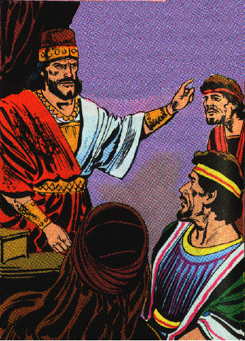
1. Elisha reveals Syrian troop movements 8-14
8 Now the king of Aram was warring against Israel; and he counseled with his servants saying, "In such and such a place shall be my camp."

Slide 24
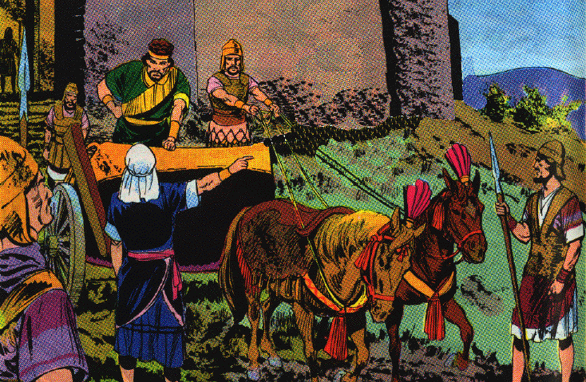
1. Elisha reveals Syrian troop movements 8-14
9 And the man of God sent word to the king of Israel saying, "Beware that you do not pass this place, for the Arameans are coming down there."
10 And the king of Israel sent to the place about which the man of God had told him; thus he warned him, so that he guarded himself there, more than once or twice.

Slide 25
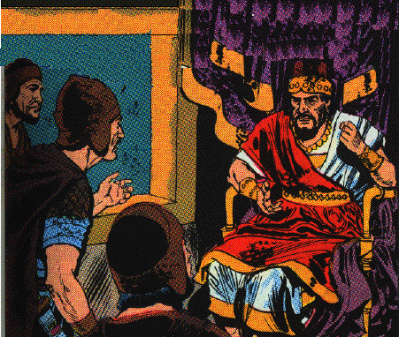
1. Elisha reveals Syrian troop movements 8-14
11 Now the heart of the king of Aram was enraged over this thing; and he called his servants and said to them, "Will you tell me which of us is for the king of Israel?"
12 And one of his servants said, "No, my lord, O king; but Elisha, the prophet who is in Israel, tells the king of Israel the words that you speak in your bedroom."

Slide 26
Lessons
1. A wicked Ben-hadad tried to outwit God and capture his prophet.
2. The wicked are secretive in their purposes.
3. The Lord knows their most secret words.
4. The revealing of the plans of the wicked will frustrate them.

Slide 27
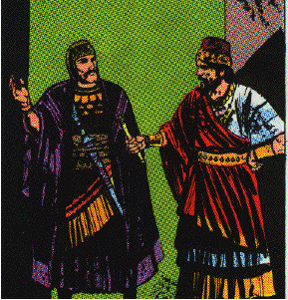
1. Elisha reveals Syrian troop movements 8-14
13 So he said, "Go and see where he is, that I may send and take him." And it was told him, saying, "Behold, he is in Dothan."
14 And he sent horses and chariots and a great army there, and they came by night and surrounded the city.

Slide 28
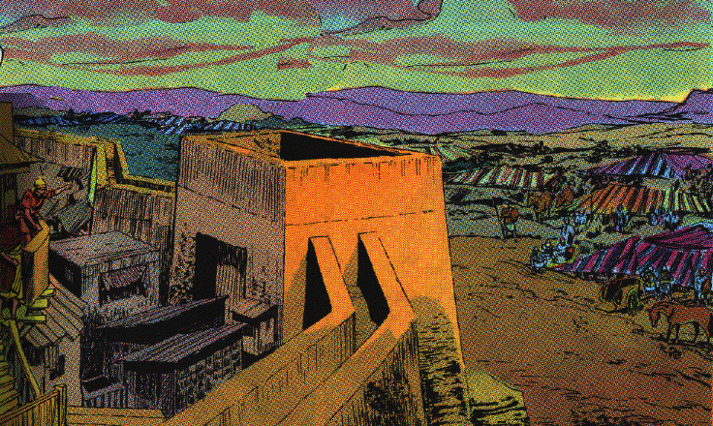
2. Elisha captures a great army of Syrians 15-19
15 Now when the attendant of the man of God had risen early and gone out, behold, an army with horses and chariots was circling the city. And his servant said to him, "Alas, my master! What shall we do?"
16 So he answered, "Do not fear, for those who are with us are more than those who are with them."

Slide 29
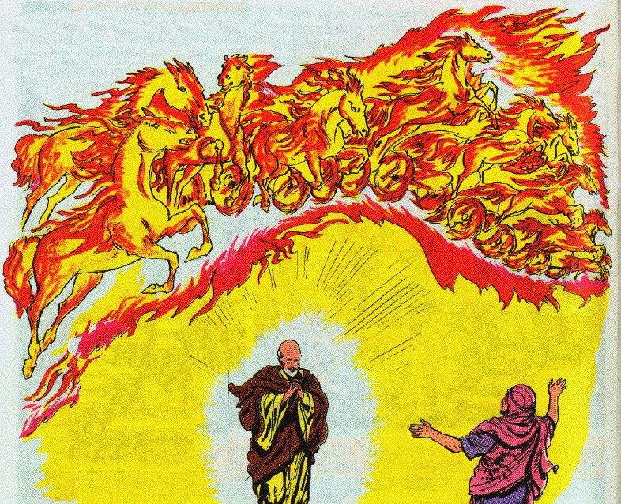
2. Elisha captures a great army of Syrians 15-19
17 Then Elisha prayed and said, "O LORD, I pray, open his eyes that he may see." And the LORD opened the servant’s eyes, and he saw; and behold, the mountain was full of horses and chariots of fire all around Elisha.

Slide 30
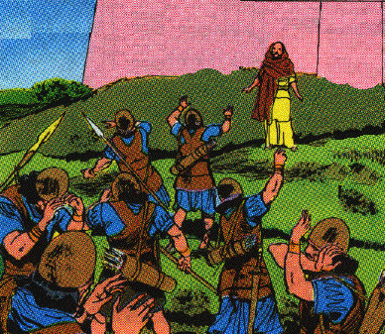
2. Elisha captures a great army of Syrians 15-19
18 And when they came down to him, Elisha prayed to the LORD and said, "Strike this people with blindness, I pray." So He struck them with blindness according to the word of Elisha.

Slide 31
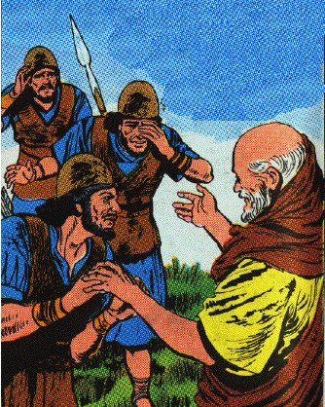
2. Elisha captures a great army of Syrians 15-19
19 Then Elisha said to them, "This is not the way, nor is this the city; follow me and I will bring you to the man whom you seek." And he brought them to Samaria.

Slide 32
Lessons
1. The spirit-world is a reality and is perpetual present, around us and about.
2. They encamp around the righteous, Ps. 34:7
3. Faithful people calmly trust God.
4. A miracle performed on the eyes of the servant to give them more power to see?
5. The enemies of God’s people forget or are ignorant that God is with them
6. It is good to be on God’s side
7. We should undertake great things for God
8. We should never allow ourselves to be daunted, or depressed by difficulties

Slide 33
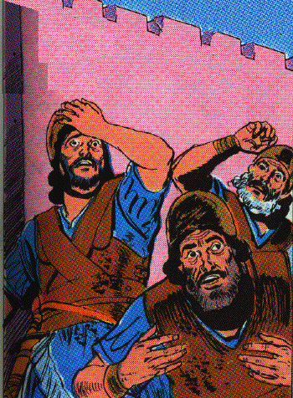
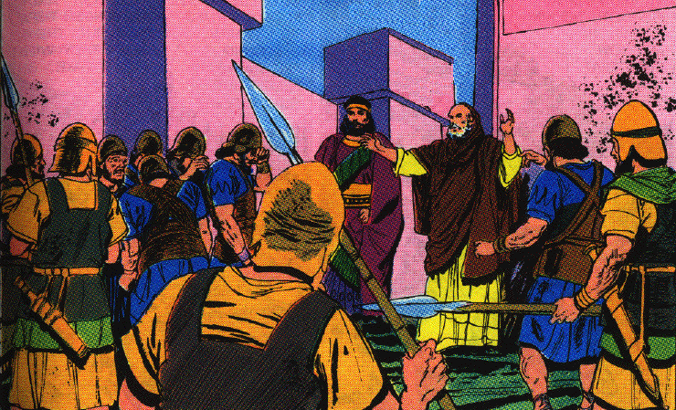
3. Elisha orders mercy, food & freedom be given to the Syrians 20-23
20 And it came about when they had come into Samaria, that Elisha said, "O LORD, open the eyes of these men, that they may see." So the LORD opened their eyes, and they saw; and behold, they were in the midst of Samaria.

Slide 34
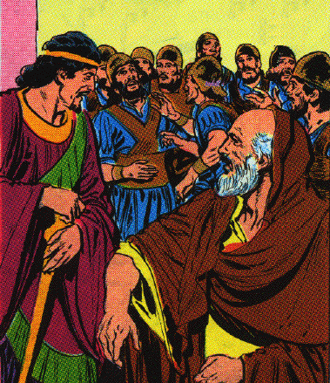
3. Elisha orders mercy, food & freedom be given to the Syrians 20-23
21 Then the king of Israel when he saw them, said to Elisha, "My father, shall I kill them? Shall I kill them?"
22 And he answered, "You shall not kill them. Would you kill those you have taken captive with your sword and with your bow? Set bread and water before them, that they may eat and drink and go to their master."

Slide 35
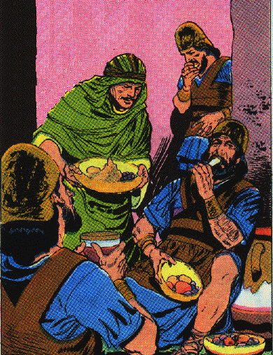
3. Elisha orders mercy, food & freedom be given to the Syrians 20-23
23 So he prepared a great feast for them; and when they had eaten and drunk he sent them away, and they went to their master. And the marauding bands of Arameans did not come again into the land of Israel.

Slide 36
Lessons
1. The king of Syria should believe in Jehovah and respect His people especially His prophet
2. The power of prayer. 3 prayers in this short account.
3. Overcome evil with good. feed your enemy

Slide 37
B. Three predictive miracles 6:24—8:15

Slide 38
1. Prediction of the deliverance for Samaria from a Syrian siege 6:24—7:1

Slide 39
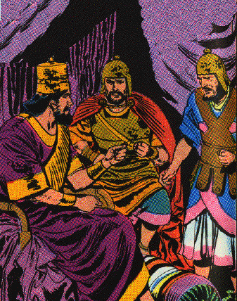
a. The sad plight of Samaria 6:24-30a
24 Now it came about after this, that Ben-hadad king of Aram gathered all his army and went up and besieged Samaria.

Slide 40
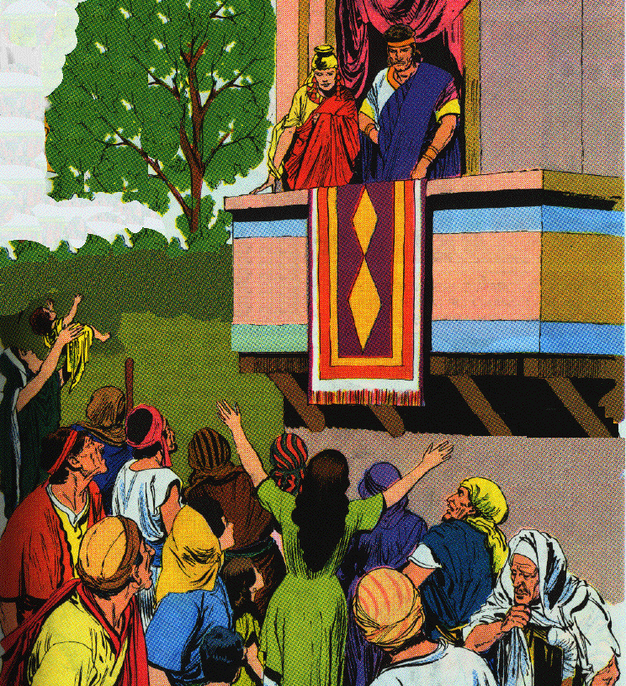
a. The sad plight of Samaria 6:24-30a
25 And there was a great famine in Samaria; and behold, they besieged it, until a donkey’s head was sold for eighty shekels of silver, and a fourth of a kab of dove’s dung for five shekels of silver.
26 And as the king of Israel was passing by on the wall a woman cried out to him, saying, "Help, my lord, O king!"
27 And he said, "If the LORD does not help you, from where shall I help you? From the threshing floor, or from the wine press?"

Slide 41
a. The sad plight of Samaria 6:24-30a
28 And the king said to her, "What is the matter with you?" And she answered, "This woman said to me, ‘Give your son that we may eat him today, and we will eat my son tomorrow.’
29 "So we boiled my son and ate him; and I said to her on the next day, ‘Give your son, that we may eat him’; but she has hidden her son."
30 And it came about when the king heard the words of the woman, that he tore his clothes

Slide 42
Lessons
1. The evil result of forsaking God
2. Deut. 28:53-57

Slide 43
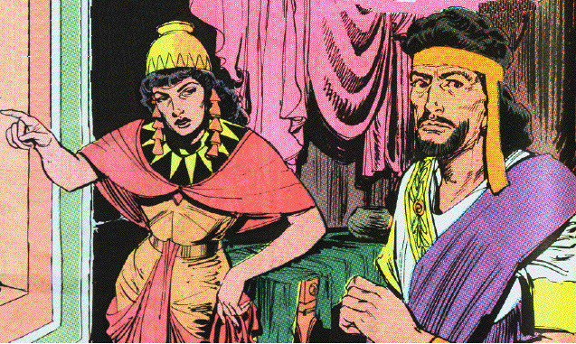
b. The personal jeopardy of Elisha 6:30b-33
30b --now he was passing by on the wall--and the people looked, and behold, he had sackcloth beneath on his body.
31 Then he said, "May God do so to me and more also, if the head of Elisha the son of Shaphat remains on him today."

Slide 44
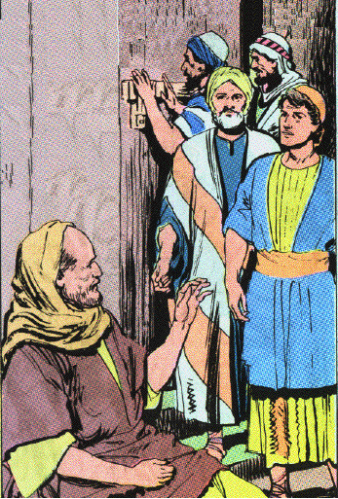
b. The personal jeopardy of Elisha 6:30b-33
32 Now Elisha was sitting in his house, and the elders were sitting with him. And the king sent a man from his presence; but before the messenger came to him, he said to the elders, "Do you see how this son of a murderer has sent to take away my head? Look, when the messenger comes, shut the door and hold the door shut against him. Is not the sound of his master’s feet behind him?"
33 And while he was still talking with them, behold, the messenger came down to him, and he said, "Behold, this evil is from the LORD; why should I wait for the LORD any longer?"

Slide 45
Lessons - Halfheartedness
1. Jehoram was double minded man & miserable for it. Listened to & respected Elisha but worshiped Baal and the calves
2. Wanted to repent secretly, & when discovered order the death of Elisha
3. Ordered the death of Elisha, then rushed after the servant to stop it
4. Calamity hardens the wicked
5. We need to wait on God a little longer

Slide 46
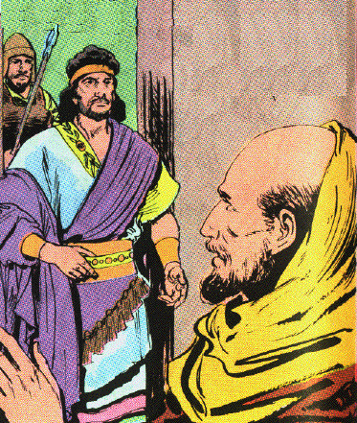
c. The dramatic prediction of the prophet 7:1-2
1 Then Elisha said, "Listen to the word of the LORD; thus says the LORD, ‘Tomorrow about this time a measure of fine flour shall be sold for a shekel, and two measures of barley for a shekel, in the gate of Samaria.’"
2 And the royal officer on whose hand the king was leaning answered the man of God and said, "Behold, if the LORD should make windows in heaven, could this thing be?" Then he said, "Behold you shall see it with your own eyes, but you shall not eat of it."

Slide 47
Lessons
1. No natural or human way to fulfill these words.
2. Unbelief may appear to have reason on its side.

Slide 48
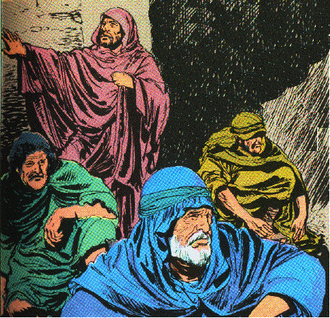
d. The joyous discovery of four lepers 7:3-11
3 Now there were four leprous men at the entrance of the gate; and they said to one another, "Why do we sit here until we die?

Slide 49
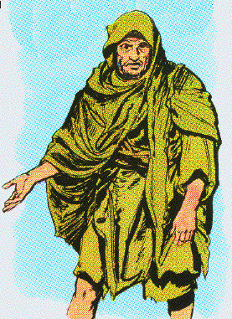
d. The joyous discovery of four lepers 7:3-11
4 "If we say, ‘We will enter the city,’ then the famine is in the city and we shall die there; and if we sit here, we die also. Now therefore come, and let us go over to the camp of the Arameans. If they spare us, we shall live; and if they kill us, we shall but die."

Slide 50
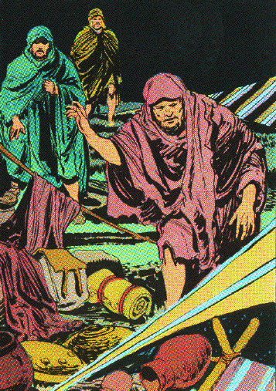
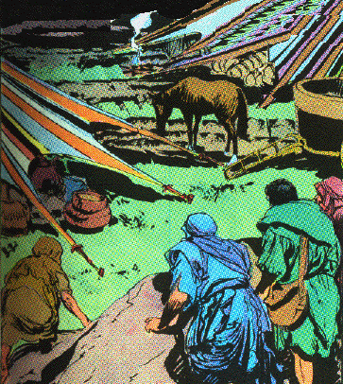
d. The joyous discovery of four lepers 7:3-11
5 And they arose at twilight to go to the camp of the Arameans; when they came to the outskirts of the camp of the Arameans, behold, there was no one there.

Slide 51
d. The joyous discovery of four lepers 7:3-11
6 For the Lord had caused the army of the Arameans to hear a sound of chariots and a sound of horses, even the sound of a great army, so that they said to one another, "Behold, the king of Israel has hired against us the kings of the Hittites and the kings of the Egyptians, to come upon us."
7 Therefore they arose and fled in the twilight, and left their tents and their horses and their donkeys, even the camp just as it was, and fled for their life.

Slide 52
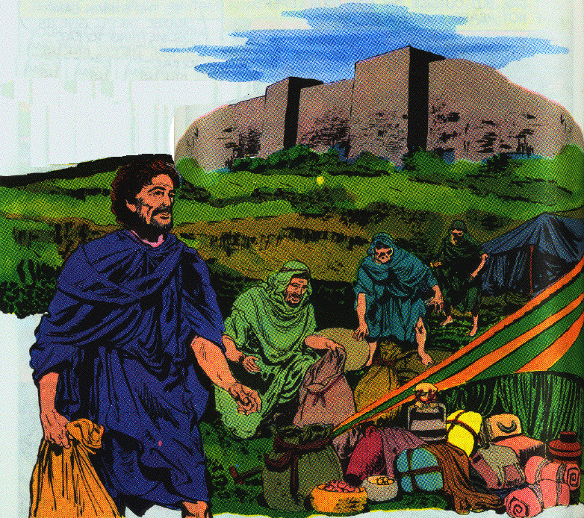
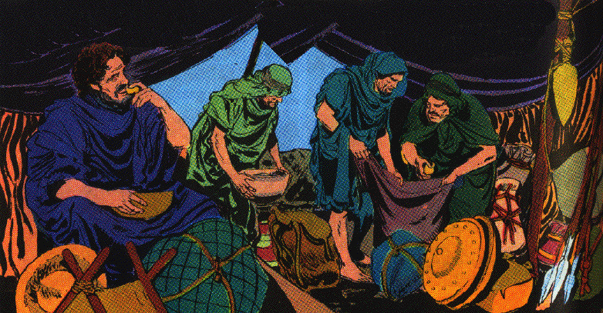
d. The joyous discovery of four lepers 7:3-11
8 When these lepers came to the outskirts of the camp, they entered one tent and ate and drank, and carried from there silver and gold and clothes, and went and hid them; and they returned and entered another tent and carried from there also, and went and hid them.

Slide 53
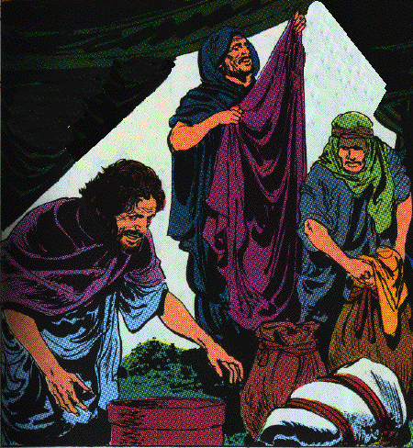
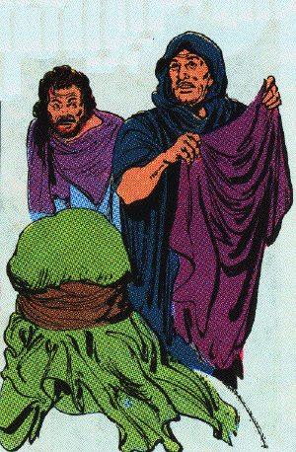
d. The joyous discovery of four lepers 7:3-11
9 Then they said to one another, "We are not doing right. This day is a day of good news, but we are keeping silent; if we wait until morning light, punishment will overtake us. Now therefore come, let us go and tell the king’s household."

Slide 54
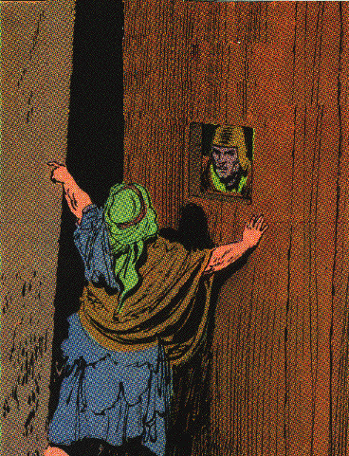
d. The joyous discovery of four lepers 7:3-11
10 So they came and called to the gatekeepers of the city, and they told them, saying, "We came to the camp of the Arameans, and behold, there was no one there, nor the voice of man, only the horses tied and the donkeys tied, and the tents just as they were."
11 And the gatekeepers called, and told it within the king’s household.

Slide 55
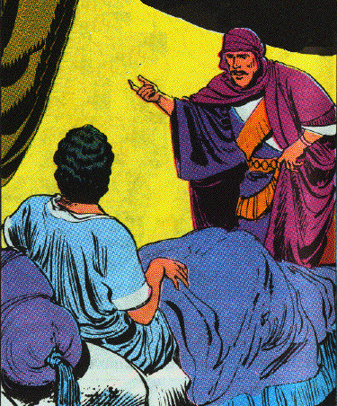
e. The cautious investigation by the king 7:12-15
12 Then the king arose in the night and said to his servants, "I will now tell you what the Arameans have done to us. They know that we are hungry; therefore they have gone from the camp to hide themselves in the field, saying, ‘When they come out of the city, we shall capture them alive and get into the city.’"
13 And one of his servants answered and said, "Please, let some men take five of the horses which remain, which are left in the city. Behold, they will be in any case like all the multitude of Israel who are left in it; behold, they will be in any case like all the multitude of Israel who have already perished, so let us send and see."

Slide 56
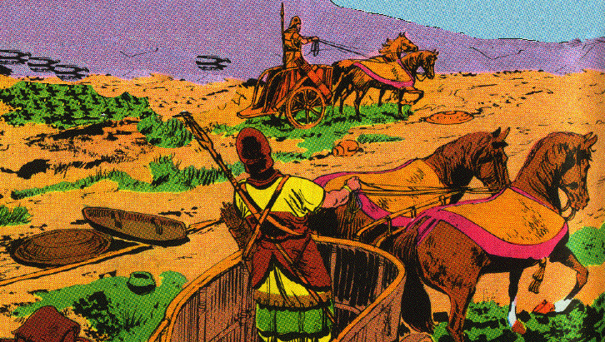
e. The cautious investigation by the king 7:12-15
14 They took therefore two chariots with horses, and the king sent after the army of the Arameans, saying, "Go and see."
15 And they went after them to the Jordan, and behold, all the way was full of clothes and equipment, which the Arameans had thrown away in their haste. Then the messengers returned and told the king.

Slide 57
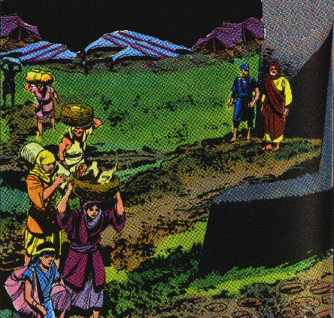
f. The literal fulfillment of Elisha’s prophecy 7:16-20
16 So the people went out and plundered the camp of the Arameans. Then a measure of fine flour was sold for a shekel and two measures of barley for a shekel, according to the word of the LORD.

Slide 58
f. The literal fulfillment of Elisha’s prophecy 7:16-20
17 Now the king appointed the royal officer on whose hand he leaned to have charge of the gate; but the people trampled on him at the gate, and he died just as the man of God had said, who spoke when the king came down to him.
18 And it came about just as the man of God had spoken to the king, saying, "Two measures of barley for a shekel and a measure of fine flour for a shekel, shall be sold tomorrow about this time at the gate of Samaria."
19 Then the royal officer answered the man of God and said, "Now behold, if the LORD should make windows in heaven, could such a thing be?" And he said, "Behold, you shall see it with your own eyes, but you shall not eat of it."
20 And so it happened to him, for the people trampled on him at the gate, and he died.

Slide 59
2. Prediction of a famine in Israel 8:1-6
1 Now Elisha spoke to the woman whose son he had restored to life, saying, "Arise and go with your household, and sojourn wherever you can sojourn; for the LORD has called for a famine, and it shall even come on the land for seven years."
2 So the woman arose and did according to the word of the man of God, and she went with her household and sojourned in the land of the Philistines seven years.
3 And it came about at the end of seven years, that the woman returned from the land of the Philistines; and she went out to appeal to the king for her house and for her field.

Slide 60
2. Prediction of a famine in Israel 8:1-6
4 Now the king was talking with Gehazi, the servant of the man of God, saying, "Please relate to me all the great things that Elisha has done."
5 And it came about, as he was relating to the king how he had restored to life the one who was dead, that behold, the woman whose son he had restored to life, appealed to the king for her house and for her field. And Gehazi said, "My lord, O king, this is the woman and this is her son, whom Elisha restored to life."
6 When the king asked the woman, she related it to him. So the king appointed for her a certain officer, saying, "Restore all that was hers and all the produce of the field from the day that she left the land even until now."

Slide 61
3. Prediction of the murderous carrier of Hazael 8:7-15
7 Then Elisha came to Damascus. Now Ben-hadad king of Aram was sick, and it was told him, saying, "The man of God has come here."
8 And the king said to Hazael, "Take a gift in your hand and go to meet the man of God, and inquire of the LORD by him, saying, ‘Will I recover from this sickness?’"
9 So Hazael went to meet him and took a gift in his hand, even every kind of good thing of Damascus, forty camels’ loads; and he came and stood before him and said, "Your son Ben-hadad king of Aram has sent me to you, saying, ‘Will I recover from this sickness?’"
10 Then Elisha said to him, "Go, say to him, ‘You shall surely recover,’ but the LORD has shown me that he will certainly die."

Slide 62
3. Prediction of the murderous carrier of Hazael 8:7-15
11 And he fixed his gaze steadily on him until he was ashamed, and the man of God wept.
12 And Hazael said, "Why does my lord weep?" Then he answered, "Because I know the evil that you will do to the sons of Israel: their strongholds you will set on fire, and their young men you will kill with the sword, and their little ones you will dash in pieces, and their women with child you will rip up."
13 Then Hazael said, "But what is your servant, who is but a dog, that he should do this great thing?" And Elisha answered, "The LORD has shown me that you will be king over Aram."
14 So he departed from Elisha and returned to his master, who said to him, "What did Elisha say to you?" And he answered, "He told me that you would surely recover."
15 And it came about on the morrow, that he took the cover and dipped it in water and spread it on his face, so that he died. And Hazael became king in his place.

Slide 63
Hazael the ancient king of Syria in Biblical archaeology

Slide 64
C. The reigns of two contemporary kings of Judah 8:16-29

Slide 66
1. The reign of Jehoram 8:16-24 (853/848-841 B.C.)
16 Now in the fifth year of Joram the son of Ahab king of Israel, Jehoshaphat being then the king of Judah, Jehoram the son of Jehoshaphat king of Judah became king.
17 He was thirty-two years old when he became king, and he reigned eight years in Jerusalem.
The Tel Dan Stela. Found at Tel Dan in Northern Israel in 1993, it is an inscription by Syrian overlords naming Jehoram and Ahaziah, both kings of the House of David. Once again, here is a reference made by a traditional enemy whose accuracy is therefore extremely credible.

Slide 67
1. The reign of Jehoram 8:16-24 (853/848-841 B.C.)
18 And he walked in the way of the kings of Israel, just as the house of Ahab had done, for the daughter of Ahab became his wife; and he did evil in the sight of the LORD.
[2 C 21:4 Now when Jehoram had taken over the kingdom of his father and made himself secure, he killed all his brothers with the sword, and some of the rulers of Israel also.
21:11 Moreover, he made high places in the mountains of Judah, and caused the inhabitants of Jerusalem to play the harlot and led Judah astray.]
19 However, the LORD was not willing to destroy Judah, for the sake of David His servant, since He had promised him to give a lamp to him through his sons always.

Slide 68
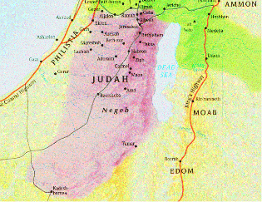
1. The reign of Jehoram 8:16-24 (853/848-841 B.C.)
20 In his days Edom revolted from under the hand of Judah, and made a king over themselves.
21 Then Joram crossed over to Zair, and all his chariots with him. And it came about that he arose by night and struck the Edomites who had surrounded him and the captains of the chariots; but his army fled to their tents.
22a So Edom revolted against Judah to this day.

Slide 69
1. The reign of Jehoram 8:16-24 (853/848-841 B.C.)
Letter From Elijah 2 C 21:12-15
12 Then a letter came to him from Elijah the prophet saying, "Thus says the LORD God of your father David, ‘Because you have not walked in the ways of Jehoshaphat your father and the ways of Asa king of Judah,
13 but have walked in the way of the kings of Israel, and have caused Judah and the inhabitants of Jerusalem to play the harlot as the house of Ahab played the harlot, and you have also killed your brothers, your own family, who were better than you,
14 behold, the LORD is going to strike your people, your sons, your wives, and all your possessions with a great calamity;
15 and you will suffer severe sickness, a disease of your bowels, until your bowels come out because of the sickness, day by day.’"

Slide 70
1. The reign of Jehoram 8:16-24 (853/848-841 B.C.)
22b Then Libnah revolted at the same time.
[2 C 21:16-17
16 Then the LORD stirred up against Jehoram the spirit of the Philistines and the Arabs who bordered the Ethiopians;
17 and they came against Judah and invaded it, and carried away all the possessions found in the king’s house together with his sons and his wives, so that no son was left to him except Jehoahaz, the youngest of his sons. ]
.
Libnah

Slide 71
1. The reign of Jehoram 8:16-24 (853/848-841 B.C.)
23 And the rest of the acts of Joram and all that he did, are they not written in the Book of the Chronicles of the Kings of Judah?
24 So Joram slept with his fathers, and was buried with his fathers in the city of David; and Ahaziah his son became king in his place.
[2 C 21:18-20
18 So after all this the LORD smote him in his bowels with an incurable sickness.
19 Now it came about in the course of time, at the end of two years, that his bowels came out because of his sickness and he died in great pain. And his people made no fire for him like the fire for his fathers.
20 He was thirty-two years old when he became king, and he reigned in Jerusalem eight years; and he departed with no one’s regret, and they buried him in the city of David, but not in the tombs of the kings.]

Slide 72
2. The reign of Ahaziah 25-29
25 In the twelfth year of Joram the son of Ahab king of Israel, Ahaziah the son of Jehoram king of Judah began to reign.
26 Ahaziah was twenty-two years old when he became king, and he reigned one year in Jerusalem. And his mother’s name was Athaliah the granddaughter of Omri king of Israel.
27 And he walked in the way of the house of Ahab, and did evil in the sight of the LORD, like the house of Ahab had done, because he was a son-in-law of the house of Ahab.
28 Then he went with Joram the son of Ahab to war against Hazael king of Aram at Ramoth-gilead, and the Arameans wounded Joram.
29 So King Joram returned to be healed in Jezreel of the wounds which the Arameans had inflicted on him at Ramah, when he fought against Hazael king of Aram. Then Ahaziah the son of Jehoram king of Judah went down to see Joram the son of Ahab in Jezreel because he was sick.

