Slide 1
X. Elisha and the Syrians 2 Kings 6:8—8:29

Slide 2
A. Elisha’s patriotic miracles 6:8-23

Slide 3
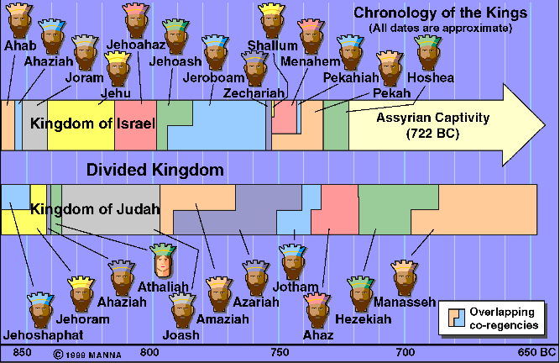

Slide 4
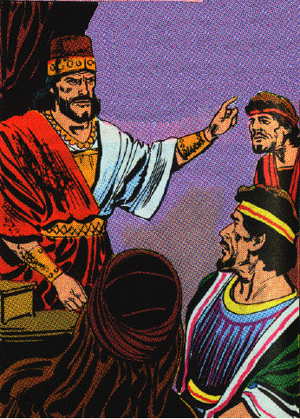
1. Elisha reveals Syrian troop movements 8-14
8 Now the king of Aram was warring against Israel; and he counseled with his servants saying, "In such and such a place shall be my camp."

Slide 5
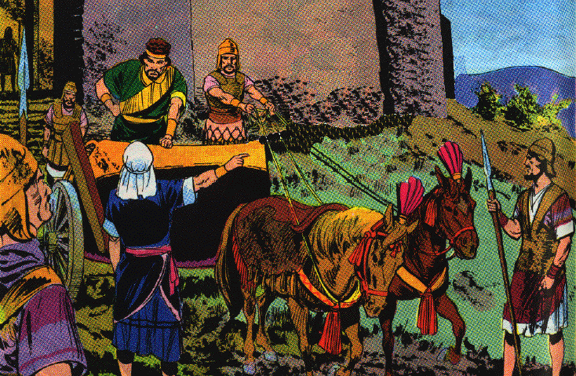
1. Elisha reveals Syrian troop movements 8-14
9 And the man of God sent word to the king of Israel saying, "Beware that you do not pass this place, for the Arameans are coming down there."
10 And the king of Israel sent to the place about which the man of God had told him; thus he warned him, so that he guarded himself there, more than once or twice.

Slide 6
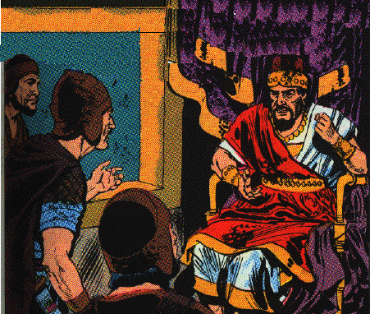
1. Elisha reveals Syrian troop movements 8-14
11 Now the heart of the king of Aram was enraged over this thing; and he called his servants and said to them, "Will you tell me which of us is for the king of Israel?"
12 And one of his servants said, "No, my lord, O king; but Elisha, the prophet who is in Israel, tells the king of Israel the words that you speak in your bedroom."

Slide 7
Lessons
1. A wicked Ben-hadad tried to outwit God & capture his prophet.
2. The wicked are secretive in their purposes.
3. The Lord knows their most secret words.
4. The revealing of the plans of the wicked will frustrate them.

Slide 8
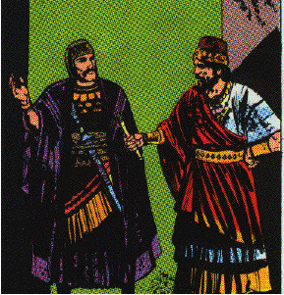
1. Elisha reveals Syrian troop movements 8-14
13 So he said, "Go and see where he is, that I may send and take him." And it was told him, saying, "Behold, he is in Dothan."
14 And he sent horses and chariots and a great army there, and they came by night and surrounded the city.

Slide 9
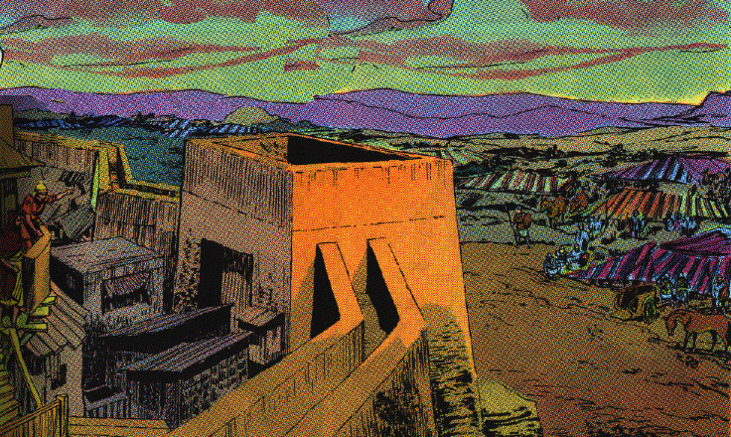
2. Elisha captures a great army of Syrians 15-19
15 Now when the attendant of the man of God had risen early and gone out, behold, an army with horses and chariots was circling the city. And his servant said to him, "Alas, my master! What shall we do?"
16 So he answered, "Do not fear, for those who are with us are more than those who are with them."

Slide 10
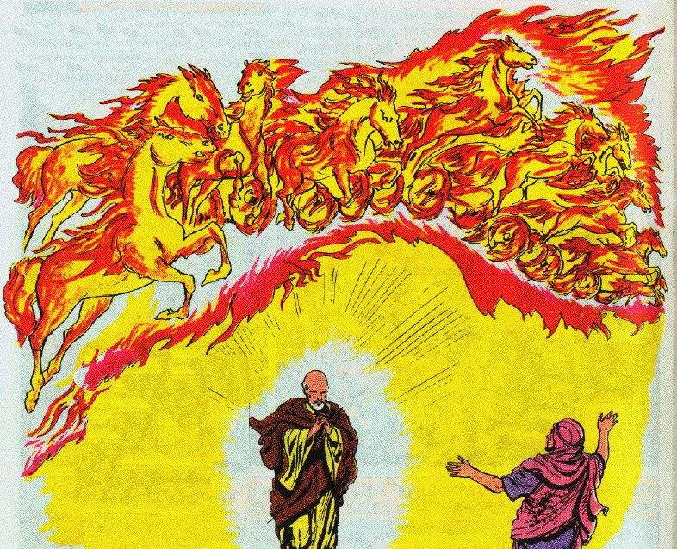
2. Elisha captures a great army of Syrians 15-19
17 Then Elisha prayed and said, "O LORD, I pray, open his eyes that he may see." And the LORD opened the servant’s eyes, and he saw; and behold, the mountain was full of horses and chariots of fire all around Elisha.

Slide 11
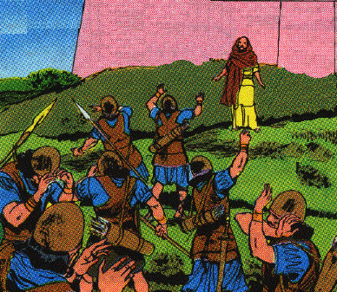
2. Elisha captures a great army of Syrians 15-19
18 And when they came down to him, Elisha prayed to the LORD and said, "Strike this people with blindness, I pray." So He struck them with blindness according to the word of Elisha.

Slide 12
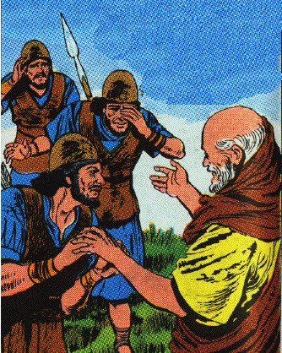
2. Elisha captures a great army of Syrians 15-19
19 Then Elisha said to them, "This is not the way, nor is this the city; follow me and I will bring you to the man whom you seek." And he brought them to Samaria.

Slide 13
Lessons
1. The spirit-world is a reality & is perpetual present, around us & about.
2. They encamp around the righteous, Ps. 34:7
3. Faithful people calmly trust God.
4. A miracle performed on the eyes of the servant to give them more power to see?
5. The enemies of God’s people forget or are ignorant that God is with them
6. It is good to be on God’s side
7. We should undertake great things for God
8. We should never allow ourselves to be daunted, or depressed by difficulties

Slide 14
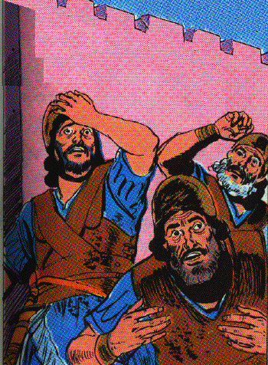
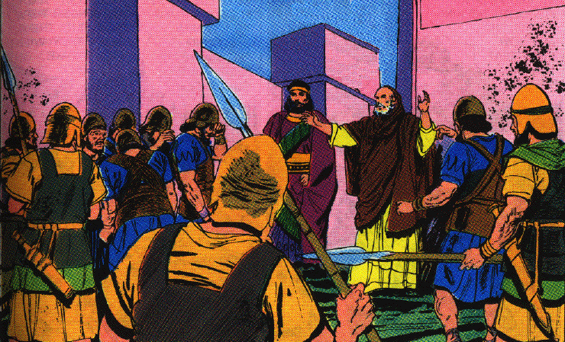
3. Elisha orders mercy, food & freedom be given to the Syrians 20-23
20 And it came about when they had come into Samaria, that Elisha said, "O LORD, open the eyes of these men, that they may see." So the LORD opened their eyes, and they saw; and behold, they were in the midst of Samaria.

Slide 15
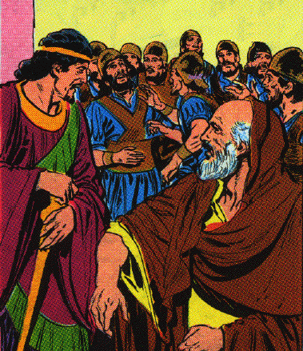
3. Elisha orders mercy, food & freedom be given to the Syrians 20-23
21 Then the king of Israel when he saw them, said to Elisha, "My father, shall I kill them? Shall I kill them?"
22 And he answered, "You shall not kill them. Would you kill those you have taken captive with your sword and with your bow? Set bread and water before them, that they may eat and drink and go to their master."

Slide 16
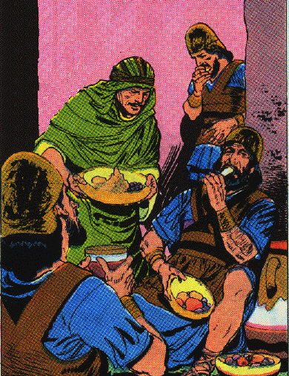
3. Elisha orders mercy, food & freedom be given to the Syrians 20-23
23 So he prepared a great feast for them; and when they had eaten and drunk he sent them away, and they went to their master. And the marauding bands of Arameans did not come again into the land of Israel.

Slide 17
Lessons
1. The king of Syria should believe in Jehovah and respect His people especially His prophet
2. The power of prayer. 3 prayers in this short account.
3. Overcome evil with good. feed your enemy

Slide 18
B. Three predictive miracles 6:24—8:15

Slide 19
1. Prediction of the deliverance for Samaria from a Syrian siege 6:24—7:1

Slide 20
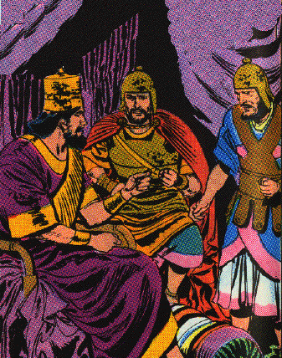
a. The sad plight of Samaria 6:24-30a
24 Now it came about after this, that Ben-hadad king of Aram gathered all his army and went up and besieged Samaria.

Slide 21
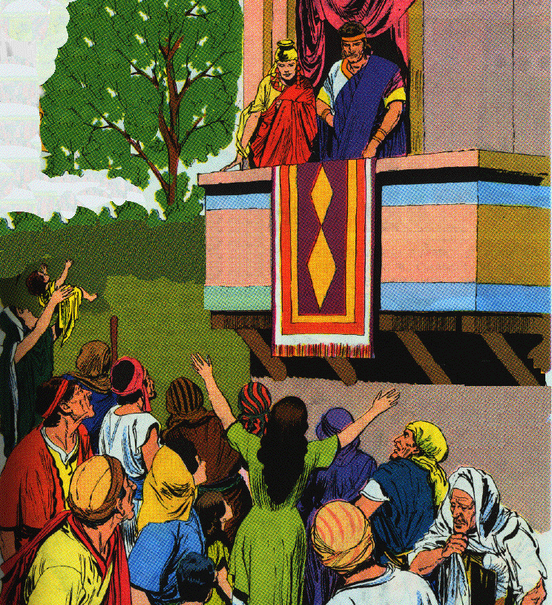
a. The sad plight of Samaria 6:24-30a
25 And there was a great famine in Samaria; and behold, they besieged it, until a donkey’s head was sold for eighty shekels of silver, and a fourth of a kab of dove’s dung for five shekels of silver.
26 And as the king of Israel was passing by on the wall a woman cried out to him, saying, "Help, my lord, O king!"
27 And he said, "If the LORD does not help you, from where shall I help you? From the threshing floor, or from the wine press?"

Slide 22
a. The sad plight of Samaria 6:24-30a
28 And the king said to her, "What is the matter with you?" And she answered, "This woman said to me, ‘Give your son that we may eat him today, and we will eat my son tomorrow.’
29 "So we boiled my son and ate him; and I said to her on the next day, ‘Give your son, that we may eat him’; but she has hidden her son."
30 And it came about when the king heard the words of the woman, that he tore his clothes

Slide 23
Lessons
1. The evil result of forsaking God
2. Deut. 28:53-57

Slide 24
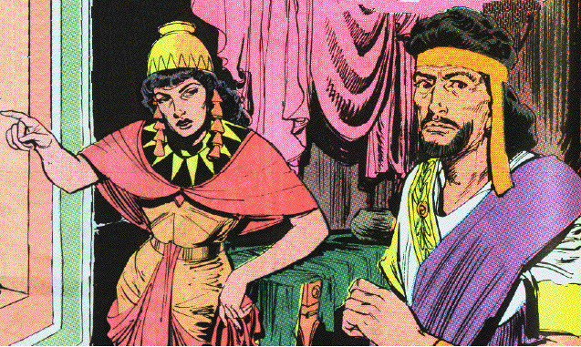
b. The personal jeopardy of Elisha 6:30b-33
30b --now he was passing by on the wall--and the people looked, and behold, he had sackcloth beneath on his body.
31 Then he said, "May God do so to me and more also, if the head of Elisha the son of Shaphat remains on him today."

Slide 25
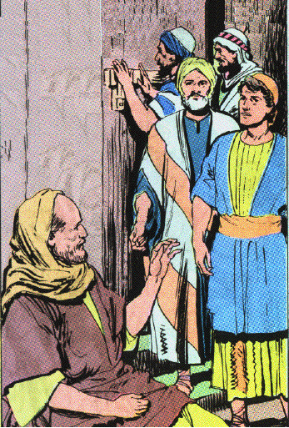
b. The personal jeopardy of Elisha 6:30b-33
32 Now Elisha was sitting in his house, and the elders were sitting with him. And the king sent a man from his presence; but before the messenger came to him, he said to the elders, "Do you see how this son of a murderer has sent to take away my head? Look, when the messenger comes, shut the door and hold the door shut against him. Is not the sound of his master’s feet behind him?"
33 And while he was still talking with them, behold, the messenger came down to him, and he said, "Behold, this evil is from the LORD; why should I wait for the LORD any longer?"

Slide 26
Lessons - Halfheartedness
1. Jehoram was double minded man & miserable for it. Listened to & respected Elisha but worshiped Baal & the calves
2. Wanted to repent secretly, & when discovered order the death of Elisha
3. Ordered the death of Elisha, then rushed after the servant to stop it
4. Calamity hardens the wicked
5. We need to wait on God a little longer

Slide 27
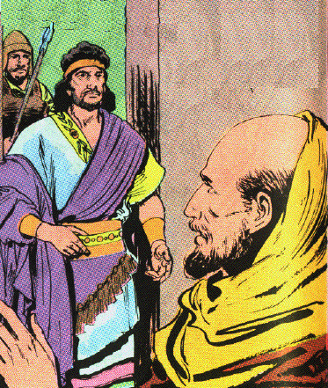
c. The dramatic prediction of the prophet 7:1-2
1 Then Elisha said, "Listen to the word of the LORD; thus says the LORD, ‘Tomorrow about this time a measure of fine flour shall be sold for a shekel, and two measures of barley for a shekel, in the gate of Samaria.’"
2 And the royal officer on whose hand the king was leaning answered the man of God and said, "Behold, if the LORD should make windows in heaven, could this thing be?" Then he said, "Behold you shall see it with your own eyes, but you shall not eat of it."

Slide 28
Lessons
1. No natural or human way to fulfill these words.
2. Unbelief may appear to have reason on its side.

Slide 29
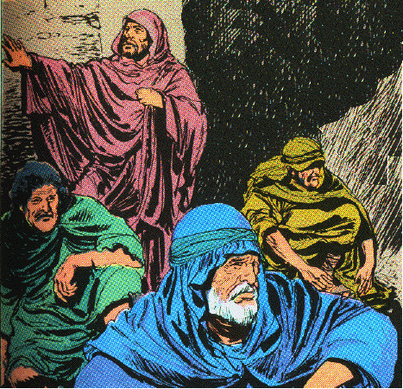
d. The joyous discovery of four lepers 7:3-11
3 Now there were four leprous men at the entrance of the gate; and they said to one another, "Why do we sit here until we die?

Slide 30
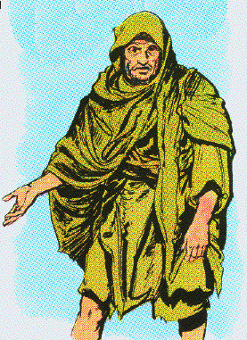
d. The joyous discovery of four lepers 7:3-11
4 "If we say, ‘We will enter the city,’ then the famine is in the city and we shall die there; and if we sit here, we die also. Now therefore come, and let us go over to the camp of the Arameans. If they spare us, we shall live; and if they kill us, we shall but die."

Slide 31
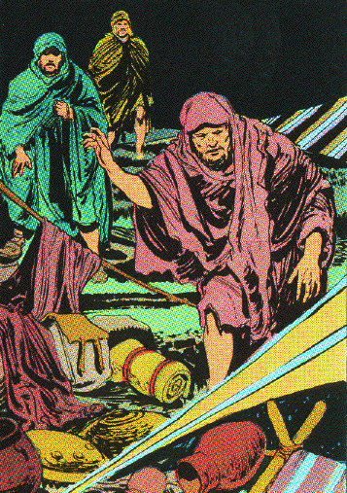
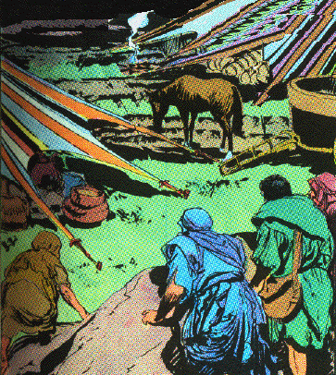
d. The joyous discovery of four lepers 7:3-11
5 And they arose at twilight to go to the camp of the Arameans; when they came to the outskirts of the camp of the Arameans, behold, there was no one there.

Slide 32
d. The joyous discovery of four lepers 7:3-11
6 For the Lord had caused the army of the Arameans to hear a sound of chariots and a sound of horses, even the sound of a great army, so that they said to one another, "Behold, the king of Israel has hired against us the kings of the Hittites and the kings of the Egyptians, to come upon us."
7 Therefore they arose and fled in the twilight, and left their tents and their horses and their donkeys, even the camp just as it was, and fled for their life.

Slide 33
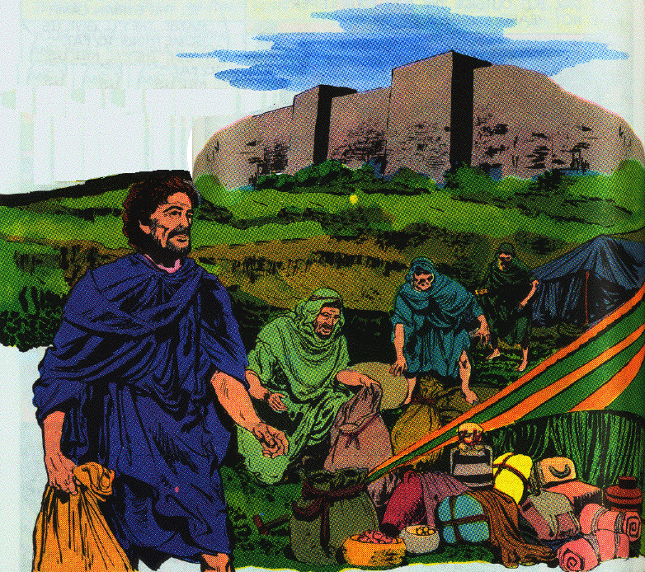
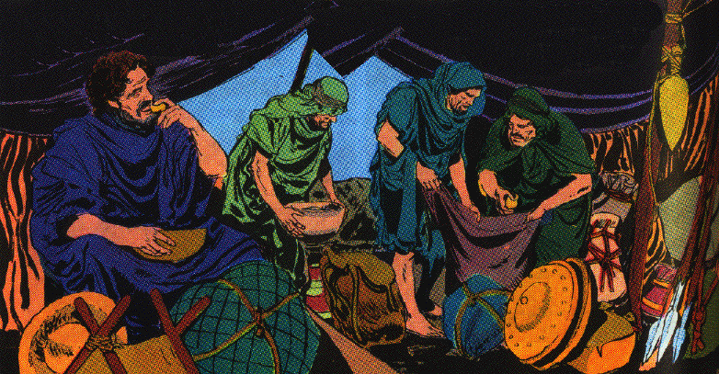
d. The joyous discovery of four lepers 7:3-11
8 When these lepers came to the outskirts of the camp, they entered one tent and ate and drank, and carried from there silver and gold and clothes, and went and hid them; and they returned and entered another tent and carried from there also, and went and hid them.

Slide 34
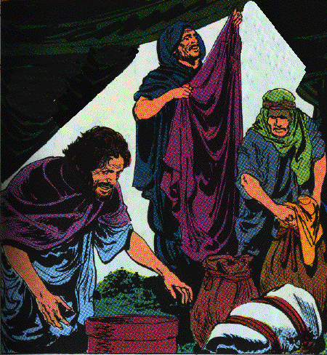
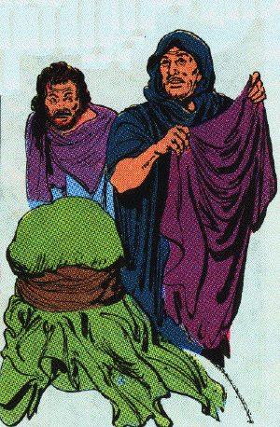
d. The joyous discovery of four lepers 7:3-11
9 Then they said to one another, "We are not doing right. This day is a day of good news, but we are keeping silent; if we wait until morning light, punishment will overtake us. Now therefore come, let us go and tell the king’s household."

Slide 35
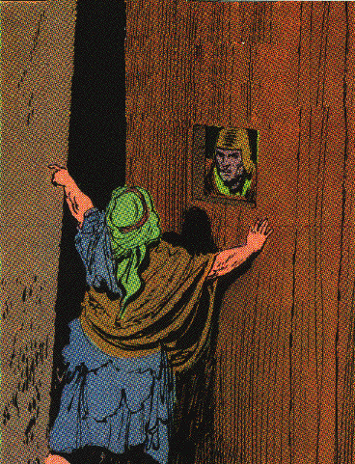
d. The joyous discovery of four lepers 7:3-11
10 So they came and called to the gatekeepers of the city, and they told them, saying, "We came to the camp of the Arameans, and behold, there was no one there, nor the voice of man, only the horses tied and the donkeys tied, and the tents just as they were."
11 And the gatekeepers called, and told it within the king’s household.

Slide 36
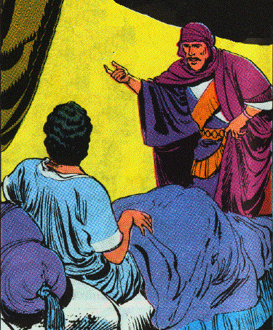
e. The cautious investigation by the king 7:12-15
12 Then the king arose in the night and said to his servants, "I will now tell you what the Arameans have done to us. They know that we are hungry; therefore they have gone from the camp to hide themselves in the field, saying, ‘When they come out of the city, we shall capture them alive and get into the city.’"
13 And one of his servants answered and said, "Please, let some men take five of the horses which remain, which are left in the city. Behold, they will be in any case like all the multitude of Israel who are left in it; behold, they will be in any case like all the multitude of Israel who have already perished, so let us send and see."

Slide 37
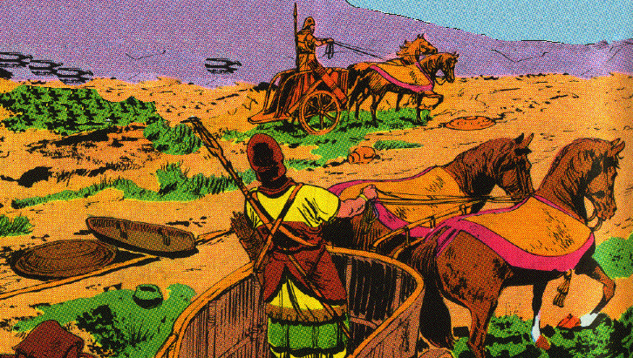
e. The cautious investigation by the king 7:12-15
14 They took therefore two chariots with horses, and the king sent after the army of the Arameans, saying, "Go and see."
15 And they went after them to the Jordan, and behold, all the way was full of clothes and equipment, which the Arameans had thrown away in their haste. Then the messengers returned and told the king.

Slide 38
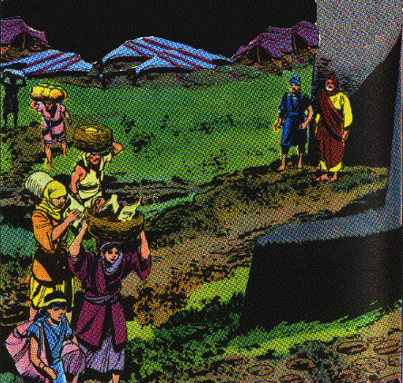
f. The literal fulfillment of Elisha’s prophecy 7:16-20
16 So the people went out and plundered the camp of the Arameans. Then a measure of fine flour was sold for a shekel and two measures of barley for a shekel, according to the word of the LORD.

Slide 39
f. The literal fulfillment of Elisha’s prophecy 7:16-20
17 Now the king appointed the royal officer on whose hand he leaned to have charge of the gate; but the people trampled on him at the gate, and he died just as the man of God had said, who spoke when the king came down to him.
18 And it came about just as the man of God had spoken to the king, saying, "Two measures of barley for a shekel and a measure of fine flour for a shekel, shall be sold tomorrow about this time at the gate of Samaria."
19 Then the royal officer answered the man of God and said, "Now behold, if the LORD should make windows in heaven, could such a thing be?" And he said, "Behold, you shall see it with your own eyes, but you shall not eat of it."
20 And so it happened to him, for the people trampled on him at the gate, and he died.

Slide 40
2. Prediction of a famine in Israel 8:1-6
1 Now Elisha spoke to the woman whose son he had restored to life, saying, "Arise and go with your household, and sojourn wherever you can sojourn; for the LORD has called for a famine, and it shall even come on the land for seven years."
2 So the woman arose and did according to the word of the man of God, and she went with her household and sojourned in the land of the Philistines seven years.
3 And it came about at the end of seven years, that the woman returned from the land of the Philistines; and she went out to appeal to the king for her house and for her field.

Slide 41
2. Prediction of a famine in Israel 8:1-6
4 Now the king was talking with Gehazi, the servant of the man of God, saying, "Please relate to me all the great things that Elisha has done."
5 And it came about, as he was relating to the king how he had restored to life the one who was dead, that behold, the woman whose son he had restored to life, appealed to the king for her house and for her field. And Gehazi said, "My lord, O king, this is the woman and this is her son, whom Elisha restored to life."
6 When the king asked the woman, she related it to him. So the king appointed for her a certain officer, saying, "Restore all that was hers and all the produce of the field from the day that she left the land even until now."

Slide 42
3. Prediction of the murderous carrier of Hazael 8:7-15
7 Then Elisha came to Damascus. Now Ben-hadad king of Aram was sick, and it was told him, saying, "The man of God has come here."
8 And the king said to Hazael, "Take a gift in your hand and go to meet the man of God, and inquire of the LORD by him, saying, ‘Will I recover from this sickness?’"
9 So Hazael went to meet him and took a gift in his hand, even every kind of good thing of Damascus, forty camels’ loads; and he came and stood before him and said, "Your son Ben-hadad king of Aram has sent me to you, saying, ‘Will I recover from this sickness?’"
10 Then Elisha said to him, "Go, say to him, ‘You shall surely recover,’ but the LORD has shown me that he will certainly die."

Slide 43
3. Prediction of the murderous carrier of Hazael 8:7-15
11 And he fixed his gaze steadily on him until he was ashamed, and the man of God wept.
12 And Hazael said, "Why does my lord weep?" Then he answered, "Because I know the evil that you will do to the sons of Israel: their strongholds you will set on fire, and their young men you will kill with the sword, and their little ones you will dash in pieces, and their women with child you will rip up."
13 Then Hazael said, "But what is your servant, who is but a dog, that he should do this great thing?" And Elisha answered, "The LORD has shown me that you will be king over Aram."

Slide 44
3. Prediction of the murderous carrier of Hazael 8:7-15
14 So he departed from Elisha and returned to his master, who said to him, "What did Elisha say to you?" And he answered, "He told me that you would surely recover."
15 And it came about on the morrow, that he took the cover and dipped it in water and spread it on his face, so that he died. And Hazael became king in his place.

Slide 45
Hazael the ancient king of Syria in Biblical archaeology

Slide 46
C. The reigns of two contemporary kings of Judah 8:16-29

Slide 48
Israel
Ahaziah
Omri
Ahab
Joram
885
874
869
853
848
841
Judah
Asa
Jehoshaphat
Jehoram
Ahaziah

Slide 49
1. The reign of Jehoram 8:16-24 (853/848-841 B.C.)
16 Now in the fifth year of Joram the son of Ahab king of Israel, Jehoshaphat being then the king of Judah, Jehoram the son of Jehoshaphat king of Judah became king.
17 He was thirty-two years old when he became king, and he reigned eight years in Jerusalem.
The Tel Dan Stela. Found at Tel Dan in Northern Israel in 1993, it is an inscription by Syrian overlords naming Jehoram and Ahaziah, both kings of the House of David. Once again, here is a reference made by a traditional enemy whose accuracy is therefore extremely credible.

Slide 50
1. The reign of Jehoram 8:16-24 (853/848-841 B.C.)
18 And he walked in the way of the kings of Israel, just as the house of Ahab had done, for the daughter of Ahab became his wife; and he did evil in the sight of the LORD.
[2 C 21:4 Now when Jehoram had taken over the kingdom of his father and made himself secure, he killed all his brothers with the sword, and some of the rulers of Israel also.
21:11 Moreover, he made high places in the mountains of Judah, and caused the inhabitants of Jerusalem to play the harlot and led Judah astray.]
19 However, the LORD was not willing to destroy Judah, for the sake of David His servant, since He had promised him to give a lamp to him through his sons always.

Slide 51
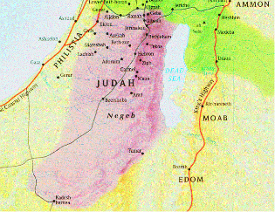
1. The reign of Jehoram 8:16-24 (853/848-841 B.C.)
20 In his days Edom revolted from under the hand of Judah, and made a king over themselves.
21 Then Joram crossed over to Zair, and all his chariots with him. And it came about that he arose by night and struck the Edomites who had surrounded him and the captains of the chariots; but his army fled to their tents.
22a So Edom revolted against Judah to this day.

Slide 52
1. The reign of Jehoram 8:16-24 (853/848-841 B.C.)
Letter From Elijah 2 C 21:12-15
12 Then a letter came to him from Elijah the prophet saying, "Thus says the LORD God of your father David, ‘Because you have not walked in the ways of Jehoshaphat your father and the ways of Asa king of Judah,
13 but have walked in the way of the kings of Israel, and have caused Judah and the inhabitants of Jerusalem to play the harlot as the house of Ahab played the harlot, and you have also killed your brothers, your own family, who were better than you,
14 behold, the LORD is going to strike your people, your sons, your wives, and all your possessions with a great calamity;
15 and you will suffer severe sickness, a disease of your bowels, until your bowels come out because of the sickness, day by day.’"

Slide 53
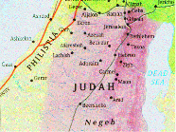
1. The reign of Jehoram 8:16-24 (853/848-841 B.C.)
22b Then Libnah revolted at the same time.
[2 C 21:16-17
16 Then the LORD stirred up against Jehoram the spirit of the Philistines and the Arabs who bordered the Ethiopians;
17 and they came against Judah and invaded it, and carried away all the possessions found in the king’s house together with his sons and his wives, so that no son was left to him except Jehoahaz, the youngest of his sons. ]
.
Libnah

Slide 54
1. The reign of Jehoram 8:16-24 (853/848-841 B.C.)
23 And the rest of the acts of Joram and all that he did, are they not written in the Book of the Chronicles of the Kings of Judah?
24 So Joram slept with his fathers, and was buried with his fathers in the city of David; and Ahaziah his son became king in his place.
[2 C 21:18-20
18 So after all this the LORD smote him in his bowels with an incurable sickness.
19 Now it came about in the course of time, at the end of two years, that his bowels came out because of his sickness and he died in great pain. And his people made no fire for him like the fire for his fathers.
20 He was thirty-two years old when he became king, and he reigned in Jerusalem eight years; and he departed with no one’s regret, and they buried him in the city of David, but not in the tombs of the kings.]

Slide 55
2. The reign of Ahaziah 25-29
25 In the twelfth year of Joram the son of Ahab king of Israel, Ahaziah the son of Jehoram king of Judah began to reign.
26 Ahaziah was twenty-two years old when he became king, and he reigned one year in Jerusalem. And his mother’s name was Athaliah the granddaughter of Omri king of Israel.
27 And he walked in the way of the house of Ahab, and did evil in the sight of the LORD, like the house of Ahab had done, because he was a son-in-law of the house of Ahab.
28 Then he went with Joram the son of Ahab to war against Hazael king of Aram at Ramoth-gilead, and the Arameans wounded Joram.
29 So King Joram returned to be healed in Jezreel of the wounds which the Arameans had inflicted on him at Ramah, when he fought against Hazael king of Aram. Then Ahaziah the son of Jehoram king of Judah went down to see Joram the son of Ahab in Jezreel because he was sick.

Slide 56
X. The Revolution of 841 B.C. 2 K 9—10:28
A. The Anointing of Jehu 9:1-13

Slide 57
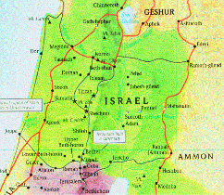

Slide 58
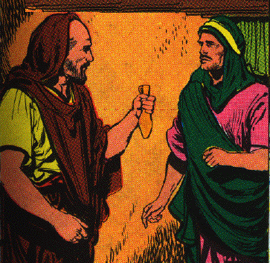
1. Anointed by a prophet sent from Elisha 9:1-10
1 Now Elisha the prophet called one of the sons of the prophets, and said to him, "Gird up your loins, and take this flask of oil in your hand, and go to Ramoth-gilead.
2 "When you arrive there, search out Jehu the son of Jehoshaphat the son of Nimshi, and go in and bid him arise from among his brothers, and bring him to an inner room.
3 "Then take the flask of oil and pour it on his head and say, ‘Thus says the LORD, "I have anointed you king over Israel."’ Then open the door and flee and do not wait."

Slide 59
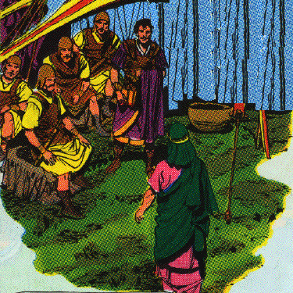
1. Anointed by a prophet sent from Elisha 9:1-10
4 So the young man, the servant of the prophet, went to Ramoth-gilead.
5 When he came, behold, the captains of the army were sitting, and he said, "I have a word for you, O captain." And Jehu said, "For which one of us?" And he said, "For you, O captain."

Slide 60
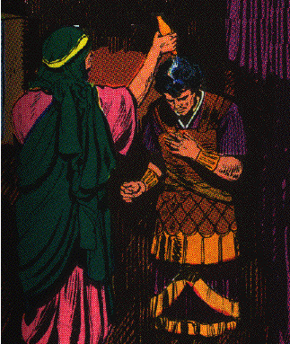
1. Anointed by a prophet sent from Elisha 9:1-10
6 And he arose and went into the house, and he poured the oil on his head and said to him, "Thus says the LORD, the God of Israel, ‘I have anointed you king over the people of the LORD, even over Israel.

Slide 61
1. Anointed by a prophet sent from Elisha 9:1-10
7 ‘And you shall strike the house of Ahab your master, that I may avenge the blood of My servants the prophets, and the blood of all the servants of the LORD, at the hand of Jezebel.
8 ‘For the whole house of Ahab shall perish, and I will cut off from Ahab every male person both bond and free in Israel.
9 ‘And I will make the house of Ahab like the house of Jeroboam the son of Nebat, and like the house of Baasha the son of Ahijah.
10 ‘And the dogs shall eat Jezebel in the territory of Jezreel, and none shall bury her.’ "Then he opened the door and fled.

Slide 62
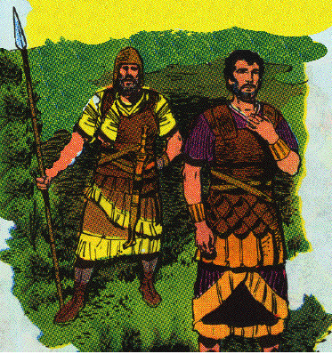
2. Acclaimed king by his fellow officers 9:11-13
11 Now Jehu came out to the servants of his master, and one said to him, "Is all well? Why did this mad fellow come to you?" And he said to them, "You know very well the man and his talk."
12 And they said, "It is a lie, tell us now." And he said, "Thus and thus he said to me, ‘Thus says the LORD, "I have anointed you king over Israel."’"

Slide 63
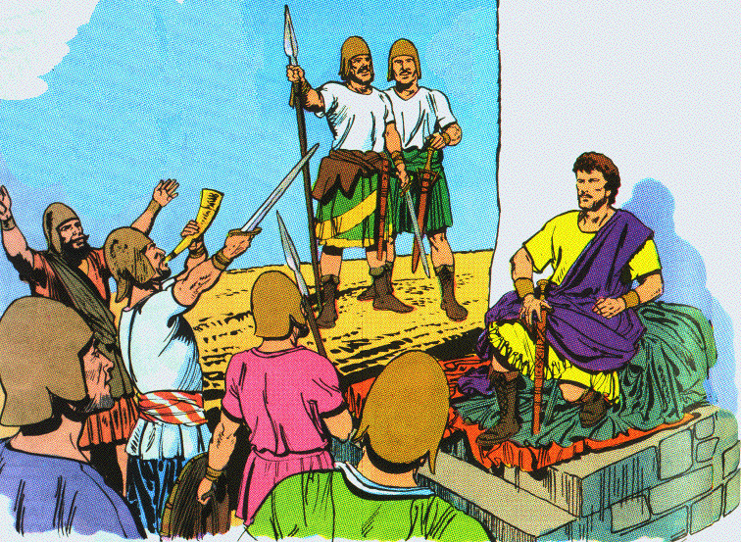
2. Acclaimed king by his fellow officers 9:11-13
13 Then they hurried and each man took his garment and placed it under him on the bare steps, and blew the trumpet, saying, "Jehu is king!"

Slide 64
B. Jehu confronts Joram at Jezreel 9:14-37

Slide 65
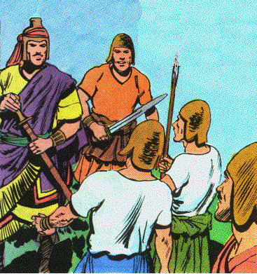
1. Setting for the coup d’etat 9:14-16
14 So Jehu the son of Jehoshaphat the son of Nimshi conspired against Joram. Now Joram with all Israel was defending Ramoth-gilead against Hazael king of Aram,
15 but King Joram had returned to Jezreel to be healed of the wounds which the Arameans had inflicted on him when he fought with Hazael king of Aram. So Jehu said, "If this is your mind, then let no one escape or leave the city to go tell it in Jezreel."
16 Then Jehu rode in a chariot and went to Jezreel, for Joram was lying there. And Ahaziah king of Judah had come down to see Joram.

Slide 66
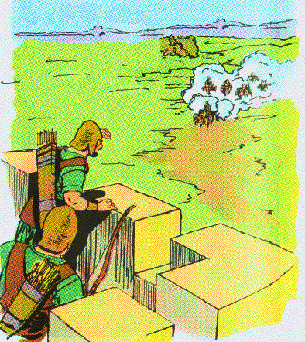
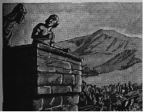
2. The bloody death of Joram of Israel 9:17-26
a. Jehu’s approach to the city 17-20
17 Now the watchman was standing on the tower in Jezreel and he saw the company of Jehu as he came, and said, "I see a company." And Joram said, "Take a horseman and send him to meet them and let him say, ‘Is it peace?’"

Slide 67
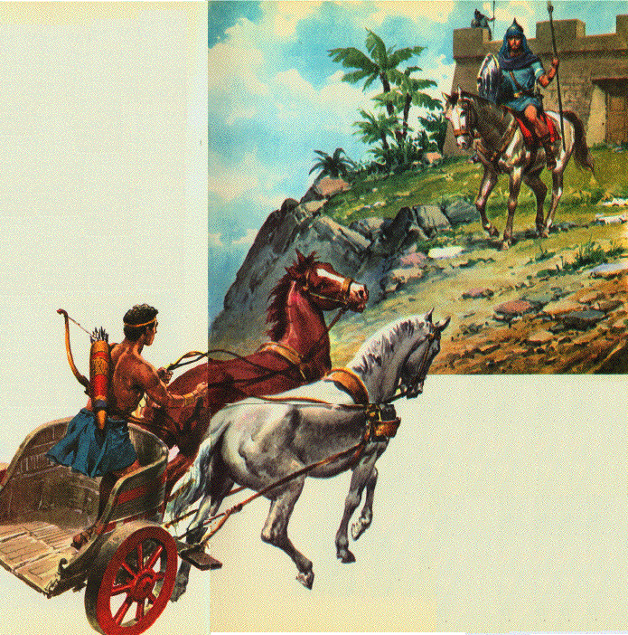
2. The bloody death of Joram of Israel 9:17-26
18 So a horseman went to meet him and said, "Thus says the king, ‘Is it peace?’" And Jehu said, "What have you to do with peace? Turn behind me." And the watchman reported, "The messenger came to them, but he did not return."
19 Then he sent out a second horseman, who came to them and said, "Thus says the king, ‘Is it peace?’" And Jehu answered, "What have you to do with peace? Turn behind me."
20 And the watchman reported, "He came even to them, and he did not return; and the driving is like the driving of Jehu the son of Nimshi, for he drives furiously."

Slide 68
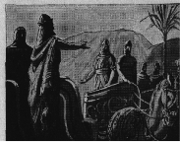
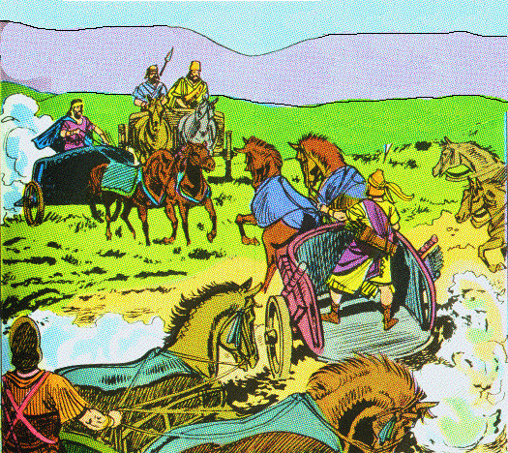
2. The bloody death of Joram of Israel 9:17-26
b. Joram and Ahaziah meet Jehu on Naboth’s land 21, 22
21 Then Joram said, "Get ready." And they made his chariot ready. And Joram king of Israel and Ahaziah king of Judah went out, each in his chariot, and they went out to meet Jehu and found him in the property of Naboth the Jezreelite.
22 And it came about, when Joram saw Jehu, that he said, "Is it peace, Jehu?" And he answered, "What peace, so long as the harlotries of your mother Jezebel and her witchcrafts are so many?"

Slide 69
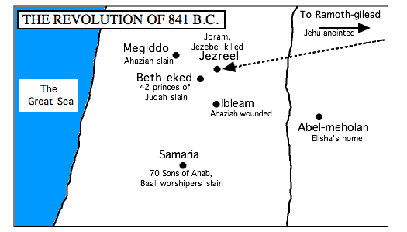
Jordan River

Slide 70
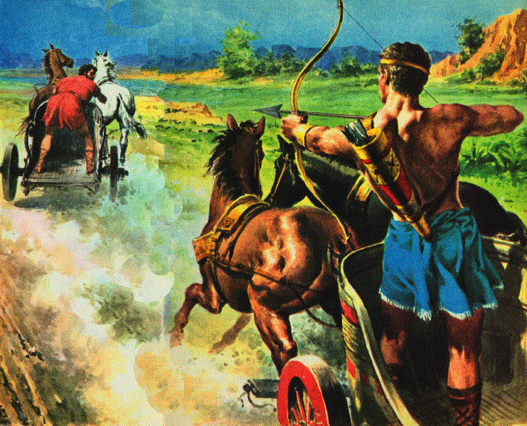
2. The bloody death of Joram of Israel 9:17-26
c. Joram is killed and Naboth is avenged 23-26
23 So Joram reined about and fled and said to Ahaziah, "There is treachery, O Ahaziah!"
24 And Jehu drew his bow with his full strength and shot Joram between his arms; and the arrow went through his heart, and he sank in his chariot.

Slide 71
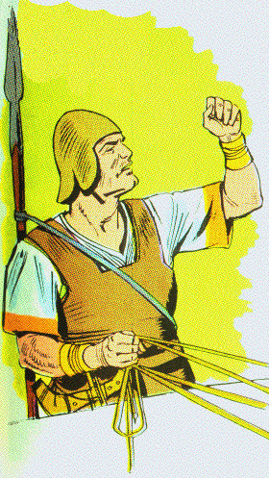
2. The bloody death of Joram of Israel 9:17-26
25 Then Jehu said to Bidkar his officer, "Take him up and cast him into the property of the field of Naboth the Jezreelite, for I remember when you and I were riding together after Ahab his father, that the LORD laid this oracle against him:
26 ‘Surely I have seen yesterday the blood of Naboth and the blood of his sons,’ says the LORD, ‘and I will repay you in this property,’ says the LORD. Now then, take and cast him into the property, according to the word of the LORD."

Slide 72
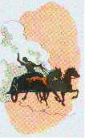
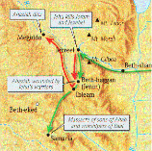
3. The death of Ahaziah of Judah 9:27-29
27 When Ahaziah the king of Judah saw this, he fled by the way of the garden house. And Jehu pursued him and said, "Shoot him too, in the chariot." So they shot him at the ascent of Gur, which is at Ibleam. But he fled to Megiddo and died there.

Slide 73
3. The death of Ahaziah of Judah 9:27-29
28 Then his servants carried him in a chariot to Jerusalem, and buried him in his grave with his fathers in the city of David.
29 Now in the eleventh year of Joram, the son of Ahab, Ahaziah became king over Judah.

Slide 74
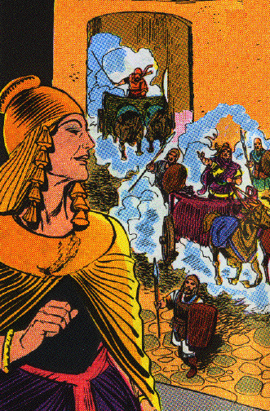
4. The death of Jezebel 9:30-37
a. Jehu finds Jezebel in Jezreel 30, 31
30 When Jehu came to Jezreel, Jezebel heard of it, and she painted her eyes and adorned her head, and looked out the window.
31 And as Jehu entered the gate, she said, "Is it well, Zimri, your master’s murderer?"

Slide 75
4. The death of Jezebel 9:30-37
b. She is throw down and trampled 32, 33
32 Then he lifted up his face to the window and said, "Who is on my side? Who?" And two or three officials looked down at him.
33 And he said, "Throw her down." So they threw her down, and some of her blood was sprinkled on the wall and on the horses, and he trampled her under foot.

Slide 76
4. The death of Jezebel 9:30-37
c. Jezebel is eaten by dogs 34, 35
34 When he came in, he ate and drank; and he said, "See now to this cursed woman and bury her, for she is a king’s daughter."
35 And they went to bury her, but they found no more of her than the skull and the feet and the palms of her hands.

Slide 77
4. The death of Jezebel 9:30-37
d. Jehu remembers the prophecy of Elijah 36, 37
36 Therefore they returned and told him. And he said, "This is the word of the LORD, which He spoke by His servant Elijah the Tishbite, saying, ‘In the property of Jezreel the dogs shall eat the flesh of Jezebel;
37 and the corpse of Jezebel shall be as dung on the face of the field in the property of Jezreel, so they cannot say, "This is Jezebel."’"

