Slide 1
C. Elisha and King Jehoram 3:1-27

Slide 2
1. Introduction to the reign of Jehoram 1-3
1 Now Jehoram the son of Ahab became king over Israel at Samaria in the eighteenth year of Jehoshaphat king of Judah, and reigned twelve years.
2 And he did evil in the sight of the LORD, though not like his father and his mother; for he put away the sacred pillar of Baal which his father had made.
3 Nevertheless, he clung to the sins of Jeroboam the son of Nebat, which he made Israel sin; he did not depart from them.

Slide 3
Lesson - half repentance is not accepted
Half-haeartedness is from first to last condemned by Scripture, Deut. 5:29; 10:17
Half-heartedness contains within itself the germs of weakness & of failure Jas. 1:8

Slide 4
2. Israel & Judah’s joint campaign against Moab 3:4-27

Slide 5
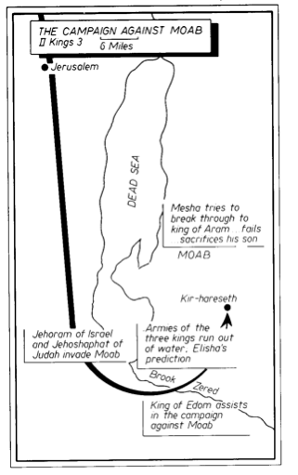

Slide 6
a. How the joint effort came to be undertaken 4-8
4 Now Mesha king of Moab was a sheep breeder, and used to pay the king of Israel 100,000 lambs and the wool of 100,000 rams.
5 But it came about, when Ahab died, the king of Moab rebelled against the king of Israel.
6 ¶ And King Jehoram went out of Samaria at that time and mustered all Israel.
7 Then he went and sent word to Jehoshaphat the king of Judah, saying, "The king of Moab has rebelled against me. Will you go with me to fight against Moab?" And he said, "I will go up; I am as you are, my people as your people, my horses as your horses."
8 And he said, "Which way shall we go up?" And he answered, "The way of the wilderness of Edom."

Slide 7
b. The plight of the allied forces 9-12
9 So the king of Israel went with the king of Judah and the king of Edom; and they made a circuit of seven days’ journey, and there was no water for the army or for the cattle that followed them.
10 Then the king of Israel said, "Alas! For the LORD has called these three kings to give them into the hand of Moab."
11 But Jehoshaphat said, "Is there not a prophet of the LORD here, that we may inquire of the LORD by him?" And one of the king of Israel’s servants answered and said, "Elisha the son of Shaphat is here, who used to pour water on the hands of Elijah."
12 And Jehoshaphat said, "The word of the LORD is with him." So the king of Israel and Jehoshaphat and the king of Edom went down to him.

Slide 8
c. The prophecy of Elisha 13-20
13 Now Elisha said to the king of Israel, "What do I have to do with you? Go to the prophets of your father and to the prophets of your mother." And the king of Israel said to him, "No, for the LORD has called these three kings together to give them into the hand of Moab."
14 And Elisha said, "As the LORD of hosts lives, before whom I stand, were it not that I regard the presence of Jehoshaphat the king of Judah, I would not look at you nor see you.
15 "But now bring me a minstrel." And it came about, when the minstrel played, that the hand of the LORD came upon him.
16 And he said, "Thus says the LORD, ‘Make this valley full of trenches.’

Slide 9
c. The prophecy of Elisha 13-20
17 "For thus says the LORD, ‘You shall not see wind nor shall you see rain; yet that valley shall be filled with water, so that you shall drink, both you and your cattle and your beasts.
18 ‘And this is but a slight thing in the sight of the LORD; He shall also give the Moabites into your hand.
19 ‘Then you shall strike every fortified city and every choice city, and fell every good tree and stop all springs of water, and mar every good piece of land with stones.’"
20 And it happened in the morning about the time of offering the sacrifice, that behold, water came by the way of Edom, and the country was filled with water.

Slide 10
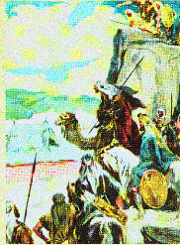
d. The defeat of Moab 21-25
21 Now all the Moabites heard that the kings had come up to fight against them. And all who were able to put on armor and older were summoned, and stood on the border.
22 And they rose early in the morning, and the sun shone on the water, and the Moabites saw the water opposite them as red as blood.
23 Then they said, "This is blood; the kings have surely fought together, and they have slain one another. Now therefore, Moab, to the spoil!"

Slide 11
d. The defeat of Moab 21-25
24 But when they came to the camp of Israel, the Israelites arose and struck the Moabites, so that they fled before them; and they went forward into the land, slaughtering the Moabites.
25 Thus they destroyed the cities; and each one threw a stone on every piece of good land and filled it. So they stopped all the springs of water and felled all the good trees, until in Kir-hareseth only they left its stones; however, the slingers went about it and struck it.

Slide 12
e. Siege of the Moabite capital at Kir-hareseth 26, 27
26 When the king of Moab saw that the battle was too fierce for him, he took with him 700 men who drew swords, to break through to the king of Edom; but they could not.
27 Then he took his oldest son who was to reign in his place, and offered him as a burnt offering on the wall. And there came great wrath against Israel, and they departed from him and returned to their own land.

Slide 13
VIII. Private Miracles in the Ministry of Elisha
2 Kings 4:1—6:7

Slide 14
A. Miracles on behalf of two faithful women
4:1-37

Slide 15
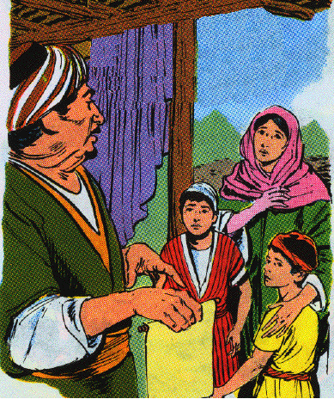
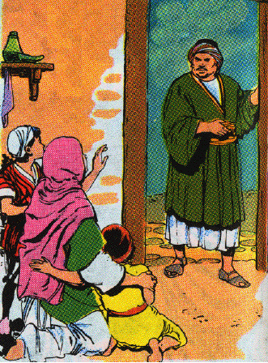
1. Miraculous increase of oil for a destitute widow 1-7
1 Now a certain woman of the wives of the sons of the prophets cried out to Elisha, "Your servant my husband is dead, and you know that your servant feared the LORD; and the creditor has come to take my two children to be his slaves."

Slide 16
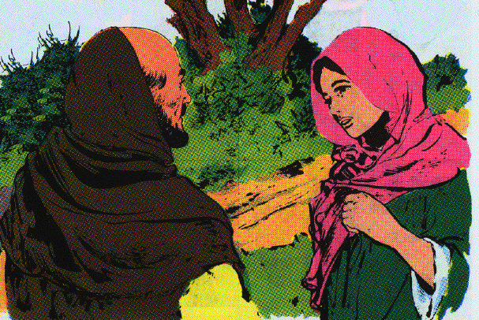
1. Miraculous increase of oil for a destitute widow 1-7
2 And Elisha said to her, "What shall I do for you? Tell me, what do you have in the house?" And she said, "Your maidservant has nothing in the house except a jar of oil."
3 Then he said, "Go, borrow vessels at large for yourself from all your neighbors, even empty vessels; do not get a few.
4 "And you shall go in and shut the door behind you and your sons, and pour out into all these vessels; and you shall set aside what is full."

Slide 17
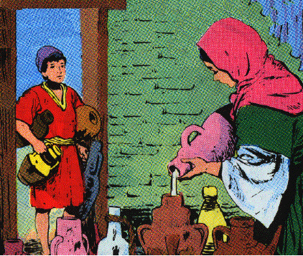
1. Miraculous increase of oil for a destitute widow 1-7
5 So she went from him and shut the door behind her and her sons; they were bringing the vessels to her and she poured.

Slide 18
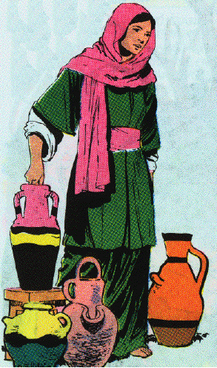
1. Miraculous increase of oil for a destitute widow 1-7
6 And it came about when the vessels were full, that she said to her son, "Bring me another vessel." And he said to her, "There is not one vessel more." And the oil stopped.
7 Then she came and told the man of God. And he said, "Go, sell the oil and pay your debt, and you and your sons can live on the rest."

Slide 19
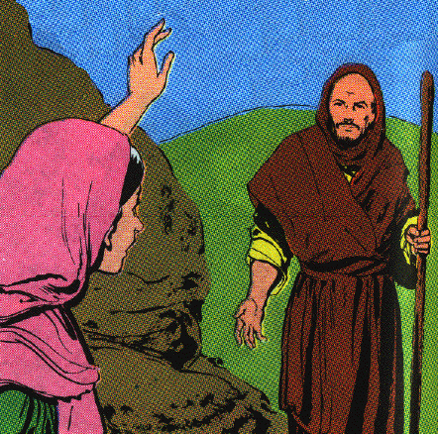
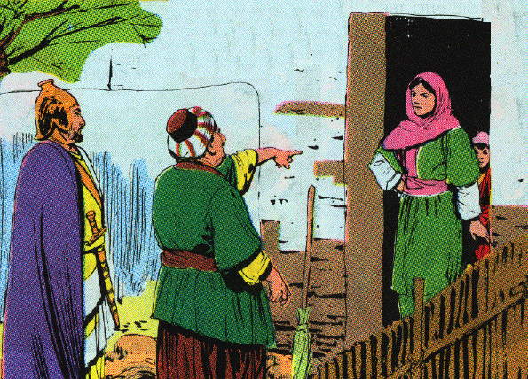
1. Miraculous increase of oil for a destitute widow 1-7
7 Then she came and told the man of God. And he said, "Go, sell the oil and pay your debt, and you and your sons can live on the rest."

Slide 20
Lessons:
a. We must care for the fatherless and widows Ex. 22:22-24; Deut. 14:29; 24:17, 19; 26:12; 27:19; Jas. 1:27 Elisha helped her promptly, effectively
b. God is the protector of their rights Deut. 10:18; Ps. 68:5; 146:9; Isa. 9:17
c. The seed of the righteous are not forsaken by God Promise - Ex. 20:5, 6; Ps. 37:25; 103:17; 102:28
d. The foolishness & danger of getting into debt. Sometimes things beyond our control can happen. Poverty is not necessarily a disgrace.

Slide 21
Lessons:
e. The best lives are subjected to trials
f. Love of money leads to cruelty on the part of creditors
g. We must make full use of what we have before we expect God to help
h. The woman’s faith - gathering & filling empty vessels from her jar
i. No oil was wasted on the ground. God only gave what could be used.
J. We trust God even more so for spiritual supplies Phil. 4:19

Slide 22
2. The promise of a child to the Shunammite 8-17
8 Now there came a day when Elisha passed over to Shunem, where there was a prominent woman, and she persuaded him to eat food. And so it was, as often as he passed by, he turned in there to eat food.
9 And she said to her husband, "Behold now, I perceive that this is a holy man of God passing by us continually.
10 "Please, let us make a little walled upper chamber and let us set a bed for him there, and a table and a chair and a lampstand; and it shall be, when he comes to us, that he can turn in there."

Slide 23
2. The promise of a child to the Shunammite 8-17
11 One day he came there and turned in to the upper chamber and rested.
12 Then he said to Gehazi [gih HAY zigh] his servant, "Call this Shunammite." And when he had called her, she stood before him.
13 And he said to him, "Say now to her, ‘Behold, you have been careful for us with all this care; what can I do for you? Would you be spoken for to the king or to the captain of the army?’" And she answered, "I live among my own people."
14 So he said, "What then is to be done for her?" And Gehazi answered, "Truly she has no son and her husband is old."

Slide 24
2. The promise of a child to the Shunammite 8-17
15 And he said, "Call her." When he had called her, she stood in the doorway.
16 Then he said, "At this season next year you shall embrace a son." And she said, "No, my lord, O man of God, do not lie to your maidservant."
17 And the woman conceived and bore a son at that season the next year, as Elisha had said to her.

Slide 25
lessons
a. Hospitality: from the heart, involved trouble & expense
b. Hospitality: rewarded

Slide 26
3. The resurrection of the Shunammite’s son 18-37
18 When the child was grown, the day came that he went out to his father to the reapers.
19 And he said to his father, "My head, my head." And he said to his servant, "Carry him to his mother."

Slide 27
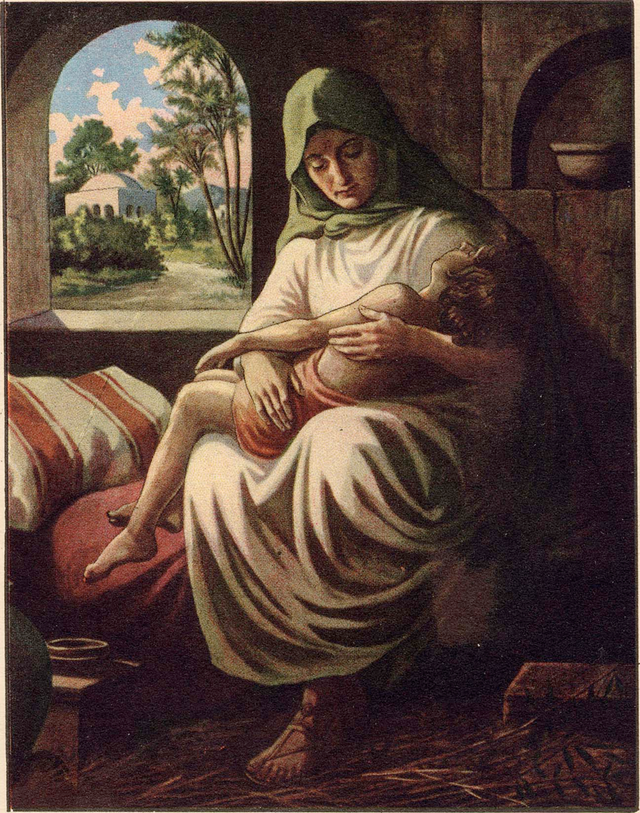
3. The resurrection of the Shunammite’s son 18-37
20 When he had taken him and brought him to his mother, he sat on her lap until noon, and then died.
21 And she went up and laid him on the bed of the man of God, and shut the door behind him, and went out.

Slide 28
3. The resurrection of the Shunammite’s son 18-37
22 Then she called to her husband and said, "Please send me one of the servants and one of the donkeys, that I may run to the man of God and return."
23 And he said, "Why will you go to him today? It is neither new moon nor sabbath." And she said, "It will be well."
24 Then she saddled a donkey and said to her servant, "Drive and go forward; do not slow down the pace for me unless I tell you."

Slide 29
3. The resurrection of the Shunammite’s son 18-37
25 So she went and came to the man of God to Mount Carmel. And it came about when the man of God saw her at a distance, that he said to Gehazi his servant, "Behold, yonder is the Shunammite.
26 "Please run now to meet her and say to her, ‘Is it well with you? Is it well with your husband? Is it well with the child?’" And she answered, "It is well."

Slide 30
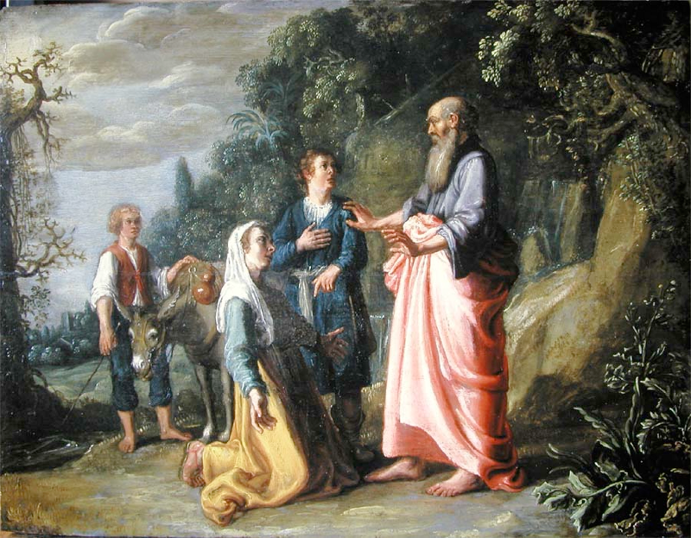
3. The resurrection of the Shunammite’s son 18-37
27 When she came to the man of God to the hill, she caught hold of his feet. And Gehazi came near to push her away; but the man of God said, "Let her alone, for her soul is troubled within her; and the LORD has hidden it from me and has not told me."
28 Then she said, "Did I ask for a son from my lord? Did I not say, ‘Do not deceive me’?"

Slide 31
3. The resurrection of the Shunammite’s son 18-37
29 Then he said to Gehazi, "Gird up your loins and take my staff in your hand, and go your way; if you meet any man, do not salute him, and if anyone salutes you, do not answer him; and lay my staff on the lad’s face."
30 And the mother of the lad said, "As the LORD lives and as you yourself live, I will not leave you." And he arose and followed her.

Slide 32
3. The resurrection of the Shunammite’s son 18-37
31 Then Gehazi passed on before them and laid the staff on the lad’s face, but there was neither sound nor response. So he returned to meet him and told him, "The lad has not awakened."
32 When Elisha came into the house, behold the lad was dead and laid on his bed.
33 So he entered and shut the door behind them both, and prayed to the LORD.

Slide 33
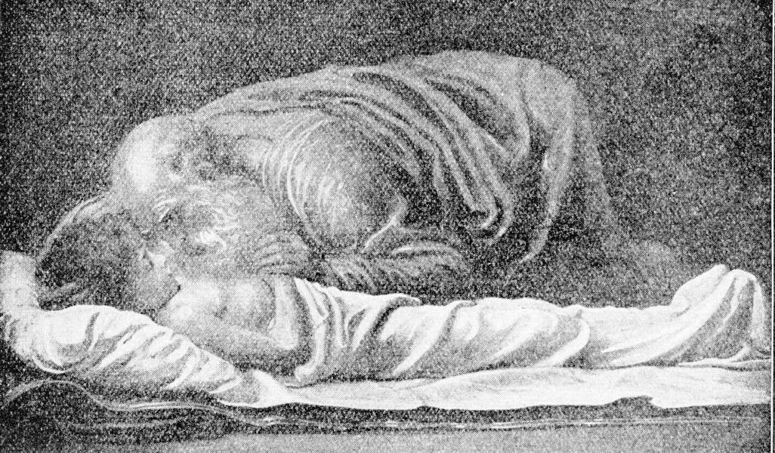
3. The resurrection of the Shunammite’s son 18-37
34 And he went up and lay on the child, and put his mouth on his mouth and his eyes on his eyes and his hands on his hands, and he stretched himself on him; and the flesh of the child became warm.
35 Then he returned and walked in the house once back and forth, and went up and stretched himself on him; and the lad sneezed seven times and the lad opened his eyes.

Slide 34
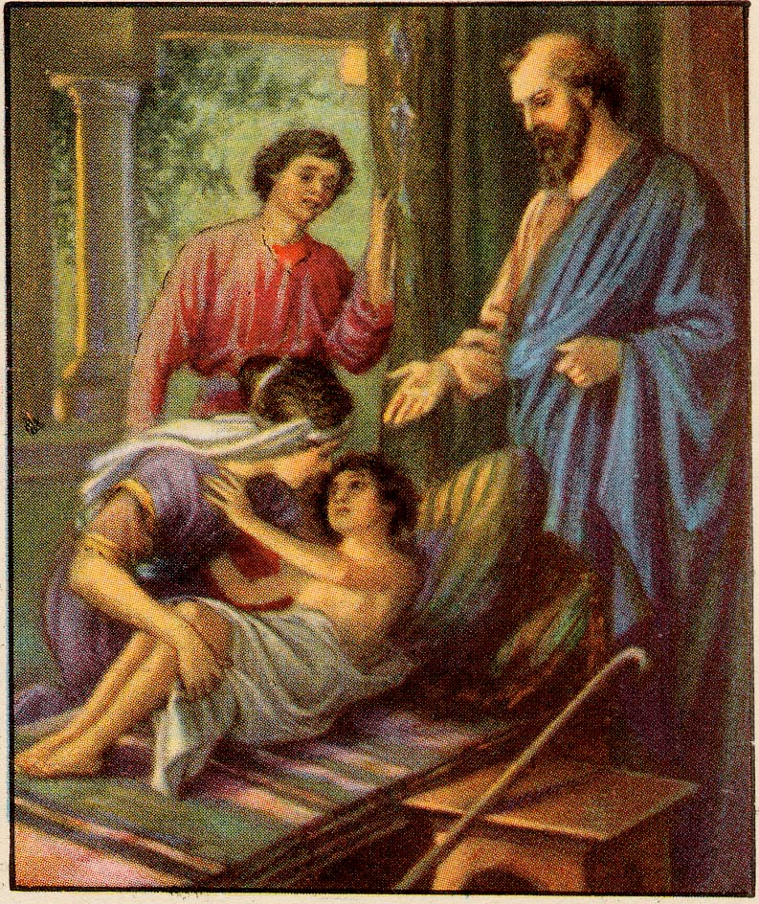
3. The resurrection of the Shunammite’s son 18-37
36 And he called Gehazi and said, "Call this Shunammite." So he called her. And when she came in to him, he said, "Take up your son."
37 Then she went in and fell at his feet and bowed herself to the ground, and she took up her son and went out.

Slide 35
Lessons
a. Great trials often follow great blessings
b. She patiently endured (it is well)
c. She went to get God’s word and believed in His power
d. The trial had a blessed end
e. Elisha’s perseverance in prayer

Slide 36
B. Miracles on behalf of the sons of the prophets
4:38-44

Slide 37
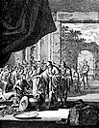
1. The healing of the noxious stew 38-41
38 When Elisha returned to Gilgal, there was a famine in the land. As the sons of the prophets were sitting before him, he said to his servant, "Put on the large pot and boil stew for the sons of the prophets."
39 Then one went out into the field to gather herbs, and found a wild vine and gathered from it his lap full of wild gourds, and came and sliced them into the pot of stew, for they did not know what they were.
40 So they poured it out for the men to eat. And it came about as they were eating of the stew, that they cried out and said, "O man of God, there is death in the pot." And they were unable to eat.
41 But he said, "Now bring meal." And he threw it into the pot, and he said, "Pour it out for the people that they may eat." Then there was no harm in the pot.

Slide 38
2. The multiplication of the loaves 42-44
42 Now a man came from Baal-shalishah [SHAL ih shuh], and brought the man of God bread of the first fruits, twenty loaves of barley and fresh ears of grain in his sack. And he said, "Give them to the people that they may eat."
43 And his attendant said, "What, shall I set this before a hundred men?" But he said, "Give them to the people that they may eat, for thus says the LORD, ‘They shall eat and have some left over.’"
44 So he set it before them, and they ate and had some left over, according to the word of the LORD.

Slide 39
C. Miraculous cleansing of the Aramean general Naaman
5:1-19

Slide 40
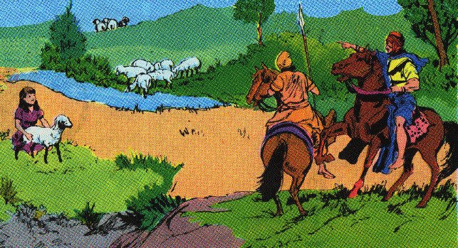
1. Naaman’s condition 1-7
1 Now Naaman, captain of the army of the king of Aram, was a great man with his master, and highly respected, because by him the LORD had given victory to Aram. The man was also a valiant warrior, but he was a leper.
2 Now the Arameans had gone out in bands, and had taken captive a little girl from the land of Israel; and she waited on Naaman’s wife.

Slide 41
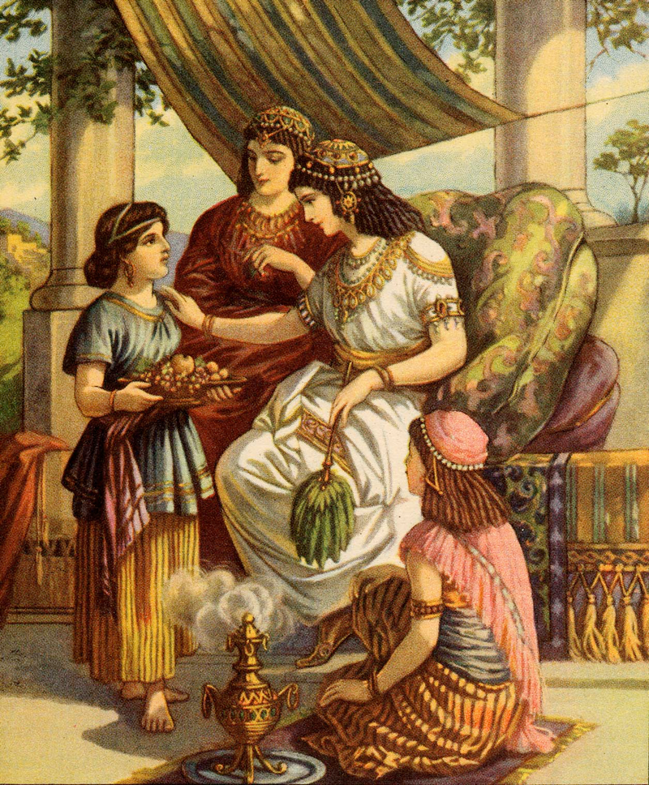
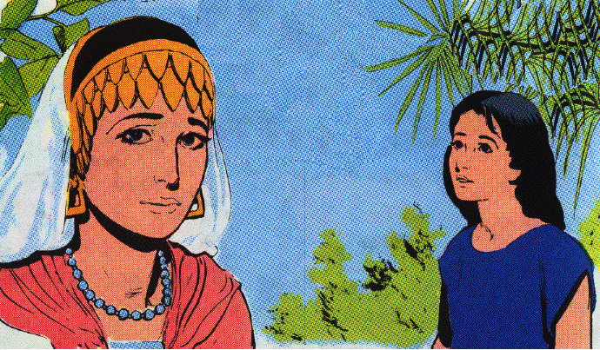
1. Naaman’s condition 1-7
3 And she said to her mistress, "I wish that my master were with the prophet who is in Samaria! Then he would cure him of his leprosy."

Slide 42
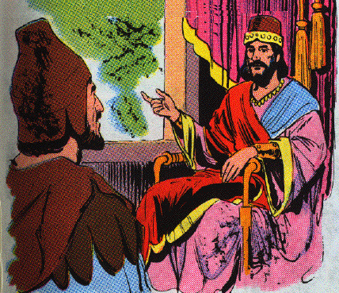
1. Naaman’s condition 1-7
4 And Naaman went in and told his master, saying, "Thus and thus spoke the girl who is from the land of Israel."
5 Then the king of Aram said, "Go now, and I will send a letter to the king of Israel." And he departed and took with him ten talents of silver and six thousand shekels of gold and ten changes of clothes.

Slide 43
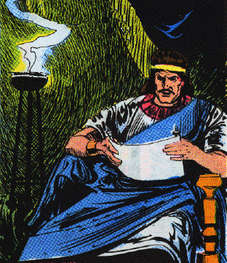
1. Naaman’s condition 1-7
6 And he brought the letter to the king of Israel, saying, "And now as this letter comes to you, behold, I have sent Naaman my servant to you, that you may cure him of his leprosy."

Slide 44
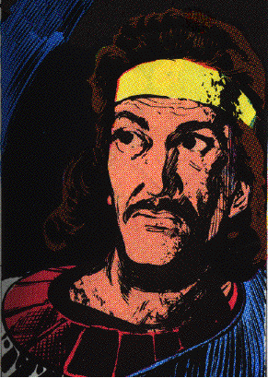
1. Naaman’s condition 1-7
7 And it came about when the king of Israel read the letter, that he tore his clothes and said, "Am I God, to kill and to make alive, that this man is sending word to me to cure a man of his leprosy? But consider now, and see how he is seeking a quarrel against me."

Slide 45
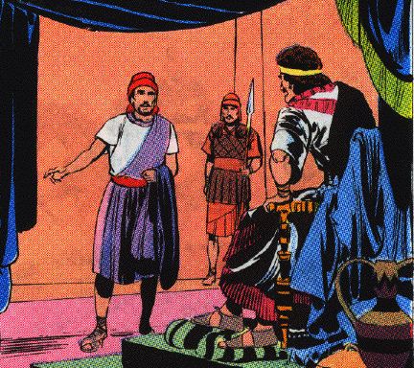
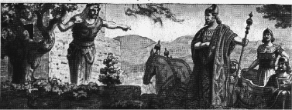
2. Naaman’s cleansing 8-14
8 And it happened when Elisha the man of God heard that the king of Israel had torn his clothes, that he sent word to the king, saying, "Why have you torn your clothes? Now let him come to me, and he shall know that there is a prophet in Israel."

Slide 46
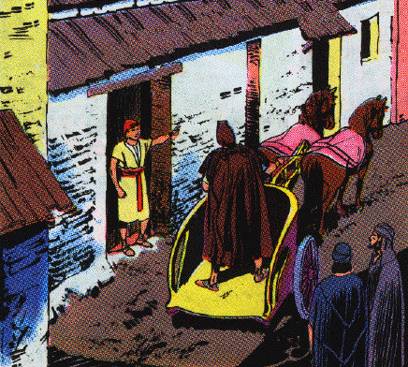
2. Naaman’s cleansing 8-14
9 So Naaman came with his horses and his chariots, and stood at the doorway of the house of Elisha.
10 And Elisha sent a messenger to him, saying, "Go and wash in the Jordan seven times, and your flesh shall be restored to you and you shall be clean."

Slide 47
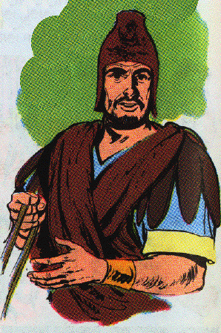
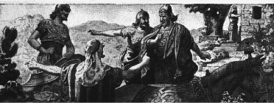
2. Naaman’s cleansing 8-14
11 But Naaman was furious and went away and said, "Behold, I thought, ‘He will surely come out to me, and stand and call on the name of the LORD his God, and wave his hand over the place, and cure the leper.’
12 "Are not Abanah and Pharpar, the rivers of Damascus, better than all the waters of Israel? Could I not wash in them and be clean?" So he turned and went away in a rage.

Slide 48
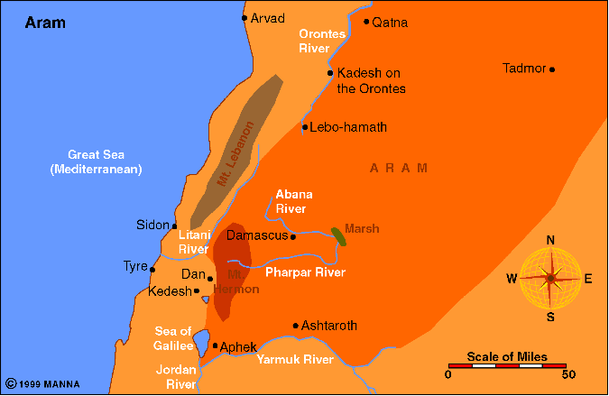

Slide 49
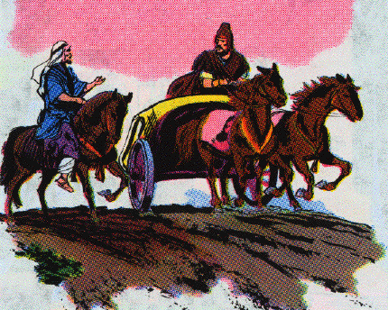
2. Naaman’s cleansing 8-14
13 Then his servants came near and spoke to him and said, "My father, had the prophet told you to do some great thing, would you not have done it? How much more then, when he says to you, ‘Wash, and be clean’?"

Slide 50
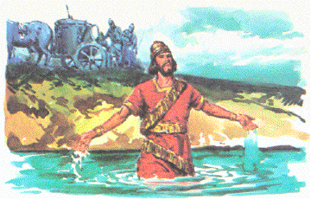
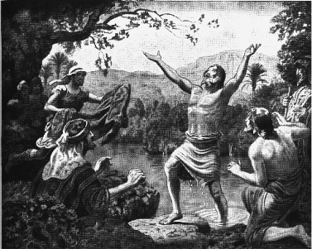
2. Naaman’s cleansing 8-14
14 So he went down and dipped himself seven times in the Jordan, according to the word of the man of God; and his flesh was restored like the flesh of a little child, and he was clean.

Slide 51
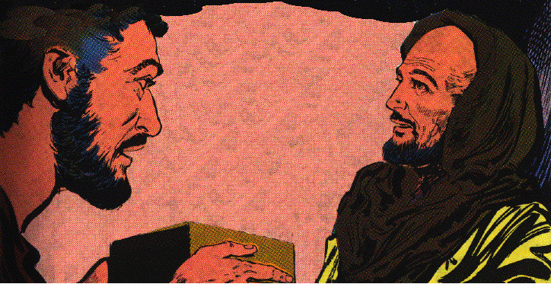
3. Naaman’s conversion 15-19
15 When he returned to the man of God with all his company, and came and stood before him, he said, "Behold now, I know that there is no God in all the earth, but in Israel; so please take a present from your servant now."
16 But he said, "As the LORD lives, before whom I stand, I will take nothing." And he urged him to take it, but he refused.

Slide 52
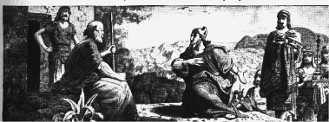
3. Naaman’s conversion 15-19
17 And Naaman said, "If not, please let your servant at least be given two mules’ load of earth; for your servant will no more offer burnt offering nor will he sacrifice to other gods, but to the LORD.
18 "In this matter may the LORD pardon your servant: when my master goes into the house of Rimmon to worship there, and he leans on my hand and I bow myself in the house of Rimmon, when I bow myself in the house of Rimmon, the LORD pardon your servant in this matter."
19 And he said to him, "Go in peace." So he departed from him some distance.

Slide 53
D. A judicial miracles against Gehazi 5:20-27
20 But Gehazi [gih HAY zigh], the servant of Elisha the man of God, thought, "Behold, my master has spared this Naaman the Aramean, by not receiving from his hands what he brought. As the LORD lives, I will run after him and take something from him."
21 So Gehazi pursued Naaman. When Naaman saw one running after him, he came down from the chariot to meet him and said, "Is all well?"
22 And he said, "All is well. My master has sent me, saying, ‘Behold, just now two young men of the sons of the prophets have come to me from the hill country of Ephraim. Please give them a talent of silver and two changes of clothes.’"
23 And Naaman said, "Be pleased to take two talents." And he urged him, and bound two talents of silver in two bags with two changes of clothes, and gave them to two of his servants; and they carried them before him.

Slide 54
D. A judicial miracles against Gehazi 5:20-27
24 When he came to the hill, he took them from their hand and deposited them in the house, and he sent the men away, and they departed.
25 But he went in and stood before his master. And Elisha said to him, "Where have you been, Gehazi?" And he said, "Your servant went nowhere."
26 Then he said to him, "Did not my heart go with you, when the man turned from his chariot to meet you? Is it a time to receive money and to receive clothes and olive groves and vineyards and sheep and oxen and male and female servants?

Slide 55
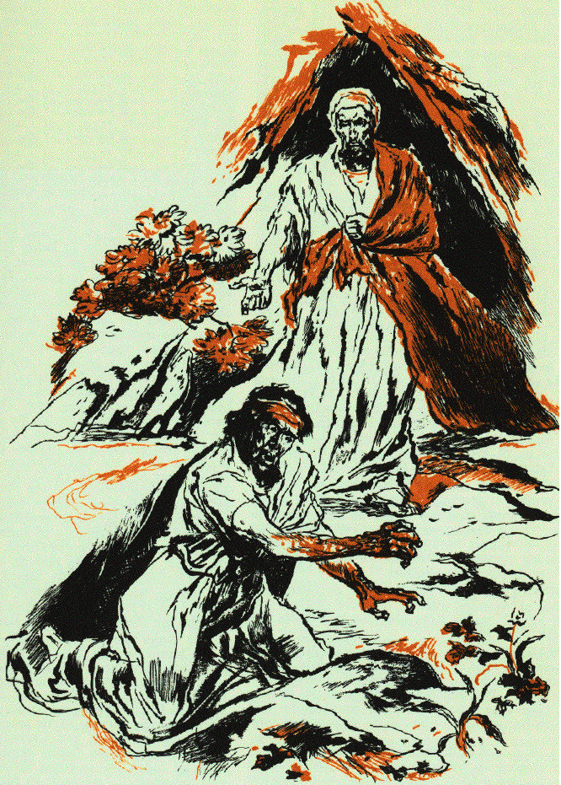
D. A judicial miracles against Gehazi 5:20-27
27 "Therefore, the leprosy of Naaman shall cleave to you and to your descendants forever." So he went out from his presence a leper as white as snow.

Slide 56
E. Miraculous levitation of the axe head 6:1-7
1 Now the sons of the prophets said to Elisha, "Behold now, the place before you where we are living is too limited for us.
2 "Please let us go to the Jordan, and each of us take from there a beam, and let us make a place there for ourselves where we may live." So he said, "Go."
3 Then one said, "Please be willing to go with your servants." And he answered, "I shall go."
4 So he went with them; and when they came to the Jordan, they cut down trees.

Slide 57
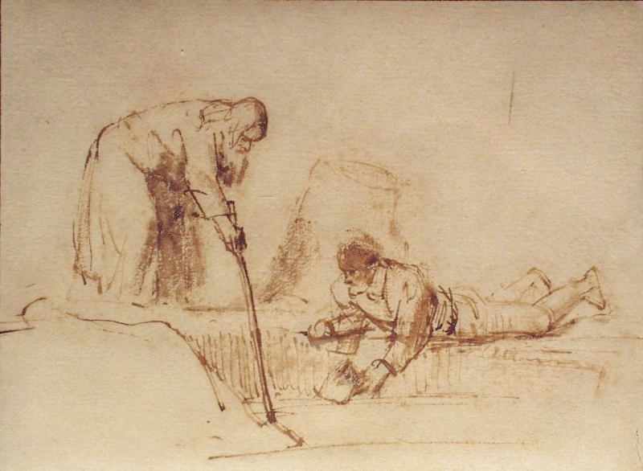
E. Miraculous levitation of the axe head 6:1-7
5 But as one was felling a beam, the axe head fell into the water; and he cried out and said, "Alas, my master! For it was borrowed."
6 Then the man of God said, "Where did it fall?" And when he showed him the place, he cut off a stick, and threw it in there, and made the iron float.
7 And he said, "Take it up for yourself." So he put out his hand and took it.

