Slide 1
VII. The Transfer of the Prophetic Mantle II K 2:1—3:27
A. Elijah’s translation and Elisha’s commission 2:1-15

Slide 2
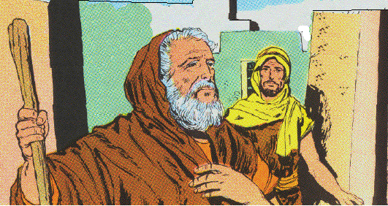
1. Elijah’s final visit to the sons of the prophets 1-6
1 And it came about when the LORD was about to take up Elijah by a whirlwind to heaven, that Elijah went with Elisha from Gilgal.
2 And Elijah said to Elisha, "Stay here please, for the LORD has sent me as far as Bethel." But Elisha said, "As the LORD lives and as you yourself live, I will not leave you." So they went down to Bethel.
3 Then the sons of the prophets who were at Bethel came out to Elisha and said to him, "Do you know that the LORD will take away your master from over you today?" And he said, "Yes, I know; be still."

Slide 3
4 And Elijah said to him, "Elisha, please stay here, for the LORD has sent me to Jericho." But he said, "As the LORD lives, and as you yourself live, I will not leave you." So they came to Jericho.
5 And the sons of the prophets who were at Jericho approached Elisha and said to him, "Do you know that the LORD will take away your master from over you today?" And he answered, "Yes, I know; be still."
6 Then Elijah said to him, "Please stay here, for the LORD has sent me to the Jordan." And he said, "As the LORD lives, and as you yourself live, I will not leave you." So the two of them went on.

Slide 4
Elijah’s time to depart from the earth
1. Time spent in busy activity and usefulness
(We want to spend our last hours well)
a. directed by the Spirit of the Lord
b. directed to the schools of the prophets
2. Worked with the young
3. Calm and self-possessed

Slide 5
Elisha’s determination to follow Elijah
1. Affection for Elijah
2. A desire to see the wonders of God’s working
3. A hope of blessing
4. With perseverance he boldly sought a blessing

Slide 6
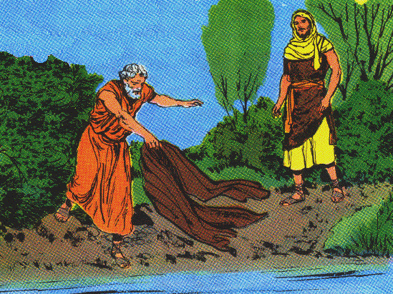
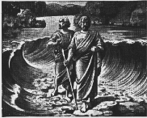
2. Elijah’s final words with Elisha 7-10
7 Now fifty men of the sons of the prophets went and stood opposite them at a distance, while the two of them stood by the Jordan.
8 And Elijah took his mantle and folded it together and struck the waters, and they were divided here and there, so that the two of them crossed over on dry ground.

Slide 7
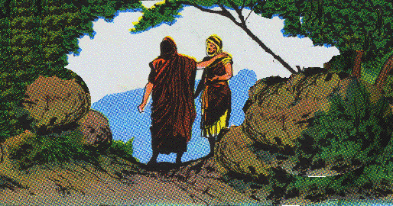
2. Elijah’s final words with Elisha 7-10
9 Now it came about when they had crossed over, that Elijah said to Elisha, "Ask what I shall do for you before I am taken from you." And Elisha said, "Please, let a double portion of your spirit be upon me.” Deut. 21:17

Slide 8
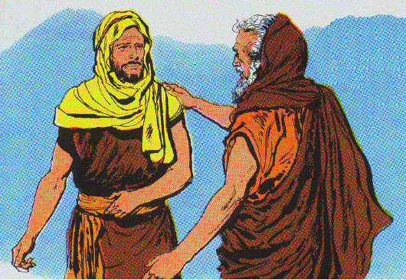
2. Elijah’s final words with Elisha 7-10
10 And he said, "You have asked a hard thing. Nevertheless, if you see me when I am taken from you, it shall be so for you; but if not, it shall not be so."

Slide 9
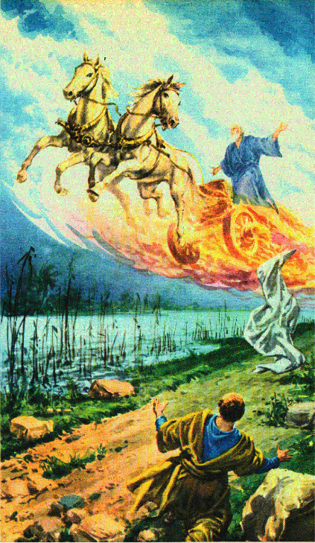
3. Elijah taken to heaven by a chariot of fire & a whirlwind 11, 12
11 Then it came about as they were going along and talking, that behold, there appeared a chariot of fire and horses of fire which separated the two of them. And Elijah went up by a whirlwind to heaven.

Slide 10
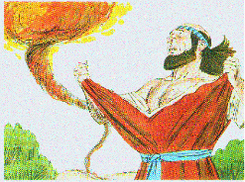
3. Elijah taken to heaven by a chariot of fire & a whirlwind 11, 12
12 And Elisha saw it and cried out, "My father, my father, the chariots of Israel and its horsemen!" And he saw him no more. Then he took hold of his own clothes and tore them in two pieces.

Slide 11
Lesson - Assurance of life after death with God
Needed in Enoch’s time and in Elijah’s - times of wickedness.
Shows the hope of a glorified body.
The example of the translation or change the living Christians will experience at the Lord’s coming.

Slide 12
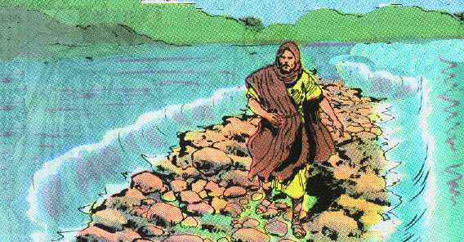
4. Elisha receives his commission to succeed Elijah 13-15
13 He also took up the mantle of Elijah that fell from him, and returned and stood by the bank of the Jordan.
14 And he took the mantle of Elijah that fell from him, and struck the waters and said, "Where is the LORD, the God of Elijah?" And when he also had struck the waters, they were divided here and there; and Elisha crossed over.

Slide 13
4. Elisha receives his commission to succeed Elijah 13-15
15 Now when the sons of the prophets who were at Jericho opposite him saw him, they said, "The spirit of Elijah rests on Elisha." And they came to meet him and bowed themselves to the ground before him.

Slide 14
B. Elisha and the sons of the prophets 2:16-25

Slide 15
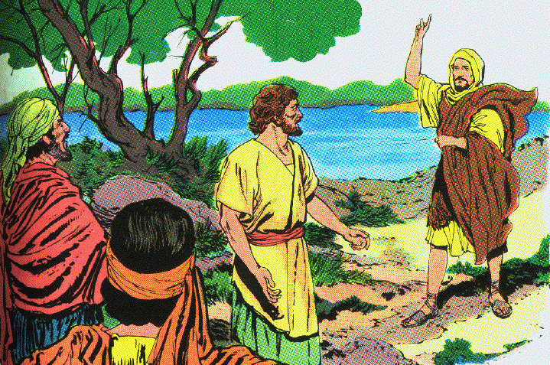
1. Elisha tells them not to search for Elijah 16-18
16 And they said to him, "Behold now, there are with your servants fifty strong men, please let them go and search for your master; perhaps the Spirit of the LORD has taken him up and cast him on some mountain or into some valley." And he said, "You shall not send."
17 But when they urged him until he was ashamed, he said, "Send." They sent therefore fifty men; and they searched three days, but did not find him.
18 And they returned to him while he was staying at Jericho; and he said to them, "Did I not say to you, ‘Do not go’?"

Slide 16
2. Elisha purifies the noxious waters at Jericho 19-22
19 Then the men of the city said to Elisha, "Behold now, the situation of this city is pleasant, as my lord sees; but the water is bad, and the land is unfruitful."
20 And he said, "Bring me a new jar, and put salt in it." So they brought it to him.
21 And he went out to the spring of water, and threw salt in it and said, "Thus says the LORD, ‘I have purified these waters; there shall not be from there death or unfruitfulness any longer.’"
22 So the waters have been purified to this day, according to the word of Elisha which he spoke.

Slide 17
3. Elisha’s curse upon the young lads at Bethel 23-25
23 Then he went up from there to Bethel; and as he was going up by the way, young lads came out from the city and mocked him and said to him, "Go up, you baldhead; go up, you baldhead!"
24 When he looked behind him and saw them, he cursed them in the name of the LORD. Then two female bears came out of the woods and tore up forty-two lads of their number.
25 And he went from there to Mount Carmel, and from there he returned to Samaria.

Slide 18
C. Elisha and King Jehoram 3:1-27

Slide 19
1. Introduction to the reign of Jehoram 1-3
1 Now Jehoram the son of Ahab became king over Israel at Samaria in the eighteenth year of Jehoshaphat king of Judah, and reigned twelve years.
2 And he did evil in the sight of the LORD, though not like his father and his mother; for he put away the sacred pillar of Baal which his father had made.
3 Nevertheless, he clung to the sins of Jeroboam the son of Nebat, which he made Israel sin; he did not depart from them.

Slide 20
Lesson - half repentance is not accepted
Half-haeartedness is from first to last condemned by Scripture, Deut. 5:29; 10:17
Half-heartedness contains within itself the germs of weakness & of failure Jas. 1:8

Slide 21
2. Israel and Judah’s joint campaign against Moab 3:4-27

Slide 22
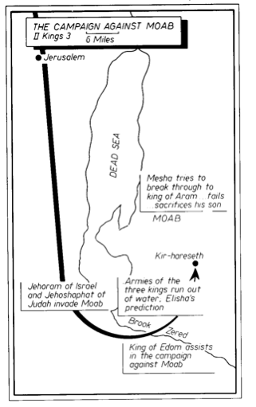

Slide 23
a. How the joint effort came to be undertaken 4-8
4 Now Mesha king of Moab was a sheep breeder, and used to pay the king of Israel 100,000 lambs and the wool of 100,000 rams.
5 But it came about, when Ahab died, the king of Moab rebelled against the king of Israel.
6 ¶ And King Jehoram went out of Samaria at that time and mustered all Israel.
7 Then he went and sent word to Jehoshaphat the king of Judah, saying, "The king of Moab has rebelled against me. Will you go with me to fight against Moab?" And he said, "I will go up; I am as you are, my people as your people, my horses as your horses."
8 And he said, "Which way shall we go up?" And he answered, "The way of the wilderness of Edom."

Slide 24
b. The plight of the allied forces 9-12
9 So the king of Israel went with the king of Judah and the king of Edom; and they made a circuit of seven days’ journey, and there was no water for the army or for the cattle that followed them.
10 Then the king of Israel said, "Alas! For the LORD has called these three kings to give them into the hand of Moab."
11 But Jehoshaphat said, "Is there not a prophet of the LORD here, that we may inquire of the LORD by him?" And one of the king of Israel’s servants answered and said, "Elisha the son of Shaphat is here, who used to pour water on the hands of Elijah."
12 And Jehoshaphat said, "The word of the LORD is with him." So the king of Israel and Jehoshaphat and the king of Edom went down to him.

Slide 25
c. The prophecy of Elisha 13-20
13 Now Elisha said to the king of Israel, "What do I have to do with you? Go to the prophets of your father and to the prophets of your mother." And the king of Israel said to him, "No, for the LORD has called these three kings together to give them into the hand of Moab."
14 And Elisha said, "As the LORD of hosts lives, before whom I stand, were it not that I regard the presence of Jehoshaphat the king of Judah, I would not look at you nor see you.
15 "But now bring me a minstrel." And it came about, when the minstrel played, that the hand of the LORD came upon him.
16 And he said, "Thus says the LORD, ‘Make this valley full of trenches.’

Slide 26
c. The prophecy of Elisha 13-20
17 "For thus says the LORD, ‘You shall not see wind nor shall you see rain; yet that valley shall be filled with water, so that you shall drink, both you and your cattle and your beasts.
18 ‘And this is but a slight thing in the sight of the LORD; He shall also give the Moabites into your hand.
19 ‘Then you shall strike every fortified city and every choice city, and fell every good tree and stop all springs of water, and mar every good piece of land with stones.’"
20 And it happened in the morning about the time of offering the sacrifice, that behold, water came by the way of Edom, and the country was filled with water.

Slide 27
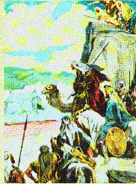
d. The defeat of Moab 21-25
21 Now all the Moabites heard that the kings had come up to fight against them. And all who were able to put on armor and older were summoned, and stood on the border.
22 And they rose early in the morning, and the sun shone on the water, and the Moabites saw the water opposite them as red as blood.
23 Then they said, "This is blood; the kings have surely fought together, and they have slain one another. Now therefore, Moab, to the spoil!"

Slide 28
d. The defeat of Moab 21-25
24 But when they came to the camp of Israel, the Israelites arose and struck the Moabites, so that they fled before them; and they went forward into the land, slaughtering the Moabites.
25 Thus they destroyed the cities; and each one threw a stone on every piece of good land and filled it. So they stopped all the springs of water and felled all the good trees, until in Kir-hareseth only they left its stones; however, the slingers went about it and struck it.

Slide 29
e. Siege of the Moabite capital at Kir-hareseth 26, 27
26 When the king of Moab saw that the battle was too fierce for him, he took with him 700 men who drew swords, to break through to the king of Edom; but they could not.
27 Then he took his oldest son who was to reign in his place, and offered him as a burnt offering on the wall. And there came great wrath against Israel, and they departed from him and returned to their own land.

