Slide 1
Conversion of Lydia
Acts 16:13-15

Slide 2
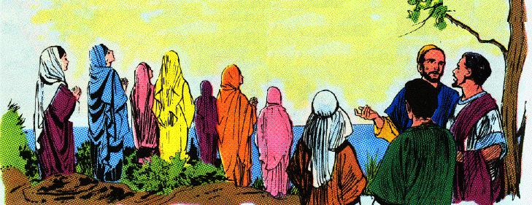
Conversion of Lydia 13-15
13 And on the Sabbath day we went outside the gate to a riverside, where we were supposing that there would be a place of prayer; and we sat down and began speaking to the women who had assembled.

Slide 3
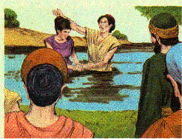
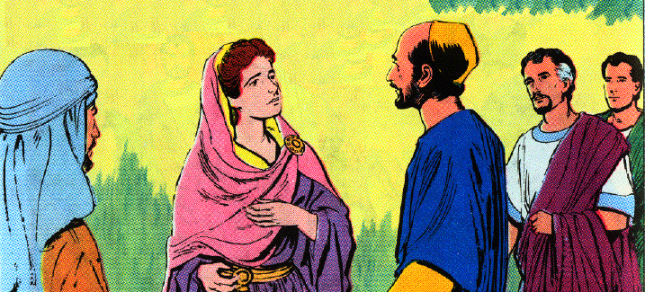
Conversion of Lydia 13-15
14 And a certain woman named Lydia, from the city of Thyatira, a seller of purple fabrics, a worshiper of God, was listening; and the Lord opened her heart to respond to the things spoken by Paul.
15 And when she and her household had been baptized, she urged us, saying, "If you have judged me to be faithful to the Lord, come into my house and stay." And she prevailed upon us.

