Slide 1
IV. Yahweh vs. Baal 17:1—18:46
A. The Great Drought in Israel 17:1-24

Slide 2
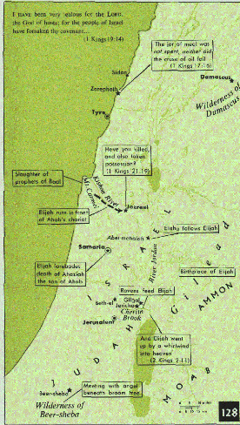

Slide 3
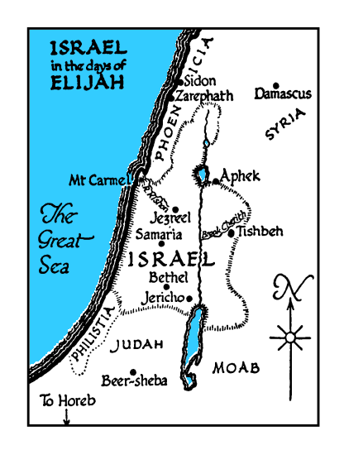

Slide 4
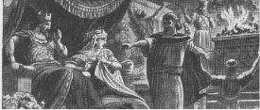
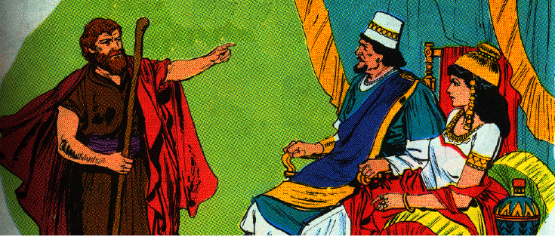
1. Elijah before the king 1
1 Now Elijah the Tishbite, who was of the settlers of Gilead, said to Ahab, "As the LORD, the God of Israel lives, before whom I stand, surely there shall be neither dew nor rain these years, except by my word."

Slide 5
2. Elijah at the brook Cherith 2-7
2 And the word of the LORD came to him, saying,
3 "Go away from here and turn eastward, and hide yourself by the brook Cherith, which is east of the Jordan.
4 "And it shall be that you shall drink of the brook, and I have commanded the ravens to provide for you there."

Slide 6
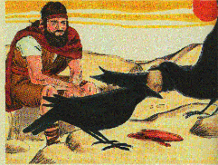
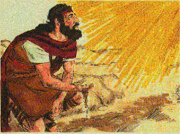
2. Elijah at the brook Cherith 2-7
5 So he went and did according to the word of the LORD, for he went and lived by the brook Cherith, which is east of the Jordan.
6 And the ravens brought him bread and meat in the morning and bread and meat in the evening, and he would drink from the brook.
7 And it happened after a while, that the brook dried up, because there was no rain in the land.

Slide 7
3. Elijah in the village of Zarephath 17:8-24

Slide 9
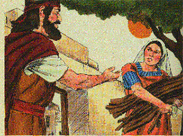
a. The miraculous provision of food in the home of a widow 8-16
8 Then the word of the LORD came to him, saying,
9 "Arise, go to Zarephath, which belongs to Sidon, and stay there; behold, I have commanded a widow there to provide for you."
10 So he arose and went to Zarephath, and when he came to the gate of the city, behold, a widow was there gathering sticks; and he called to her and said, "Please get me a little water in a jar, that I may drink."
11 And as she was going to get it, he called to her and said, "Please bring me a piece of bread in your hand."
12 But she said, "As the LORD your God lives, I have no bread, only a handful of flour in the bowl and a little oil in the jar; and behold, I am gathering a few sticks that I may go in and prepare for me and my son, that we may eat it and die."

Slide 10
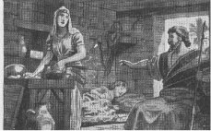
a. The miraculous provision of food in the home of a widow 8-16
13 Then Elijah said to her, "Do not fear; go, do as you have said, but make me a little bread cake from it first, and bring it out to me, and afterward you may make one for yourself and for your son.
14 "For thus says the LORD God of Israel, ‘The bowl of flour shall not be exhausted, nor shall the jar of oil be empty, until the day that the LORD sends rain on the face of the earth.’"
15 So she went and did according to the word of Elijah, and she and he and her household ate for many days.
16 The bowl of flour was not exhausted nor did the jar of oil become empty, according to the word of the LORD which He spoke through Elijah.

Slide 11
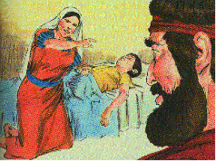
b. The resurrection of the widow’s son 17-24
17 Now it came about after these things, that the son of the woman, the mistress of the house, became sick; and his sickness was so severe, that there was no breath left in him.
18 So she said to Elijah, "What do I have to do with you, O man of God? You have come to me to bring my iniquity to remembrance, and to put my son to death!"

Slide 12
b. The resurrection of the widow’s son 17-24
19 And he said to her, "Give me your son." Then he took him from her bosom and carried him up to the upper room where he was living, and laid him on his own bed.
20 And he called to the LORD and said, "O LORD my God, hast Thou also brought calamity to the widow with whom I am staying, by causing her son to die?"

Slide 13
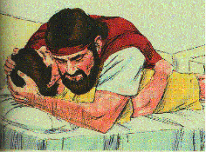
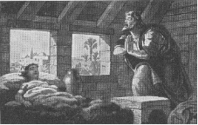
b. The resurrection of the widow’s son 17-24
21 Then he stretched himself upon the child three times, and called to the LORD, and said, "O LORD my God, I pray Thee, let this child’s life return to him."

Slide 14
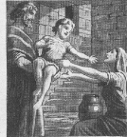
b. The resurrection of the widow’s son 17-24
22 And the LORD heard the voice of Elijah, and the life of the child returned to him and he revived.
23 And Elijah took the child, and brought him down from the upper room into the house and gave him to his mother; and Elijah said, "See, your son is alive."
24 Then the woman said to Elijah, "Now I know that you are a man of God, and that the word of the LORD in your mouth is truth."

Slide 15
The Great Contest on Carmel 18:1-46
1. The arrangements for the contest 18:1-20

Slide 16
a. Elijah’s conversation with Obadiah 18:1-16
1 Now it came about after many days, that the word of the LORD came to Elijah in the third year, saying, "Go, show yourself to Ahab, and I will send rain on the face of the earth."
2 So Elijah went to show himself to Ahab. Now the famine was severe in Samaria.

Slide 17
a. Elijah’s conversation with Obadiah 18:1-16
3 And Ahab called Obadiah who was over the household. (Now Obadiah feared the LORD greatly;
4 for it came about, when Jezebel destroyed the prophets of the LORD, that Obadiah took a hundred prophets and hid them by fifties in a cave, and provided them with bread and water.)
5 Then Ahab said to Obadiah, "Go through the land to all the springs of water and to all the valleys; perhaps we will find grass and keep the horses and mules alive, and not have to kill some of the cattle."
6 So they divided the land between them to survey it; Ahab went one way by himself and Obadiah went another way by himself.

Slide 18
a. Elijah’s conversation with Obadiah 18:1-16
7 Now as Obadiah was on the way, behold, Elijah met him, and he recognized him and fell on his face and said, "Is this you, Elijah my master?"
8 And he said to him, "It is I. Go, say to your master, ‘Behold, Elijah is here.’"
9 And he said, "What sin have I committed, that you are giving your servant into the hand of Ahab, to put me to death?
10 "As the LORD your God lives, there is no nation or kingdom where my master has not sent to search for you; and when they said, ‘He is not here,’ he made the kingdom or nation swear that they could not find you.
11 "And now you are saying, ‘Go, say to your master, "Behold, Elijah is here."’

Slide 19
a. Elijah’s conversation with Obadiah 18:1-16
12 "And it will come about when I leave you that the Spirit of the LORD will carry you where I do not know; so when I come and tell Ahab and he cannot find you, he will kill me, although I your servant have feared the LORD from my youth.
13 "Has it not been told to my master what I did when Jezebel killed the prophets of the LORD, that I hid a hundred prophets of the LORD by fifties in a cave, and provided them with bread and water?
14 "And now you are saying, ‘Go, say to your master, "Behold, Elijah is here"’; he will then kill me."
15 And Elijah said, "As the LORD of hosts lives, before whom I stand, I will surely show myself to him today."
16 So Obadiah went to meet Ahab, and told him; and Ahab went to meet Elijah.

Slide 20
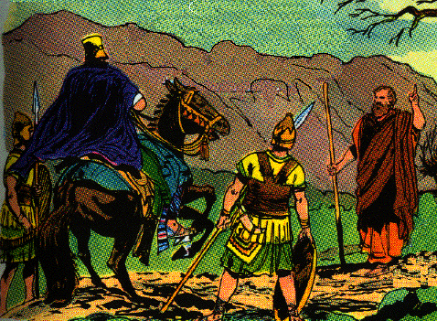
b. Elijah’s challenge of Ahab 18:17-20
17 And it came about, when Ahab saw Elijah that Ahab said to him, "Is this you, you troubler of Israel?"

Slide 21
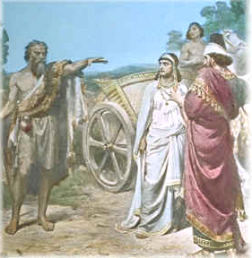
b. Elijah’s challenge of Ahab 18:17-20
18 And he said, "I have not troubled Israel, but you and your father’s house have, because you have forsaken the commandments of the LORD, and you have followed the Baals.

Slide 22
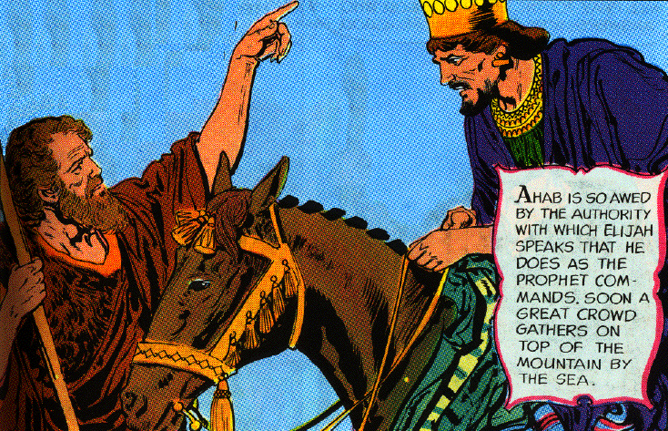
b. Elijah’s challenge of Ahab 18:17-20
19 "Now then send and gather to me all Israel at Mount Carmel, together with 450 prophets of Baal and 400 prophets of the Asherah, who eat at Jezebel’s table."
20 So Ahab sent a message among all the sons of Israel, and brought the prophets together at Mount Carmel.

Slide 24
2. Description of the contest 18:21-40

Slide 25
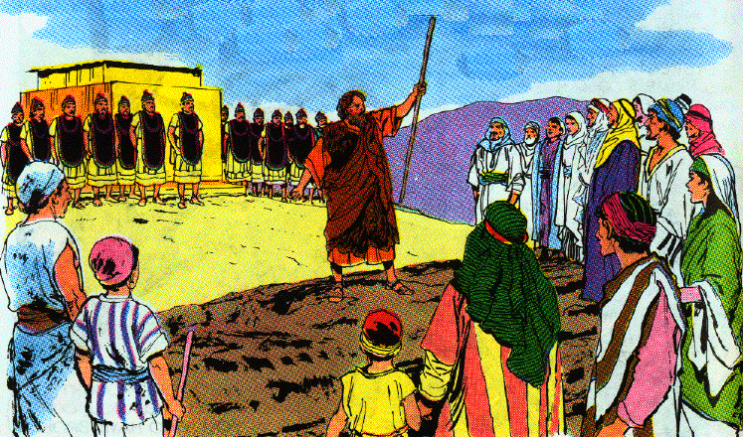
a. The preliminaries of the contest 18:21-24
21 And Elijah came near to all the people and said, "How long will you hesitate between two opinions? If the LORD is God, follow Him; but if Baal, follow him." But the people did not answer him a word.
22 Then Elijah said to the people, "I alone am left a prophet of the LORD, but Baal’s prophets are 450 men.

Slide 26
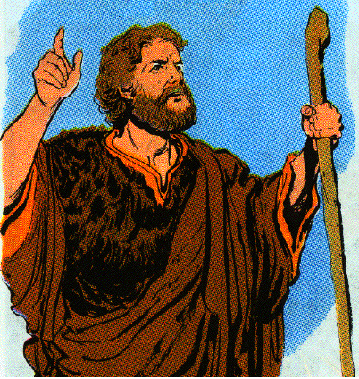
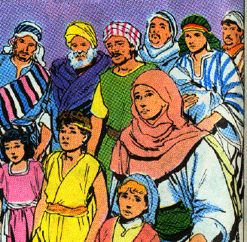
a. The preliminaries of the contest 18:21-24
23 "Now let them give us two oxen; and let them choose one ox for themselves and cut it up, and place it on the wood, but put no fire under it; and I will prepare the other ox, and lay it on the wood, and I will not put a fire under it.
24a "Then you call on the name of your god, and I will call on the name of the LORD, and the God who answers by fire, He is God."
24b And all the people answered and said, "That is a good idea."

Slide 27
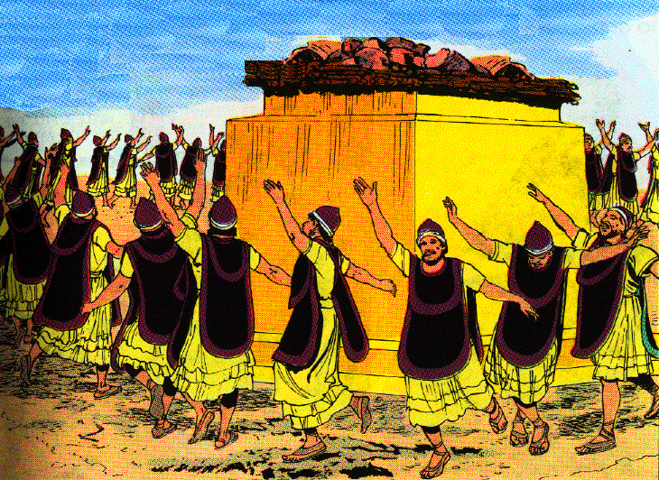
b. The prayers of the Baal prophets 18:25-29
25 So Elijah said to the prophets of Baal, "Choose one ox for yourselves and prepare it first for you are many, and call on the name of your god, but put no fire under it."
26 Then they took the ox which was given them and they prepared it and called on the name of Baal from morning until noon saying, "O Baal, answer us." But there was no voice and no one answered. And they leaped about the altar which they made.

Slide 28
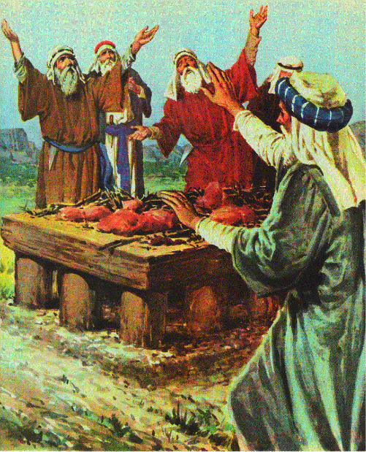
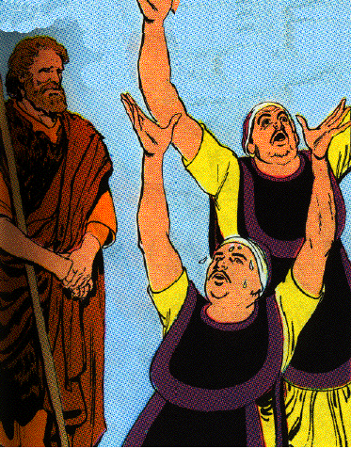
b. The prayers of the Baal prophets 18:25-29
27 And it came about at noon, that Elijah mocked them and said, "Call out with a loud voice, for he is a god; either he is occupied or gone aside, or is on a journey, or perhaps he is asleep and needs to be awakened."

Slide 29
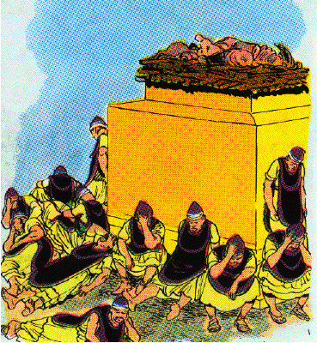
b. The prayers of the Baal prophets 18:25-29
28 So they cried with a loud voice and cut themselves according to their custom with swords and lances until the blood gushed out on them.
29 And it came about when midday was past, that they raved until the time of the offering of the evening sacrifice; but there was no voice, no one answered, and no one paid attention.

Slide 30
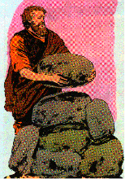
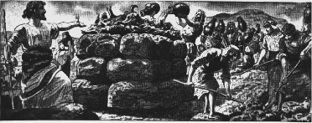
c. The preparations and prayer of Elijah 18:30-38
30 Then Elijah said to all the people, "Come near to me." So all the people came near to him. And he repaired the altar of the LORD which had been torn down.
31 And Elijah took twelve stones according to the number of the tribes of the sons of Jacob, to whom the word of the LORD had come, saying, "Israel shall be your name."
32 So with the stones he built an altar in the name of the LORD, and he made a trench around the altar, large enough to hold two measures of seed.

Slide 31
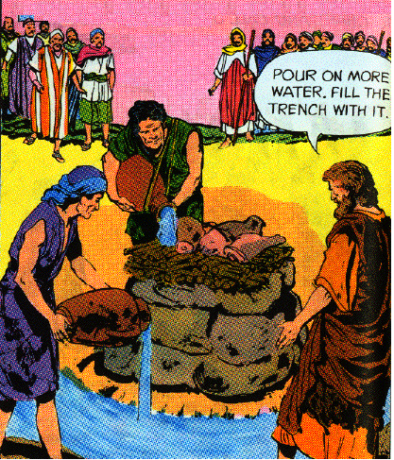
c. The preparations and prayer of Elijah 18:30-38
33 Then he arranged the wood and cut the ox in pieces and laid it on the wood. And he said, "Fill four pitchers with water and pour it on the burnt offering and on the wood."
34 And he said, "Do it a second time," and they did it a second time. And he said, "Do it a third time," and they did it a third time.
35 And the water flowed around the altar, and he also filled the trench with water.

Slide 32
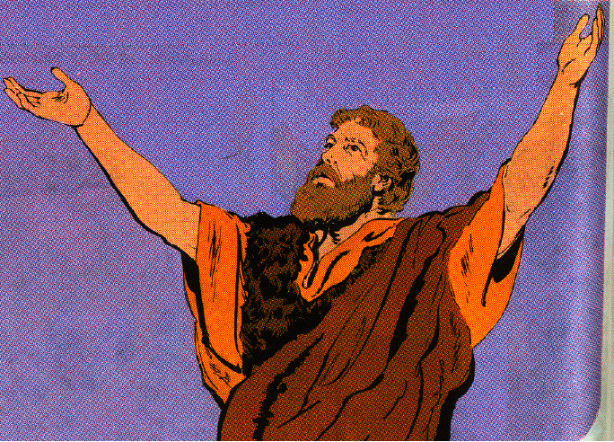
c. The preparations and prayer of Elijah 18:30-38
36 Then it came about at the time of the offering of the evening sacrifice, that Elijah the prophet came near and said, "O LORD, the God of Abraham, Isaac and Israel, today let it be known that Thou art God in Israel, and that I am Thy servant, and that I have done all these things at Thy word.
37 "Answer me, O LORD, answer me, that this people may know that Thou, O LORD, art God, and that Thou hast turned their heart back again."

Slide 33
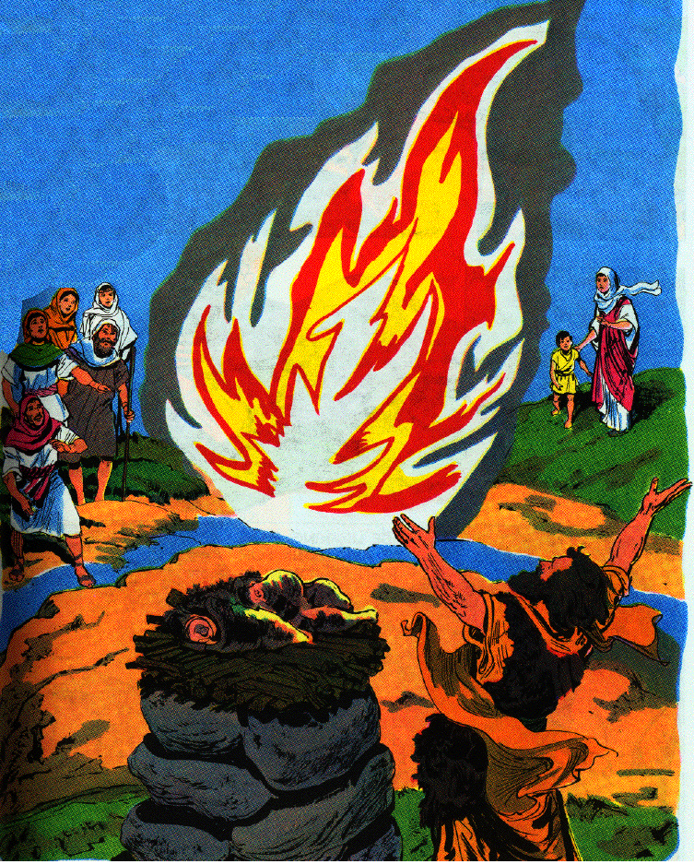
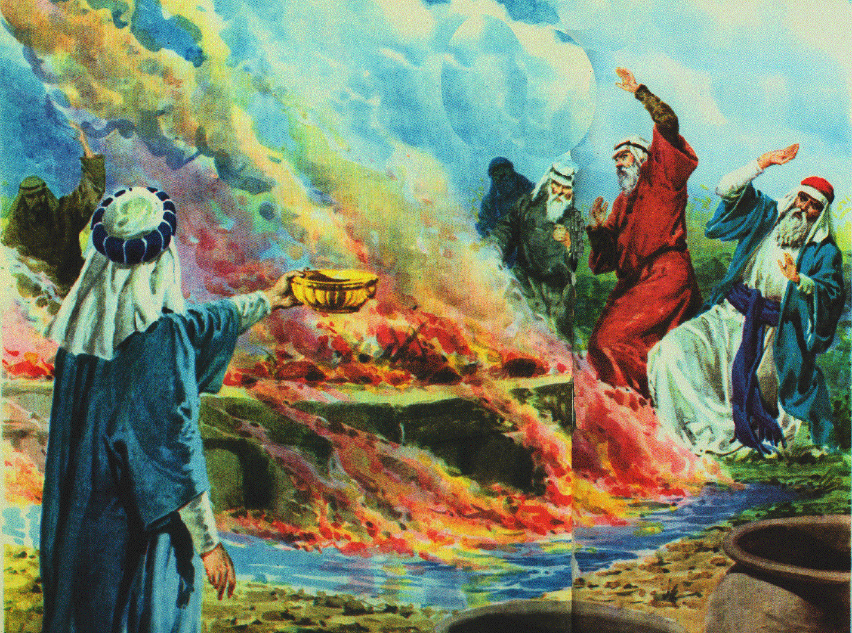
c. The preparations and prayer of Elijah 18:30-38
38 Then the fire of the LORD fell, and consumed the burnt offering and the wood and the stones and the dust, and licked up the water that was in the trench.

Slide 34
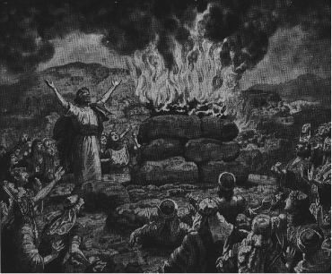
d. The punishment of the false prophets 18:39-40
39 And when all the people saw it, they fell on their faces; and they said, "The LORD, He is God; the LORD, He is God."

Slide 35
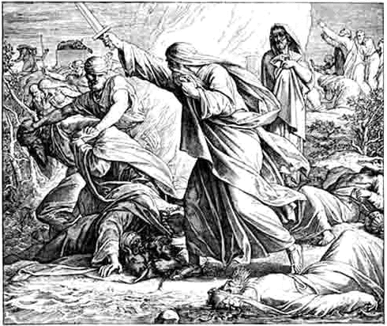
d. The punishment of the false prophets 18:39-40
40 Then Elijah said to them, "Seize the prophets of Baal; do not let one of them escape." So they seized them; and Elijah brought them down to the brook Kishon, and slew them there. Ex. 22:20; Deut. 13; Deut. 17:2-7

Slide 36
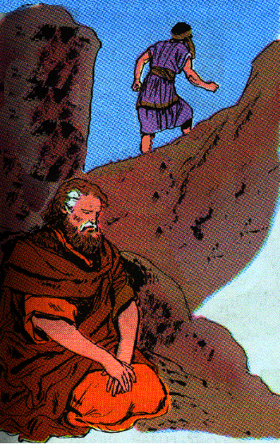
3. The aftermath of the contest 18:41-46
41 Now Elijah said to Ahab, "Go up, eat and drink; for there is the sound of the roar of a heavy shower."
42 So Ahab went up to eat and drink. But Elijah went up to the top of Carmel; and he crouched down on the earth, and put his face between his knees.
43 And he said to his servant, "Go up now, look toward the sea." So he went up and looked and said, "There is nothing." And he said, "Go back" seven times.

Slide 37
3. The aftermath of the contest 18:41-46
44 And it came about at the seventh time, that he said, "Behold, a cloud as small as a man’s hand is coming up from the sea." And he said, "Go up, say to Ahab, ‘Prepare your chariot and go down, so that the heavy shower does not stop you.’"

Slide 38
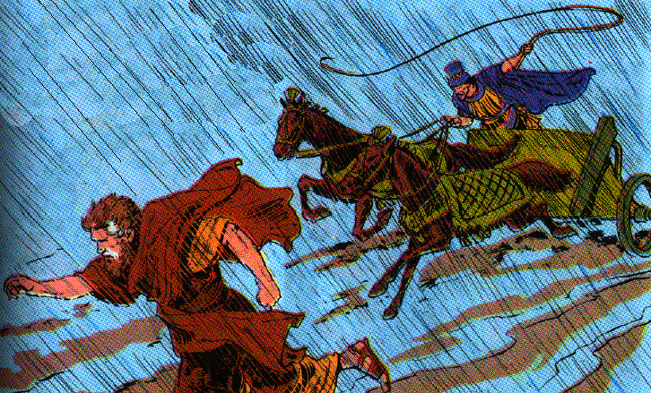
3. The aftermath of the contest 18:41-46
45 So it came about in a little while, that the sky grew black with clouds and wind, and there was a heavy shower. And Ahab rode and went to Jezreel.
46 Then the hand of the LORD was on Elijah, and he girded up his loins and outran Ahab to Jezreel.

Slide 39
V. Three Great Crises in Israel 19:1—21:29
A. The Great Spiritual Crisis of Elijah 19:1-21

Slide 40
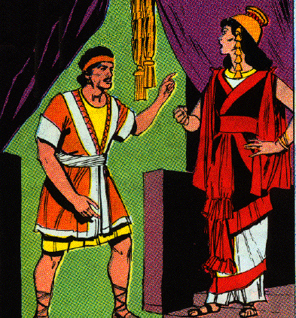
1. Elijah’s flight from Jezebel 19:1-8
1 Now Ahab told Jezebel all that Elijah had done, and how he had killed all the prophets with the sword.

Slide 41
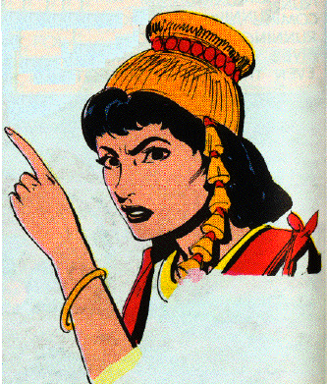
1. Elijah’s flight from Jezebel 19:1-8
2 Then Jezebel sent a messenger to Elijah, saying, "So may the gods do to me and even more, if I do not make your life as the life of one of them by tomorrow about this time."

Slide 42
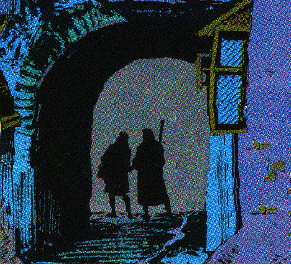
1. Elijah’s flight from Jezebel 19:1-8
3 And he was afraid and arose and ran for his life and came to Beersheba, which belongs to Judah, and left his servant there.

Slide 43
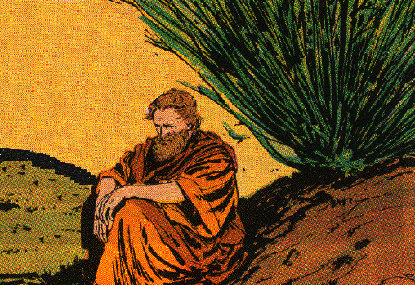
1. Elijah’s flight from Jezebel 19:1-8
4 But he himself went a day’s journey into the wilderness, and came and sat down under a juniper tree; and he requested for himself that he might die, and said, "It is enough; now, O LORD, take my life, for I am not better than my fathers."

Slide 44
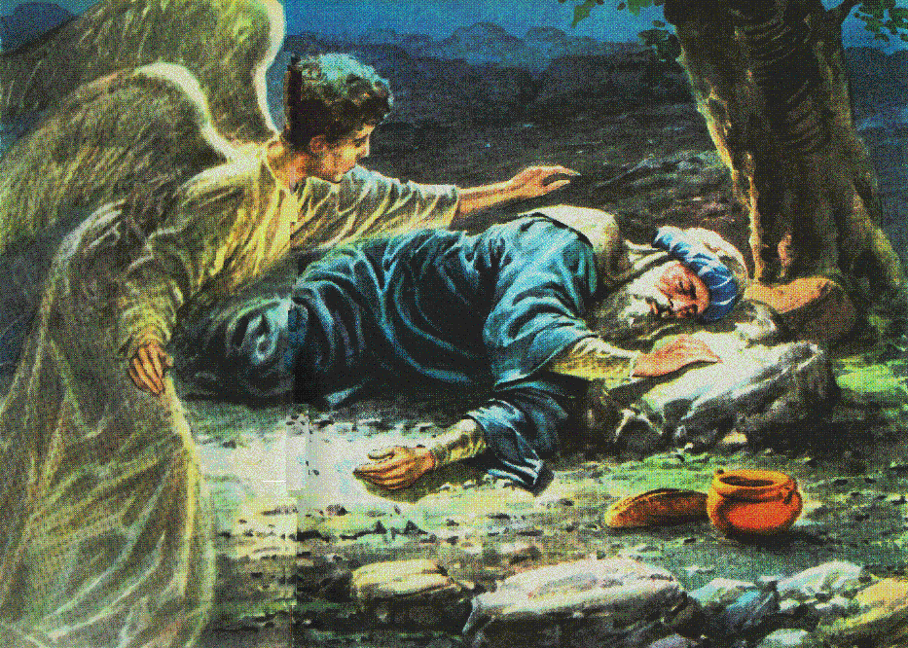
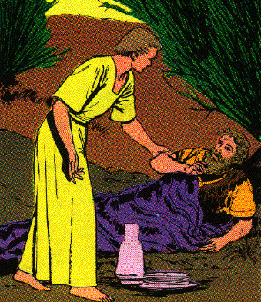
1. Elijah’s flight from Jezebel 19:1-8
5 And he lay down and slept under a juniper tree; and behold, there was an angel touching him, and he said to him, "Arise, eat."
6 Then he looked and behold, there was at his head a bread cake baked on hot stones, and a jar of water. So he ate and drank and lay down again.
7 And the angel of the LORD came again a second time and touched him and said, "Arise, eat, because the journey is too great for you."

Slide 45
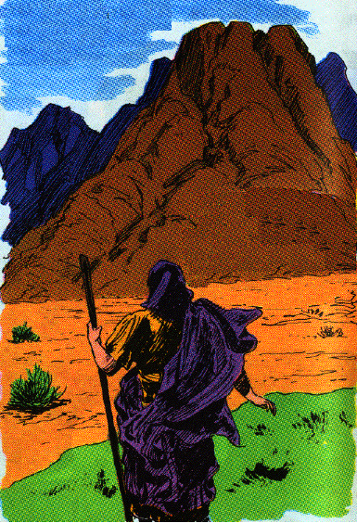
1. Elijah’s flight from Jezebel 19:1-8
8 So he arose and ate and drank, and went in the strength of that food forty days and forty nights to Horeb, the mountain of God.

Slide 46
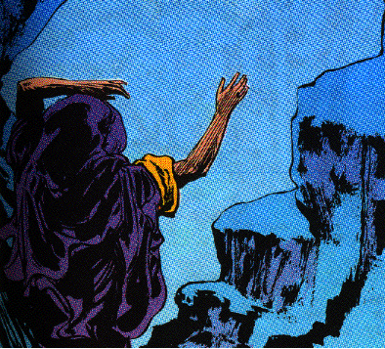
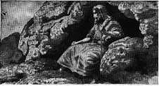
2. Elijah’s reassurance from God 19:9-18
9 Then he came there to a cave, and lodged there; and behold, the word of the LORD came to him, and He said to him, "What are you doing here, Elijah?"

Slide 47
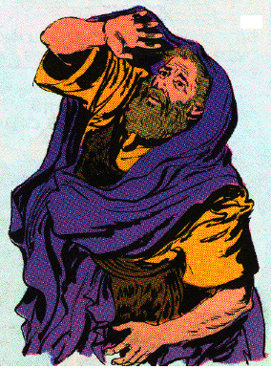
2. Elijah’s reassurance from God 19:9-18
10 And he said, "I have been very zealous for the LORD, the God of hosts; for the sons of Israel have forsaken Thy covenant, torn down Thine altars and killed Thy prophets with the sword. And I alone am left; and they seek my life, to take it away."

Slide 48
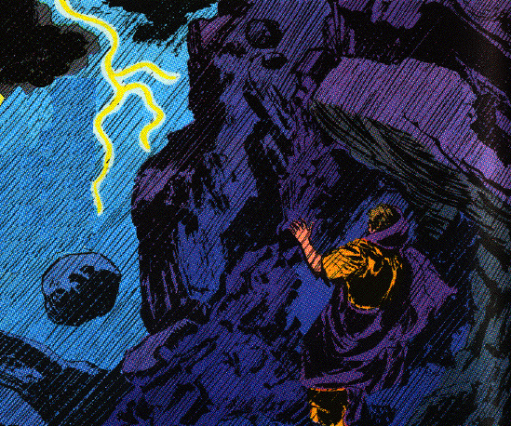
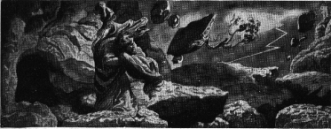
2. Elijah’s reassurance from God 19:9-18
11 So He said, "Go forth, and stand on the mountain before the LORD." And behold, the LORD was passing by! And a great and strong wind was rending the mountains and breaking in pieces the rocks before the LORD; but the LORD was not in the wind. And after the wind an earthquake, but the LORD was not in the earthquake.

Slide 49
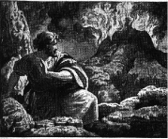
2. Elijah’s reassurance from God 19:9-18
12 And after the earthquake a fire, but the LORD was not in the fire; and after the fire a sound of a gentle blowing.

Slide 50
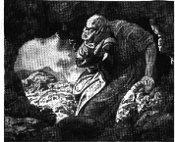
2. Elijah’s reassurance from God 19:9-18
13 And it came about when Elijah heard it, that he wrapped his face in his mantle, and went out and stood in the entrance of the cave. And behold, a voice came to him and said, "What are you doing here, Elijah?"

Slide 51
2. Elijah’s reassurance from God 19:9-18
14 Then he said, "I have been very zealous for the LORD, the God of hosts; for the sons of Israel have forsaken Thy covenant, torn down Thine altars and killed Thy prophets with the sword. And I alone am left; and they seek my life, to take it away."
15 And the LORD said to him, "Go, return on your way to the wilderness of Damascus, and when you have arrived, you shall anoint Hazael king over Aram;
16 and Jehu the son of Nimshi you shall anoint king over Israel; and Elisha the son of Shaphat of Abel-meholah you shall anoint as prophet in your place.
17 "And it shall come about, the one who escapes from the sword of Hazael, Jehu shall put to death, and the one who escapes from the sword of Jehu, Elisha shall put to death.
18 "Yet I will leave 7,000 in Israel, all the knees that have not bowed to Baal and every mouth that has not kissed him."

Slide 52
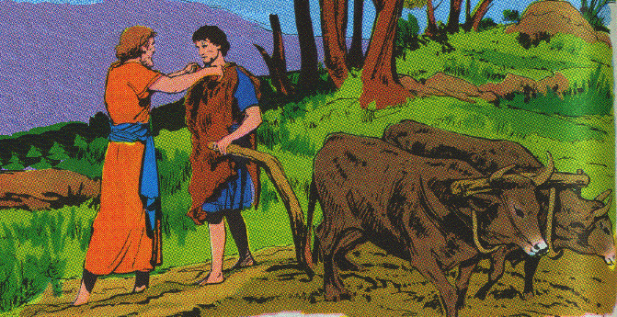
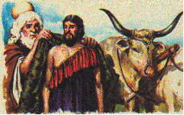
3. Elijah’s call of Elisha 19:19-21
19 So he departed from there and found Elisha the son of Shaphat, while he was plowing with twelve pairs of oxen before him, and he with the twelfth. And Elijah passed over to him and threw his mantle on him.

Slide 53
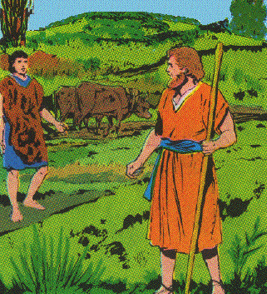
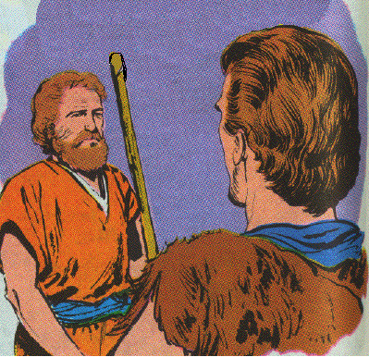
3. Elijah’s call of Elisha 19:19-21
20 And he left the oxen and ran after Elijah and said, "Please let me kiss my father and my mother, then I will follow you." And he said to him, "Go back again, for what have I done to you?"

Slide 54
3. Elijah’s call of Elisha 19:19-21
21 So he returned from following him, and took the pair of oxen and sacrificed them and boiled their flesh with the implements of the oxen, and gave it to the people and they ate. Then he arose and followed Elijah and ministered to him.

Slide 55
B. The Great Military Crisis (Invasion by Ben-hadad) 20:1-43
1. The Aramean siege of Samaria 20:1-22

Slide 57
a. The demands of Ben-hadad 20:1-12
1. Ahab’s offer of tribute rejected 1-6
1 Now Ben-hadad king of Aram gathered all his army, and there were thirty-two kings with him, and horses and chariots. And he went up and besieged Samaria, and fought against it.
2 Then he sent messengers to the city to Ahab king of Israel, and said to him, "Thus says Ben-hadad,
3 ‘Your silver and your gold are mine; your most beautiful wives and children are also mine.’"
4 And the king of Israel answered and said, "It is according to your word, my lord, O king; I am yours, and all that I have."

Slide 58
a. The demands of Ben-hadad 20:1-12
1. Ahab’s offer of tribute rejected 1-6
5 Then the messengers returned and said, "Thus says Ben-hadad, ‘Surely, I sent to you saying, "You shall give me your silver and your gold and your wives and your children,"
6 but about this time tomorrow I will send my servants to you, and they will search your house and the houses of your servants; and it shall come about, whatever is desirable in your eyes, they will take in their hand and carry away.’"

Slide 59
a. The demands of Ben-hadad 20:1-12
2. Ahab and the elders determine to fight 7-11
7 Then the king of Israel called all the elders of the land and said, "Please observe and see how this man is looking for trouble; for he sent to me for my wives and my children and my silver and my gold, and I did not refuse him."
8 And all the elders and all the people said to him, "Do not listen or consent."
9 So he said to the messengers of Ben-hadad, "Tell my lord the king, ‘All that you sent for to your servant at the first I will do, but this thing I cannot do.’" And the messengers departed and brought him word again.

Slide 60
a. The demands of Ben-hadad 20:1-12
2. Ahab and the elders determine to fight 7-11
10 And Ben-hadad sent to him and said, "May the gods do so to me and more also, if the dust of Samaria shall suffice for handfuls for all the people who follow me."
11 Then the king of Israel answered and said, "Tell him, ‘Let not him who girds on his armor boast like him who takes it off.’"

Slide 61
b. The deliverance of Samaria 20:12-21
12 And it came about when Ben-hadad heard this message, as he was drinking with the kings in the temporary shelters, that he said to his servants, "Station yourselves." So they stationed themselves against the city.
13 Now behold, a prophet approached Ahab king of Israel and said, "Thus says the LORD, ‘Have you seen all this great multitude? Behold, I will deliver them into your hand today, and you shall know that I am the LORD.’"
14 And Ahab said, "By whom?" So he said, "Thus says the LORD, ‘By the young men of the rulers of the provinces.’" Then he said, "Who shall begin the battle?" And he answered, "You."

Slide 62
b. The deliverance of Samaria 20:12-21
15 Then he mustered the young men of the rulers of the provinces, and there were 232; and after them he mustered all the people, even all the sons of Israel, 7,000.
16 And they went out at noon, while Ben-hadad was drinking himself drunk in the temporary shelters with the thirty-two kings who helped him.
17 And the young men of the rulers of the provinces went out first; and Ben-hadad sent out and they told him, saying, "Men have come out from Samaria."
18 Then he said, "If they have come out for peace, take them alive; or if they have come out for war, take them alive."

Slide 63
b. The deliverance of Samaria 20:12-21
19 So these went out from the city, the young men of the rulers of the provinces, and the army which followed them.
20 And they killed each his man; and the Arameans fled, and Israel pursued them, and Ben-hadad king of Aram escaped on a horse with horsemen.
21 And the king of Israel went out and struck the horses and chariots, and killed the Arameans with a great slaughter.

Slide 64
2. The battle of Aphek 20:23-43
a. The Aramean war counsels 23-25
23 Now the servants of the king of Aram said to him, "Their gods are gods of the mountains, therefore they were stronger than we; but rather let us fight against them in the plain, and surely we shall be stronger than they.
24 "And do this thing: remove the kings, each from his place, and put captains in their place,
25 and muster an army like the army that you have lost, horse for horse, and chariot for chariot. Then we will fight against them in the plain, and surely we shall be stronger than they. "And he listened to their voice and did so.

Slide 65
2. The battle of Aphek 20:23-43
b. The confrontation at Aphek 26-30a
26 So it came about at the turn of the year, that Ben-hadad mustered the Arameans and went up to Aphek to fight against Israel.
27 And the sons of Israel were mustered and were provisioned and went to meet them; and the sons of Israel camped before them like two little flocks of goats, but the Arameans filled the country.
28 Then a man of God came near and spoke to the king of Israel and said, "Thus says the LORD, ‘Because the Arameans have said, "The LORD is a god of the mountains, but He is not a god of the valleys"; therefore I will give all this great multitude into your hand, and you shall know that I am the LORD.’"
29 So they camped one over against the other seven days. And it came about that on the seventh day, the battle was joined, and the sons of Israel killed of the Arameans 100,000 foot soldiers in one day.
30 But the rest fled to Aphek into the city, and the wall fell on 27,000 men who were left. And Ben-hadad fled and came into the city into an inner chamber.

Slide 66
2. The battle of Aphek 20:23-43
b. The confrontation at Aphek 26-30a
29 So they camped one over against the other seven days. And it came about that on the seventh day, the battle was joined, and the sons of Israel killed of the Arameans 100,000 foot soldiers in one day.
30a But the rest fled to Aphek into the city, and the wall fell on 27,000 men who were left.

Slide 67
2. The battle of Aphek 20:23-43
c. The clemency granted Ben-hadad 30b-34
30b And Ben-hadad fled and came into the city into an inner chamber.
31 And his servants said to him, "Behold now, we have heard that the kings of the house of Israel are merciful kings, please let us put sackcloth on our loins and ropes on our heads, and go out to the king of Israel; perhaps he will save your life."
32 So they girded sackcloth on their loins and put ropes on their heads, and came to the king of Israel and said, "Your servant Ben-hadad says, ‘Please let me live.’" And he said, "Is he still alive? He is my brother."

Slide 68
2. The battle of Aphek 20:23-43
c. The clemency granted Ben-hadad 30b-34
33 Now the men took this as an omen, and quickly catching his word said, "Your brother Ben-hadad." Then he said, "Go, bring him." Then Ben-hadad came out to him, and he took him up into the chariot.
34 And Ben-hadad said to him, "The cities which my father took from your father I will restore, and you shall make streets for yourself in Damascus, as my father made in Samaria." Ahab said, "And I will let you go with this covenant." So he made a covenant with him and let him go.

Slide 69
2. The battle of Aphek 20:23-43
d. The prophetic condemnation of Ahab 35-43
35 Now a certain man of the sons of the prophets said to another by the word of the LORD, "Please strike me." But the man refused to strike him.
36 Then he said to him, "Because you have not listened to the voice of the LORD, behold, as soon as you have departed from me, a lion will kill you." And as soon as he had departed from him a lion found him, and killed him.
37 Then he found another man and said, "Please strike me." And the man struck him, wounding him.

Slide 70
2. The battle of Aphek 20:23-43
d. The prophetic condemnation of Ahab 35-43
38 So the prophet departed and waited for the king by the way, and disguised himself with a bandage over his eyes.
39 And as the king passed by, he cried to the king and said, "Your servant went out into the midst of the battle; and behold, a man turned aside and brought a man to me and said, ‘Guard this man; if for any reason he is missing, then your life shall be for his life, or else you shall pay a talent of silver.’
40 "And while your servant was busy here and there, he was gone." And the king of Israel said to him, "So shall your judgment be; you yourself have decided it."

Slide 71
2. The battle of Aphek 20:23-43
d. The prophetic condemnation of Ahab 35-43
41 Then he hastily took the bandage away from his eyes, and the king of Israel recognized him that he was of the prophets.
42 And he said to him, "Thus says the LORD, ‘Because you have let go out of your hand the man whom I had devoted to destruction, therefore your life shall go for his life, and your people for his people.’"
43 So the king of Israel went to his house sullen and vexed, and came to Samaria.

