Slide 1
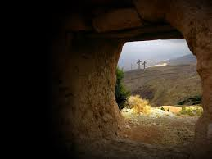
The Story of Jesus, the Cross and Salvation

Slide 2
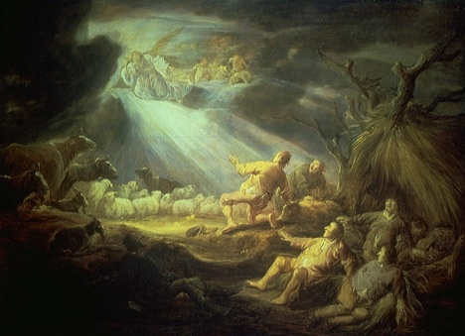
Tell me the story of Jesus, Write on my heart every word; Tell me the story most precious, Sweetest that ever was heard. Tell how the angels in chorus, Sang as they welcomed His birth, “Glory to God in the highest! Peace and good tidings to earth.”

Slide 3
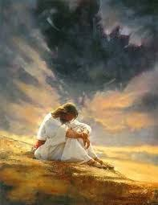
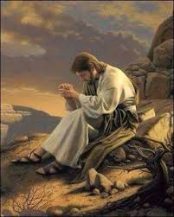
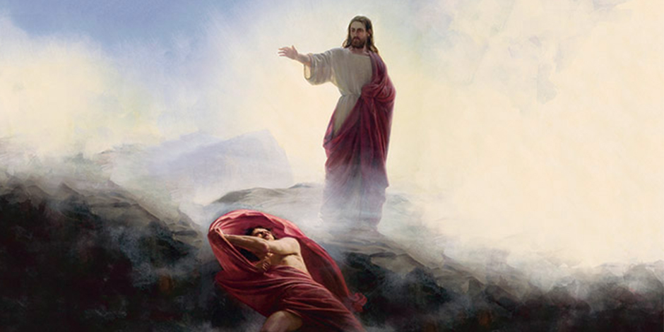
Fasting alone in the desert, Tell of the days that are past, How for our sins He was tempted, Yet was triumphant at last. Tell of the years of His labor, Tell of the sorrow He bore; He was despised and afflicted, Homeless, rejected and poor.

Slide 4
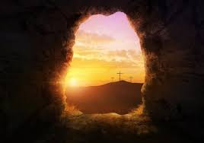
Tell of the cross where they nailed Him, Writhing in anguish and pain; Tell of the grave where they laid Him, Tell how He liveth again. Love in that story so tender, Clearer than ever I see; Stay, let me weep while you whisper, “Love paid the ransom for me.”
Tell me the story of Jesus, Write on my heart every word; Tell me the story most precious, Sweetest that ever was heard.

Slide 5
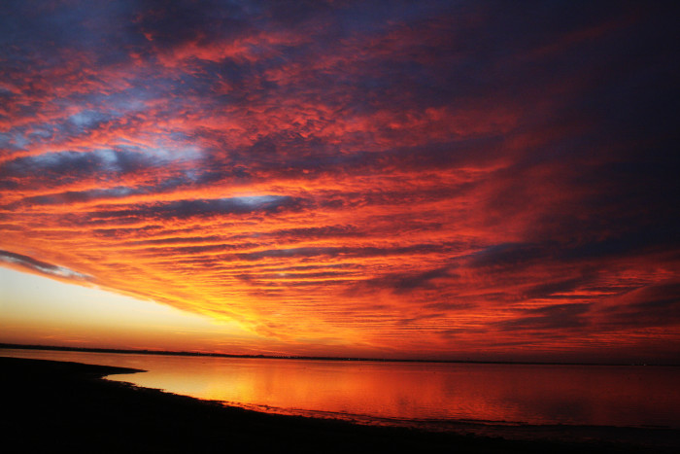
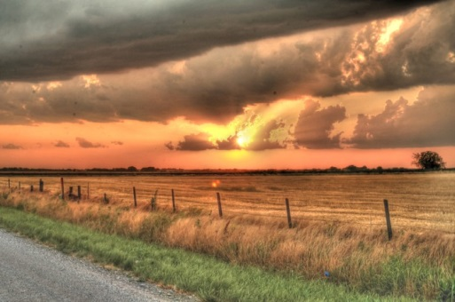
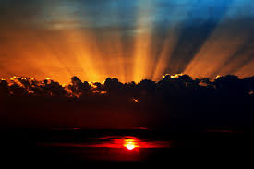
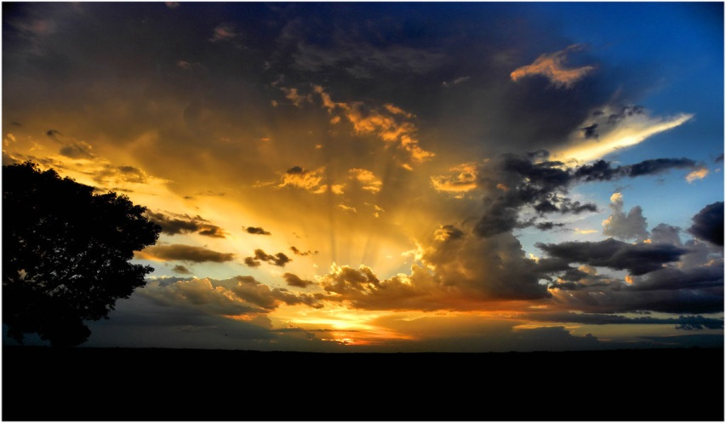
I love to tell the story Of unseen things above, Of Jesus and his glory, Of Jesus and his love.
I love to tell the story, Because I know 'tis true; It satisfies my longings As nothing else can do.
I love to tell the story, 'twill be my theme in glory, To tell the old, old story Of Jesus and his love.

Slide 6
Helping bring out the Message in these Beautiful Songs
Now we will sing these two songs in a medley. Words in yellow are meant to be sung louder and blue letter words, softer to help emphasize the key words and thoughts in these two songs.
We will change keys as we go back and forth between each song.

Slide 7
Tell me the story of Jesus, Write on my heart every word; Tell me the story most precious, Sweetest that ever was heard. Tell how the angels in chorus, Sang as they welcomed His birth, “Glory to God in the highest! Peace and good tidings to earth.”

Slide 8
Tell of the cross where they nailed Him, Writhing in anguish and pain; Tell of the grave where they laid Him, Tell how He liveth again. Love in that story so tender, Clearer than ever I see; Stay, let me weep while you whisper, “Love paid the ransom for me.”

Slide 9
Tell me the story of Jesus, Write on my heart every word; Tell me the story most precious, Sweetest that ever was heard.

Slide 10
I love to tell the story Of unseen things above, Of Jesus and his glory, Of Jesus and his love.
I love to tell the story, Because I know 'tis true; It satisfies my longings As nothing else can do.
I love to tell the story, 'twill be my theme in glory, To tell the old, old story Of Jesus and his love.

Slide 11
Tell me the story of Jesus, Write on my heart every word; Tell me the story most precious, Sweetest that ever was heard.

