Slide 1
B. The Decree Against Jeroboam 14:1-20

Slide 2
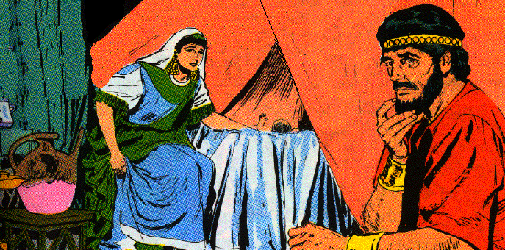
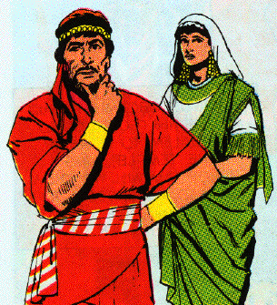
1. The mission of king’s wife 14:1-6
1 At that time Abijah the son of Jeroboam became sick.
2 And Jeroboam said to his wife, "Arise now, and disguise yourself so that they may not know that you are the wife of Jeroboam, and go to Shiloh; behold, Ahijah the prophet is there, who spoke concerning me that I would be king over this people.
3 "And take ten loaves with you, some cakes and a jar of honey, and go to him. He will tell you what will happen to the boy."

Slide 3
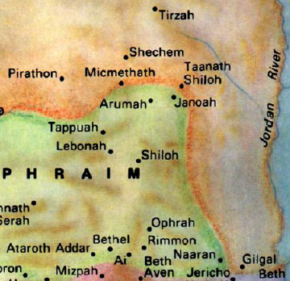

Slide 4
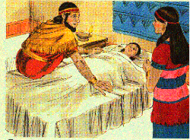
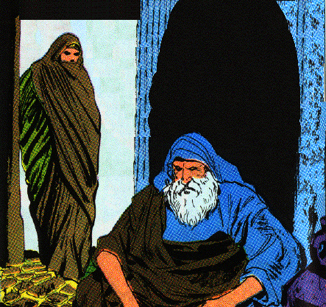
1. The mission of king’s wife 14:1-6
4 And Jeroboam’s wife did so, and arose and went to Shiloh, and came to the house of Ahijah. Now Ahijah could not see, for his eyes were dim because of his age.
5 Now the LORD had said to Ahijah, "Behold, the wife of Jeroboam is coming to inquire of you concerning her son, for he is sick. You shall say thus and thus to her, for it will be when she arrives that she will pretend to be another woman."
6 And it came about when Ahijah heard the sound of her feet coming in the doorway, that he said, "Come in, wife of Jeroboam, why do you pretend to be another woman? For I am sent to you with a harsh message.

Slide 5
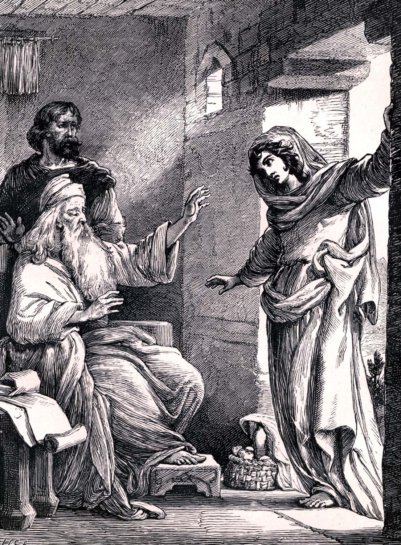
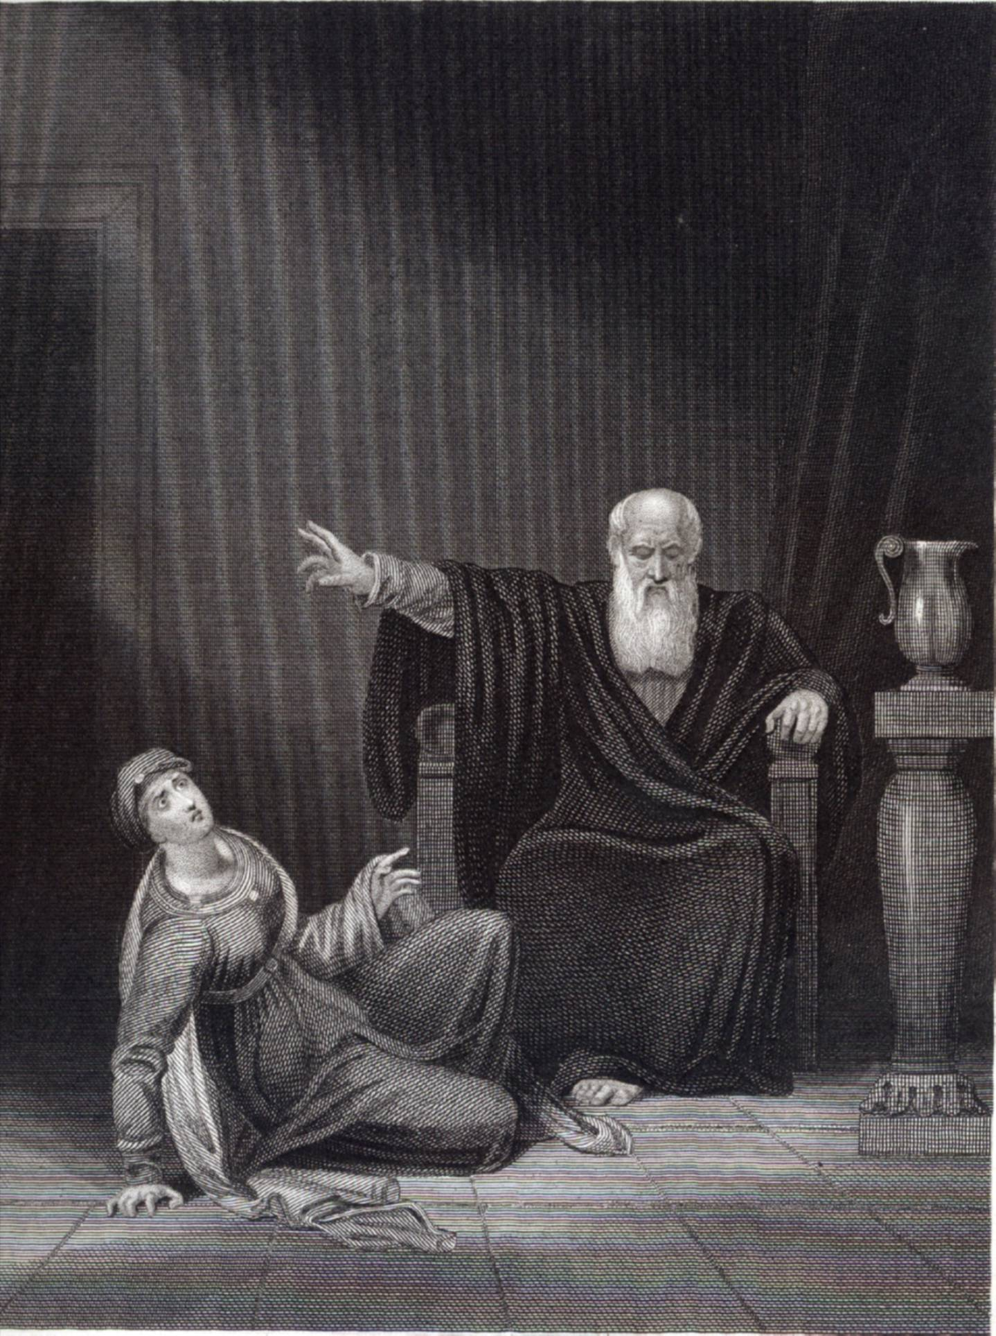
2. The message of Ahijah the prophet 14:7-16
7 "Go, say to Jeroboam, ‘Thus says the LORD God of Israel, "Because I exalted you from among the people and made you leader over My people Israel,
8 and tore the kingdom away from the house of David and gave it to you--yet you have not been like My servant David, who kept My commandments and who followed Me with all his heart, to do only that which was right in My sight;
9 you also have done more evil than all who were before you, and have gone and made for yourself other gods and molten images to provoke Me to anger, and have cast Me behind your back--
10 therefore behold, I am bringing calamity on the house of Jeroboam, and will cut off from Jeroboam every male person, both bond and free in Israel, and I will make a clean sweep of the house of Jeroboam, as one sweeps away dung until it is all gone.

Slide 6
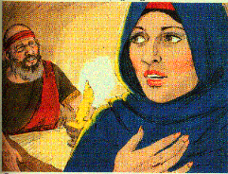
2. The message of Ahijah the prophet 14:7-16
11 "Anyone belonging to Jeroboam who dies in the city the dogs will eat. And he who dies in the field the birds of the heavens will eat; for the LORD has spoken it."’
12 "Now you arise, go to your house. When your feet enter the city the child will die.
13 "And all Israel shall mourn for him and bury him, for he alone of Jeroboam’s family shall come to the grave, because in him something good was found toward the LORD God of Israel in the house of Jeroboam.

Slide 7
2. The message of Ahijah the prophet 14:7-16
14 "Moreover, the LORD will raise up for Himself a king over Israel who shall cut off the house of Jeroboam this day and from now on.
15 "For the LORD will strike Israel, as a reed is shaken in the water; and He will uproot Israel from this good land which He gave to their fathers, and will scatter them beyond the Euphrates River, because they have made their Asherim, provoking the LORD to anger.
16 "And He will give up Israel on account of the sins of Jeroboam, which he committed and with which he made Israel to sin."

Slide 8
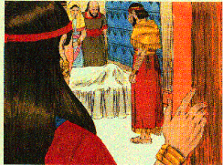
3. The mourning for the king’s son 14:17, 18
17 Then Jeroboam’s wife arose and departed and came to Tirzah. As she was entering the threshold of the house, the child died.
18 And all Israel buried him and mourned for him, according to the word of the LORD which He spoke through His servant Ahijah the prophet.

Slide 9
4. Concluding note on the reign of Jeroboam 19, 20
19 Now the rest of the acts of Jeroboam, how he made war and how he reigned, behold, they are written in the Book of the Chronicles of the Kings of Israel.
20 And the time that Jeroboam reigned was twenty-two years; and he slept with his fathers, and Nadab his son reigned in his place.
Elah
Zimri
Nadab
911-10
885
Jeroboam 22 yrs.
Baasha 24 yrs.
930
913
911
Rehoboam 17 yrs.
Abijam
3 yrs.
Asa 41 yrs.

Slide 10
III. The Kingdoms in Confrontation and Cooperation 14:21—16:34

Slide 11
A. The First Three Kings of Judah 14:21—15:24 (931-870 B.C.)
Rehoboam, Abijam, Asa
1. The apostasy of Rehoboam14:21-31
930
913
911
Rehoboam 17 yrs.
Abijam
3 yrs.
Asa 41 yrs.

Slide 12
a. The extent of the apostasy 21-24
21 Now Rehoboam the son of Solomon reigned in Judah. Rehoboam was forty-one years old when he became king, and he reigned seventeen years in Jerusalem, the city which the LORD had chosen from all the tribes of Israel to put His name there. And his mother’s name was Naamah the Ammonitess.
22 And Judah did evil in the sight of the LORD, and they provoked Him to jealousy more than all that their fathers had done, with the sins which they committed.
Influx of pious priests & Levites 2 C 11:13-17
Rehoboam built 15 fortified cities 2 C 11:5-12
18 wives, 60 concubines, 28 sons, 60 daughters 2 C 11:18-21
Sons scattered throughout Judah, supported, given responsibilities, Abijah, (Abijam) designated as crown prince 2 C 11:22-23
Rehoboam & Israel forsook the Law after he was established & strong 2 C 12:1

Slide 13
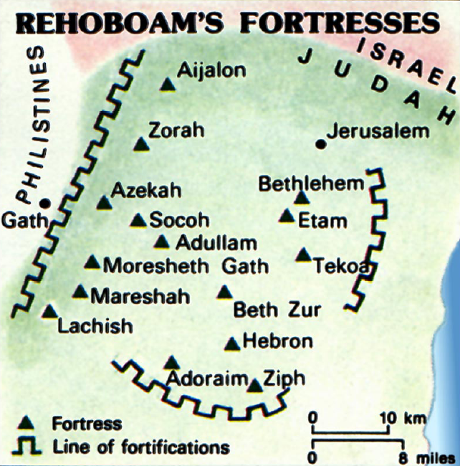

Slide 14
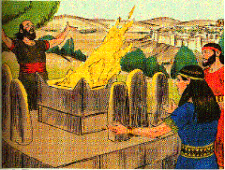
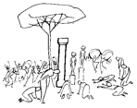
a. The extent of the apostasy 21-24
23 For they also built for themselves high places and sacred pillars and Asherim on every high hill and beneath every luxuriant tree.
24 And there were also male cult prostitutes in the land. They did according to all the abominations of the nations which the LORD dispossessed before the sons of Israel.

Slide 15
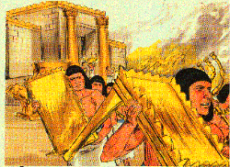
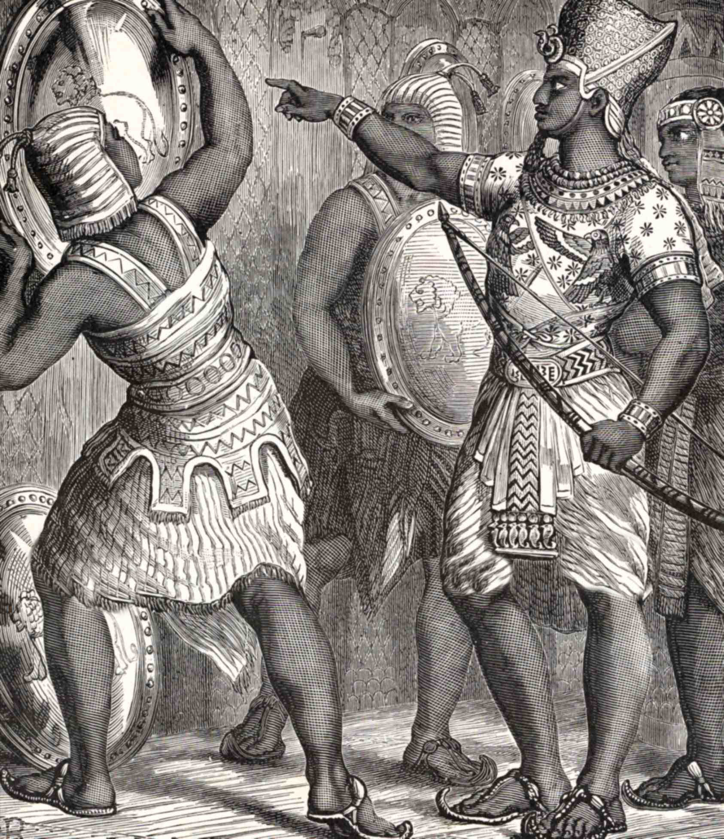
b. The punishment for the apostasy 25-28
25 Now it came about in the fifth year of King Rehoboam, that Shishak the king of Egypt came up against Jerusalem.
26 And he took away the treasures of the house of the LORD and the treasures of the king’s house, and he took everything, even taking all the shields of gold which Solomon had made.

Slide 16
Jerusalem not destroyed because Rehoboam & the nation repented 2 Chron. 12:5-8
5 Then Shemaiah the prophet came to Rehoboam and the princes of Judah who had gathered at Jerusalem because of Shishak, and he said to them, “Thus says the LORD, ‘You have forsaken Me, so I also have forsaken you to Shishak.’”
6 So the princes of Israel and the king humbled themselves and said, “The LORD is righteous.”
7 When the LORD saw that they humbled themselves, the word of the LORD came to Shemaiah, saying, “They have humbled themselves so I will not destroy them, but I will grant them some measure of deliverance, and My wrath shall not be poured out on Jerusalem by means of Shishak.
8 “But they will become his slaves so that they may learn the difference between My service and the service of the kingdoms of the countries.”

Slide 17
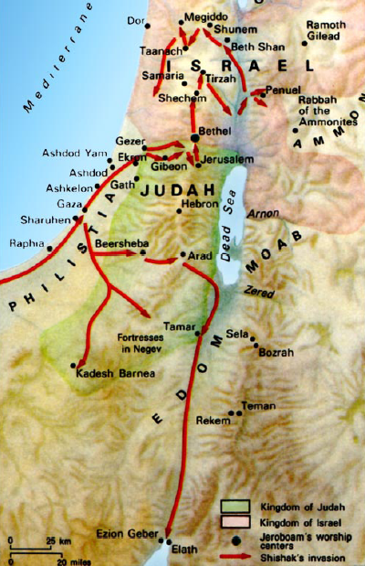

Slide 18
b. The punishment for the apostasy 25-28
27 So King Rehoboam made shields of bronze in their place, and committed them to the care of the commanders of the guard who guarded the doorway of the king’s house.
28 Then it happened as often as the king entered the house of the LORD, that the guards would carry them and would bring them back into the guards’ room.

Slide 19
c. Summary note about Rehoboam 29-31
29 Now the rest of the acts of Rehoboam and all that he did, are they not written in the Book of the Chronicles of the Kings of Judah?
30 And there was war between Rehoboam and Jeroboam continually.
31 And Rehoboam slept with his fathers, and was buried with his fathers in the city of David; and his mother’s name was Naamah the Ammonitess. And Abijam his son became king in his place.

Slide 20
2. The hypocrisy of Abijam 15:1-8

Slide 21
a. Abijam becomes king of Judah 15:1-3
1 Now in the eighteenth year of King Jeroboam, the son of Nebat, Abijam became king over Judah.
2 He reigned three years in Jerusalem; and his mother’s name was Maacah the daughter of Abishalom. [uh-BISHuh-luhm]
3 And he walked in all the sins of his father which he had committed before him; and his heart was not wholly devoted to the LORD his God, like the heart of his father David.

Slide 22
b. King for David’s sake 15:4, 5
4 But for David’s sake the LORD his God gave him a lamp in Jerusalem, to raise up his son after him and to establish Jerusalem;
5 because David did what was right in the sight of the LORD, and had not turned aside from anything that He commanded him all the days of his life, except in the case of Uriah the Hittite.

Slide 23
6 And there was war between Rehoboam and Jeroboam all the days of his life.
7 Now the rest of the acts of Abijam and all that he did, are they not written in the Book of the Chronicles of the Kings of Judah? And there was war between Abijam and Jeroboam.
8 And Abijam slept with his fathers and they buried him in the city of David; and Asa his son became king in his place.
Hostilities with Israel continued
2 C 13:3-20 Abijam invaded Israel w/ 400,000 & defeated 800,000 and annexed some of Israel & Jeroboam never recovered his strength
2 C 13:21 22 sons, 16 daughters, 14 wives

Slide 24
3. The reformation of Asa 15:9-24

Slide 25
Elah
Zimri
Nadab
911-10
885
Jeroboam 22 yrs.
Baasha 24 yrs.
930
913
911
Rehoboam 17 yrs.
Abijam
3 yrs.
Asa 41 yrs.
Divided Monarchy: Hostility Phase
(Sisters Quarreling)
930-885 BC

Slide 26
Elah
Zimri
Nadab
911-10
885
Jeroboam 22 yrs.
Baasha 24 yrs.
930
913
911
Rehoboam 17 yrs.
Abijam
3 yrs.
Asa 41 yrs.
Divided Monarchy: Hostility Phase
(Sisters Quarreling)
930-885 BC

Slide 27
a. Asa’s exercise of faith 15:9-15
9 So in the twentieth year of Jeroboam the king of Israel, Asa began to reign as king of Judah.
10 And he reigned forty-one years in Jerusalem; and his mother’s name was Maacah the daughter of Abishalom.
11 And Asa did what was right in the sight of the LORD, like David his father.

Slide 28
a. Asa’s exercise of faith 15:9-15
12 He also put away the male cult prostitutes from the land, and removed all the idols which his fathers had made.
13 And he also removed Maacah his mother from being queen mother, because she had made a horrid image as an Asherah; and Asa cut down her horrid image and burned it at the brook Kidron.
14 But the high places were not taken away; nevertheless the heart of Asa was wholly devoted to the LORD all his days.
15 And he brought into the house of the LORD the dedicated things of his father and his own dedicated things: silver and gold and utensils.

Slide 29
Information from 2 Chron. 14
A. Blessed with 10 years of peace & prosperity 1-8
- Fortified cities built & army strengthened
- 300,000 spearmen from Judah, 280,000 bowmen from Benjamin
B. Victory of Faith 9-15
- Invaded by Zerah the Ethiopian
- Meet in Mareshah for battle
- Asa prays & confesses total dependence on the LORD 9-11
- The LORD routes them - Judah pursues to Gerar, 5 miles S. of Gaza
- Much plunder - nearby cities sacked 12-15

Slide 30
Information from 2 Chron. 15
A. Prophetic Warning 1-7
- Prophet directed to Asa after battle by Spirit of God
- The Lord is with you when you are with Him
- Rehearsed days of Judges: forsaken, priestless, kingless, lawless, full of strife & oppression
- God trouble them with every kind of distress
- If Asa is strong & courageous, there would be reward for his work

Slide 31
Information from 2 Chron. 15
B. Renewed Revival 8-15
- Asa extends newly captured territories - removes idolatry
- Restores Altar of the Lord at temple
- Many pious northerners defected to Asa 8-9
- 15th year - Covenant renewal ceremony (700 oxen, 7,000 sheep)
- Covenant to seek the Lord with all their hearts
- Whoever would not seek Him should be executed
- The Lord let them find Him
- God gave them rest on every side

Slide 32
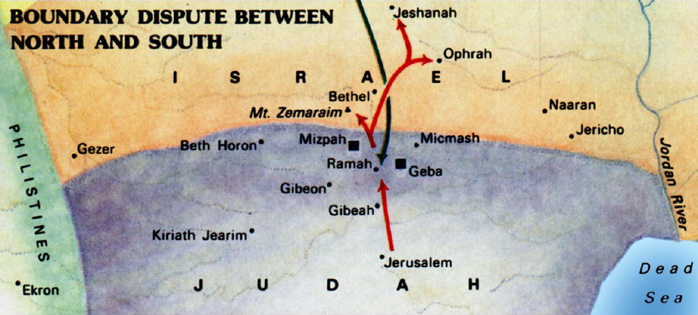
b. Asa’s failure of faith 1 Kings 15:16-22
16 Now there was war between Asa and Baasha king of Israel all their days.
17 And Baasha king of Israel went up against Judah and fortified Ramah in order to prevent anyone from going out or coming in to Asa king of Judah.

Slide 33
b. Asa’s failure of faith 15:16-22
18 Then Asa took all the silver and the gold which were left in the treasuries of the house of the LORD and the treasuries of the king’s house, and delivered them into the hand of his servants. And King Asa sent them to Ben-hadad the son of Tabrimmon (tab-RIM uhn), the son of Hezion (HEE zi ahn), king of Aram, who lived in Damascus, saying,
19 "Let there be a treaty between you and me, as between my father and your father. Behold, I have sent you a present of silver and gold; go, break your treaty with Baasha king of Israel so that he will withdraw from me."

Slide 34
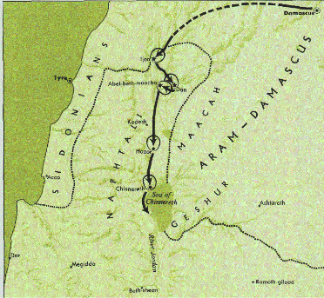
b. Asa’s failure of faith 15:16-22
20 So Ben-hadad listened to King Asa and sent the commanders of his armies against the cities of Israel, and conquered Ijon, Dan, Abel-beth-maacah and all Chinneroth, besides all the land of Naphtali.

Slide 35
b. Asa’s failure of faith 15:16-22
21 And it came about when Baasha heard of it that he ceased fortifying Ramah, and remained in Tirzah.
22 Then King Asa made a proclamation to all Judah--none was exempt--and they carried away the stones of Ramah and its timber with which Baasha had built. And King Asa built with them Geba of Benjamin and Mizpah.

Slide 36
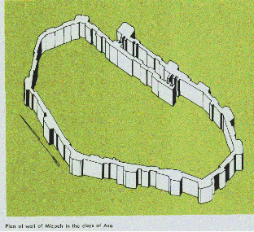

Slide 37
Asa reproved by Hanani 2 Chron. 16:7-10
7 At that time Hanani the seer came to Asa king of Judah and said to him, "Because you have relied on the king of Aram and have not relied on the LORD your God, therefore the army of the king of Aram has escaped out of your hand.
8 "Were not the Ethiopians and the Lubim an immense army with very many chariots and horsemen? Yet, because you relied on the LORD, He delivered them into your hand.
9 "For the eyes of the LORD move to and fro throughout the earth that He may strongly support those whose heart is completely His. You have acted foolishly in this. Indeed, from now on you will surely have wars."
10 Then Asa was angry with the seer and put him in prison, for he was enraged at him for this. And Asa oppressed some of the people at the same time.

Slide 38
c. Concluding statement 15:23-24
23 Now the rest of all the acts of Asa and all his might and all that he did and the cities which he built, are they not written in the Book of the Chronicles of the Kings of Judah? But in the time of his old age he was diseased in his feet.
24 And Asa slept with his fathers and was buried with his fathers in the city of David his father; and Jehoshaphat his son reigned in his place.
2 Chron. 16:12 In the thirty-ninth year of his reign Asa became diseased in his feet. His disease was severe, yet even in his disease he did not seek the LORD, but the physicians.

Slide 39
2 C 16:14 And they buried him in his own tomb which he had cut out for himself in the city of David, and they laid him in the resting place which he had filled with spices of various kinds blended by the perfumers’ art; and they made a very great fire for him.

Slide 40
B. The Kings of Israel
15:25—16:34
(910-870 B.C.)
Nadab, Baasha, Elah, Zimri, Omri, Ahab
Elah
Zimri
Nadab
910-09
885
874
Baasha 24 yrs.
Omri 24 yrs.
Ahab
Asa
Jehoshaphat

Slide 41
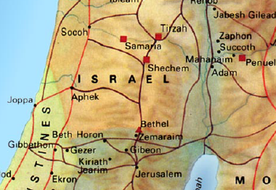
1. The fall of Jeroboam’s dynasty 15:25-31
25 Now Nadab the son of Jeroboam became king over Israel in the second year of Asa king of Judah, and he reigned over Israel two years.
26 And he did evil in the sight of the LORD, and walked in the way of his father and in his sin which he made Israel sin.
27 Then Baasha the son of Ahijah of the house of Issachar conspired against him, and Baasha struck him down at Gibbethon, which belonged to the Philistines, while Nadab and all Israel were laying siege to Gibbethon.
28 So Baasha killed him in the third year of Asa king of Judah, and reigned in his place.

Slide 42
1. The fall of Jeroboam’s dynasty 15:25-31
29 And it came about, as soon as he was king, he struck down all the household of Jeroboam. He did not leave to Jeroboam any persons alive, until he had destroyed them, according to the word of the LORD, which He spoke by His servant Ahijah the Shilonite,
30 and because of the sins of Jeroboam which he sinned, and which he made Israel sin, because of his provocation with which he provoked the LORD God of Israel to anger.
31 Now the rest of the acts of Nadab and all that he did, are they not written in the Book of the Chronicles of the Kings of Israel?

Slide 43
2. The Baasha dynasty 15:32—16:14

Slide 44
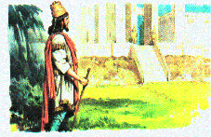
a. Reign of Baasha & prophecy of Jehu 15:32—16:7
32 And there was war between Asa and Baasha king of Israel all their days.
33 In the third year of Asa king of Judah, Baasha the son of Ahijah became king over all Israel at Tirzah, and reigned twenty-four years.
34 And he did evil in the sight of the LORD, and walked in the way of Jeroboam and in his sin which he made Israel sin.
Baasha

Slide 45
a. Reign of Baasha & prophecy of Jehu 15:32—16:7
16:1 Now the word of the LORD came to Jehu the son of Hanani against Baasha, saying,
2 "Inasmuch as I exalted you from the dust and made you leader over My people Israel, and you have walked in the way of Jeroboam and have made My people Israel sin, provoking Me to anger with their sins,
3 behold, I will consume Baasha and his house, and I will make your house like the house of Jeroboam the son of Nebat.

Slide 46
a. Reign of Baasha & prophecy of Jehu 15:32—16:7
5 Now the rest of the acts of Baasha and what he did and his might, are they not written in the Book of the Chronicles of the Kings of Israel?
6 And Baasha slept with his fathers and was buried in Tirzah, and Elah his son became king in his place.
7 Moreover, the word of the LORD through the prophet Jehu the son of Hanani also came against Baasha and his household, both because of all the evil which he did in the sight of the LORD, provoking Him to anger with the work of his hands, in being like the house of Jeroboam, and because he struck it.

Slide 47
b. The reign of Elah & his assassination by Zimri 16:8-14
8 In the twenty-sixth year of Asa king of Judah, Elah the son of Baasha became king over Israel at Tirzah, and reigned two years.
9 And his servant Zimri, commander of half his chariots, conspired against him. Now he was at Tirzah drinking himself drunk in the house of Arza, who was over the household at Tirzah.
10 Then Zimri went in and struck him and put him to death, in the twenty-seventh year of Asa king of Judah, and became king in his place.
11 And it came about, when he became king, as soon as he sat on his throne, that he killed all the household of Baasha; he did not leave a single male, neither of his relatives nor of his friends.

Slide 48
3. The seven day reign of Zimri 16:15-20
15 In the twenty-seventh year of Asa king of Judah, Zimri reigned seven days at Tirzah. Now the people were camped against Gibbethon, which belonged to the Philistines.
16 And the people who were camped heard it said, "Zimri has conspired and has also struck down the king." Therefore all Israel made Omri, the commander of the army, king over Israel that day in the camp.
17 Then Omri and all Israel with him went up from Gibbethon, and they besieged Tirzah.

Slide 49
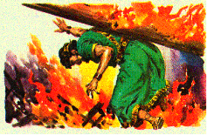
3. The seven day reign of Zimri 16:15-20
18 And it came about, when Zimri saw that the city was taken, that he went into the citadel of the king’s house and burned the king’s house over him with fire, and died,
19 because of his sins which he sinned, doing evil in the sight of the LORD, walking in the way of Jeroboam, and in his sin which he did, making Israel sin.
20 Now the rest of the acts of Zimri and his conspiracy which he carried out, are they not written in the Book of the Chronicles of the Kings of Israel?

Slide 50
4. The Omri dynasty 16:21-34

Slide 51
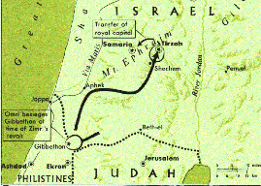
a. Omri’s rise to power 16:21-22
21 Then the people of Israel were divided into two parts: half of the people followed Tibni the son of Ginath, to make him king; the other half followed Omri.
22 But the people who followed Omri prevailed over the people who followed Tibni the son of Ginath. And Tibni died and Omri became king.

Slide 52
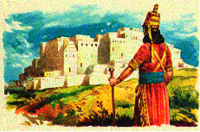
b. The reign of Omri 16:23-28
23 In the thirty-first year of Asa king of Judah, Omri became king over Israel, and reigned twelve years; he reigned six years at Tirzah.
24 And he bought the hill Samaria from Shemer for two talents of silver; and he built on the hill, and named the city which he built Samaria, after the name of Shemer, the owner of the hill.

Slide 53
Samaria
Capital of the northern kingdom, Israel, from Omri's time onwards, Samaria stood at a crossroads in the high country of Ephraim. The tell rose some 300ft above the surrounding fields. (This suggests an alternative explanation of the name Shomron to that given in 1 Kgs 16:24, the name may be derived from shmr "watch/guard" - Shomron = watch-hill.)
Remains of Ahab's Palace in Samaria

Slide 54
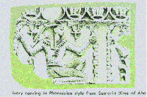

Slide 55
The collection of ivory pieces found on the site of the royal palace of Omri and Ahab

Slide 56
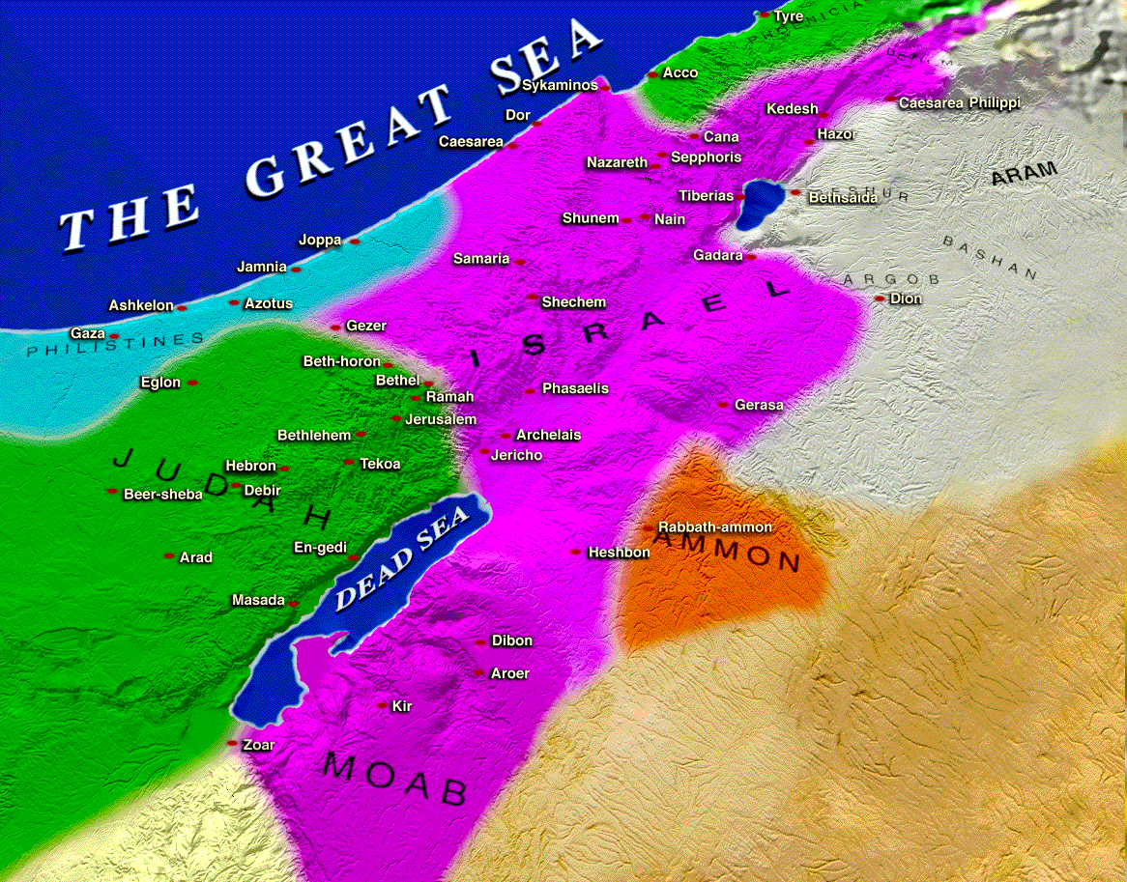

Slide 57
b. The reign of Omri 16:23-28
25 And Omri did evil in the sight of the LORD, and acted more wickedly than all who were before him.
26 For he walked in all the way of Jeroboam the son of Nebat and in his sins which he made Israel sin, provoking the LORD God of Israel with their idols.
27 Now the rest of the acts of Omri which he did and his might which he showed, are they not written in the Book of the Chronicles of the Kings of Israel?
28 So Omri slept with his fathers, and was buried in Samaria; and Ahab his son became king in his place.

Slide 58
"I Mesha, king of Moab, made this monument to Chemosh, to commemorate deliverance from Israel. My father reigned over Moab 30 years, and I reigned after my father. Omri, king of Israel oppressed Moab many days, and his son (Ahab) after him. But I made war against the king of Israel and drove him out, and took his cities, Medeba, Ataroth, Nebo, and Jahaz, which he built while he waged war against me. I destroyed his cities, and devoted the spoil to Chemosh, and the women and girls to Ashtar. I built Qorhah with prisoners from Israel."
"And Mesha king of Moab was a sheepmaster, and rendered unto the king of Israel an hundred thousand lambs, and an hundred thousand rams, with the wool. But it came to pass, when Ahab was dead, that the king of Moab rebelled against the king of Israel." - 2 Kings 3:4-5

Slide 59
c. The early years of Ahab 16:29-34
29 Now Ahab the son of Omri became king over Israel in the thirty-eighth year of Asa king of Judah, and Ahab the son of Omri reigned over Israel in Samaria twenty-two years.
30 And Ahab the son of Omri did evil in the sight of the LORD more than all who were before him.

Slide 60
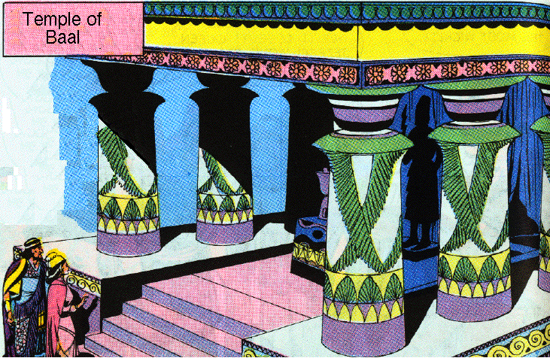
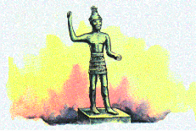
c. The early years of Ahab 16:29-34
31 And it came about, as though it had been a trivial thing for him to walk in the sins of Jeroboam the son of Nebat, that he married Jezebel the daughter of Ethbaal king of the Sidonians, and went to serve Baal and worshiped him.
32 So he erected an altar for Baal in the house of Baal, which he built in Samaria.
Text
Baal

Slide 61
c. The early years of Ahab 16:29-34
33 And Ahab also made the Asherah. Thus Ahab did more to provoke the LORD God of Israel than all the kings of Israel who were before him.
34 In his days Hiel the Bethelite built Jericho; he laid its foundations with the loss of Abiram his first-born, and set up its gates with the loss of his youngest son Segub, according to the word of the LORD, which He spoke by Joshua the son of Nun.

Slide 62
Shishak's invasion of Judah has been confirmed by archaeologists. Shishak's own record of his campaign is inscribed on the south wall of the Great Temple of Amon at Karnak. In his campaign he presents 156 cities of Judea to his god Amon.

Slide 63
"In the fifth year of King Rehoboam, King Shishak of Egypt marched against Jerusalem–for they had trespassed against the Lord–with 1,200 chariots, 60,000 horsemen and innumerable troops who came with him from Egypt: Lybians, Sukkites, and Kushites. He took the fortified towns of Judah and advanced on Jerusalem." - 2 Chronicles 12:2-4

Slide 64
Shishak smiting prisoners

Slide 65
Cartouches of place names in Palestine

Slide 66
Amon parading through Syro Palestinian cities

Slide 67
Shishak before Israelites, who raise their hands to be counted

Slide 68
When Shishak's son Osorkon-I took the throne, he gave huge amounts of gold and silver (383 tons!) to the temples of Egypt. What is more, he buried his son Sheshonq-II in a coffin made of pure silver. Where did all of this wealth come from?
Solid silver coffin of Shishak's grandson Sheshonq-II. It was discovered in 1939 by Pierre Montet at Tanis in the Egyptian delta. The silver used to make the coffin possibly came from Judah and Israel as a result of Shishak's 925 BC campaign.

