Slide 1
II. Jeroboam and The Prophets 13:1—14:20

Slide 2
A. Denunciation of Jeroboam 13:1-34

Slide 3
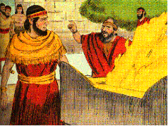
1. The mission of the man of God to denounce Jeroboam & his religious innovations 1-10
1 Now behold, there came a man of God from Judah to Bethel by the word of the LORD, while Jeroboam was standing by the altar to burn incense.
2 And he cried against the altar by the word of the LORD, and said, "O altar, altar, thus says the LORD, ‘Behold, a son shall be born to the house of David, Josiah by name; and on you he shall sacrifice the priests of the high places who burn incense on you, and human bones shall be burned on you.’"
3 Then he gave a sign the same day, saying, "This is the sign which the LORD has spoken, ‘Behold, the altar shall be split apart and the ashes which are on it shall be poured out.’"

Slide 4
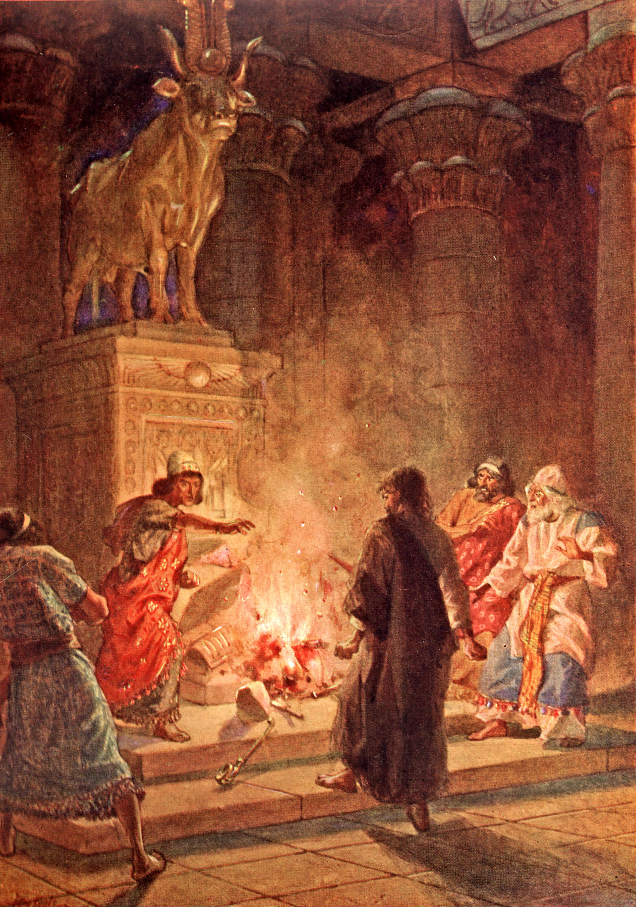
1. The mission of the man of God to denounce Jeroboam & his religious innovations 1-10
4 Now it came about when the king heard the saying of the man of God, which he cried against the altar in Bethel, that Jeroboam stretched out his hand from the altar, saying, "Seize him." But his hand which he stretched out against him dried up, so that he could not draw it back to himself.
5 The altar also was split apart and the ashes were poured out from the altar, according to the sign which the man of God had given by the word of the LORD.

Slide 5
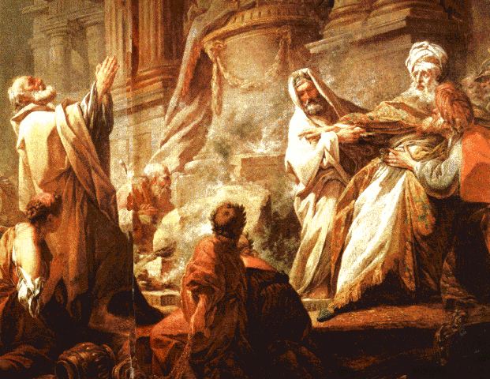
1. The mission of the man of God to denounce Jeroboam & his religious innovations 1-10
6 And the king answered and said to the man of God, "Please entreat the LORD your God, and pray for me, that my hand may be restored to me." So the man of God entreated the LORD, and the king’s hand was restored to him, and it became as it was before.

Slide 6
1. The mission of the man of God to denounce Jeroboam & his religious innovations 1-10
7 Then the king said to the man of God, "Come home with me and refresh yourself, and I will give you a reward."
8 But the man of God said to the king, "If you were to give me half your house I would not go with you, nor would I eat bread or drink water in this place.
9 "For so it was commanded me by the word of the LORD, saying, ‘You shall eat no bread, nor drink water, nor return by the way which you came.’"
10 So he went another way, and did not return by the way which he came to Bethel.

Slide 7
2. Man of God deceived into violating God’s specific command 11-19
11 Now an old prophet was living in Bethel; and his sons came and told him all the deeds which the man of God had done that day in Bethel; the words which he had spoken to the king, these also they related to their father.
12 And their father said to them, "Which way did he go?" Now his sons had seen the way which the man of God who came from Judah had gone.
13 Then he said to his sons, "Saddle the donkey for me." So they saddled the donkey for him and he rode away on it.
14 So he went after the man of God and found him sitting under an oak; and he said to him, "Are you the man of God who came from Judah?" And he said, "I am."

Slide 8
2. Man of God deceived into violating God’s specific command 11-19
15 Then he said to him, "Come home with me and eat bread."
16 And he said, "I cannot return with you, nor go with you, nor will I eat bread or drink water with you in this place.
17 "For a command came to me by the word of the LORD, ‘You shall eat no bread, nor drink water there; do not return by going the way which you came.’"
18 And he said to him, "I also am a prophet like you, and an angel spoke to me by the word of the LORD, saying, ‘Bring him back with you to your house, that he may eat bread and drink water.’" But he lied to him.
19 So he went back with him, and ate bread in his house and drank water.

Slide 9
3. Divine condemnation and judgment upon the man of God 20-26
20 Now it came about, as they were sitting down at the table, that the word of the LORD came to the prophet who had brought him back;
21 and he cried to the man of God who came from Judah, saying, "Thus says the LORD, ‘Because you have disobeyed the command of the LORD, and have not observed the commandment which the LORD your God commanded you,
22 but have returned and eaten bread and drunk water in the place of which He said to you, "Eat no bread and drink no water"; your body shall not come to the grave of your fathers.’"

Slide 10
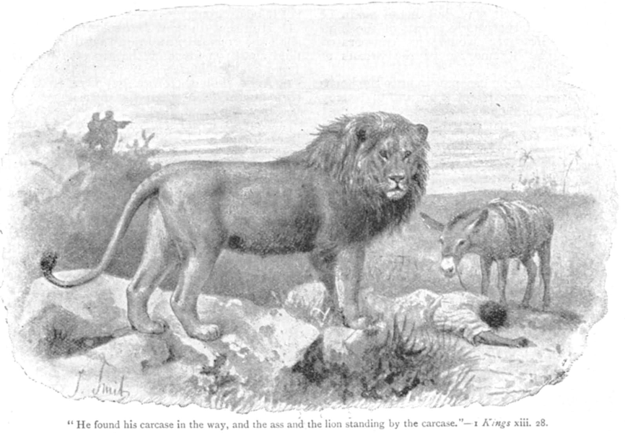
3. Divine condemnation and judgment upon the man of God 20-26
23 And it came about after he had eaten bread and after he had drunk, that he saddled the donkey for him, for the prophet whom he had brought back.
24 Now when he had gone, a lion met him on the way and killed him, and his body was thrown on the road, with the donkey standing beside it; the lion also was standing beside the body.

Slide 11
3. Divine condemnation and judgment upon the man of God 20-26
25 And behold, men passed by and saw the body thrown on the road, and the lion standing beside the body; so they came and told it in the city where the old prophet lived.
26 Now when the prophet who brought him back from the way heard it, he said, "It is the man of God, who disobeyed the command of the LORD; therefore the LORD has given him to the lion, which has torn him and killed him, according to the word of the LORD which He spoke to him."

Slide 12
4. Burial and lamentations for the man of God 27-32
27 Then he spoke to his sons, saying, "Saddle the donkey for me." And they saddled it.
28 And he went and found his body thrown on the road with the donkey and the lion standing beside the body; the lion had not eaten the body nor torn the donkey.
29 So the prophet took up the body of the man of God and laid it on the donkey, and brought it back and he came to the city of the old prophet to mourn and to bury him.
30 And he laid his body in his own grave, and they mourned over him, saying, "Alas, my brother!"

Slide 13
4. Burial and lamentations for the man of God 27-32
31 And it came about after he had buried him, that he spoke to his sons, saying, "When I die, bury me in the grave in which the man of God is buried; lay my bones beside his bones.
32 "For the thing shall surely come to pass which he cried by the word of the LORD against the altar in Bethel and against all the houses of the high places which are in the cities of Samaria."

Slide 14
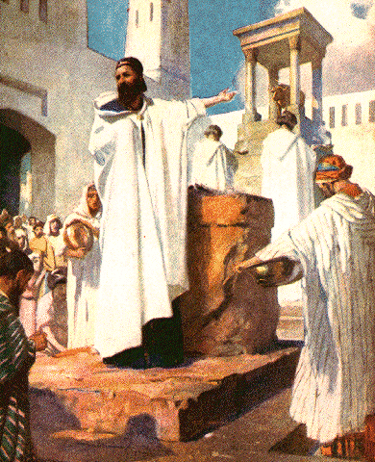
5. The Condemnation of Jeroboam 13:33-34
33 After this event Jeroboam did not return from his evil way, but again he made priests of the high places from among all the people; any who would, he ordained, to be priests of the high places.
34 And this event became sin to the house of Jeroboam, even to blot it out and destroy it from off the face of the earth.

Slide 15
B. The Decree Against Jeroboam 14:1-20

Slide 16
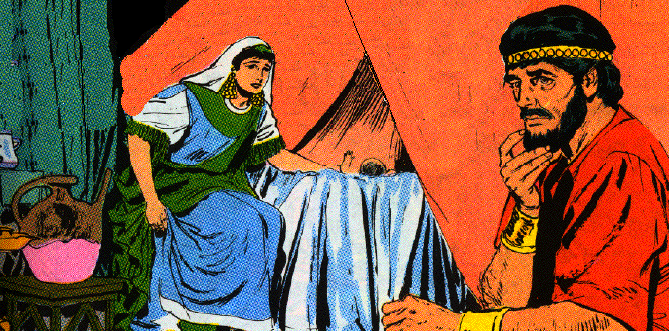
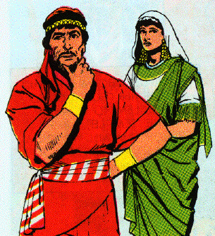
1. The mission of king’s wife 14:1-6
1 At that time Abijah the son of Jeroboam became sick.
2 And Jeroboam said to his wife, "Arise now, and disguise yourself so that they may not know that you are the wife of Jeroboam, and go to Shiloh; behold, Ahijah the prophet is there, who spoke concerning me that I would be king over this people.
3 "And take ten loaves with you, some cakes and a jar of honey, and go to him. He will tell you what will happen to the boy."

Slide 17
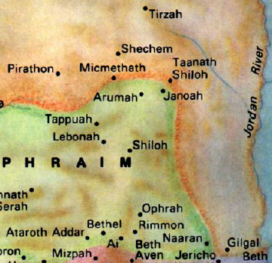

Slide 18
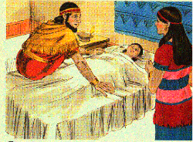
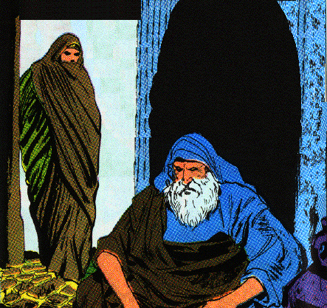
1. The mission of king’s wife 14:1-6
4 And Jeroboam’s wife did so, and arose and went to Shiloh, and came to the house of Ahijah. Now Ahijah could not see, for his eyes were dim because of his age.
5 Now the LORD had said to Ahijah, "Behold, the wife of Jeroboam is coming to inquire of you concerning her son, for he is sick. You shall say thus and thus to her, for it will be when she arrives that she will pretend to be another woman."
6 And it came about when Ahijah heard the sound of her feet coming in the doorway, that he said, "Come in, wife of Jeroboam, why do you pretend to be another woman? For I am sent to you with a harsh message.

Slide 19
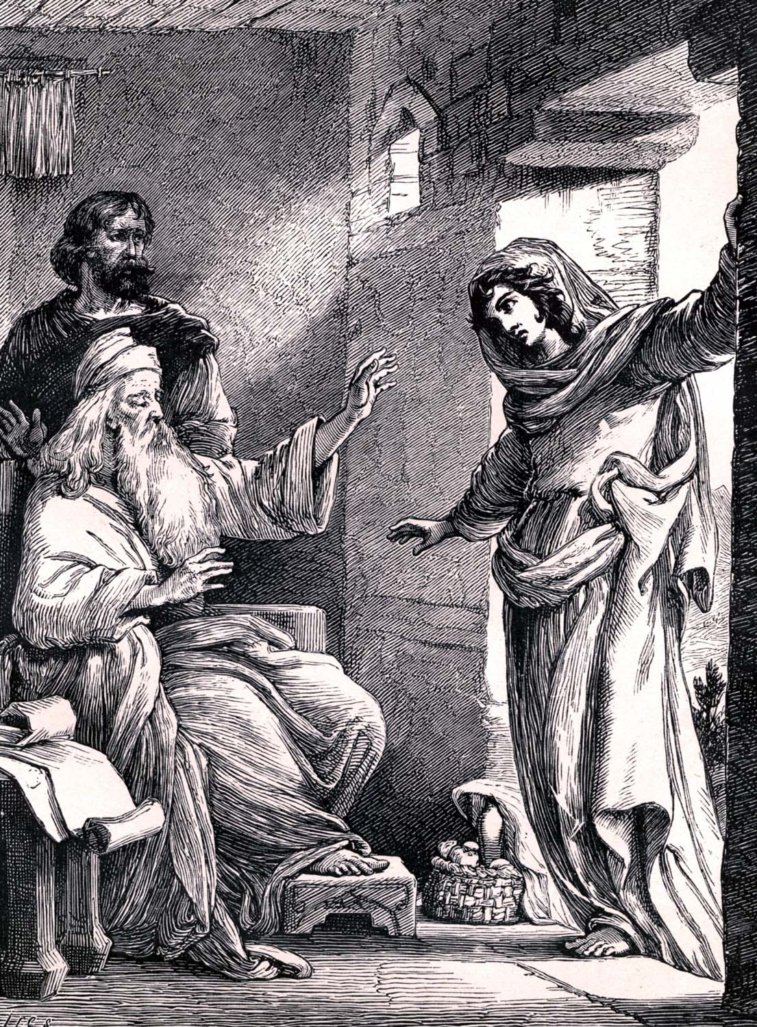
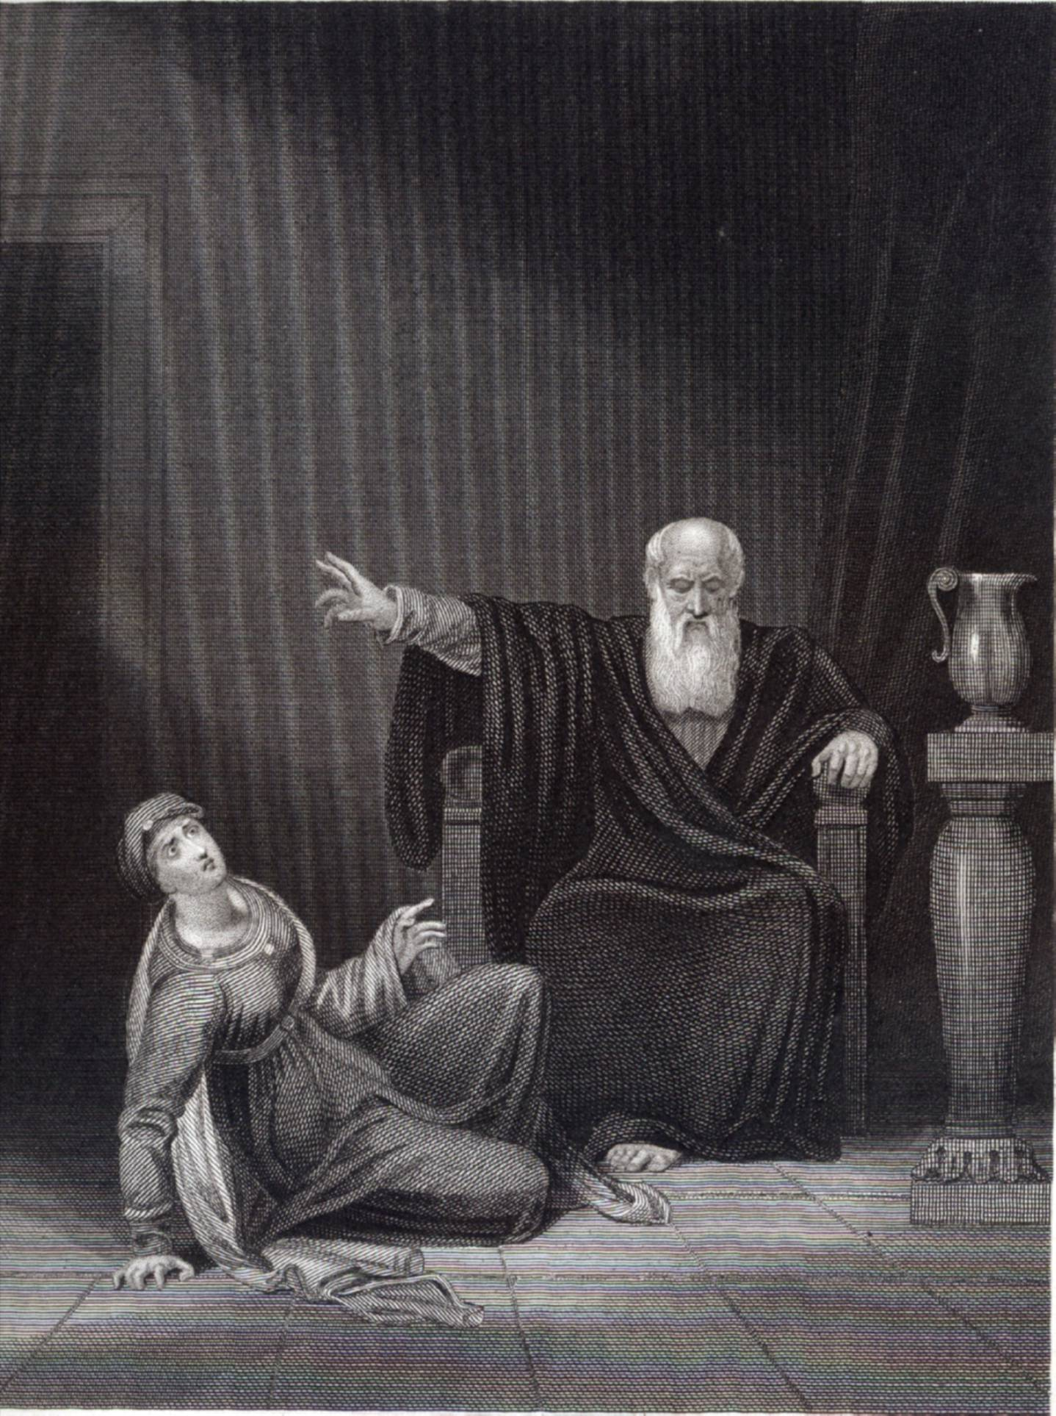
2. The message of Ahijah the prophet 14:7-16
7 "Go, say to Jeroboam, ‘Thus says the LORD God of Israel, "Because I exalted you from among the people and made you leader over My people Israel,
8 and tore the kingdom away from the house of David and gave it to you--yet you have not been like My servant David, who kept My commandments and who followed Me with all his heart, to do only that which was right in My sight;
9 you also have done more evil than all who were before you, and have gone and made for yourself other gods and molten images to provoke Me to anger, and have cast Me behind your back--
10 therefore behold, I am bringing calamity on the house of Jeroboam, and will cut off from Jeroboam every male person, both bond and free in Israel, and I will make a clean sweep of the house of Jeroboam, as one sweeps away dung until it is all gone.

Slide 20
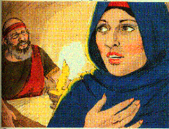
2. The message of Ahijah the prophet 14:7-16
11 "Anyone belonging to Jeroboam who dies in the city the dogs will eat. And he who dies in the field the birds of the heavens will eat; for the LORD has spoken it."’
12 "Now you arise, go to your house. When your feet enter the city the child will die.
13 "And all Israel shall mourn for him and bury him, for he alone of Jeroboam’s family shall come to the grave, because in him something good was found toward the LORD God of Israel in the house of Jeroboam.

Slide 21
2. The message of Ahijah the prophet 14:7-16
14 "Moreover, the LORD will raise up for Himself a king over Israel who shall cut off the house of Jeroboam this day and from now on.
15 "For the LORD will strike Israel, as a reed is shaken in the water; and He will uproot Israel from this good land which He gave to their fathers, and will scatter them beyond the Euphrates River, because they have made their Asherim, provoking the LORD to anger.
16 "And He will give up Israel on account of the sins of Jeroboam, which he committed and with which he made Israel to sin."

Slide 22
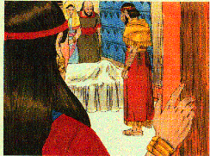
3. The mourning for the king’s son 14:17, 18
17 Then Jeroboam’s wife arose and departed and came to Tirzah. As she was entering the threshold of the house, the child died.
18 And all Israel buried him and mourned for him, according to the word of the LORD which He spoke through His servant Ahijah the prophet.

Slide 23
4. Concluding note on the reign of Jeroboam 19, 20
19 Now the rest of the acts of Jeroboam, how he made war and how he reigned, behold, they are written in the Book of the Chronicles of the Kings of Israel.
20 And the time that Jeroboam reigned was twenty-two years; and he slept with his fathers, and Nadab his son reigned in his place.
Elah
Zimri
Nadab
911-10
885
Jeroboam 22 yrs.
Baasha 24 yrs.
930
913
911
Rehoboam 17 yrs.
Abijam
3 yrs.
Asa 41 yrs.

Slide 24
III. The Kingdoms in Confrontation and Cooperation 14:21—16:34

Slide 25
A. The First Three Kings of Judah 14:21—15:24 (931-870 B.C.)
Rehoboam, Abijam, Asa
1. The apostasy of Rehoboam14:21-31
930
913
911
Rehoboam 17 yrs.
Abijam
3 yrs.
Asa 41 yrs.

Slide 26
a. The extent of the apostasy 21-24
21 Now Rehoboam the son of Solomon reigned in Judah. Rehoboam was forty-one years old when he became king, and he reigned seventeen years in Jerusalem, the city which the LORD had chosen from all the tribes of Israel to put His name there. And his mother’s name was Naamah the Ammonitess.
22 And Judah did evil in the sight of the LORD, and they provoked Him to jealousy more than all that their fathers had done, with the sins which they committed.
Influx of pious priests & Levites 2 C 11:13-17
Rehoboam built 15 fortified cities 2 C 11:5-12
18 wives, 60 concubines, 28 sons, 60 daughters 2 C 11:18-21
Sons scattered throughout Judah, supported, given responsibilities, Abijah, (Abijam) designated as crown prince 2 C 11:22-23
Rehoboam & Israel forsook the Law after he was established & strong 2 C 12:1

Slide 27
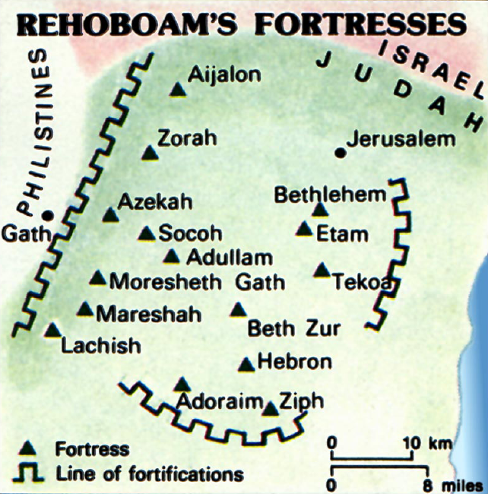

Slide 28
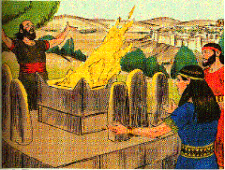
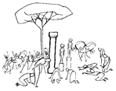
a. The extent of the apostasy 21-24
23 For they also built for themselves high places and sacred pillars and Asherim on every high hill and beneath every luxuriant tree.
24 And there were also male cult prostitutes in the land. They did according to all the abominations of the nations which the LORD dispossessed before the sons of Israel.

Slide 29
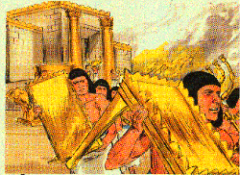
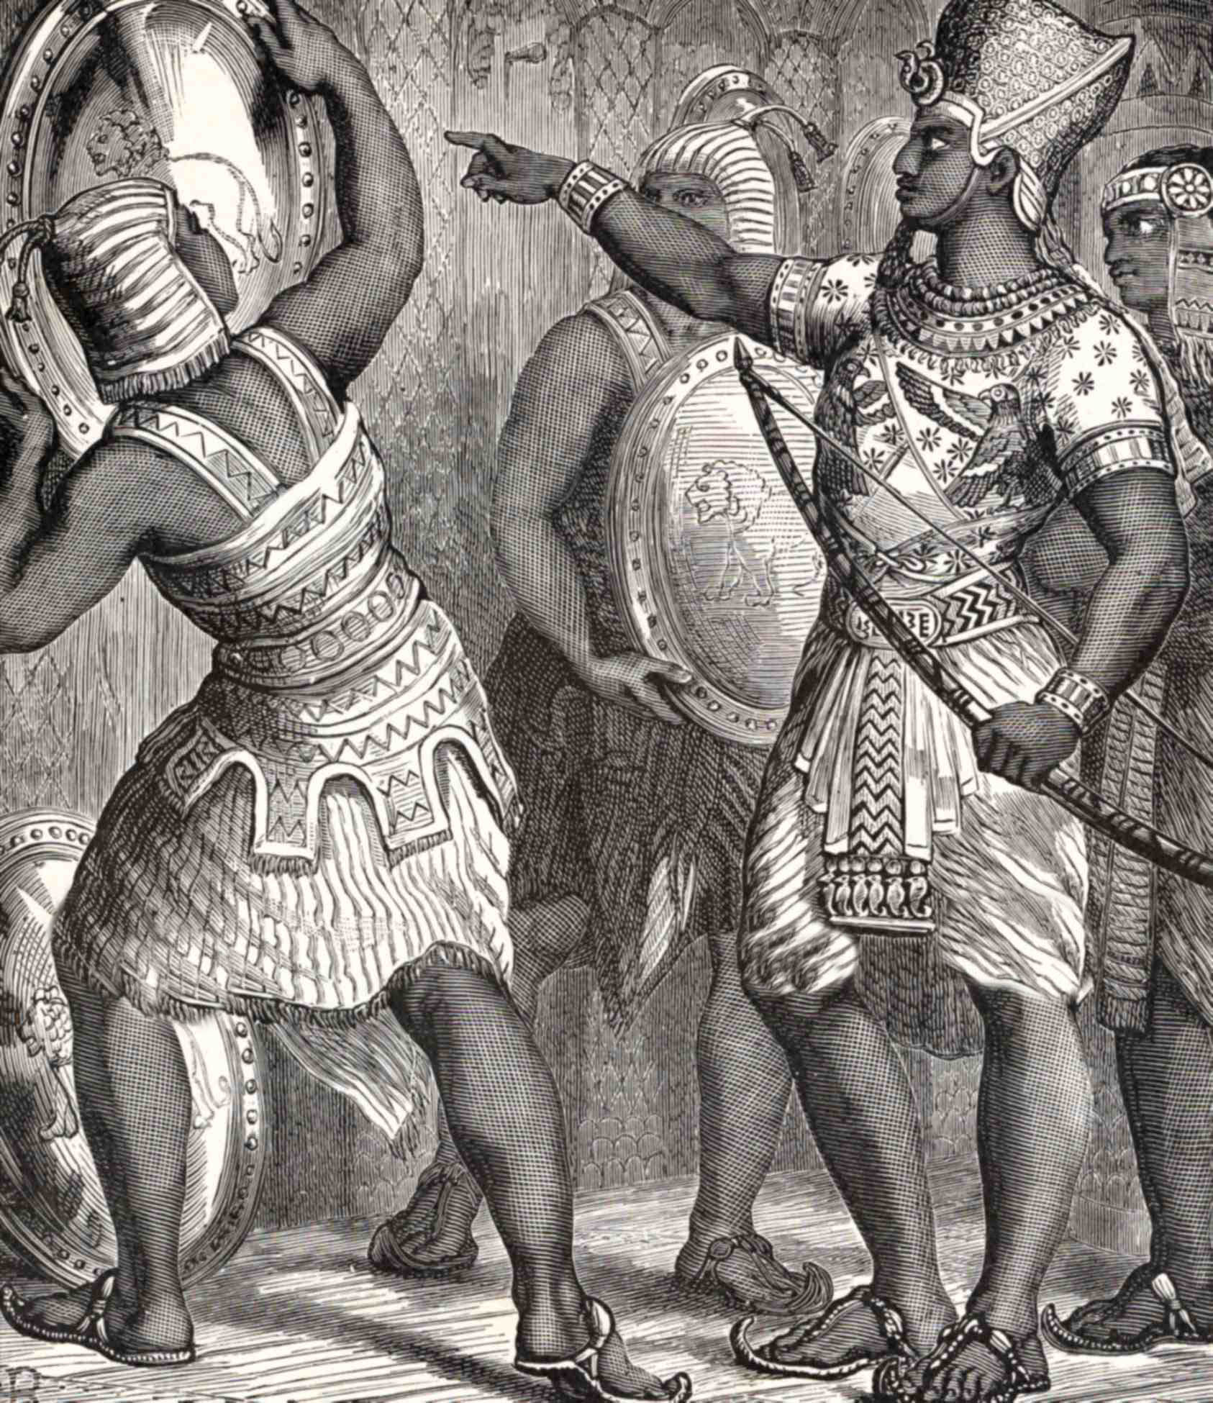
b. The punishment for the apostasy 25-28
25 Now it came about in the fifth year of King Rehoboam, that Shishak the king of Egypt came up against Jerusalem.
26 And he took away the treasures of the house of the LORD and the treasures of the king’s house, and he took everything, even taking all the shields of gold which Solomon had made.

Slide 30
Jerusalem not destroyed because Rehoboam & the nation repented 2 Chron. 12:5-8
5 Then Shemaiah the prophet came to Rehoboam and the princes of Judah who had gathered at Jerusalem because of Shishak, and he said to them, “Thus says the LORD, ‘You have forsaken Me, so I also have forsaken you to Shishak.’”
6 So the princes of Israel and the king humbled themselves and said, “The LORD is righteous.”
7 When the LORD saw that they humbled themselves, the word of the LORD came to Shemaiah, saying, “They have humbled themselves so I will not destroy them, but I will grant them some measure of deliverance, and My wrath shall not be poured out on Jerusalem by means of Shishak.
8 “But they will become his slaves so that they may learn the difference between My service and the service of the kingdoms of the countries.”

Slide 31
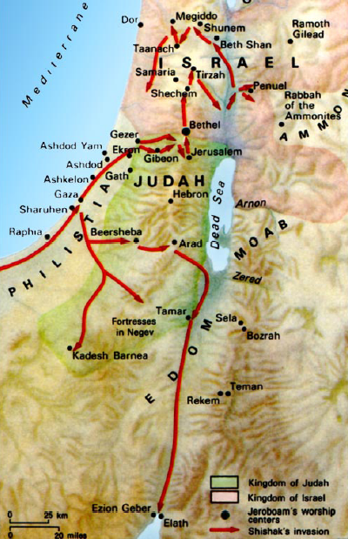

Slide 32
b. The punishment for the apostasy 25-28
27 So King Rehoboam made shields of bronze in their place, and committed them to the care of the commanders of the guard who guarded the doorway of the king’s house.
28 Then it happened as often as the king entered the house of the LORD, that the guards would carry them and would bring them back into the guards’ room.

Slide 33
c. Summary note about Rehoboam 29-31
29 Now the rest of the acts of Rehoboam and all that he did, are they not written in the Book of the Chronicles of the Kings of Judah?
30 And there was war between Rehoboam and Jeroboam continually.
31 And Rehoboam slept with his fathers, and was buried with his fathers in the city of David; and his mother’s name was Naamah the Ammonitess. And Abijam his son became king in his place.

Slide 34
2. The hypocrisy of Abijam 15:1-8

Slide 35
a. Abijam becomes king of Judah 15:1-3
1 Now in the eighteenth year of King Jeroboam, the son of Nebat, Abijam became king over Judah.
2 He reigned three years in Jerusalem; and his mother’s name was Maacah the daughter of Abishalom. [uh-BISHuh-luhm]
3 And he walked in all the sins of his father which he had committed before him; and his heart was not wholly devoted to the LORD his God, like the heart of his father David.

Slide 36
b. King for David’s sake 15:4, 5
4 But for David’s sake the LORD his God gave him a lamp in Jerusalem, to raise up his son after him and to establish Jerusalem;
5 because David did what was right in the sight of the LORD, and had not turned aside from anything that He commanded him all the days of his life, except in the case of Uriah the Hittite.

Slide 37
6 And there was war between Rehoboam and Jeroboam all the days of his life.
7 Now the rest of the acts of Abijam and all that he did, are they not written in the Book of the Chronicles of the Kings of Judah? And there was war between Abijam and Jeroboam.
8 And Abijam slept with his fathers and they buried him in the city of David; and Asa his son became king in his place.
Hostilities with Israel continued
II C 13:3-20 Abijam invaded Israel w/ 400,000 & defeated 800,000 and annexed some of Israel & Jeroboam never recovered his strength
II C 13:21 22 sons, 16 daughters, 14 wives

Slide 38
3. The reformation of Asa 15:9-24

Slide 39
Elah
Zimri
Nadab
911-10
885
Jeroboam 22 yrs.
Baasha 24 yrs.
930
913
911
Rehoboam 17 yrs.
Abijam
3 yrs.
Asa 41 yrs.
Divided Monarchy: Hostility Phase
(Sisters Quarreling)
930-885 BC

Slide 40
Elah
Zimri
Nadab
911-10
885
Jeroboam 22 yrs.
Baasha 24 yrs.
930
913
911
Rehoboam 17 yrs.
Abijam
3 yrs.
Asa 41 yrs.
Divided Monarchy: Hostility Phase
(Sisters Quarreling)
930-885 BC

Slide 41
a. Asa’s exercise of faith 15:9-15
9 So in the twentieth year of Jeroboam the king of Israel, Asa began to reign as king of Judah.
10 And he reigned forty-one years in Jerusalem; and his mother’s name was Maacah the daughter of Abishalom.
11 And Asa did what was right in the sight of the LORD, like David his father.

Slide 42
a. Asa’s exercise of faith 15:9-15
12 He also put away the male cult prostitutes from the land, and removed all the idols which his fathers had made.
13 And he also removed Maacah his mother from being queen mother, because she had made a horrid image as an Asherah; and Asa cut down her horrid image and burned it at the brook Kidron.
14 But the high places were not taken away; nevertheless the heart of Asa was wholly devoted to the LORD all his days.
15 And he brought into the house of the LORD the dedicated things of his father and his own dedicated things: silver and gold and utensils.

Slide 43
Information from 2 Chron. 14
A. Blessed with 10 years of peace & prosperity 1-8
- Fortified cities built & army strengthened
- 300,000 spearmen from Judah, 280,000 bowmen from Benjamin
B. Victory of Faith 9-15
- Invaded by Zerah the Ethiopian
- Meet in Mareshah for battle
- Asa prays & confesses total dependence on the LORD 9-11
- The LORD routes them - Judah pursues to Gerar, 5 miles S. of Gaza
- Much plunder - nearby cities sacked 12-15

Slide 44
Information from 2 Chron. 15
A. Prophetic Warning 1-7
- Prophet directed to Asa after battle by Spirit of God
- The Lord is with you when you are with him
- Rehearsed days of Judges: forsaken, priestless, kingless, lawless, full of strife & oppression
- God trouble them with every kind of distress
- If Asa is strong & courageous, there would be reward for his work

Slide 45
Information from 2 Chron. 15
B. Renewed Revival 8-15
- Asa extends newly captured territories - removes idolatry
- Restores Altar of the Lord at temple
- Many pious northerners defect to Asa 8-9
- 15th year - Covenant renewal ceremony (700 oxen, 7,000 sheep)
- Covenant to seek the Lord with all their hearts
- Whoever would not seek Him should be executed
- The Lord let them find Him
- God gave them rest on every side

Slide 46
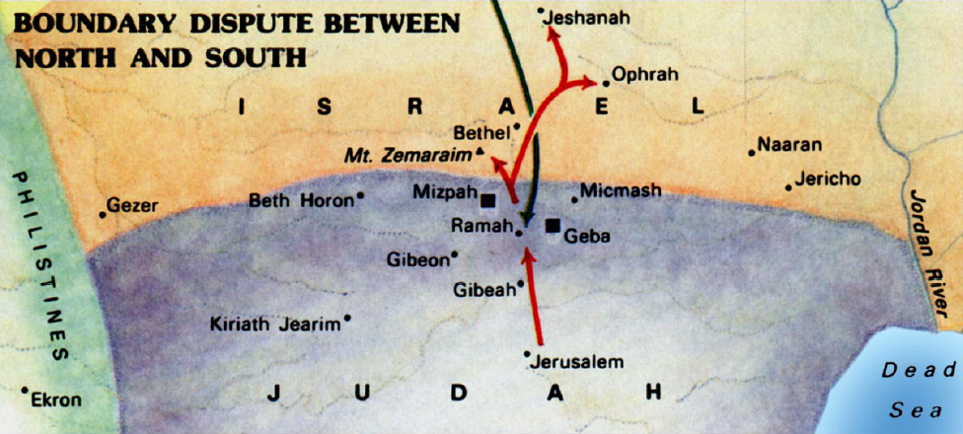
b. Asa’s failure of faith 1 Kings 15:16-22
16 Now there was war between Asa and Baasha king of Israel all their days.
17 And Baasha king of Israel went up against Judah and fortified Ramah in order to prevent anyone from going out or coming in to Asa king of Judah.

Slide 47
b. Asa’s failure of faith 15:16-22
18 Then Asa took all the silver and the gold which were left in the treasuries of the house of the LORD and the treasuries of the king’s house, and delivered them into the hand of his servants. And King Asa sent them to Ben-hadad the son of Tabrimmon (tab-RIM uhn), the son of Hezion (HEE zi ahn), king of Aram, who lived in Damascus, saying,
19 "Let there be a treaty between you and me, as between my father and your father. Behold, I have sent you a present of silver and gold; go, break your treaty with Baasha king of Israel so that he will withdraw from me."

Slide 48
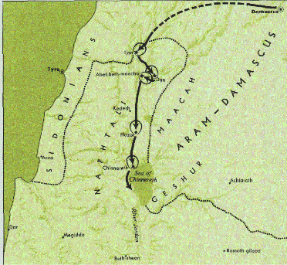
b. Asa’s failure of faith 15:16-22
20 So Ben-hadad listened to King Asa and sent the commanders of his armies against the cities of Israel, and conquered Ijon, Dan, Abel-beth-maacah and all Chinneroth, besides all the land of Naphtali.

Slide 49
b. Asa’s failure of faith 15:16-22
21 And it came about when Baasha heard of it that he ceased fortifying Ramah, and remained in Tirzah.
22 Then King Asa made a proclamation to all Judah--none was exempt--and they carried away the stones of Ramah and its timber with which Baasha had built. And King Asa built with them Geba of Benjamin and Mizpah.

Slide 50
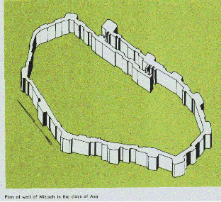

Slide 51
Asa reproved by Hanani 2 Chron. 16:7-10
7 At that time Hanani the seer came to Asa king of Judah and said to him, "Because you have relied on the king of Aram and have not relied on the LORD your God, therefore the army of the king of Aram has escaped out of your hand.
8 "Were not the Ethiopians and the Lubim an immense army with very many chariots and horsemen? Yet, because you relied on the LORD, He delivered them into your hand.
9 "For the eyes of the LORD move to and fro throughout the earth that He may strongly support those whose heart is completely His. You have acted foolishly in this. Indeed, from now on you will surely have wars."
10 Then Asa was angry with the seer and put him in prison, for he was enraged at him for this. And Asa oppressed some of the people at the same time.

Slide 52
c. Concluding statement 15:23-24
23 Now the rest of all the acts of Asa and all his might and all that he did and the cities which he built, are they not written in the Book of the Chronicles of the Kings of Judah? But in the time of his old age he was diseased in his feet.
24 And Asa slept with his fathers and was buried with his fathers in the city of David his father; and Jehoshaphat his son reigned in his place.

Slide 53
2 C 16:14 And they buried him in his own tomb which he had cut out for himself in the city of David, and they laid him in the resting place which he had filled with spices of various kinds blended by the perfumers’ art; and they made a very great fire for him.

Slide 54
Shishak's invasion of Judah has been confirmed by archaeologists. Shishak's own record of his campaign is inscribed on the south wall of the Great Temple of Amon at Karnak. In his campaign he presents 156 cities of Judea to his god Amon.

Slide 55
"In the fifth year of King Rehoboam, King Shishak of Egypt marched against Jerusalem–for they had trespassed against the Lord–with 1,200 chariots, 60,000 horsemen and innumerable troops who came with him from Egypt: Lybians, Sukkites, and Kushites. He took the fortified towns of Judah and advanced on Jerusalem." - 2 Chronicles 12:2-4

Slide 56
Shishak smiting prisoners

Slide 57
Cartouches of place names in Palestine

Slide 58
Amon parading through Syro Palestinian cities

Slide 59
Shishak before Israelites, who raise their hands to be counted

Slide 60
When Shishak's son Osorkon-I took the throne, he gave huge amounts of gold and silver (383 tons!) to the temples of Egypt. What is more, he buried his son Sheshonq-II in a coffin made of pure silver. Where did all of this wealth come from?
Solid silver coffin of Shishak's grandson Sheshonq-II. It was discovered in 1939 by Pierre Montet at Tanis in the Egyptian delta. The silver used to make the coffin possibly came from Judah and Israel as a result of Shishak's 925 BC campaign.

