Slide 1
VIII. Solomon’s Transgression & Troubles 11:1-43

Slide 2
A. The Apostasy of Solomon 1-13
1. His attachment to foreign women & consequent idolatry 1-2
Number of wives & concubines 3
Turn his heart away from God in his old age 4
Built temples for idols & burned incense & sacrificed to them 5-8
Lord’s anger: will deprive him of the kingdom, but will leave one tribe for David’s sake 9-13
1 Now King Solomon loved many foreign women along with the daughter of Pharaoh: Moabite, Ammonite, Edomite, Sidonian, and Hittite women,
2 from the nations concerning which the LORD had said to the sons of Israel, "You shall not associate with them, neither shall they associate with you, for they will surely turn your heart away after their gods." Solomon held fast to these in love.
2. Number of wives & concubines 3
3 And he had seven hundred wives, princesses, and three hundred concubines, and his wives turned his heart away.

Slide 3
A. The Apostasy of Solomon 1-13
3. Turn his heart away from God in his old age 4
Number of wives & concubines 3
Turn his heart away from God in his old age 4
Built temples for idols & burned incense & sacrificed to them 5-8
Lord’s anger: will deprive him of the kingdom, but will leave one tribe for David’s sake 9-13
4 For it came about when Solomon was old, his wives turned his heart away after other gods; and his heart was not wholly devoted to the LORD his God, as the heart of David his father had been.

Slide 4
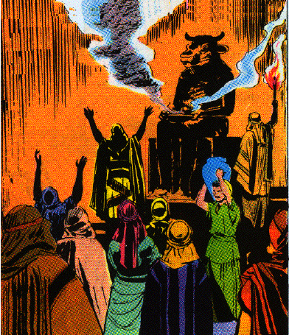
A. The Apostasy of Solomon 1-13
4. Built temples for idols & burned incense & sacrificed to them 5-8
5 For Solomon went after Ashtoreth the goddess of the Sidonians and after Milcom the detestable idol of the Ammonites.
6 And Solomon did what was evil in the sight of the LORD, and did not follow the LORD fully, as David his father had done.
7 Then Solomon built a high place for Chemosh the detestable idol of Moab, on the mountain which is east of Jerusalem, and for Molech the detestable idol of the sons of Ammon.
8 Thus also he did for all his foreign wives, who burned incense and sacrificed to their gods.

Slide 5
5. Lord’s anger: will deprive him of the kingdom, but will leave one tribe for David’s sake 9-13
9 Now the LORD was angry with Solomon because his heart was turned away from the LORD, the God of Israel, who had appeared to him twice,
10 and had commanded him concerning this thing, that he should not go after other gods; but he did not observe what the LORD had commanded.
11 So the LORD said to Solomon, "Because you have done this, and you have not kept My covenant and My statutes, which I have commanded you, I will surely tear the kingdom from you, and will give it to your servant.
12 "Nevertheless I will not do it in your days for the sake of your father David, but I will tear it out of the hand of your son.
13 "However, I will not tear away all the kingdom, but I will give one tribe to your son for the sake of My servant David and for the sake of Jerusalem which I have chosen."

Slide 6
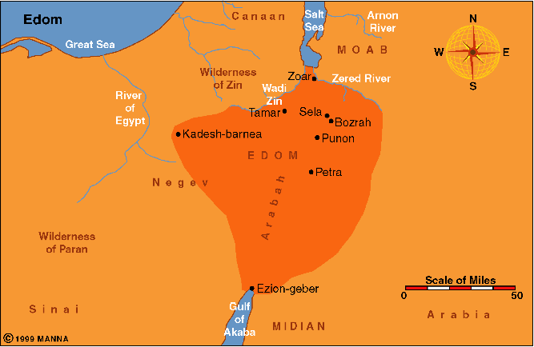
B. The consequences of Solomon’s Apostasy 14-40
1. The rebellion of Hadad the Edomite 14-22

Slide 7
1. The rebellion of Hadad the Edomite 14-22
14 Then the LORD raised up an adversary to Solomon, Hadad the Edomite; he was of the royal line in Edom.
15 For it came about, when David was in Edom, and Joab the commander of the army had gone up to bury the slain, and had struck down every male in Edom
16 (for Joab and all Israel stayed there six months, until he had cut off every male in Edom),
17 that Hadad fled to Egypt, he and certain Edomites of his father’s servants with him, while Hadad was a young boy.
18 And they arose from Midian and came to Paran; and they took men with them from Paran and came to Egypt, to Pharaoh king of Egypt, who gave him a house and assigned him food and gave him land.

Slide 8
B. The consequences of Solomon’s Apostasy 14-40
1. The rebellion of Hadad the Edomite 14-22
19 Now Hadad found great favor before Pharaoh, so that he gave him in marriage the sister of his own wife, the sister of Tahpenes [tah’puh-neez] the queen.
20 And the sister of Tahpenes bore his son Genubath, whom Tahpenes weaned in Pharaoh’s house; and Genubath was in Pharaoh’s house among the sons of Pharaoh.
21 But when Hadad heard in Egypt that David slept with his fathers, and that Joab the commander of the army was dead, Hadad said to Pharaoh, "Send me away, that I may go to my own country."
22 Then Pharaoh said to him, "But what have you lacked with me, that behold, you are seeking to go to your own country?" And he answered, "Nothing; nevertheless you must surely let me go."

Slide 9
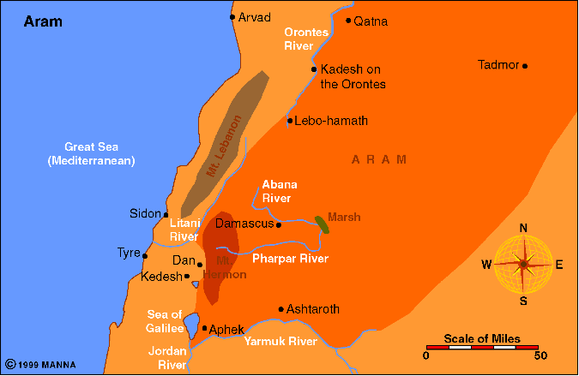
B. The consequences of Solomon’s Apostasy 14-40
2. Rezon and Damascus 23-25
Zobah

Slide 10
B. The consequences of Solomon’s Apostasy 14-40
2. Rezon and Damascus 23-25
23 God also raised up another adversary to him, Rezon the son of Eliada, who had fled from his lord Hadadezer [hay’dad-ee’zuhr] king of Zobah.
24 And he gathered men to himself and became leader of a marauding band, after David slew them of Zobah; and they went to Damascus and stayed there, and reigned in Damascus.
25 So he was an adversary to Israel all the days of Solomon, along with the evil that Hadad did; and he abhorred Israel and reigned over Aram.

Slide 11
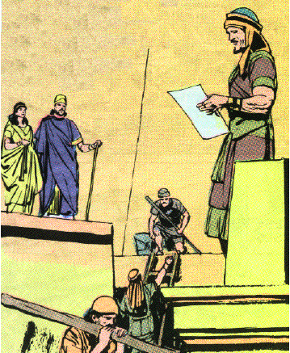
B. The consequences of Solomon’s Apostasy 14-40
3. Jeroboam of Ephraim 26-40
Why Jeroboam became his enemy 26-28
26 Then Jeroboam the son of Nebat, an Ephraimite of Zeredah [ZER ih duh], Solomon’s servant, whose mother’s name was Zeruah, a widow, also rebelled against the king.
27 Now this was the reason why he rebelled against the king: Solomon built the Millo, and closed up the breach of the city of his father David.
28 Now the man Jeroboam was a valiant warrior, and when Solomon saw that the young man was industrious, he appointed him over all the forced labor of the house of Joseph.

Slide 12
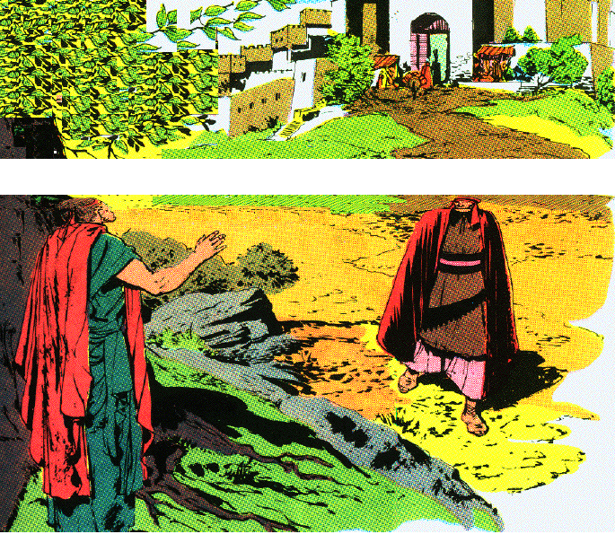
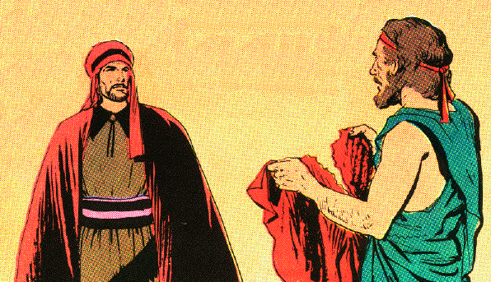
3. Jeroboam of Ephraim 26-40
Prophet Ahijah promises God will tear Israel from Solomon’s family & give 10 tribes to him 29-39
29 And it came about at that time, when Jeroboam went out of Jerusalem, that the prophet Ahijah the Shilonite found him on the road. Now Ahijah had clothed himself with a new cloak; and both of them were alone in the field.
30 Then Ahijah took hold of the new cloak which was on him, and tore it into twelve pieces.

Slide 13
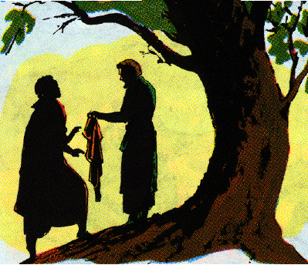
3. Jeroboam of Ephraim 26-40
Prophet Ahijah promises God will tear Israel from Solomon’s family & give 10 tribes to him 29-39
31 And he said to Jeroboam, "Take for yourself ten pieces; for thus says the LORD, the God of Israel, ‘Behold, I will tear the kingdom out of the hand of Solomon and give you ten tribes
32 (but he will have one tribe, for the sake of My servant David and for the sake of Jerusalem, the city which I have chosen from all the tribes of Israel),
33 because they have forsaken Me, and have worshiped Ashtoreth the goddess of the Sidonians, Chemosh the god of Moab, and Milcom the god of the sons of Ammon; and they have not walked in My ways, doing what is right in My sight and observing My statutes and My ordinances, as his father David did.

Slide 14
3. Jeroboam of Ephraim 26-40
Prophet Ahijah promises God will tear Israel from Solomon’s family & give 10 tribes to him 29-39
34 ‘Nevertheless I will not take the whole kingdom out of his hand, but I will make him ruler all the days of his life, for the sake of My servant David whom I chose, who observed My commandments and My statutes;
35 but I will take the kingdom from his son’s hand and give it to you, even ten tribes.
36 ‘But to his son I will give one tribe, that My servant David may have a lamp always before Me in Jerusalem, the city where I have chosen for Myself to put My name.
37 ‘And I will take you, and you shall reign over whatever you desire, and you shall be king over Israel.

Slide 15
3. Jeroboam of Ephraim 26-40
Prophet Ahijah promises God will tear Israel from Solomon’s family & give 10 tribes to him 29-39
38 ‘Then it will be, that if you listen to all that I command you and walk in My ways, and do what is right in My sight by observing My statutes and My commandments, as My servant David did, then I will be with you and build you an enduring house as I built for David, and I will give Israel to you.
39 ‘Thus I will afflict the descendants of David for this, but not always.’"

Slide 16
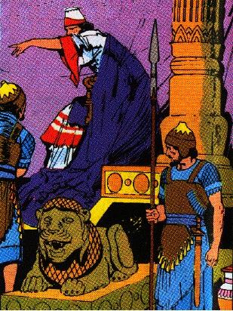
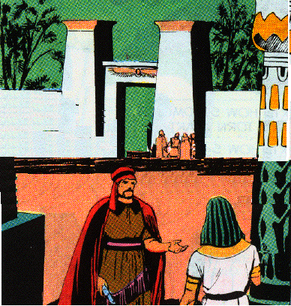
3. Jeroboam of Ephraim 26-40
Solomon seeks his life & he flees to Egypt until the death of the king 40
40 Solomon sought therefore to put Jeroboam to death; but Jeroboam arose and fled to Egypt to Shishak king of Egypt, and he was in Egypt until the death of Solomon.
Sheshonq I
(Shee shongk)
Shishak
945-924 B.C.

Slide 17
C. A Summary Statement of Solomon’s Reign 41-43
41 Now the rest of the acts of Solomon and whatever he did, and his wisdom, are they not written in the book of the acts of Solomon?
42 Thus the time that Solomon reigned in Jerusalem over all Israel was forty years.
43 And Solomon slept with his fathers and was buried in the city of his father David, and his son Rehoboam reigned in his place.

Slide 18
The Sister Kingdoms
I Kings 12—II Kings 17
The Divided Kingdom (Israel & Judah)
931-722 B.C.

Slide 19
I. The Division of the Kingdom 12:1-33

Slide 20
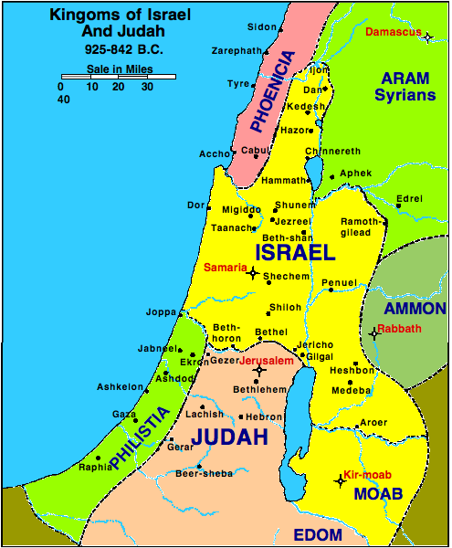
A. The Great Schism 12:1-24
1. The request of Israel 1-5
1 Then Rehoboam went to Shechem, for all Israel had come to Shechem to make him king.
2 Now it came about when Jeroboam the son of Nebat heard of it, that he was living in Egypt (for he was yet in Egypt, where he had fled from the presence of King Solomon).

Slide 21
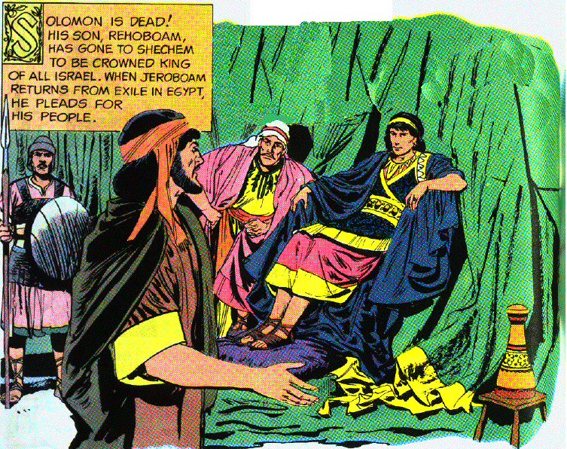
A. The Great Schism 12:1-24
1. The request of Israel 1-5
3 Then they sent and called him, and Jeroboam and all the assembly of Israel came and spoke to Rehoboam, saying,
4 "Your father made our yoke hard; now therefore lighten the hard service of your father and his heavy yoke which he put on us, and we will serve you."
5 Then he said to them, "Depart for three days, then return to me." So the people departed.

Slide 22
A. The Great Schism 12:1-24
2. The recommendation of the counselors 6-11
5 Then he said to them, "Depart for three days, then return to me." So the people departed.
6 And King Rehoboam consulted with the elders who had served his father Solomon while he was still alive, saying, "How do you counsel me to answer this people?"
7 Then they spoke to him, saying, "If you will be a servant to this people today, will serve them, grant them their petition, and speak good words to them, then they will be your servants forever."
8 But he forsook the counsel of the elders which they had given him, and consulted with the young men who grew up with him and served him.

Slide 23
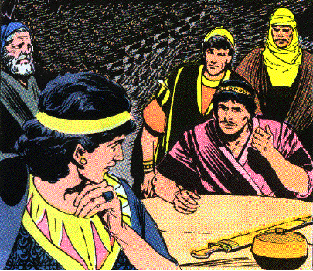
A. The Great Schism 12:1-24
2. The recommendation of the counselors 6-11
9 So he said to them, "What counsel do you give that we may answer this people who have spoken to me, saying, ‘Lighten the yoke which your father put on us’?"
10 And the young men who grew up with him spoke to him, saying, "Thus you shall say to this people who spoke to you, saying, ‘Your father made our yoke heavy, now you make it lighter for us!’ But you shall speak to them, ‘My little finger is thicker than my father’s loins!
11 ‘Whereas my father loaded you with a heavy yoke, I will add to your yoke; my father disciplined you with whips, but I will discipline you with scorpions.’"

Slide 24
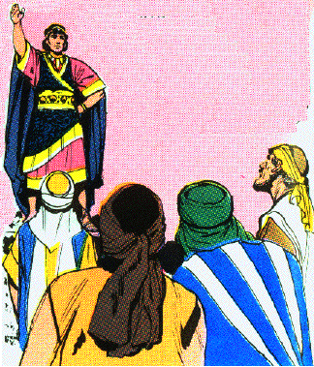
A. The Great Schism 12:1-24
3. The reply of Rehoboam 12-15
12 Then Jeroboam and all the people came to Rehoboam on the third day as the king had directed, saying, "Return to me on the third day."
13 And the king answered the people harshly, for he forsook the advice of the elders which they had given him,
14 and he spoke to them according to the advice of the young men, saying, "My father made your yoke heavy, but I will add to your yoke; my father disciplined you with whips, but I will discipline you with scorpions."
15 So the king did not listen to the people; for it was a turn of events from the LORD, that He might establish His word, which the LORD spoke through Ahijah the Shilonite to Jeroboam the son of Nebat.

Slide 25
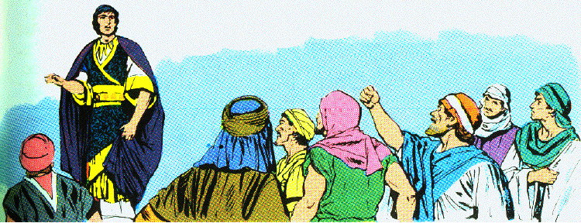
A. The Great Schism 12:1-24
4. The rebellion of Israel 16-20
16 When all Israel saw that the king did not listen to them, the people answered the king, saying, "What portion do we have in David? We have no inheritance in the son of Jesse; To your tents, O Israel! Now look after your own house, David!" So Israel departed to their tents.
17 But as for the sons of Israel who lived in the cities of Judah, Rehoboam reigned over them.

Slide 26
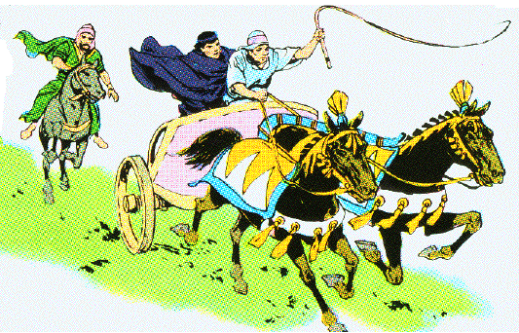
4. The rebellion of Israel 16-20
18 Then King Rehoboam sent Adoram, who was over the forced labor, and all Israel stoned him to death. And King Rehoboam made haste to mount his chariot to flee to Jerusalem.
19 So Israel has been in rebellion against the house of David to this day.
20 And it came about when all Israel heard that Jeroboam had returned, that they sent and called him to the assembly and made him king over all Israel. None but the tribe of Judah followed the house of David.

Slide 27
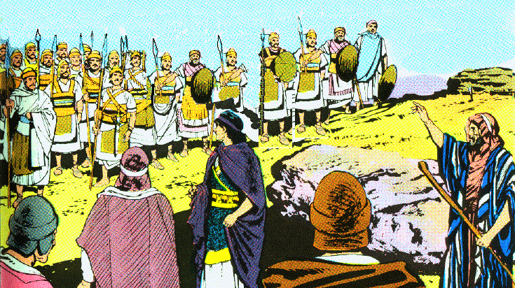
5. The response of Rehoboam 21-24
21 Now when Rehoboam had come to Jerusalem, he assembled all the house of Judah and the tribe of Benjamin, 180,000 chosen men who were warriors, to fight against the house of Israel to restore the kingdom to Rehoboam the son of Solomon.
22 But the word of God came to Shemaiah the man of God, saying,

Slide 28
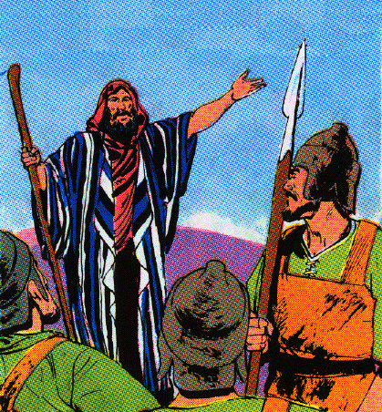
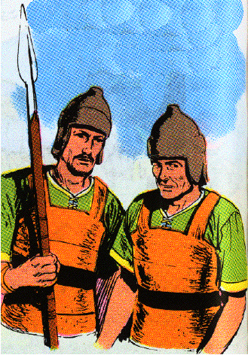
5. The response of Rehoboam 21-24
23 "Speak to Rehoboam the son of Solomon, king of Judah, and to all the house of Judah and Benjamin and to the rest of the people, saying,
24 ‘Thus says the LORD, "You must not go up and fight against your relatives the sons of Israel; return every man to his house, for this thing has come from Me."’ "So they listened to the word of the LORD, and returned and went their way according to the word of the LORD.

Slide 30
B. The Great Apostasy 12:25-33
1. Shechem fortified 25
25 Then Jeroboam built Shechem in the hill country of Ephraim, and lived there. And he went out from there and built Penuel.

Slide 31
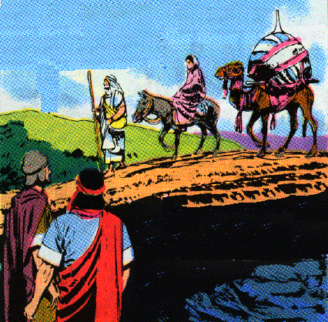
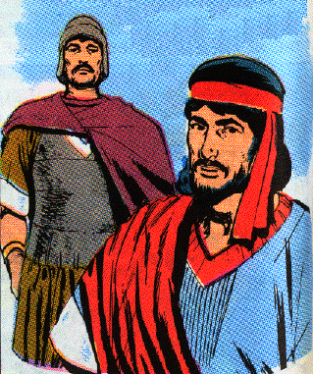
2. A new religion for the north 26-27
26 And Jeroboam said in his heart, "Now the kingdom will return to the house of David.
27 "If this people go up to offer sacrifices in the house of the LORD at Jerusalem, then the heart of this people will return to their lord, even to Rehoboam king of Judah; and they will kill me and return to Rehoboam king of Judah."

Slide 32
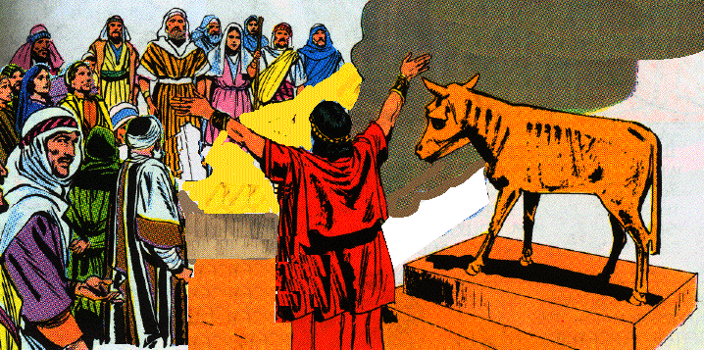
3. The golden calves conveniently placed 28, 29
28 So the king consulted, and made two golden calves, and he said to them, "It is too much for you to go up to Jerusalem; behold your gods, O Israel, that brought you up from the land of Egypt."
29 And he set one in Bethel, and the other he put in Dan.
4. Zeal for the new worship 30
30 Now this thing became a sin, for the people went to worship before the one as far as Dan.

Slide 33
5. Further details of the counterfeit religion 31-33
31 And he made houses on high places, and made priests from among all the people who were not of the sons of Levi.
32 And Jeroboam instituted a feast in the eighth month on the fifteenth day of the month, like the feast which is in Judah, and he went up to the altar; thus he did in Bethel, sacrificing to the calves which he had made. And he stationed in Bethel the priests of the high places which he had made.
33 Then he went up to the altar which he had made in Bethel on the fifteenth day in the eighth month, even in the month which he had devised in his own heart; and he instituted a feast for the sons of Israel, and went up to the altar to burn incense.

Slide 34
Special study - The Schism of 931 B.C.
1. The event was caused or allowed by God 12:15
a. Judah is isolated from northern tribes
b. Judgment of the house of David 11:11-13 33

Slide 35
Special study - The Schism of 931 B.C.
2. Historical rivalry between Ephraim & Judah
a. Ephraim complained about allotment Josh. 17:24
b. Ephraim dispute with Gideon Judges 8:1
c. Made war with Gilead & Jephthah Judges 12:4
d. Gave allegiance to Ish-bosheth 2 Sam. 2:10
e. Many joined Sheba’s rebellion 2 Sam. 20:2

Slide 36
Special study - The Schism of 931 B.C.
3. Geographical factor
a. Judah isolated by mountains & barren
b. Ephraim exposed to invaders & fertile
c. Commercial highway went through Israel
d. Judah’s inhabitants more sturdy, brave, loyal & durable
e. Israel: luxury-loving, carefree, tolerant, eager for foreign ideas, cults & customs

Slide 37
Special study - The Schism of 931 B.C.
4. Political factor
- Division was to Egypt and Syria’s advantage
5. Economic factor
- Heavy taxation and forced labor of Solomon 12:4
6. Petty factor
- Jeroboam’s ambition and Rehoboam’s foolishness

Slide 38
Consequences of the Schism
1. Political consequences
a. Loss of Damascus and Syria, Moab, Ammon, Edom
b. Little resistance to invasion by Egypt 926 B.C.
2. Economic consequences
a. Ezion-geber lost
b. Lost control of trade routes
c. 40 years of war
3. Religious consequences
a. Counterfeit worship in north
b. Watered down religion could not resist baal worship
c. Worship at Jerusalem hindered
d. Population drain on Northern kingdom

Slide 39
The Conditions After the Schism
1. Advantages of Israel over Judah
a. Five times the territory & twice the population
b. More fertile & wealthy
2. Advantages of Judah over Israel
a. Stable monarchy
b. A royal city
c. Jerusalem, the Temple, the ark, the Levites
d. Geographical isolation
e. Pure Israelite stock (few Canaanites)

Slide 40
II. Jeroboam and The Prophets 13:1—14:20

Slide 41
A. Denunciation of Jeroboam 13:1-34

Slide 42
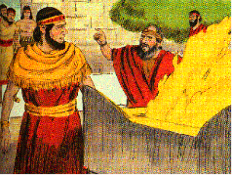
1. The mission of the man of God to denounce Jeroboam & his religious innovations 1-10
1 Now behold, there came a man of God from Judah to Bethel by the word of the LORD, while Jeroboam was standing by the altar to burn incense.
2 And he cried against the altar by the word of the LORD, and said, "O altar, altar, thus says the LORD, ‘Behold, a son shall be born to the house of David, Josiah by name; and on you he shall sacrifice the priests of the high places who burn incense on you, and human bones shall be burned on you.’"
3 Then he gave a sign the same day, saying, "This is the sign which the LORD has spoken, ‘Behold, the altar shall be split apart and the ashes which are on it shall be poured out.’"

Slide 43
1. The mission of the man of God to denounce Jeroboam & his religious innovations 1-10
4 Now it came about when the king heard the saying of the man of God, which he cried against the altar in Bethel, that Jeroboam stretched out his hand from the altar, saying, "Seize him." But his hand which he stretched out against him dried up, so that he could not draw it back to himself.
5 The altar also was split apart and the ashes were poured out from the altar, according to the sign which the man of God had given by the word of the LORD.
6 And the king answered and said to the man of God, "Please entreat the LORD your God, and pray for me, that my hand may be restored to me." So the man of God entreated the LORD, and the king’s hand was restored to him, and it became as it was before.

Slide 44
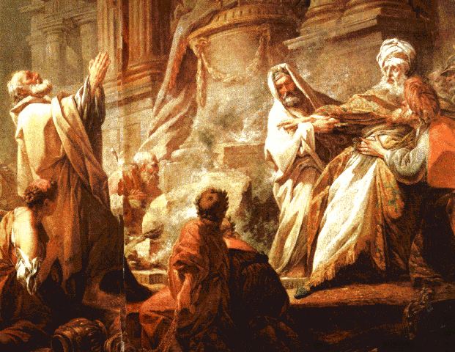
1. The mission of the man of God to denounce Jeroboam & his religious innovations 1-10
6 And the king answered and said to the man of God, "Please entreat the LORD your God, and pray for me, that my hand may be restored to me." So the man of God entreated the LORD, and the king’s hand was restored to him, and it became as it was before.

Slide 45
1. The mission of the man of God to denounce Jeroboam & his religious innovations 1-10
7 Then the king said to the man of God, "Come home with me and refresh yourself, and I will give you a reward."
8 But the man of God said to the king, "If you were to give me half your house I would not go with you, nor would I eat bread or drink water in this place.
9 "For so it was commanded me by the word of the LORD, saying, ‘You shall eat no bread, nor drink water, nor return by the way which you came.’"
10 So he went another way, and did not return by the way which he came to Bethel.

Slide 46
2. Man of God deceived into violating God’s specific command 11-19
11 Now an old prophet was living in Bethel; and his sons came and told him all the deeds which the man of God had done that day in Bethel; the words which he had spoken to the king, these also they related to their father.
12 And their father said to them, "Which way did he go?" Now his sons had seen the way which the man of God who came from Judah had gone.
13 Then he said to his sons, "Saddle the donkey for me." So they saddled the donkey for him and he rode away on it.
14 So he went after the man of God and found him sitting under an oak; and he said to him, "Are you the man of God who came from Judah?" And he said, "I am."

Slide 47
2. Man of God deceived into violating God’s specific command 11-19
15 Then he said to him, "Come home with me and eat bread."
16 And he said, "I cannot return with you, nor go with you, nor will I eat bread or drink water with you in this place.
17 "For a command came to me by the word of the LORD, ‘You shall eat no bread, nor drink water there; do not return by going the way which you came.’"
18 And he said to him, "I also am a prophet like you, and an angel spoke to me by the word of the LORD, saying, ‘Bring him back with you to your house, that he may eat bread and drink water.’" But he lied to him.
19 So he went back with him, and ate bread in his house and drank water.

Slide 48
3. Divine condemnation and judgment upon the man of God 20-26
20 Now it came about, as they were sitting down at the table, that the word of the LORD came to the prophet who had brought him back;
21 and he cried to the man of God who came from Judah, saying, "Thus says the LORD, ‘Because you have disobeyed the command of the LORD, and have not observed the commandment which the LORD your God commanded you,
22 but have returned and eaten bread and drunk water in the place of which He said to you, "Eat no bread and drink no water"; your body shall not come to the grave of your fathers.’"

Slide 49
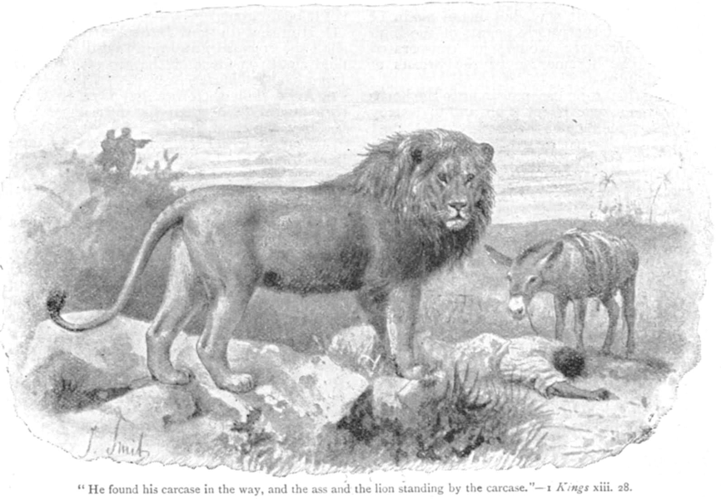
3. Divine condemnation and judgment upon the man of God 20-26
23 And it came about after he had eaten bread and after he had drunk, that he saddled the donkey for him, for the prophet whom he had brought back.
24 Now when he had gone, a lion met him on the way and killed him, and his body was thrown on the road, with the donkey standing beside it; the lion also was standing beside the body.

Slide 50
3. Divine condemnation and judgment upon the man of God 20-26
25 And behold, men passed by and saw the body thrown on the road, and the lion standing beside the body; so they came and told it in the city where the old prophet lived.
26 Now when the prophet who brought him back from the way heard it, he said, "It is the man of God, who disobeyed the command of the LORD; therefore the LORD has given him to the lion, which has torn him and killed him, according to the word of the LORD which He spoke to him."

Slide 51
4. Burial and lamentations for the man of God 27-32
27 Then he spoke to his sons, saying, "Saddle the donkey for me." And they saddled it.
28 And he went and found his body thrown on the road with the donkey and the lion standing beside the body; the lion had not eaten the body nor torn the donkey.
29 So the prophet took up the body of the man of God and laid it on the donkey, and brought it back and he came to the city of the old prophet to mourn and to bury him.
30 And he laid his body in his own grave, and they mourned over him, saying, "Alas, my brother!"

Slide 52
4. Burial and lamentations for the man of God 27-32
31 And it came about after he had buried him, that he spoke to his sons, saying, "When I die, bury me in the grave in which the man of God is buried; lay my bones beside his bones.
32 "For the thing shall surely come to pass which he cried by the word of the LORD against the altar in Bethel and against all the houses of the high places which are in the cities of Samaria."

Slide 53
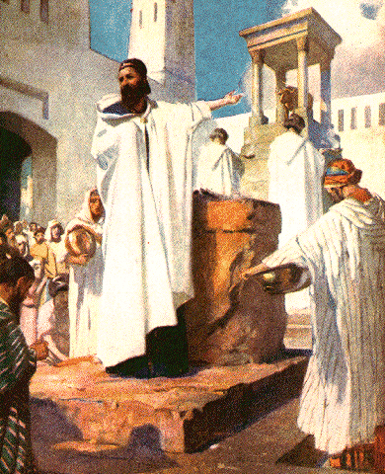
5. The Condemnation of Jeroboam 13:33-34
33 After this event Jeroboam did not return from his evil way, but again he made priests of the high places from among all the people; any who would, he ordained, to be priests of the high places.
34 And this event became sin to the house of Jeroboam, even to blot it out and destroy it from off the face of the earth.

