Slide 1
4. Solomon’s Benediction 8:54-61
59 “And may these words of mine, with which I have made supplication before the LORD, be near to the LORD our God day and night, that He may maintain the cause of His servant and the cause of His people Israel, as each day requires,
60 so that all the peoples of the earth may know that the LORD is God; there is no one else.
61 “Let your heart therefore be wholly devoted to the LORD our God, to walk in His statutes and to keep His commandments, as at this day.”
Words, supplication be near to God
Maintain the cause of His servant, people as each day requires
All people know the LORD is God & keep commandments
Be wholly devoted, walk in statues, keep commands

Slide 2
God answers with fire & the glory 2 Chron. 7:1-3
1 Now when Solomon had finished praying, fire came down from heaven and consumed the burnt offering and the sacrifices; and the glory of the LORD filled the house.
2 And the priests could not enter into the house of the LORD, because the glory of the LORD filled the LORD’S house.
3 And all the sons of Israel, seeing the fire come down and the glory of the LORD upon the house, bowed down on the pavement with their faces to the ground, and they worshiped and gave praise to the LORD, saying, "Truly He is good, truly His lovingkindness is everlasting."

Slide 3
5. Dedicatory sacrifices 8:62-64
King & nation offer sacrifice 62
62 Now the king and all Israel with him offered sacrifice before the LORD.
Solomon’s peace offering: 22,000 oxen & 120,000 sheep 63
63 Solomon offered for the sacrifice of peace offerings, which he offered to the LORD, 22,000 oxen and 120,000 sheep. So the king and all the sons of Israel dedicated the house of the LORD.
Offered over 14 days
2 to 3 thousand priests
Priest only had to offer the blood & burn pieces
100 to 500 thousand may have been present
Only the fat of a peace offering was burned

Slide 4
5. Dedicatory sacrifices 8:62-64
Middle court consecrated for burnt offerings 64
64 On the same day the king consecrated the middle of the court that was before the house of the LORD, because there he offered the burnt offering and the grain offering and the fat of the peace offerings; for the bronze altar that was before the LORD was too small to hold the burnt offering and the grain offering and the fat of the peace offerings.

Slide 5
6. The feasts observed 8:65-66
A great assembly for fourteen days 65
65 So Solomon observed the feast at that time, and all Israel with him, a great assembly from the entrance of Hamath to the brook of Egypt, before the LORD our God, for seven days and seven more days, even fourteen days.
Feast of dedication - 7 days
Feast of Tabernacles - 7 days
On the 8th day of the 2nd feast the people were dismissed 66
66 On the eighth day he sent the people away and they blessed the king. Then they went to their tents joyful and glad of heart for all the goodness that the LORD had shown to David His servant and to Israel His people.

Slide 6
God’s Answer to Solomon 9:1-9

Slide 7
1. Promise 1-3; 2 Chron. 7:12-22
1 Now it came about when Solomon had finished building the house of the LORD, and the king’s house, and all that Solomon desired to do,
2 that the LORD appeared to Solomon a second time, as He had appeared to him at Gibeon.
3 And the LORD said to him, "I have heard your prayer and your supplication, which you have made before Me; I have consecrated this house which you have built by putting My name there forever, and My eyes and My heart will be there perpetually.

Slide 8
2. Obedience 4, 5
4 "And as for you, if you will walk before Me as your father David walked, in integrity of heart and uprightness, doing according to all that I have commanded you and will keep My statutes and My ordinances,
5 then I will establish the throne of your kingdom over Israel forever, just as I promised to your father David, saying, ‘You shall not lack a man on the throne of Israel.’

Slide 9
3. Warning 6-9
6 "But if you or your sons shall indeed turn away from following Me, and shall not keep My commandments and My statutes which I have set before you and shall go and serve other gods and worship them,
7 then I will cut off Israel from the land which I have given them, and the house which I have consecrated for My name, I will cast out of My sight. So Israel will become a proverb and a byword among all peoples.
8 "And this house will become a heap of ruins; everyone who passes by will be astonished and hiss and say, ‘Why has the LORD done thus to this land and to this house?’
9 "And they will say, ‘Because they forsook the LORD their God, who brought their fathers out of the land of Egypt, and adopted other gods and worshiped them and served them, therefore the LORD has brought all this adversity on them.’"

Slide 10
Capsule History of Solomon’s Temple
Event Reference Date B.C.
Construction of the Temple by Solomon 1 K 6-7; 2 C 3-4 966-960
Dedication of the Temple I K 8; 2 C 5-6 960
House filled with the glory of the Lord I K 8:10, 11; 2 C 5:13-14 960
Temple plundered by Shishak I K 14:25-28; 2 C 12:2-9 927
Abomination introduced to Temple I K 15:2, 12, 13 913-911 worship by Maacah, mother of Abijam
Asa cleanses the Temple I K 15:11-15; 2 C 15:8-16 911-900
Asa uses Temple treasures to bribe 1 K 15:18, 19; 2 C 16:1-2 895 Benhadad
Jehoshaphat enlarged the Temple court 2 C 20:5 870-53
Temple repairs made by Jehoash 2 K 12:4-16; 2 C 24:4-14 835

Slide 11
Capsule History of Solomon’s Temple
Event Reference Date B.C.
Uzziah tried to enter Holy Place - II C 26:16 750 smitten with leprosy
Jotham refuses to enter Temple II C 27:2 750-31
Jotham built a new gate for the Temple II K 15:35; II C 27:3 739-35
Ahaz bribes Tiglath-pileser with Temple II K 16:8 733 treasure
Ahaz introduces a pagan altar - II K 16:10-17 732 removes bronze altar, bases and ornaments of lavers and oxen under the sea
Hezekiah cleanses the Temple II C 29 720-15
Hezekiah removes the gold leaf II K 18:14-16; II C 32:31 701 from the doors of Temple (which he himself had put there) as payment to Sennacherib

Slide 12
Capsule History of Solomon’s Temple
Event Reference Date B.C.
Idolatrous altars erected in Temple II K 21:3-7; 23:7, 11 by Manasseh - an Asherah - worship of host of heaven - horses & chariot dedicated to the sun in Temple court
Josiah cleansed the Temple - II K 22-23; II C 34-35 632-21 law book discovered within
Pagan practices reintroduced Ezek. 8:7-18 609-587 under Jehoiakim & Zedekiah
Nebuchadnezzar carries off some Dan. 1:1-3 605 Temple vessels
Additional Temple vessels II K 24:13; II C 36:7 597 carried to Babylon
Temple destroyed by Babylonians - II K 25:13-16 587 pillars, Sea broken up, carried off along with lesser vessels

Slide 13
VII. Solomon In All His Glory 9:10—10:29
A. The Basis of Solomon’s Glory 9:10-28

Slide 14
1. His connection with Hiram for building materials 10-14
10 It came about at the end of twenty years in which Solomon had built the two houses, the house of the LORD and the king’s house
11 (Hiram king of Tyre had supplied Solomon with cedar and cypress timber and gold according to all his desire), then King Solomon gave Hiram twenty cities in the land of Galilee.
12 So Hiram came out from Tyre to see the cities which Solomon had given him, and they did not please him.
13 He said, “What are these cities which you have given me, my brother?” So they were called the land of Cabul to this day.
14 And Hiram sent to the king 120 talents of gold.
20 years of building projects
Temple 7 yrs
Palace complex 13 yrs
Hiram supplied cedar & fir trees & gold (120 talents)
Talent = between 90 & 45 pounds

Slide 15
1. His connection with Hiram for building materials 10-14
10 It came about at the end of twenty years in which Solomon had built the two houses, the house of the LORD and the king’s house
11 (Hiram king of Tyre had supplied Solomon with cedar and cypress timber and gold according to all his desire), then King Solomon gave Hiram twenty cities in the land of Galilee.
12 So Hiram came out from Tyre to see the cities which Solomon had given him, and they did not please him.
13 He said, “What are these cities which you have given me, my brother?” So they were called the land of Cabul to this day.
14 And Hiram sent to the king 120 talents of gold.
Solomon gave Hiram 20 cities in Galilee & he was not pleased with them
Possibly security for a loan of Gold
Thought to be Canaanite cities
Cabul - mortgaged or worthless, nothing
A mark of Solomon’s stinginess

Slide 16
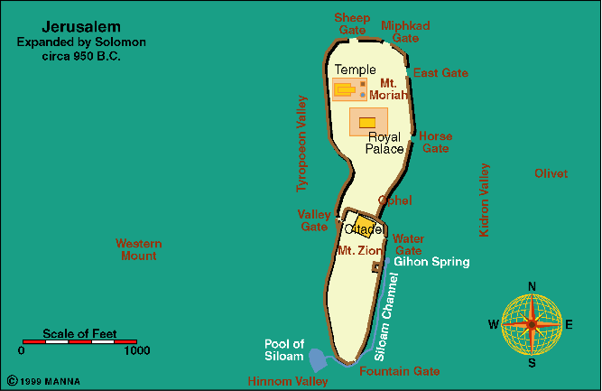

Slide 17
2. The forced labor within his kingdom 15-25
a. The projects of the forced labor 15-19
15a Now this is the account of the forced labor which King Solomon levied to build the house of the LORD, his own house, the Millo, the wall of Jerusalem,
1) The Jerusalem projects 15a
a) The Millo - the filling in - part of defensive works - strengthened by Solomon
b) The walls of Jerusalem

Slide 18
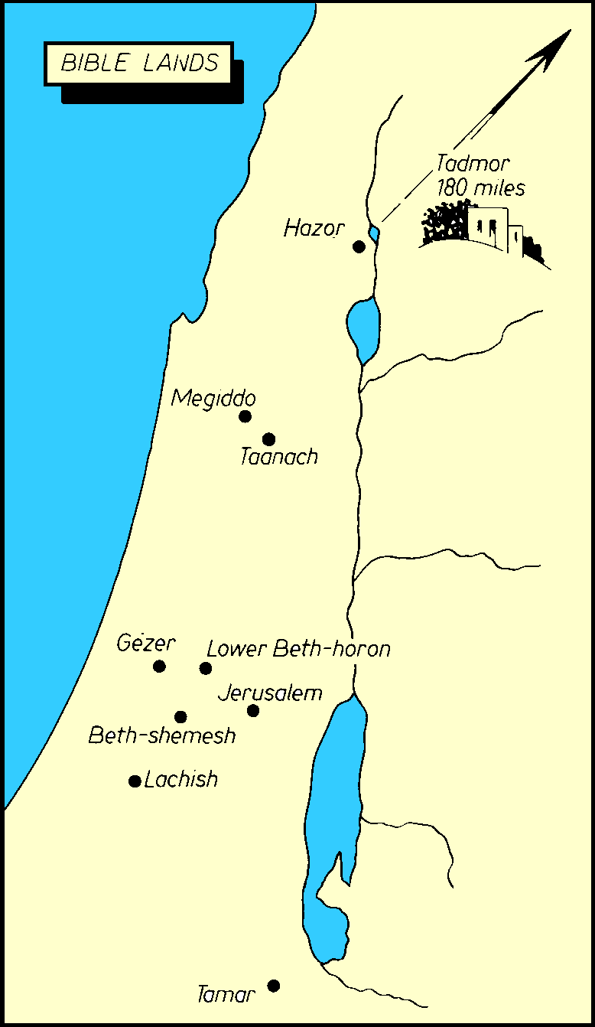
15b the wall of Jerusalem, Hazor, Megiddo, and Gezer.
16 For Pharaoh king of Egypt had gone up and captured Gezer and burned it with fire, and killed the Canaanites who lived in the city, and had given it as a dowry to his daughter, Solomon’s wife.
17 So Solomon rebuilt Gezer and the lower Beth-horon
18 and Baalath and Tamar in the wilderness, in the land of Judah,
2) The fortress cities 15b-18
Hazor - overlooks Merom - large city
Megiddo - Pass - highway
Gezer - foot hills - highway - Pharoah’s wedding gift
Lower Beth-horon - foot of ravine
Baalath
Tamar - city of palms - road to Ezion-geber

Slide 19
19 and all the storage cities which Solomon had, even the cities for his chariots and the cities for his horsemen, and all that it pleased Solomon to build in Jerusalem, in Lebanon, and in all the land under his rule.
3) The store cities 19a public storage
4) Chariot cities 19b base, stables

Slide 20
Hazor
The Largest Tell
Known in Joshua's day as "the head of all those kingdoms," the tell of Hazor is today the largest in Israel at 200 acres.
At its height in the Canaanite period, the city encompassed the entire tell. Later when it was inhabited by Israelites, the fortified city included only the Upper City.
Storehouse/Stable
This type of building, better known as an Israelite tripartite pillared building, has been found at numerous sites throughout the country.
Many functions for this type of structure have been suggested. Some archaeologists believe that these were used for the storage of food; more likely, the primary function of this building was for housing the royal cavalry.

Slide 21
Solomonic Gate
Archaeologists have uncovered a six-chambered gate at Hazor, which is nearly identical in size and design to gates at Megiddo and Gezer.
The best explanation for this is that these gates were all built by the same government. These gates are a remarkable testimony to Solomon's building activity as described in 1 Kings 9:15.

Slide 22
Megiddo Aerial
Inhabited from the Chalcolithic period, Megiddo has approximately 26 levels of occupation. American excavators from the Oriental Institute worked from 1925 with the ambitious goal of excavating every level in its entirety. The made it through the first three levels before concentrating the work on certain areas.
Megiddo Pass
From the earliest times Megiddo assumes a prominent role. This is largely owing to its strategic location astride the Megiddo Pass (Wadi Ara) and inside the busy Jezreel Valley. The modern road follows the ancient one; the tell is just off the bottom right corner.

Slide 23
Gezer
Solomonic Gate
Here is a beautiful monumental gateway from the time of Solomon, similar to those at Hazor and Megiddo. The date of this gate is confirmed by the presence of a destruction level underneath it (from the unnamed pharaoh who gave the city to Solomon) and a destruction level not long after its construction (by Shishak in 925 B.C.). Biblical history is dramatically confirmed by these archaeological findings.

Slide 24
2. The tributary labor from within his kingdom 15-25
b. The composition of the forced labor 20-23
20 As for all the people who were left of the Amorites, the Hittites, the Perizzites, the Hivites and the Jebusites, who were not of the sons of Israel,
21 their descendants who were left after them in the land whom the sons of Israel were unable to destroy utterly, from them Solomon levied forced laborers, even to this day.
22 But Solomon did not make slaves of the sons of Israel; for they were men of war, his servants, his princes, his captains, his chariot commanders, and his horsemen.
23 These were the chief officers who were over Solomon’s work, five hundred and fifty, who ruled over the people doing the work.
Amorites, Hittites, Perizzites, Hivites, Jebusites
Canaanites not complete destroyed
No Israelites
Israelites served in the army & royal court as princes & officers
550 officers

Slide 25
2. The tributary labor from within his kingdom 15-25
c. Final construction notices 24-25
24 As soon as Pharaoh’s daughter came up from the city of David to her house which Solomon had built for her, then he built the Millo.
25 Now three times in a year Solomon offered burnt offerings and peace offerings on the altar which he built to the LORD, burning incense with them on the altar which was before the LORD. So he finished the house.
1) Pharoah’s daughter comes from the city of David 24
2) Solomon sacrifices 3 times year at the temple 25

Slide 26
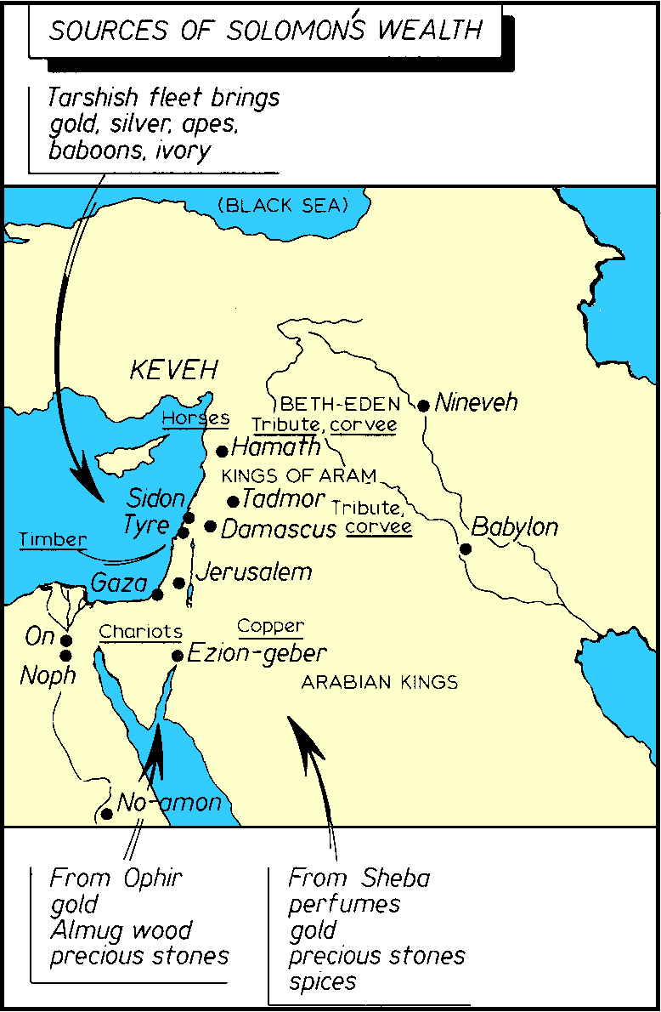
3. Sea expedition to Ophir brought great wealth and fame 26-28
26 King Solomon also built a fleet of ships in Ezion-geber, which is near Eloth on the shore of the Red Sea, in the land of Edom.
27 And Hiram sent his servants with the fleet, sailors who knew the sea, along with the servants of Solomon.
28 And they went to Ophir, and took four hundred and twenty talents of gold from there, and brought it to King Solomon.

Slide 27
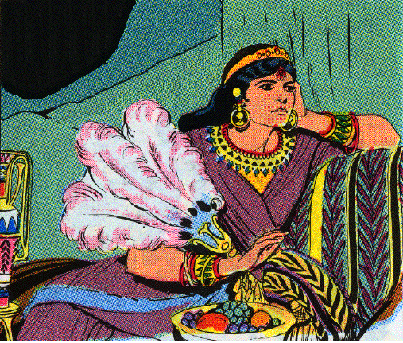
B. The Recognition of Solomon’s Glory 10:1-13
Queen of Sheba

Slide 28
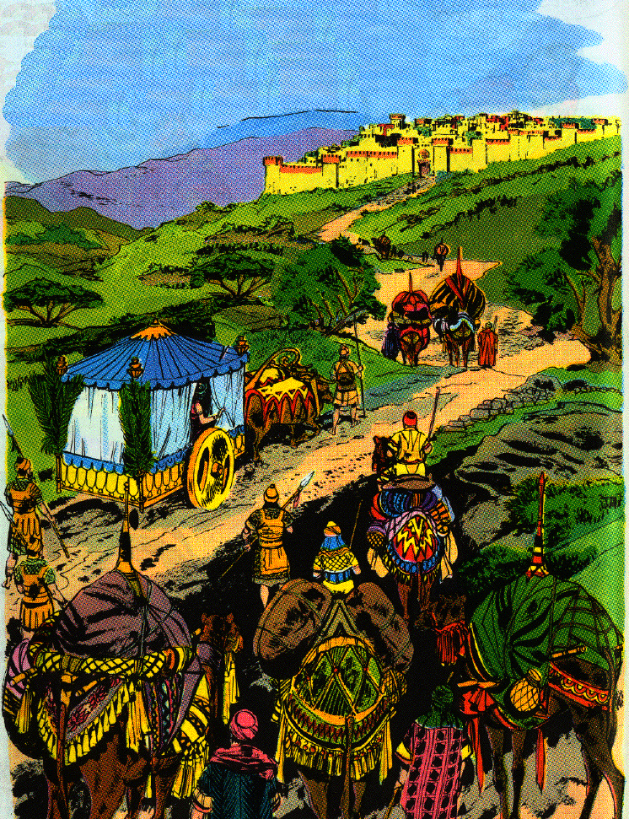
1. Queen of Sheba visits & questions Solomon 1-3
1 Now when the queen of Sheba heard about the fame of Solomon concerning the name of the LORD, she came to test him with difficult questions.
2 So she came to Jerusalem with a very large retinue, with camels carrying spices and very much gold and precious stones. When she came to Solomon, she spoke with him about all that was in her heart.
3 And Solomon answered all her questions; nothing was hidden from the king which he did not explain to her.

Slide 29
2. Surprise at his wisdom, buildings & court 4-7
4 When the queen of Sheba perceived all the wisdom of Solomon, the house that he had built,
5 the food of his table, the seating of his servants, the attendance of his waiters and their attire, his cupbearers, and his stairway by which he went up to the house of the LORD, there was no more spirit in her.

Slide 30
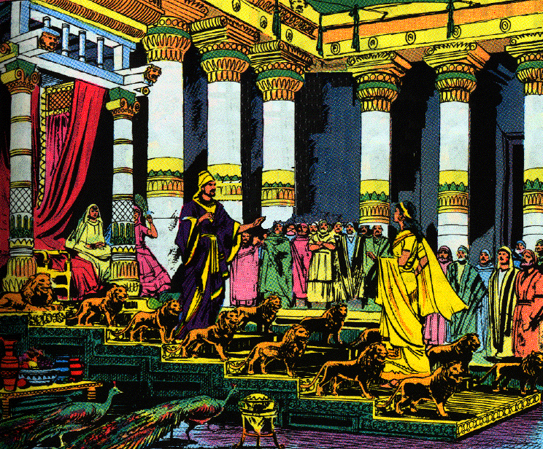
2. Surprise at his wisdom, buildings & court 4-7
6 Then she said to the king, "It was a true report which I heard in my own land about your words and your wisdom.
7 "Nevertheless I did not believe the reports, until I came and my eyes had seen it. And behold, the half was not told me. You exceed in wisdom and prosperity the report which I heard.

Slide 31
3. She praises God for placing him on the throne 8-9
8 "How blessed are your men, how blessed are these your servants who stand before you continually and hear your wisdom.
9 "Blessed be the LORD your God who delighted in you to set you on the throne of Israel; because the LORD loved Israel forever, therefore He made you king, to do justice and righteousness."

Slide 32
3. Gifts exchanged 10-14
10 And she gave the king a hundred and twenty talents of gold, and a very great amount of spices and precious stones. Never again did such abundance of spices come in as that which the queen of Sheba gave King Solomon.
11 And also the ships of Hiram, which brought gold from Ophir, brought in from Ophir a very great number of almug trees and precious stones.
12 And the king made of the almug trees supports for the house of the LORD and for the king’s house, also lyres and harps for the singers; such almug trees have not come in again, nor have they been seen to this day.
13 And King Solomon gave to the queen of Sheba all her desire which she requested, besides what he gave her according to his royal bounty. Then she turned and went to her own land together with her servants.

Slide 33
C. Indications of Solomon’s Glory 10:14-29

Slide 34
1. Solomon’s enormous gold revenues 14-21
Solomon’s annual revenue 14, 15
666 talents in one year
annual revenues from caravans
He makes 200 Large shields (9 pds. each) & 300 shields of gold 16-17
His magnificent ivory throne 18-20
Drinking vessels of gold 21
What the navy of Tarshish brought every 3 yrs 22

Slide 36
1. Solomon’s enormous gold revenues 14-21
His magnificent ivory throne 18-20
Drinking vessels of gold 21
What the navy of Tarshish brought every 3 yrs 22

Slide 37
2. His wealth in other substances & silver 22-29
His great riches, numerous chariots, and horsemen 23-27
22 For the king had at sea the ships of Tarshish with the ships of Hiram; once every three years the ships of Tarshish came bringing gold and silver, ivory and apes and peacocks.
23 So King Solomon became greater than all the kings of the earth in riches and in wisdom.
24 And all the earth was seeking the presence of Solomon, to hear his wisdom which God had put in his heart.
25 And they brought every man his gift, articles of silver and gold, garments, weapons, spices, horses, and mules, so much year by year.
26 Now Solomon gathered chariots and horsemen; and he had 1,400 chariots and 12,000 horsemen, and he stationed them in the chariot cities and with the king in Jerusalem.
27 And the king made silver as common as stones in Jerusalem, and he made cedars as plentiful as sycamore trees that are in the lowland.

Slide 38
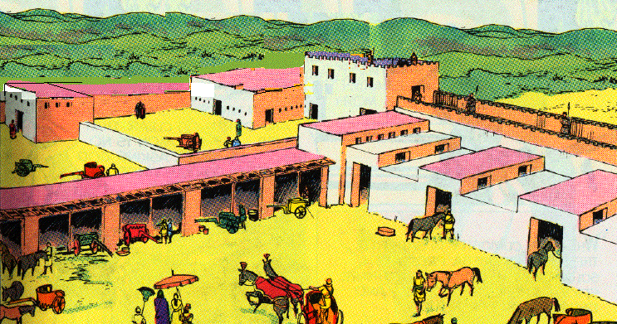
2. His wealth in other substances & silver 22-29
Chariots & horses from Egypt 28-29
28 Also Solomon’s import of horses was from Egypt and Kue, and the king’s merchants procured them from Kue for a price.
29 And a chariot was imported from Egypt for 600 shekels of silver, and a horse for 150; and by the same means they exported them to all the kings of the Hittites and to the kings of the Arameans.

Slide 39
VIII. Solomon’s Transgression & Troubles 11:1-43

Slide 40
A. The Apostasy of Solomon 1-13
1. His attachment to foreign women & consequent idolatry 1-2
Number of wives & concubines 3
Turn his heart away from God in his old age 4
Built temples for idols & burned incense & sacrificed to them 5-8
Lord’s anger: will deprive him of the kingdom, but will leave one tribe for David’s sake 9-13
1 Now King Solomon loved many foreign women along with the daughter of Pharaoh: Moabite, Ammonite, Edomite, Sidonian, and Hittite women,
2 from the nations concerning which the LORD had said to the sons of Israel, "You shall not associate with them, neither shall they associate with you, for they will surely turn your heart away after their gods." Solomon held fast to these in love.
2. Number of wives & concubines 3
3 And he had seven hundred wives, princesses, and three hundred concubines, and his wives turned his heart away.

Slide 41
A. The Apostasy of Solomon 1-13
3. Turn his heart away from God in his old age 4
Number of wives & concubines 3
Turn his heart away from God in his old age 4
Built temples for idols & burned incense & sacrificed to them 5-8
Lord’s anger: will deprive him of the kingdom, but will leave one tribe for David’s sake 9-13
4 For it came about when Solomon was old, his wives turned his heart away after other gods; and his heart was not wholly devoted to the LORD his God, as the heart of David his father had been.

Slide 42
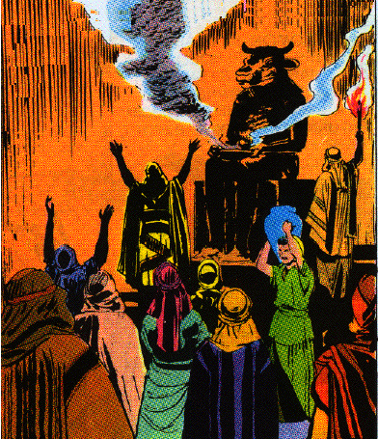
A. The Apostasy of Solomon 1-13
4. Built temples for idols & burned incense & sacrificed to them 5-8
5 For Solomon went after Ashtoreth the goddess of the Sidonians and after Milcom the detestable idol of the Ammonites.
6 And Solomon did what was evil in the sight of the LORD, and did not follow the LORD fully, as David his father had done.
7 Then Solomon built a high place for Chemosh the detestable idol of Moab, on the mountain which is east of Jerusalem, and for Molech the detestable idol of the sons of Ammon.
8 Thus also he did for all his foreign wives, who burned incense and sacrificed to their gods.

Slide 43
A. The Apostasy of Solomon 1-13
5. Lord’s anger: will deprive him of the kingdom, but will leave one tribe for David’s sake 9-13
9 Now the LORD was angry with Solomon because his heart was turned away from the LORD, the God of Israel, who had appeared to him twice,
10 and had commanded him concerning this thing, that he should not go after other gods; but he did not observe what the LORD had commanded.
11 So the LORD said to Solomon, "Because you have done this, and you have not kept My covenant and My statutes, which I have commanded you, I will surely tear the kingdom from you, and will give it to your servant.
12 "Nevertheless I will not do it in your days for the sake of your father David, but I will tear it out of the hand of your son.
13 "However, I will not tear away all the kingdom, but I will give one tribe to your son for the sake of My servant David and for the sake of Jerusalem which I have chosen."

Slide 44
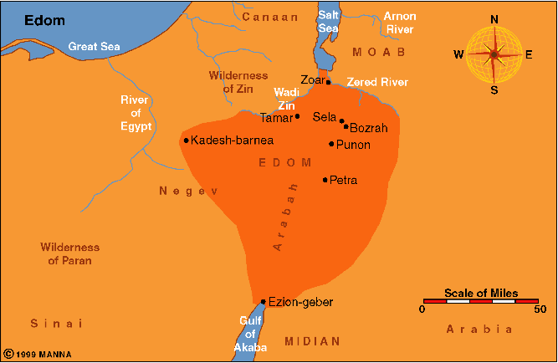
B. The consequences of Solomon’s Apostasy 14-40
1. The rebellion of Hadad the Edomite 14-22

Slide 45
B. The consequences of Solomon’s Apostasy 14-40
1. The rebellion of Hadad the Edomite 14-22
14 Then the LORD raised up an adversary to Solomon, Hadad the Edomite; he was of the royal line in Edom.
15 For it came about, when David was in Edom, and Joab the commander of the army had gone up to bury the slain, and had struck down every male in Edom
16 (for Joab and all Israel stayed there six months, until he had cut off every male in Edom),
17 that Hadad fled to Egypt, he and certain Edomites of his father’s servants with him, while Hadad was a young boy.
18 And they arose from Midian and came to Paran; and they took men with them from Paran and came to Egypt, to Pharaoh king of Egypt, who gave him a house and assigned him food and gave him land.

Slide 46
B. The consequences of Solomon’s Apostasy 14-40
1. The rebellion of Hadad the Edomite 14-22
19 Now Hadad found great favor before Pharaoh, so that he gave him in marriage the sister of his own wife, the sister of Tahpenes the queen.
20 And the sister of Tahpenes bore his son Genubath, whom Tahpenes weaned in Pharaoh’s house; and Genubath was in Pharaoh’s house among the sons of Pharaoh.
21 But when Hadad heard in Egypt that David slept with his fathers, and that Joab the commander of the army was dead, Hadad said to Pharaoh, "Send me away, that I may go to my own country."
22 Then Pharaoh said to him, "But what have you lacked with me, that behold, you are seeking to go to your own country?" And he answered, "Nothing; nevertheless you must surely let me go."

Slide 47
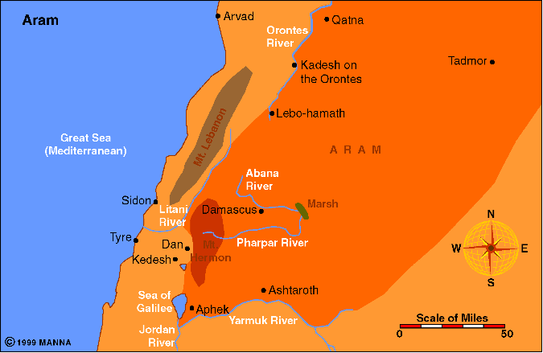
B. The consequences of Solomon’s Apostasy 14-40
2. Rezon and Damascus 23-25
Zobah

Slide 48
B. The consequences of Solomon’s Apostasy 14-40
2. Rezon and Damascus 23-25
23 God also raised up another adversary to him, Rezon the son of Eliada, who had fled from his lord Hadadezer king of Zobah.
24 And he gathered men to himself and became leader of a marauding band, after David slew them of Zobah; and they went to Damascus and stayed there, and reigned in Damascus.
25 So he was an adversary to Israel all the days of Solomon, along with the evil that Hadad did; and he abhorred Israel and reigned over Aram.

Slide 49
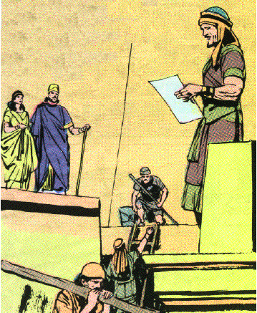
B. The consequences of Solomon’s Apostasy 14-40
3. Jeroboam of Ephraim 26-40
Why Jeroboam became his enemy 26-28
26 Then Jeroboam the son of Nebat, an Ephraimite of Zeredah [ZER ih duh], Solomon’s servant, whose mother’s name was Zeruah, a widow, also rebelled against the king.
27 Now this was the reason why he rebelled against the king: Solomon built the Millo, and closed up the breach of the city of his father David.
28 Now the man Jeroboam was a valiant warrior, and when Solomon saw that the young man was industrious, he appointed him over all the forced labor of the house of Joseph.

Slide 50
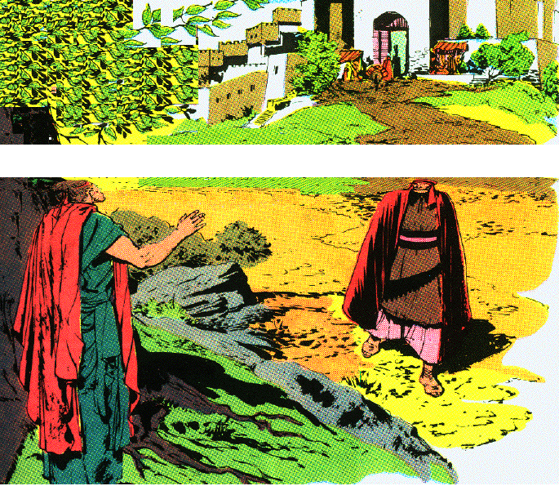
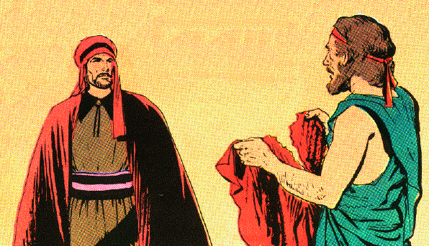
B. The consequences of Solomon’s Apostasy 14-40
3. Jeroboam of Ephraim 26-40
Prophet Ahijah promises God will tear Israel from Solomon’s family & give 10 tribes to him 29-39
29 And it came about at that time, when Jeroboam went out of Jerusalem, that the prophet Ahijah the Shilonite found him on the road. Now Ahijah had clothed himself with a new cloak; and both of them were alone in the field.
30 Then Ahijah took hold of the new cloak which was on him, and tore it into twelve pieces.

Slide 51
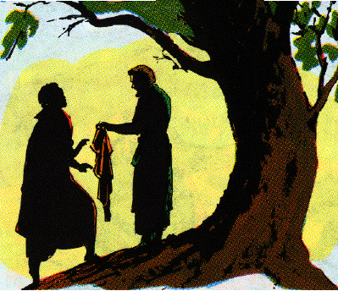
B. The consequences of Solomon’s Apostasy 14-40
3. Jeroboam of Ephraim 26-40
Prophet Ahijah promises God will tear Israel from Solomon’s family & give 10 tribes to him 29-39
31 And he said to Jeroboam, "Take for yourself ten pieces; for thus says the LORD, the God of Israel, ‘Behold, I will tear the kingdom out of the hand of Solomon and give you ten tribes
32 (but he will have one tribe, for the sake of My servant David and for the sake of Jerusalem, the city which I have chosen from all the tribes of Israel),
33 because they have forsaken Me, and have worshiped Ashtoreth the goddess of the Sidonians, Chemosh the god of Moab, and Milcom the god of the sons of Ammon; and they have not walked in My ways, doing what is right in My sight and observing My statutes and My ordinances, as his father David did.

Slide 52
B. The consequences of Solomon’s Apostasy 14-40
3. Jeroboam of Ephraim 26-40
Prophet Ahijah promises God will tear Israel from Solomon’s family & give 10 tribes to him 29-39
34 ‘Nevertheless I will not take the whole kingdom out of his hand, but I will make him ruler all the days of his life, for the sake of My servant David whom I chose, who observed My commandments and My statutes;
35 but I will take the kingdom from his son’s hand and give it to you, even ten tribes.
36 ‘But to his son I will give one tribe, that My servant David may have a lamp always before Me in Jerusalem, the city where I have chosen for Myself to put My name.
37 ‘And I will take you, and you shall reign over whatever you desire, and you shall be king over Israel.

Slide 53
B. The consequences of Solomon’s Apostasy 14-40
3. Jeroboam of Ephraim 26-40
Prophet Ahijah promises God will tear Israel from Solomon’s family & give 10 tribes to him 29-39
38 ‘Then it will be, that if you listen to all that I command you and walk in My ways, and do what is right in My sight by observing My statutes and My commandments, as My servant David did, then I will be with you and build you an enduring house as I built for David, and I will give Israel to you.
39 ‘Thus I will afflict the descendants of David for this, but not always.’"

Slide 54
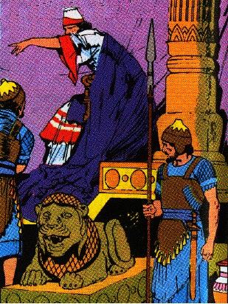
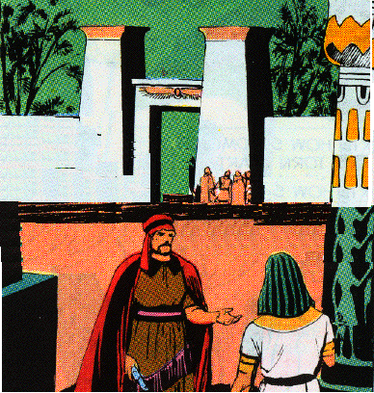
B. The consequences of Solomon’s Apostasy 14-40
3. Jeroboam of Ephraim 26-40
Solomn seeks his life & he flees to Egypt until the death of the king 40
40 Solomon sought therefore to put Jeroboam to death; but Jeroboam arose and fled to Egypt to Shishak king of Egypt, and he was in Egypt until the death of Solomon.
Sheshonq I
(Shee shongk)
Shishak
945-924 B.C.

Slide 55
C. A Summary Statement of Solomon’s Reign 41-43
41 Now the rest of the acts of Solomon and whatever he did, and his wisdom, are they not written in the book of the acts of Solomon?
42 Thus the time that Solomon reigned in Jerusalem over all Israel was forty years.
43 And Solomon slept with his fathers and was buried in the city of his father David, and his son Rehoboam reigned in his place.

