Slide 1
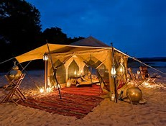
Sustaining Our Lives in Christ
“At what point do we fold up our tents and discontinue the pilgrimage with Christ?”

Slide 2
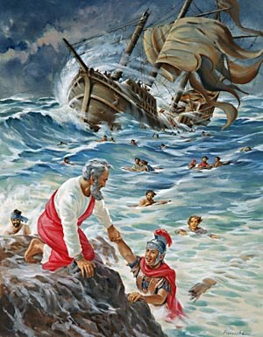
1 Corinthians 4:9-13 THE COST OF PAUL’S LIFE IN CHRIST
Judged by Fellow Believers
Poorly Clothed
Condemned to Death
Roughly Treated
A Spectacle to Others
Homeless
A Fool for Christ
Toiled with His Own Hands
Weak
Reviled
Without Honor
Persecuted
Hungry and Thirsty
Slandered
Viewed As the Scum and Dregs of the Earth

Slide 3
2 Timothy 4:7 Paul Survived
Paul survived by simply viewing the temporal things of life in light of the eternal.
This is the reason we never collapse. The outward man does indeed suffer wear and tear, but every day the inward man receives fresh strength.
These little troubles (which are really so transitory) are winning for us a permanent, glorious and solid reward out of all proportion to our pain.
We are looking…not at the visible things but at the invisible. The visible are transitory: It is the invisible things that are really permanent
(2 Corinthians 4:16-18, Phillips Translation).

Slide 4
Live, Knowing . . . Eternity Is Just One Heartbeat Away
Take Hold of the Eternal Life (1 Timothy 6:12)
Regain New Strength (Isaiah 40:31)
Press On (Philippians 3:12)
Finish the Course (2 Timothy 4:7-8)
So, at What Point then Should We Fold up Our Tents and Discontinue Our Pilgrimage with Christ?
NEVER! Be Faithful until Death (Revelation 2:10)

