Slide 1
D. Pharaoh’s unprecedented recognition of Solomon 3:1
1 Then Solomon formed a marriage alliance with Pharaoh king of Egypt, and took Pharaoh’s daughter and brought her to the city of David, until he had finished building his own house and the house of the LORD and the wall around Jerusalem.

Slide 2
E. Solomon’s commitment to God 3:2, 3
2 The people were still sacrificing on the high places, because there was no house built for the name of the LORD until those days.
3 Now Solomon loved the LORD, walking in the statutes of his father David, except he sacrificed and burned incense on the high places.

Slide 3
III. Solomon’s Government 3:4—4:34

Slide 4
III. Solomon’s Government 3:4—4:34
1. An explanation of Solomon’s wisdom 3:4-15

Slide 5
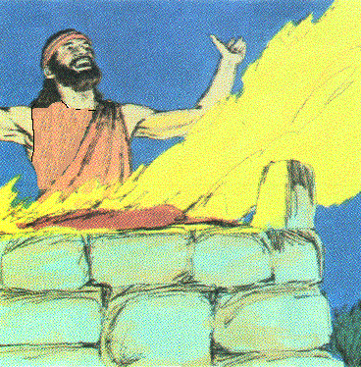
a. Solomon prayed for wisdom to guide & govern his people 4-9
4 And the king went to Gibeon to sacrifice there, for that was the great high place; Solomon offered a thousand burnt offerings on that altar.

Slide 6
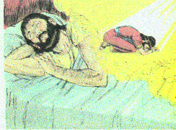
a. Solomon prayed for wisdom to guide & govern his people 4-9
5 In Gibeon the LORD appeared to Solomon in a dream at night; and God said, "Ask what you wish me to give you."
6 Then Solomon said, "Thou hast shown great lovingkindness to Thy servant David my father, according as he walked before Thee in truth and righteousness and uprightness of heart toward Thee; and Thou hast reserved for him this great lovingkindness, that Thou hast given him a son to sit on his throne, as it is this day.

Slide 7
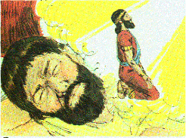
a. Solomon prayed for wisdom to guide & govern his people 4-9
7 "And now, O LORD my God, Thou hast made Thy servant king in place of my father David, yet I am but a little child; I do not know how to go out or come in.
8 "And Thy servant is in the midst of Thy people which Thou hast chosen, a great people who cannot be numbered or counted for multitude.
9 "So give Thy servant an understanding heart to judge Thy people to discern between good and evil. For who is able to judge this great people of Thine?"

Slide 8
b. God blessed him with wisdom & added blessings 10-15
10 And it was pleasing in the sight of the Lord that Solomon had asked this thing.
11 And God said to him, "Because you have asked this thing and have not asked for yourself long life, nor have asked riches for yourself, nor have you asked for the life of your enemies, but have asked for yourself discernment to understand justice,
12 behold, I have done according to your words. Behold, I have given you a wise and discerning heart, so that there has been no one like you before you, nor shall one like you arise after you.

Slide 9
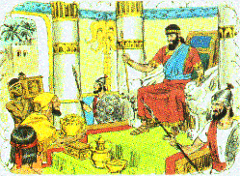
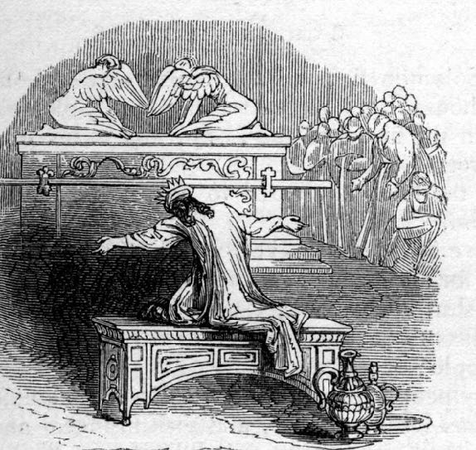
b. God blessed him with wisdom & added blessings 10-15
13 "And I have also given you what you have not asked, both riches and honor, so that there will not be any among the kings like you all your days.
14 "And if you walk in My ways, keeping My statutes and commandments, as your father David walked, then I will prolong your days."
15 Then Solomon awoke, and behold, it was a dream. And he came to Jerusalem and stood before the ark of the covenant of the Lord, and offered burnt offerings and made peace offerings, and made a feast for all his servants.

Slide 10
III. Solomon’s Government 3:4—4:34
2. A demonstration of his wisdom in practice 3:16-28

Slide 11
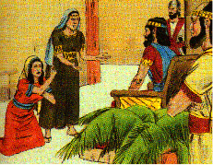
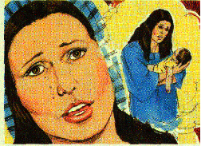
a. The women’s testimony 16-22
16 Then two women who were harlots came to the king and stood before him.
17 And the one woman said, "Oh, my lord, this woman and I live in the same house; and I gave birth to a child while she was in the house.
18 "And it happened on the third day after I gave birth, that this woman also gave birth to a child, and we were together. There was no stranger with us in the house, only the two of us in the house.

Slide 12
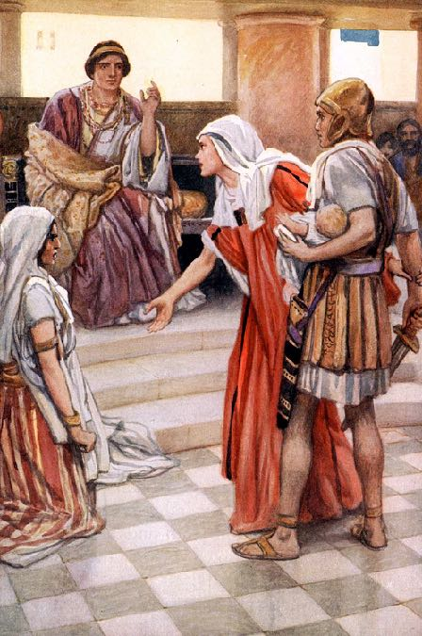
a. The women’s testimony 16-22
19 "And this woman’s son died in the night, because she lay on it.
20 "So she arose in the middle of the night and took my son from beside me while your maidservant slept, and laid him in her bosom, and laid her dead son in my bosom.
21 "And when I rose in the morning to nurse my son, behold, he was dead; but when I looked at him carefully in the morning, behold, he was not my son, whom I had borne."

Slide 13
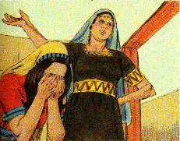
a. The women’s testimony 16-22
22 Then the other woman said, "No! For the living one is my son, and the dead one is your son." But the first woman said, "No! For the dead one is your son, and the living one is my son." Thus they spoke before the king.

Slide 14
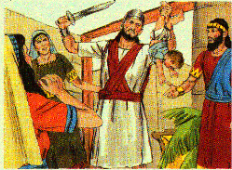
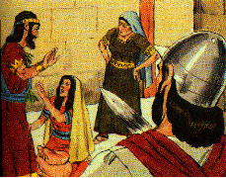
b. Solomon’s stratagem 23-26
23 Then the king said, "The one says, ‘This is my son who is living, and your son is the dead one’; and the other says, ‘No! For your son is the dead one, and my son is the living one.’"
24 And the king said, "Get me a sword." So they brought a sword before the king.
25 And the king said, "Divide the living child in two, and give half to the one and half to the other."
26 Then the woman whose child was the living one spoke to the king, for she was deeply stirred over her son and said, "Oh, my lord, give her the living child, and by no means kill him." But the other said, "He shall be neither mine nor yours; divide him!"

Slide 15
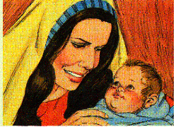
c. Solomon’s decision and the nation impressed 27, 28
27 Then the king answered and said, "Give the first woman the living child, and by no means kill him. She is his mother."
28 When all Israel heard of the judgment which the king had handed down, they feared the king; for they saw that the wisdom of God was in him to administer justice.

Slide 16
B. Solomon’s management of his kingdom 4:1-20

Slide 17
1. The ministers of state 4:1-6
a. Azariah son of Zadok - priest - prime minister
b. Elihoreph (El ih HOH ref) and Ahijah - secretaries - court scribes
c. Jehoshaphat - recorder - remembrancer
d. Benaiah - over the army
e. Zadok and Abiathar - priests
f. Azariah son of Nathan - over the deputies - 12 governors
g. Zabud - king’s friend - confidential adviser
h. Ahishar (uh HIGH shahr) - over the household
i. Adoniram (AD uh NIGH ruhm) - over forced labor

Slide 18
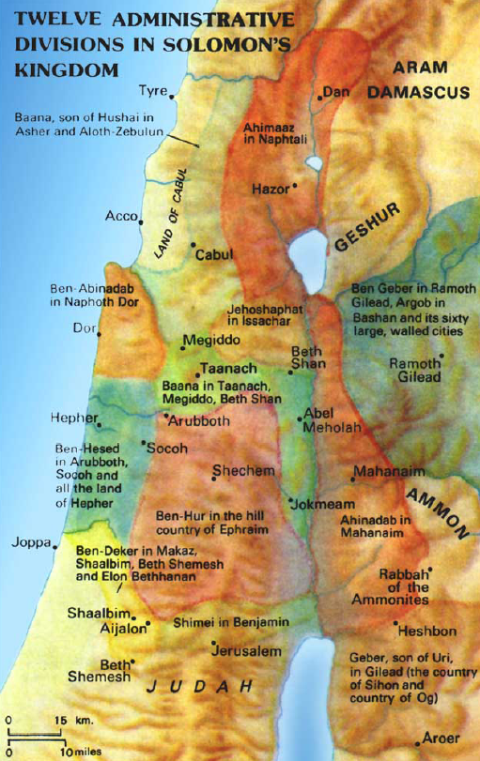
2. The financial officers 4:7-19
a. Tax districts nearly equal with tribal boundaries (adjustments for economic equality)
b. Chronological list according to when their provisions were due
c. Two officers married Solomon’s daughters - they were over the farthest districts

Slide 19
C. The wonderment of his reign 4:21-34

Slide 20
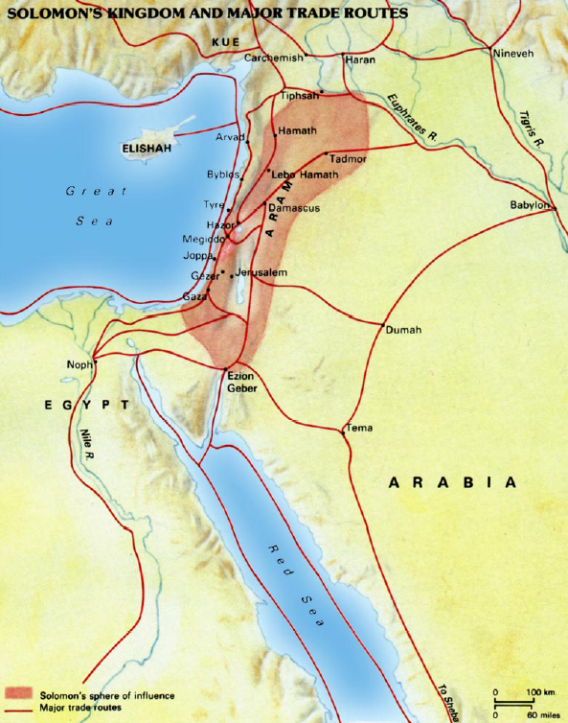

Slide 21
1. The extent and power of the kingdom 4:20-28
20 Judah and Israel were as numerous as the sand that is on the seashore in abundance; they were eating and drinking and rejoicing.
21 Now Solomon ruled over all the kingdoms from the River to the land of the Philistines and to the border of Egypt; they brought tribute and served Solomon all the days of his life.
a. The nation was as numerous as the sand - Gen. 22:17; 32:12
b. Euphrates to river of Egypt Gen. 15:18, v. 21

Slide 22
1. The extent and power of the kingdom 4:20-28
22 Solomon’s provision for one day was thirty kors of fine flour and sixty kors of meal,
23 ten fat oxen, twenty pasture-fed oxen, a hundred sheep besides deer, gazelles, roebucks, and fattened fowl.
c. Daily consumption of the royal household vv. 22-23
340 bushels of flour, 155 bushels of meal
30 head of beef, 100 head of sheep, wild game
Enough for 14-35 thousand servants

Slide 23
1. The extent and power of the kingdom 4:20-28
24 For he had dominion over everything west of the River, from Tiphsah even to Gaza, over all the kings west of the River; and he had peace on all sides around about him.
25 So Judah and Israel lived in safety, every man under his vine and his fig tree, from Dan even to Beersheba, all the days of Solomon.even to Gaza, over all the kings west of the River; and he had peace on all sides around about him.
d. Controlled all the land west of the Euphrates vv. 24, 25
Syria, Philistines
Judah & Israel enjoyed peace

Slide 24
1. The extent and power of the kingdom 4:20-28
26 Solomon had 40,000 stalls of horses for his chariots, and 12,000 horsemen.
27 Those deputies provided for King Solomon and all who came to King Solomon’s table, each in his month; they left nothing lacking.
28 They also brought barley and straw for the horses and swift steeds to the place where it should be, each according to his charge.
e. Multiplied horses, vv. 26-28 - Deut. 17:16 40,000 or 4,000? 2 Chron. 9:25
4,000 seems correct - 1,400 chariots, 10:26 & 12,000 cavalry horses
Governors provided for horses needs (barley and straw)

Slide 25
2. The profound wisdom and fame of the king 4:29-34
29 Now God gave Solomon wisdom and very great discernment and breadth of mind, like the sand that is on the seashore.
30 And Solomon’s wisdom surpassed the wisdom of all the sons of the east and all the wisdom of Egypt.
31 For he was wiser than all men, than Ethan the Ezrahite, Heman, Calcol and Darda, the sons of Mahol; and his fame was known in all the surrounding nations.
32 He also spoke 3,000 proverbs, and his songs were 1,005.
33 And he spoke of trees, from the cedar that is in Lebanon even to the hyssop that grows on the wall; he spoke also of animals and birds and creeping things and fish.
34 And men came from all peoples to hear the wisdom of Solomon, from all the kings of the earth who had heard of his wisdom.

