Slide 1
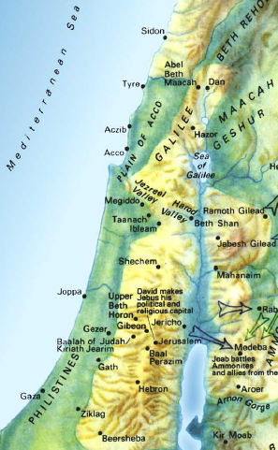
J. Absalom fled to Geshur and stayed there three years 37-39
37 Now Absalom fled and went to Talmai the son of Ammihud, the king of Geshur. And David mourned for his son every day.
38 So Absalom had fled and gone to Geshur, and was there three years.

Slide 2
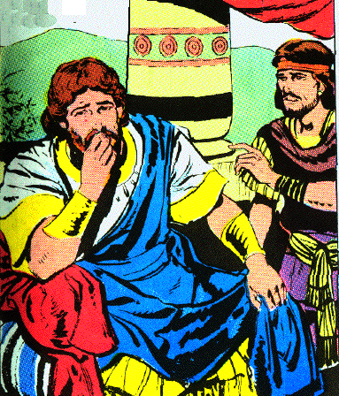
J. Absalom fled to Geshur and stayed there three years 37-39
39 And the heart of King David longed to go out to Absalom; for he was comforted concerning Amnon, since he was dead.

Slide 3
V. Absalom is recalled from exile 14:1-33

Slide 4
A. Joab finds a woman of Tekoa to pretend to be a mourner before David 1-3
1 Now Joab the son of Zeruiah perceived that the king's heart was inclined toward Absalom.
2 So Joab sent to Tekoa and brought a wise woman from there and said to her, "Please pretend to be a mourner, and put on mourning garments now, and do not anoint yourself with oil, but be like a woman who has been mourning for the dead many days;
3 then go to the king and speak to him in this manner. "So Joab put the words in her mouth.

Slide 5
B. The woman fictitious story of two sons 4-7
4 Now when the woman of Tekoa spoke to the king, she fell on her face to the ground and prostrated herself and said, "Help, O king."
5 And the king said to her, "What is your trouble?" And she answered, "Truly I am a widow, for my husband is dead.
6 "And your maidservant had two sons, but the two of them struggled together in the field, and there was no one to separate them, so one struck the other and killed him.
7 "Now behold, the whole family has risen against your maidservant, and they say, 'Hand over the one who struck his brother, that we may put him to death for the life of his brother whom he killed, and destroy the heir also.' Thus they will extinguish my coal which is left, so as to leave my husband neither name nor remnant on the face of the earth."

Slide 6
C. David promises to protect her surviving son 8-11
8 Then the king said to the woman, "Go to your house, and I will give orders concerning you."
9 And the woman of Tekoa said to the king, "O my lord, the king, the iniquity is on me and my father's house, but the king and his throne are guiltless."
10 So the king said, "Whoever speaks to you, bring him to me, and he will not touch you anymore."
11 Then she said, "Please let the king remember the Lord your God, so that the avenger of blood may not continue to destroy, lest they destroy my son." And he said, "As the Lord lives, not one hair of your son shall fall to the ground."

Slide 7
D. She says David is inconsistent in keeping Absalom away 12-17
12 Then the woman said, "Please let your maidservant speak a word to my lord the king." And he said, "Speak."
13 And the woman said, "Why then have you planned such a thing against the people of God? For in speaking this word the king is as one who is guilty, in that the king does not bring back his banished one.
14 "For we shall surely die and are like water spilled on the ground which cannot be gathered up again. Yet God does not take away life, but plans ways so that the banished one may not be cast out from him.

Slide 8
D. She says David is inconsistent in keeping Absalom away 12-17
15 "Now the reason I have come to speak this word to my lord the king is because the people have made me afraid; so your maidservant said, 'Let me now speak to the king, perhaps the king will perform the request of his maidservant.
16 'For the king will hear and deliver his maidservant from the hand of the man who would destroy both me and my son from the inheritance of God.'
17 "Then your maidservant said, 'Please let the word of my lord the king be comforting, for as the angel of God, so is my lord the king to discern good and evil. And may the Lord your God be with you.'"

Slide 9
E. David suspects that Joab is behind her words 18-20
18 Then the king answered and said to the woman, "Please do not hide anything from me that I am about to ask you." And the woman said, "Let my lord the king please speak."
19 So the king said, "Is the hand of Joab with you in all this?" And the woman answered and said, "As your soul lives, my lord the king, no one can turn to the right or to the left from anything that my lord the king has spoken. Indeed, it was your servant Joab who commanded me, and it was he who put all these words in the mouth of your maidservant;
20 in order to change the appearance of things your servant Joab has done this thing. But my lord is wise, like the wisdom of the angel of God, to know all that is in the earth. "

Slide 10
F. Joab is told to recall Absalom but not to allow him to see the king 21-24
21 Then the king said to Joab, "Behold now, I will surely do this thing; go therefore, bring back the young man Absalom."
22 And Joab fell on his face to the ground, prostrated himself and blessed the king; then Joab said, "Today your servant knows that I have found favor in your sight, O my lord, the king, in that the king has performed the request of his servant."

Slide 11
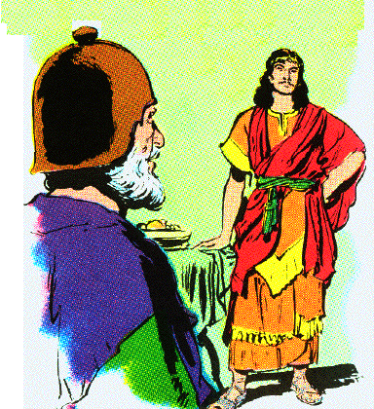
F. Joab is told to recall Absalom but not to allow him to see the king 21-24
23 So Joab arose and went to Geshur, and brought Absalom to Jerusalem.

Slide 12
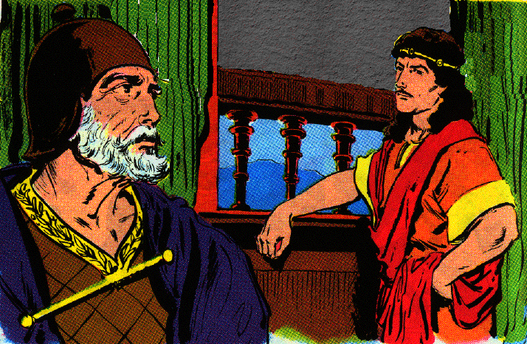
F. Joab is told to recall Absalom but not to allow him to see the king 21-24
24 However the king said, "Let him turn to his own house, and let him not see my face." So Absalom turned to his own house and did not see the king's face.

Slide 13
G. Absalom’s appearance and family 25-27
25 Now in all Israel was no one as handsome as Absalom, so highly praised; from the sole of his foot to the crown of his head there was no defect in him.
26 And when he cut the hair of his head (and it was at the end of every year that he cut it, for it was heavy on him so he cut it), he weighed the hair of his head at 200 shekels by the king's weight.
27 And to Absalom there were born three sons, and one daughter whose name was Tamar; she was a woman of beautiful appearance.

Slide 14
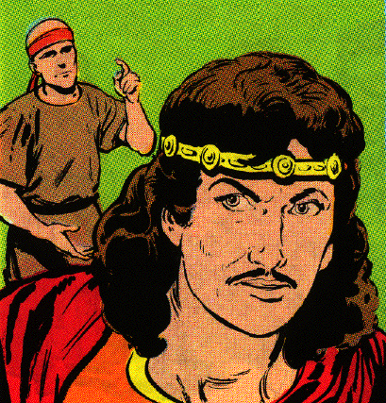
H. After two years, Absalom demands to see the king & is restored 28-33
28 Now Absalom lived two full years in Jerusalem, and did not see the king's face.
29 Then Absalom sent for Joab, to send him to the king, but he would not come to him. So he sent again a second time, but he would not come.

Slide 15
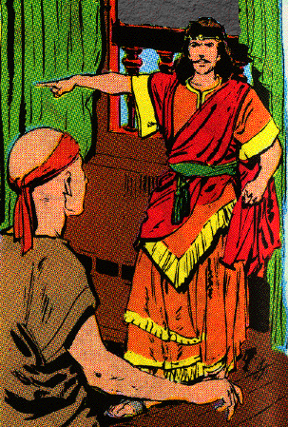
H. After two years, Absalom demands to see the king & is restored 28-33
30 Therefore he said to his servants, "See, Joab's field is next to mine, and he has barley there; go and set it on fire." So Absalom's servants set the field on fire.

Slide 16
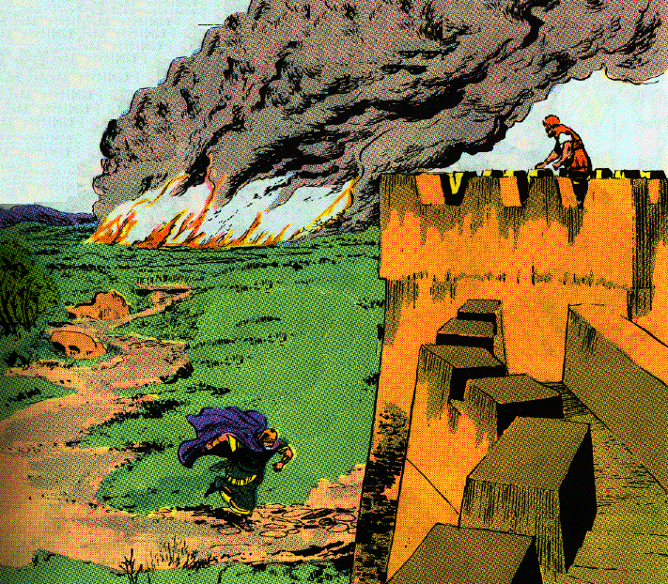
H. After two years, Absalom demands to see the king & is restored 28-33
31 Then Joab arose, came to Absalom at his house and said to him, "Why have your servants set my field on fire?"

Slide 17
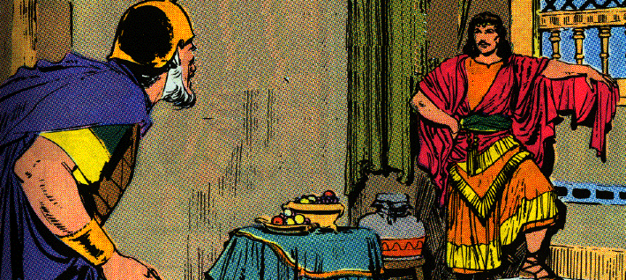
H. After two years, Absalom demands to see the king & is restored 28-33
32 And Absalom answered Joab, "Behold, I sent for you, saying, 'Come here, that I may send you to the king, to say," Why have I come from Geshur? It would be better for me still to be there. "' Now therefore, let me see the king's face; and if there is iniquity in me, let him put me to death."

Slide 18
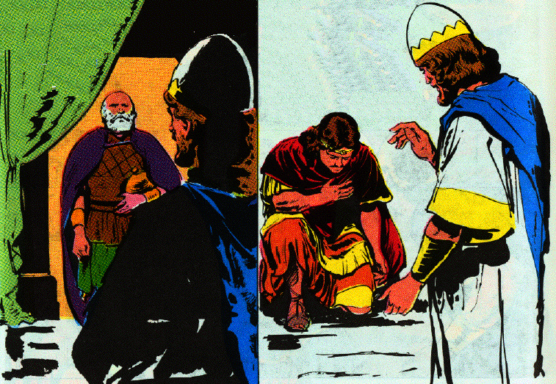
H. After two years, Absalom demands to see the king & is restored 28-33
33 So when Joab came to the king and told him, he called for Absalom. Thus he came to the king and prostrated himself on his face to the ground before the king, and the king kissed Absalom.

Slide 19
Absalom’s Revolt
2 Samuel 15:1—19:43

Slide 20
A. Beginning of the rebellion
2 Samuel15:1-37

Slide 21
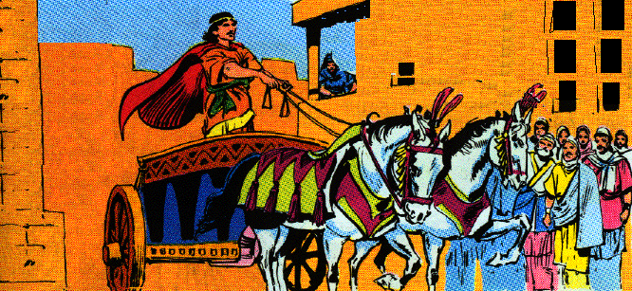
1. Absalom’s seduction of the people 15:1-6
1 Now it came about after this that Absalom provided for himself a chariot and horses, and fifty men as runners before him.

Slide 22
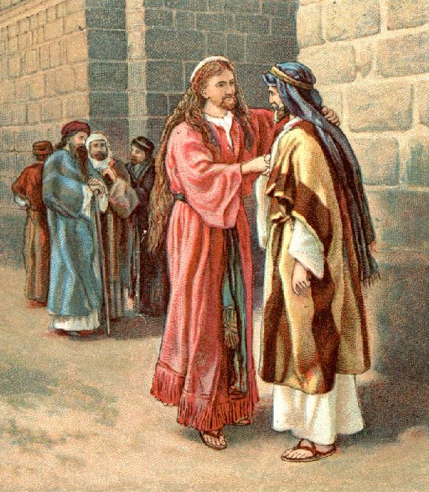
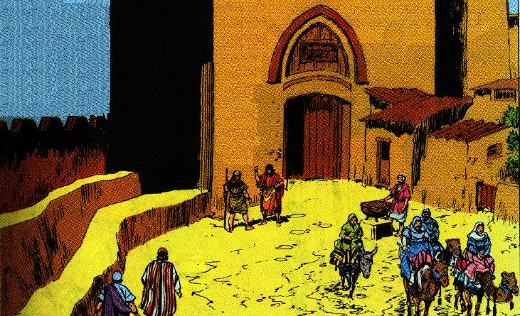
1. Absalom’s seduction of the people 15:1-6
2 And Absalom used to rise early and stand beside the way to the gate; and it happened that when any man had a suit to come to the king for judgment, Absalom would call to him and say, "From what city are you?" And he would say, "Your servant is from one of the tribes of Israel."
3 Then Absalom would say to him, "See, your claims are good and right, but no man listens to you on the part of the king."

Slide 23
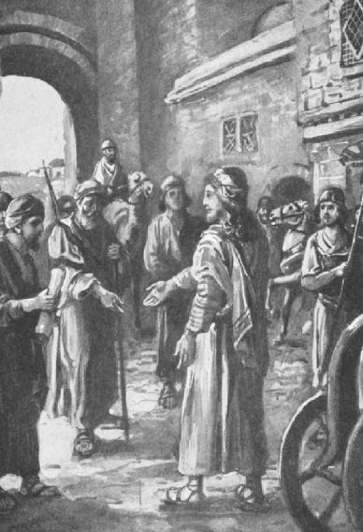
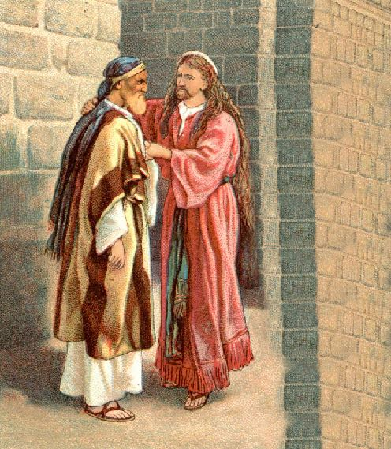
1. Absalom’s seduction of the people 15:1-6
4 Moreover, Absalom would say, "Oh that one would appoint me judge in the land, then every man who has any suit or cause could come to me, and I would give him justice.
5 And it happened that when a man came near to prostrate himself before him, he would put out his hand and take hold of him and kiss him.
6 And in this manner Absalom dealt with all Israel who came to the king for judgment; so Absalom stole away the hearts of the men of Israel.

Slide 24
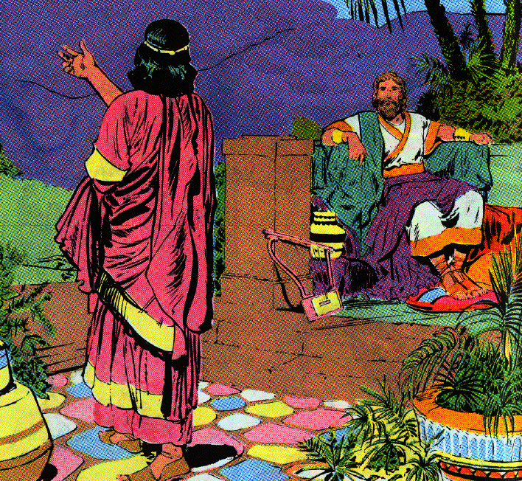
2. Absalom proclaimed king in Hebron 7-12
7 Now it came about at the end of forty¹ years that Absalom said to the king, "Please let me go and pay my vow which I have vowed to the LORD, in Hebron.
8 "For your servant vowed a vow while I was living at Geshur in Aram, saying, ‘If the LORD shall indeed bring me back to Jerusalem, then I will serve the LORD.’"
9 And the king said to him, "Go in peace." So he arose and went to Hebron.
1 - LXX, Josephus - 4 years

Slide 25
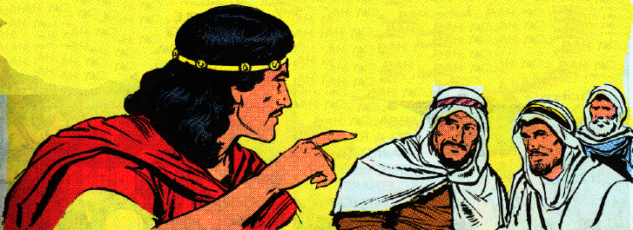
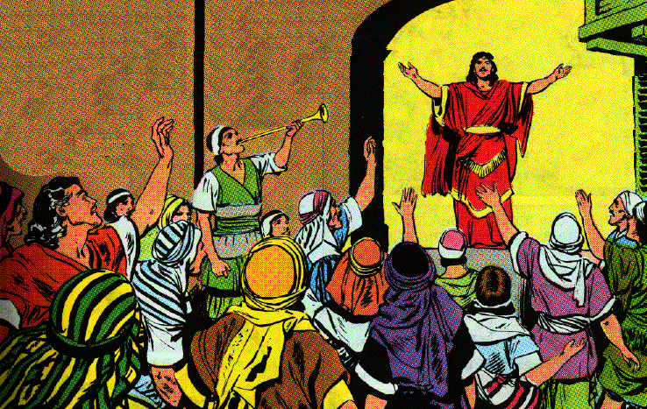
2. Absalom proclaimed king in Hebron 7-12
10 But Absalom sent spies throughout all the tribes of Israel, saying, "As soon as you hear the sound of the trumpet, then you shall say, ‘Absalom is king in Hebron.’"

Slide 26
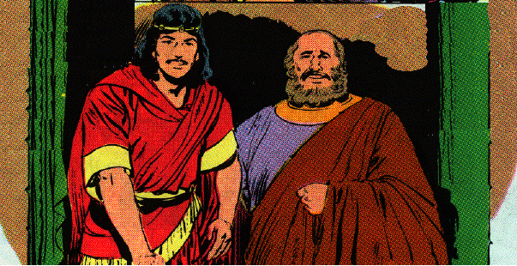
2. Absalom proclaimed king in Hebron 7-12
11 Then two hundred men went with Absalom from Jerusalem, who were invited and went innocently, and they did not know anything
12 And Absalom sent for Ahithophel the Gilonite, David’s counselor, from his city Giloh, while he was offering the sacrifices. And the conspiracy was strong, for the people increased continually with Absalom.
Ahithophel

Slide 27
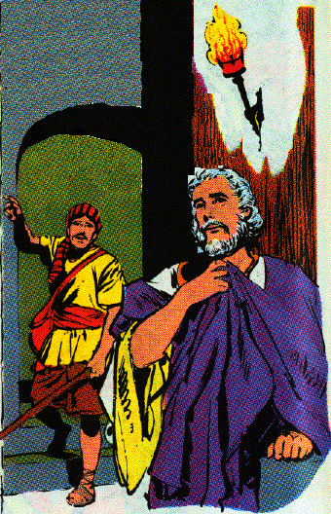
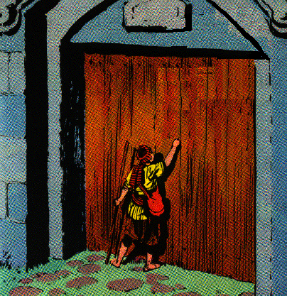
3. David and his servants flee toward the wilderness 13-18
13 Then a messenger came to David, saying, "The hearts of the men of Israel are with Absalom."

Slide 28
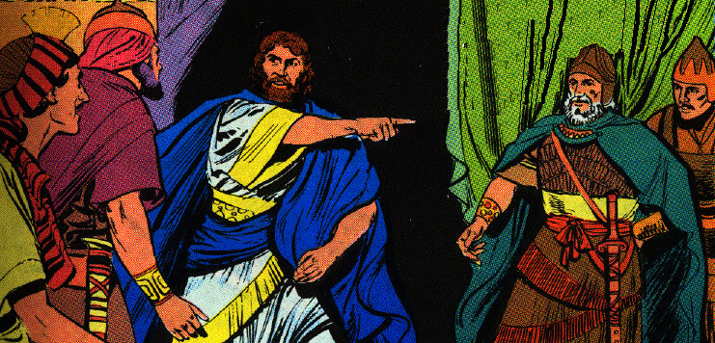
3. David and his servants flee toward the wilderness 13-18
14 And David said to all his servants who were with him at Jerusalem, "Arise and let us flee, for otherwise none of us shall escape from Absalom. Go in haste, lest he overtake us quickly and bring down calamity on us and strike the city with the edge of the sword."
15 Then the king’s servants said to the king, "Behold, your servants are ready to do whatever my lord the king chooses."

Slide 29
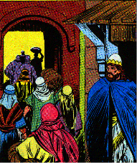
3. David and his servants flee toward the wilderness 13-18
16 So the king went out and all his household with him. But the king left ten concubines to keep the house.
17 And the king went out and all the people with him, and they stopped at the last house.
18 Now all his servants passed on beside him, all the Cherethites, all the Pelethites, and all the Gittites, six hundred men who had come with him from Gath, passed on before the king.

Slide 30
4. The steadfast friendship of Ittai the Gittite 19-23
19 Then the king said to Ittai the Gittite, "Why will you also go with us? Return and remain with the king, for you are a foreigner and also an exile; return to your own place.
20 "You came only yesterday, and shall I today make you wander with us, while I go where I will? Return and take back your brothers; mercy and truth be with you."

Slide 31
4. The steadfast friendship of Ittai the Gittite 19-23
21 But Ittai answered the king and said, "As the LORD lives, and as my lord the king lives, surely wherever my lord the king may be, whether for death or for life, there also your servant will be."
22 Therefore David said to Ittai, "Go and pass over." So Ittai the Gittite passed over with all his men and all the little ones who were with him.

Slide 36
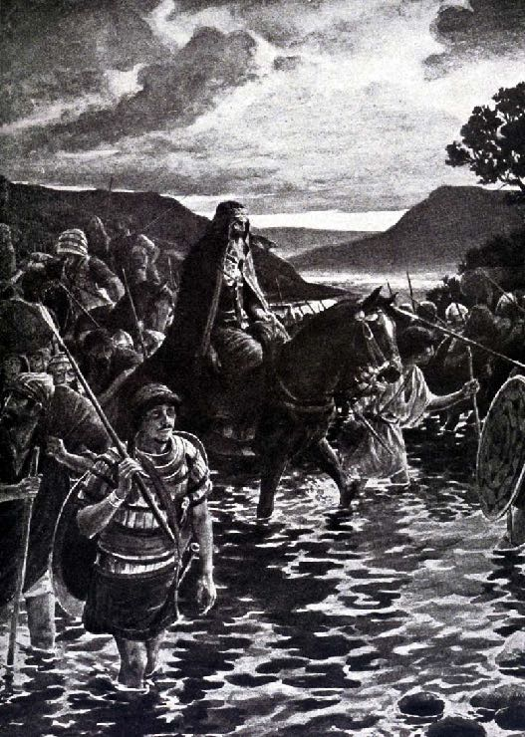
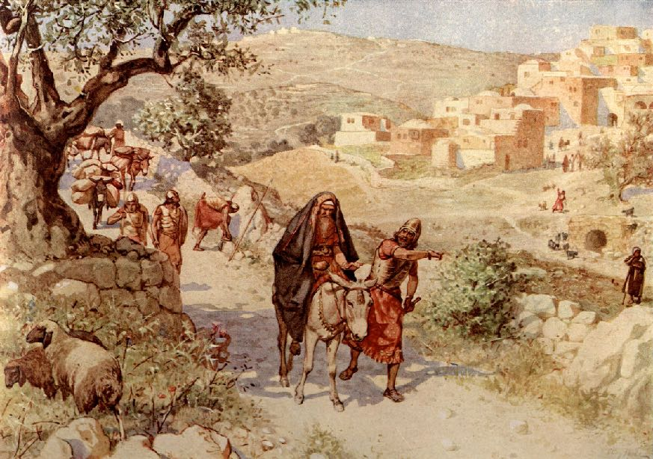
4. The steadfast friendship of Ittai the Gittite 19-23
23 While all the country was weeping with a loud voice, all the people passed over. The king also passed over the brook Kidron, and all the people passed over toward the way of the wilderness.

Slide 37
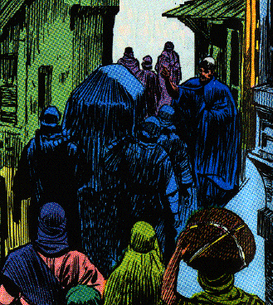
5. Zadok and Levites return with the Ark 24-29
24 Now behold, Zadok also came, and all the Levites with him carrying the ark of the covenant of God. And they set down the ark of God, and Abiathar came up until all the people had finished passing from the city.
25 And the king said to Zadok, "Return the ark of God to the city. If I find favor in the sight of the LORD, then He will bring me back again, and show me both it and His habitation.
26 "But if He should say thus, ‘I have no delight in you,’ behold, here I am, let Him do to me as seems good to Him."

Slide 38
5. Zadok and Levites return with the Ark 24-29
27 The king said also to Zadok the priest, "Are you not a seer? Return to the city in peace and your two sons with you, your son Ahimaaz and Jonathan the son of Abiathar.
28 "See, I am going to wait at the fords of the wilderness until word comes from you to inform me."
29 Therefore Zadok and Abiathar returned the ark of God to Jerusalem and remained there.
Notes:
Ahimaaz - uh-him’ ay-az

Slide 39
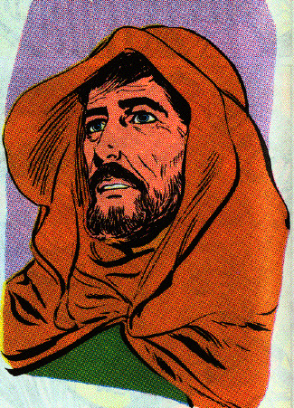
6. David goes up the ascent of the Mt. of Olives 30-37
31 Now someone told David, saying, "Ahithophel is among the conspirators with Absalom." And David said, "O LORD, I pray, make the counsel of Ahithophel foolishness." Ps. 41:9; 55:11-14
32 It happened as David was coming to the summit, where God was worshiped, that behold, Hushai the Archite met him with his coat torn, and dust on his head.
33 And David said to him, "If you pass over with me, then you will be a burden to me.
Hushai

Slide 40
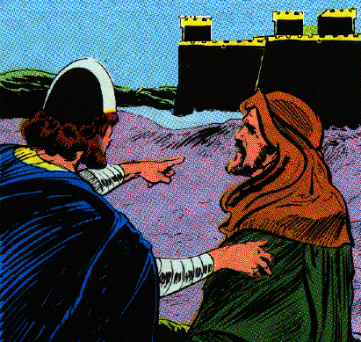
6. David goes up the ascent of the Mt. of Olives 30-37
34 "But if you return to the city, and say to Absalom, ‘I will be your servant, O king; as I have been your father’s servant in time past, so I will now be your servant,’ then you can thwart the counsel of Ahithophel for me.
35 "And are not Zadok and Abiathar the priests with you there? So it shall be that whatever you hear from the king’s house, you shall report to Zadok and Abiathar the priests.
36 "Behold their two sons are with them there, Ahimaaz, Zadok’s son and Jonathan, Abiathar’s son; and by them you shall send me everything that you hear."
37 So Hushai, David’s friend, came into the city, and Absalom came into Jerusalem.

Slide 41
B. The rule of Absalom in Jerusalem
2 Samuel 16:1-23

Slide 42
1. Mephibosheth’s servant Ziba gives David provisions and obtains his masters property through false insinuations 1-4
1 Now when David had passed a little beyond the summit, behold, Ziba the servant of Mephibosheth met him with a couple of saddled donkeys, and on them were two hundred loaves of bread, a hundred clusters of raisins, a hundred summer fruits, and a jug of wine.
2 And the king said to Ziba, "Why do you have these?" And Ziba said, "The donkeys are for the king's household to ride, and the bread and summer fruit for the young men to eat, and the wine, for whoever is faint in the wilderness to drink."

Slide 43
1. Mephibosheth’s servant Ziba gives David provisions and obtains his masters property through false insinuations 1-4
3 Then the king said, "And where is your master's son?" And Ziba said to the king, "Behold, he is staying in Jerusalem, for he said, 'Today the house of Israel will restore the kingdom of my father to me.'"
4 So the king said to Ziba, "Behold, all that belongs to Mephibosheth is yours." And Ziba said, "I prostrate myself; let me find favor in your sight, O my lord, the king!"

Slide 44
2. Shimei curses David 5-8
5 When King David came to Bahurim, behold, there came out from there a man of the family of the house of Saul whose name was Shimei, the son of Gera; he came out cursing continually as he came.
6 And he threw stones at David and at all the servants of King David; and all the people and all the mighty men were at his right hand and at his left.

Slide 45
2. Shimei curses David 5-8
7 And thus Shimei said when he cursed, "Get out, get out, you man of bloodshed, and worthless fellow!
8 "The Lord has returned upon you all the bloodshed of the house of Saul, in whose place you have reigned; and the Lord has given the kingdom into the hand of your son Absalom. And behold, you are taken in your own evil, for you are a man of bloodshed!"

Slide 46
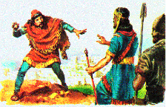
3. David restrains Abishai from slaying Shimei 9-14
9 Then Abishai the son of Zeruiah said to the king, "Why should this dead dog curse my lord the king? Let me go over now, and cut off his head.
10 But the king said, "What have I to do with you, O sons of Zeruiah? If he curses, and if the Lord has told him, 'Curse David,' then who shall say, 'Why have you done so?'"
11 Then David said to Abishai and to all his servants, "Behold, my son who came out from me seeks my life; how much more now this Benjamite? Let him alone and let him curse, for the Lord has told him.

Slide 47
3. David restrains Abishai from slaying Shimei 9-14
12 "Perhaps the Lord will look on my affliction and return good to me instead of his cursing this day."
13 So David and his men went on the way; and Shimei went along on the hillside parallel with him and as he went he cursed, and cast stones and threw dust at him.
14 And the king and all the people who were with him arrived weary and he refreshed himself there.

Slide 48
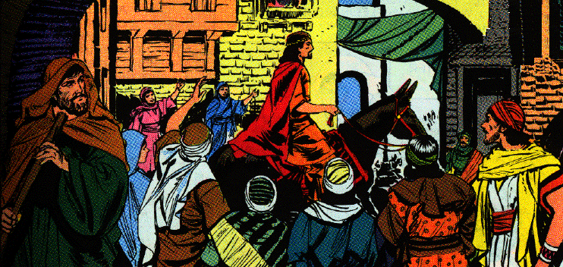
4. Hushai pretends to offer his service to Absalom 15-19
15 Then Absalom and all the people, the men of Israel, entered Jerusalem, and Ahithophel with him.
16 Now it came about when Hushai the Archite, David's friend, came to Absalom, that Hushai said to Absalom, " Long live the king! Long live the king!"

Slide 49
4. Hushai pretends to offer his service to Absalom 15-19
17 And Absalom said to Hushai, "Is this your loyalty to your friend? Why did you not go with your friend?"
18 Then Hushai said to Absalom, "No! For whom the Lord, this people, and all the men of Israel have chosen, his will I be, and with him I will remain.
19 "And besides, whom should I serve? Should I not serve in the presence of his son? As I have served in your father's presence, so I will be in your presence."

Slide 50
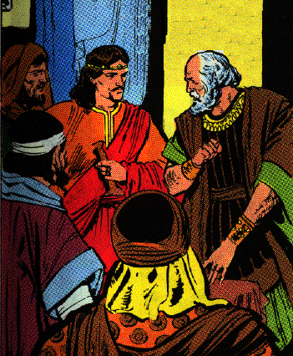
5. Ahithophel’s advice 20-23
20 Then Absalom said to Ahithophel, "Give your advice. What shall we do?"
21 And Ahithophel said to Absalom, "Go in to your father's concubines, whom he has left to keep the house; then all Israel will hear that you have made yourself odious to your father. The hands of all who are with you will also be strengthened."
22 So they pitched a tent for Absalom on the roof, and Absalom went in to his father's concubines in the sight of all Israel.
23 And the advice of Ahithophel, which he gave in those days, was as if one inquired of the word of God; so was all the advice of Ahithophel regarded by both David and Absalom.

Slide 51
C. The Rebellion Defeated
2 Sam. 17:1—18:1-33

Slide 52
1. Ahithophel advises an immediate attack with 12,000 men 1-4
1 Furthermore, Ahithophel said to Absalom, "Please let me choose 12,000 men that I may arise and pursue David tonight.
2 "And I will come upon him while he is weary and exhausted and will terrify him so that all the people who are with him will flee. Then I will strike down the king alone,
3 and I will bring back all the people to you. The return of everyone depends on the man you seek; then all the people shall be at peace."
4 So the plan pleased Absalom and all the elders of Israel.

Slide 53
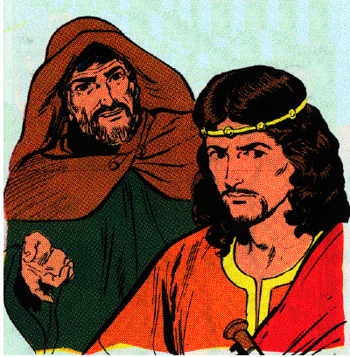
2. Hushai’s counsel 5-14
5 Then Absalom said, "Now call Hushai the Archite also, and let us hear what he has to say."
6 When Hushai had come to Absalom, Absalom said to him, "Ahithophel has spoken thus. Shall we carry out his plan? If not, you speak."
7 So Hushai said to Absalom, "This time the advice that Ahithophel has given is not good."

Slide 54
2. Hushai’s counsel 5-14
8 Moreover, Hushai said, "You know your father and his men, that they are mighty men and they are fierce, like a bear robbed of her cubs in the field. And your father is an expert in warfare, and will not spend the night with the people.
9 "Behold, he has now hidden himself in one of the caves or in another place; and it will be when he falls on them at the first attack, that whoever hears it will say, 'There has been a slaughter among the people who follow Absalom.'
10 "And even the one who is valiant, whose heart is like the heart of a lion, will completely lose heart; for all Israel knows that your father is a mighty man and those who are with him are valiant men.

Slide 55
2. Hushai’s counsel 5-14
11 "But I counsel that all Israel be surely gathered to you, from Dan even to Beersheba, as the sand that is by the sea in abundance, and that you personally go into battle.
12 "So we shall come to him in one of the places where he can be found, and we will fall on him as the dew falls on the ground; and of him and of all the men who are with him, not even one will be left.
13 "And if he withdraws into a city, then all Israel shall bring ropes to that city, and we will drag it into the valley until not even a small stone is found there."

Slide 56
2. Hushai’s counsel 5-14
14 Then Absalom and all the men of Israel said, "The counsel of Hushai the Archite is better than the counsel of Ahithophel." For the Lord had ordained to thwart the good counsel of Ahithophel, in order that the Lord might bring calamity on Absalom.

Slide 57
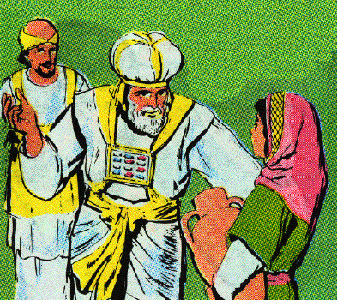
3. Hushai informs Zadock & Abiathar & they send word to David 17:15-20
15 Then Hushai said to Zadok and to Abiathar the priests, "This is what Ahithophel counseled Absalom and the elders of Israel, and this is what I have counseled.
16 "Now therefore, send quickly and tell David, saying, 'Do not spend the night at the fords of the wilderness, but by all means cross over, lest the king and all the people who are with him be destroyed.'"

Slide 58
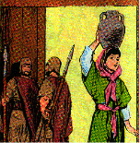
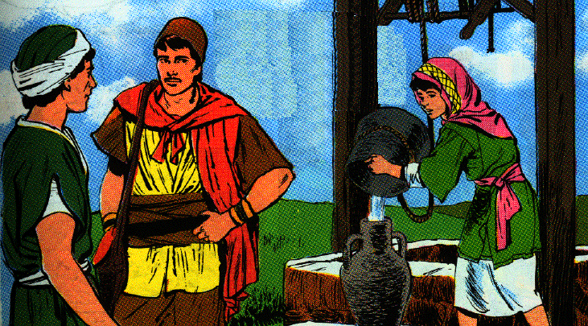
3. Hushai informs Zadock & Abiathar & they send word to David 17:15-20
17 Now Jonathan and Ahimaaz were staying at En-rogel, and a maidservant would go and tell them, and they would go and tell King David, for they could not be seen entering the city.

Slide 59
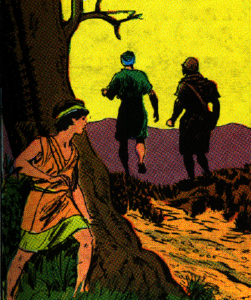
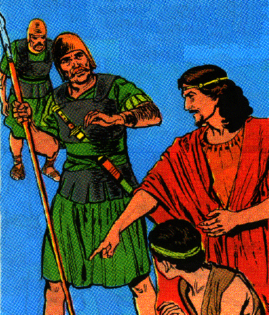
3. Hushai informs Zadock & Abiathar & they send word to David 17:15-20
18 But a lad did see them, and told Absalom; so the two of them departed quickly and came to the house of a man in Bahurim, who had a well in his courtyard, and they went down into it.

Slide 60
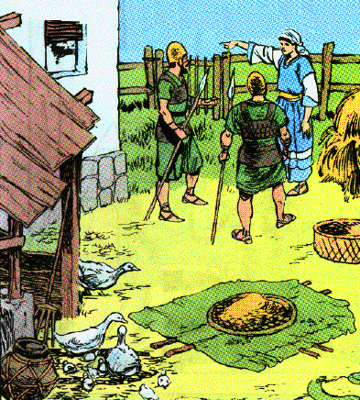
3. Hushai informs Zadock & Abiathar & they send word to David 17:15-20
19 And the woman took a covering and spread it over the well's mouth and scattered grain on it, so that nothing was known.
20 Then Absalom's servants came to the woman at the house and said, "Where are Ahimaaz and Jonathan?" And the woman said to them, "They have crossed the brook of water." And when they searched and could not find them, they returned to Jerusalem.

Slide 61
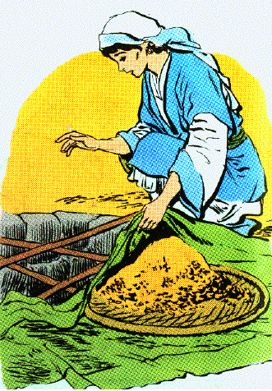
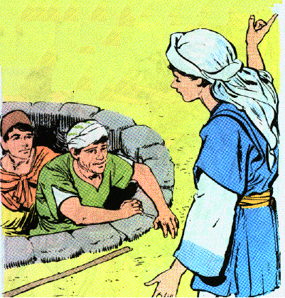
4. David escaped across the Jordan and Ahithophel commits suicide 21-23
21 And it came about after they had departed that they came up out of the well and went and told King David; and they said to David, "Arise and cross over the water quickly for thus Ahithophel has counseled against you."

Slide 62
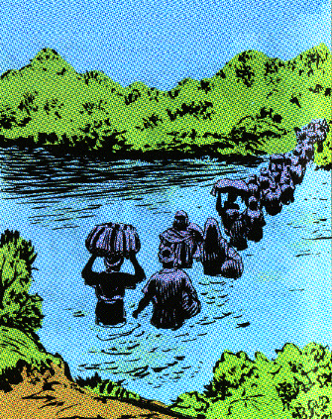
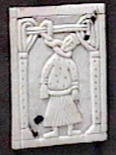
4. David escaped across the Jordan and Ahithophel commits suicide 21-23
22 Then David and all the people who were with him arose and crossed the Jordan; and by dawn not even one remained who had not crossed the Jordan.
23 Now when Ahithophel saw that his counsel was not followed, he saddled his donkey and arose and went to his home, to his city, and set his house in order, and strangled himself; thus he died and was buried in the grave of his father.

Slide 63
5. David at Mahanaim 24-26
24 Then David came to Mahanaim. And Absalom crossed the Jordan, he and all the men of Israel with him.
25 And Absalom set Amasa over the army in place of Joab. Now Amasa was the son of a man whose name was Ithra the Israelite, who went in to Abigail the daughter of Nahash, sister of Zeruiah, Joab's mother.
26 And Israel and Absalom camped in the land of Gilead.

Slide 64
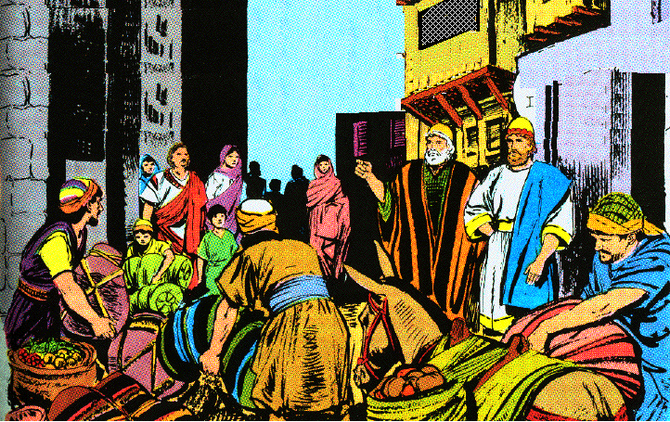
6. David is reinforced by friends at Mahanaim 27-29
27 Now when David had come to Mahanaim, Shobi the son of Nahash from Rabbah of the sons of Ammon, Machir the son of Ammiel from Lo-debar, and Barzillai the Gileadite from Rogelim
28 brought beds, basins, pottery, wheat, barley, flour, parched grain, beans, lentils, parched seeds,
29 honey, curds, sheep, and cheese of the herd, for David and for the people who were with him, to eat; for they said, "The people are hungry and weary and thirsty in the wilderness."

Slide 65
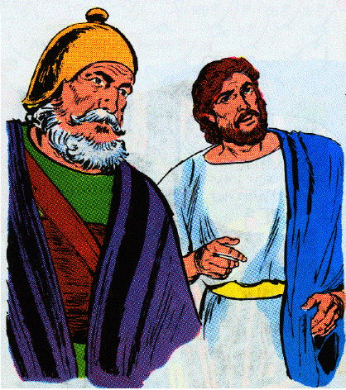
7. David’s preparation for war 18:1-5
1 Then David numbered the people who were with him and set over them commanders of thousands and commanders of hundreds.
2 And David sent the people out, one third under the command of Joab, one third under the command of Abishai the son of Zeruiah, Joab's brother, and one third under the command of Ittai the Gittite. And the king said to the people, "I myself will surely go out with you also."
3 But the people said, "You should not go out; for if we indeed flee, they will not care about us, even if half of us die, they will not care about us. But you are worth ten thousand of us; therefore now it is better that you be ready to help us from the city."

Slide 66
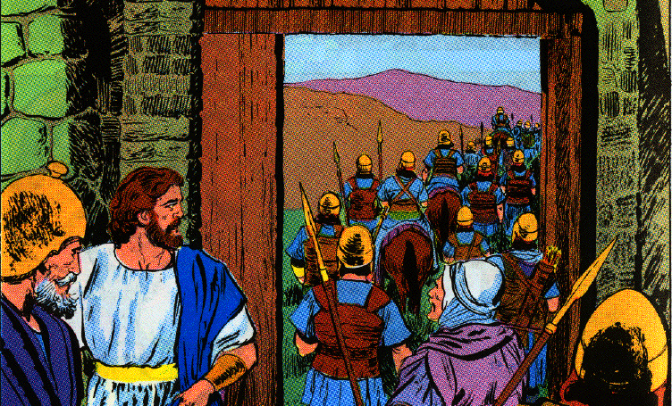
7. David’s preparation for war 18:1-5
4 Then the king said to them, "Whatever seems best to you I will do." So the king stood beside the gate, and all the people went out by hundreds and thousands.
5 And the king charged Joab and Abishai and Ittai, saying, " Deal gently for my sake with the young man Absalom." And all the people heard when the king charged all the commanders concerning Absalom.

Slide 67
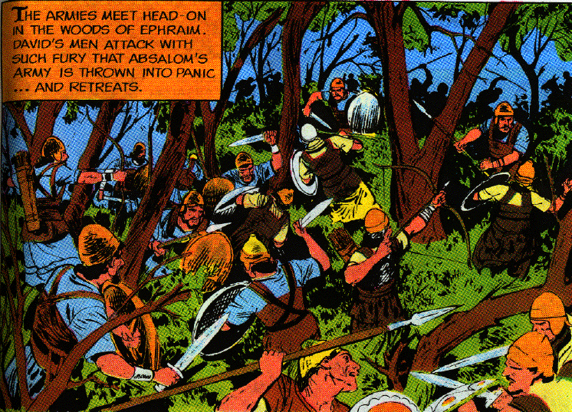
8. The battle is in the forest of Ephraim 6-8
6 Then the people went out into the field against Israel, and the battle took place in the forest of Ephraim.
7 And the people of Israel were defeated there before the servants of David, and the slaughter there that day was great, 20,000 men.
8 For the battle there was spread over the whole countryside, and the forest devoured more people that day than the sword devoured.

Slide 68
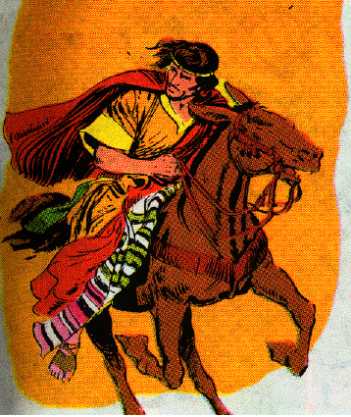
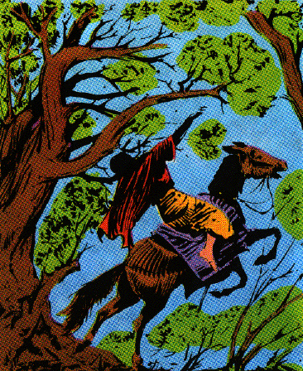
9. Absalom is killed 9-15
9 Now Absalom happened to meet the servants of David. For Absalom was riding on his mule, and the mule went under the thick branches of a great oak. And his head caught fast in the oak, so he was left hanging between heaven and earth, while the mule that was under him kept going.

Slide 69
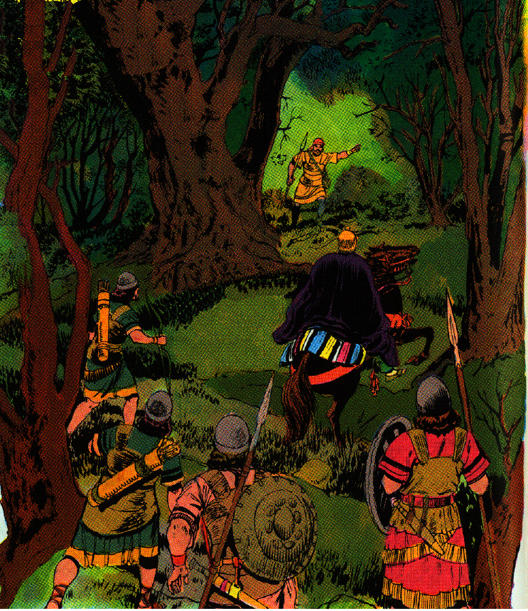
9. Absalom is killed 9-15
10 When a certain man saw it, he told Joab and said, "Behold, I saw Absalom hanging in an oak."
11 Then Joab said to the man who had told him, "Now behold, you saw him! Why then did you not strike him there to the ground? And I would have given you ten pieces of silver and a belt."

Slide 70
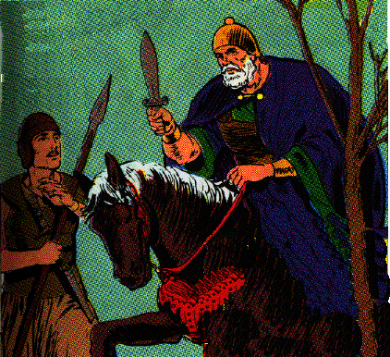
9. Absalom is killed 9-15
12 And the man said to Joab, "Even if I should receive a thousand pieces of silver in my hand, I would not put out my hand against the king's son; for in our hearing the king charged you and Abishai and Ittai, saying, 'Protect for me the young man Absalom!'
13 "Otherwise, if I had dealt treacherously against his life (and there is nothing hidden from the king), then you yourself would have stood aloof."

Slide 71
9. Absalom is killed 9-15
14 Then Joab said, "I will not waste time here with you." So he took three spears in his hand and thrust them through the heart of Absalom while he was yet alive in the midst of the oak.
15 And ten young men who carried Joab's armor gathered around and struck Absalom and killed him.

Slide 72
10. David’s servants are recalled and Absalom is buried 16-18
16 Then Joab blew the trumpet, and the people returned from pursuing Israel, for Joab restrained the people.
17 And they took Absalom and cast him into a deep pit in the forest and erected over him a very great heap of stones. And all Israel fled, each to his tent.
18 Now Absalom in his lifetime had taken and set up for himself a pillar which is in the King's Valley, for he said, "I have no son to preserve my name." So he named the pillar after his own name, and it is called Absalom's monument to this day.

Slide 73
11. A Cushite and Ahimaaz run to tell David the news 19-23
19 Then Ahimaaz the son of Zadok said, "Please let me run and bring the king news that the Lord has freed him from the hand of his enemies."
20 But Joab said to him, "You are not the man to carry news this day, but you shall carry news another day; however, you shall carry no news today because the king's son is dead."
21 Then Joab said to the Cushite, "Go, tell the king what you have seen." So the Cushite bowed to Joab and ran.

Slide 74
11. A Cushite and Ahimaaz run to tell David the news 19-23
22 Now Ahimaaz the son of Zadok said once more to Joab, "But whatever happens, please let me also run after the Cushite." And Joab said, "Why would you run, my son, since you will have no reward for going?"
23 "But whatever happens," he said, "I will run." So he said to him, "Run." Then Ahimaaz ran by way of the plain and passed up the Cushite.

Slide 75
12. David and the watchman observe the runners 24-27
24 Now David was sitting between the two gates; and the watchman went up to the roof of the gate by the wall, and raised his eyes and looked, and behold, a man running by himself.
25 And the watchman called and told the king. And the king said, "If he is by himself there is good news in his mouth." And he came nearer and nearer.
26 Then the watchman saw another man running; and the watchman called to the gatekeeper and said, "Behold, another man running by himself." And the king said, "This one also is bringing good news."
27 And the watchman said, "I think the running of the first one is like the running of Ahimaaz the son of Zadok." And the king said, "This is a good man and comes with good news."

Slide 76
13. Ahimaaz announces the victory 28-30
28 And Ahimaaz called and said to the king, "All is well." And he prostrated himself before the king with his face to the ground. And he said, "Blessed is the Lord your God, who has delivered up the men who lifted their hands against my lord the king."
29 And the king said, "Is it well with the young man Absalom?" And Ahimaaz answered, "When Joab sent the king's servant, and your servant, I saw a great tumult, but I did not know what it was."
30 Then the king said, "Turn aside and stand here." So he turned aside and stood still.

Slide 77
14. The Cushite informs David of Absalom’s death 31-33
31 And behold, the Cushite arrived, and the Cushite said, "Let my lord the king receive good news, for the Lord has freed you this day from the hand of all those who rose up against you."
32 Then the king said to the Cushite, "Is it well with the young man Absalom?" And the Cushite answered, "Let the enemies of my lord the king, and all who rise up against you for evil, be as that young man!"

Slide 78
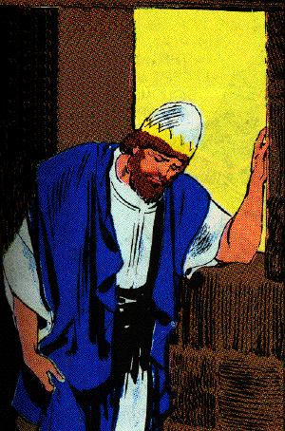
14. The Cushite informs David of Absalom’s death 31-33
33 And the king was deeply moved and went up to the chamber over the gate and wept. And thus he said as he walked, "O my son Absalom, my son, my son Absalom! Would I had died instead of you, O Absalom, my son, my son!"

Slide 79
D. David restored to power
2 Samuel 19:1-23

Slide 80
1. David’s mourning, and Joab’s reproof, 1-8
1 Then it was told Joab, "Behold, the king is weeping and mourns for Absalom."
2 And the victory that day was turned to mourning for all the people, for the people heard it said that day, "The king is grieved for his son."
3 So the people went by stealth into the city that day, as people who are humiliated steal away when they flee in battle.
4 And the king covered his face and cried out with a loud voice, "O my son Absalom, O Absalom, my son, my son!"

Slide 81
1. David’s mourning, and Joab’s reproof 1-8
5 Then Joab came into the house to the king and said, "Today you have covered with shame the faces of all your servants, who today have saved your life and the lives of your sons and daughters, the lives of your wives, and the lives of your concubines,
6 by loving those who hate you, and by hating those who love you. For you have shown today that princes and servants are nothing to you; for I know this day that if Absalom were alive and all of us were dead today, then you would be pleased.

Slide 82
1. David’s mourning, and Joab’s reproof 1-8
7 "Now therefore arise, go out and speak kindly to your servants, for I swear by the Lord, if you do not go out, surely not a man will pass the night with you, and this will be worse for you than all the evil that has come upon you from your youth until now."
8 So the king arose and sat in the gate. When they told all the people, saying, "Behold, the king is sitting in the gate," then all the people came before the king.

Slide 83
2. Arguments throughout Israel and appeals to bring David back 9-10
9 And all the people were quarreling throughout all the tribes of Israel, saying, "The king delivered us from the hand of our enemies and saved us from the hand of the Philistines, but now he has fled out of the land from Absalom.
10 "However, Absalom, whom we anointed over us, has died in battle. Now then, why are you silent about bringing the king back?"

Slide 84
3. Priests sent to the Judah’s elders to pursued them to bring David back 11-15
11 Then King David sent to Zadok and Abiathar the priests, saying, "Speak to the elders of Judah, saying, ‘Why are you the last to bring the king back to his house, since the word of all Israel has come to the king, even to his house?
12 ‘You are my brothers; you are my bone and my flesh. Why then should you be the last to bring back the king?’

Slide 85
3. Priests sent to the Judah’s elders to pursued them to bring David back 11-15
13 "And say to Amasa, ‘Are you not my bone and my flesh? May God do so to me, and more also, if you will not be commander of the army before me continually in place of Joab.’"
14 Thus he turned the hearts of all the men of Judah as one man, so that they sent word to the king, saying, "Return, you and all your servants."
15 The king then returned and came as far as the Jordan. And Judah came to Gilgal in order to go to meet the king, to bring the king across the Jordan.

Slide 86
4. Shimei’s confession of sin and his life is spared 16-23
16 Then Shimei the son of Gera, the Benjamite who was from Bahurim, hurried and came down with the men of Judah to meet King David.
17 And there were a thousand men of Benjamin with him, with Ziba the servant of the house of Saul, and his fifteen sons and his twenty servants with him; and they rushed to the Jordan before the king.
18 Then they kept crossing the ford to bring over the king’s household, and to do what was good in his sight. And Shimei the son of Gera fell down before the king as he was about to cross the Jordan.
19 So he said to the king, "Let not my lord consider me guilty, nor remember what your servant did wrong on the day when my lord the king came out from Jerusalem, so that the king should take it to heart.
20 "For your servant knows that I have sinned; therefore behold, I have come today, the first of all the house of Joseph to go down to meet my lord the king."

Slide 87
4. Shimei’s confession of sin and his life is spared 16-23
21 But Abishai the son of Zeruiah answered and said, "Should not Shimei be put to death for this, because he cursed the LORD’S anointed?"
22 David then said, "What have I to do with you, O sons of Zeruiah, that you should this day be an adversary to me? Should any man be put to death in Israel today? For do I not know that I am king over Israel today?"
23 And the king said to Shimei, "You shall not die." Thus the king swore to him.

Slide 88
5. Mephibosheth meets the king and receives back half of his land 24-30
24 Then Mephibosheth the son of Saul came down to meet the king; and he had neither cared for his feet, nor trimmed his mustache, nor washed his clothes, from the day the king departed until the day he came home in peace.
25 And it was when he came from Jerusalem to meet the king, that the king said to him, "Why did you not go with me, Mephibosheth?"

Slide 89
5. Mephibosheth meets the king and receives back half of his land 24-30
26 So he answered, "O my lord, the king, my servant deceived me; for your servant said, ‘I will saddle a donkey for myself that I may ride on it and go with the king,’ because your servant is lame.
27 "Moreover, he has slandered your servant to my lord the king; but my lord the king is like the angel of God, therefore do what is good in your sight.
28 "For all my father’s household was nothing but dead men before my lord the king; yet you set your servant among those who ate at your own table. What right do I have yet that I should complain anymore to the king?"
29 So the king said to him, "Why do you still speak of your affairs? I have decided, ‘You and Ziba shall divide the land.’"
30 And Mephibosheth said to the king, "Let him even take it all, since my lord the king has come safely to his own house."

Slide 90
6. Barzillai’s conversation with David 31-39
31 Now Barzillai the Gileadite had come down from Rogelim; and he went on to the Jordan with the king to escort him over the Jordan.
32 Now Barzillai was very old, being eighty years old; and he had sustained the king while he stayed at Mahanaim, for he was a very great man.
33 And the king said to Barzillai, "You cross over with me and I will sustain you in Jerusalem with me."

Slide 91
6. Barzillai’s conversation with David 31-39
34 But Barzillai said to the king, "How long have I yet to live, that I should go up with the king to Jerusalem?
35 "I am now eighty years old. Can I distinguish between good and bad? Or can your servant taste what I eat or what I drink? Or can I hear anymore the voice of singing men and women? Why then should your servant be an added burden to my lord the king?
36 "Your servant would merely cross over the Jordan with the king. Why should the king compensate me with this reward?
37 "Please let your servant return, that I may die in my own city near the grave of my father and my mother. However, here is your servant Chimham, let him cross over with my lord the king, and do for him what is good in your sight."

Slide 92
6. Barzillai’s conversation with David 31-39
38 And the king answered, "Chimham shall cross over with me, and I will do for him what is good in your sight; and whatever you require of me, I will do for you."
39 All the people crossed over the Jordan and the king crossed too. The king then kissed Barzillai and blessed him, and he returned to his place.

Slide 93
7. David cross the Jordan to Gilgal 40-43 (Dispute between Israel & Judah about Judah bring David back)
40 Now the king went on to Gilgal, and Chimham went on with him; and all the people of Judah and also half the people of Israel accompanied the king.
41 And behold, all the men of Israel came to the king and said to the king, "Why had our brothers the men of Judah stolen you away, and brought the king and his household and all David’s men with him over the Jordan?"
42 Then all the men of Judah answered the men of Israel, "Because the king is a close relative to us. Why then are you angry about this matter? Have we eaten at all at the king’s expense, or has anything been taken for us?"
43 But the men of Israel answered the men of Judah and said, "We have ten parts in the king, therefore we also have more claim on David than you. Why then did you treat us with contempt? Was it not our advice first to bring back our king?" Yet the words of the men of Judah were harsher than the words of the men of Israel.

