Slide 1
E. The final siege of Rabbah 26-31
1. Joab captured the city 26
26 Now Joab fought against Rabbah of the sons of Ammon, and captured the royal city.

Slide 2
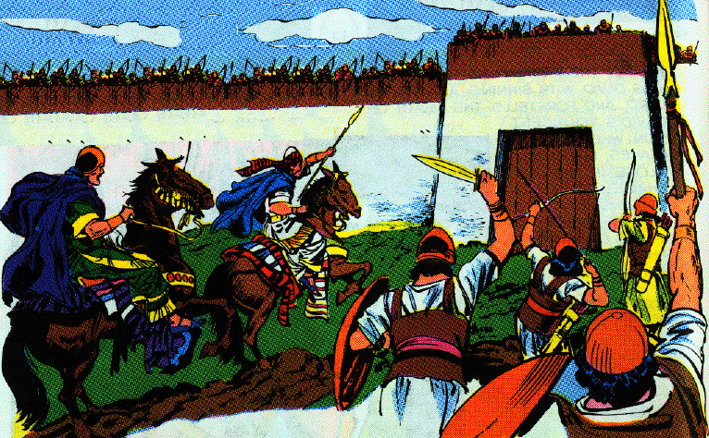
E. The final siege of Rabbah 26-31
2. Joab gives David the opportunity to capture the city 27-28
27 And Joab sent messengers to David and said, "I have fought against Rabbah, I have even captured the city of waters.
28 "Now therefore, gather the rest of the people together and camp against the city and capture it, lest I capture the city myself and it be named after me."

Slide 3
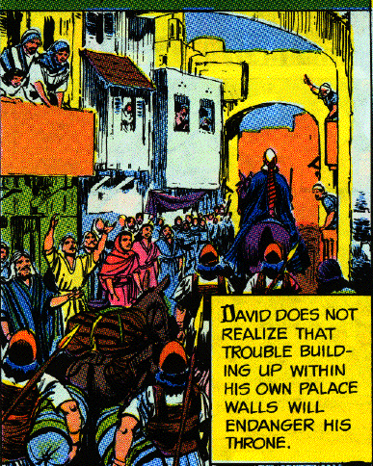
E. The final siege of Rabbah 26-31
3. David gathers the people captures the city and its spoils 29-31
29 So David gathered all the people and went to Rabbah, fought against it, and captured it.
30 Then he took the crown of their king from his head; and its weight was a talent of gold, and in it was a precious stone; and it was placed on David's head. And he brought out the spoil of the city in great amounts.
31 He also brought out the people who were in it, and set them under saws, sharp iron instruments, and iron axes, and made them pass through the brickkiln. And thus he did to all the cities of the sons of Ammon. Then David and all the people returned to Jerusalem.

Slide 4
Section 3 Trouble in David’s Family
2 Samuel 10:1—14:33

Slide 5
IV. Amnon’s Death 13:1-39

Slide 6
A. Amnon loves his sister Tamar & fakes sickness to have her brought to him 1-6
1 Now it was after this that Absalom the son of David had a beautiful sister whose name was Tamar, and Amnon the son of David loved her.
2 And Amnon was so frustrated because of his sister Tamar that he made himself ill, for she was a virgin, and it seemed hard to Amnon to do anything to her.
3 But Amnon had a friend whose name was Jonadab, the son of Shimeah, David’s brother; and Jonadab was a very shrewd man.

Slide 7
A. Amnon loves his sister Tamar & fakes sickness to have her brought to him 1-6
4 And he said to him, "O son of the king, why are you so depressed morning after morning? Will you not tell me?" Then Amnon said to him, "I am in love with Tamar, the sister of my brother Absalom."
5 Jonadab then said to him, "Lie down on your bed and pretend to be ill; when your father comes to see you, say to him, ‘Please let my sister Tamar come and give me some food to eat, and let her prepare the food in my sight, that I may see it and eat from her hand.’"
6 So Amnon lay down and pretended to be ill; when the king came to see him, Amnon said to the king, "Please let my sister Tamar come and make me a couple of cakes in my sight, that I may eat from her hand."

Slide 8
B. David sends her to minister to him and he rapes her 7-14
7 Then David sent to the house for Tamar, saying, "Go now to your brother Amnon's house, and prepare food for him."
8 So Tamar went to her brother Amnon's house, and he was lying down. And she took dough, kneaded it, made cakes in his sight, and baked the cakes.
9 And she took the pan and dished them out before him, but he refused to eat. And Amnon said, "Have everyone go out from me." So everyone went out from him.
10 Then Amnon said to Tamar, "Bring the food into the bedroom, that I may eat from your hand." So Tamar took the cakes which she had made and brought them into the bedroom to her brother Amnon.
11 When she brought them to him to eat, he took hold of her and said to her, "Come, lie with me, my sister."

Slide 9
B. David sends her to minister to him and he rapes her 7-14
12 But she answered him, "No, my brother, do not violate me, for such a thing is not done in Israel; do not do this disgraceful thing!
13 "As for me, where could I get rid of my reproach? And as for you, you will be like one of the fools in Israel. Now therefore, please speak to the king, for he will not withhold me from you."
14 However, he would not listen to her; since he was stronger than she, he violated her and lay with her.

Slide 10
C. Amnon hates her and put her out of his house 15-18
15 Then Amnon hated her with a very great hatred; for the hatred with which he hated her was greater than the love with which he had loved her. And Amnon said to her, "Get up, go away!"
16 But she said to him, "No, because this wrong in sending me away is greater than the other that you have done to me!" Yet he would not listen to her.
17 Then he called his young man who attended him and said, "Now throw this woman out of my presence, and lock the door behind her."
18 Now she had on a long-sleeved garment; for in this manner the virgin daughters of the king dressed themselves in robes. Then his attendant took her out and locked the door behind her.

Slide 11
D. Tamar’s sorrow 19
19 And Tamar put ashes on her head, and tore her long-sleeved garment which was on her; and she put her hand on her head and went away, crying aloud as she went.

Slide 12
E. Absalom learns of Amnon’s sin against his sister 20-22
20 Then Absalom her brother said to her, "Has Amnon your brother been with you? But now keep silent, my sister, he is your brother; do not take this matter to heart." So Tamar remained and was desolate in her brother Absalom's house.
21 Now when King David heard of all these matters, he was very angry.
22 But Absalom did not speak to Amnon either good or bad; for Absalom hated Amnon because he had violated his sister Tamar.

Slide 13
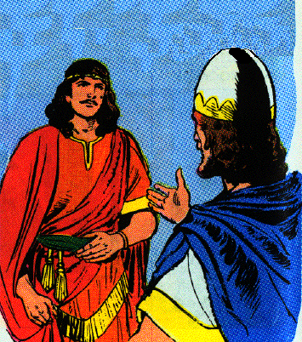
F. Two years later Absalom persuades David to send all his sons to Absalom’s sheep-shearing 23-27
23 Now it came about after two full years that Absalom had sheepshearers in Baal-hazor, which is near Ephraim, and Absalom invited all the king's sons.
24 And Absalom came to the king and said, "Behold now, your servant has sheepshearers; please let the king and his servants go with your servant."
25 But the king said to Absalom, "No, my son, we should not all go, lest we be burdensome to you." Although he urged him, he would not go, but blessed him.

Slide 14
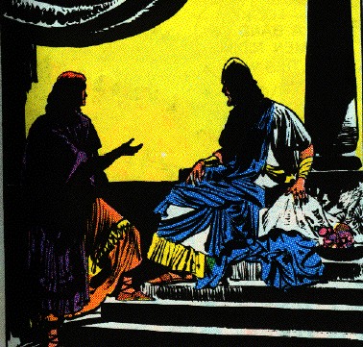
F. Two years later Absalom persuades David to send all his sons to Absalom’s sheep-shearing 23-27
26 Then Absalom said, "If not, please let my brother Amnon go with us." And the king said to him, "Why should he go with you?"
27 But when Absalom urged him, he let Amnon and all the king's sons go with him.

Slide 15
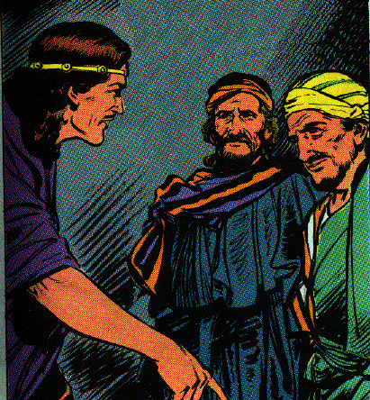
G. Absalom commands his servants to kill Amnon at the feast 28, 29
28 And Absalom commanded his servants, saying, "See now, when Amnon's heart is merry with wine, and when I say to you, 'Strike Amnon,' then put him to death. Do not fear; have not I myself commanded you? Be courageous and be valiant."

Slide 16
G. Absalom commands his servants to kill Amnon at the feast 28, 29
29 And the servants of Absalom did to Amnon just as Absalom had commanded. Then all the king's sons arose and each mounted his mule and fled.

Slide 17
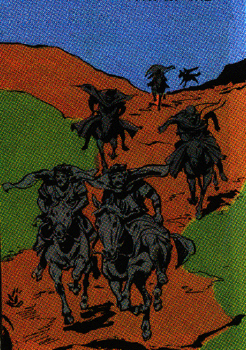
G. Absalom commands his servants to kill Amnon at the feast 28, 29
29 And the servants of Absalom did to Amnon just as Absalom had commanded. Then all the king's sons arose and each mounted his mule and fled.

Slide 18
H. David hears that all of his sons have been struck down 30-33
30 Now it was while they were on the way that the report came to David, saying, "Absalom has struck down all the king's sons, and not one of them is left."
31 Then the king arose, tore his clothes and lay on the ground; and all his servants were standing by with clothes torn.
32 And Jonadab, the son of Shimeah, David's brother, responded, "Do not let my lord suppose they have put to death all the young men, the king's sons, for Amnon alone is dead; because by the intent of Absalom this has been determined since the day that he violated his sister Tamar.
33 "Now therefore, do not let my lord the king take the report to heart, namely, 'all the king's sons are dead,' for only Amnon is dead."

Slide 19
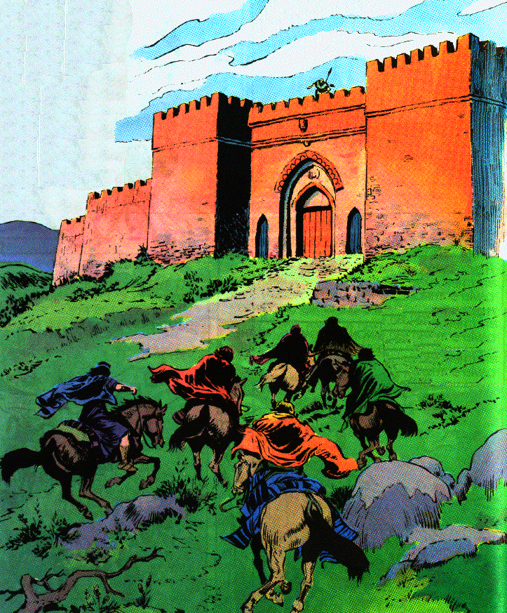
I. David’s sons return to David and mourn 34-36
34 Now Absalom had fled. And the young man who was the watchman raised his eyes and looked, and behold, many people were coming from the road behind him by the side of the mountain.
35 And Jonadab said to the king, "Behold, the king's sons have come; according to your servant's word, so it happened."
36 And it came about as soon as he had finished speaking, that behold, the king's sons came and lifted their voices and wept; and also the king and all his servants wept very bitterly.

Slide 20
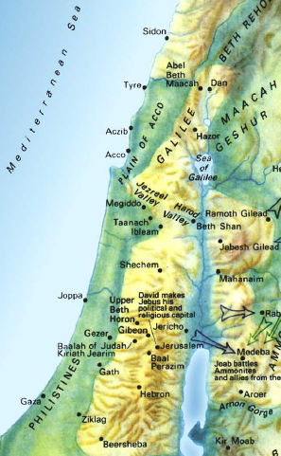
J. Absalom fled to Geshur and stayed there three years 37-39
37 Now Absalom fled and went to Talmai the son of Ammihud, the king of Geshur. And David mourned for his son every day.
38 So Absalom had fled and gone to Geshur, and was there three years.

Slide 21
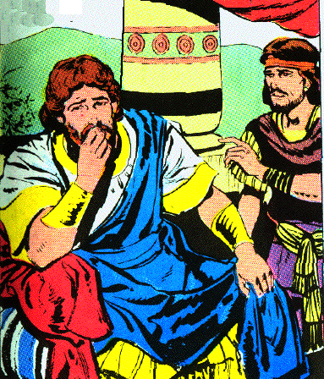
J. Absalom fled to Geshur and stayed there three years 37-39
39 And the heart of King David longed to go out to Absalom; for he was comforted concerning Amnon, since he was dead.

Slide 22
V. Absalom is recalled from exile 14:1-33

Slide 23
A. Joab finds a woman of Tekoa to pretend to be a mourner before David 1-3
1 Now Joab the son of Zeruiah perceived that the king's heart was inclined toward Absalom.
2 So Joab sent to Tekoa and brought a wise woman from there and said to her, "Please pretend to be a mourner, and put on mourning garments now, and do not anoint yourself with oil, but be like a woman who has been mourning for the dead many days;
3 then go to the king and speak to him in this manner. "So Joab put the words in her mouth.

Slide 24
B. The woman fictitious story of two sons 4-7
4 Now when the woman of Tekoa spoke to the king, she fell on her face to the ground and prostrated herself and said, "Help, O king."
5 And the king said to her, "What is your trouble?" And she answered, "Truly I am a widow, for my husband is dead.
6 "And your maidservant had two sons, but the two of them struggled together in the field, and there was no one to separate them, so one struck the other and killed him.
7 "Now behold, the whole family has risen against your maidservant, and they say, 'Hand over the one who struck his brother, that we may put him to death for the life of his brother whom he killed, and destroy the heir also.' Thus they will extinguish my coal which is left, so as to leave my husband neither name nor remnant on the face of the earth."

Slide 25
C. David promises to protect her surviving son 8-11
8 Then the king said to the woman, "Go to your house, and I will give orders concerning you."
9 And the woman of Tekoa said to the king, "O my lord, the king, the iniquity is on me and my father's house, but the king and his throne are guiltless."
10 So the king said, "Whoever speaks to you, bring him to me, and he will not touch you anymore."
11 Then she said, "Please let the king remember the Lord your God, so that the avenger of blood may not continue to destroy, lest they destroy my son." And he said, "As the Lord lives, not one hair of your son shall fall to the ground."

Slide 26
D. She says David is inconsistent in keeping Absalom away 12-17
12 Then the woman said, "Please let your maidservant speak a word to my lord the king." And he said, "Speak."
13 And the woman said, "Why then have you planned such a thing against the people of God? For in speaking this word the king is as one who is guilty, in that the king does not bring back his banished one.
14 "For we shall surely die and are like water spilled on the ground which cannot be gathered up again. Yet God does not take away life, but plans ways so that the banished one may not be cast out from him.

Slide 27
D. She says David is inconsistent in keeping Absalom away 12-17
15 "Now the reason I have come to speak this word to my lord the king is because the people have made me afraid; so your maidservant said, 'Let me now speak to the king, perhaps the king will perform the request of his maidservant.
16 'For the king will hear and deliver his maidservant from the hand of the man who would destroy both me and my son from the inheritance of God.'
17 "Then your maidservant said, 'Please let the word of my lord the king be comforting, for as the angel of God, so is my lord the king to discern good and evil. And may the Lord your God be with you.'"

Slide 28
E. David suspects that Joab is behind her words 18-20
18 Then the king answered and said to the woman, "Please do not hide anything from me that I am about to ask you." And the woman said, "Let my lord the king please speak."
19 So the king said, "Is the hand of Joab with you in all this?" And the woman answered and said, "As your soul lives, my lord the king, no one can turn to the right or to the left from anything that my lord the king has spoken. Indeed, it was your servant Joab who commanded me, and it was he who put all these words in the mouth of your maidservant;
20 in order to change the appearance of things your servant Joab has done this thing. But my lord is wise, like the wisdom of the angel of God, to know all that is in the earth. "

Slide 29
F. Joab is told to recall Absalom but not to allow him to see the king 21-24
21 Then the king said to Joab, "Behold now, I will surely do this thing; go therefore, bring back the young man Absalom."
22 And Joab fell on his face to the ground, prostrated himself and blessed the king; then Joab said, "Today your servant knows that I have found favor in your sight, O my lord, the king, in that the king has performed the request of his servant."

Slide 30
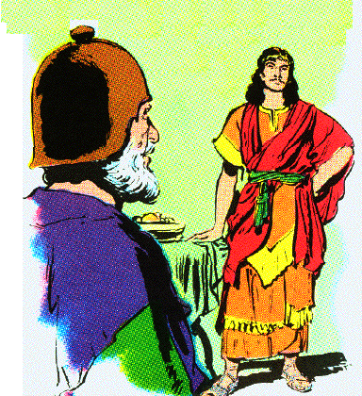
F. Joab is told to recall Absalom but not to allow him to see the king 21-24
23 So Joab arose and went to Geshur, and brought Absalom to Jerusalem.

Slide 31
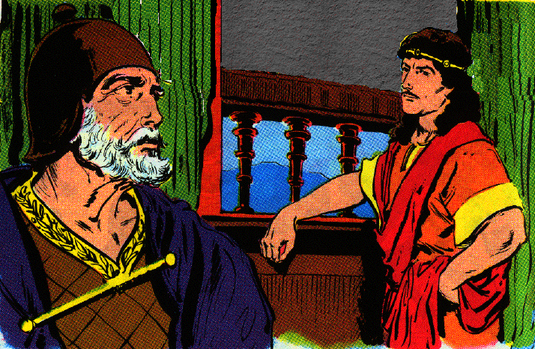
F. Joab is told to recall Absalom but not to allow him to see the king 21-24
24 However the king said, "Let him turn to his own house, and let him not see my face." So Absalom turned to his own house and did not see the king's face.

Slide 32
G. Absalom’s appearance and family 25-27
25 Now in all Israel was no one as handsome as Absalom, so highly praised; from the sole of his foot to the crown of his head there was no defect in him.
26 And when he cut the hair of his head (and it was at the end of every year that he cut it, for it was heavy on him so he cut it), he weighed the hair of his head at 200 shekels by the king's weight.
27 And to Absalom there were born three sons, and one daughter whose name was Tamar; she was a woman of beautiful appearance.

Slide 33
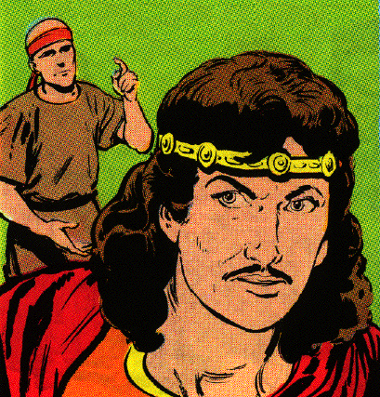
H. After two years, Absalom demands to see the king & is restored 28-33
28 Now Absalom lived two full years in Jerusalem, and did not see the king's face.
29 Then Absalom sent for Joab, to send him to the king, but he would not come to him. So he sent again a second time, but he would not come.

Slide 34
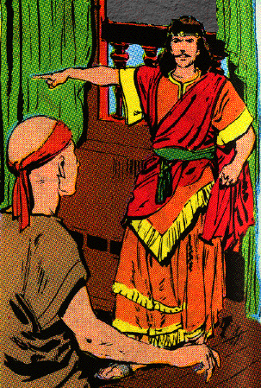
H. After two years, Absalom demands to see the king & is restored 28-33
30 Therefore he said to his servants, "See, Joab's field is next to mine, and he has barley there; go and set it on fire." So Absalom's servants set the field on fire.

Slide 35
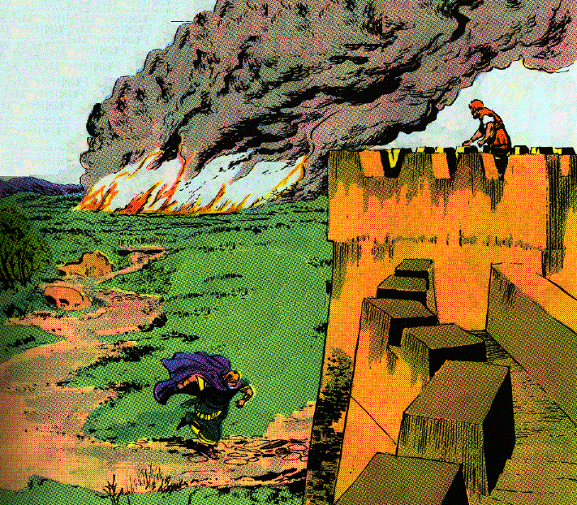
H. After two years, Absalom demands to see the king & is restored 28-33
31 Then Joab arose, came to Absalom at his house and said to him, "Why have your servants set my field on fire?"

Slide 36
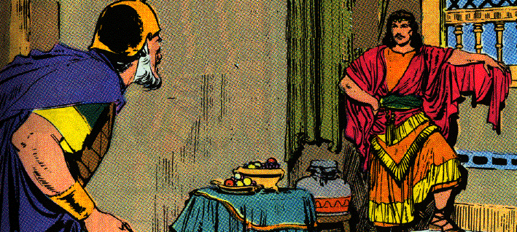
H. After two years, Absalom demands to see the king & is restored 28-33
32 And Absalom answered Joab, "Behold, I sent for you, saying, 'Come here, that I may send you to the king, to say," Why have I come from Geshur? It would be better for me still to be there. "' Now therefore, let me see the king's face; and if there is iniquity in me, let him put me to death."

Slide 37
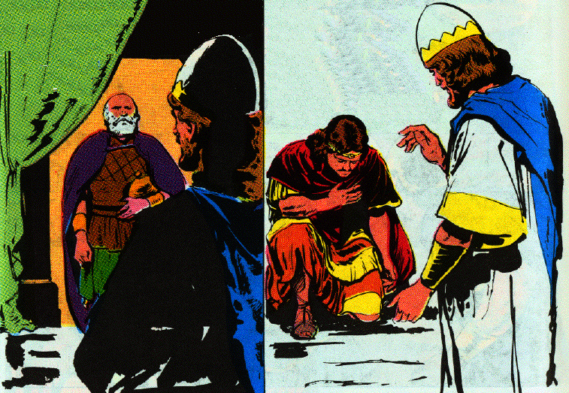
H. After two years, Absalom demands to see the king & is restored 28-33
33 So when Joab came to the king and told him, he called for Absalom. Thus he came to the king and prostrated himself on his face to the ground before the king, and the king kissed Absalom.

