Slide 1
Section 3 Trouble in David’s Family
2 Samuel 10:1—14:33

Slide 2
II. David’s Sin with Bathsheba 11:1-27

Slide 3
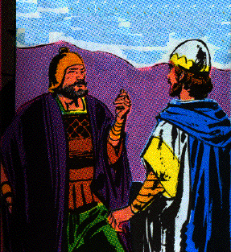
A. Joab sent to besiege Ammonite city of Rabbah 1
1 Then it happened in the spring, at the time when kings go out to battle, that David sent Joab and his servants with him and all Israel, and they destroyed the sons of Ammon and besieged Rabbah. But David stayed at Jerusalem.

Slide 4
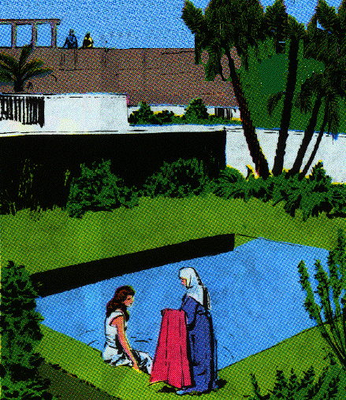
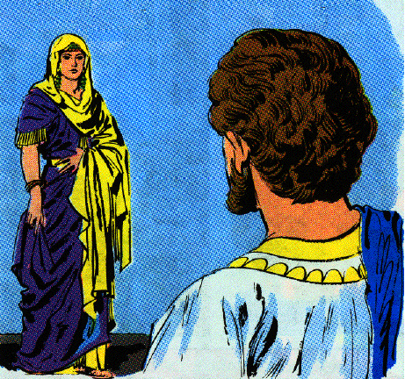
B. David adultery with Bathsheba 1-5
1. David sees her, sends for, & commits adultery with her 2-4
2 Now when evening came David arose from his bed and walked around on the roof of the king's house, and from the roof he saw a woman bathing; and the woman was very beautiful in appearance.
3 So David sent and inquired about the woman. And one said, "Is this not Bathsheba, the daughter of Eliam, the wife of Uriah the Hittite?"
4 And David sent messengers and took her, and when she came to him, he lay with her; and when she had purified herself from her uncleanness, she returned to her house.

Slide 5
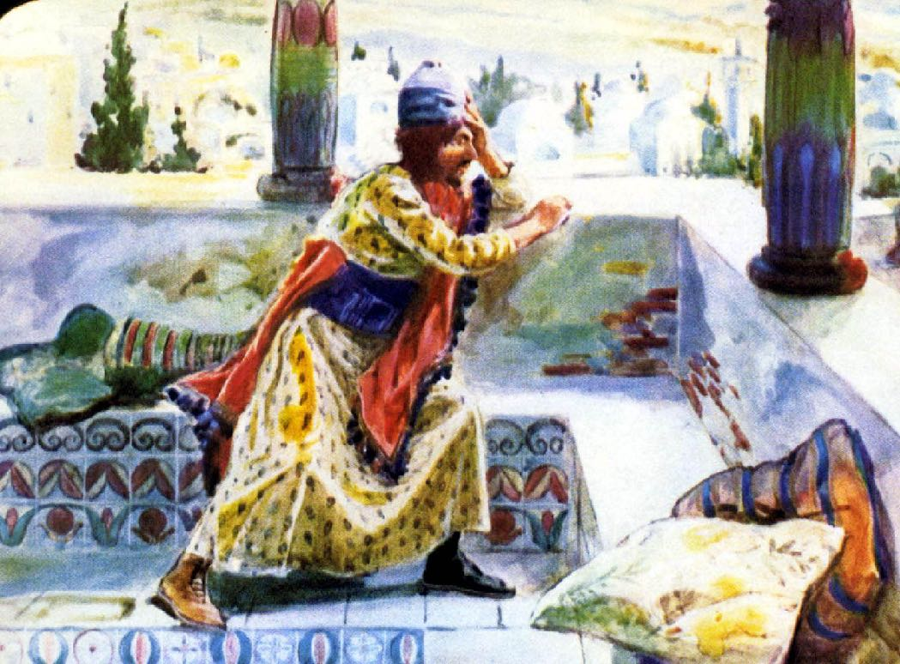
B. David adultery with Bathsheba 1-5
2. Bathsheba conceives a child and informs David 5
5 And the woman conceived; and she sent and told David, and said, "I am pregnant."

Slide 6
C. David tries to cover his sin by bring Uriah home from war 6-13
6 Then David sent to Joab, saying, "Send me Uriah the Hittite." So Joab sent Uriah to David.
7 When Uriah came to him, David asked concerning the welfare of Joab and the people and the state of the war.
8 Then David said to Uriah, "Go down to your house, and wash your feet." And Uriah went out of the king's house, and a present from the king was sent out after him.
9 But Uriah slept at the door of the king's house with all the servants of his lord, and did not go down to his house.

Slide 7
C. David tries to cover his sin by bring Uriah home from war 6-13
10 Now when they told David, saying, "Uriah did not go down to his house," David said to Uriah, "Have you not come from a journey? Why did you not go down to your house?"
11 And Uriah said to David, "The ark and Israel and Judah are staying in temporary shelters, and my lord Joab and the servants of my lord are camping in the open field. Shall I then go to my house to eat and to drink and to lie with my wife? By your life and the life of your soul, I will not do this thing."

Slide 8
C. David tries to cover his sin by bring Uriah home from war 6-13
12 Then David said to Uriah, "Stay here today also, and tomorrow I will let you go." So Uriah remained in Jerusalem that day and the next.
13 Now David called him, and he ate and drank before him, and he made him drunk; and in the evening he went out to lie on his bed with his lord's servants, but he did not go down to his house.

Slide 9
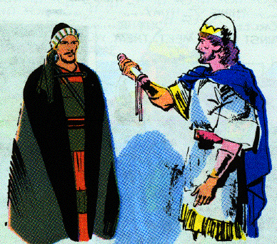
D. David orders Joab to arrange for Uriah to be killed in battle 14-21
14 Now it came about in the morning that David wrote a letter to Joab, and sent it by the hand of Uriah.
15 And he had written in the letter, saying, "Place Uriah in the front line of the fiercest battle and withdraw from him, so that he may be struck down and die."

Slide 10
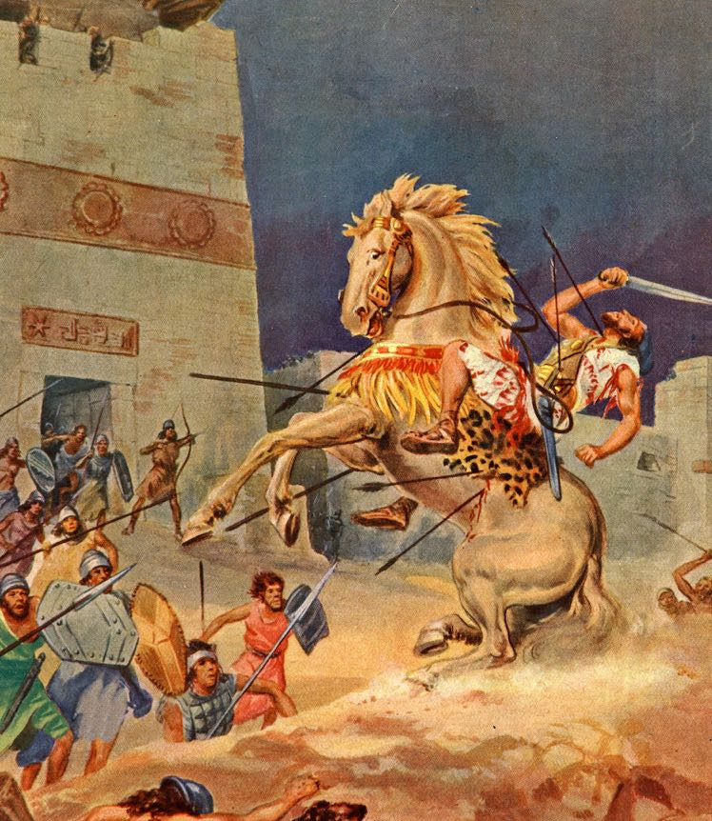
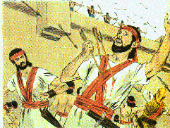
D. David orders Joab to arrange for Uriah to be killed in battle 14-21
16 So it was as Joab kept watch on the city, that he put Uriah at the place where he knew there were valiant men.
17 And the men of the city went out and fought against Joab, and some of the people among David's servants fell; and Uriah the Hittite also died.

Slide 11
D. David orders Joab to arrange for Uriah to be killed in battle 14-21
18 Then Joab sent and reported to David all the events of the war.
19 And he charged the messenger, saying, "When you have finished telling all the events of the war to the king,
20 and if it happens that the king's wrath rises and he says to you, 'Why did you go so near to the city to fight? Did you not know that they would shoot from the wall?
21 'Who struck down Abimelech the son of Jerubbesheth? Did not a woman throw an upper millstone on him from the wall so that he died at Thebez? Why did you go so near the wall?'-- then you shall say, 'Your servant Uriah the Hittite is dead also.' "

Slide 12
E. Joab’s messengers bring David news of the battle & Uriah’s death 22-25
22 So the messenger departed and came and reported to David all that Joab had sent him to tell.
23 And the messenger said to David, "The men prevailed against us and came out against us in the field, but we pressed them as far as the entrance of the gate.
24 "Moreover, the archers shot at your servants from the wall; so some of the king's servants are dead, and your servant Uriah the Hittite is also dead."
25 Then David said to the messenger, "Thus you shall say to Joab, 'Do not let this thing displease you, for the sword devours one as well as another; make your battle against the city stronger and overthrow it'; and so encourage him."

Slide 13
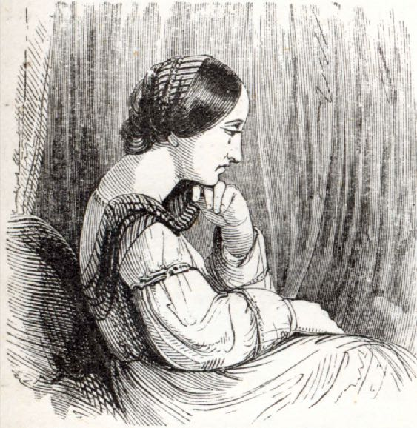
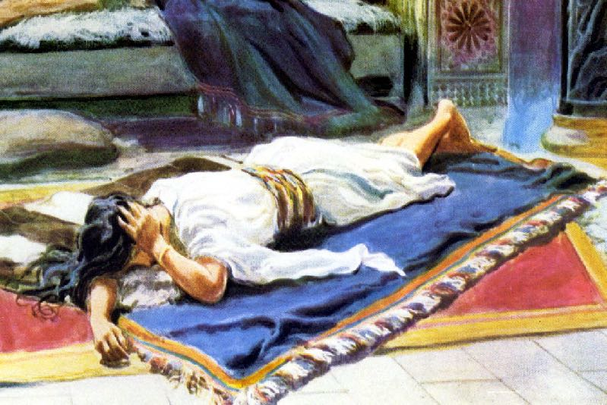
F. David marries Bathsheba 26, 27
26 Now when the wife of Uriah heard that Uriah her husband was dead, she mourned for her husband.
27 When the time of mourning was over, David sent and brought her to his house and she became his wife; then she bore him a son. But the thing that David had done was evil in the sight of the Lord.

Slide 14
III. David’s sin revealed and his repentance 12:1-31

Slide 15
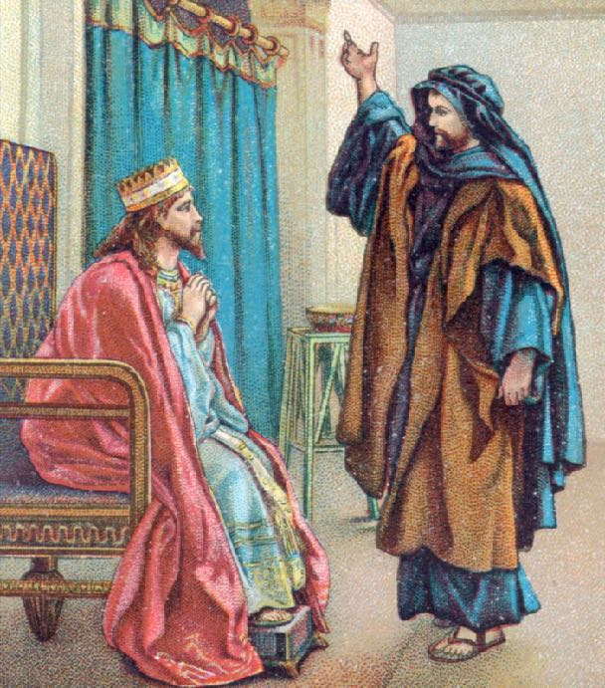
A. Nathan’s parable 1-6
1 Then the LORD sent Nathan to David. And he came to him, and said, "There were two men in one city, the one rich and the other poor.
2 "The rich man had a great many flocks and herds.

Slide 16
A. Nathan’s parable 1-6
3 "But the poor man had nothing except one little ewe lamb Which he bought and nourished; And it grew up together with him and his children. It would eat of his bread and drink of his cup and lie in his bosom, And was like a daughter to him.
4 "Now a traveler came to the rich man, And he was unwilling to take from his own flock or his own herd, To prepare for the wayfarer who had come to him; Rather he took the poor man’s ewe lamb and prepared it for the man who had come to him."

Slide 17
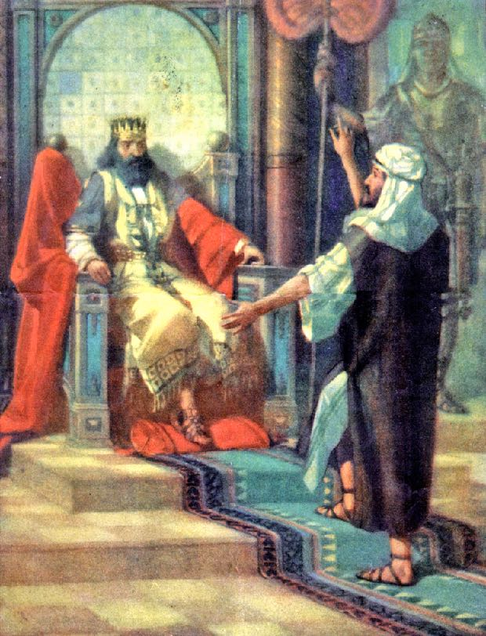
A. Nathan’s parable 1-6
5 Then David’s anger burned greatly against the man, and he said to Nathan, "As the LORD lives, surely the man who has done this deserves to die.
6 "And he must make restitution for the lamb fourfold, because he did this thing and had no compassion.”
Ex. 22:1

Slide 18
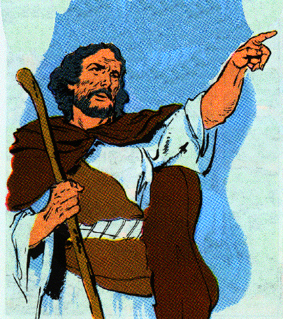
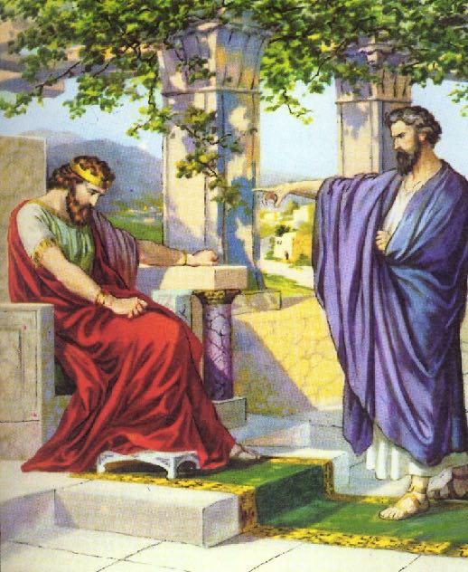
B. Nathan reveals David’s sin & its consequences 7-15a
1. You are the man 7-9
7 Nathan then said to David, "You are the man! Thus says the LORD God of Israel, 'It is I who anointed you king over Israel and it is I who delivered you from the hand of Saul.
8 'I also gave you your master's house and your master's wives into your care, and I gave you the house of Israel and Judah; and if that had been too little, I would have added to you many more things like these!
9 'Why have you despised the word of the LORD by doing evil in His sight? You have struck down Uriah the Hittite with the sword, have taken his wife to be your wife, and have killed him with the sword of the sons of Ammon.

Slide 19
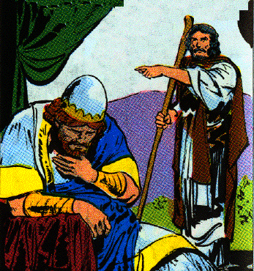
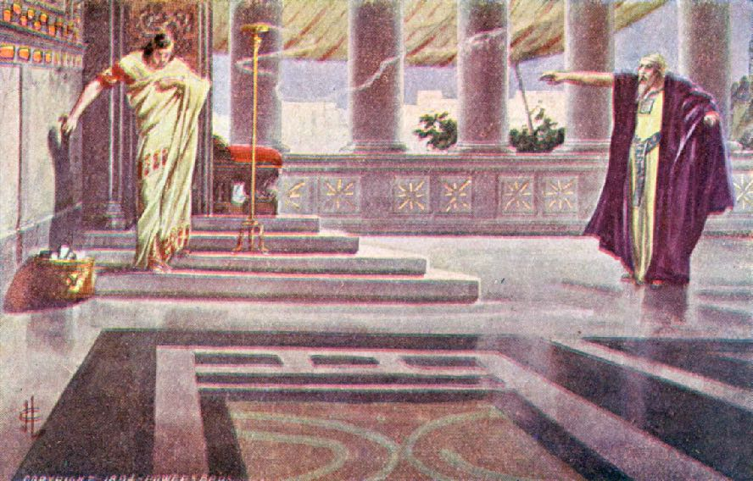
B. Nathan reveals David’s sin & its consequences 7-15a
2. Consequences of David’s sins 10-12
11 "Thus says the LORD, 'Behold, I will raise up evil against you from your own household; I will even take your wives before your eyes and give them to your companion, and he will lie with your wives in broad daylight.
12 'Indeed you did it secretly, but I will do this thing before all Israel, and under the sun.'"

Slide 20
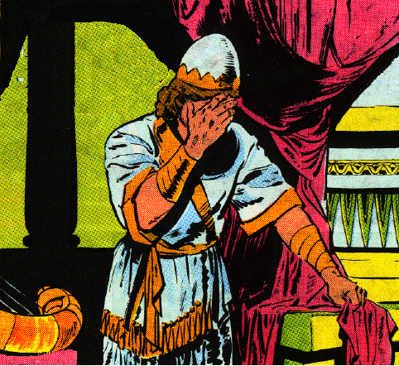
B. Nathan reveals David’s sin and its consequences 7-15a
3. David’s confession and God’s forgiveness 13
13 Then David said to Nathan, "I have sinned against the LORD." And Nathan said to David, "The LORD also has taken away your sin; you shall not die. Ps. 32:5; Ps. 51:4; Prov. 28:13
4. Immediate consequence: the child shall die 14
14 "However, because by this deed you have given occasion to the enemies of the LORD to blaspheme, the child also that is born to you shall surely die."

Slide 21
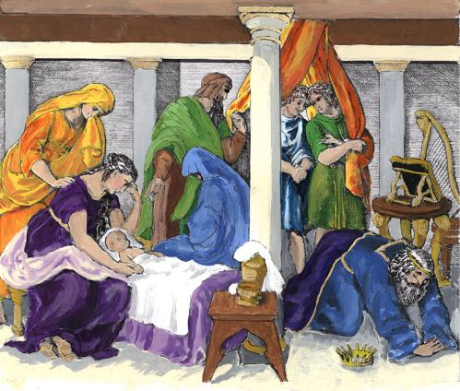
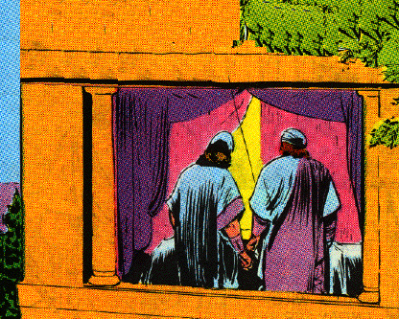
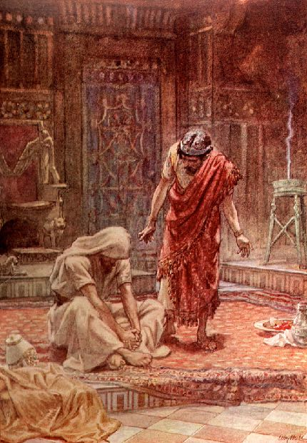
C. The Lord strikes David’s child & it dies 15b-23
1. Child sick for seven days and dies 15-17
David inquired of God for him & would not eat
15 So Nathan went to his house. Then the LORD struck the child that Uriah's widow bore to David, so that he was very sick.
16 David therefore inquired of God for the child; and David fasted and went and lay all night on the ground.
17 The elders of his household stood beside him in order to raise him up from the ground, but he was unwilling and would not eat food with them.

Slide 22
C. The Lord strikes David’s child & it dies 15b-23
2. The servant are afraid to inform David of the child’s death, 12:18
18 Then it happened on the seventh day that the child died. And the servants of David were afraid to tell him that the child was dead, for they said, "Behold, while the child was still alive, we spoke to him and he did not listen to our voice. How then can we tell him that the child is dead, since he might do himself harm!"

Slide 23
C. The Lord strikes David’s child & it dies 15b-23
2. David cleans up, takes food and worships God 19, 20
19 But when David saw that his servants were whispering together, David perceived that the child was dead; so David said to his servants, "Is the child dead?" And they said, "He is dead."
20 So David arose from the ground, washed, anointed himself, and changed his clothes; and he came into the house of the LORD and worshiped. Then he came to his own house, and when he requested, they set food before him and he ate.

Slide 24
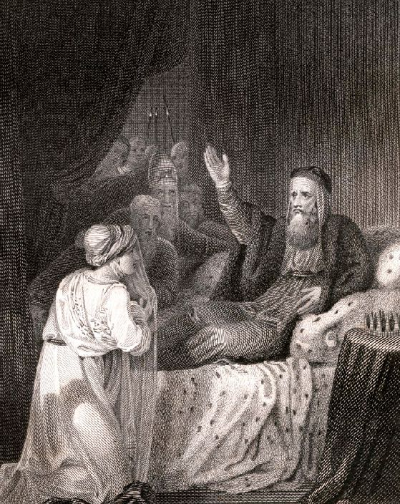
C. The Lord strikes David’s child and it dies 15b-23
3. David explains his behavior to his servants 21-23
21 Then his servants said to him, "What is this thing that you have done? While the child was alive, you fasted and wept; but when the child died, you arose and ate food."
22 And he said, "While the child was still alive, I fasted and wept; for I said, ‘Who knows, the LORD may be gracious to me, that the child may live.’
23 "But now he has died; why should I fast? Can I bring him back again? I shall go to him, but he will not return to me."

Slide 25
D. Bathsheba gives birth to Solomon who is Beloved of the Lord 24, 25
24 Then David comforted his wife Bathsheba, and went in to her and lay with her; and she gave birth to a son, and he named him Solomon. Now the LORD loved him
25 and sent word through Nathan the prophet, and he named him Jedidiah for the LORD’S sake.
Solomon - Peacable
Jedidiah - Loved by the Lord

Slide 26
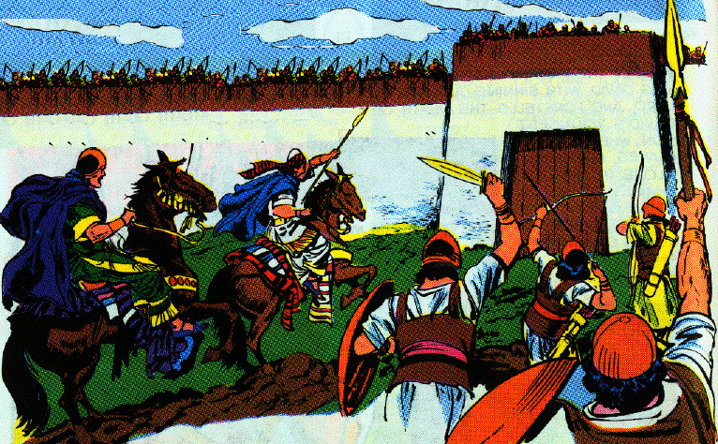
E. The final siege of Rabbah 26-31
1. Joab captured the city 26
26 Now Joab fought against Rabbah of the sons of Ammon, and captured the royal city.

Slide 27
E. The final siege of Rabbah 26-31
2. Joab gives David the opportunity to capture the city 27-28
27 And Joab sent messengers to David and said, "I have fought against Rabbah, I have even captured the city of waters.
28 "Now therefore, gather the rest of the people together and camp against the city and capture it, lest I capture the city myself and it be named after me."

Slide 28
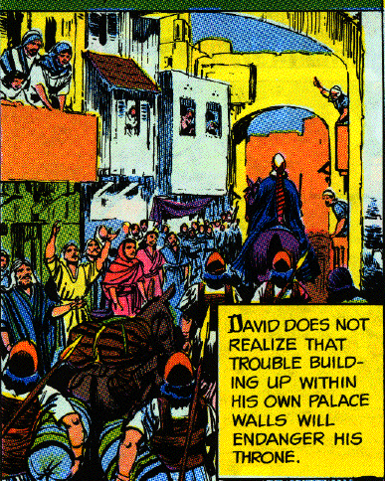
E. The final siege of Rabbah 26-31
3. David gathers the people captures the city and its spoils 29-31
29 So David gathered all the people and went to Rabbah, fought against it, and captured it.
30 Then he took the crown of their king from his head; and its weight was a talent of gold, and in it was a precious stone; and it was placed on David's head. And he brought out the spoil of the city in great amounts.
31 He also brought out the people who were in it, and set them under saws, sharp iron instruments, and iron axes, and made them pass through the brickkiln. And thus he did to all the cities of the sons of Ammon. Then David and all the people returned to Jerusalem.

