Slide 1
The Prosperous Period of David’s Reign 6:1-9:13

Slide 2
I. David Brings the Ark to Jerusalem 6:1-23

Slide 3
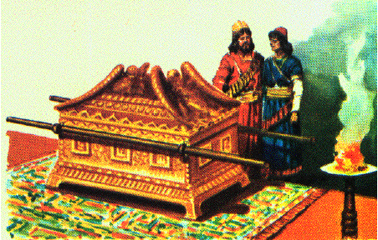
A. Uzzah Smitten 6:1-11
Ark in the house of Abinadab
His sons Uzzah & Ahio

Slide 4
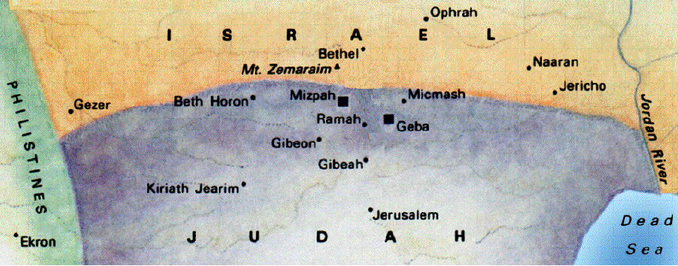
1. David & 30,000 men to bring the ark to Jerusalem 1-5
1 Now David again gathered all the chosen men of Israel, thirty thousand.
2 And David arose and went with all the people who were with him to Baale-judah, to bring up from there the ark of God which is called by the Name, the very name of the LORD of hosts who is enthroned above the cherubim.

Slide 5
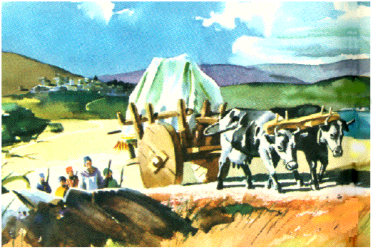
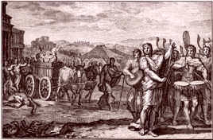
1. David & 30,000 men to bring the ark to Jerusalem 1-5
3 And they placed the ark of God on a new cart that they might bring it from the house of Abinadab which was on the hill; and Uzzah and Ahio, the sons of Abinadab, were leading the new cart.
4 So they brought it with the ark of God from the house of Abinadab, which was on the hill; and Ahio was walking ahead of the ark.
5 Meanwhile, David and all the house of Israel were celebrating before the LORD with all kinds of instruments made of fir wood, and with lyres, harps, tambourines, castanets and cymbals.

Slide 6
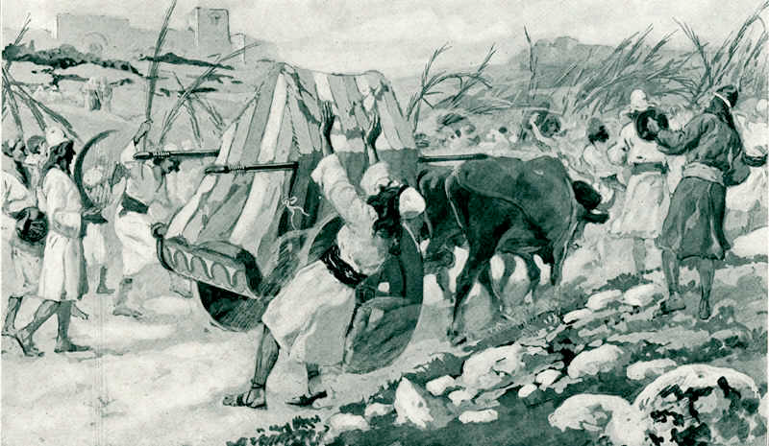
2. Uzzah touches the ark and is killed 6, 7
6 But when they came to the threshing floor of Nacon, Uzzah reached out toward the ark of God and took hold of it, for the oxen nearly upset it.
7 And the anger of the LORD burned against Uzzah, and God struck him down there for his irreverence; and he died there by the ark of God.

Slide 7
3. David, being angry & afraid took the ark Obed-edom’s house 8-11
8 And David became angry because of the LORD’S outburst against Uzzah, and that place is called Perez-uzzah to this day.
9 So David was afraid of the LORD that day; and he said, "How can the ark of the LORD come to me?"
10 And David was unwilling to move the ark of the LORD into the city of David with him; but David took it aside to the house of Obed-edom the Gittite.
11 Thus the ark of the LORD remained in the house of Obed-edom the Gittite three months, and the LORD blessed Obed-edom and all his household.

Slide 8
B. The Ark Brought To Jerusalem 6:12-19

Slide 9
1. David, heard Obed-edom was prospered & brings the ark with sacrifices & solemn rejoicing to Jerusalem 12-15
12 Now it was told King David, saying, "The LORD has blessed the house of Obed-edom and all that belongs to him, on account of the ark of God." And David went and brought up the ark of God from the house of Obed-edom into the city of David with gladness.
13 And so it was, that when the bearers of the ark of the LORD had gone six paces, he sacrificed an ox and a fatling.
a. David also discovered his fault I Chron. 15:2
2 Then David said, "No one is to carry the ark of God but the Levites; for the LORD chose them to carry the ark of God, and to minister to Him forever." Num. 4:4, 15

Slide 10
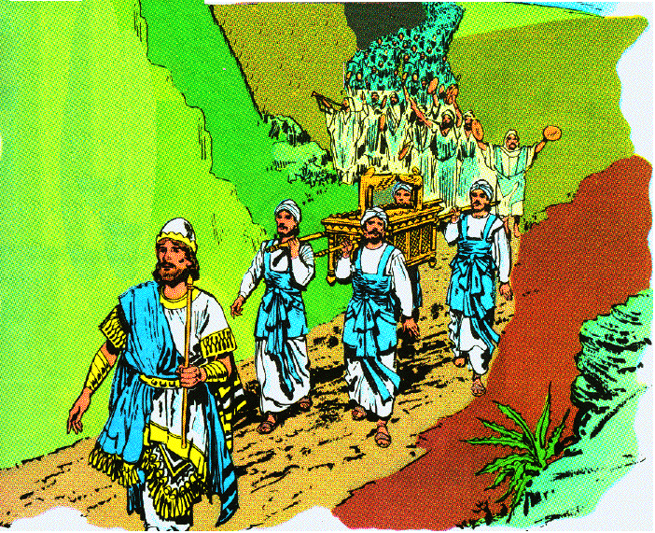
1. David, heard Obed-edom was prospered & brings the ark with sacrifices & solemn rejoicing to Jerusalem 12-15
a. David also discovered his fault I Chron. 15:2
2 Then David said, "No one is to carry the ark of God but the Levites; for the LORD chose them to carry the ark of God, and to minister to Him forever." Num. 4:4, 15

Slide 11
The Levites carried the ark this time 1 Chron. 15:5-11
11 Then David called for Zadok and Abiathar the priests, and for the Levites, for Uriel, Asaiah, Joel, Shemaiah, Eliel, and Amminadab
12 and said to them, "You are the heads of the fathers’ households of the Levites; consecrate yourselves both you and your relatives, that you may bring up the ark of the LORD God of Israel, to the place that I have prepared for it.
13 "Because you did not carry it at the first, the LORD our God made an outburst on us, for we did not seek Him according to the ordinance."
14 So the priests and the Levites consecrated themselves to bring up the ark of the LORD God of Israel.
15 And the sons of the Levites carried the ark of God on their shoulders, with the poles thereon as Moses had commanded according to the word of the LORD.

Slide 12
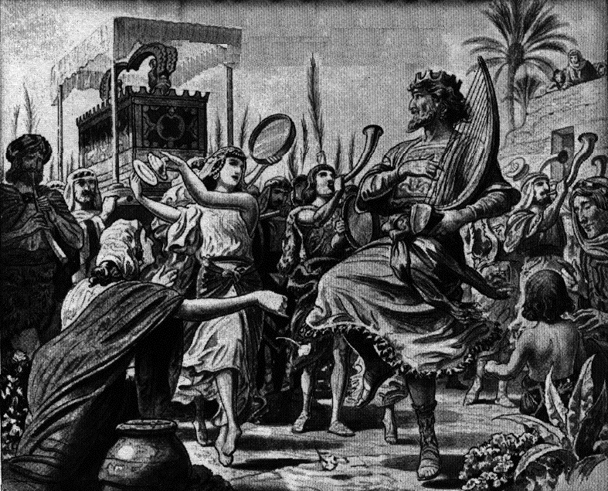
1. David, heard Obed-edom was prospered & brings the ark with sacrifices & solemn rejoicing to Jerusalem 12-15
14 And David was dancing before the LORD with all his might, and David was wearing a linen ephod.
15 So David and all the house of Israel were bringing up the ark of the LORD with shouting and the sound of the trumpet.

Slide 13
2. Michal, seeing David dancing before the ark, despises him 16
16 Then it happened as the ark of the LORD came into the city of David that Michal the daughter of Saul looked out of the window and saw King David leaping and dancing before the LORD; and she despised him in her heart.

Slide 14
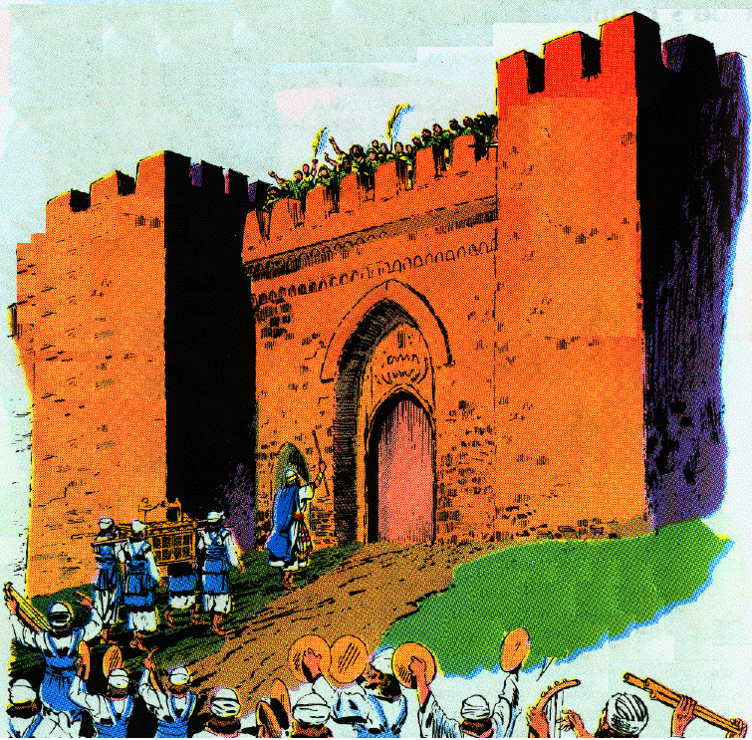
3. He offers burnt offerings & peace offerings, and distributes to all the people a cake of bread, one of dates, one of raisins 17-19

Slide 15
C. Michal Cursed 20-23
20 But when David returned to bless his household, Michal the daughter of Saul came out to meet David and said, "How the king of Israel distinguished himself today! He uncovered himself today in the eyes of his servants’ maids as one of the foolish ones shamelessly uncovers himself!"

Slide 16
C. Michal Cursed 20-23
21 So David said to Michal, "It was before the LORD, who chose me above your father and above all his house, to appoint me ruler over the people of the LORD, over Israel; therefore I will celebrate before the LORD.
22 "And I will be more lightly esteemed than this and will be humble in my own eyes, but with the maids of whom you have spoken, with them I will be distinguished."
23 And Michal the daughter of Saul had no child to the day of her death.

Slide 17
II. David’s Plan to Build a Temple 7:1-29

Slide 18
A. David’s desire to build a temple thwarted 7:1-11
1. David is dissatisfied with the ark remaining in a tent 1,2
1 Now it came about when the king lived in his house, and the LORD had given him rest on every side from all his enemies,
2 that the king said to Nathan the prophet, "See now, I dwell in a house of cedar, but the ark of God dwells within tent curtains."
2. Nathan gives him encouragement in his plan for a temple 3
3 And Nathan said to the king, "Go, do all that is in your mind, for the LORD is with you."

Slide 19
A. David’s desire to build a temple thwarted 7:1-11
3. Nathan’s message from God - David cannot build Him a house 4-11
a. God as been pleased to move from place to place in a tent 6
b. God wanted no other dwelling place while Israel was unsettled 7
c. God has regard for David 8-11
1) He took him from humble circumstances & made him king 8
2) He cut off his enemies & will make his name great 9
3) He will grant his people stability & peace 10
4) He will receive rest from his enemies & an enduring family 11

Slide 20
B. God’s covenant with David 7:12-17
1. Elevation of his son 12a; I Chron. 17:11; 22:9; 28:10
2. Establishment of the kingdom in security, peace & happiness 12b
12 "When your days are complete and you lie down with your fathers, I will raise up your descendant after you, who will come forth from you, and I will establish his kingdom.

Slide 21
B. God’s covenant with David 7:12-17
3. Erection of the temple & the dwelling of God among the people 13
13 "He shall build a house for My name, and I will establish the throne of his kingdom forever.
David not allowed to build because of bloodshed I Chron. 28:2, 3
Messiah temple builder Ezek. 40-48; 1 Pet. 2:5
Dwell place of God - tent of Shem, Tabernacle, Temple, Body of Christ, the Christian & the church Gen. 9:27; Ex. 40:34ff; 1 Kings 8:13; Jn. 1:14; 2:19; 1 Cor. 6:19; 1 Tim. 3:15
The line will culminate in the eternal Christ Ps. 89:29, 36, 37; Lk. 1:32-33

Slide 22
B. God’s covenant with David 7:12-17
4. Relationship of Father and son 14
14 "I will be a father to him and he will be a son to Me; when he commits iniquity, I will correct him with the rod of men and the strokes of the sons of men,
God’s Son, Ex. 4:22-23
Solomon & Christ 1 Chron. 28:6; Ps. 89:26, 27; Jn. 3:35

Slide 23
B. God’s covenant with David 7:12-17
5. Unchanging mercy of God 15
15 but My lovingkindness shall not depart from him, as I took it away from Saul, whom I removed from before you.
Individuals punished & cast off, but not the line I Chron. 28:9
6. The eternal endurance of the throne 16
16 "And your house and your kingdom shall endure before Me forever; your throne shall be established forever."’"

Slide 24
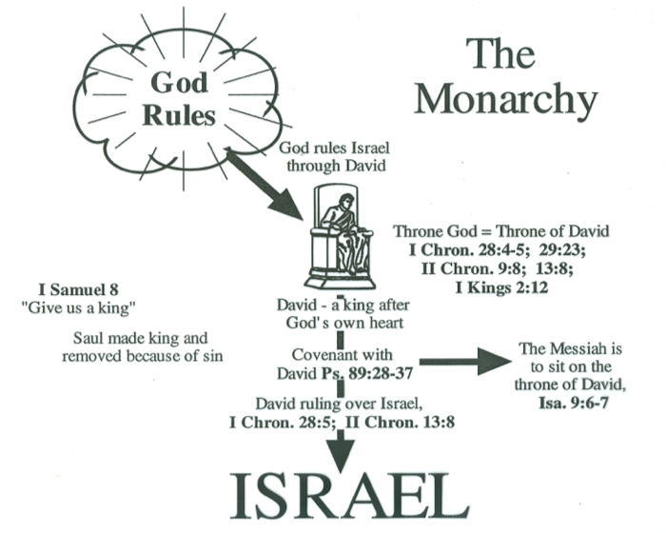

Slide 25
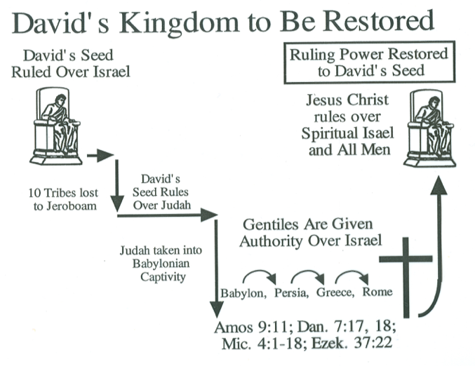

Slide 26
C. David’s response to the Lord’s will 7:18-29
1. Expresses wonder at what God did for him in the past & His promises for the distant future 18-20
18 Then David the king went in and sat before the LORD, and he said, "Who am I, O Lord GOD, and what is my house, that Thou hast brought me this far?
19 "And yet this was insignificant in Thine eyes, O Lord GOD, for Thou hast spoken also of the house of Thy servant concerning the distant future. And this is the custom of man, O Lord GOD.
20 "And again what more can David say to Thee? For Thou knowest Thy servant, O Lord GOD!

Slide 27
C. David’s response to the Lord’s will 7:18-29
2. Filled with humility because God did this out of His own will 21
21 "For the sake of Thy word, and according to Thine own heart, Thou hast done all this greatness to let Thy servant know.
3. Adores God’s greatness 22
4. Thankful for God work for Israel’s salvation 23, 24
5. A desire & trust that God’s purpose will be fulfilled & establish in him 25-27
6. Request for God’s blessings & assistance for His family 28, 29

Slide 28
III. The Throne of David Established 8:1-18

Slide 29
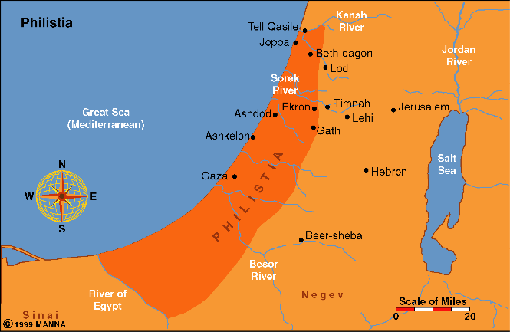
A. David’s victories 1-13
1. He subdues the Philistines 1
1 Now after this it came about that David defeated the Philistines and subdued them; and David took control of the chief city from the hand of the Philistines.

Slide 30
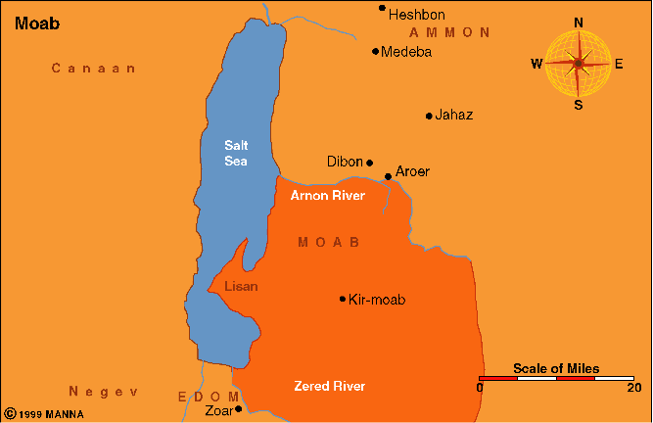
2. He subdues the Moabites 2
2 And he defeated Moab, and measured them with the line, making them lie down on the ground; and he measured two lines to put to death and one full line to keep alive. And the Moabites became servants to David, bringing tribute.

Slide 31
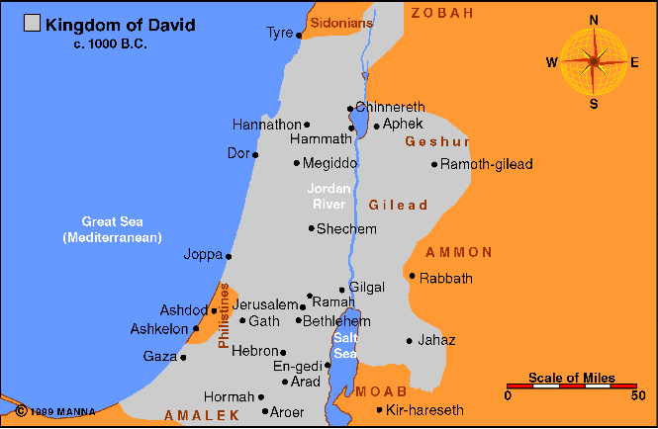
3. He defeats the king of Zobah 3, 4
3 Then David defeated Hadadezer, the son of Rehob king of Zobah, as he went to restore his rule at the River.
4 And David captured from him 1,700 horsemen and 20,000 foot soldiers; and David hamstrung the chariot horses, but reserved enough of them for 100 chariots.

Slide 32
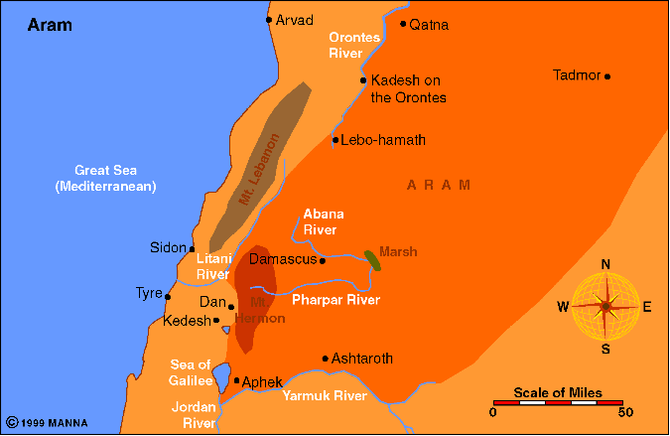
4. Toi, king of Hamath sends congratulation & gifts 9-10
9 Now when Toi king of Hamath heard that David had defeated all the army of Hadadezer,
10 Toi sent Joram his son to King David to greet him and bless him, because he had fought against Hadadezer and defeated him; for Hadadezer had been at war with Toi. And Joram brought with him articles of silver, of gold and of bronze.
Zobah

Slide 33
5. David dedicates all the spoils to God 11-13
11 King David also dedicated these to the LORD, with the silver and gold that he had dedicated from all the nations which he had subdued:
12 from Aram and Moab and the sons of Ammon and the Philistines and Amalek, and from the spoil of Hadadezer, son of Rehob, king of Zobah.
13 So David made a name for himself when he returned from killing 18,000 Arameans in the Valley of Salt.

Slide 34
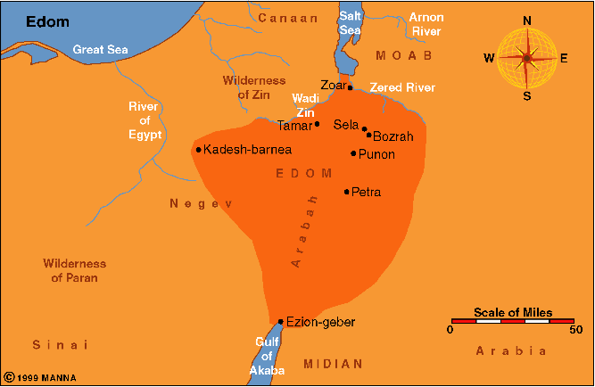

Slide 35
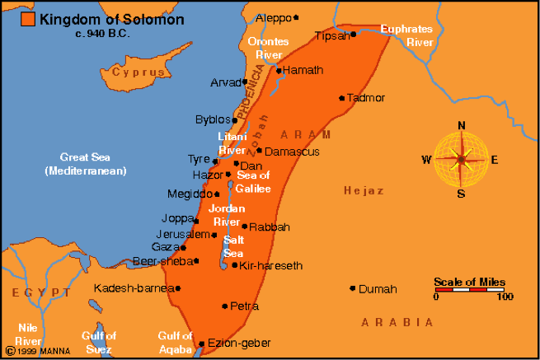

Slide 36
B. David’s government 8:14-18
1. He puts garrison in Edom 14
2. He reigns over all Israel 15
3. An account of his chief officers 16-18
a. Joab (JOH ab) - over army
b. Jehoshaphat (jih HAHSH uh fat) - recorder
c. Zadok & Ahimelech - Priests
d. Seraiah (sih RIGH uh) or Sheva, Shavsha - secretary
e. Benaiah (bee NIGH uh) - over Cherethites & Pelethites
f. David’s sons - chief ministers

Slide 37
IV. David’s Kindness to the House of Saul 9:1-13

Slide 38
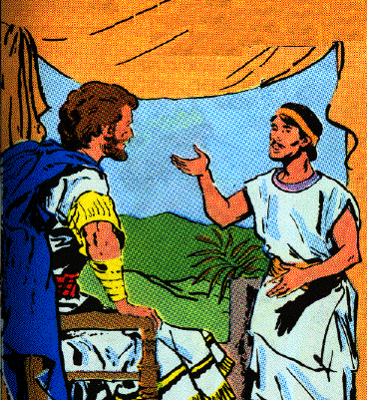
A. David seeks Saul’s heirs 9:1-4
1 Then David said, "Is there yet anyone left of the house of Saul, that I may show him kindness for Jonathan’s sake?"
2 Now there was a servant of the house of Saul whose name was Ziba, and they called him to David; and the king said to him, "Are you Ziba?" And he said, "I am your servant."
3 And the king said, "Is there not yet anyone of the house of Saul to whom I may show the kindness of God?" And Ziba said to the king, "There is still a son of Jonathan who is crippled in both feet."
4 So the king said to him, "Where is he?" And Ziba said to the king, "Behold, he is in the house of Machir the son of Ammiel in Lo-debar."
David questions Ziba
Ziba - ZIGH buh
Machir - MAY kir
Ammiel - AM ih el
Lo-debar - lo-DEE bahr

Slide 39
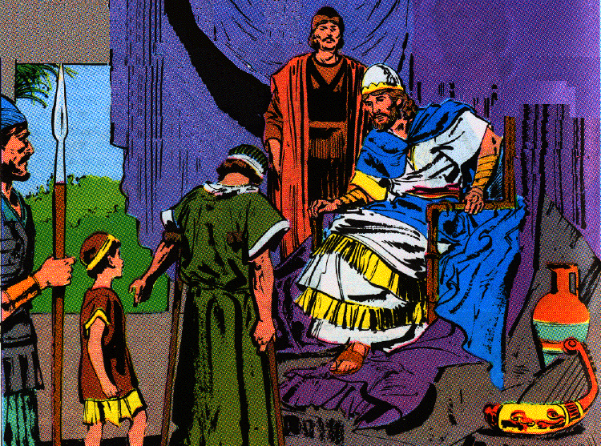
B. Mephibosheth brought to David 9:5-13
1. He sends for him and gives him all the land of Saul 5-8
5 Then King David sent and brought him from the house of Machir the son of Ammiel, from Lo-debar.
6 And Mephibosheth, the son of Jonathan the son of Saul, came to David and fell on his face and prostrated himself. And David said, "Mephibosheth." And he said, "Here is your servant!"
Mephibosheth & Mica before David

Slide 40
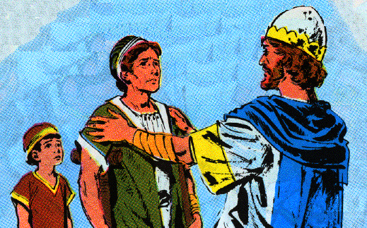
B. Mephibosheth brought to David 9:5-13
1. He sends for him and gives him all the land of Saul 5-8
7 And David said to him, "Do not fear, for I will surely show kindness to you for the sake of your father Jonathan, and will restore to you all the land of your grandfather Saul; and you shall eat at my table regularly."
8 Again he prostrated himself and said, "What is your servant, that you should regard a dead dog like me?"

Slide 41
B. Mephibosheth brought to David 9:5-13
2. He appoints Ziba, the servant of Saul & his family to till the ground for Mephibosheth 9-13
9 Then the king called Saul’s servant Ziba, and said to him, "All that belonged to Saul and to all his house I have given to your master’s grandson.
10 "And you and your sons and your servants shall cultivate the land for him, and you shall bring in the produce so that your master’s grandson may have food; nevertheless Mephibosheth your master’s grandson shall eat at my table regularly." Now Ziba had fifteen sons and twenty servants.

Slide 42
B. Mephibosheth brought to David 9:5-13
2. He appoints Ziba, the servant of Saul & his family to till the ground for Mephibosheth 9-13
11 Then Ziba said to the king, "According to all that my lord the king commands his servant so your servant will do." So Mephibosheth ate at David’s table as one of the king’s sons.
12 And Mephibosheth had a young son whose name was Mica. And all who lived in the house of Ziba were servants to Mephibosheth.
13 So Mephibosheth lived in Jerusalem, for he ate at the king’s table regularly. Now he was lame in both feet.

