Slide 1
IV. David’s Kindness to the House of Saul 9:1-13

Slide 2
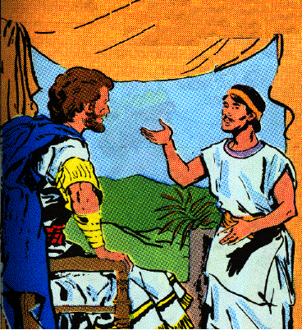
A. David seeks Saul’s heirs 9:1-4
1 Then David said, "Is there yet anyone left of the house of Saul, that I may show him kindness for Jonathan’s sake?"
2 Now there was a servant of the house of Saul whose name was Ziba, and they called him to David; and the king said to him, "Are you Ziba?" And he said, "I am your servant."
3 And the king said, "Is there not yet anyone of the house of Saul to whom I may show the kindness of God?" And Ziba said to the king, "There is still a son of Jonathan who is crippled in both feet."
4 So the king said to him, "Where is he?" And Ziba said to the king, "Behold, he is in the house of Machir the son of Ammiel in Lo-debar."
David questions Ziba
Ziba - ZIGH buh
Machir - MAY kir
Ammiel - AM ih el
Lo-debar - lo-DEE bahr

Slide 3
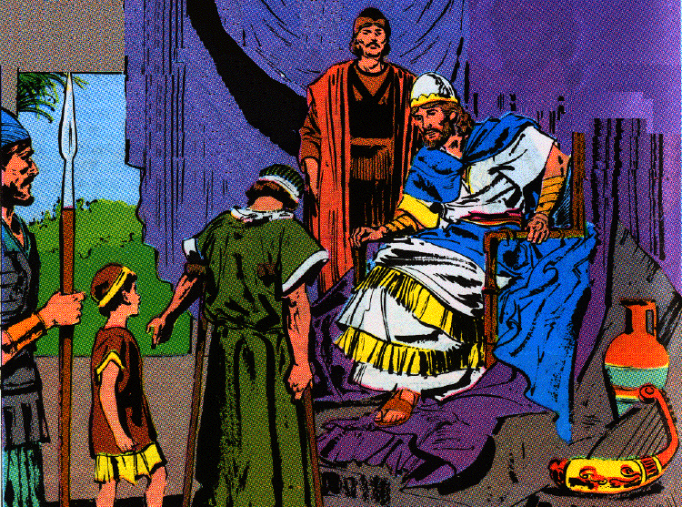
B. Mephibosheth brought to David 9:5-13
1. He sends for him and gives him all the land of Saul 5-8
5 Then King David sent and brought him from the house of Machir the son of Ammiel, from Lo-debar.
6 And Mephibosheth, the son of Jonathan the son of Saul, came to David and fell on his face and prostrated himself. And David said, "Mephibosheth." And he said, "Here is your servant!"
Mephibosheth & Mica before David

Slide 4
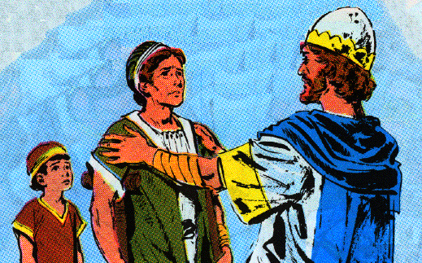
B. Mephibosheth brought to David 9:5-13
1. He sends for him and gives him all the land of Saul 5-8
7 And David said to him, "Do not fear, for I will surely show kindness to you for the sake of your father Jonathan, and will restore to you all the land of your grandfather Saul; and you shall eat at my table regularly."
8 Again he prostrated himself and said, "What is your servant, that you should regard a dead dog like me?"

Slide 5
B. Mephibosheth brought to David 9:5-13
2. He appoints Ziba, the servant of Saul & his family to till the ground for Mephibosheth 9-13
9 Then the king called Saul’s servant Ziba, and said to him, "All that belonged to Saul and to all his house I have given to your master’s grandson.
10 "And you and your sons and your servants shall cultivate the land for him, and you shall bring in the produce so that your master’s grandson may have food; nevertheless Mephibosheth your master’s grandson shall eat at my table regularly." Now Ziba had fifteen sons and twenty servants.

Slide 6
B. Mephibosheth brought to David 9:5-13
2. He appoints Ziba, the servant of Saul & his family to till the ground for Mephibosheth 9-13
11 Then Ziba said to the king, "According to all that my lord the king commands his servant so your servant will do." So Mephibosheth ate at David’s table as one of the king’s sons.
12 And Mephibosheth had a young son whose name was Mica. And all who lived in the house of Ziba were servants to Mephibosheth.
13 So Mephibosheth lived in Jerusalem, for he ate at the king’s table regularly. Now he was lame in both feet.

Slide 7
Section 3 Trouble in David’s Family
2 Samuel 10:1—14:33
I. The war with Ammon 10:1-19

Slide 8
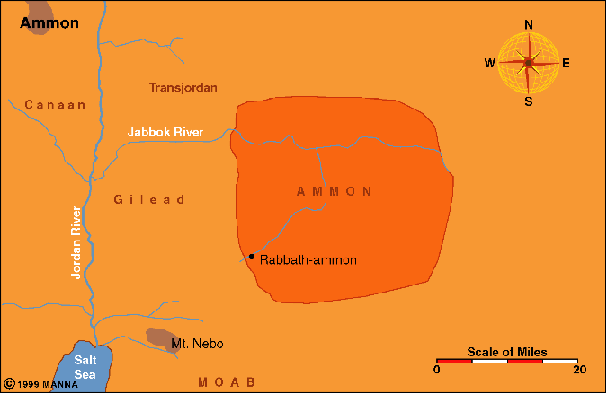
A. David’s Ambassadors shamed by Hanun king of Ammon 1-5
1. Death of the Ammonite king - David’s servants to comfort his son 1, 2
1 Now it happened afterwards that the king of the Ammonites died, and Hanun his son became king in his place.
2 Then David said, "I will show kindness to Hanun the son of Nahash, just as his father showed kindness to me." So David sent some of his servants to console him concerning his father. But when David's servants came to the land of the Ammonites,
Hanun - HAY nuhn
Ammonites - AM uhn ights
Nahash - NAY hash

Slide 9
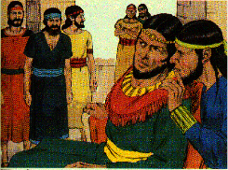
A. David’s Ambassadors shamed by Hanun king of Ammon 1-5
2. Ammonite princes mislead Hanun & he abuses the servants 3-5
3 the princes of the Ammonites said to Hanun their lord, "Do you think that David is honoring your father because he has sent consolers to you? Has David not sent his servants to you in order to search the city, to spy it out and overthrow it?"

Slide 10
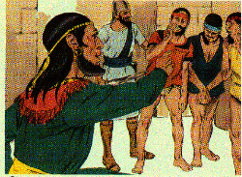
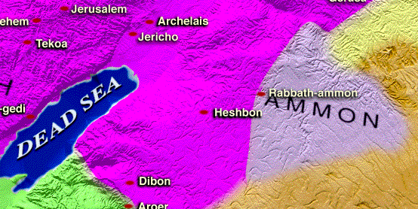
A. David’s Ambassadors shamed by Hanun king of Ammon 1-5
2. Ammonite princes mislead Hanun & he abuses the servants 3-5
4 So Hanun took David's servants and shaved off half of their beards, and cut off their garments in the middle as far as their hips, and sent them away.
5 When they told it to David, he sent to meet them, for the men were greatly humiliated. And the king said, "Stay at Jericho until your beards grow, and then return."

Slide 11
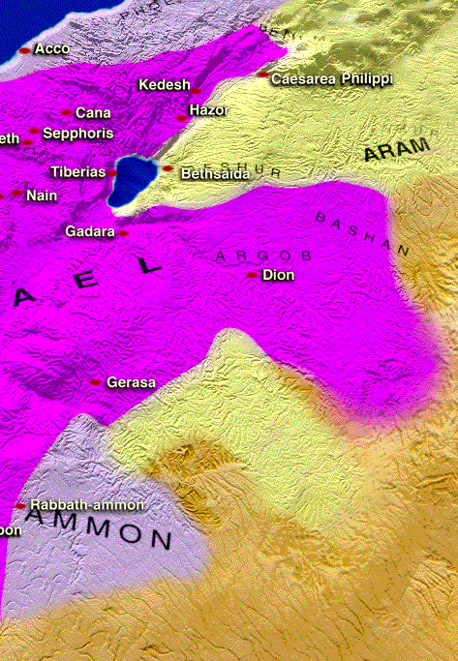
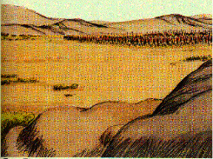
B. Ammon & Syria defeated 6-19
1. Ammonites hire Syrians to make war with David 6
6 Now when the sons of Ammon saw that they had become odious to David, the sons of Ammon sent and hired the Arameans of Beth-rehob and the Arameans of Zobah, 20,000 foot soldiers, and the king of Maacah with 1,000 men, and the men of Tob with 12,000 men.

Slide 12
B. Ammon & Syria defeated 6-19
2. David’s army & mighty men caught between two armies 7-8
7 When David heard of it, he sent Joab and all the army, the mighty men.
8 And the sons of Ammon came out and drew up in battle array at the entrance of the city, while the Arameans of Zobah and of Rehob and the men of Tob and Maacah were by themselves in the field.

Slide 13
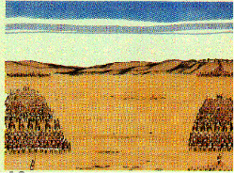
B. Ammon & Syria defeated 6-19
3. Joab & Abishai divide David’s army and win on both fronts 9-14
9 Now when Joab saw that the battle was set against him in front and in the rear, he selected from all the choice men of Israel, and arrayed them against the Arameans.
10 But the remainder of the people he placed in the hand of Abishai his brother, and he arrayed them against the sons of Ammon.

Slide 14
B. Ammon & Syria defeated 6-19
3. Joab & Abishai divide David’s army and win on both fronts 9-14
11 And he said, "If the Arameans are too strong for me, then you shall help me, but if the sons of Ammon are too strong for you, then I will come to help you.
12 "Be strong, and let us show ourselves courageous for the sake of our people and for the cities of our God; and may the Lord do what is good in His sight."

Slide 15
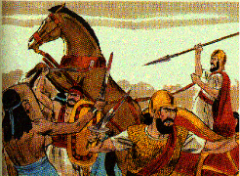
B. Ammon & Syria defeated 6-19
3. Joab & Abishai divide David’s army and win on both fronts 9-14
13 So Joab and the people who were with him drew near to the battle against the Arameans, and they fled before him.
14 When the sons of Ammon saw that the Arameans fled, they also fled before Abishai and entered the city. Then Joab returned from fighting against the sons of Ammon and came to Jerusalem.

Slide 16
B. Ammon & Syria defeated 6-19
4. Syrian king Hadadezer gather a second army & is defeated 15-18
15 When the Arameans saw that they had been defeated by Israel, they gathered themselves together.
16 And Hadadezer sent and brought out the Arameans who were beyond the River, and they came to Helam; and Shobach the commander of the army of Hadadezer led them.
17 Now when it was told David, he gathered all Israel together and crossed the Jordan, and came to Helam. And the Arameans arrayed themselves to meet David and fought against him.
18 But the Arameans fled before Israel, and David killed 700 charioteers of the Arameans and 40,000 horsemen and struck down Shobach the commander of their army, and he died there.

Slide 17
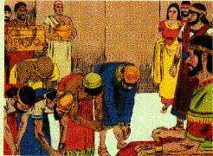
B. Ammon & Syria defeated 6-19
5. Arameans make a separate peace with Israel 19
19 When all the kings, servants of Hadadezer, saw that they were defeated by Israel, they made peace with Israel and served them. So the Arameans feared to help the sons of Ammon anymore.

Slide 18
Section 3 Trouble in David’s Family
2 Samuel 10:1—14:33

Slide 19
II. David’s Sin with Bathsheba 11:1-27

Slide 20
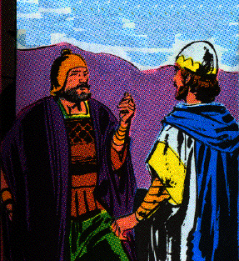
A. Joab sent to besiege Ammonite city of Rabbah 1
1 Then it happened in the spring, at the time when kings go out to battle, that David sent Joab and his servants with him and all Israel, and they destroyed the sons of Ammon and besieged Rabbah. But David stayed at Jerusalem.

Slide 21
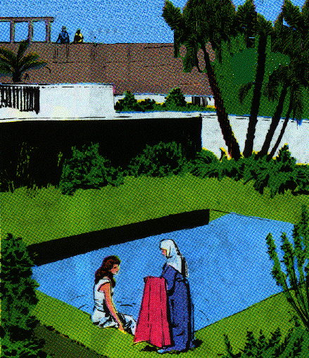
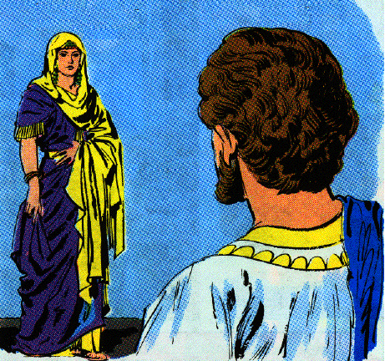
B. David adultery with Bathsheba 1-5
1. David sees her, sends for, & commits adultery with her 2-4
2 Now when evening came David arose from his bed and walked around on the roof of the king's house, and from the roof he saw a woman bathing; and the woman was very beautiful in appearance.
3 So David sent and inquired about the woman. And one said, "Is this not Bathsheba, the daughter of Eliam, the wife of Uriah the Hittite?"
4 And David sent messengers and took her, and when she came to him, he lay with her; and when she had purified herself from her uncleanness, she returned to her house.

Slide 22
B. David adultery with Bathsheba 1-5
2. Bathsheba conceives a child and informs David 5
5 And the woman conceived; and she sent and told David, and said, "I am pregnant."

Slide 23
C. David tries to cover his sin by bring Uriah home from war 6-13
6 Then David sent to Joab, saying, "Send me Uriah the Hittite." So Joab sent Uriah to David.
7 When Uriah came to him, David asked concerning the welfare of Joab and the people and the state of the war.
8 Then David said to Uriah, "Go down to your house, and wash your feet." And Uriah went out of the king's house, and a present from the king was sent out after him.
9 But Uriah slept at the door of the king's house with all the servants of his lord, and did not go down to his house.

Slide 24
C. David tries to cover his sin by bring Uriah home from war 6-13
10 Now when they told David, saying, "Uriah did not go down to his house," David said to Uriah, "Have you not come from a journey? Why did you not go down to your house?"
11 And Uriah said to David, "The ark and Israel and Judah are staying in temporary shelters, and my lord Joab and the servants of my lord are camping in the open field. Shall I then go to my house to eat and to drink and to lie with my wife? By your life and the life of your soul, I will not do this thing."

Slide 25
C. David tries to cover his sin by bring Uriah home from war 6-13
12 Then David said to Uriah, "Stay here today also, and tomorrow I will let you go." So Uriah remained in Jerusalem that day and the next.
13 Now David called him, and he ate and drank before him, and he made him drunk; and in the evening he went out to lie on his bed with his lord's servants, but he did not go down to his house.

Slide 26
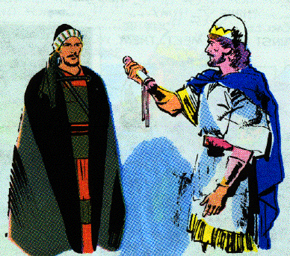
D. David orders Joab to arrange for Uriah to be killed in battle 14-21
14 Now it came about in the morning that David wrote a letter to Joab, and sent it by the hand of Uriah.
15 And he had written in the letter, saying, "Place Uriah in the front line of the fiercest battle and withdraw from him, so that he may be struck down and die."

Slide 27
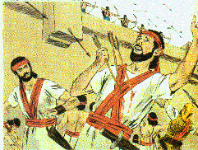
D. David orders Joab to arrange for Uriah to be killed in battle 14-21
16 So it was as Joab kept watch on the city, that he put Uriah at the place where he knew there were valiant men.
17 And the men of the city went out and fought against Joab, and some of the people among David's servants fell; and Uriah the Hittite also died.

Slide 28
D. David orders Joab to arrange for Uriah to be killed in battle 14-21
18 Then Joab sent and reported to David all the events of the war.
19 And he charged the messenger, saying, "When you have finished telling all the events of the war to the king,
20 and if it happens that the king's wrath rises and he says to you, 'Why did you go so near to the city to fight? Did you not know that they would shoot from the wall?
21 'Who struck down Abimelech the son of Jerubbesheth? Did not a woman throw an upper millstone on him from the wall so that he died at Thebez? Why did you go so near the wall?'-- then you shall say, 'Your servant Uriah the Hittite is dead also.' "

Slide 29
E. Joab’s messengers bring David news of the battle & Uriah’s death 22-25
22 So the messenger departed and came and reported to David all that Joab had sent him to tell.
23 And the messenger said to David, "The men prevailed against us and came out against us in the field, but we pressed them as far as the entrance of the gate.
24 "Moreover, the archers shot at your servants from the wall; so some of the king's servants are dead, and your servant Uriah the Hittite is also dead."
25 Then David said to the messenger, "Thus you shall say to Joab, 'Do not let this thing displease you, for the sword devours one as well as another; make your battle against the city stronger and overthrow it'; and so encourage him."

Slide 30
F. David marries Bathsheba 26, 27
26 Now when the wife of Uriah heard that Uriah her husband was dead, she mourned for her husband.
27 When the time of mourning was over, David sent and brought her to his house and she became his wife; then she bore him a son. But the thing that David had done was evil in the sight of the Lord.

