Slide 1
C. Saul’s last battle 31

Slide 2
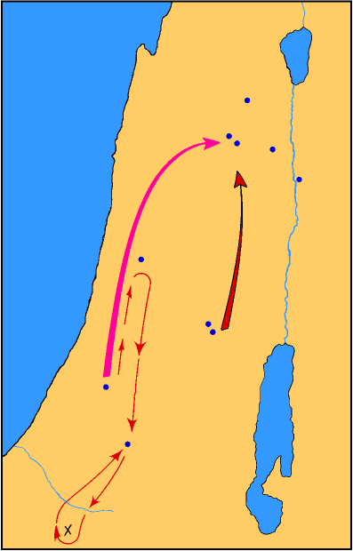
Endor
Shunem
Jezreel
MT GILBOA
Beth-shan
Jabesh-gilead
Aphek
SAUL’S MARCH
PHILISTINE MARCH
Ramah
Gibeah
Gath
PHILISTINES
Ziklag
NEGEV

Slide 3
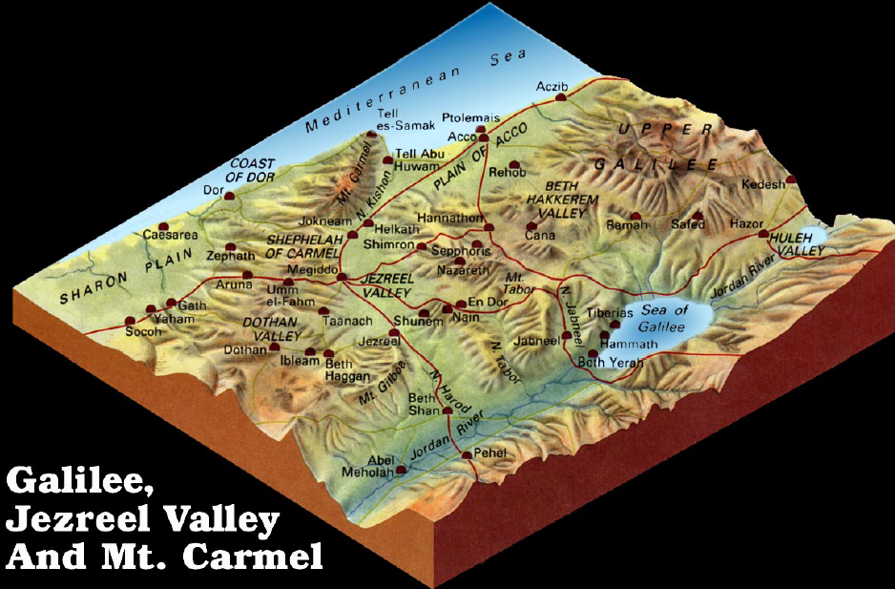

Slide 4
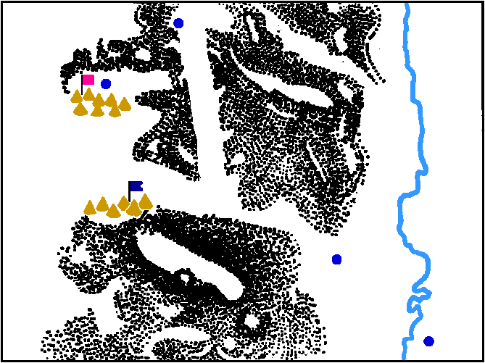
Endor
Philistine
camp
Jordan River
Israelite
camp
Mt. Gilboa
Beth Shean
Jabesh-
Gilead

Slide 5
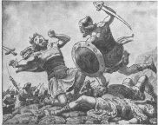
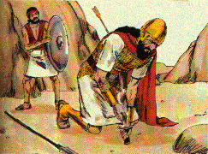
1. Saul, his three sons & his armor bearer die at Gilboa 31:1-6;
1 Chron. 10:1-6
Israel fled before Philistines at Gilboa
Philistines kill the sons of Saul
Saul is wounded & asks his armor bearer to kill him
The armor bearer would not
Saul falls on his sword & dies
His armor bearer falls on his sword

Slide 6
I Chronicles 10:13-14
13 So Saul died for his trespass which he committed against the LORD, because of the word of the LORD which he did not keep; and also because he asked counsel of a medium, making inquiry of it,
14 and did not inquire of the LORD. Therefore He killed him, and turned the kingdom to David the son of Jesse.

Slide 7
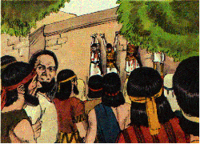
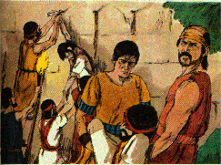
2. Saul’s burial 31:7-13 (1 Chron. 10:7-12)
Men of North Israel abandoned cities to the Philistines
The bodies of Saul & his sons are found, stripped, & mutilated
Word & armor passed throughout Philistia & houses of Idols
Saul & son’s bodies hung on the wall of Beth-shan
Men of Jabesh-gilead came & removed the bodies, burned them & burned their bones

Slide 8
Lessons
The word of God is sure
Providential righteous judgment through the outwork of events
Being self-willed against God is sinning against yourself Prov. 8:36 But he who sins against me injures himself; All those who hate me love death.
It is a fearful thing to fall into the hands of the living God
Retribution will surely overtake the impenitent transgressor, Prov. 29:1; Rom. 6:23
Sins of parent often cut off opportunities for their children

Slide 9
Lessons
Sins of parent often cut off opportunities for their children
The innocent often suffer along with the guilty.
God - supreme owner of every human life - a right to dispose of it as He wills
United men to each other in close relationships - effect each other for good & bad
Godly often suffer because of these connections
The sufferings & death of the righteous often has beneficial purposes
Jonathan’s death increased the impression of the severity of God’s judgment on the house of Saul
David's ascension was clearer & more indisputable
Called a little earlier than others to paradise

Slide 10
Lessons
Sin of suicide
Against the law of self-preservation
Unfaithful to the trust of God’s gift of life
Cowardice before real or imagined evils
Prohibited by God’s law - You shall not murder; Acts 16:28
Forbidden by N.T. exhortation to endure with patience
Condemned by the example of good men - bore the heaviest afflictions with holy courage
empowered against - faith in God’s providence, wisdom, goodness, promises
The evil example of those in high position is too faithfully followed

Slide 11
Lessons
Consequences for choosing an earthly king
Lost soldiers & their king
Loss of cities
Enemies triumphant
Humiliation: opportunity to see God as their true strength
Faithful friends are priceless (Jabesh-gilead rescued Saul’s body)

Slide 12
2 Samuel - Background & Survey

Slide 13
2 Samuel Introduction
The Second Book of Samuel Picks Up The Story Concerning the Death of Saul
I. Background

Slide 14
A. Purpose of 2 Samuel
1. To record some highlights of David’s reign
Event recorded are chosen by the Holy Spirit for God’s purpose
Cf. I Chron. 11-29 & many Psalms; 58 N.T. references to David
a. Forty year reign
b. Prominent themes
1) David - a king 2:4
2) Jerusalem - a city 5:6-12 - Zion 5:7; 6:1-17
3) Davidic - a covenant 7:8-17
4) Everlasting - a kingdom 7:16; 23:1-17

Slide 15
A. Purpose of 2 Samuel
2. To teach important spiritual truths
a. Dependence on God 2:1; 5:3; 6:16, 21; 7:18; 8:6, 14; 12:16; 22:1
b. Sins & its working & punishment & pardon

Slide 16
B. A title & key verse
The second king of Israel, David
2 Sam. 5:4, 5 David was thirty years old when he became king, and he reigned forty years. At Hebron he reigned over Judah seven years and six months, and in Jerusalem he reigned thirty-three years over all Israel and Judah.

Slide 17
C. The man David
A man after God’s heart
70 years - served his own generation by the will of God Acts 13:36
Shining light for God
Man of action, poet, lover, generous in victory, stern in justice, loyal friend
Not a perfect man - sins recorded
Honest & contrite enough to acknowledge sins & seek forgiveness

Slide 18
The Life of David
Proposed Chronology
EVENT
DATE BC
AGE
Birth
Anointed by Samuel
In Saul’s Court
Fought Goliath
In Saul’s Army
Flight from Saul
In Achish’s Army
Anointed by Judah
Anointed by Israel
Sin with Bathsheba
Rebellion by Absalom
Death
1040
1029
1028
1021
1020
1016
1012
1010
1003
993
979
970
11
12
19
20
24
28
30
37
47
61
70

Slide 19
PARALLELS IN THE MONARCHY BOOKS
1 Samuel
2 Samuel
1 Kings
2 Kings
Preface:
Judgeship
of
Samuel
Reign
of
Saul
Reign
of
David
Reign
of
Solomon
Reigns of
kings of
Israel & Judah
Appendix
Chs. 1-7
Chs. 8-30
Chs. 1-24
Chs.
12-22
Chs. 1-11
Chs. 1-25
25:27-30
1 Chronicles
2 Chronicles
Preface:
Genealogies
Reign
of
David
Reign
of
Solomon
Reigns of
kings of
Judah
Appendix
Chs. 1-9
Chs. 10-29
Chs. 1-9
Chs. 10-36
36:20-23

Slide 20
David Made King of Israel 2 Sam.1:1—5:25
I. David Receives News of Saul’s Death 1:1-27

Slide 21
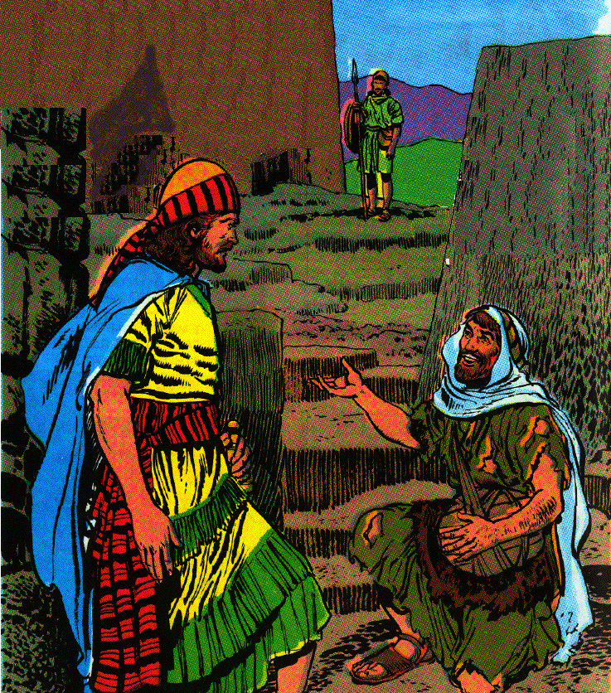
A. The Amalekite’s account of Saul’s death 1-12
1. Two days back in Ziklag, on the 3rd day an Amalekite tell David of Saul’s death
2. The messenger did not clean up after the battle & wears the signs of mourning
4 And David said to him, "How did things go? Please tell me." And he said, "The people have fled from the battle, and also many of the people have fallen and are dead; and Saul and Jonathan his son are dead also."
5 So David said to the young man who told him, "How do you know that Saul and his son Jonathan are dead?"

Slide 22
A. The Amalekite’s account of Saul’s death 1-12
3. Amalekite claims to have killed Saul
6 And the young man who told him said, "By chance I happened to be on Mount Gilboa, and behold, Saul was leaning on his spear. And behold, the chariots and the horsemen pursued him closely.
7 "And when he looked behind him, he saw me and called to me. And I said, ‘Here I am.’
8 "And he said to me, ‘Who are you?’ And I answered him, ‘I am an Amalekite.’
9 "Then he said to me, ‘Please stand beside me and kill me; for agony has seized me because my life still lingers in me.’

Slide 23
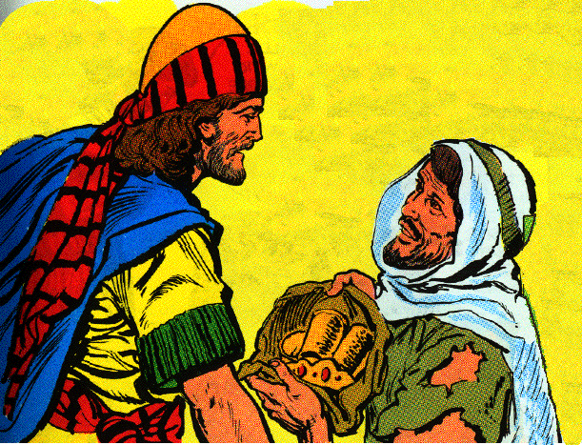
A. The Amalekite’s account of Saul’s death 1-12
10 "So I stood beside him and killed him, because I knew that he could not live after he had fallen. And I took the crown which was on his head and the bracelet which was on his arm, and I have brought them here to my lord."
4. David & his men mourn for Saul, Jonathan, & Israel until evening.

Slide 24
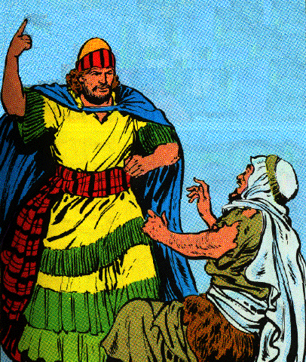
B. David’s punishment of the Amalekite 1:13-16
1. David interrogates the man again
2. David orders him killed
14 Then David said to him, "How is it you were not afraid to stretch out your hand to destroy the LORD’S anointed?"
15 And David called one of the young men and said, "Go, cut him down." So he struck him and he died.
16 And David said to him, "Your blood is on your head, for your mouth has testified against you, saying, ‘I have killed the LORD’S anointed.’"

Slide 25
C. The Song of the Bow 1:17-27
19 "Your beauty, O Israel, is slain on your high places! How have the mighty fallen!
20 "Tell it not in Gath, Proclaim it not in the streets of Ashkelon; Lest the daughters of the Philistines rejoice, Lest the daughters of the uncircumcised exult.
21 "O mountains of Gilboa, Let not dew or rain be on you, nor fields of offerings; For there the shield of the mighty was defiled, The shield of Saul, not anointed with oil.

Slide 26
C. The Song of the Bow 1:17-27
22 "From the blood of the slain, from the fat of the mighty, The bow of Jonathan did not turn back, And the sword of Saul did not return empty.
23 "Saul and Jonathan, beloved and pleasant in their life, And in their death they were not parted; They were swifter than eagles, They were stronger than lions.

Slide 27
C. The Song of the Bow 1:17-27
24 "O daughters of Israel, weep over Saul, Who clothed you luxuriously in scarlet, Who put ornaments of gold on your apparel.
25 "How have the mighty fallen in the midst of the battle! Jonathan is slain on your high places.
26 "I am distressed for you, my brother Jonathan; You have been very pleasant to me. Your love to me was more wonderful Than the love of women.
27 "How have the mighty fallen, And the weapons of war perished!"

Slide 28
Lessons
1. Abstain from all appearance of evil I Thess. 5:22
2. Mercy kill is murder
2. There is some good in most men.

Slide 29
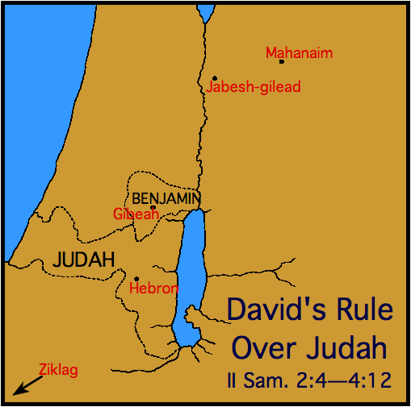
II. David’s Reign begun in Hebron 2:1-32

Slide 30
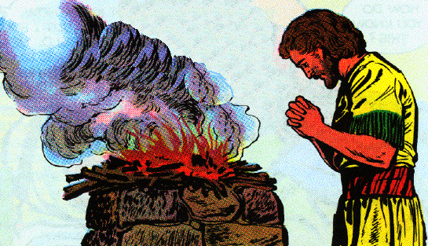
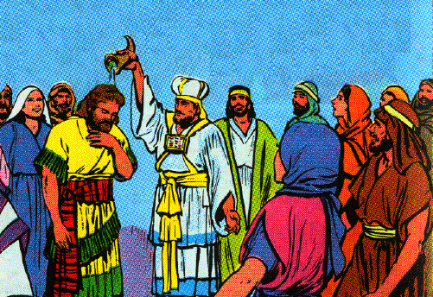
A. David, king in Hebron 2:1-7
1. David inquires of God & is sent to Hebron
2. Wives: Ahinoam, Abigail Carmelite
3. Anointed king by the house of Judah
4. Letter of blessing & encouragement to Jabesh-gilead Honest praise & diplomatic

Slide 31
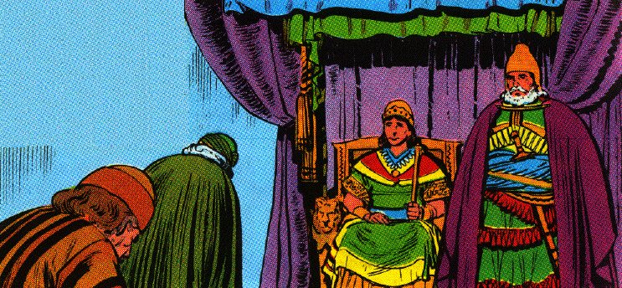
B. Abner makes Ish-bosheth king over Israel 8-11
1. Ish-boseth the son of Saul is brought to Mahanaim and made king over Gilead and Israel
40 years old, two year reign
Ish-boseth = son of shame
Called Esh-baal in I Chron. 8:33
2. David king of Judah in Hebron 7 years

Slide 32
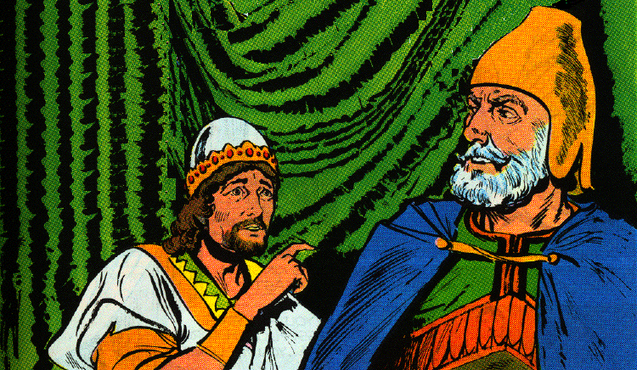
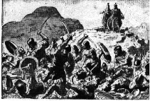
C. Contest between Abner and Joab 12-17
1. Abner leads the servants of Ish-boseth to Gibeon
2. Joab and Abner meet at Gibeon
3. Contest between 12 sons of Benjamin & 12 servants of David; all are fell wounded
4. Severe battle; Abner and Israel beaten

Slide 33
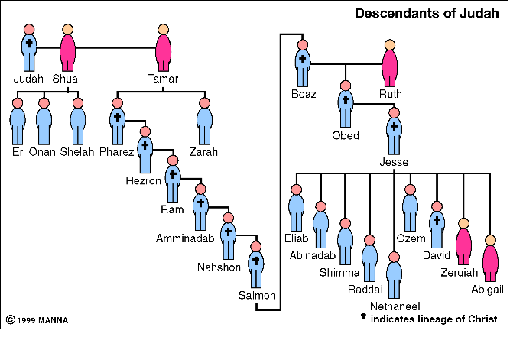
D. Abner kills Asahel 18-23
1. Sons of Zeruiah (David’s sister): Joab, Abishai, Asahel
18 Now the three sons of Zeruiah were there, Joab and Abishai and Asahel; and Asahel was as swift-footed as one of the gazelles which is in the field.

Slide 34
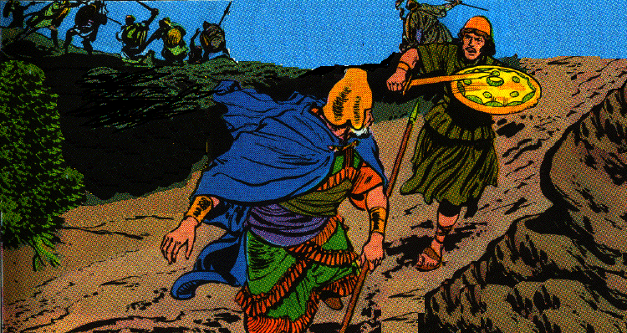
D. Abner kills Asahel 18-23
2. Abner pursued by Asahel
19 And Asahel pursued Abner and did not turn to the right or to the left from following Abner.
20 Then Abner looked behind him and said, "Is that you, Asahel?" And he answered, "It is I."
21 So Abner said to him, "Turn to your right or to your left, and take hold of one of the young men for yourself, and take for yourself his spoil." But Asahel was not willing to turn aside from following him.
22 And Abner repeated again to Asahel, "Turn aside from following me. Why should I strike you to the ground? How then could I lift up my face to your brother Joab?"

Slide 35
D. Abner kills Asahel 18-23
3. Asahel killed
23 However, he refused to turn aside; therefore Abner struck him in the belly with the butt end of the spear, so that the spear came out at his back. And he fell there and died on the spot. And it came about that all who came to the place where Asahel had fallen and died, stood still

Slide 36
E. Abner call on Joab to end the bloodshed 24-29
1. Abner calls for the killing of brothers to stop
2. Joab blew the trumpet
3. Abner crosses the Arabah and the Jordan to Mahanaim

Slide 37
F. Result of the battle between Judah & Benjamin 30-32
30 Then Joab returned from following Abner; when he had gathered all the people together, nineteen of David’s servants besides Asahel were missing.
31 But the servants of David had struck down many of Benjamin and Abner’s men, so that three hundred and sixty men died.
32 And they took up Asahel and buried him in his father’s tomb which was in Bethlehem. Then Joab and his men went all night until the day dawned at Hebron.

Slide 38
III. A Period of Two Kings in Israel 3:1-39

Slide 39
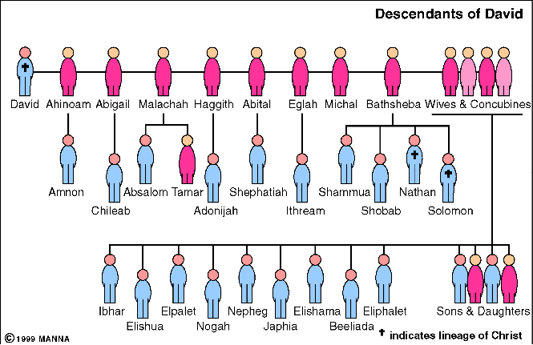
A. Continued war between Israel and Judah 1
David continued to get stronger
The house of Saul grew weaker
B. David’s family 2-5

Slide 40
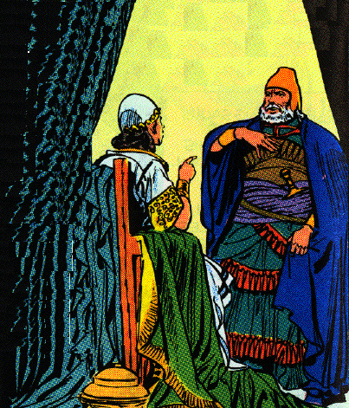
C. Abner rebels against Ish-bosheth 6-11
1. Abner was strong in the house of Saul
2. Abner took one of Saul’s concubines & was questioned by Ish-boseth
3. Abner is offend and swear to fulfill God’s oath to give the kingdom to David.

Slide 41
C. Abner rebels against Ish-bosheth 6-11
3. Abner is offend and swear to fulfill God’s oath to give the kingdom to David
8 Then Abner was very angry over the words of Ish-bosheth and said, "Am I a dog’s head that belongs to Judah? Today I show kindness to the house of Saul your father, to his brothers and to his friends, and have not delivered you into the hands of David; and yet today you charge me with a guilt concerning the woman.
9 "May God do so to Abner, and more also, if as the LORD has sworn to David, I do not accomplish this for him,
10 to transfer the kingdom from the house of Saul, and to establish the throne of David over Israel and over Judah, from Dan even to Beersheba."
11 And he could no longer answer Abner a word, because he was afraid of him.

Slide 42
D. Abner contacts David to make a covenant 12-16
1. Abner will bring Israel to David under a covenant
2. David first demands that Abner return Michal to him
3. David asked Ish-boseth to send Michal to him
4. Paltiel follows Michal to Bahurim, but is then sent home by Abner

Slide 43
E. Abner promotes David’s kingship to Israel 17-19
17 Now Abner had consultation with the elders of Israel, saying, "In times past you were seeking for David to be king over you.
18 "Now then, do it! For the LORD has spoken of David, saying, ‘By the hand of My servant David I will save My people Israel from the hand of the Philistines and from the hand of all their enemies.’"
19 And Abner also spoke in the hearing of Benjamin; and in addition Abner went to speak in the hearing of David in Hebron all that seemed good to Israel and to the whole house of Benjamin.

Slide 44
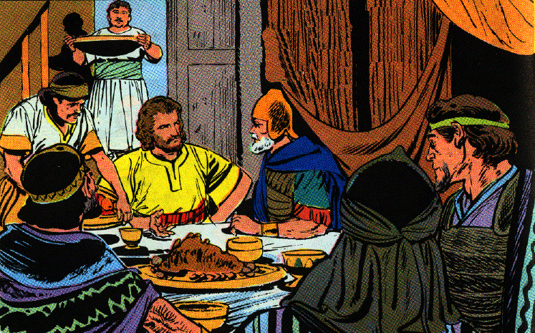
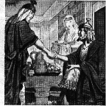
F. Abner & David meet & make agreements 20, 21
20 Then Abner and twenty men with him came to David at Hebron. And David made a feast for Abner and the men who were with him.
21 And Abner said to David, "Let me arise and go, and gather all Israel to my lord the king that they may make a covenant with you, and that you may be king over all that your soul desires." So David sent Abner away, and he went in peace.

Slide 45
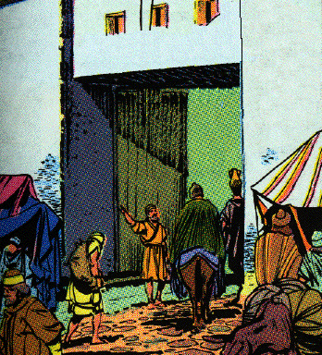
G. Joab returns from a raid and speaks against Abner 22-25
22 And behold, the servants of David and Joab came from a raid and brought much spoil with them; but Abner was not with David in Hebron, for he had sent him away, and he had gone in peace.
23 When Joab and all the army that was with him arrived, they told Joab, saying, "Abner the son of Ner came to the king, and he has sent him away, and he has gone in peace."

Slide 46
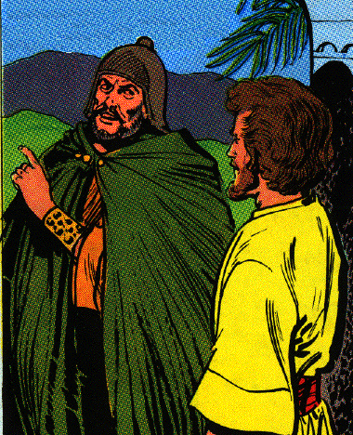
G. Joab returns from a raid and speaks against Abner 22-25
24 Then Joab came to the king and said, "What have you done? Behold, Abner came to you; why then have you sent him away and he is already gone?
25 "You know Abner the son of Ner, that he came to deceive you and to learn of your going out and coming in, and to find out all that you are doing."

Slide 47
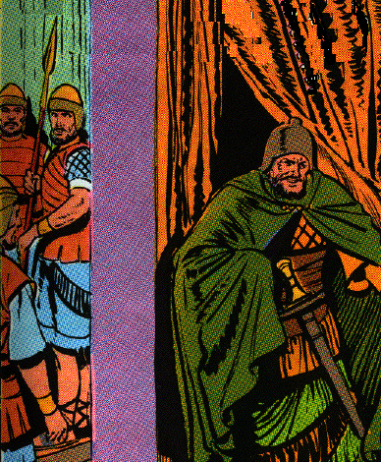
H. Joab murders Abner 26-30
26 When Joab came out from David, he sent messengers after Abner, and they brought him back from the well of Sirah; but David did not know it.
27 So when Abner returned to Hebron, Joab took him aside into the middle of the gate to speak with him privately, and there he struck him in the belly so that he died on account of the blood of Asahel his brother.

Slide 48
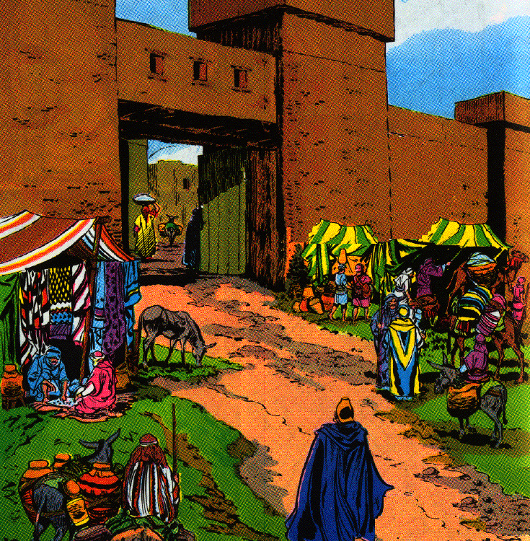
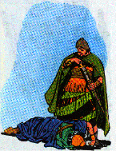
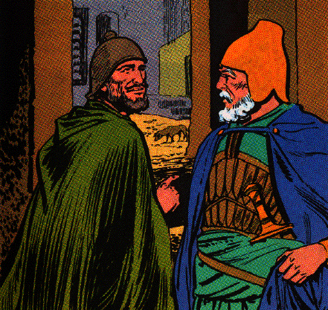
H. Joab murders Abner 26-30
27 So when Abner returned to Hebron, Joab took him aside into the middle of the gate to speak with him privately, and there he struck him in the belly so that he died on account of the blood of Asahel his brother.

Slide 49
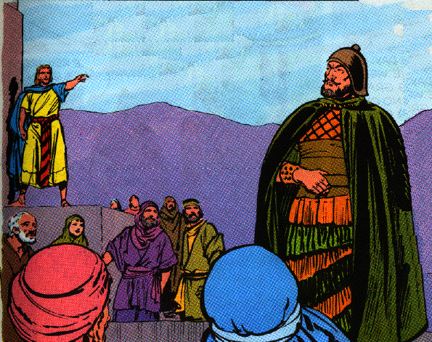
H. Joab murders Abner 26-30
28 And afterward when David heard it, he said, "I and my kingdom are innocent before the LORD forever of the blood of Abner the son of Ner.
29 "May it fall on the head of Joab and on all his father’s house; and may there not fail from the house of Joab one who has a discharge, or who is a leper, or who takes hold of a distaff, or who falls by the sword, or who lacks bread."
30 So Joab and Abishai his brother killed Abner because he had put their brother Asahel to death in the battle at Gibeon.

Slide 50
I. David mourns Abner 31-39
1. Joab and the people are ordered to mourn in sackcloth
2. Walked behind the bier & wept at Abner’s funeral
3. Chanted & lamented & refused to eat until sun down
4. Pleasing to the people
5. Expressed his admiration for Abner to his servants privately
6. Felt too weak to deal with the sons of Zeruiah & left them to God

Slide 51
IV. The King in Gilead Slain 2 Sam. 4:1-12

Slide 52
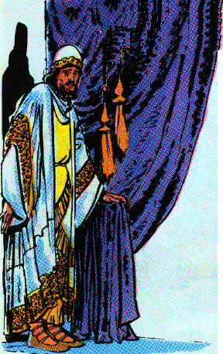
A. Ish-bosheth loses courage & his murders are introduced 1-3
1. The death of Abner discouraged Ish-bosheth
1 Now when Ish-bosheth, Saul’s son, heard that Abner had died in Hebron, he lost courage, and all Israel was disturbed.

Slide 53
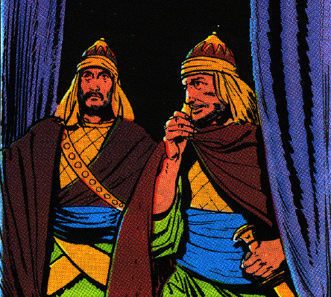
A. Ish-bosheth loses courage & his murders are introduced 1-3
2. Baanah and Rechab - commanders of bands
2 And Saul’s son had two men who were commanders of bands: the name of the one was Baanah and the name of the other Rechab, sons of Rimmon the Beerothite, of the sons of Benjamin (for Beeroth is also considered part of Benjamin,
3 and the Beerothites fled to Gittaim, and have been aliens there until this day).

Slide 54
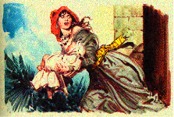
B. Mephibosheth introduced 4
4 Now Jonathan, Saul’s son, had a son crippled in his feet. He was five years old when the report of Saul and Jonathan came from Jezreel, and his nurse took him up and fled. And it happened that in her hurry to flee, he fell and became lame. And his name was Mephibosheth.

Slide 55
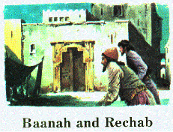
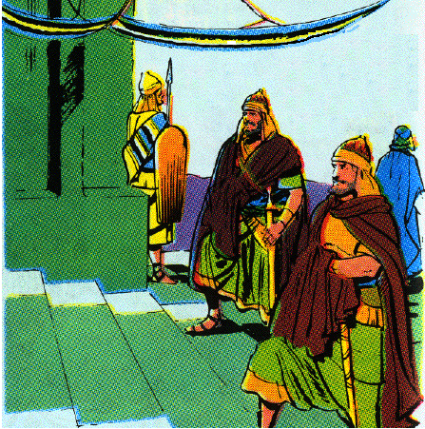
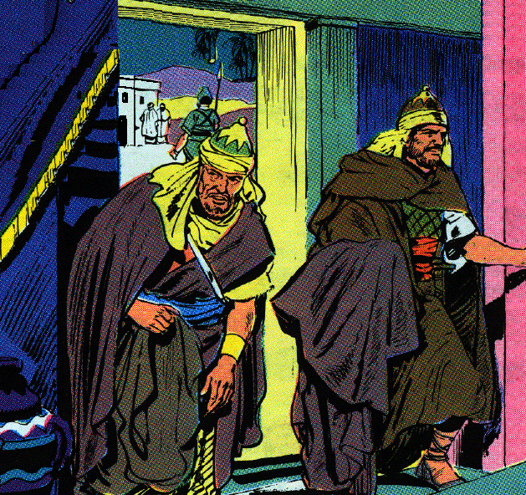
C. Ish-bosheth slain 5-8
1. Killed while he rested in his house at midday
5 So the sons of Rimmon the Beerothite, Rechab and Baanah, departed and came to the house of Ish-bosheth in the heat of the day while he was taking his midday rest.
6 And they came to the middle of the house as if to get wheat, and they struck him in the belly; and Rechab and Baanah his brother escaped.

Slide 56
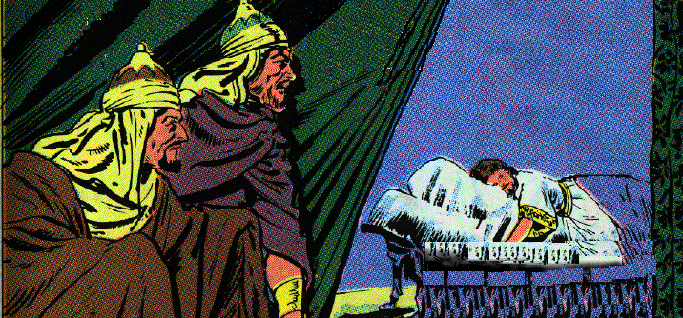
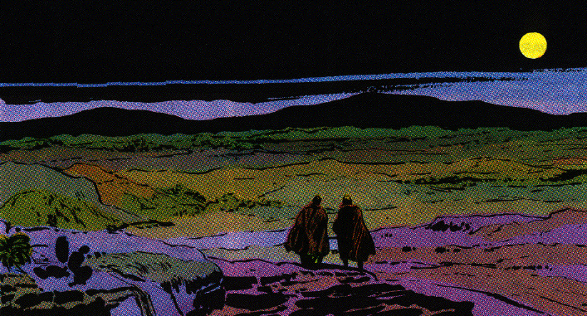
C. Ish-bosheth slain 5-8
2. Rechab and Baanah take his head to David
7 Now when they came into the house, as he was lying on his bed in his bedroom, they struck him and killed him and beheaded him. And they took his head and traveled by way of the Arabah all night.

Slide 57
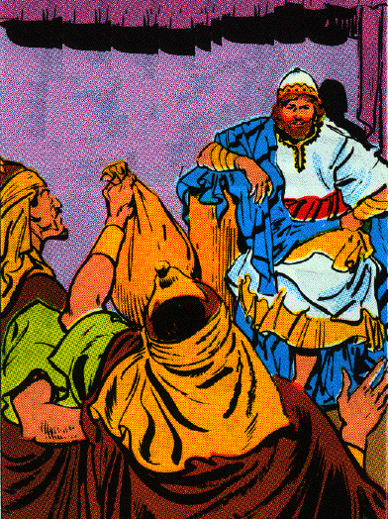
C. Ish-bosheth slain 5-8
3. They claim the murder was in God’s providence
8 Then they brought the head of Ish-bosheth to David at Hebron, and said to the king, "Behold, the head of Ish-bosheth, the son of Saul, your enemy, who sought your life; thus the LORD has given my lord the king vengeance this day on Saul and his descendants."

Slide 58
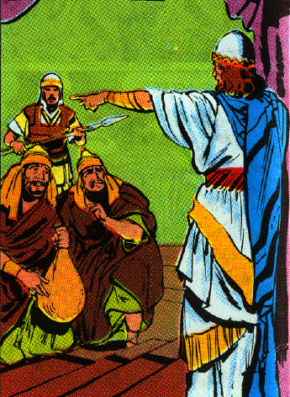
D. David executes the murders 9-12
1. They are like the Amalekite he order killed earlier
2. Killed a righteous man deserve to be destroyed from the earth
11 "How much more, when wicked men have killed a righteous man in his own house on his bed, shall I not now require his blood from your hand, and destroy you from the earth?"
3. Young men execute them & cut off their hands & feet and hang them up
4. Head buried in Abner’s tomb

Slide 59
V. David Made King over all Israel 5:1-25

Slide 60
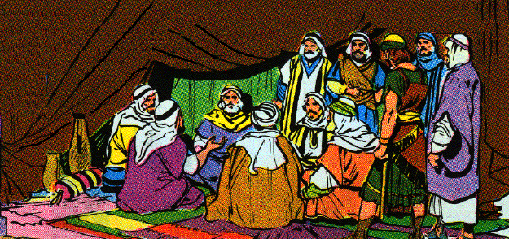
A. David king over all Israel 1-5
1. David is their relative, past general, & will be their shepherd & ruler
1 Then all the tribes of Israel came to David at Hebron and said, "Behold, we are your bone and your flesh.
2 "Previously, when Saul was king over us, you were the one who led Israel out and in. And the LORD said to you, ‘You will shepherd My people Israel, and you will be a ruler over Israel.’"
Elders of Israel decide David should be their king

Slide 61
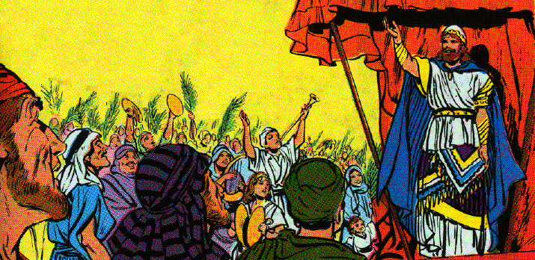
A. David king over all Israel 1-5
2. Covenant and anointing at Hebron
3 So all the elders of Israel came to the king at Hebron, and King David made a covenant with them before the LORD at Hebron; then they anointed David king over Israel.
4 David was thirty years old when he became king, and he reigned forty years.
5 At Hebron he reigned over Judah seven years and six months, and in Jerusalem he reigned thirty-three years over all Israel and Judah.

Slide 62
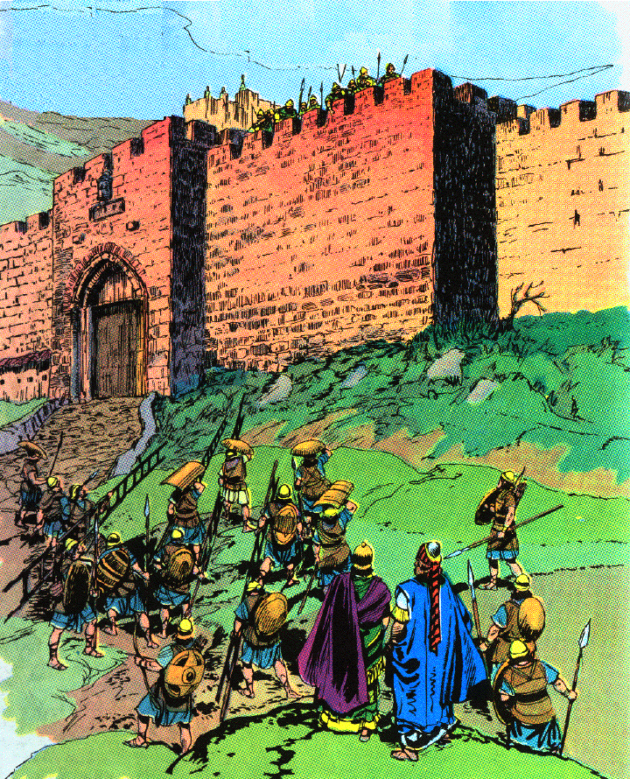
B. David captures Jerusalem 6-10
1. Jebusites express their confidence in their defenses
6 Now the king and his men went to Jerusalem against the Jebusites, the inhabitants of the land, and they said to David, "You shall not come in here, but the blind and lame shall turn you away"; thinking, "David cannot enter here."
7 Nevertheless, David captured the stronghold of Zion, that is the city of David.

Slide 63
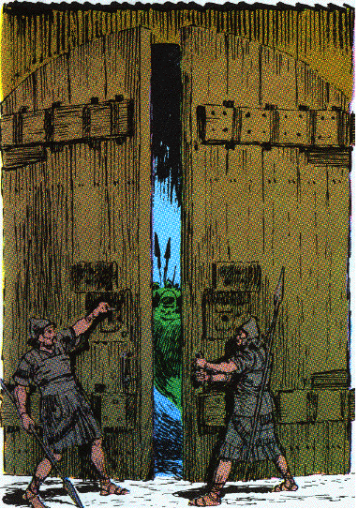
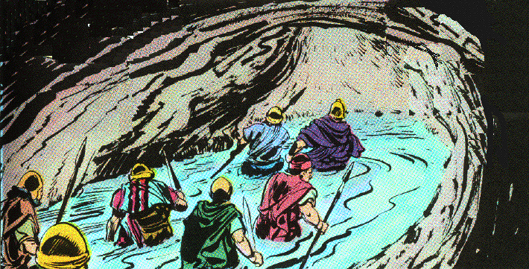
B. David captures Jerusalem 6-10
2. Joab becomes chief by capturing the city through the water tunnel (I Chron. 11:4-9)
8 And David said on that day, "Whoever would strike the Jebusites, let him reach the lame and the blind, who are hated by David’s soul, through the water tunnel." Therefore they say, "The blind or the lame shall not come into the house."

Slide 64
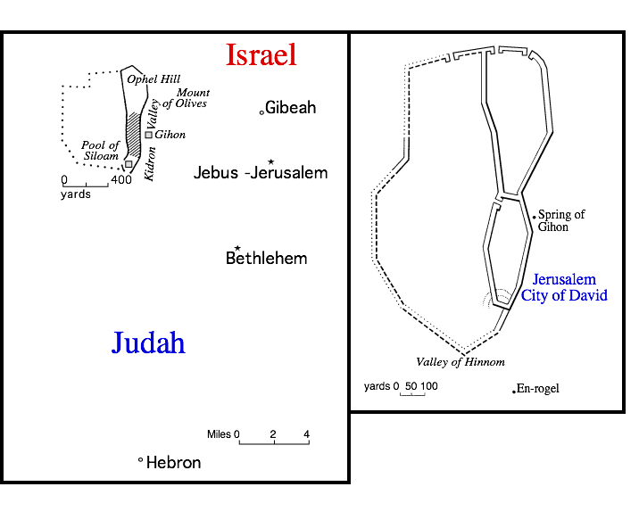
B. David captures Jerusalem 6-10
9 So David lived in the stronghold, and called it the city of David. And David built all around from the Millo and inward.
10 And David became greater and greater, for the LORD God of hosts was with him.

Slide 65
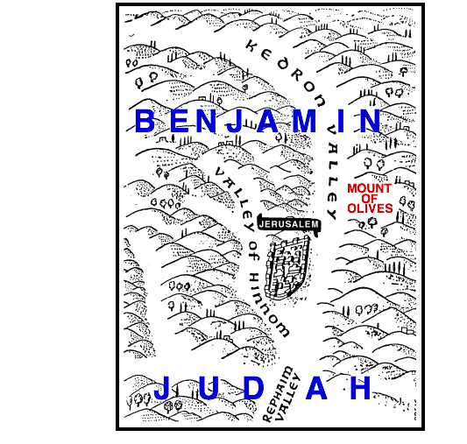
David’s Love For Jerusalem Ps. 48
1 Great is the LORD, and greatly to be praised, In the city of our God, His holy mountain.
2 Beautiful in elevation, the joy of the whole earth, Is Mount Zion in the far north, The city of the great King.
3 God, in her palaces, Has made Himself known as a stronghold.
12 Walk about Zion, and go around her; Count her towers;
13 Consider her ramparts; Go through her palaces; That you may tell it to the next generation.

Slide 66
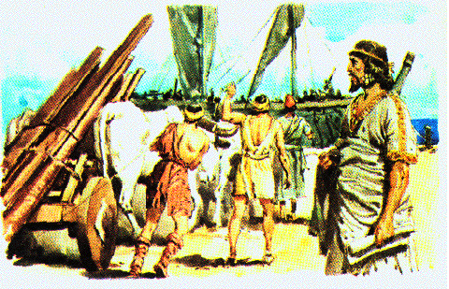
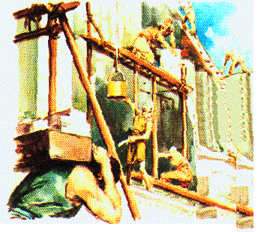
C. David house is built by Hiram king of Tyre 11, 12
11 Then Hiram king of Tyre sent messengers to David with cedar trees and carpenters and stonemasons; and they built a house for David.
12 And David realized that the LORD had established him as king over Israel, and that He had exalted his kingdom for the sake of His people Israel.

Slide 67
D. David takes more concubines and wives 13-16
1. Sons in Jerusalem: Shammua, Shobab, Nathan, Solomon, Ibhar, Elishua, Nephjeg, Japhia, Elishama, Eliada, Eliphelet

Slide 68
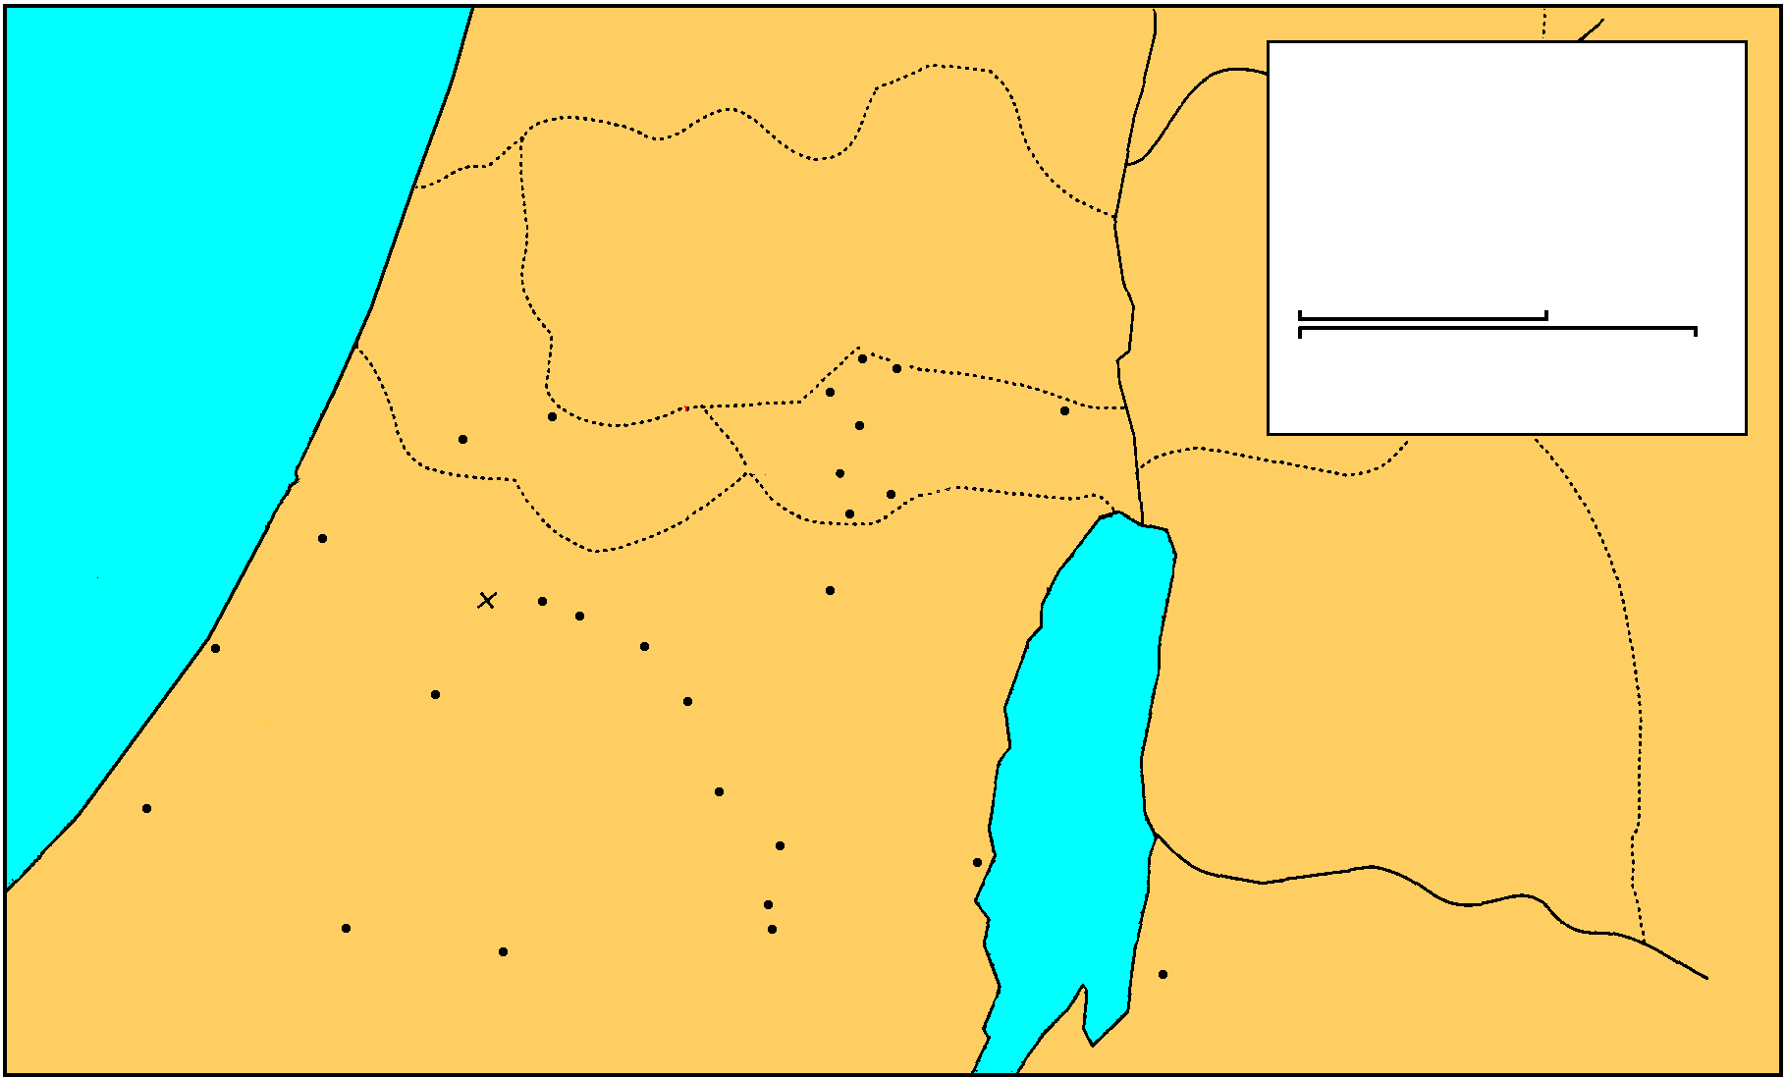
E. David against the Philistines 17-25
1. The Philistine invade when they hear that David has been anointed king of Israel
MANASSEH
David 1st Battle with Philistines
THE GREAT SEA
EPHRAIM
GAD
2 Samuel 5:17-21
DAN
25 km
Bethel
Ai
0
25 Miles
Gezer
Mizpah
Ekron
Ramah
Jericho
Goliath Slain
Gibeah
BENJAMIN
Nob
Ashdod
Valley of Rephaim
Jerusalem
Azekah
Bethlehem
Ashkelon
Socho
PHILISTINES
Adullam
Gath
Keilah
JUDAH
REUBEN
Hebron
Salt
Sea
Gaza
Ziph
En-gedi
Gerar
Carmel
Maon
SIMEON
Ziklag
Mizpeh of Moab
MOAB

Slide 69
E. David against the Philistines 17-25
2. David goes to the stronghold
The Philistines spread out in the valley of Rephaim
MANASSEH
David 1st Battle with Philistines
THE GREAT SEA
EPHRAIM
GAD
2 Samuel 5:17-21
DAN
25 km
Bethel
Ai
0
25 Miles
Gezer
Mizpah
Ekron
Ramah
Jericho
Goliath Slain
Gibeah
BENJAMIN
Nob
Ashdod
Valley of Rephaim
Jerusalem
Azekah
Bethlehem
Ashkelon
Socho
PHILISTINES
Adullam
Gath
Keilah
JUDAH
REUBEN
Hebron
Salt
Sea
Gaza
Ziph
En-gedi
Gerar
Carmel
Maon
SIMEON
Ziklag
Mizpeh of Moab
MOAB

Slide 70
E. David against the Philistines 17-25
3. David attacks them after inquiring of the Lord
Baal-perazim: breaking through of water, idols destroyed I Chron.14:1
MANASSEH
David 1st Battle with Philistines
THE GREAT SEA
EPHRAIM
GAD
2 Samuel 5:17-21
DAN
25 km
Bethel
Ai
0
25 Miles
Gezer
Mizpah
Ekron
Ramah
Jericho
Goliath Slain
Gibeah
BENJAMIN
Nob
Ashdod
Valley of Rephaim
Jerusalem
Azekah
Bethlehem
Ashkelon
Socho
PHILISTINES
Adullam
Gath
Keilah
JUDAH
REUBEN
Hebron
Salt
Sea
Gaza
Ziph
En-gedi
Gerar
Carmel
Maon
SIMEON
Ziklag
Mizpeh of Moab
MOAB

Slide 71
E. David against the Philistines 17-25
4. A second battle in the same valley
Inquired of the Lord - given battle plan
Marching in the trees - signal to attack - Geba to Gezer
MANASSEH
David 2nd Battle with Philistines
THE GREAT SEA
EPHRAIM
GAD
2 Samuel 5:22-25
DAN
25 km
Bethel
Ai
0
25 Miles
Gezer
Mizpah
Ekron
Ramah
Jericho
Goliath Slain
Gibeah
BENJAMIN
Nob
Ashdod
Valley of Rephaim
Jerusalem
Azekah
Bethlehem
Ashkelon
Socho
PHILISTINES
Adullam
Gath
Keilah
JUDAH
REUBEN
Hebron
Salt
Sea
Gaza
Ziph
En-gedi
Gerar
Carmel
Maon
SIMEON
Ziklag
Mizpeh of Moab
MOAB

Slide 72
