Slide 1
4. David addresses Saul 26:17-21
Why is he being pursued?
David will atone for his sin if God has stirred up Saul against David
Let slanderous men be cursed if they are the cause
David is a flea or a partridge

Slide 2
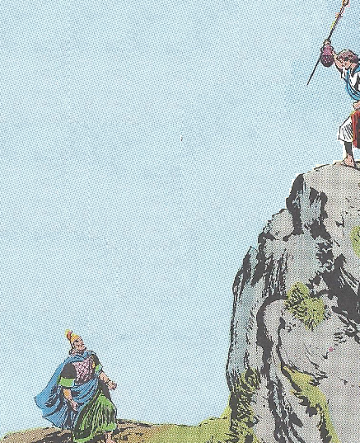
5. Saul again repents 26:21-25
Confesses sin, promises him no harm
Admits he has acted like a fool, blessed David
Predicted David would prevail

Slide 3
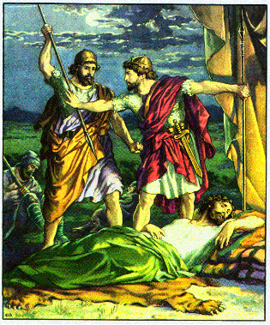
Lessons:
1. Men should respect the things appointed by God
2. Forgive & let God worry about justice

Slide 4
G. Lapse of David - 2nd flight to Gath 27

Slide 5
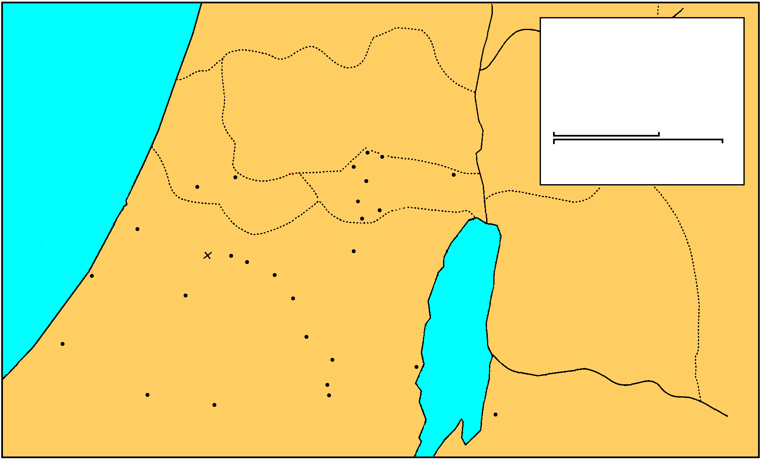
MANASSEH
Saul And David
EPHRAIM
1 Samuel 16-27
THE GREAT SEA
GAD
DAN
25 km
Bethel
Ai
0
25 Miles
Gezer
Mizpah
Ekron
Ramah
Jericho
Goliath Slain
Gibeah
BENJAMIN
Nob
Ashdod
Valley of Elah
Jerusalem
Azekah
Bethlehem
Ashkelon
Socho
PHILISTINES
Adullam
Gath
Keilah
JUDAH
REUBEN
Hebron
Salt
Sea
Gaza
Ziph
En-gedi
Gerar
Carmel
Maon
SIMEON
Ziklag
Mizpeh of Moab
MOAB

Slide 6
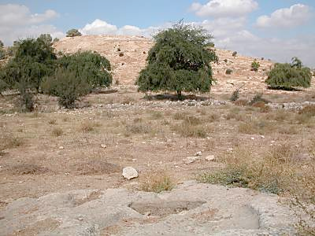
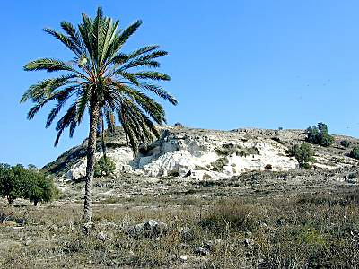
Gat at Gath
The name of the city in Hebrew is "gat," which means "winepress." This picture has an ancient winepress in the foreground, with the city behind. The area around Gath was very fertile and it's likely that the city had a number of winepresses. Archaeological excavations at Gath's neighbor, Ekron, found an abundance of oil presses on the site.
White Cliffs
Most scholars agree today that Gath is to be identified with Tell es-Safi. This Arabic name for the site means "the white mound" and is appropriate because of the white chalky cliffs visible on the sides of the tell. The biblical site of Libnah (which means "white") is probably not to be identified with Tell es-Safi in spite of the meaning of the names.

Slide 7
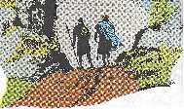
1. David again in Gath 27:1-7
a. David gave in to fear
David becomes very discouraged
Believes if he remains in the land Saul will eventually take his life
Disobeyed the order of Gad the prophet 22:5
He decides to escape to Philistia 1
Loss of faith - grew weary, suffering, needs for food, family
May have lost his constant devotion & prayer
Looks for expediences not approved
David crosses with 600 men to Achish 2
Lived at Gath & 2 wives (Ahinoam & Abigail) 3
Saul stopped searching 4

Slide 8
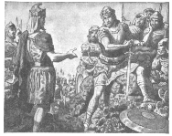
1. David again in Gath 27:1-7
b. Philistine are convinced David is considered an enemy by Saul, 5-7
David proved his worth to the King
Requested his own city
Removed his followers from the corrupting influence of a pagan culture
Achish thinks David will guard the southern border of the Land
Ziklag give to David - remain a possession of the kings of Judah
16 months in Philistine territory
David goes to King Achish, a Philistine

Slide 9
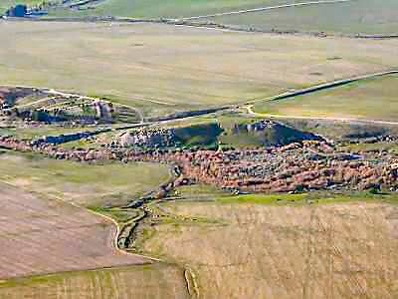
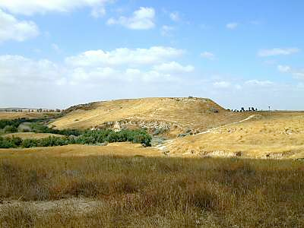
Biblical History
Ziklag was listed as one of the 29 towns in Negev and was assigned to the tribe of Simeon (Josh 15:31; 19:5). It was apparently controlled by the Philistines during King Saul's rule, and was given by King Achish of Gath to David when he was running from Saul. David used it for a home base for raids against various groups who threatened the southern borders of Judah (1 Sam 27). After being away one time, he returned to find it ransacked by the Amalekites

Slide 10
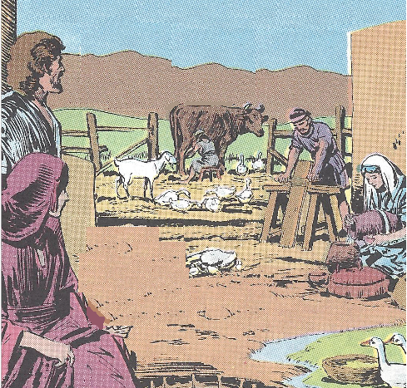
1. David again in Gath 27:1-7
c. David requests and receive a town 27:5-7
Achish gives David Ziglag
Ziglag has belong to Judah’s king ever since
Had the people to settle a town
Could protect Gath & southern Judah
Would not be an embarrassment to the king
d. David in Ziklag one year & four months

Slide 11
2. David’s pretended campaign against Judah 27:8-12
David raids - Geshurites, Girzites, Amalekites
He told Achish he was raiding Judah, Jerahmeelites, Kenites
David left no witnesses alive - Supplies gained - Support built
Achish believes David has become odious to Israel & will serve him

Slide 12
Lessons
1. The weakness of the flesh.
David gave in to the wisdom of the world
Must pray and not lose heart
Trust the Lord and not our own understanding
2. A lie is never justifiable.
One sin leads to another.

Slide 13
IV. Last Days of Saul’s Reign 1 Samuel 28—31:13

Slide 14
A. Preparation for Saul’s last Battle 28:1—29:11

Slide 15
1. David with Achish in battle 28:1-2
David is now is the position of being expected to fight against Israel in payment for his security
Philistine gathers to battle Israel
David to help Achish - be his body guard

Slide 16
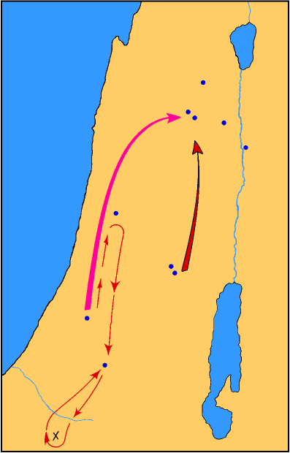
SAUL’S THIRD PHILISTINE WAR
Endor
Shunem
Jezreel
I Sam. 28-31
MT GILBOA
Beth-shan
Jabesh-gilead
Aphek
SAUL’S MARCH
PHILISTINE MARCH
Ramah
Gibeah
Gath
PHILISTINES
Ziklag
NEGEV

Slide 17
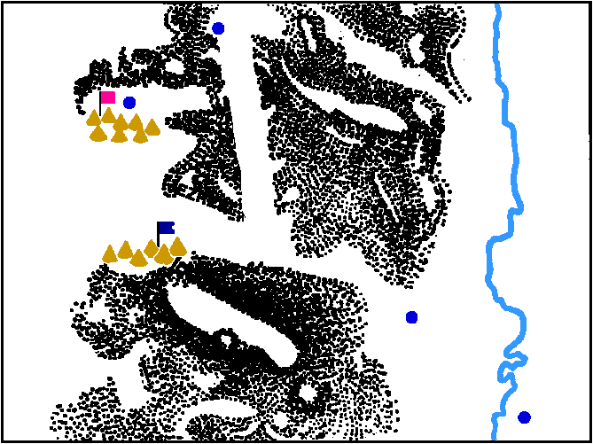
Endor
Philistine
camp
Jordan River
Israelite
camp
Mt. Gilboa
Beth Shean
Jabesh-
Gilead

Slide 18
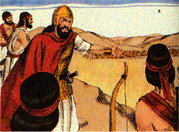
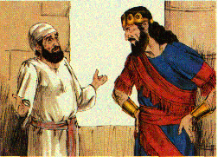
2. Saul forsaken by God 28:3-7
Saul had no prophet to bring him the word of God
Samuel was dead & all the spiritualist had been driven out of the land
Saul feared the Philistine because he felt forsaken
The Lord gives him no answer by Dream, Urim or prophet
Opposing armies gather at Shunem and Gilboa
Saul asks for and is told about a medium at Endor

Slide 19
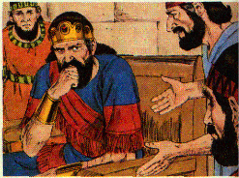
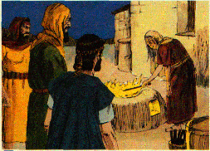
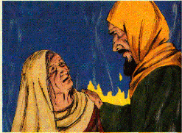
3. Saul seeks a medium at Endor 28:8-14
Unlawful Deut. 18:10, 11
Saul disguised himself and went to the woman by night with two men
She ask why they have come to cause her to be destroyed by Saul
Saul vows no punishment will come to her

Slide 20
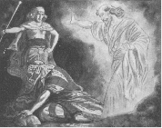
3. Saul seeks a medium at Endor 28:8-14
She is to bring up Samuel
Samuel appears to the woman she screams and recognizes Saul
She describes Samuel & Saul bows in homage

Slide 21
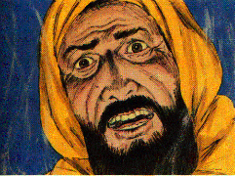
4. Samuel’s appearance & word of doom to Saul 28:15-18
Samuel wants to know why he was disturbed
Saul tells him he could get no answer from God
Samuel tells him God’s word has been fulfilled
God departed from Saul
The kingdom has been torn from him
His neighbor David has been given the Kingdom
Punished for not exterminating the Amalekites
Israel & Saul will be given into the power of the Philistines tomorrow
He & his sons will die

Slide 22
5. Saul terror and depression 28:19-25
Saul has no strength because of Samuel’s word & no eating
fell full length - falls, fainting with fear, fatigue & lack of food
The woman & the men encourage him to eat
Women wants to speed his departure
they compelled him to eat - overcame his will
He ate a fattened calf & unleavened bread
He arose & departed while it was still night

Slide 23
Lessons
A man forsaken by God is really all alone
There is life after death.

Slide 24
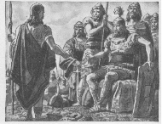
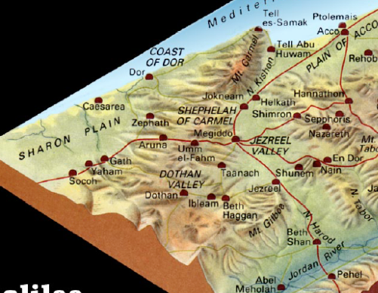
6. The Philistine Lords refused to have David fight with them 29:1-5
Philistines gather at Aphek - Israel at spring of Jezreel
Philistine command ask about David & the Hebrews with Achish
Achish assures them David has proven faithful
The Philistines say he could regain Saul’s favor by becoming their enemies & taking their heads

Slide 25
7. David departs from Achish
29:6-11
Endor
Achish tells David he must return to Ziklag
David is pleasing to Achish but not the commanders of the Philistines.
Could become their adversary - other Israelites had done it before
Kill them to reconcile with Saul
He killed his 10,000s
David protests
David returns to the land of the Philistines
Shunem
Jezreel
MT GILBOA
Beth-shan
Jabesh-gilead
Aphek
SAUL’S MARCH
PHILISTINE MARCH
Ramah
Gibeah
Gath
PHILISTINES
Ziklag
NEGEV

Slide 26
Lessons
All things work together for good to those who love God
Be careful not to fight against God’s people

Slide 27
B. David’s return to Ziklag 30

Slide 28
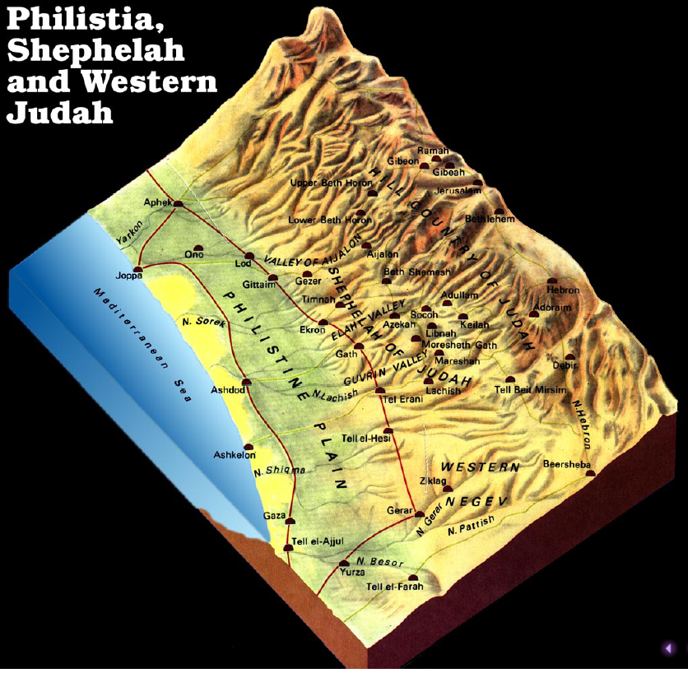

Slide 29
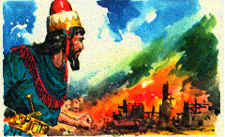
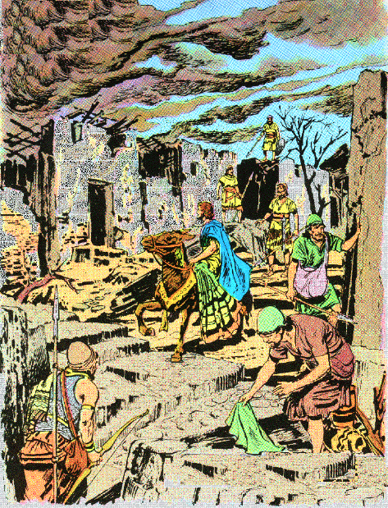
1. David’s camp looted 30:1-6
David finds Ziklag has been destroyed
Amalekites overthrew & burned Ziklag
All the women, sons & daughter taken captive
David’s people weep & speak of stoning him
David strengthens himself in the Lord

Slide 30
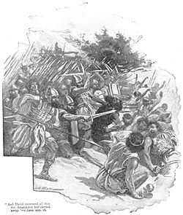
2. David inquires of God and pursues the Amalekites 7-10
David inquires of the Lord by the Ephod of Abiathar
David is assure he should pursue, overtake and rescue all
600 men pursue to brook Besor - 200 remain there

Slide 31
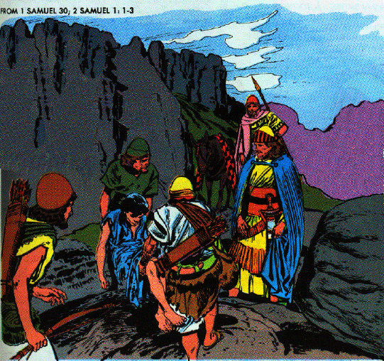
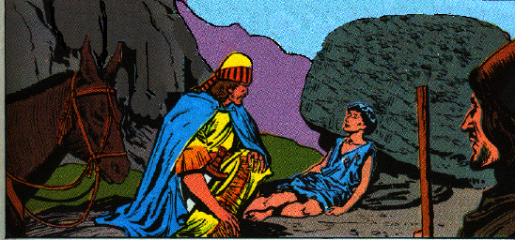
3. A Egyptian slave assists
David 11-15
Egyptian found & fed & restored to life
A servant of an Amalekite
He fell sick 3 days before & was left to die

Slide 32
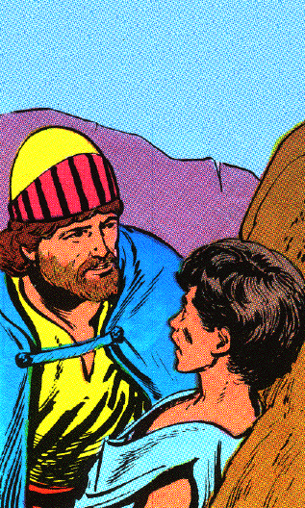
3. A Egyptian slave assists David 11-15
15 Then David said to him, "Will you bring me down to this band?" And he said, "Swear to me by God that you will not kill me or deliver me into the hands of my master, and I will bring you down to this band."

Slide 33
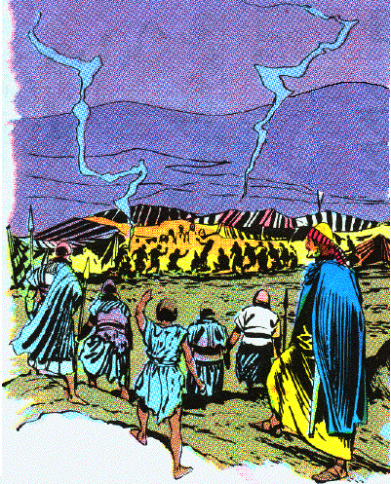
4. David finds the Amalekites and rescues his people 16-20
16 And when he had brought him down, behold, they were spread over all the land, eating and drinking and dancing because of all the great spoil that they had taken from the land of the Philistines and from the land of Judah.

Slide 34
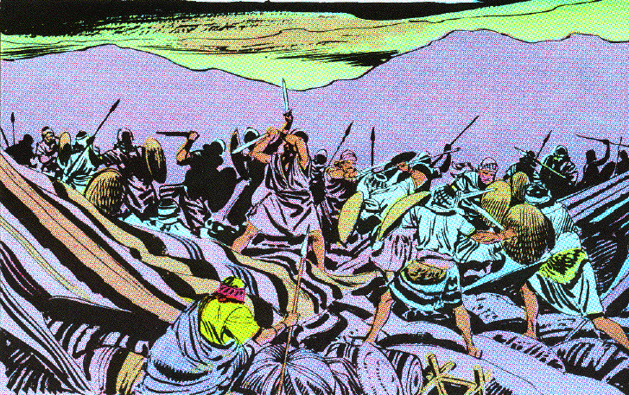
4. David finds the Amalekites and rescues his people 16-20
17 And David slaughtered them from the twilight until the evening of the next day; and not a man of them escaped, except four hundred young men who rode on camels and fled.

Slide 35
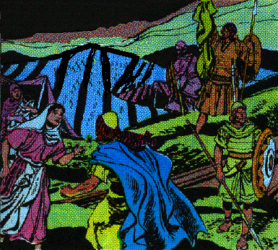
4. David finds the Amalekites & rescues his people 16-20
18 So David recovered all that the Amalekites had taken, and rescued his two wives.
19 But nothing of theirs was missing, whether small or great, sons or daughters, spoil or anything that they had taken for themselves; David brought it all back.
20 So David had captured all the sheep and the cattle which the people drove ahead of the other livestock, and they said, "This is David's spoil."

Slide 36
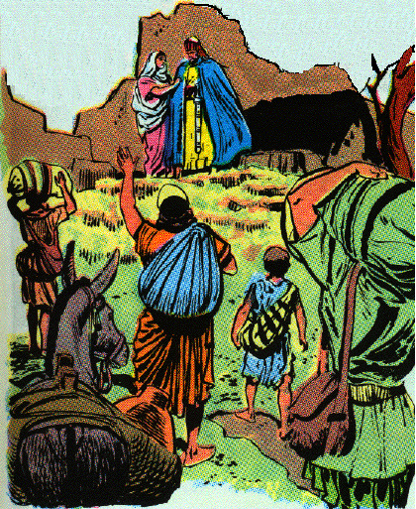
5. David returns to Ziklag with spoils - they are to be
shared with all 21-25
They return to Ziklag
The wicked & worthless do not want to share the spoil
David says all shall share alike
Made a statute

Slide 37
6. Gifts of spoil given to cities of Judah, Jerahmeelites & Kenites 26-31
Some spoil sent to the elders of Judah & to his friends
26b “Behold, a gift for you from the spoil of the enemies of the LORD.”
All the places where David was accustomed to go

Slide 38
Lessons
There is strength in the Lord
Victory belongs to the soldiers of the Lord
Blessings are to be shared

Slide 39
C. Saul’s last battle 31

Slide 40
Endor
Shunem
Jezreel
MT GILBOA
Beth-shan
Jabesh-gilead
Aphek
SAUL’S MARCH
PHILISTINE MARCH
Ramah
Gibeah
Gath
PHILISTINES
Ziklag
NEGEV

Slide 41
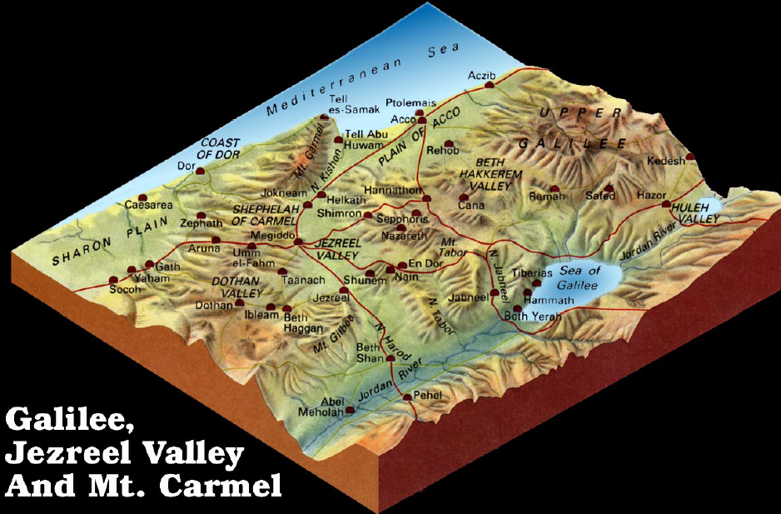

Slide 42
Endor
Philistine
camp
Jordan River
Israelite
camp
Mt. Gilboa
Beth Shean
Jabesh-
Gilead

Slide 43
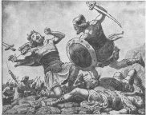
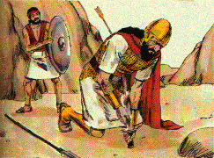
1. Saul, his three sons & his armor bearer die at Gilboa 31:1-6;
1 Chron. 10:1-6
Israel fled before Philistines at Gilboa
Philistines kill the sons of Saul
Saul is wounded & asks his armor bearer to kill him
The armor bearer would not
Saul falls on his sword & dies
His armor bearer falls on his sword

Slide 44
I Chronicles 10:13-14
13 So Saul died for his trespass which he committed against the LORD, because of the word of the LORD which he did not keep; and also because he asked counsel of a medium, making inquiry of it,
14 and did not inquire of the LORD. Therefore He killed him, and turned the kingdom to David the son of Jesse.

Slide 45
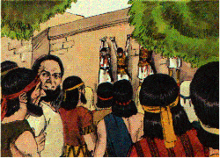
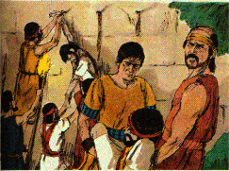
2. Saul’s burial 31:7-13 (1 Chron. 10:7-12)
Men of North Israel abandoned cities to the Philistines
The bodies of Saul & his sons are found, stripped, & mutilated
Word & armor passed throughout Philistia & houses of Idols
Saul & son’s bodies hung on the wall of Beth-shan
Men of Jabesh-gilead came & removed the bodies, burned them & burned their bones

Slide 46
Lessons
The word of God is sure
Faithful friends are priceless (Jabesh-gilead rescued Saul’s body)

