Slide 1
E. Death of Samuel, Nabal & Abigail 25:1-44

Slide 2
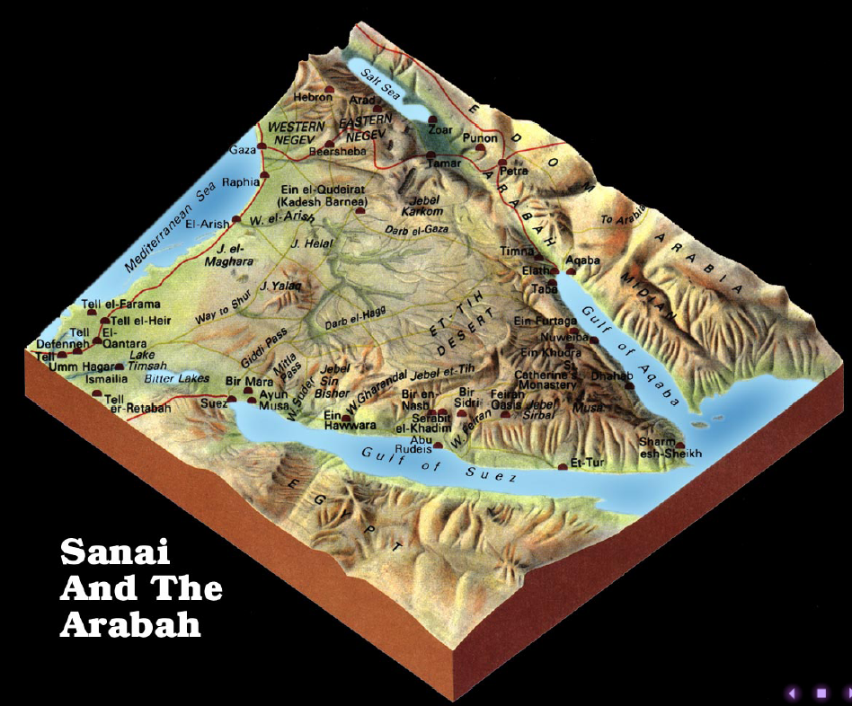
1. The death of Samuel 25:1
a. Samuel buried on his own property, in his own tomb.
b. David to wilderness of Paran
- extreme southern part Judah to the gulf of Aquaba
c. LXX - wilderness of Maon

Slide 3
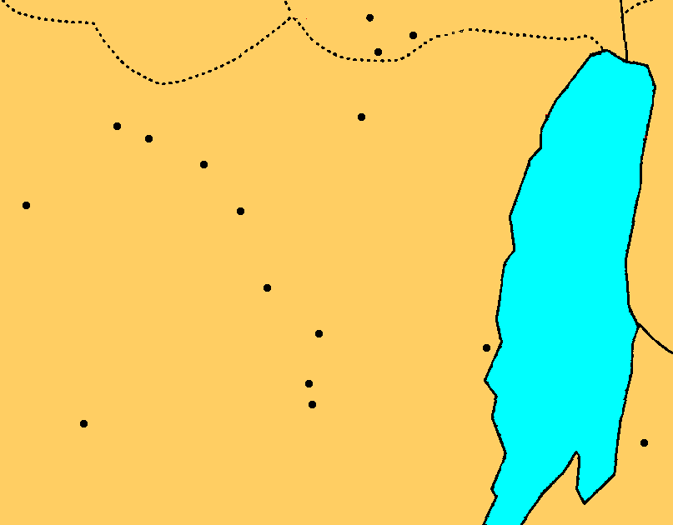
Gibeah
BENJAMIN
Nob
Jerusalem
Azekah
Socho
Bethlehem
Adullam
Gath
Keilah
JUDAH
Hebron
Salt
Sea
Ziph
En-gedi
Carmel
Ziklag
Maon
Mizpeh
MOAB

Slide 4
2. Nabal’s shameful treatment of David 25:2-13
a. Nabal, Abigail and the sheep shearing 25:2-8
David had protected Nabal’s sheep & herdsmen
David’s instruction to 10 young men - give to David

Slide 5
2. Nabal’s shameful treatment of David 25:2-13
b. The young men appeal to Nabal & David is rejected 25:9-13
Nabal was told to ask his young men about the matter
Nabal at a joyful time of prosperity when the request was made
Nabal rejects David
Insults his family, calls David a deserter from Saul’s army.
Does not give bread to men he does not know

Slide 6
2. Nabal’s shameful treatment of David 25:2-13
c. David is ready to kill Nabal 25:13
200 men left with women & children, 400 readied for battle.
David has allowed a quick temper to get the better of him

Slide 7
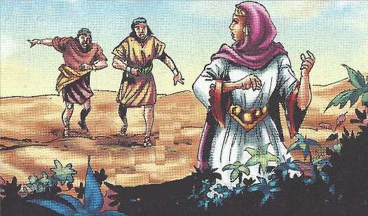
3. Abigail appeals to David 25:14-38
a. A servant tells Abigail about the situation 25:14-17
David saved their sheep, equipment - a wall to the servants
Evil is planned
Calls his master a son of Belial - worthless, bestial in character
He will not listen

Slide 8
3. Abigail appeals to David 25:14-38
b. Abigail’s gift 25:18-20
200 loaves of bread, 2 full wineskins,
5 sheep already dressed, measures of parched wheat,
100 clusters of raisins, 200 fig cakes
The gifts are sent before her
David did not intent to leave one male of Nabal alive 25:21-22

Slide 9
3. Abigail appeals to David 25:14-38
c. David did not intent to leave one male of Nabal alive 25:21-22
Felt Nabal did not appreciate his protection
in vain - sheqer - deception, disappointment, falsehood; in vain (without success or result)
guarded - shamar - to keep, watch, preserve
returned evil for good
Does not justify personal revenge
Does not justify killing the innocent children and servants

Slide 10
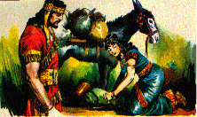
3. Abigail appeals to David 25:14-38
d. Abigail wise approach to David 23-31
Fell, bows & confesses blame (fault) for the problem
Her husband is a Nabal - wicked fool - worthless man - not worth David committing such a sin
Glad David has been stopped from shedding innocent blood - Abigail is the Lord’s intercessor with David to restrain him
Calls her present a blessing
Forgive your maidservant
David would have a great family because he fought for God
David has not yet done evil
He is protected by God - his enemies will be slung out
He will regret killing Nabal after he becomes king
Remember her

Slide 11
3. Abigail appeals to David 25:14-38
e. David views her as a messenger of God by providence 32-35
1. Praised God for sending her
2. Thanks her for keeping him from shedding innocent blood
3. Graciously thanked her for the gifts
4. Dismissed her in peace

Slide 12
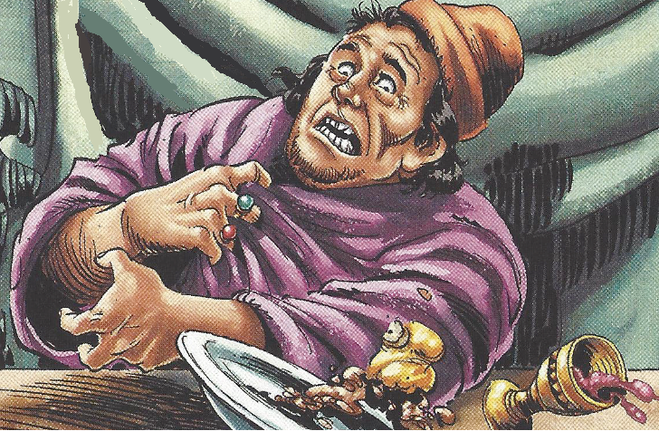
3. Abigail appeals to David 25:14-38
f. Death of Nabal 25:36-38
Nabal after sobering up was told
His heart became like a stone
Heart attack, stroke, paralyzed, coma?
10 days later God struck him & he died
No need for David to take revenge or enforce respect

Slide 13
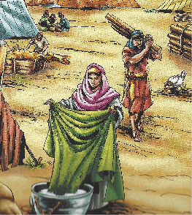
4. David blesses God & takes Abigail for his wife 25:39-42
God plead David cause in punishing Nabal
Kept him from sin through Abigail
sent a proposal - spoke with her
Abigail a humble women ready to wash his servant’s feet - professes humility
Brought 5 handmaids & became his wife

Slide 14
5. David’s wives 25:43-44
Michal, Abigail, Ahinoam
Michal given to another man (Palti)

Slide 15
Lessons:
1. The death of God’s people are precious in his sight Ps. 116:15
2. Words spoken with wisdom are apples of gold Prov. 25:11
3. Abigail - discreet, humble, generous, god-fearing, knowledgeable, affluent

Slide 16
F. Saul’s third pursuit of David 26:1-25

Slide 17
1. Saul’s pursues David again 26:1-5
a. Ziphites betray David again
b. 3,000 men with Saul - probably the size of the standing army
c. David was in the wilderness of Ziph
d. Scouts sent out to find out the location & size of Saul’s army
e. Saul is in the center of the camp with the supplies

Slide 18
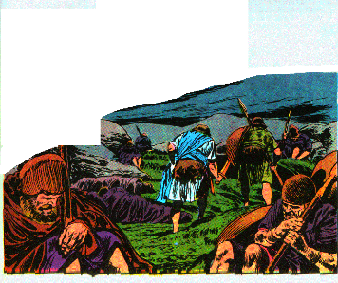
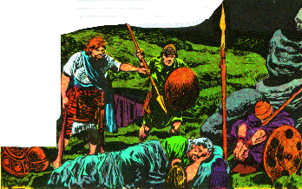
2. David again spares Saul 26:6-12
a. David goes into Saul’s camp with Abishai, God cause the camp to sleep deeply
b. Abishai wants to kill with one blow
c. David will not raise his hand against Saul: he will die in battle
or in another way of God’s choosing
d. David takes Sauls spear & drinking cup

Slide 19
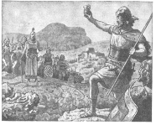
3. David reveals himself to Saul 26:13-16
David rebukes Abner

Slide 20
4. David addresses Saul 26:17-21
Why is he being pursued?
David will atone for his sin if God has stirred up Saul against David
Let slanderous men be cursed if they are the cause
David is a flea or a partridge

Slide 21
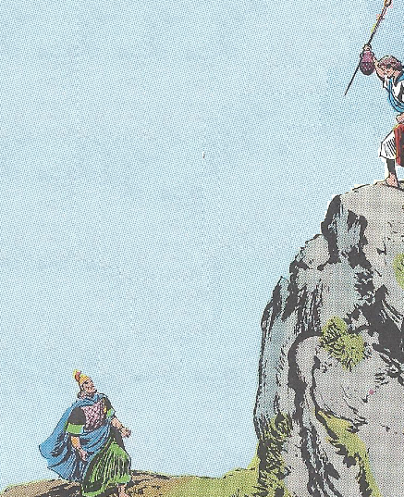
5. Saul again repents 26:21-25
Confesses sin, promises him no harm
Admits he has acted like a fool, blessed David
Predicted David would prevail

Slide 22
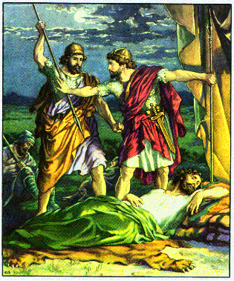
Lessons:
1. Men should respect the things appointed by God
2. Forgive & let God worry about justice

Slide 23
G. Lapse of David - 2nd flight to Gath 27

Slide 24
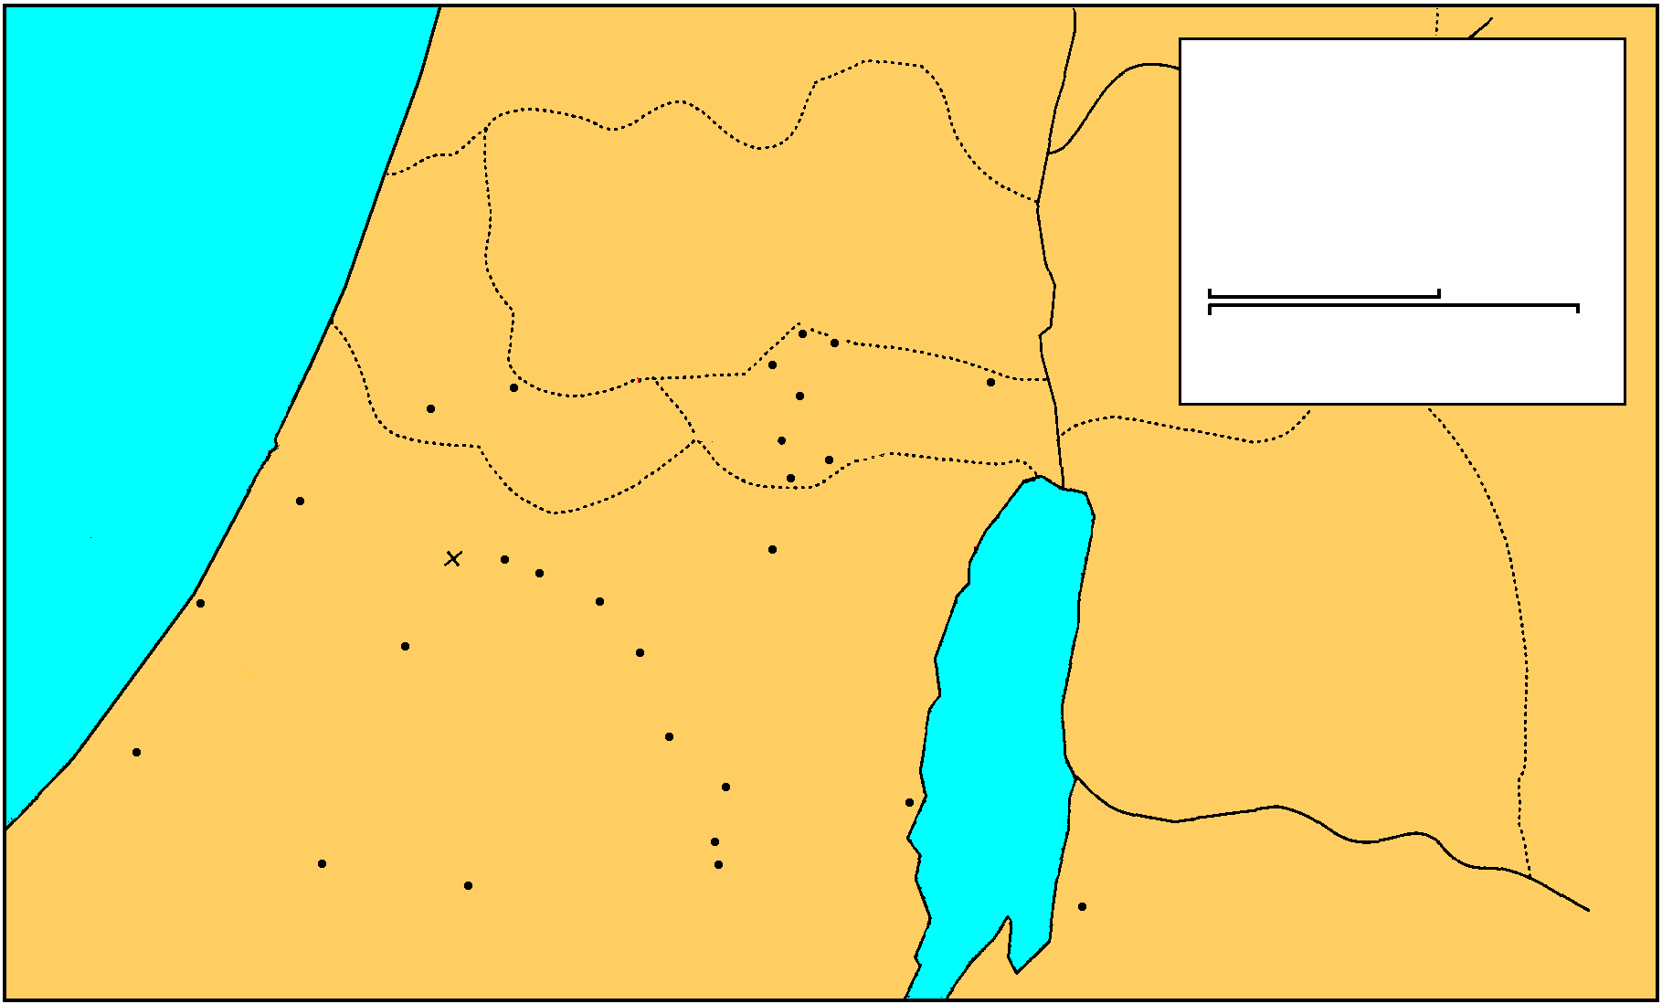
MANASSEH
Saul And David
EPHRAIM
1 Samuel 16-27
THE GREAT SEA
GAD
DAN
25 km
Bethel
Ai
0
25 Miles
Gezer
Mizpah
Ekron
Ramah
Jericho
Goliath Slain
Gibeah
BENJAMIN
Nob
Ashdod
Valley of Elah
Jerusalem
Azekah
Bethlehem
Ashkelon
Socho
PHILISTINES
Adullam
Gath
Keilah
JUDAH
REUBEN
Hebron
Salt
Sea
Gaza
Ziph
En-gedi
Gerar
Carmel
Maon
SIMEON
Ziklag
Mizpeh of Moab
MOAB

Slide 25
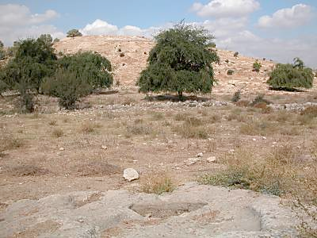
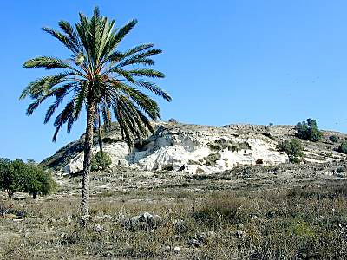
Gat at Gath
The name of the city in Hebrew is "gat," which means "winepress." This picture has an ancient winepress in the foreground, with the city behind. The area around Gath was very fertile and it's likely that the city had a number of winepresses. Archaeological excavations at Gath's neighbor, Ekron, found an abundance of oil presses on the site.
White Cliffs
Most scholars agree today that Gath is to be identified with Tell es-Safi. This Arabic name for the site means "the white mound" and is appropriate because of the white chalky cliffs visible on the sides of the tell. The biblical site of Libnah (which means "white") is probably not to be identified with Tell es-Safi in spite of the meaning of the names.

Slide 26
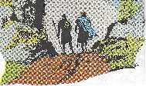
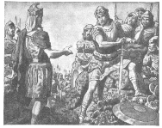
1. David again in Gath 27:1-7
a. David gave in to fear
Disobeyed the order of Gad the prophet 22:5
He decides to escape to Philistia 1
David crosses with 600 men to Achish 2
Lived at Gath & 2 wives (Ahinoam & Abigail) 3
Saul stopped searching 4
b. Philistine are convinced David is considered an enemy by Saul
David goes to King Achish, a Philistine

Slide 27
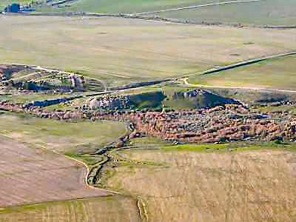
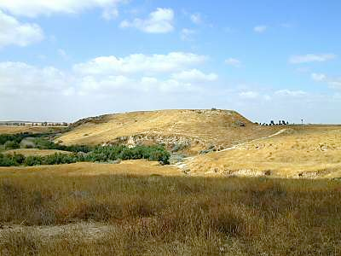
Biblical History
Ziklag was listed as one of the 29 towns in Negev and was assigned to the tribe of Simeon (Josh 15:31; 19:5). It was apparently controlled by the Philistines during King Saul's rule, and was given by King Achish of Gath to David when he was running from Saul. David used it for a home base for raids against various groups who threatened the southern borders of Judah (1 Sam 27). After being away one time, he returned to find it ransacked by the Amalekites

Slide 28
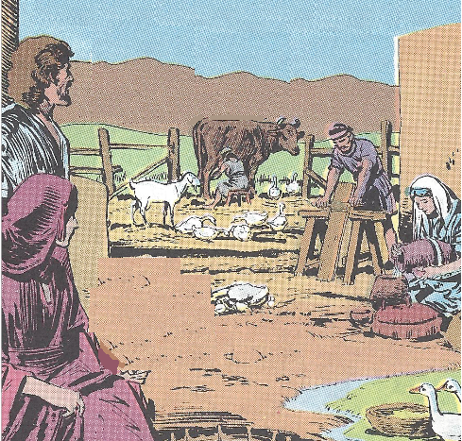
1. David again in Gath 27:1-7
c. David requests and receive a town 27:5-7
Achish gives David Ziglag
Ziglag has belong to Judah’s king ever since
Had the people to settle a town
Could protect Gath & southern Judah
Would not be an embarrassment to the king
d. David in Ziklag one year & four months

Slide 29
2. David’s pretended campaign against Judah 27:8-12
David raids - Geshurites, Girzites, Amalekites
He told Achish he was raiding Judah, Jerahmeelites, Kenites
David left no witnesses alive?
Achish believes David has become odious to Israel & will serve him

Slide 30
Lessons
1. The weakness of the flesh.
David gave in to the wisdom of the world.
2. A lie is never justifiable.
One sin leads to another.

