Slide 1
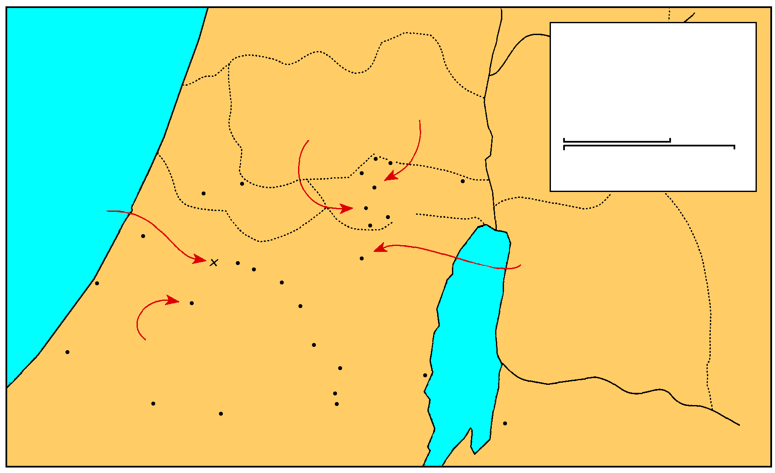
MANASSEH
Saul And David
EPHRAIM
1 Samuel 16-27
THE GREAT SEA
Samuel’s home
GAD
DAN
Saul’s capital
25 km
Bethel
Ai
0
25 Miles
Gezer
Mizpah
Ekron
Ramah
Jericho
Goliath Slain
Gibeah
BENJAMIN
Nob
Ashdod
Valley of Elah
Jerusalem
Azekah
Bethlehem
David anointed
Ashkelon
Socho
PHILISTINES
Adullam
Gath
Keilah
JUDAH
REUBEN
Hebron
Salt
Sea
Gaza
City of Goliath
Ziph
En-gedi
Gerar
Carmel
Maon
SIMEON
Ziklag
Mizpeh of Moab
MOAB

Slide 2
D. David at Nob 21
Ahimelech gives David consecrated bread 1-6
Observed by Doeg Saul’s servant 7
David is given Goliath’s sword 8, 9

Slide 3
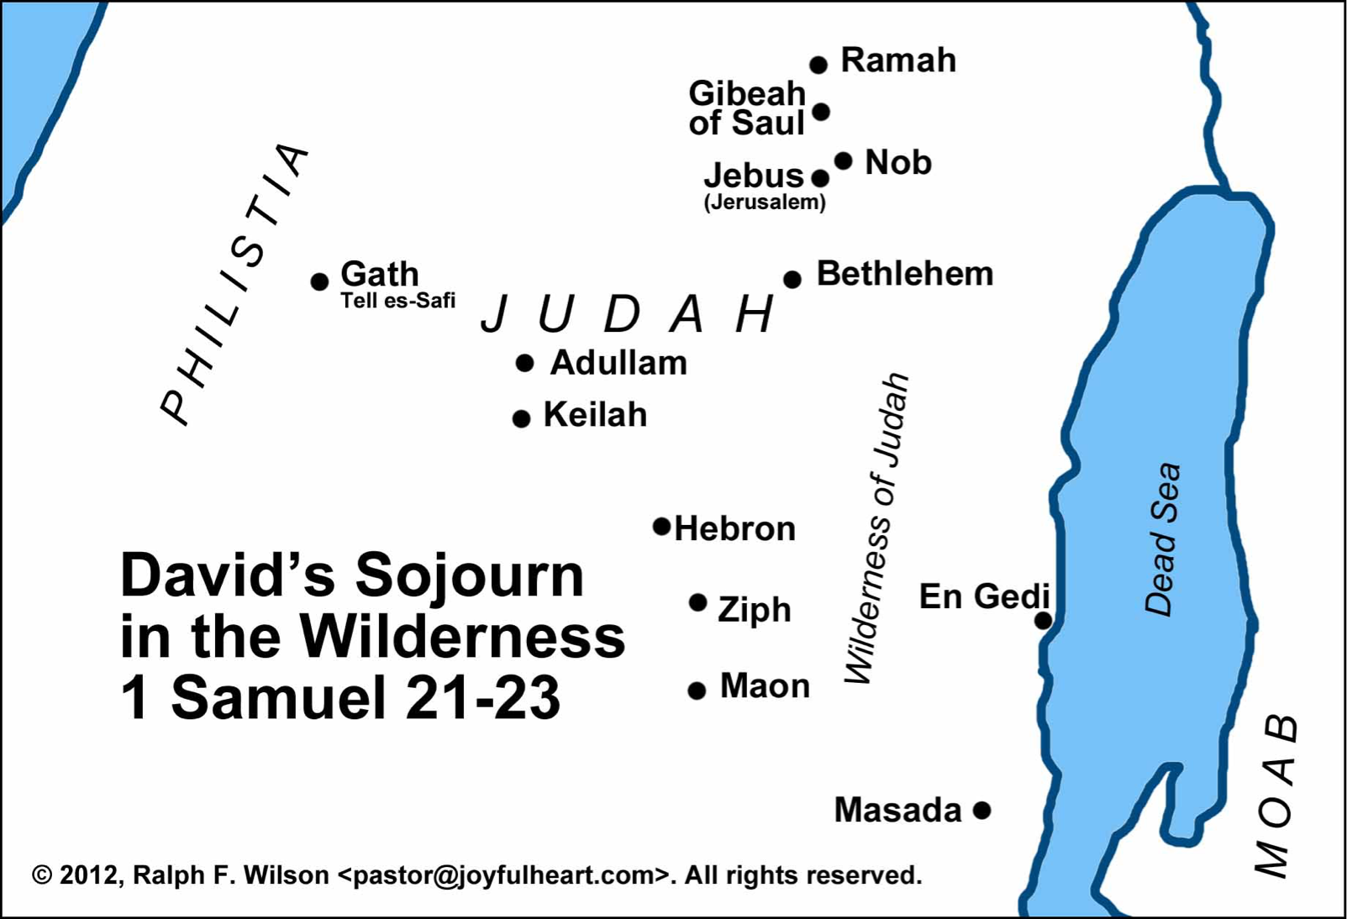

Slide 4
Ahimelech gives David consecrated bread 21:1-6
David came to Nob from Gibeah
Nob - to be high - priestly city, N of Jerusalem
Ahimelech - high priest - father of Abiathar
Trouble with Saul seems to be known
David alone - priest afraid
He did not know Saul was seeking to kill David
Secret mission - going to unspecific place
Flee for his life - a lie - weakness
Mitigated by war & strategy
Some suggest a mission was give before he fled
Did have men he was meeting Matt. 12:3, 4

Slide 5
Ahimelech gives David consecrated bread 21:1-6
5 loaves or whatever may be found
Showbread given for an emergency
The men were not ceremonially unclean
Mercy extended though the ceremonial law was broken
Mercy in emergencies before ceremony or tradition Matt. 12:1-8; Mk. 2:23-28; Lk 6:1-5
The high priest inquire of God for David 1 Sam. 22:10

Slide 6
Observed by Doeg Saul’s servant 21:7
Doeg - Saul’s servant, chief shepherd, Edomite
detained - atsar - restrained, stayed, under restraint, keep in custody
unclean, waiting for trespass offering?
an unfortunate witness

Slide 7
David is given Goliath’s sword 21:8, 9
Asked for sword or spear
On secret mission, urgency needed
Goliath’s sword had been left there as a trophy
The feat was know of far and near
Normal size sword - very excellently made
behind the ephod - should piece of H.P.
David was glad to have the sword

Slide 8
III. David in Exile 21:10—28:2

Slide 9
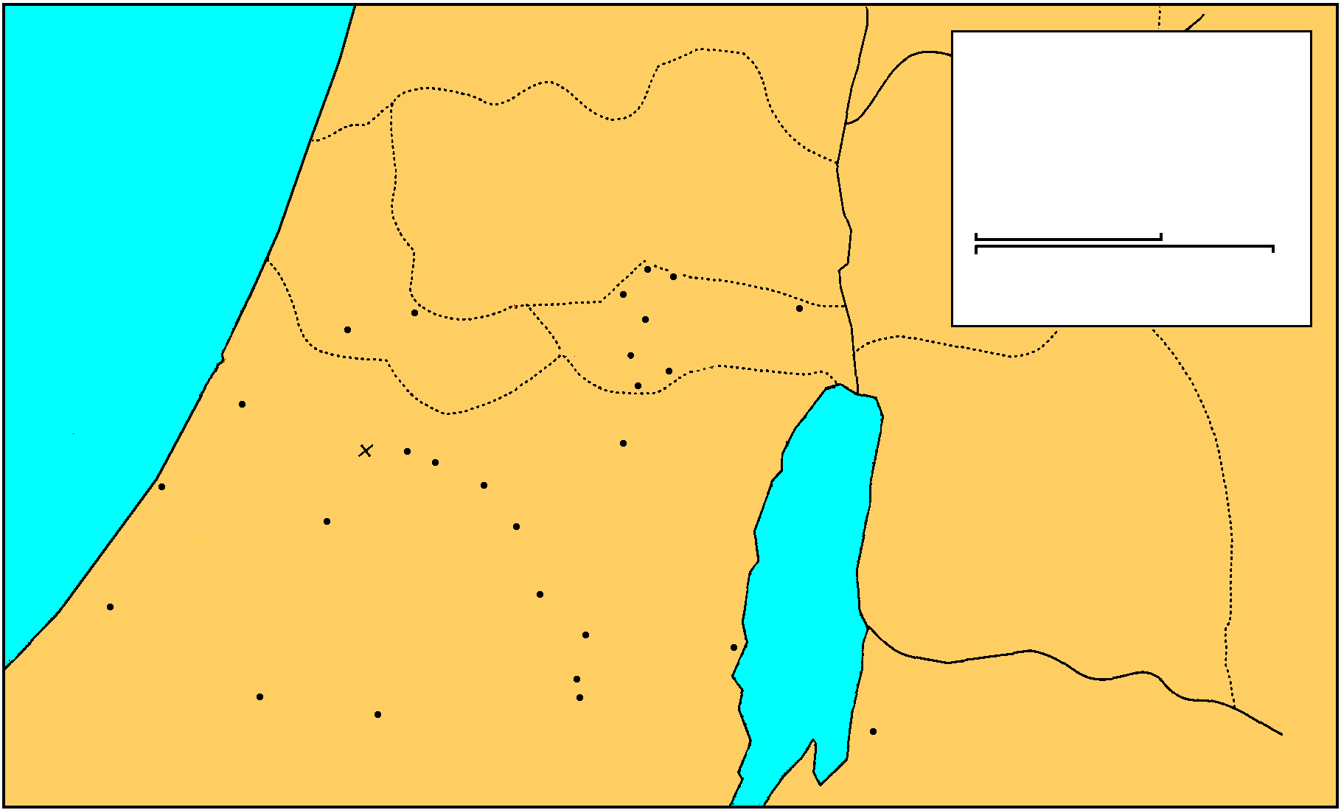
A. David seeks refuge among Philistines (rejected) 21:10-15 Flight to Gath and faking madness
MANASSEH
Saul And David
EPHRAIM
1 Samuel 16-27
THE GREAT SEA
GAD
DAN
25 km
Bethel
Ai
0
25 Miles
Gezer
Mizpah
Ekron
Ramah
Jericho
Goliath Slain
Gibeah
BENJAMIN
Nob
Ashdod
Valley of Elah
Jerusalem
Azekah
Bethlehem
Ashkelon
Socho
PHILISTINES
Adullam
Gath
Keilah
JUDAH
REUBEN
Hebron
Salt
Sea
Gaza
Ziph
En-gedi
Gerar
Carmel
Maon
SIMEON
Ziklag
Mizpeh of Moab
MOAB

Slide 10
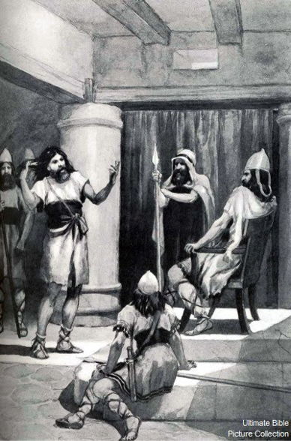
A. David seeks refuge among Philistines (rejected) 21:10-15 Flight to Gath and faking madness
Ps. 34 God delivered him in answer to prayer
God should be our refuge
God will deliver the righteous
They have many afflictions - God delivers
Achish king of Gath - title Abimelech “my father is king”
Gath - city of Goliath
David though he would not be recognize or that he would be given security because he was Saul’s enemy
He was seized by the Philistines Ps. 56
Philistines remember David’s victories & fame & songs sung in his honor

Slide 11
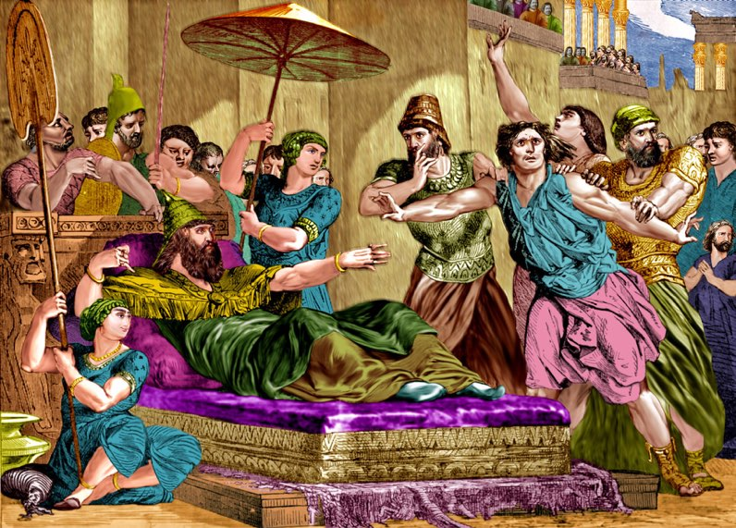
A. David seeks refuge among Philistines (rejected) 21:10-15 Flight to Gath and faking madness
David knew the danger he was in - extremely afraid
Disguised his sanity - disfigured his face
Acted insane - acted like a madman
Wrote non-sense on the door
Drooled spittle down his beard
His stratagem worked
Outwitted them w/ God’s help
Achish sees him as insane
No interest in David
Insane were touched by the gods - sacrosanct

Slide 12
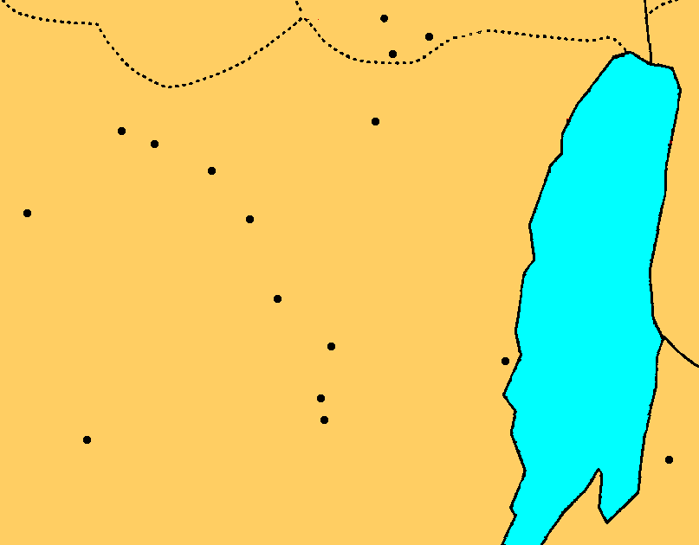
B. No refuge in Philistia or Judah 22:1-5
1. David flees to the cave of Adullam, where he is joined by 400 men of various descriptions 1, 2
Gibeah
Nob
BENJAMIN
Jerusalem
Azekah
Socho
Bethlehem
Adullam
Gath
Keilah
JUDAH
Hebron
Salt
Sea
Ziph
En-gedi
Carmel
Ziklag
Maon
Mizpeh
MOAB

Slide 13
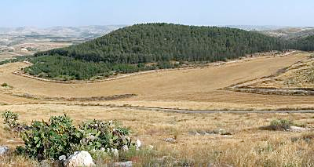
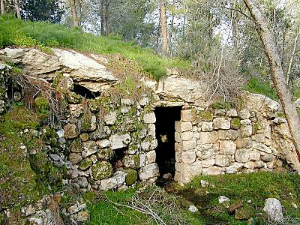
Adullam
Located on the east end of the valley is the site of Adullam. This place proved to be the perfect place for David to hide in his initial flight from Saul. As it today rests on the border between pre-'67 Israel and the West Bank, so in David's day, this site was apparently in "no-man's land" where he could stay safely out of the path of Saul or the Philistines.
Cave of Adullam
1 Samuel 22 says that David hid in the "cave of Adullam." Today there are many caves at the site and it's not clear which one or ones David used, as many have been used and modified in the years since. While he was here, 400 men who were in debt, distress or discontent, gathered around David.

Slide 14
B. No refuge in Philistia or Judah 22:1-5
1. David flees to the cave of Adullam, where he is joined by 400 men of various descriptions 1, 2
Adullam - uh-duhl’uhm
Cave 10 miles ESE. of Gath
500 feet high
Brothers & relatives come
Many in distress, debt, discontent came to him
400 men
Ps. 57, 142

Slide 15
B. No refuge in Philistia or Judah 22:1-5
2. Shelter in Moab 3-4
MANASSEH
Saul And David
EPHRAIM
1 Samuel 16-27
THE GREAT SEA
GAD
DAN
25 km
Bethel
Ai
0
25 Miles
Gezer
Mizpah
Ekron
Ramah
Jericho
Goliath Slain
Gibeah
BENJAMIN
Nob
Ashdod
Valley of Elah
Jerusalem
Azekah
Bethlehem
Ashkelon
Socho
PHILISTINES
Adullam
Gath
Keilah
JUDAH
REUBEN
Hebron
Salt
Sea
Gaza
Ziph
En-gedi
Gerar
Carmel
Maon
SIMEON
Ziklag
Mizpeh of Moab
MOAB

Slide 16
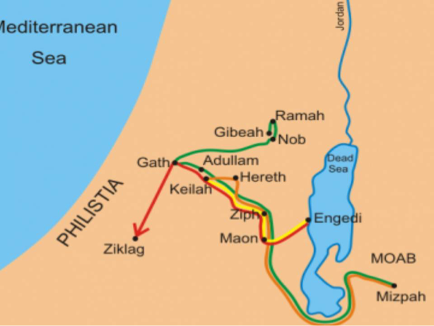
B. No refuge in Philistia or Judah 22:1-5
2. Shelter in Moab 3-4
To Mizpeh in Moab
David descendant of Ruth the Moabite
King protected his father & mother
Eliminating a vulnerability - possible ransom situation
At some point God will make David king
stronghold - in or near Adullum - 1 Chron. 11:15-16
rugged, rocky formation for natural defense & a hideout

Slide 17
B. No refuge in Philistia or Judah 22:1-5
3. Prophet Gad & the forest of Hereth 5
David goes by the advice of prophet Gad, to forest of Hereth
MANASSEH
Saul And David
EPHRAIM
1 Samuel 16-27
THE GREAT SEA
GAD
DAN
25 km
Bethel
Ai
0
25 Miles
Gezer
Mizpah
Ekron
Ramah
Jericho
Goliath Slain
Gibeah
BENJAMIN
Nob
Ashdod
Valley of Elah
Jerusalem
Azekah
Bethlehem
Ashkelon
Socho
PHILISTINES
Adullam
Gath
Keilah
JUDAH
REUBEN
Hebron
Salt
Sea
Gaza
Ziph
En-gedi
Gerar
Carmel
Maon
SIMEON
Ziklag
Mizpeh of Moab
MOAB

Slide 18
B. No refuge in Philistia or Judah 22:1-5
3. Prophet Gad & the forest of Hereth 5
David goes by the advice of prophet Gad, to forest of Hereth
Prophet Gad first mention
A writer with Samuel & Nathan of the acts of David, 1 Chron. 29:29
forest of Hereth - hihr’ith - large thicket composed of desert shrubs & bushes
Possibly in the wilderness of Ziph

Slide 19
C. Saul’s first pursuit of David 22:6—23:29

Slide 20
1. Saul’s increasing Jealousy 22:6-10
a. Accuses family & officers of conspiracy 6-8
Saul in Gibeah under a tamarisk tree
spear for septer
Psycotic paranoia & suspicion
holding an inquiry
accuses them of conspiring with David
David will not give Benjamites fields, vineyards, or make them commanders
None tell him of Jonathan’s covenant
none sorry for him
Jonathan stirred David to rebel
David want to ambush him

Slide 21
1. Saul’s increasing Jealousy 22:6-10
b. Doeg reveals that the priests helped David 9, 10
Doeg tells of Ahimelech helping David
Inquired of the Lord for him
Gave him provisions
Gave him the sword of Goliath
Evil implication that the H.P. was rebelling in helping David
Ps. 52:2-4 lying & devouring tongue

Slide 22
2. Saul sends for & then executes the Priests 22:11-19
a. All priests summoned from Nob 11
b. Saul asks why they conspired with David? 12, 13
c. Ahimelech’s defense 14-15
David the most faithful servant
Son-in-law
Captain over king’s guard
Honored in Saul’s house
Inquired many times for David
Don’t attribute guilt on his servant or house
Knows nothing of any plot

Slide 23
2. Saul sends for & then executes the Priests 22:11-19
d. Saul’s slaughter of the priests 16-19
Death sentence pronounced 16
Servants of king will not strike the priests 17
Respect for priesthood by men
Doeg slays 85 priest & their women, children, infants, animals 18, 19
Murder of innocent priests and families
Prophesy concerning Eli’s house fufilled

Slide 24
3. Abiathar, the son of Ahimelech, alone escapes; he joins with David & is assured of protection 22:20-23
David confesses responsibility for the death of his family.

Slide 25
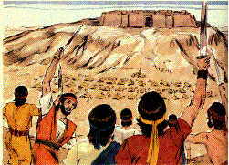
4. David saves Keilah from the Philistines 23:1-6
a. Keilah attacked
b. David inquires of God - He should deliver them
c. Servant afraid - inquires again - promised victory
d. Struck Philistines with great slaughter and saved Keilah

Slide 26
5. David escapes Keilah after inquires of the Lord 23:6-14
a. Abiathar, the priest & the ephod with David
b. Saul thinks David will be trapped in the city
c. David inquires about the people of the city & Saul’s plans
Saul will come down - the people will surrender him
d. David flees with 600 men to wilderness of Ziph and Stronghold
e. Saul can not capture him.
Gibeah
Nob
BENJAMIN
Jerusalem
Azekah
Socho
Bethlehem
Adullam
Gath
Keilah
JUDAH
Hebron
Salt
Sea
Ziph
En-gedi
Carmel
Ziklag
Maon
Mizpeh
MOAB

Slide 27
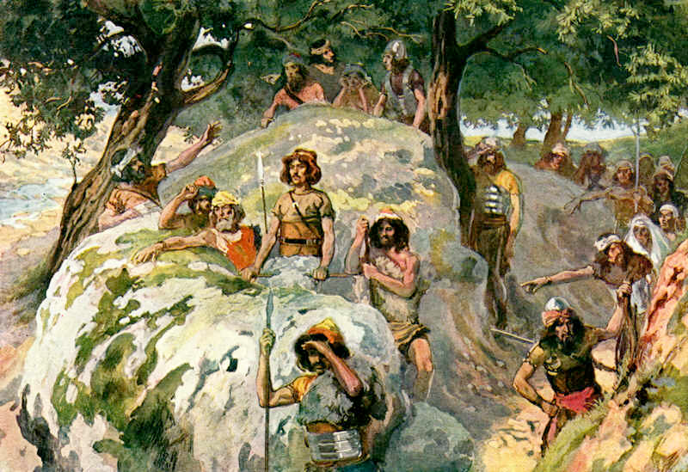
6. David’s and Jonathan’s meeting 23:15-18
a. Horesh (wood) - aware of Saul’s new pursuit
b. Jonathan encourages David - he will be king - covenant renewed

Slide 28
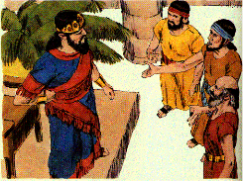
7. Ziphites help Saul 23:19-23
a. They tell Saul that David is in their area
b. They promise to surrender him
c. Saul sends them back to spy out David’s places of refuge

Slide 29
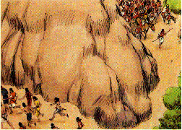
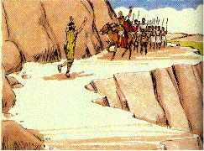
8. Saul pursues David in the Wilderness of Maon 23:24-28
a. Saul and his men on one side of the mountain and David on the other.
b. A messenger tells Saul that the Philistines have invaded
c. David’s rock of escape
d. David moves to strongholds of Engedi
Gibeah
Nob
BENJAMIN
Jerusalem
Azekah
Socho
Bethlehem
Adullam
Gath
Keilah
JUDAH
Hebron
Salt
Sea
Ziph
En-gedi
Carmel
Ziklag
Maon
Mizpeh
MOAB

Slide 30
