Slide 1
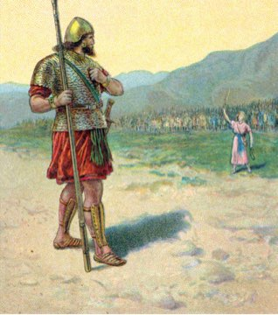
9. David retorts his defiance 45-47
45 Then David said to the Philistine, "You come to me with a sword, a spear, and a javelin, but I come to you in the name of the LORD of hosts, the God of the armies of Israel, whom you have taunted.
46 "This day the LORD will deliver you up into my hands, and I will strike you down and remove your head from you. And I will give the dead bodies of the army of the Philistines this day to the birds of the sky and the wild beasts of the earth, that all the earth may know that there is a God in Israel,
47 and that all this assembly may know that the LORD does not deliver by sword or by spear; for the battle is the LORD'S and He will give you into our hands."

Slide 2
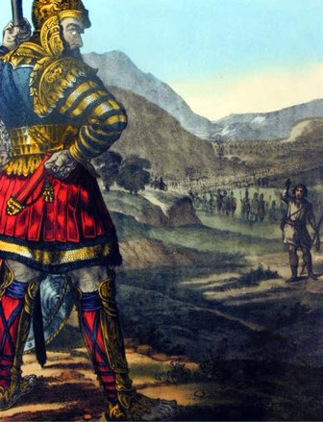
9. David retorts his defiance 45-47
a. He comes in the Name of the LORD
b. Goliath will be killed, beheaded & the Philistines will be destroyed to show there is a God in Israel
c. Israel will know the battle is the Lord’s

Slide 3
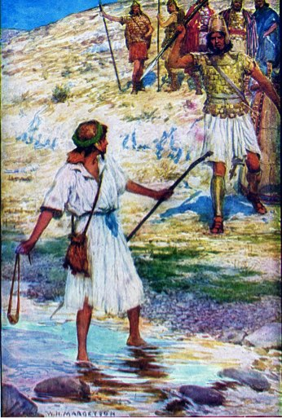
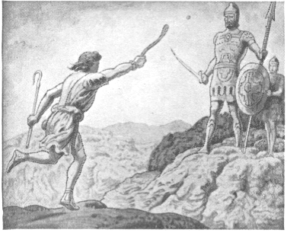
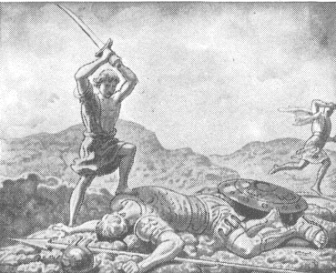
10. They draw near for battle, & David slings a stone, hits Goliath in the forehead, slays him, & cuts off his head with his own sword 48-51a
Goliath comes forward
David ran toward Goliath
Removes stone & places it in His sling
slung - qala - sling, hurled forth
struck on his forehead - metsach - brow, forehead
sank into - taba - sink down, pierce, drown
fell to the ground
prevailed - chazaq - grew strong, proved more powerful, was victorious
With a sling & a sword - no sword
Cut off his head with his own sword

Slide 4
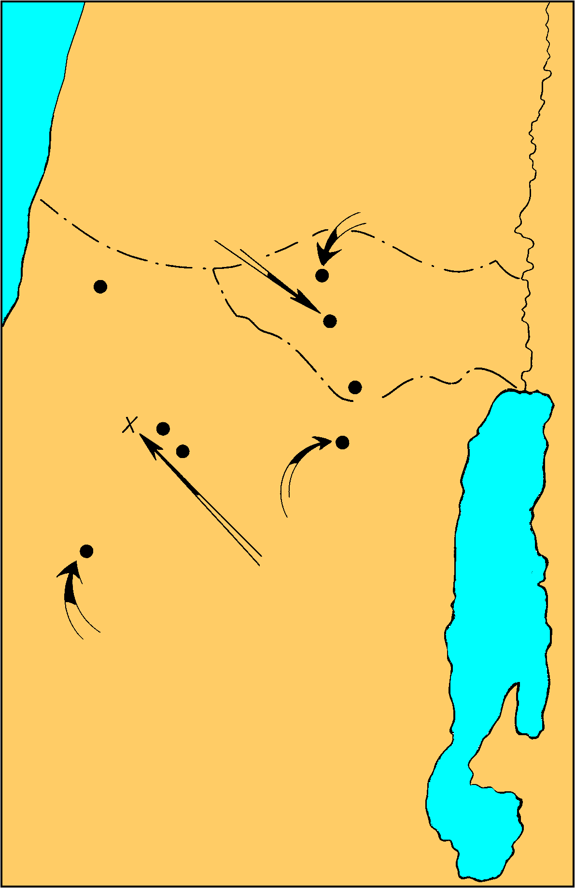
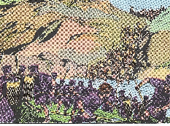
Anointing of David and Saul’s Second Philistine War
1 Sam. 16-17
11. The Philistines flee & are pursued by the Israelites 51b-53 (Ps. 18:32, 34)
Security of Giant gone
Shocked by defeat
fled - nus - escaped, took flight
pursued by Israel & Judah
to Gath & Ekron
slain Philistines - chalal - pierced, fatally wounded
Shaaraim - town in Judah, double gate - possibly found 6.5 miles due east of Gath
Israel plunders the camp
Saul’s captial
Samuel’s home
DAN
Ekron
Ramah
Gibeah
BENJAMIN
PHILISTINES
Valley of Elah
Jerusalem
Azekah
Socho
Bethlehem
David anointed
Gath
Goliath Slain
JUDAH
City of Goliath

Slide 5
Shaaraim
Western city gate of "Shaaraim"
Southern city gate of "Shaaraim"

Slide 6
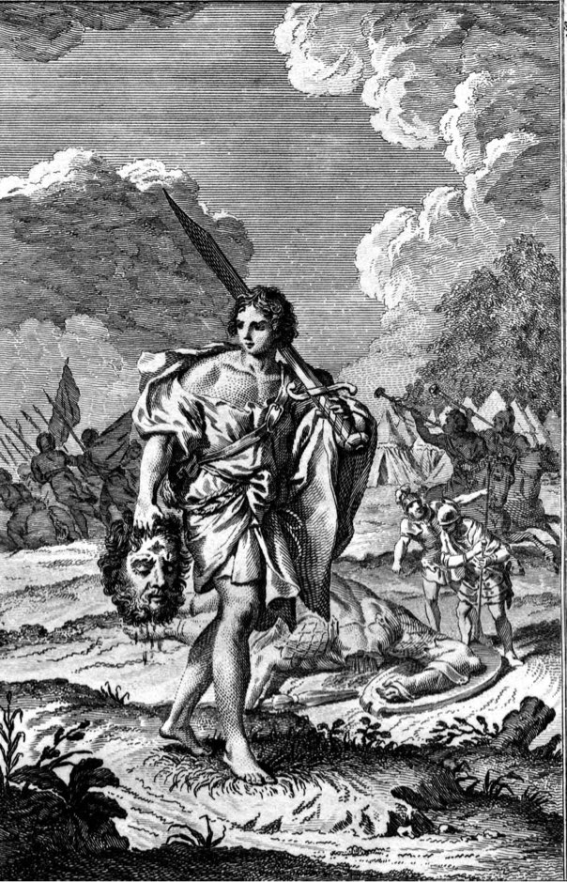
12. David brings the Philistines’ head to Jerusalem 54
Goliath’s head a trophy
Jebusites possessed citadel
Weapons put in his own tent
Possibly his reward for victory

Slide 7
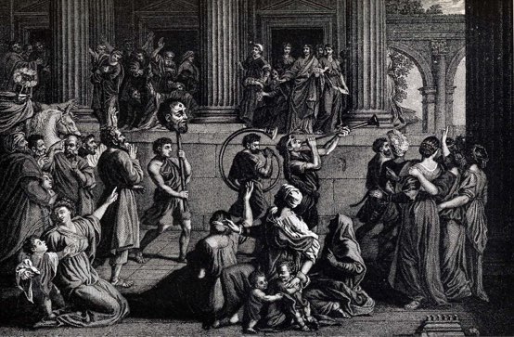
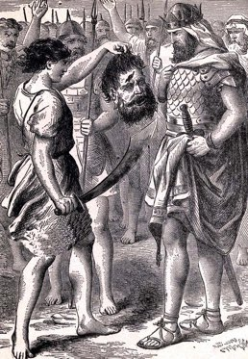
13. Conversation between Saul & Abner concerning David, who is brought before Saul 55-58
Neither Saul or Abner know David’s father
A long time since David played the lyre for Saul?
David's appearance had changed?
Robert Jamieson, “The growth of the beard & other changes in the now full-grown youth prevented the king from recognizing his former favorite minstrel.”
The events of 16 were a summary - not chronological

Slide 8
II. David Flees From Saul
18:1—21:9

Slide 9
David’s Relationship to Saul
A courtier 18:1—19:17
A fugitive 19:18—22:5
An outlaw 22:6—26:25
A mercenary 27:1-12

Slide 10
Jonathan & David commence a lasting friendship 18:1-4
Soul knit, covenant, armor given
Male bonding
Infer Jonathan was at the battle
Loves David - same faith & courage
knit - qashar -to bind, league together, to be bound
Deep affection, admiration, devotion, loyalty
Saul attached David to permanent service
Jonathan & David made covenant of friendship & helpfulness
Gives David His robe - meheel - mantle, outer garment, armor
Sword & bow & belt
Gesture of friendship, admiration of his valor

Slide 11
David acts obediently & wisely & is placed over the men of war 18:5
prospered - sakal - to be prudent, circumspect, have success
pleasing - yatab - good, pleasing to
Good decision to promote David
Approved by civil & military officials

Slide 12
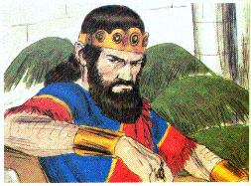
Saul becomes jealous of David, on account of the esteem in which he is held in Israel 18:6-9
Women of cities & villages
Singing & dancing & playing
David has slain 10,000s
Sang alternately to one another
Saul very angry - charah - hot, furious, to burn or be kindled with anger
displeased - raa - to be evil, bad, to be displeased, annoyed, dissatisfied
looked with suspicion - in - to eye (enviously), look (askance)
Saul from that day saw David as a threat

Slide 13
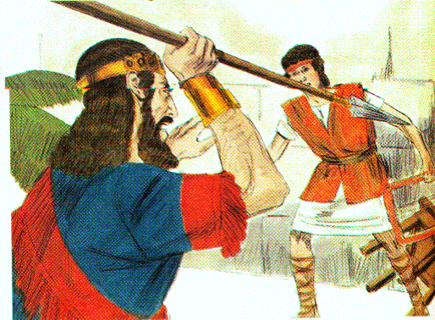
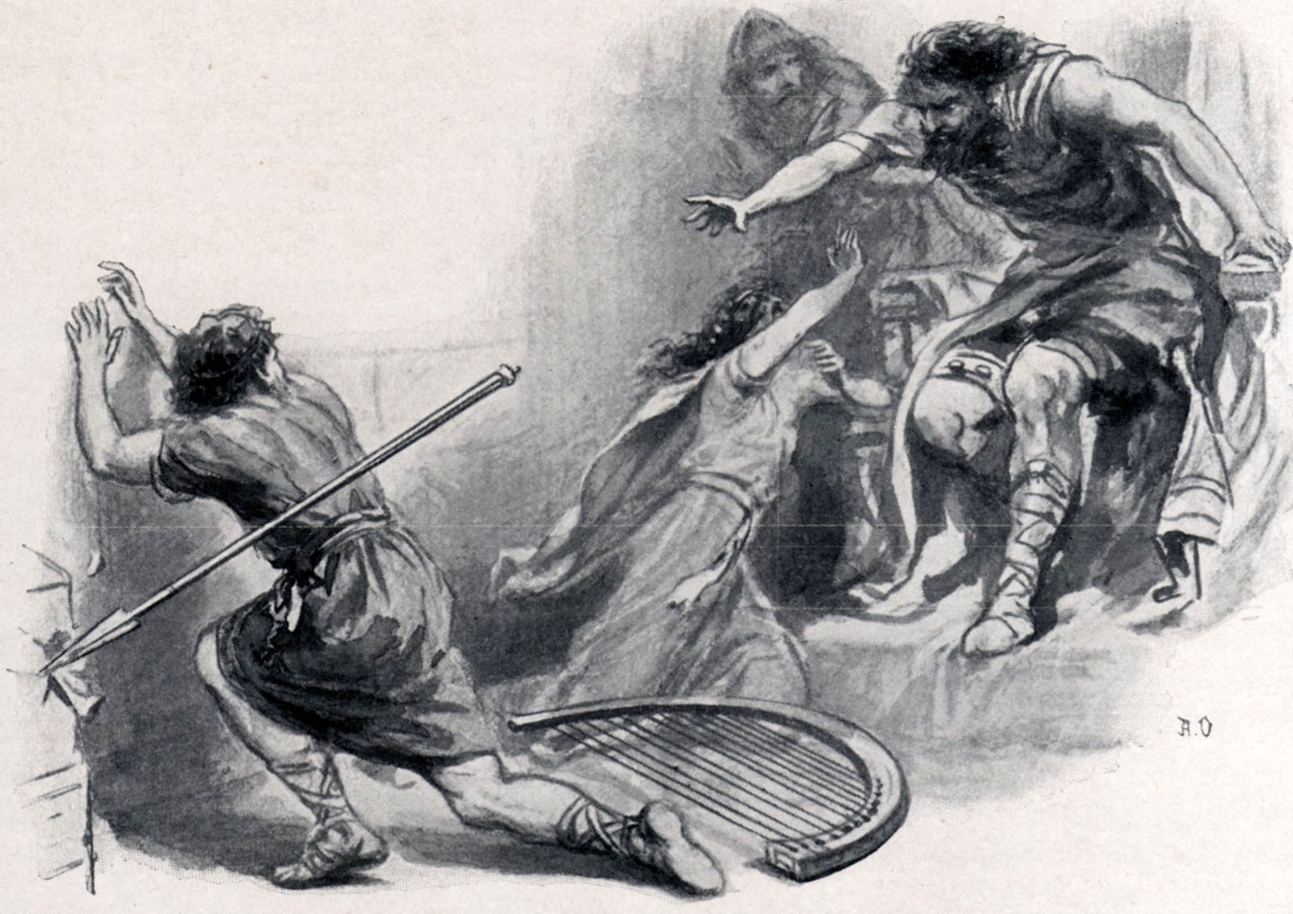
David driven out of Saul’s court 18:10-16
Saul in fury endeavors to destroy David 10-12
the next day
an evil spirit fell upon him
raved - naba - prophesy, excited to violence, talk wildly or incoherently
David played the harp to try and soothe him
Saul tried to kill him with a spear
David escaped twice
escaped - sabab - to turn about, go around
Aware God was with Him
Afraid

Slide 14
David driven out of Saul’s court 18:10-16
b. David is made captain over a thousand; & the people love & respect him 13-16
Sent away from Saul’s presence
Commander of a thousand
In the view of the people
Standing army now
Prospering - valor, courage, faith, intelligence - adept a warfare
Providential help
Saul dreaded - gur - to dread (anticipated with great apprehension or fear), be afraid
Israel and Judah loved David
out and in - carried out military enterprises

Slide 15
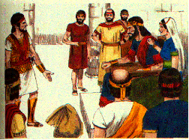
5. Saul, in order to ensnare David, offers him his daughters in marriage 18:17-29
Merab offered to David then given to another 17-19
Merab offered as wife for victories
Laying a trap
Planned for David to be killed by Philistines
David humbly refuses
Merab given to Adriel
insult to David?

Slide 16
5. Saul, in order to ensnare David, offers him his daughters in marriage 18:17-29
b. Michal is offered to David 20-29
Michal love David
New opportunity to destroy David
Servant find out David reasons for refusing
no wealth, lightly esteemed
1) Saul requires a hundred Philistine foreskins for dowry; hoping David would be killed in procuring them 25
2) David agrees to the conditions, fulfills them, & has Michal for his wife 26-29
Killed 200 - counted them out
Michal given - Saul more afraid
Enemy of God’s man

Slide 17
6. David behaves more wisely against the Philistine than all the servants of Saul 18:30
Philistines continue to invade
David outstanding and wiser than others
Name highly esteemed

Slide 18
B. David’s final flight from Saul’s court 19
Jonathan pleads for David before Saul, who is for the present reconciled 19:1-7
Jealousy & madness cause Saul to plot against David
Jonathan warned David to hide
Delights in David
Intercedes for David in field where David hid
David had done good for the king and the kingdom
David risked his life to fight the Philistine
Gave great deliverance
Why shed innocent blood
Logic worked
David brought to Saul - reconciled

Slide 19
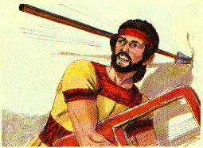
B. David’s final flight from Saul’s court 19
David defeats the Philistines & Saul becomes envious, & endeavors to slay him, but he escapes 19:8-10
Philistine invade - David puts them to flight
Evil spirit upon Saul
Tries to kill David with his spear
David fled & escaped that night

Slide 20
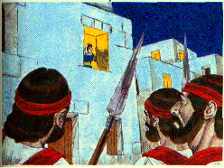
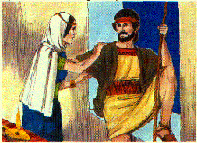
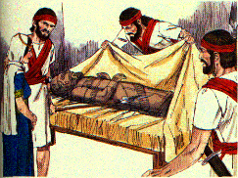
Saul sends men to David’s house, to lie in wait for him; but Michal saves him by stratagem 19:1-17 (Ps. 59)
Servant send to David’s house to slay him in the morning
Michal warns David to flee that night
Ps. 59 written
David calls God’s wrath down on the wicked
Appealing for justice
Let down from window by Michal
Image placed in bed
Teraphim was Michal’s - for fertility
goat’s hair at the head
covered with cloth
Saul’s messengers sent to kill David 11
Michal warns David & lets him down through a window 11b, 12
Michal buys time for David 13-17

Slide 21
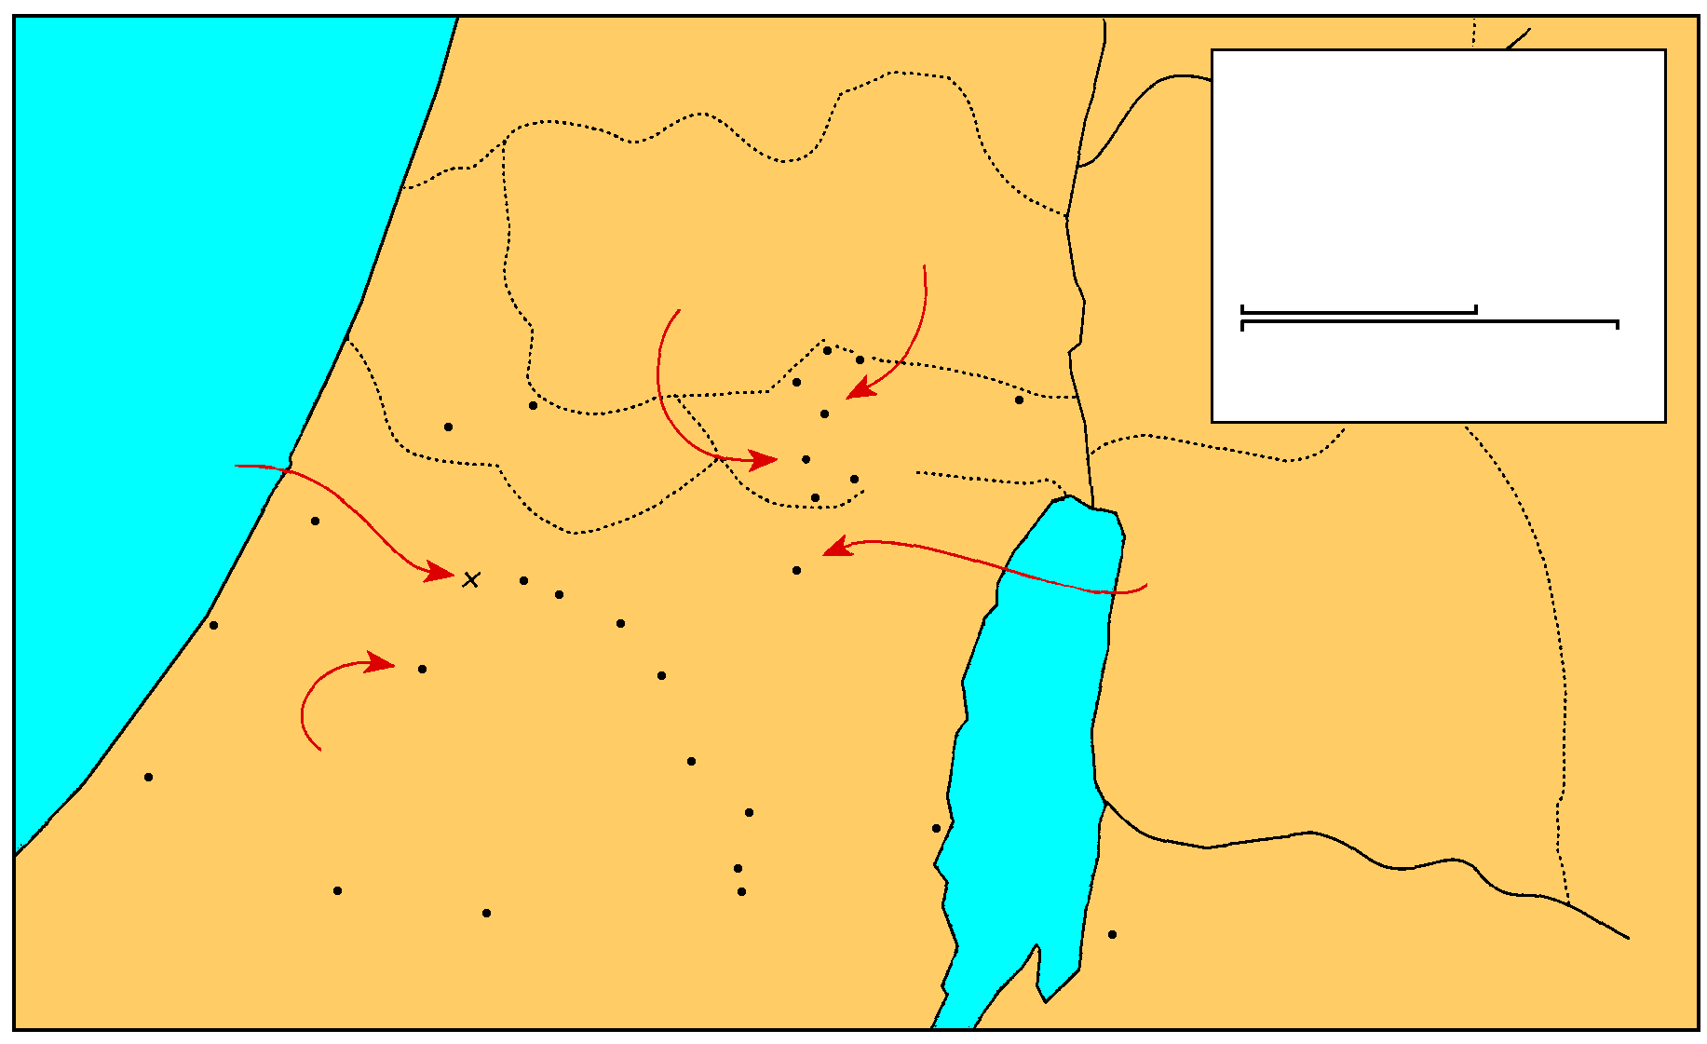
MANASSEH
Saul And David
EPHRAIM
1 Samuel 16-27
THE GREAT SEA
Samuel’s home
GAD
DAN
Saul’s capital
25 km
Bethel
Ai
0
25 Miles
Gezer
Mizpah
Ekron
Ramah
Jericho
Goliath Slain
Gibeah
BENJAMIN
Nob
Ashdod
Valley of Elah
Jerusalem
Azekah
Bethlehem
David anointed
Ashkelon
Socho
PHILISTINES
Adullam
Gath
Keilah
JUDAH
REUBEN
Hebron
Salt
Sea
Gaza
City of Goliath
Ziph
En-gedi
Gerar
Carmel
Maon
SIMEON
Ziklag
Mizpeh of Moab
MOAB

Slide 22
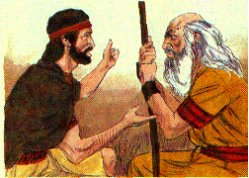
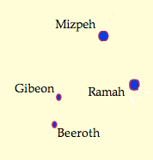
David flees to Samuel, at Ramah 19:18
Made good escape
Came to Samuel
Both went to Naioth nay’yoth - a dwelling place of prophets in the time of Samuel
ISBE - a school of prophets under Samuel - dwelling or compound in Ramah

Slide 23
Saul, hearing of it, sends messengers three times to take him; but God’s Spirit makes them prophesy 19:19-21
Saul hears David is a Ramah
Messenger sent to arrest David
Company - lahaqah - band, group
of prophets prophesying
with Samuel presiding - natsab - standing over, stationed, appointed over
Samuel was the leader over the prophets
the Spirit came upon the messengers and they prophesied
2nd& 3rd group of messengers sent - same result
God will not allow them to arrest David

Slide 24
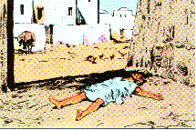
Saul, hearing of this, goes after David himself, and falls under the same influence 19:22-24
Saul comes to arrest David
come to large well in Secu - the watch-tower - a city near Ramah with a great wall
Asked for the location of Samuel & David
Goes toward Naioth, but overcome by the Spirit and prophesied
Out of control - strips off his outer garment and lay down all day and night
‘Is Saul also among the prophet?’ Became a saying a 2nd time

Slide 25
C. David’s farewell to Jonathan 20

Slide 26
David complains to Jonathan about Saul enmity against him; Jonathan comforts him 20:1-11
Jonathan knew & suspected nothing about his father; David explains that Saul knows of their friendship; but a step between me & death 20:1-3
David flees to Jonathan for help
What iniquity or sin has cause Saul to seek his life?
Jonathan can’t believe it - His father would have told him
David knew that Saul would not share his wicked plan with Jonathan
Did not want to grieve Jonathan
Truly only a step between David & death

Slide 27
Jonathan to find out Saul plans at the New Moon celebration; Jonathan is to tell Saul that David has gone to a family sacrifice in Bethlehem & see if he becomes angry 20:4-11
Samuel will do whatever David says
New moon - time of additional sacrifices, Num. 28:11-15, special meals
David expected to be with Saul, but he will hide in the field
To tell Saul David requested to go to Bethlehem to a family feast
It is good - safe - very angry - evil decided
Deal kindly - a covenant - kill me yourself
Jonathan will tell him if evil is decided
A plan for warning David is needed
They go out into the field & Jonathan explains the plan

Slide 28
Jonathan’s plan to warn David and asks for a covenant with David to protect his house 20:12-17
Jonathan puts himself under oath to tell David the truth
He will search out his father’s intentions
He will answer by the morrow or the next day
Jonathan again swears to let David know
He prays for the Lord to help David as he did Saul in the early days
Jonathan want the same kindness toward Jonathan - spare his life
Show kindness to his descendants when he overcomes
A covenant with David’s house - enforced with a curse - David would be punished by his enemies
Causes David to swear to the covenant
Loved David as his own life - true friendship

Slide 29
Jonathan informs him how he will ascertain the disposition of his father towards him and how he will give him the news 20:18-23
Jonathan would follow David suggestion about the new moon meal
Wait until the third day
David is to hide where he hid at his first escape
at the stone Ezel (departure) place between Ramah & Nob
Will shoot 3 arrows as if shooting at a taget
“arrows at this side of you” - there is safety
“Behold, the arrows are beyond you” - go - sent away by the Lord
The Lord is between us forever

Slide 30
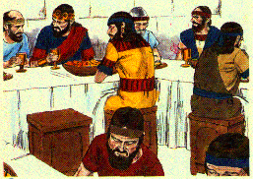
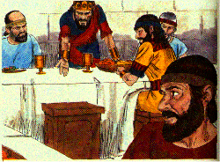
David hides himself; is missed by Saul; Jonathan is questioned concerning his absence; makes an excuse for David; Saul is enraged, & endeavors to kill Jonathan 20:24-33
David hides - King’s meal begins
Saul set with the wall at his back & Jonathan & Abner (Saul’s cousin - army captain) at his side
Saul thinks David’s seat is empty because he is ceremonially unclean
The next tells Saul why David is absent - at Bethlehem by his permission
Saul’s anger - insults Jonathan’s mother
Like his mother he is stubborn & disloyal
Accuses him of choosing David to his shame
Saul believe David will endanger his kingdom
Saul has departed from God & is like a typical pagan ruler - kill those in his way
David must surely die, 31
David’s place was empty 24-26
2nd day Jonathan questioned 27

Slide 31
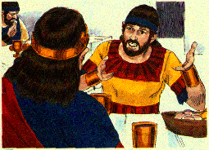
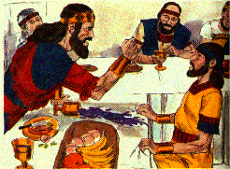
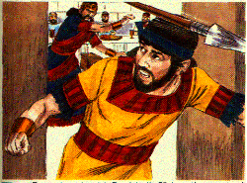
David hides himself; is missed by Saul; Jonathan is questioned concerning his absence; makes an excuse for David; Saul is enraged, & endeavors to kill Jonathan 20:24-33
Jonathan want to know what David has done to deserve death
Saul throws a spear at Jonathan
He cannot be reasoned with
Dead for David has been decided
Jonathan explains 28, 29
Saul’s anger burned against Jonathan 30, 31
Saul hurls a spear to strike him down 33

Slide 32
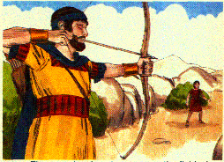
Jonathan goes out to the field; give David the sign they had agreed on, & by which David would know that king sought to kill him 20:34-39
Jonathan ashamed of his father
Grieved for David
Ashamed at his own treatment
Next morning went out shot his arrows
little lad naar qaton - younger than a teenager
Signal given to David to flee
The boy his hurried to gather the arrows

Slide 33
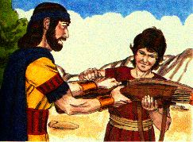
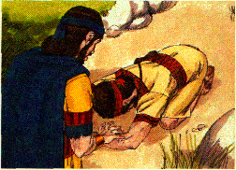
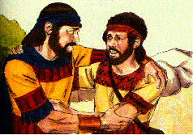
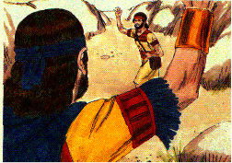
Jonathan sends his servant back into the city; & then he & David meet, renew their covenant, & have a very affectionate parting 20:40-42
the boy is sent away with Jonathan’s weapons
David came out & bowed to Jonathan
Kissed as brothers & wept
David wept more than Jonathan
David should go in peace and remember their covenant

Slide 34
MANASSEH
Saul And David
EPHRAIM
1 Samuel 16-27
THE GREAT SEA
Samuel’s home
GAD
DAN
Saul’s capital
25 km
Bethel
Ai
0
25 Miles
Gezer
Mizpah
Ekron
Ramah
Jericho
Goliath Slain
Gibeah
BENJAMIN
Nob
Ashdod
Valley of Elah
Jerusalem
Azekah
Bethlehem
David anointed
Ashkelon
Socho
PHILISTINES
Adullam
Gath
Keilah
JUDAH
REUBEN
Hebron
Salt
Sea
Gaza
City of Goliath
Ziph
En-gedi
Gerar
Carmel
Maon
SIMEON
Ziklag
Mizpeh of Moab
MOAB

Slide 35
D. David at Nob 21
Ahimelech gives David consecrated bread 1-6
Observed by Doeg Saul’s servant 7
David is given Goliath’s sword 8, 9

Slide 37
Ahimelech gives David consecrated bread 21:1-6
David came to Nob from Gibeah
Nob - to be high - priestly city, N of Jerusalem
Ahimelech - high priest - father of Abiathar
Trouble with Saul seems to be known
David alone - priest afraid
He did not know Saul was seeking to kill David
Secret mission - going to unspecific place
Flee for his life - a lie - weakness
Mitigated by war & strategy
Did have men he was meeting Matt. 12:3, 4
5 loaves or whatever may be found
Showbread given for an emergency
The men were not ceremonially unclean
Mercy extended though the ceremonial law was broken
Mercy in emergencies before ceremony or tradition Matt. 12:1-8; Mk.2:23-28; Lk 6:1-5

Slide 38
Observed by Doeg Saul’s servant 21:7

Slide 39
David is given Goliath’s sword 21:8, 9
the boy is sent away with Jonathan’s weapons
David came out & bowed to Jonathan
Kissed as brothers & wept
David wept more than Jonathan
David should go in peace and remember their covenant

Slide 40
III. David in Exile 21:10—28:2

Slide 41
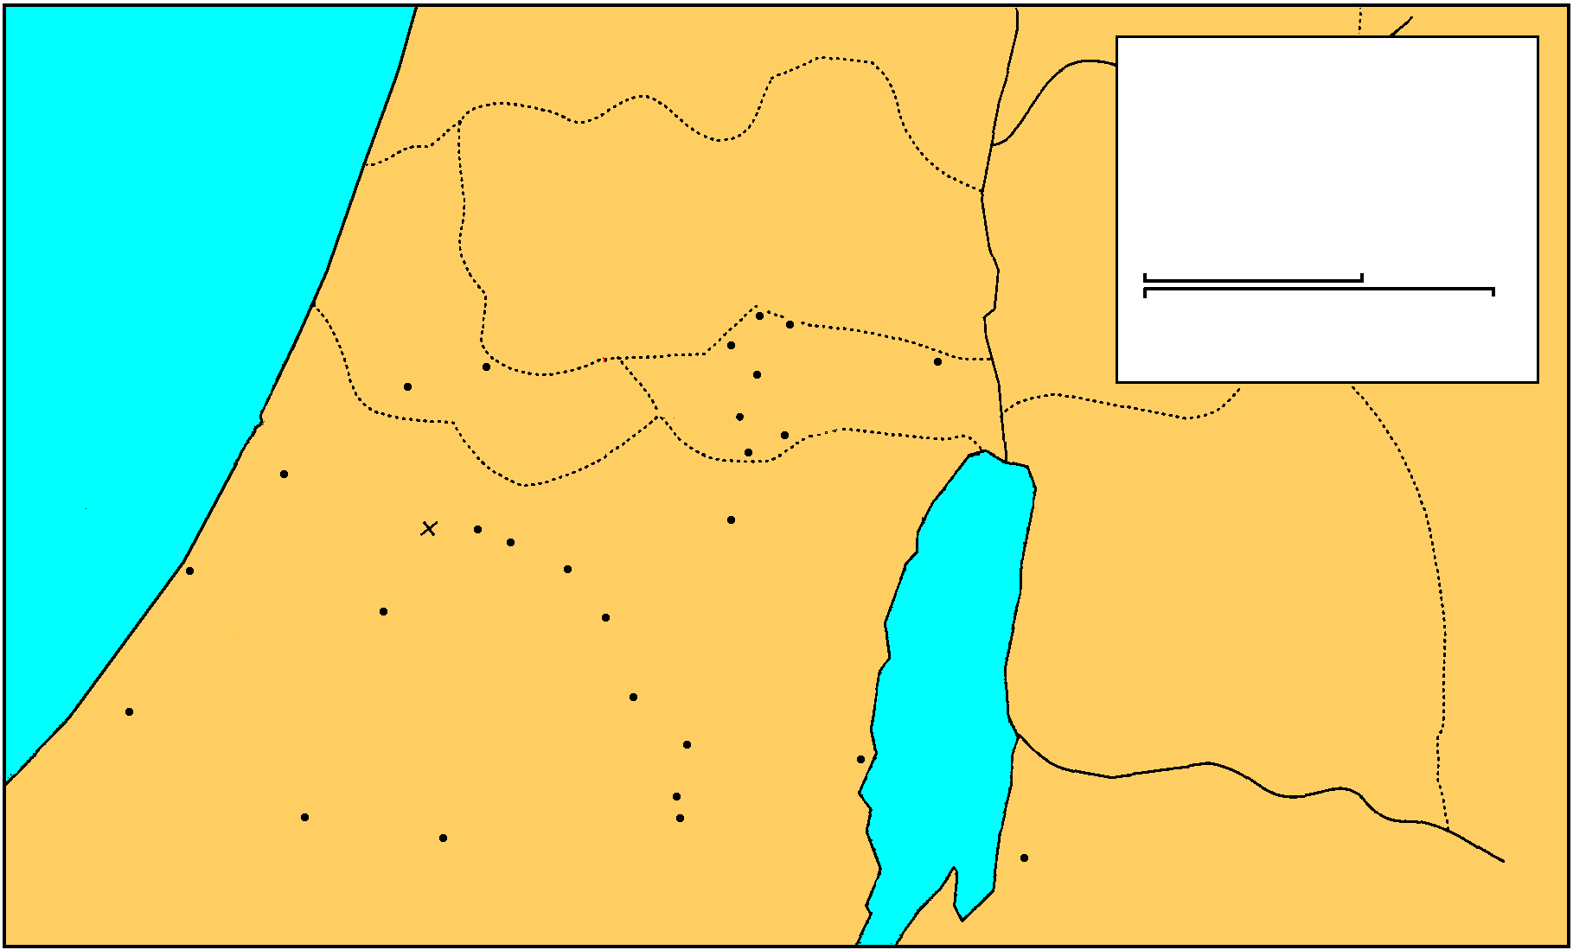
A. David seeks refuge among Philistines (rejected) 21:10-15 Flight to Gath and faking madness
MANASSEH
Saul And David
EPHRAIM
1 Samuel 16-27
THE GREAT SEA
GAD
DAN
25 km
Bethel
Ai
0
25 Miles
Gezer
Mizpah
Ekron
Ramah
Jericho
Goliath Slain
Gibeah
BENJAMIN
Nob
Ashdod
Valley of Elah
Jerusalem
Azekah
Bethlehem
Ashkelon
Socho
PHILISTINES
Adullam
Gath
Keilah
JUDAH
REUBEN
Hebron
Salt
Sea
Gaza
Ziph
En-gedi
Gerar
Carmel
Maon
SIMEON
Ziklag
Mizpeh of Moab
MOAB

Slide 42
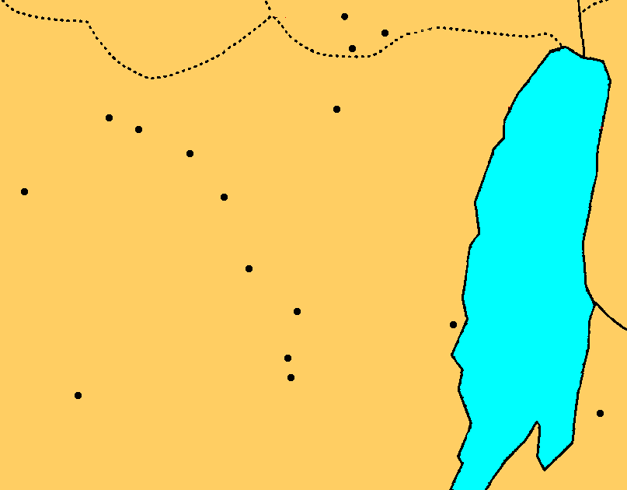
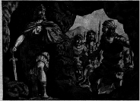
B. No refuge in Philistia or Judah 22:1-5
1. David flees to the cave of Adullam, where he is joined by 400 men of various descriptions 1, 2
Gibeah
Nob
BENJAMIN
Jerusalem
Azekah
Socho
Bethlehem
Adullam
Gath
Keilah
JUDAH
Hebron
Salt
Sea
Ziph
En-gedi
Carmel
Ziklag
Maon
Mizpeh
MOAB

Slide 43
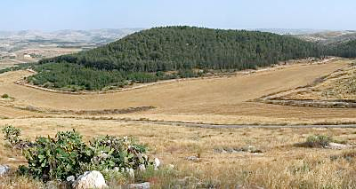
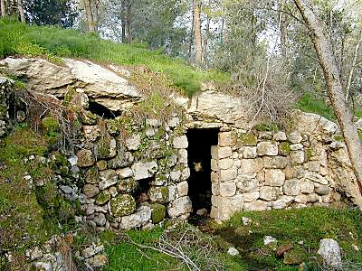
Adullam
Located on the east end of the valley is the site of Adullam. This place proved to be the perfect place for David to hide in his initial flight from Saul. As it today rests on the border between pre-'67 Israel and the West Bank, so in David's day, this site was apparently in "no-man's land" where he could stay safely out of the path of Saul or the Philistines.
Cave of Adullam
1 Samuel 22 says that David hid in the "cave of Adullam." Today there are many caves at the site and it's not clear which one or ones David used, as many have been used and modified in the years since. While he was here, 400 men who were in debt, distress or discontent, gathered around David.

Slide 44
B. No refuge in Philistia or Judah 22:1-5
2. Shelter in Moab 3-4
MANASSEH
Saul And David
EPHRAIM
1 Samuel 16-27
THE GREAT SEA
GAD
DAN
25 km
Bethel
Ai
0
25 Miles
Gezer
Mizpah
Ekron
Ramah
Jericho
Goliath Slain
Gibeah
BENJAMIN
Nob
Ashdod
Valley of Elah
Jerusalem
Azekah
Bethlehem
Ashkelon
Socho
PHILISTINES
Adullam
Gath
Keilah
JUDAH
REUBEN
Hebron
Salt
Sea
Gaza
Ziph
En-gedi
Gerar
Carmel
Maon
SIMEON
Ziklag
Mizpeh of Moab
MOAB

Slide 45
B. No refuge in Philistia or Judah 22:1-5
3. Prophet Gad and the forest of Hereth 5
David goes by the advice of prophet Gad, to forest of Hereth
MANASSEH
Saul And David
EPHRAIM
1 Samuel 16-27
THE GREAT SEA
GAD
DAN
25 km
Bethel
Ai
0
25 Miles
Gezer
Mizpah
Ekron
Ramah
Jericho
Goliath Slain
Gibeah
BENJAMIN
Nob
Ashdod
Valley of Elah
Jerusalem
Azekah
Bethlehem
Ashkelon
Socho
PHILISTINES
Adullam
Gath
Keilah
JUDAH
REUBEN
Hebron
Salt
Sea
Gaza
Ziph
En-gedi
Gerar
Carmel
Maon
SIMEON
Ziklag
Mizpeh of Moab
MOAB

Slide 46
C. Saul’s first pursuit of David 22:6—23:29

Slide 47
1. Saul’s increasing Jealousy 22:6-10
a. Accuses family and officers of conspiracy 6-8
1) David will not give Benjamites fields, vineyards, or make them commanders
2) None tell him of Jonathan’s covenant
b. Doeg reveals that the priests helped David 9, 10

Slide 48
2. Saul sends for and then executes the Priests 11-19
a. Priests summoned 11
b. Saul asks why they conspired with David? 12, 13
c. Ahimelech’s defense 14-15
1) David the most faithful servant
2) Son-in-law
3) Inquired many times for David
4) Knows nothing

Slide 49
2. Saul sends for and then executes the Priests 11-19
d. Saul’s slaughter of the priests 16-19
1) Death sentence pronounced 16
2) Servants of king will not strike the priests 17
3) Doeg slays 85 priest & their women, children, infants, animals 18, 19

Slide 50
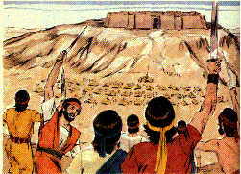
3. Abiathar, the son of Ahimelech, alone escapes; he joins with David and is assured of protection 22:20-23
David confesses responsibility for the death of his family.
4. David saves Keilah from the Philistines 23:1-6
a. Keilah attacked
b. David inquires of God - He should deliver them
c. Servant afraid - inquires again - promised victory
d. Struck Philistines with great slaughter and saved Keilah

Slide 51
5. David escapes Keilah after inquires of the Lord 23:6-14
a. Abiathar, the priest & the ephod with David
b. Saul thinks David will be trapped in the city
c. David inquires about the people of the city & Saul’s plans
Saul will come down - the people will surrender him
d. David flees with 600 men to wilderness of Ziph and Stronghold
e. Saul can not capture him.
Gibeah
Nob
BENJAMIN
Jerusalem
Azekah
Socho
Bethlehem
Adullam
Gath
Keilah
JUDAH
Hebron
Salt
Sea
Ziph
En-gedi
Carmel
Ziklag
Maon
Mizpeh
MOAB

Slide 52
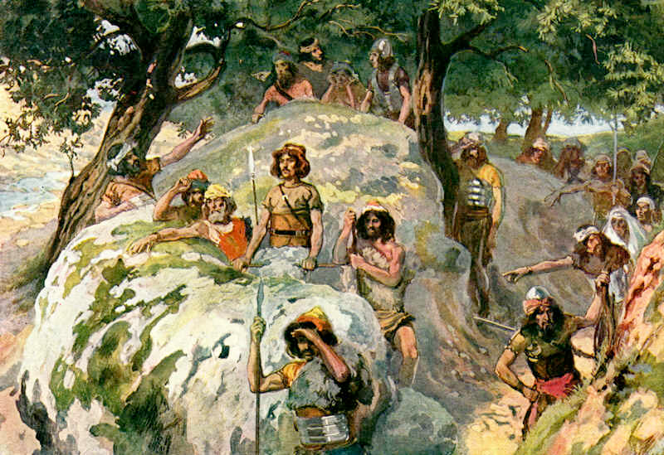
6. David’s and Jonathan’s meeting 23:15-18
a. Horesh (wood) - aware of Saul’s new pursuit
b. Jonathan encourages David - he will be king - covenant renewed

Slide 53
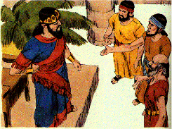
7. Ziphites help Saul 23:19-23
a. They tell Saul that David is in their area
b. They promise to surrender him
c. Saul sends them back to spy out David’s places of refuge

Slide 54
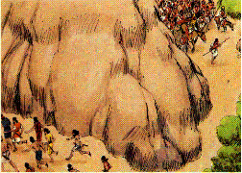
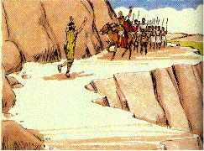
8. Saul pursues David in the Wilderness of Maon 23:24-28
a. Saul and his men on one side of the mountain and David on the other.
b. A messenger tells Saul that the Philistines have invaded
c. David’s rock of escape
d. David moves to strongholds of Engedi
Gibeah
Nob
BENJAMIN
Jerusalem
Azekah
Socho
Bethlehem
Adullam
Gath
Keilah
JUDAH
Hebron
Salt
Sea
Ziph
En-gedi
Carmel
Ziklag
Maon
Mizpeh
MOAB

Slide 55
