Slide 1
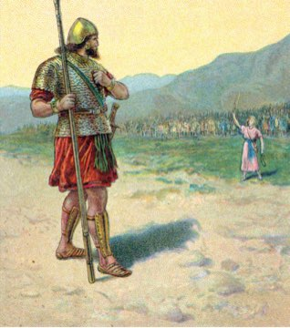
9. David retorts his defiance 45-47
45 Then David said to the Philistine, "You come to me with a sword, a spear, and a javelin, but I come to you in the name of the LORD of hosts, the God of the armies of Israel, whom you have taunted.
46 "This day the LORD will deliver you up into my hands, and I will strike you down and remove your head from you. And I will give the dead bodies of the army of the Philistines this day to the birds of the sky and the wild beasts of the earth, that all the earth may know that there is a God in Israel,
47 and that all this assembly may know that the LORD does not deliver by sword or by spear; for the battle is the LORD'S and He will give you into our hands."

Slide 2
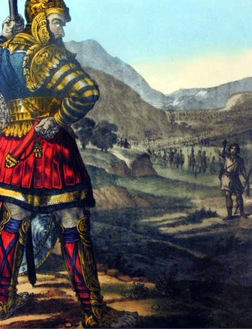
9. David retorts his defiance 45-47
a. He comes in the Name of the LORD
b. Goliath will be killed, beheaded & the Philistines will be destroyed to show there is a God in Israel
c. Israel will know the battle is the Lord’s

Slide 3
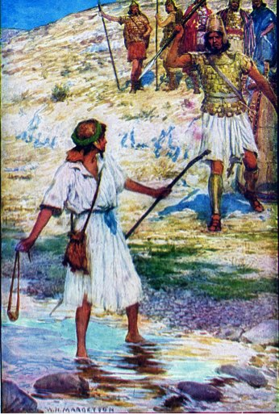
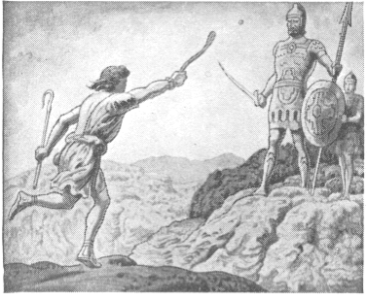
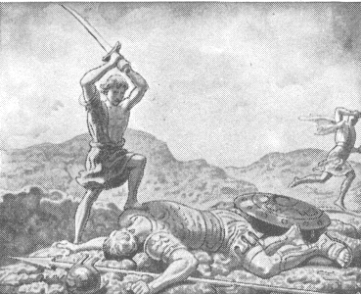
10. They draw near for battle, & David slings a stone, hits Goliath in the forehead, slays him, & cuts off his head with his own sword 48-51a
Goliath comes forward
David ran toward Goliath
Removes stone & places it in His sling
slung - qala - sling, hurled forth
struck on his forehead - metsach - brow, forehead
sank into - taba - sink down, pierce, drown
fell to the ground
prevailed - chazaq - grew strong, proved more powerful, was victorious
With a sling & a sword - no sword
Cut off his head with his own sword

Slide 4
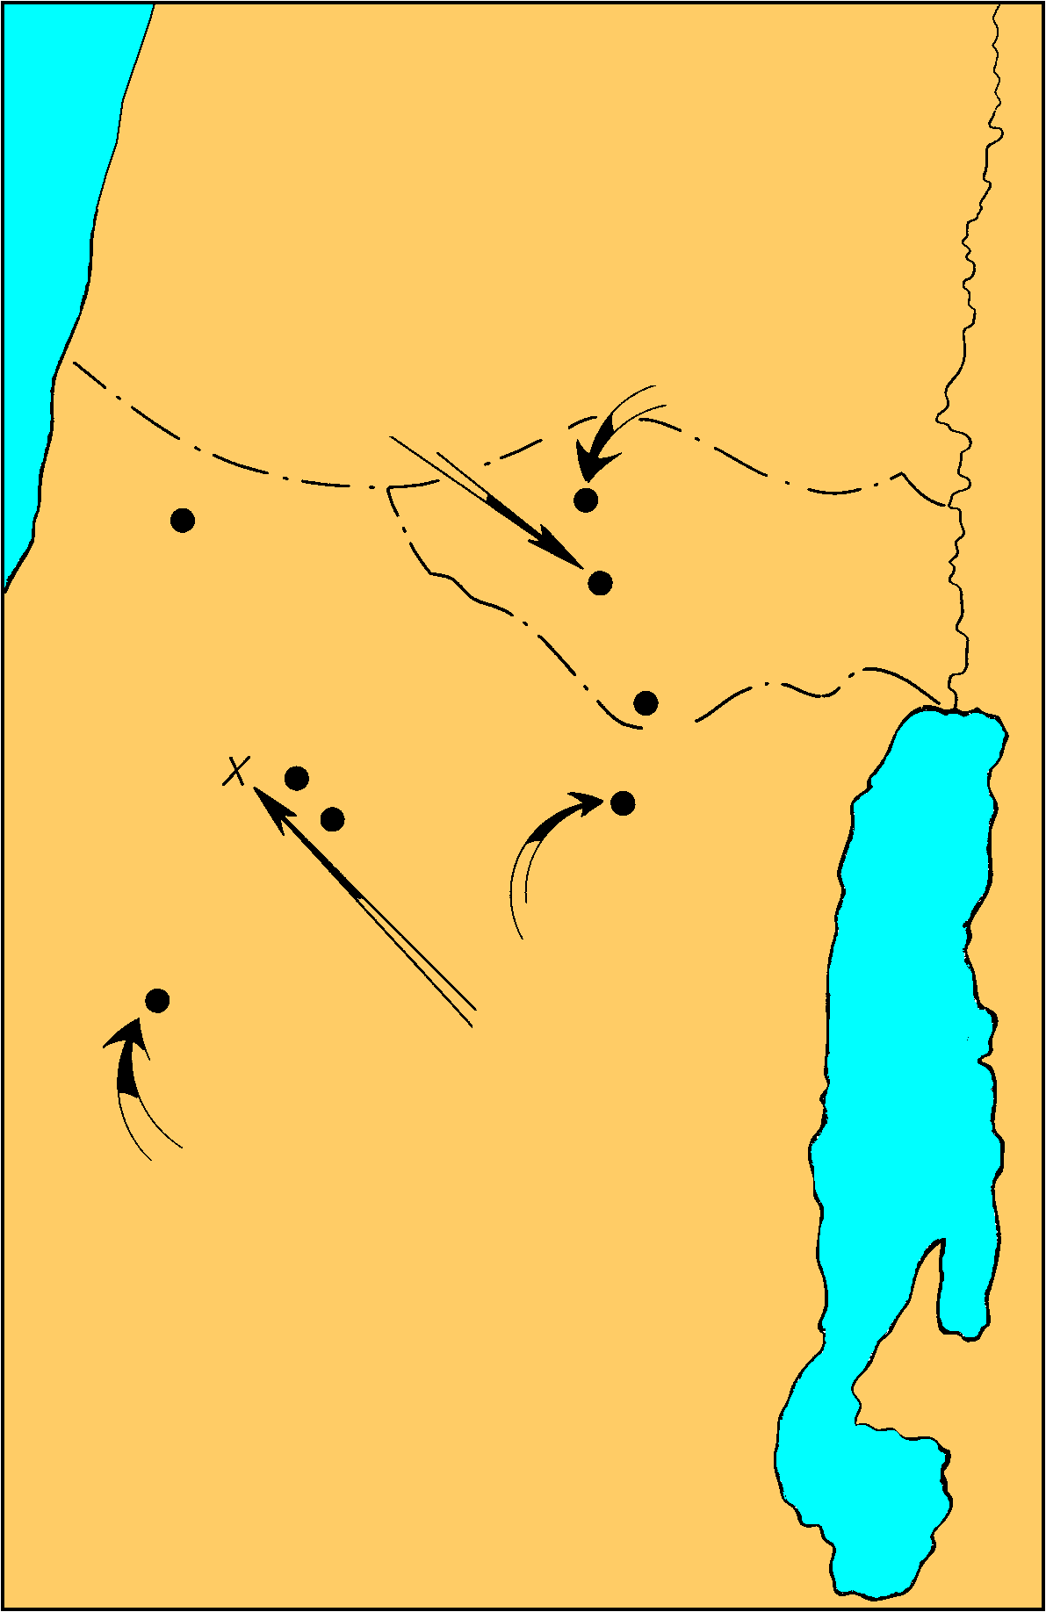
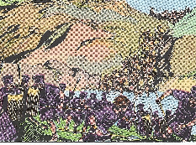
Anointing of David and Saul’s Second Philistine War
1 Sam. 16-17
11. The Philistines flee & are pursued by the Israelites 51b-53 (Ps. 18:32, 34)
Security of Giant gone
Shocked by defeat
fled - nus - escaped, took flight
pursued by Israel & Judah
to Gath & Ekron
slain Philistines - chalal - pierced, fatally wounded
Shaaraim - town in Judah, double gate - possibly found 6.5 miles due east of Gath
Israel plunders the camp
Saul’s captial
Samuel’s home
DAN
Ekron
Ramah
Gibeah
BENJAMIN
PHILISTINES
Valley of Elah
Jerusalem
Azekah
Socho
Bethlehem
David anointed
Gath
Goliath Slain
JUDAH
City of Goliath

Slide 5
Shaaraim
Western city gate of "Shaaraim"
Southern city gate of "Shaaraim"

Slide 6
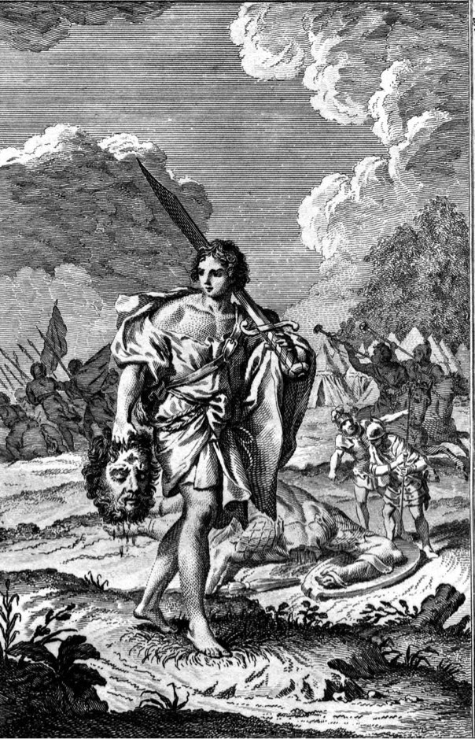
12. David brings the Philistines’ head to Jerusalem 54
Goliath’s head a trophy
Jebusites possessed citadel
Weapons put in his own tent
Possibly his reward for victory

Slide 7
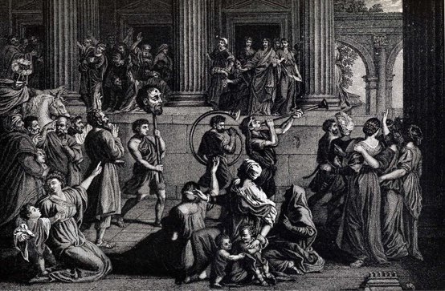
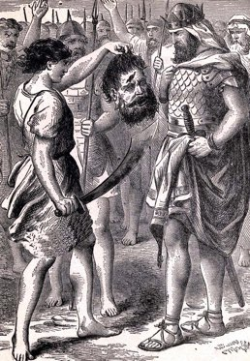
13. Conversation between Saul & Abner concerning David, who is brought before Saul 55-58
Neither Saul or Abner know David’s father
A long time since David played the lyre for Saul?
David's appearance had changed?
Robert Jamieson, “The growth of the beard & other changes in the now full-grown youth prevented the king from recognizing his former favorite minstrel.”
The events of 16 were a summary - not chronological

Slide 8
II. David Flees From Saul
18:1—21:9

Slide 9
David’s Relationship to Saul
A courtier 18:1—19:17
A fugitive 19:18—22:5
An outlaw 22:6—26:25
A mercenary 27:1-12

Slide 10
Jonathan & David commence a lasting friendship 18:1-4
Soul knit, covenant, armor given
Male bonding
Infer Jonathan was at the battle
Loves David - same faith & courage
knit - qashar -to bind, league together, to be bound
Deep affection, admiration, devotion, loyalty
Saul attached David to permanent service
Jonathan & David made covenant of friendship & helpfulness
Gives David His robe - meheel - mantle, outer garment, armor
Sword & bow & belt
Gesture of friendship, admiration of his valor

Slide 11
David acts obediently & wisely & is placed over the men of war 18:5
prospered - sakal - to be prudent, circumspect, have success
pleasing - yatab - good, pleasing to
Good decision to promote David
Approved by civil & military officials

Slide 12
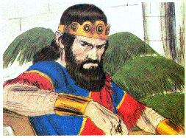
Saul becomes jealous of David, on account of the esteem in which he is held in Israel 18:6-9
Women of cities & villages
Singing & dancing & playing
David has slain 10,000s
Sang alternately to one another
Saul very angry - charah - hot, furiousto burn or be kindled with anger
displeased - raa - to be evil, bad, to be displeased, annoyed, dissatisfied
looked with suspicion - in - to eye (enviously), look (askance)
Saul from that day saw David as a threat

Slide 13
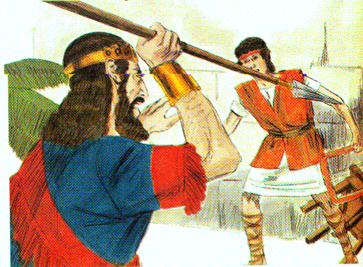
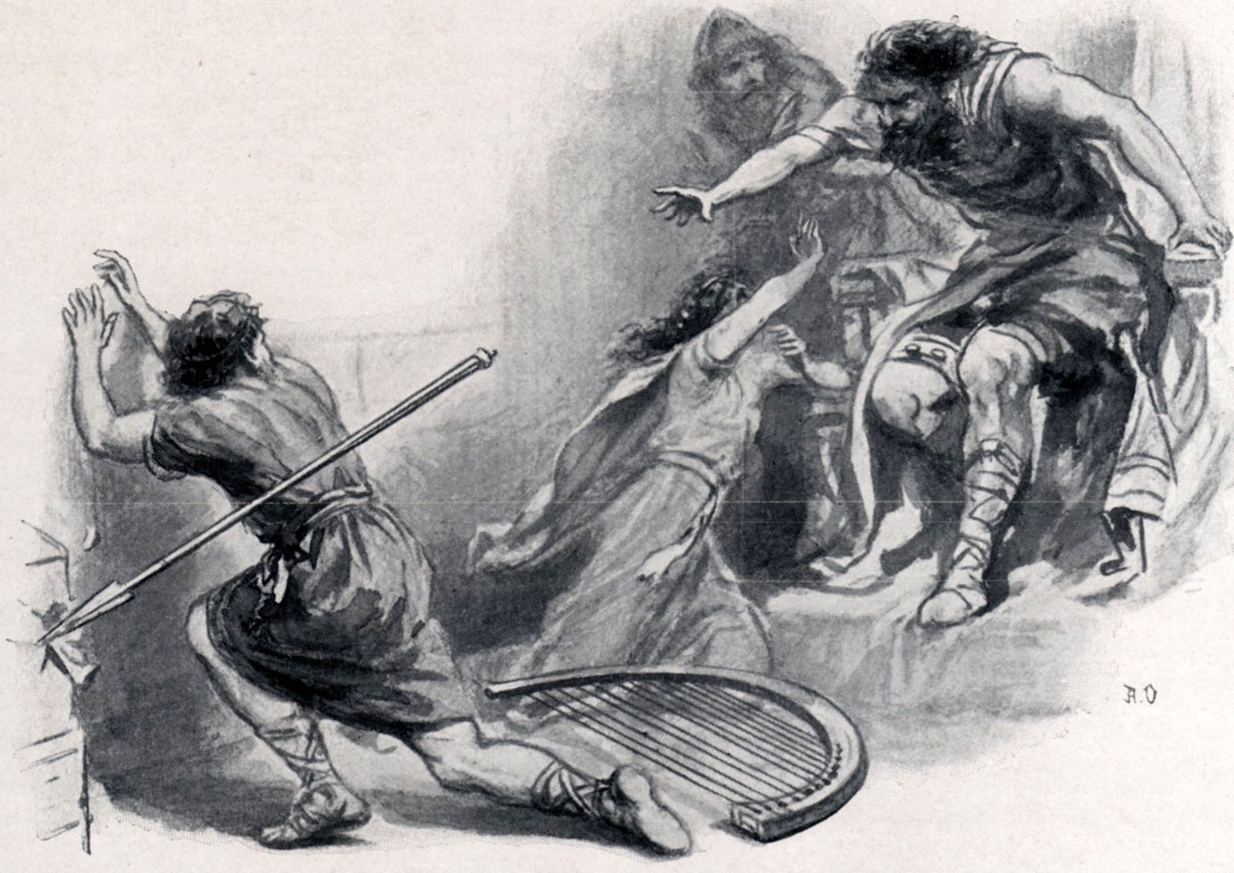
David driven out of Saul’s court 18:10-16
Saul in fury endeavors to destroy David 10-12
the next day
an evil spirit fell upon him
raved - naba - prophesy, excited to violence, talk wildly or incoherently
David played the harp to try and soothe him
Saul tried to kill him with a spear
David escaped twice
escaped - sabab - to turn about, go around
Aware God was with Him
Afraid

Slide 14
David driven out of Saul’s court 18:10-16
b. David is made captain over a thousand; & the people love & respect him 13-16
Sent away from Saul’s presence
Commander of a thousand
In the view of the people
Standing army now
Prospering - valor, courage, faith, intelligence - adept a warfare
Providential help
Saul dreaded - gur - to dread (anticipated with great apprehension or fear), be afraid
Israel and Judah loved David
out and in - carried out military enterprises

Slide 15
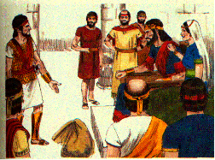
5. Saul, in order to ensnare David, offers him his daughters in marriage 18:17-29
Merab offered to David then given to another 17-19
Merab offered as wife for victories
Laying a trap
Planned for David to be killed by Philistines
David humbly refuses
Merab given to Adriel
insult to David?

Slide 16
5. Saul, in order to ensnare David, offers him his daughters in marriage 18:17-29
b. Michal is offered to David 20-29
Michal love David
New opportunity to destroy David
Servant find out David reasons for refusing
no wealth, lightly esteemed
1) Saul requires a hundred Philistine foreskins for dowry; hoping David would be killed in procuring them 25
2) David agrees to the conditions, fulfills them, & has Michal for his wife 26-29
Killed 200 - counted them out
Michal given - Saul more afraid
Enemy of God’s man

Slide 17
6. David behaves more wisely against the Philistine than all the servants of Saul 18:30
Philistines continue to invade
David outstanding and wiser than others
Name highly esteemed

Slide 18
B. David’s final flight from Saul’s court 19
Jonathan pleads for David before Saul, who is for the present reconciled 19:1-7
Jealousy & madness cause Saul to plot against David
Jonathan warned David to hide
Delights in David
Intercedes for David in field where David hid
David had done good for the king and the kingdom
David risked his life to fight the Philistine
Gave great deliverance
Why shed innocent blood
Logic worked
David brought to Saul - reconciled

Slide 19
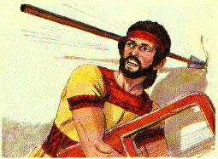
B. David’s final flight from Saul’s court 19
David defeats the Philistines & Saul becomes envious, & endeavors to slay him, but he escapes 19:8-10
Philistine invade - David puts them to flight
Evil spirit upon Saul
Tries to kill David with his spear
David fled & escaped that night

Slide 20
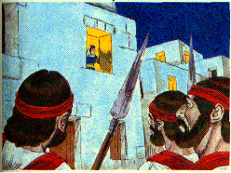
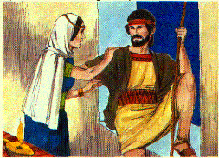
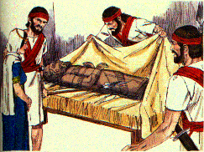
Saul sends men to David’s house, to lie in wait for him; but Michal saves him by stratagem 19:1-17 (Ps. 59)
Servant send to David’s house to slay him in the morning
Michal warns David to flee that night
Ps. 59 written
David calls God’s wrath down on the wicked
Appealing for justice
Let down from window by Michal
Image placed in bed
Teraphim was Michal’s - for fertility
goat’s hair at the head
covered with cloth
Saul’s messengers sent to kill David 11
Michal warns David & lets him down through a window 11b, 12
Michal buys time for David 13-17

Slide 21
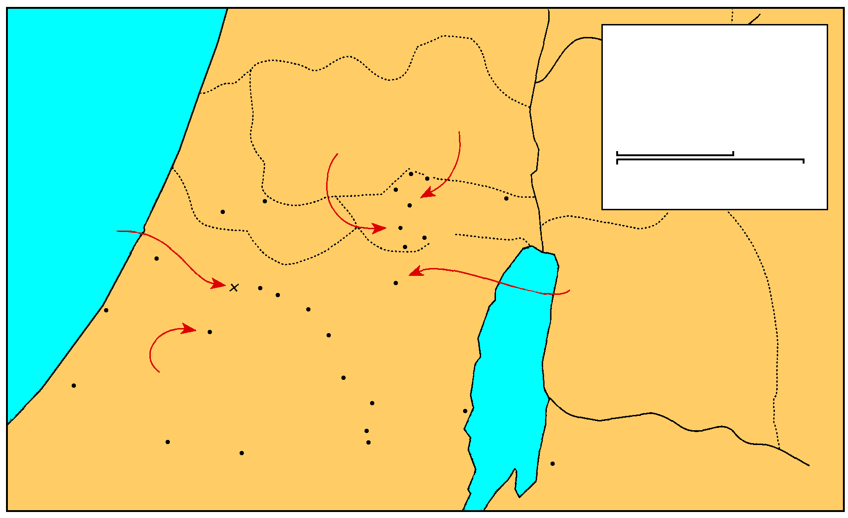
MANASSEH
Saul And David
EPHRAIM
1 Samuel 16-27
THE GREAT SEA
Samuel’s home
GAD
DAN
Saul’s capital
25 km
Bethel
Ai
0
25 Miles
Gezer
Mizpah
Ekron
Ramah
Jericho
Goliath Slain
Gibeah
BENJAMIN
Nob
Ashdod
Valley of Elah
Jerusalem
Azekah
Bethlehem
David anointed
Ashkelon
Socho
PHILISTINES
Adullam
Gath
Keilah
JUDAH
REUBEN
Hebron
Salt
Sea
Gaza
City of Goliath
Ziph
En-gedi
Gerar
Carmel
Maon
SIMEON
Ziklag
Mizpeh of Moab
MOAB

Slide 22
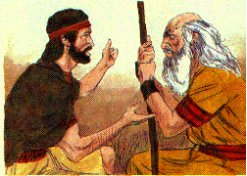
David flees to Samuel, at Ramah 19:18
S

Slide 23
Saul, hearing of it, sends messengers three times to take him; but God’s Spirit makes them prophesy 19:19-21
S

Slide 24
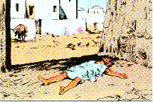
Saul, hearing of this, goes after David himself, and falls under the same influence 19:22-24
Security of Giant gone
Shocked by defeat

Slide 25
C. David’s farewell to Jonathan 20

Slide 26
David complains to Jonathan about Saul enmity against him; Jonathan comforts him 20:1-11
Jonathan knew and suspected nothing about his father; David explains that Saul knows of their friendship; but a step between me and death 20:1-3
Security of Giant gone
Shocked by defeat

Slide 27
David complains to Jonathan about Saul enmity against him; Jonathan comforts him 20:1-11
Jonathan to find out Saul plans at the New Moon celebration; Jonathan is to tell Saul that David has gone to a family sacrifice in Bethlehem & see if he becomes angry 20:4-11
Security of Giant gone
Shocked by defeat

Slide 28
Jonathan’s plan to warn David and asks for a covenant with David to protect his house 20:12-17
Security of Giant gone
Shocked by defeat

Slide 29
Jonathan informs him how he will ascertain the disposition of his father towards him and how he will give him the news 20:18-23
Security of Giant gone
Shocked by defeat

Slide 30
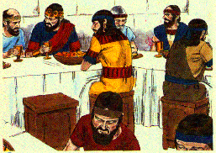
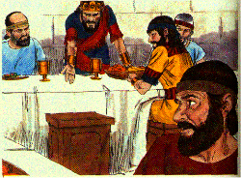
David hides himself; is missed by Saul; Jonathan is questioned concerning his absence; makes an excuse for David; Saul is enraged, & endeavors to kill Jonathan 20:24-33
Security of Giant gone
Shocked by defeat
David’s place was empty 24-26
2nd day Jonathan questioned 27

Slide 31
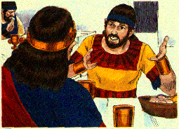
David hides himself; is missed by Saul; Jonathan is questioned concerning his absence; makes an excuse for David; Saul is enraged, & endeavors to kill Jonathan 20:24-33
Security of Giant gone
Shocked by defeat
Jonathan explains 28, 29

Slide 32
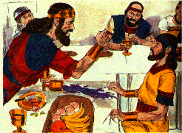
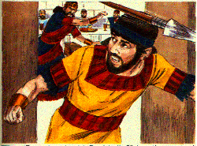
David hides himself; is missed by Saul; Jonathan is questioned concerning his absence; makes an excuse for David; Saul is enraged, & endeavors to kill Jonathan 20:24-33
Security of Giant gone
Shocked by defeat
Saul’s anger burned against Jonathan 30, 31
Saul hurls a spear to strike him down 33

Slide 33
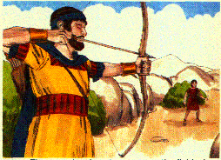
Jonathan goes out to the field; give David the sign they had agreed on, & by which David would know that king sought to kill him 20:34-39
Security of Giant gone
Shocked by defeat

Slide 34
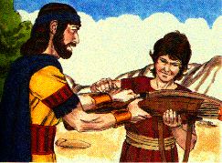
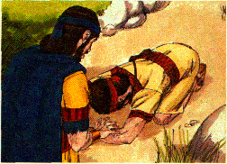
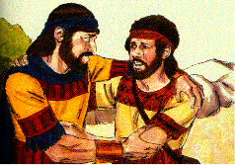
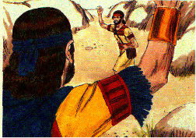
Jonathan sends his servant back into the city; & then he & David meet, renew their covenant, & have a very affectionate parting 20:40-42
Security of Giant gone
Shocked by defeat

Slide 35
MANASSEH
Saul And David
EPHRAIM
1 Samuel 16-27
THE GREAT SEA
Samuel’s home
GAD
DAN
Saul’s capital
25 km
Bethel
Ai
0
25 Miles
Gezer
Mizpah
Ekron
Ramah
Jericho
Goliath Slain
Gibeah
BENJAMIN
Nob
Ashdod
Valley of Elah
Jerusalem
Azekah
Bethlehem
David anointed
Ashkelon
Socho
PHILISTINES
Adullam
Gath
Keilah
JUDAH
REUBEN
Hebron
Salt
Sea
Gaza
City of Goliath
Ziph
En-gedi
Gerar
Carmel
Maon
SIMEON
Ziklag
Mizpeh of Moab
MOAB

Slide 36
D. David at Nob 21
Ahimelech gives David consecrated bread 1-6
Observed by Doeg Saul’s servant 7
David is given Goliath’s sword 8, 9

