Slide 1
The Lord will not change His mind 15:29-31
The Lord will not change His mind
His Nature & plan will not change
Grief will not move God to change His plan
God does right
Honor me now before the elders
Wants honor as king
Most interested in being popular
worship your God
Saul worshipped

Slide 2
Samuel causes slays Agag, & gives the reason 15:32-33
Shows Saul’s disobedience
Samuel sees the Lord’s will done
Agag - to burn, to be violent, might, I will overtop
came cheerfully - Rt. to be soft, lax, pliant; as adverb cheerfully, willingly
Thought he was spared - would not be killed now
made childless - shakal - to be bereaved
Agag was a murderer
hewed to pieces - shaspah - cut in pieces

Slide 3
Samuel Returns to Ramah 15:34-35
Samuel returned home - did not see Saul again
Permanent break with God & Samuel
Samuel’s grief over Saul
grieved - abal - to mourn, lament
over what he might have been
The Lord sorry - nacham - be sorry, rue, suffer grief
King Saul
Lost his dynasty
His character
His throne & crown
A godly friend
He will lose
His self-control & good sense
His last battle & life

Slide 4
King Saul
GOOD POINTS
striking appearance 9:2
initiative 11:7
bravery 13:3
patriotic Spirit-filling 11:6
DEGENERATED INTO
pride 18:8
rebellion 20:31
recklessness 14:24
Evil spirit depressed 16:14

Slide 5
LESSONS FOR LEARNING
Sin cannot go unpunished
Amalekites remembered Exodus 17:14
God will remember sins of the unrepentant
To obey is better than sacrifice
Eternal principle
Better to do God's will in the first place
Obedience is the preferred sacrifice

Slide 6
Section Three: Saul and David, 1 Sam. 16—31 & 2 Sam. 1

Slide 7
David Anointed 1 Samuel 16—17:58
David’s rise to prominence in Israel
A. David is chosen as Saul’s successor 16

Slide 8
1. Samuel is sent from Ramah to Bethlehem, to Anoint David 16:1-13
a. Samuel commanded to anoint a son of Jesse as king 1
Time to move on from Saul
Rejected
Fill your horn with oil
Anoint a son of Jesse
Gen. 49:10 from Judah
Boaz & Ruth, Obed, Jesse, David, Ruth 4:18-22

Slide 9
b. Samuel fears Saul & the Lord tells him to go & offer a sacrifice at Bethlehem 2-3
Saul would kill him
Take a heifer for sacrifice
Female offered as a peace offering Lev. 3:1, 6, 12
Sacrifice at Bethlehem
Occasion for His trip
Jesse to be called to the sacrifice

Slide 10
c. Elders of Bethlehem and Jesse & his sons are invited to the sacrifice 4, 5
Elders trembled - harad - to fear, be timid, tremble
nervous & fearful
Comes peaceably
Sacrifice to the Lord
Elders & Jesse & sons invited

Slide 11
d. God looks at the heart & rejects seven sons of Jesse 6-10
Eliab, 1st born
Looked kingly
Do not look at physical appearance
Rejected - lightly esteemed, refused
God examines the heart
Abinadab, Shammah, all seven
Not chosen
8 Sons of Jesse - one died
7 Sons have names recorded
1 Chron. 2:13-15

Slide 12
e. David is sent for & anointed 11-13
All your children?
youngest - quatan - small, insignificant, unimportant, youngest
tending sheep
Will not sit down at the feast
ruddy - admoni - red, a face having a healthy red color
beautiful eyes - yapheh - fair, beautiful
handsome - towb - fair, pleasant, good, agreeable
Arise & anoint
surrounded by brothers
Holy Spirit - inspired 2 Sam. 23:2

Slide 13
The Remarkable Prolepsis Of Events To Come
Not intended as a detailed sequel to 1 Sam. 16:1-13
A panoramic picture of events to be detailed in next chapters
This type of historical writing is found frequently in the Bible,
Book of Revelation

Slide 14
2. The Spirit of the Lord departs from Saul, & an evil spirit comes upon him 16:14
evil spirit - demon influence or fits of depression & paranoia
Permitted by God or sent as punishment by God
terrorized - baath - to fall upon, startle, terrify; bring dark depression & torments

Slide 15
3. His servants encourage him to get a skillful harper to play for him 16:15-16
spirit - disposition or being
music a common remedy for depression & mental illness
skillful - yada - to know by experience, know how, skillful in
player - nagan - to touch or play a stringed instrument
The plan worked v. 23

Slide 16
4. He is pleased with the advice, & commands that such a man be found 16:17
Saul calls for such a man
David was just this kind of player
5. David is recommended to Saul 16:18
David was know to one of the servants
Good with the harp
Mighty man of valor
A warrior
Prudent in speech - intelligent, discreet, knowing
Handsome
The Lord is with him - providentially & religiously

Slide 17
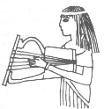
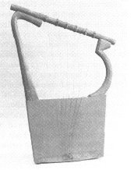
6. David is sent for, comes, plays for Saul, and finds favor in his sight 16:19-23
Servants sent to Jesse
David sent to Saul with gifts: bread, skin of wine, kid
stood before - placed as his disposal
Saul loves David and makes him his armor bearer
David plays the harp and refreshes Saul

Slide 18
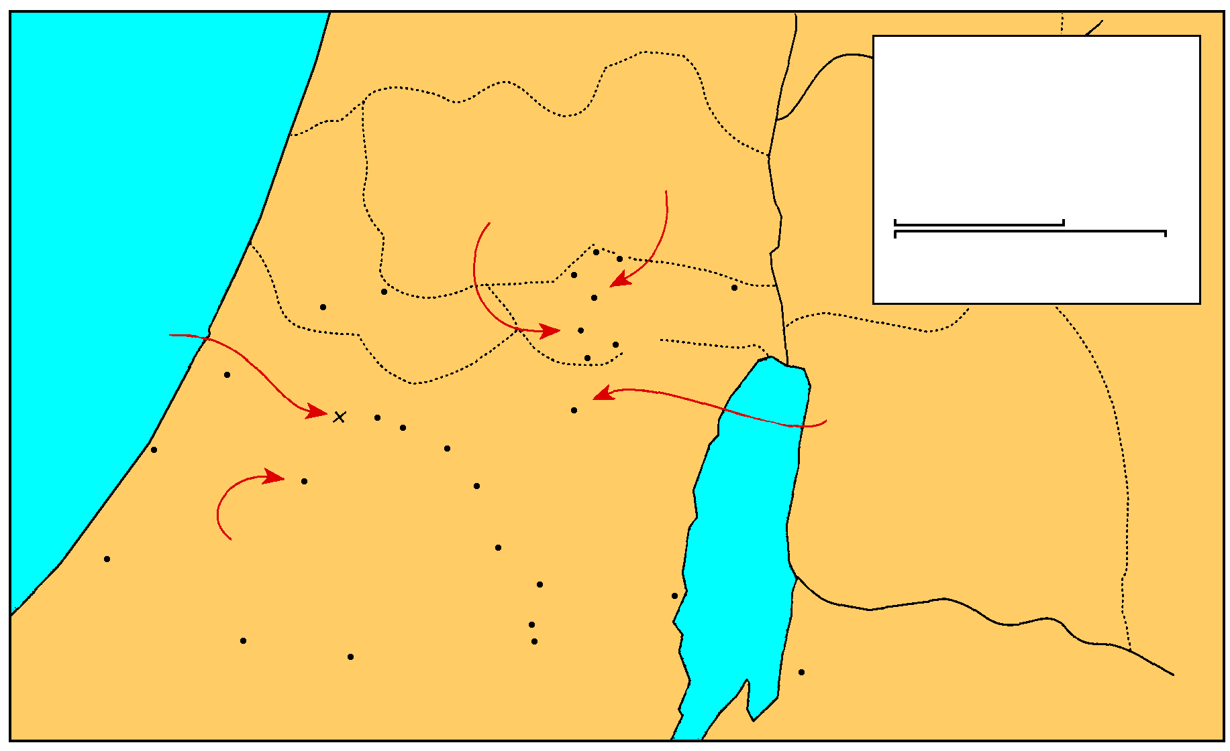
MANASSEH
Saul And David
1 Samuel 16-27
THE GREAT SEA
EPHRAIM
Samuel’s home
GAD
DAN
Saul’s capital
25 km
Bethel
Ai
Mizpah
0
25 Miles
Gezer
Ramah
Jericho
Ekron
Gibeah
BENJAMIN
Goliath Slain
Nob
Valley of Elah
Jerusalem
Ashdod
Azekah
Socho
Bethlehem
David anointed
Ashkelon
Adullam
PHILISTINES
Keilah
Gath
JUDAH
REUBEN
Salt
Sea
City of Goliath
Hebron
Gaza
Ziph
En-gedi
Gerar
Carmel
Maon
Ziklag
Mizpeh of Moab
SIMEON
MOAB

Slide 19
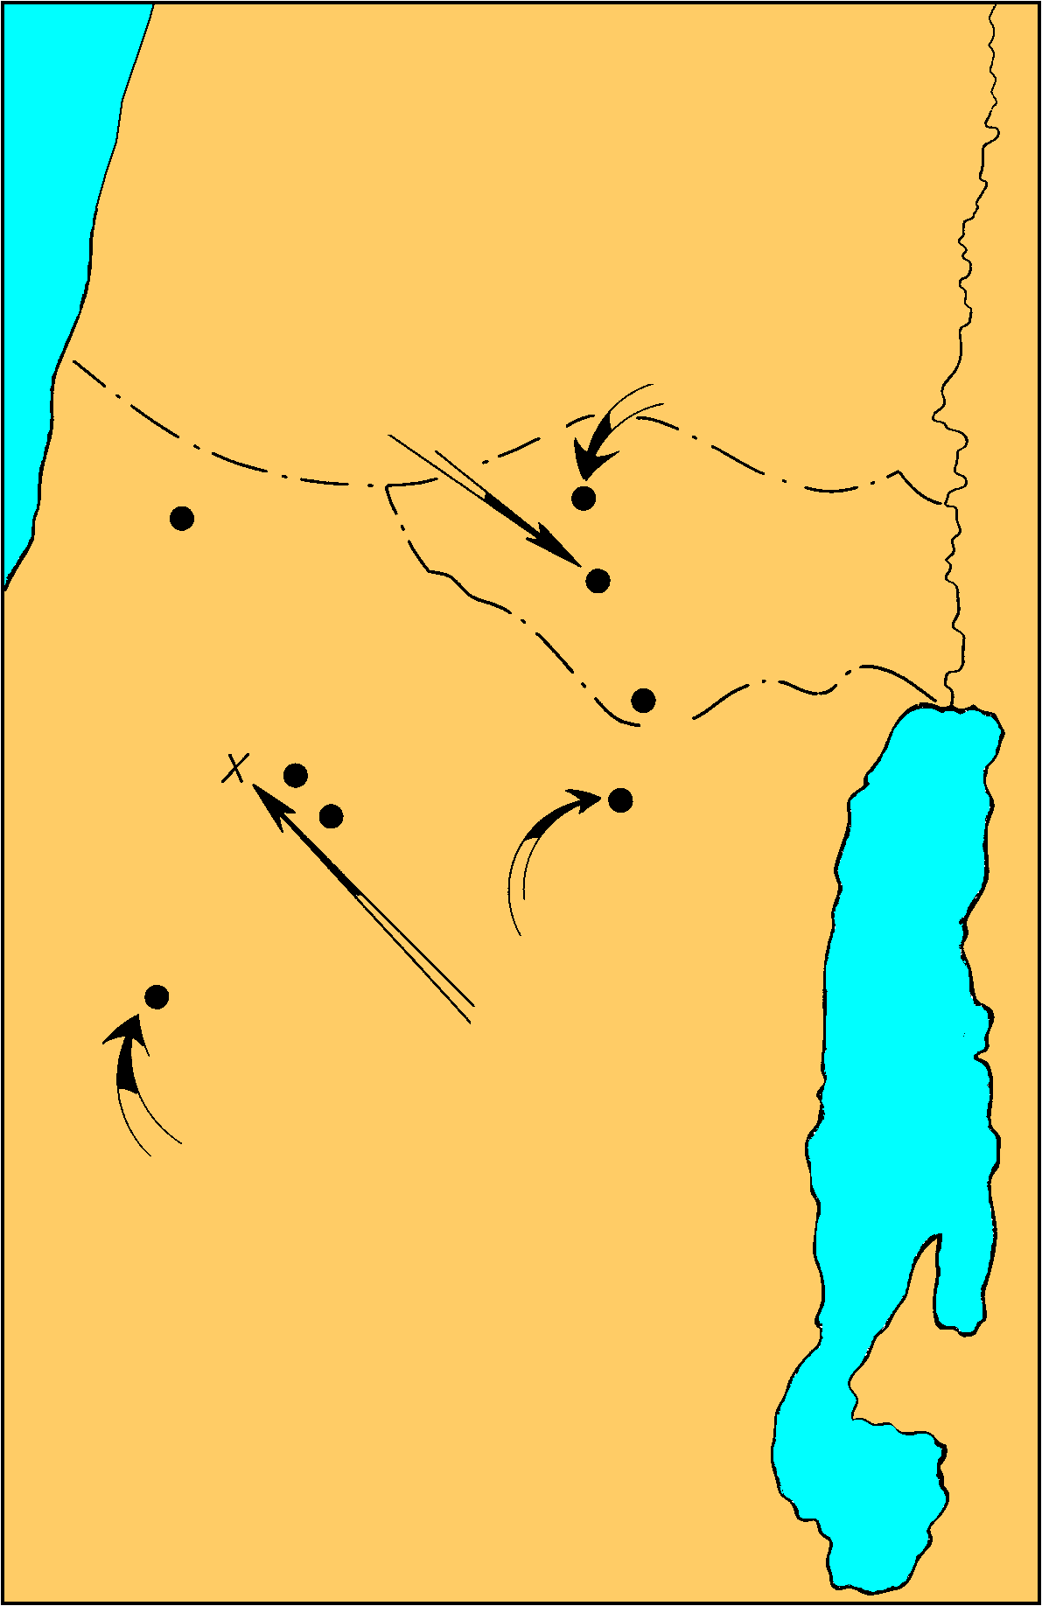
B. David’s victory over Goliath 17
Anointing of David and Saul’s Second Philistine War
1 Sam. 16-17
1. The Philistines gather together against Israel between Socoh & Azekah, and Saul and his men camped near the valley of Elah 1-3
Saul’s captial
Samuel’s home
DAN
Ekron
Ramah
Gibeah
BENJAMIN
PHILISTINES
Valley of Elah
Jerusalem
Azekah
Socho
Bethlehem
David anointed
Gath
Goliath Slain
JUDAH
City of Goliath

Slide 20
1. The Philistines gather together against Israel between Socoh & Azekah, & Saul and his men camped near the valley of Elah 1-3
Socoh & Azekah - border between them
Gath 7 miles W NW of Socoh
Socoh & Azekah - 5 miles apart
Philistine camp - Ephes-dammim “border of blood”
forces arranged for advantage
wadi - filled with smooth stones
Notes:
uh-zee’kuh
soh’koh
ee’fiz-dam’im

Slide 21
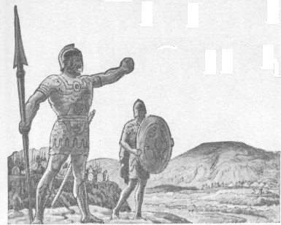
2. Goliath’s challenge 4-11
a. Goliath of Gath, a gigantic man, whose height was six cubits and a span 4
b. His armor described 5-7
c. He defies the Israelites’ armies, & proposes to end all contests by single combat 8-10
d. Saul and his army are greatly dismayed 11

Slide 22
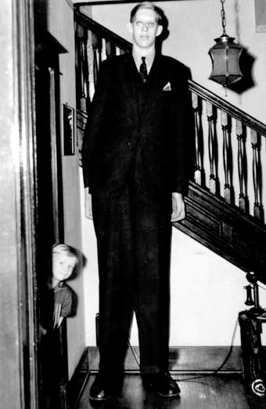
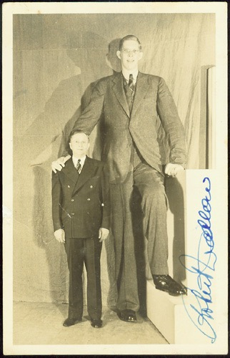
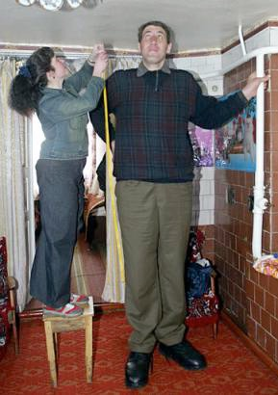
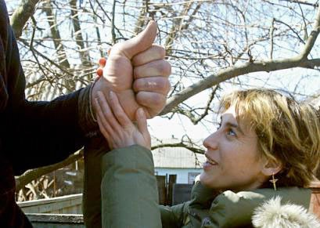
The tallest man ever recorded was Robert Wadlow of Illinois who at his death was 8ft 11ins. He died in 1940 at the age of 22.
Leonid Stadnik 8ft. 4ins

Slide 23
B. David’s victory over Goliath 17
3. David hears Goliath’s challenge 12-27
a. David three oldest brothers where with Saul, but David went back and forth from Saul to tend his father’s sheep 12-16
b. David is sent by his father with food to his brothers 17-19
c. David comes to the camp of Saul, greets his brothers, hears the challenge and the promise of reward for the man who kills Goliath 20-25
David inquires into the circumstances, thinks it a reproach to Israel that no man can be found to accept the challenge 26-30

Slide 24
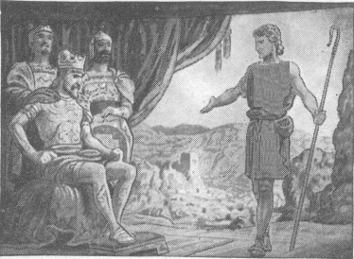
B. David’s victory over Goliath 17
4. David is brought before Saul, and proposes to undertake the combat 30-32
5. Saul objects because of his youth and inexperience 33

Slide 25
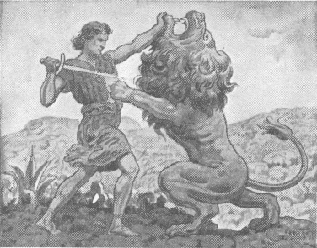
B. David’s victory over Goliath 17
6. David shows the grounds for accepting the challenge 34-37
a. He killed the lion and bear 34-36
b. The Lord will deliver him 37

Slide 26
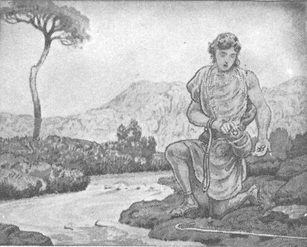
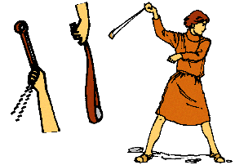
B. David’s victory over Goliath 17
7. Saul arms him with his own armor; but David, finds it an encumbrance and puts them off, and takes his staff, sling and five stones from the brook, and goes to meet Goliath 38-40
8. The Philistine draws near, disdains, defies and curses David 41-44

Slide 27
B. David’s victory over Goliath 17
9. David retorts his defiance 45-47
45 Then David said to the Philistine, "You come to me with a sword, a spear, and a javelin, but I come to you in the name of the LORD of hosts, the God of the armies of Israel, whom you have taunted.
46 "This day the LORD will deliver you up into my hands, and I will strike you down and remove your head from you. And I will give the dead bodies of the army of the Philistines this day to the birds of the sky and the wild beasts of the earth, that all the earth may know that there is a God in Israel,
47 and that all this assembly may know that the LORD does not deliver by sword or by spear; for the battle is the LORD'S and He will give you into our hands."

Slide 28
B. David’s victory over Goliath 17
9. David retorts his defiance 45-47
a. He comes in the Name of the LORD
b. Goliath will be killed, beheaded and the Philistines will be destroyed to show there is a God in Israel
c. Israel will know the battle is the Lord’s

Slide 29
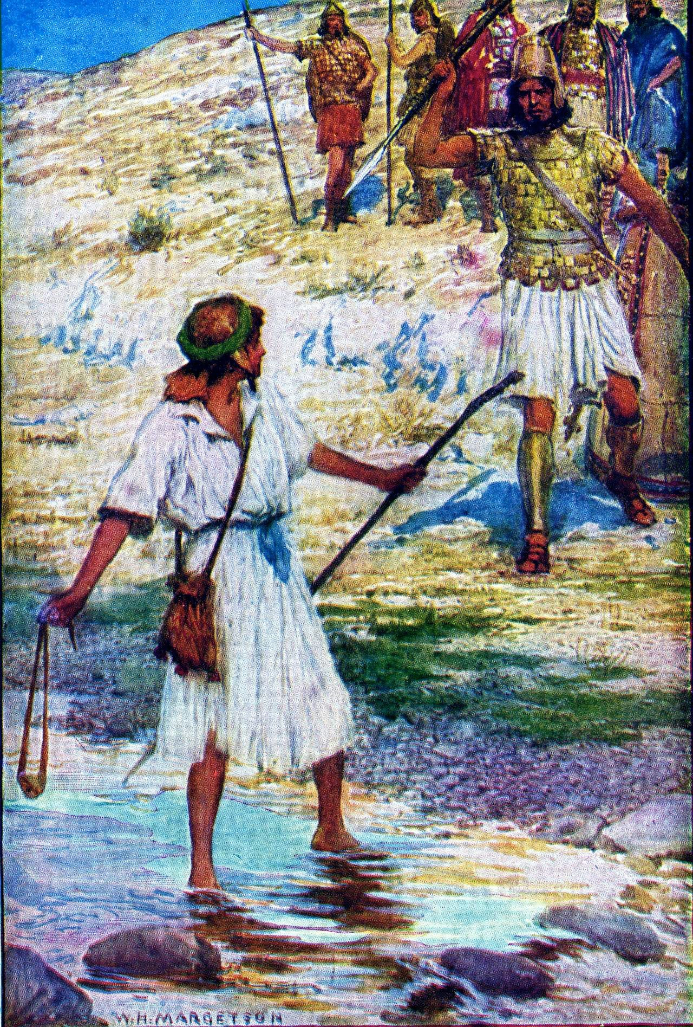
B. David’s victory over Goliath 17
10. They draw near for battle, and David slings a stone, hits Goliath in the forehead, slays him, and cuts off his head with his own sword 48-51a

Slide 30
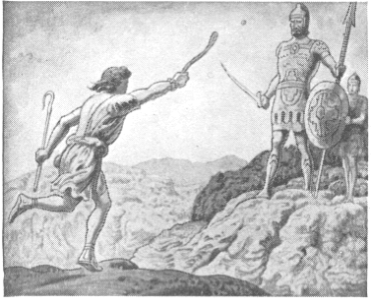
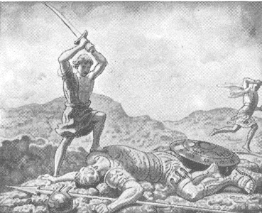
B. David’s victory over Goliath 17
10. They draw near for battle, and David slings a stone, hits Goliath in the forehead, slays him, and cuts off his head with his own sword 48-51a

Slide 31
B. David’s victory over Goliath 17
Anointing of David and Saul’s Second Philistine War
1 Sam. 16-17
11. The Philistines flee & are pursued by the Israelites 51b-53
Ps. 18:32, 34
Saul’s captial
Samuel’s home
DAN
Ekron
Ramah
Gibeah
BENJAMIN
PHILISTINES
Valley of Elah
Jerusalem
Azekah
Socho
Bethlehem
David anointed
Gath
Goliath Slain
JUDAH
City of Goliath

Slide 32
B. David’s victory over Goliath 17
12. David brings the Philistines’ head to Jerusalem 54
13. Conversation between Saul and Abner concerning David, who is as a consequence brought before Saul 55-58
Neither Saul or Abner recognize David
A long time since David played the lyre for Saul
David's appearance had changed
Robert Jamieson, “The growth of the beard and other changes in the now full-grown youth prevented the king from recognizing his former favorite minstrel.”

