Slide 1
Section Two: Samuel and Saul
7:3—15:35

Slide 2
C. The ark is returned to Israel 6-7:2
3. Men of Beth-shemesh smitten 6:19-21
For too curiously looking into the ark, the men of Beth-shemesh are smitten of the Lord, 19-20
They send to the inhabitants of Kiriath-jearim, that they may take away the ark, 21

Slide 3
Lessons
Keep watch over the first risings of a spirit of regarding divine things lightly.
Cultivate in young & old reverence for all things connected with worship of God.
The severity of God is really mercy to his creatures as a whole.

Slide 4
C. The ark is returned to Israel 6-7:2
4. The ark in the house of Abinadab 7:1-2

Slide 5
Section Two: Samuel and Saul
7:3—15:35

Slide 6
I. Samuel the Judge 7:3—8:22

Slide 7
A. Consecrates the people and defeats the Philistines 7:3-17
Purification of Israel from idolatry 3-4
Samuel reproves and exhorts the people
Whole hearted return demanded

Slide 8
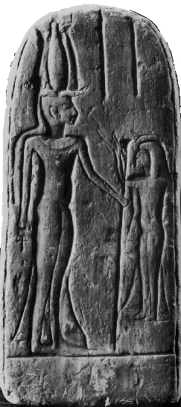
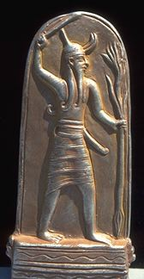
Baal and Ashtaroth

Slide 9
A. Consecrates the people and defeats the Philistines 7:3-17
Purification of Israel from idolatry 3-4
Seeking the Lord
Put away false gods - Prepare hearts
Remove our idols (money, hobbies, material things)
Idols in heart are most dangerous

Slide 10
2. Victory obtained over the Philistines through Samuel’s prayer 5-14
Samuel gathers Israel together at Mizpah, where they fast, pray, and confess their sins 5, 6
Confessed their sins
poured out water or souls
broken and contrite heart Ps. 51:7
Samuel judged the people as God’s deputy

Slide 11
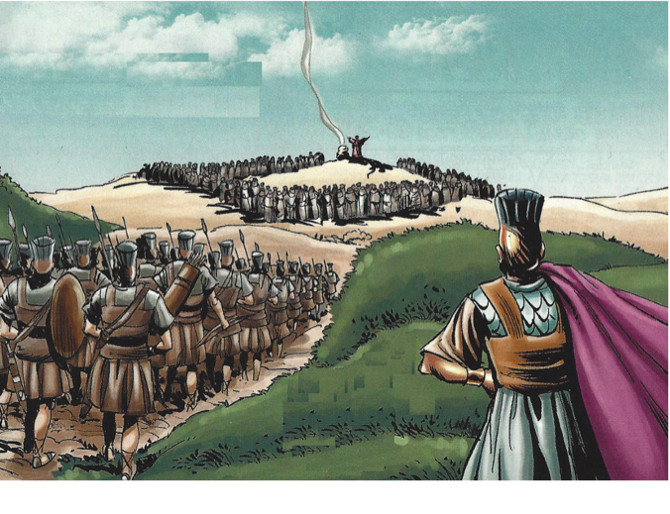
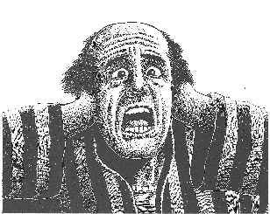
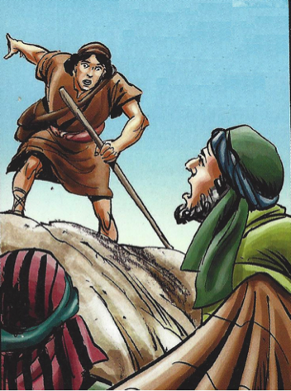
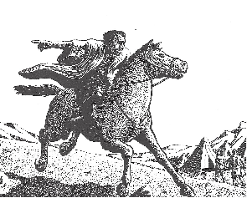
The Philistines go up against Israel; the Israelites cry to the Lord for help; Samuel offers sacrifices; and the Lord confuses the Philistines with thunder; Israel routes and pursues them to Bethcar 7-11
Mizpah was five miles northwest of Jerusalem
Because of their sins the people feared the Philistines
They ask Samuel to pray for them

Slide 12
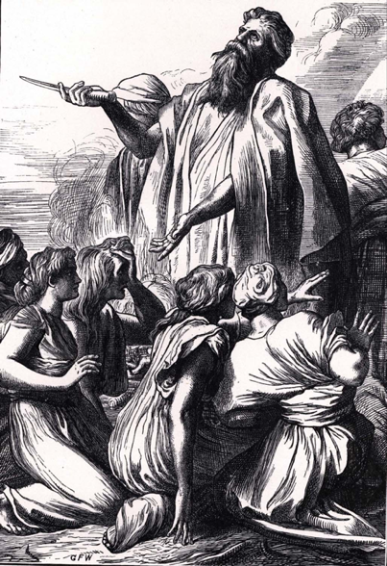
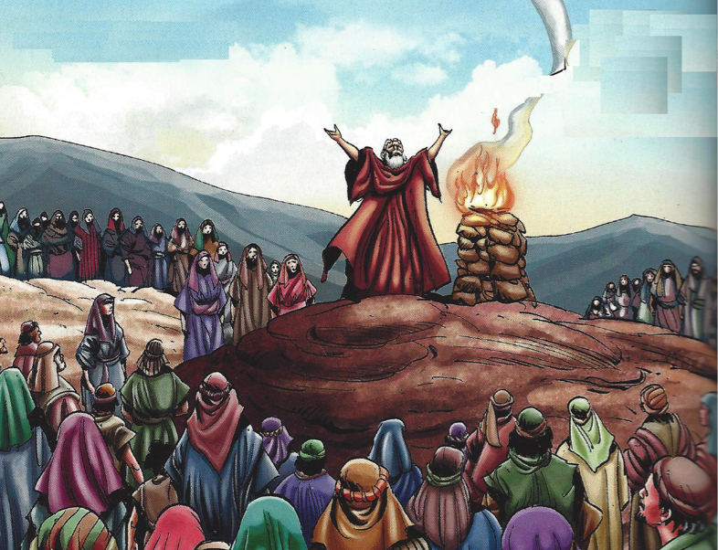
The Philistines go up against Israel; the Israelites cry to the Lord for help; Samuel offers sacrifices; and the Lord confuses the Philistines with thunder; Israel routes and pursues them to Bethcar 7-11
Burnt offering indicated - the total dependence

Slide 13
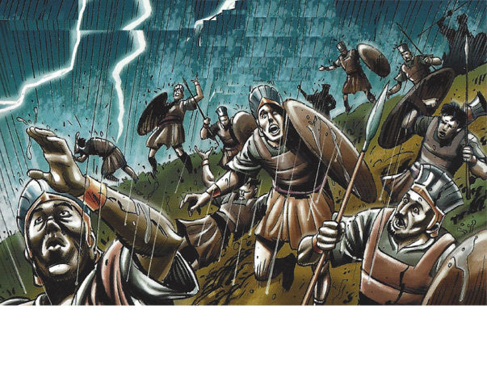
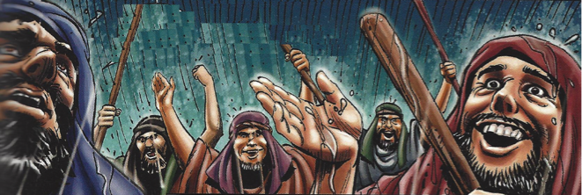
The Philistines go up against Israel; the Israelites cry to the Lord for help; Samuel offers sacrifices; and the Lord confuses the Philistines with thunder; Israel routes and pursues them to Bethcar 7-11
A great thunder confused the Philistines and helped
Beth-car - place of the lamb - unknown

Slide 14
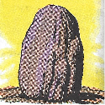
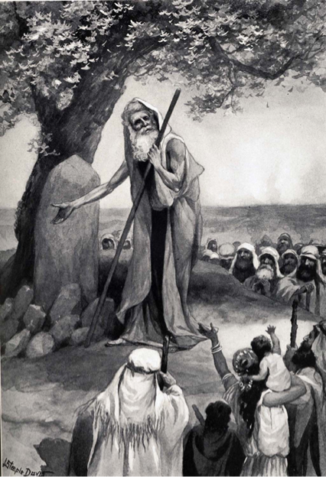
Samuel erects a stone for a memorial and calls it Ebenezer 12
Ebenezer - stone of help
God brought them to repentance and victory
Samuel believed God would help them further
They commemorated the victory
Jacob stone at Bethel
Achon’s disobedience - heap
Ai king - heap
Cave at Makkedah - 5 kings defeated and slain
Death of Joshua, stone of witness “serve the Lord”

Slide 15
2. Victory obtained over the Philistines through Samuel’s prayer 5-14
The Philistines are totally subdued, and Israel recovers all its lost cities 13-14
The hand of the Lord was against the Philistines
Amorites (high ones) - Canaanites - Gen. 15:16, 19-21
They gave Israel no trouble at this time

Slide 16
3. Samuel’s labors as judge 15-17
Samuel travels from place to place as a judge in Israel
He does not seem to have judged them for many years
From the death of Eli to the reign of Saul.
They respected Samuel
Ministered to whole nation - appointed leader by God

Slide 17
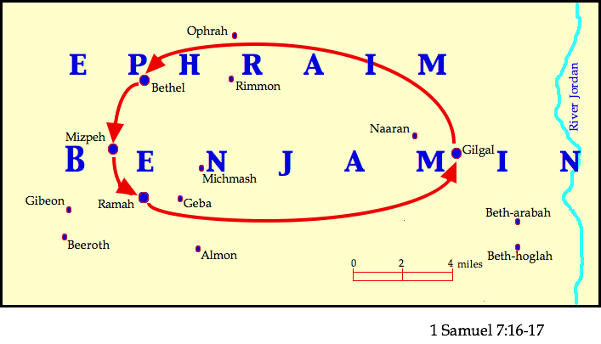

Slide 18
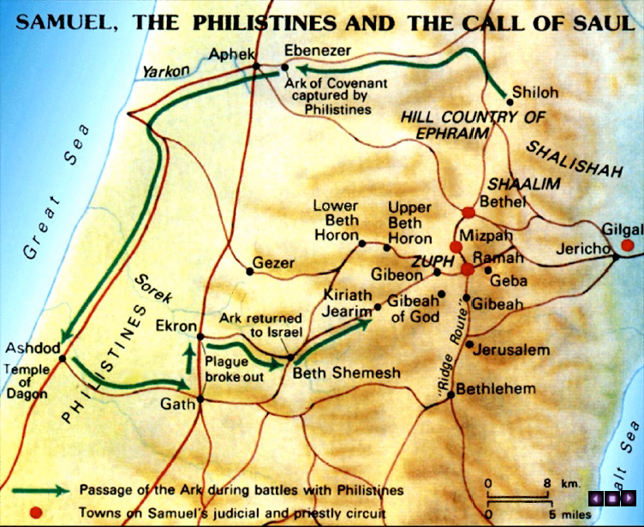

Slide 19
3. Samuel’s labors as judge 15-17
He does not seem to have judged them for many years
From the death of Eli to the reign of Saul
They respected Samuel
Ministered to whole nation - appointed leader by God

Slide 20
LESSONS
Peace with God precedes going to war for God
God helps His followers to fight their battles
3. God is love to those who repent & do His will
4. God is a opposed to those who do wickedly
5. Repentance is brought about by teaching
6. Calamities & sorrow often open one to teaching
7. The gospel is the power of God Rom. 1:16
8. Men can and do harden their hearts against the gospel Matt. 13:15

Slide 21
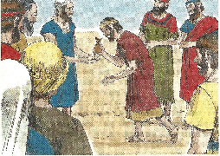
B. Appoints his sons as judges, 8:1-3
Samuel grown old, makes his sons judges in Beersheba 1-2
2. They pervert judgment 3

Slide 22
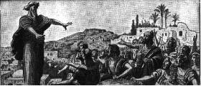
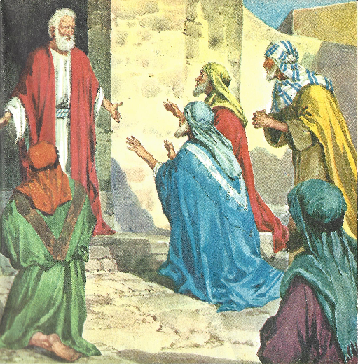
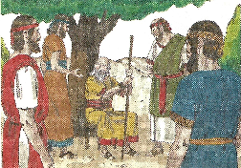
The people ask for a king, 8:4-22
1. The people ask for a king, 4-5

Slide 23
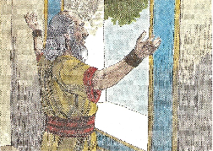
The people ask for a king, 8:4-22
2. The Lord instructs Samuel, 6-9
a. Samuel is displeased, and inquires of the Lord, 6
b. The Lord is also displeased; but directs Samuel to appoint them a king, and to show them solemnly the consequences of their choice, 7-9

Slide 24
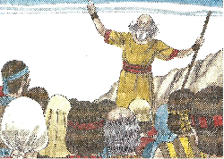
The people ask for a king 8:4-22
3. Samuel describes a king, 10-18
a. Your sons taken for army service
b. Military command system
c. Sons to plow his fields & make weapons
d. Daughters - perfumers, cooks, bakers
e. Best of land for his servants
f. 1/10 new tax of seed, vineyards for officers & servants
g. Male servants, female servants - best young men, donkeys - for his work
h. 1/10 of flock
i. You will cry out & God will not answer

Slide 25
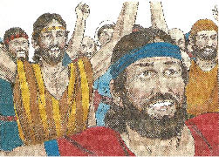
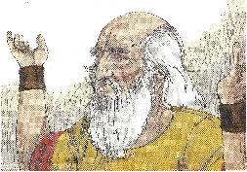
The people ask for a king 8:4-22
4. The people persist, 19-22

Slide 26
Lessons
The pull of the world
Pressure - prevailing social custom
What others do matters to us
Style of dress
Moral standards
Bible interpreted
2. The Patience of God

