Slide 1
Section One: Shiloh & Samuel 1:1—7:1
Samuel’s Birth and Call 1:1—3:21

Slide 2
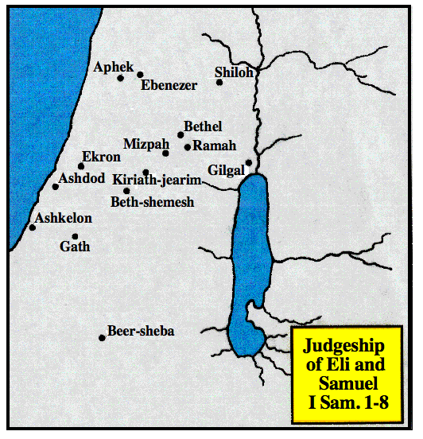

Slide 3
A. The birth & infancy of Samuel 1:1—2:11
1. Eli & Samuel simple surroundings 1:1-8
2. Hannah’s prayer and vow 1:9-18
3. Birth of Samuel 1:19-23
4. Dedication of the child 1:24-28
5. Hannah’s song 2:1-11

Slide 4
1. Eli & Samuel simple surroundings 1:1-8
a. Elkanah and his two wives, Peninnah and Hannah, 1-2
b. His annual worship at Shiloh and the portions he gave at such times to his wives, 3-5

Slide 5
1. Eli & Samuel simple surroundings 1:1-8
c. Hannah, being barren, is reproached by Peninnah, especially in their going up to Shiloh, 6, 7
d. Elkanah comforts her, 8
Lesson: Samuel’s mothers was a noble woman & a model mother. She could teach him & pray for him

Slide 6
2. Hannah’s prayer and vow 1:9-18
a. Her prayer & vow in the tabernacle — if God would give her a son, she would consecrate him to His service, 9-11.

Slide 7
2. Hannah’s prayer and vow 1:9-18
b. Eli, the high priest, indistinctly hearing her pray, charges her with being drunk, 12-14

Slide 8
2. Hannah’s prayer and vow 1:9-18
c. Her defense of her conduct, 15-16.
d. Eli, undeceived, blesses her & she takes courage, 17-18.
Lesson - It always pays, in the long run, to return to the Lord what He first has given us, whether it is time, money, service, talent or children.

Slide 9
3. Birth of Samuel 1:19-23
a. Hannah and Elkanah return home; she conceives, bears a son, & calls him Samuel, 19-20
b. Elkanah & his family go again to Shiloh to worship; but Hannah stays at home to nurse her child, purposing, as soon as he is weaned, to go and offer him to the Lord, according to her vow, 21-23

Slide 10
4. Dedication of the child 1:24-28
When weaned, she takes him to Shiloh, presents her child to Eli to be consecrated to the Lord
Offers a 3 year old bull, an ephah of flour, & a jug of wine, for his consecration
ephah - measure of grain 3/5 bushel - 6 gal.

Slide 11
5. Hannah’s song, 2:1-11
Hannah’s prophetic hymn, 1-10
Rejoiced in the personal deliverance from misery, 1
Rejoiced in the person of God - his holiness, strength & knowledge, 2-3
God judges and weighs actions
Rejoiced in the government of God, 4-8. The rich, powerful & blessed are humbled - the poor, weak & dishonorable are suddenly exalted - “brings low & exalts"
Rejoiced in her hope, 9-10. The righteous are under the watchful care of God; the wicked, are swallowed up in darkness when God’s light of grace is withdrawn. God will ultimately a) judge the whole world, b) give strength to his king c) exalt the horn or power of his anointed - the Messiah
Samuel minister to the Lord, 11

Slide 12
B. Eli’s rejection & Samuel’s call 2:12—3:21
1. Eli’s sinful sons 2:12-17
2. Samuel’s service in the tabernacle 2:18-26
3. A prophet’s message to Eli 2:27-35
4. Samuel’s first vision 3:1-10
5. Samuel established as a prophet 3:15-21

Slide 13
1. Eli’s sinful sons 2:12-17
a. Worthless men
b. Stole from God - lead people to despise the sacrifices
c. No knowledge of God

Slide 14
2. Samuel’s service in the tabernacle 2:18-26
a. Further account of Samuel, and of the divine blessing on Elkanah and Hannah, 18-21
b. Eli’s reprehensible remissness towards his sons in not restraining them, 22-26

Slide 15
3. A prophet’s message to Eli, 2:27-36
The message of God to Eli, & the prophecy of the down fall of his family, & the slaughter of his wicked sons, Hophni & Phinehas.
An unnamed man that served the purpose of God - a prophet

Slide 16
Lessons - contrast between Hannah & Eli
One humble, obscure - other prominent, priestly office
Joy of seeing child grow up noble, useful, honored, blessed - Pain of seeing children disgrace their name & office
Hannah talked with God - praised & thanked Him - Eli talked with his sons, feebly rebuked their wickedness.

Slide 17
Lessons - contrast between Hannah & Eli
Hannah blessed & given more children - Eli rebuked & his children sentenced to death
Both worshiped God
Hannah’s attitude was to honor God & give His work & glory first place in her heart.
Eli honored his sons above God in the matter of offerings, 2:29 See 2:30 for principle

Slide 18
4. Samuel’s first vision, 3:1-14
a. Samuel minister to the Lord before Eli, visions were rare - no vision spread abroad - breaking through - spread abroad, i.e. frequent, 1
b. He is three times called by the Lord, who informs him of the evils that shall be brought on the house of Eli, 2-14.

Slide 19
5. Samuel established as a prophet, 3:15-21
a. Eli inquires of Samuel what the Lord had said, 16-17.
b. He gives a faithful account of the what God said. Eli receives it with great submission, 18
c. Samuel prospers; is established as a prophet in Israel; and the Lord reveals himself to him in Shiloh, 19-21. in Shiloh - the location of the temple where the priests ministered
Lesson: True prophets deliver the joyous and the most unwelcome messages from Lord faithfully.

Slide 20
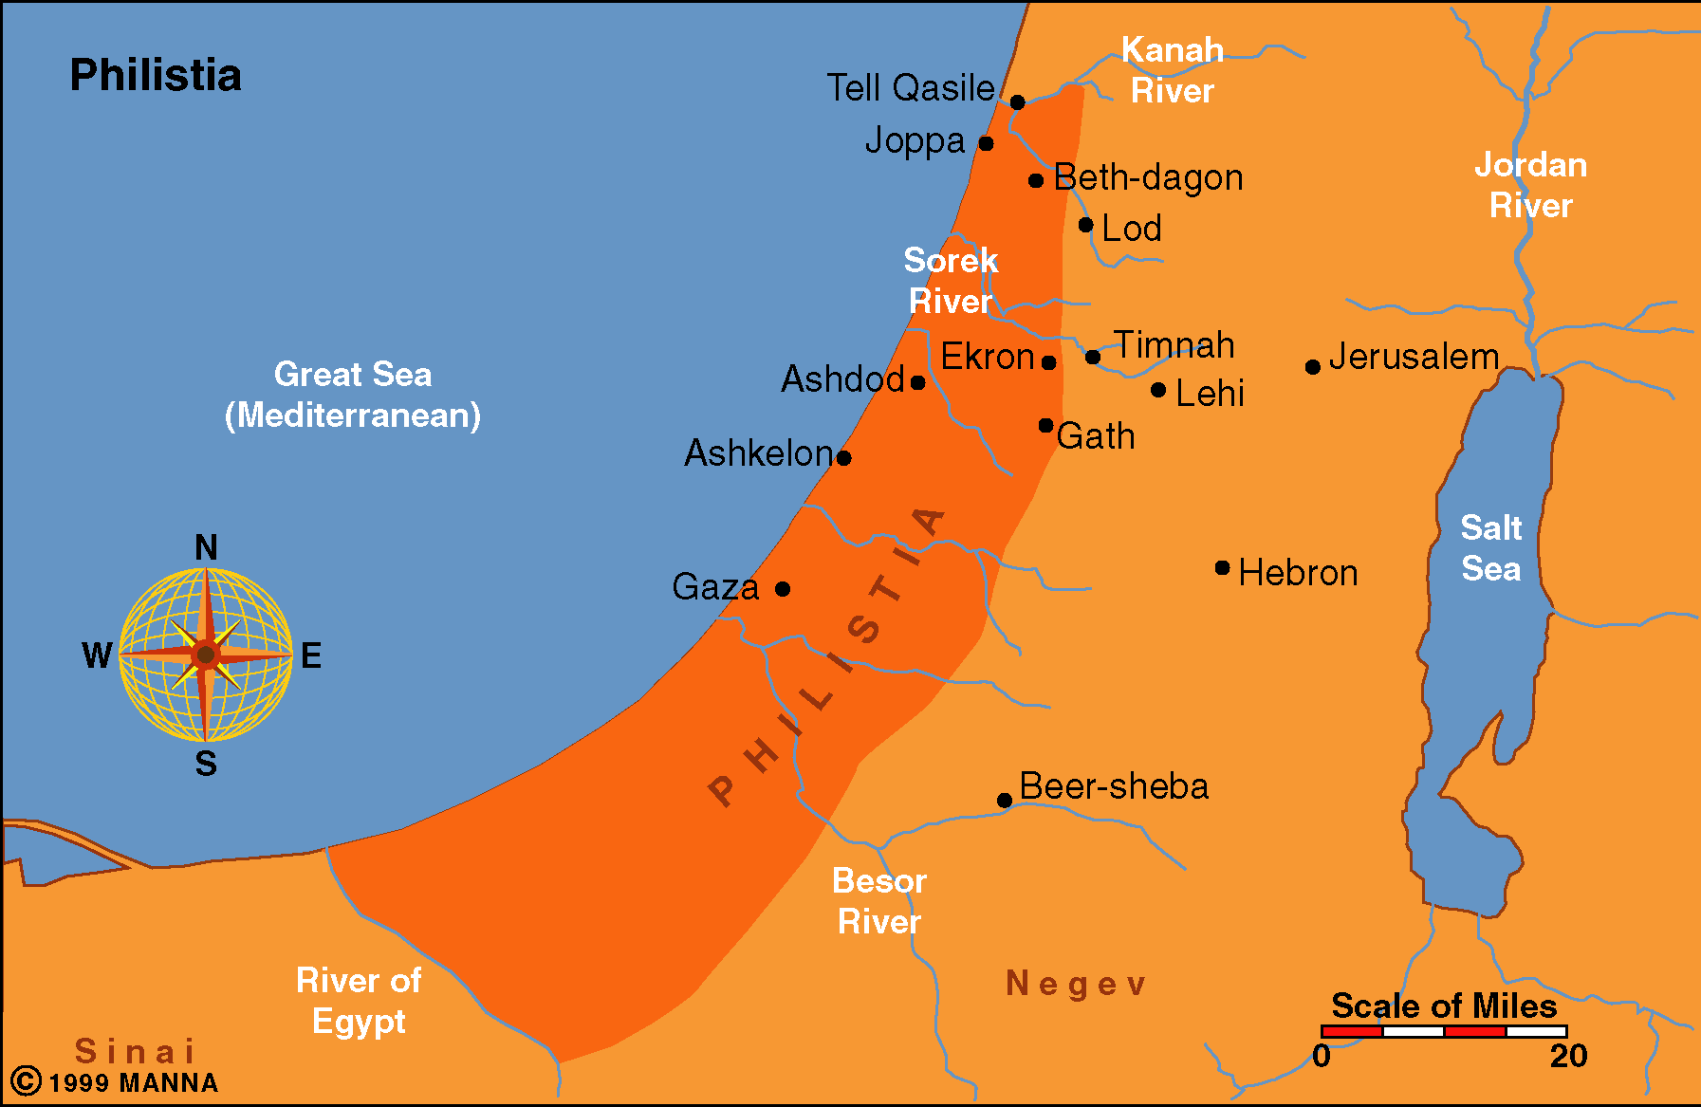

Slide 21
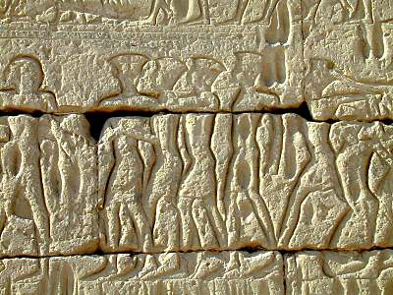
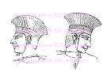
Depictions of the Philistines
In about 1175 B.C. Ramses III successfully stopped the Sea Peoples (including the Philistines) from invading Egypt. This account is recorded on the walls of his mortuary temple. The Philistines are known by their use of feather head dresses, swan decorations, two edged swords, spears, and rounded shields. The majority of the Sea Peoples are clean-shaven, but a few Philistines are depicted with beards.

Slide 22
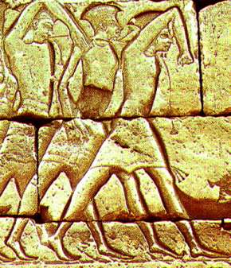
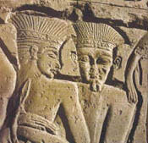
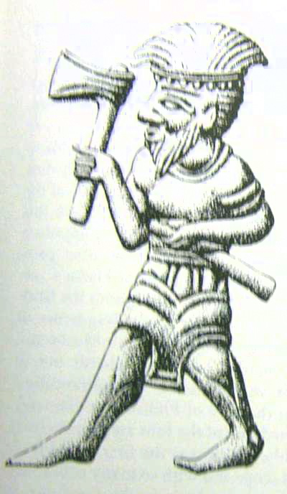
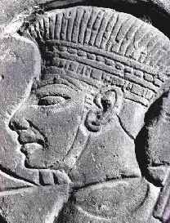
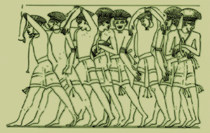

Slide 23
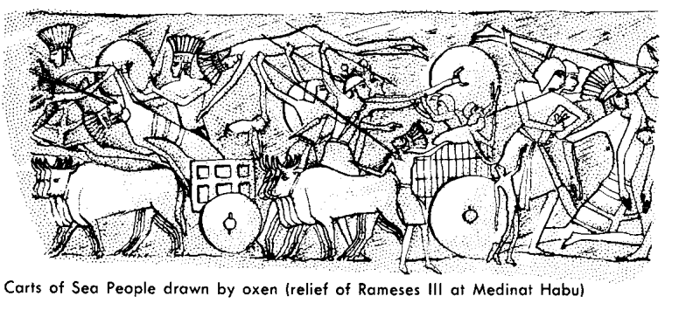
Carts of Sea People drawn by oxen
(relief of Rameses III at Medinat Habu)

Slide 24
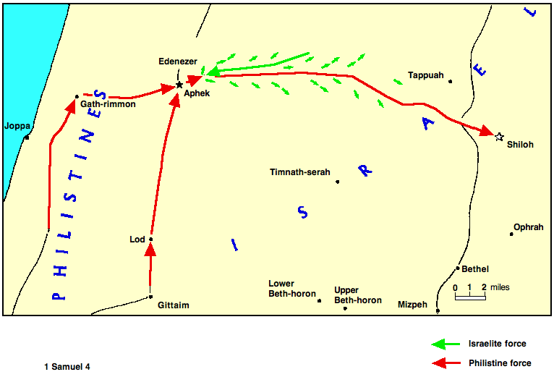

Slide 25
II. The Ark of The Lord 4:1-7:2

Slide 26
A. The ark is taken from Israel 4
1. First battle of Edenezer 4:1-4
Israel defeated by Philistines & lose 4000 men 1-2
Israel resolves to battle again & bring the ark of the Lord, with Hophni & Phinehas, the priests, into the camp 3-4

Slide 27
A. The ark is taken from Israel 4
Second battles of Ebenezer; Death of Eli's sons, ark taken 4:5-11
They bring the ark into the camp and become foolishly confident 5
At this the Philistines are dismayed 6-9
c. The battle commences; the Israelites again defeated - loss of 30,000 men; Hophni & Phinehas are among the slain; and the Lord’s ark is taken 10-11

Slide 28
Lessons 4:1-11
People long for the freedom & prosperity God originally designed
Must first have God’s favor to have true success
Revealed condition of God’s favor- to conform to His will
4. Conforming to God’s will: Exertion & Moral character
5. Striving alone for freedom & blessing ends in final disaster
6. A holy man & religious symbols no substitutes for righteousness
7. Salvation of the soul is according to God’s law Matt. 11:28, 29; Acts 4:12; 10:43; 1 Cor. 9:25; 2 Tim. 2:5
a. Outward failure remedied by a renewal of spiritual power
b. In times of failure - look to the spiritual condition of God’s servants not new expedients to subdue the world

Slide 29
How God fulfilled His words to Eli
Men adopted conduct different from their usual practice
Israelites who had despised ceremonies turn to the ark
Superstitious Philistines become determined to die like men
God sometimes does things not anticipated
The ark was used to inspire their enemies to fight harder
We cannot see all of God’s ways - His thoughts are not our thoughts

Slide 30
How God fulfilled His words to Eli
By the coincidence of unexpected human & divine actions the purposes of God are sometimes accomplished.
The sons of Eli would have been at Shiloh
God rules the lives of men & yet does not violate their free will
c. Confidently belief God’s promises - He can bring about the desired effect
d. Wicked men, whose judgment is delayed, should tremble because judgment comes like a thief in the night

Slide 31
A. The ark is taken from Israel 4
3. Death of Eli 4:12-18
4. Sadness in Israel 4:19-22

Slide 32
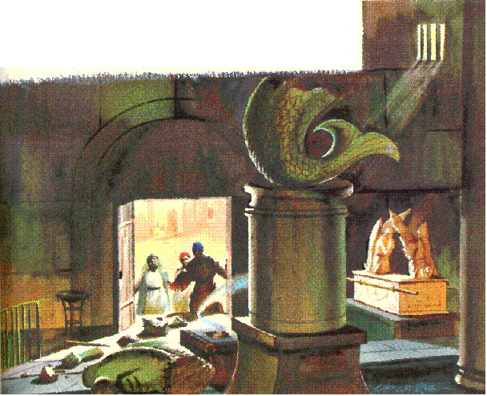
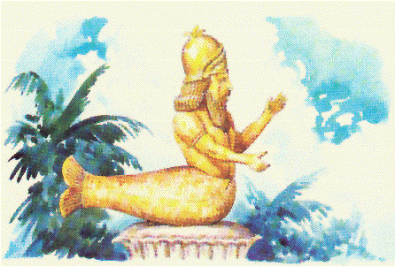
II. The Ark of The Lord 4:1-7:2
B. The ark moves among Philistines 5:1- Judgment on Philistines
1. The ark in Dagon's house 5:1-5

Slide 33
A foreshadowing of the the fall of heathenism
Heathenism is doomed to perish
By contract with God’s truth
By the power of God exercised through his truth
After repeated efforts to revive it.
All efforts to dishonor God’s revelation of Himself.
The gospel should have no rivals

Slide 34
B. The ark moves among Philistines 5:1-12 Judgment on Philistines
2. The Philistines are also struck with a grievous disease, 6

Slide 35
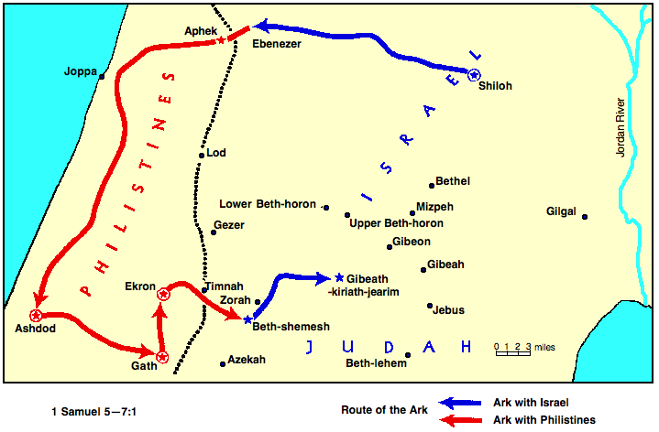

Slide 36
B. The ark moves among Philistines 5:1-12 Judgment on Philistines
2. The ark in Gath 5:7-9
People of Ashdod refuse to let the ark stay with them - the lords of the Philistines, with whom they consulted, order it to be carried to Gath, 7-8
They do so; & God smites the inhabitants of that city, young & old, with same disease, 9
3. The ark in Ekron 5:10-12
A heavy destruction falls upon that city
Resolve to send it back to Shiloh

Slide 37
C. The ark is returned to Israel 6—7:2
1. The decision to return the ark 6:1-9
After seven months in the land of the Philistines, they consult their priests & diviners about sending the ark to Shiloh, 1-2.
Advised to sent it back with a trespass offering of 5 golden tumors & 5 golden mice, 3-6.
Advised to sent it back on a new cart, drawn by two milch cows, from who their calves should be tied up - if these cows take the way of Beth-shemesh, going to the Israelite border, then the Lord had afflicted them; if not, then their evils were accidental, 7-9.

Slide 38
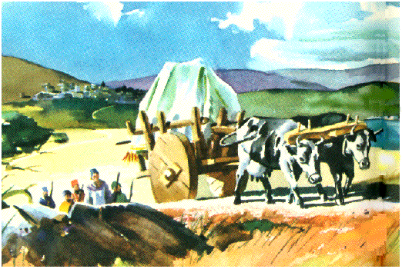
C. The ark is returned to Israel 6—7:2
2. The ark returned 6:10-18
Do as directed; & the cow takes the way of Beth-shemesh, 10-13

Slide 39
C. The ark is returned to Israel 6—7:2
2. The ark returned 6:10-18
They stop in the field of Joshua & the men of Beth-shemesh take them & offer them to the Lord for a burnt offering & split the wood of the cart to burn them & make many other offerings, 14-15
The offerings of the five lords of the Philistines, 16-18

Slide 40
C. The ark is returned to Israel 6-7:2
3. Men of Beth-shemesh smitten 6:19-21
For too curiously looking into the ark, the men of Beth-shemesh are smitten of the Lord, 19-20
They send to the inhabitants of Kiriath-jearim, that they may take away the ark, 21

Slide 41
Lessons
Keep watch over the first risings of a spirit of regarding divine things lightly.
Cultivate in young & old reverence for all things connected with worship of God.
The severity of God is really mercy to his creatures as a whole.

Slide 42
C. The ark is returned to Israel 6-7:2
4. The ark in the house of Abinadab 7:1-2

Slide 43
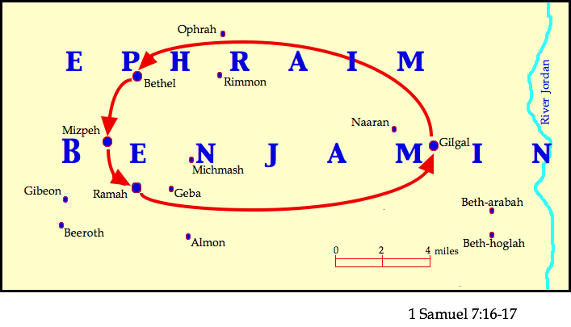

Slide 44
