Slide 1
The Time of Youth 11:9, 10
A. A Positive Admonition 11:9
9 Rejoice, young man, during your childhood, and let your heart be pleasant during the days of young manhood. And follow the impulses of your heart and the desires of your eyes. Yet know that God will bring you to judgment for all these things.
B. A Negative Admonition 11:10
10 So, remove vexation from your heart and put away pain from your body, because childhood and the prime of life are fleeting.

Slide 2
The Time of Youth 11:9, 10
A. A Positive Admonition 11:9
9 Rejoice, young man, during your childhood, and let your heart be pleasant during the days of young manhood. And follow the impulses of your heart and the desires of your eyes. Yet know that God will bring you to judgment for all these things.
B. A Negative Admonition 11:10
10 So, remove vexation from your heart and put away pain from your body, because childhood and the prime of life are fleeting.

Slide 3
Ecclesiastes 12

Slide 4
I. The Time of Old Age
Ecc. 12:1-7

Slide 5
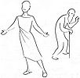
A. General Description of Old Age 12:1-2
1 Remember also your Creator in the days of your youth, before the evil days come and the years draw near when you will say, “I have no delight in them”;
2 before the sun, the light, the moon, and the stars are darkened, and clouds return after the rain;
Evil Days
Night scene
Youth
Notes:
Remember - recall God’s claims on you
Creator - lit. creators - majesty, Godhead
Not created for self-gratification
Created - to glorify God, follow his will, responsible to Him, all comes from Him
before evil days - days of affliction, bad days
days become years - no delight
Barzillai, 2 Sam. 19:35
Youth - lights shine - joy, divine favor
Sun, moon, stars - kinds & classes of joy
Old age - winter, rainy season, clouds, joy dimmed, one storm after another
darkening light = sadness

Slide 6
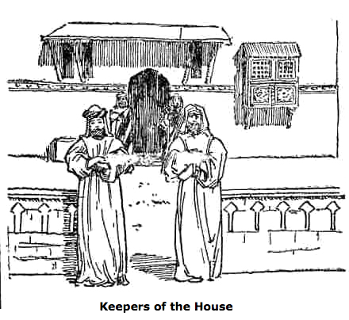
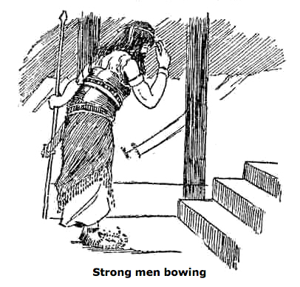
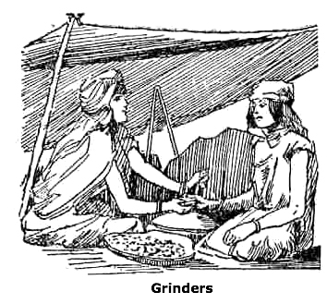
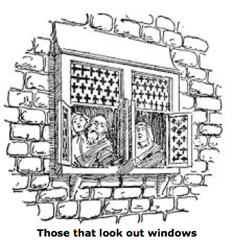
B. The Infirmities of Old Age 12:3‑4
3 in the day that the watchmen of the house tremble, and mighty men stoop, the grinding ones stand idle because they are few, and those who look through windows grow dim;
Hands
Legs
Teeth
Eyes
Notes:
old age - dilapidated house
body likened to house - Job 4:19; 2 Cor 5:lf.; 2 Pet 1:13ff.
watchmen - hands & arms
mighty men - legs feeble & bent
grinding ones - teeth
those who look - eyes
doors - ears closed to sound
arise at sound - light sleep in morning

Slide 7
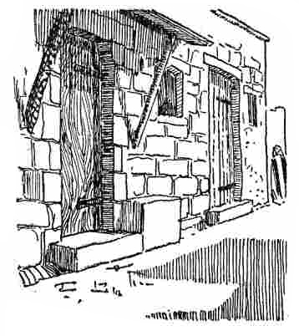
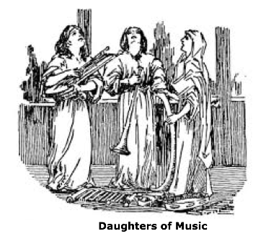
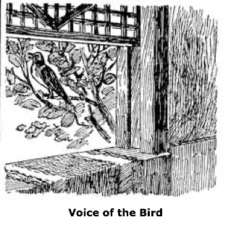
B. The Infirmities of Old Age 12:3‑4
4 and the doors on the street are shut as the sound of the grinding mill is low, and one will arise at the sound of the bird, and all the daughters of song will sing softly.
Doors on the Street Shut
Cannot Sing
Ears
Light Sleep
Notes:
old age - dilapidated house
body likened to house - Job 4:19; 2 Cor 5:lf.; 2 Pet 1:13ff.
watchmen - hands & arms
mighty men - legs feeble & bent
grinding ones - teeth
those who look - eyes
doors - ears closed to sound
arise at sound - light sleep in morning

Slide 8
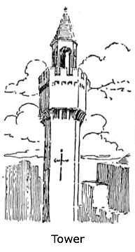
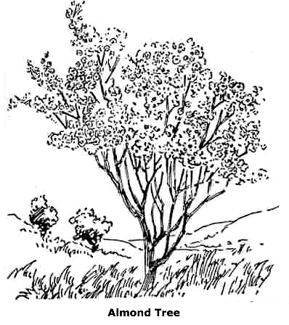
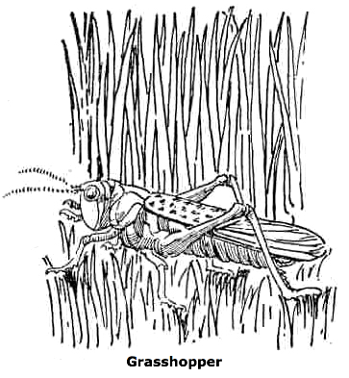
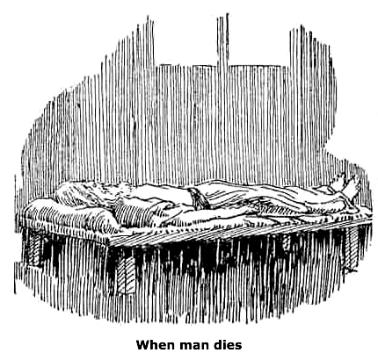
C. En Route to the Grave 12:5
5 Furthermore, men are afraid of a high place and of terrors on the road; the almond tree blossoms, the grasshopper drags himself along, and the caperberry is ineffective. For man goes to his eternal home while mourners go about in the street.
Fear of climbing
or walking
White hair
Dragging gait
Notes:
fear of heights - hard to climb & not to fall
terrors on the road - accidents easy, reflexes slow
almond tree - white flowers, white hair, sign of decay
grasshopper - just hatched locust, walks clumsily and slowly
caperberry - of stimulating desire
goes - going - symptoms of approaching death
eternal home - long house - this life is temporary - then eternity
mourner - wait to ply their trade
Remember God before these days come.

Slide 9
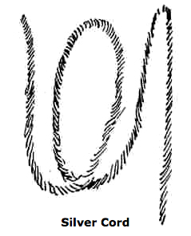
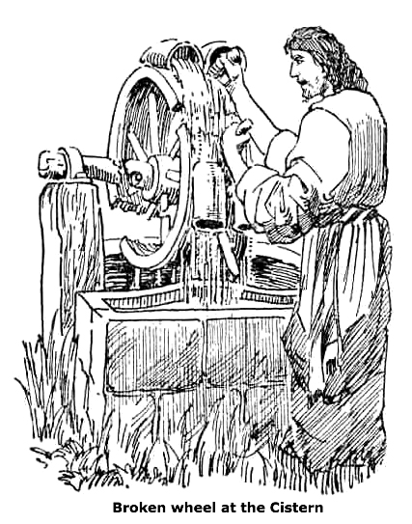
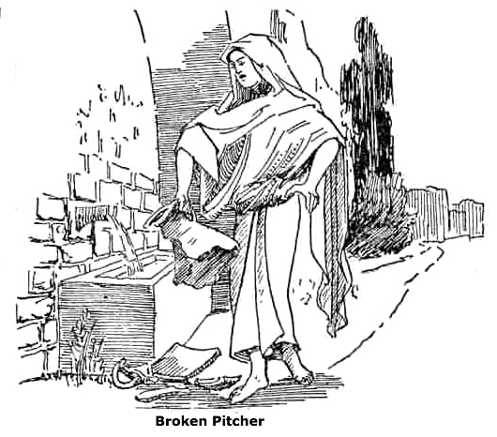
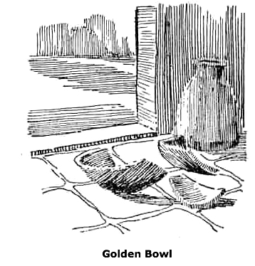
D. The Finality of Death 12:6
6 Remember Him before the silver cord is broken and the golden bowl is crushed, the pitcher by the well is shattered and the wheel at the cistern is crushed;
Living power - soul
Fragile Life
The body
Bodily Organ Fail
Notes:
silver cord - thread of life, living power, soul
golden bowl - reservoir of an oil lamp, light extinguished, the body
silver, gold - preciousness
Pitcher shattered - earthen vessel smashed on stones at well, fragile, life is fragile
wheel crushed - draws water from a deep well, it fails & rope & bucket fall, no water drawn, heart & breathing stop, engine of life fails

Slide 10
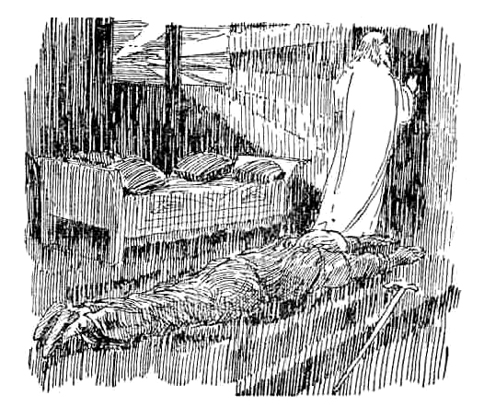
E. The Result of Death 12:7
7 then the dust will return to the earth as it was, and the spirit will return to God who gave it.
Spirit returns to God
Notes:
body returns to dust - original material, Gen 2:7; 3:19
spirit returns to God - a future for the soul, brought to God after death, final judgment
remember the Creator

Slide 11
II. EPILOGUE: Solomon's Claims
Ecc. 12:8‑11

Slide 12
A. His Basic Thesis Regarding Life 12:8
8 “Vanity of vanities,” says the Preacher, “all is vanity!”
Notes:
life under the sun - fragile, unsatisfying, impossible to find true happiness
behind all is God - will do right - must trust oneself to His care and guidance

Slide 13
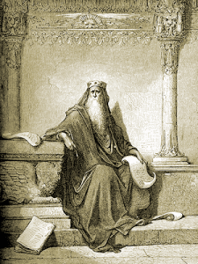
B. His Credentials to Speak 12:9
9 In addition to being a wise man, the Preacher also taught the people knowledge; and he pondered, searched out and arranged many proverbs.
Notes:
claims the gift of wisdom
Taught the people of his age as a sage
Wise - ethically & religiously, fear God
3rd person speech common in Bible: Daniel, John’s gospel - confirm authority of testimony
knowledge - leader of godly thought
pondered, searched, arranged - careful scholar

Slide 14
C. His Claims about His Book 12:10, 11
10 The Preacher sought to find delightful words and to write words of truth correctly.
11 The words of wise men are like goads, and masters of these collections are like well-driven nails; they are given by one Shepherd.

Slide 15
D. His Admonition Regarding Study 12:12
12 But beyond this, my son, be warned: the writing of many books is endless, and excessive devotion to books is wearying to the body.

Slide 16
III. EPILOGUE: Solomon's Conclusion
Ecc. 12:13‑14

Slide 17
A. The Fear of God 12:13
13 The conclusion, when all has been heard, is: fear God and keep His commandments, because this applies to every person.

Slide 18
B. The Final Judgment 12:14
14 For God will bring every act to judgment, everything which is hidden, whether it is good or evil.

Slide 19
The Ten Vanities
2:15‑16 Human Wisdom
2:19‑21 Human Labor
2:26 Human Purpose
4:4 Human Rivalry
4:7 Human Avarice
4:16 Human Fame
5:10 Human Insatiety
6:9 Human Coveting
7:6 Human Frivolity
8:10,14 Human Awards

