Slide 1
Section One: Shiloh & Samuel 1:1—7:1
Samuel’s Birth and Call 1:1—3:21

Slide 2
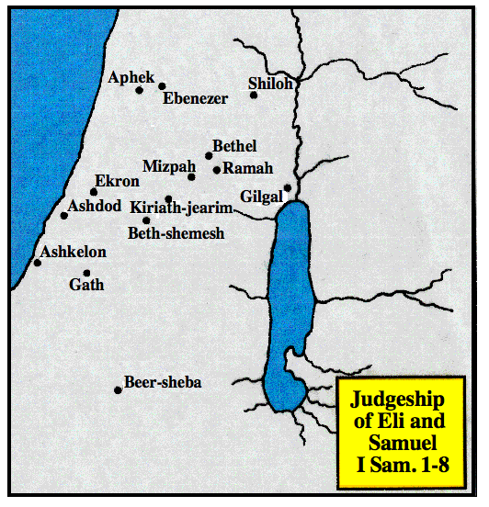

Slide 3
A. The birth & infancy of Samuel 1:1—2:11
1. Eli & Samuel simple surroundings 1:1-8
2. Hannah’s prayer and vow 1:9-18
3. Birth of Samuel 1:19-23
4. Dedication of the child 1:24-28
5. Hannah’s song 2:1-11

Slide 4
1. Eli & Samuel simple surroundings 1:1-8
a. Elkanah and his two wives, Peninnah and Hannah, 1-2
b. His annual worship at Shiloh and the portions he gave at such times to his wives, 3-5

Slide 5
1. Eli & Samuel simple surroundings 1:1-8
c. Hannah, being barren, is reproached by Peninnah, especially in their going up to Shiloh, 6, 7
d. Elkanah comforts her, 8
Lesson: Samuel’s mothers was a noble woman & a model mother. She could teach him & pray for him

Slide 6
2. Hannah’s prayer and vow 1:9-18
a. Her prayer & vow in the tabernacle — if God would give her a son, she would consecrate him to His service, 9-11.

Slide 7
2. Hannah’s prayer and vow 1:9-18
b. Eli, the high priest, indistinctly hearing her pray, charges her with being drunk, 12-14

Slide 8
2. Hannah’s prayer and vow 1:9-18
c. Her defense of her conduct, 15-16.
d. Eli, undeceived, blesses her & she takes courage, 17-18.
Lesson - It always pays, in the long run, to return to the Lord what He first has given us, whether it is time, money, service, talent or children.

Slide 9
3. Birth of Samuel 1:19-23
a. Hannah and Elkanah return home; she conceives, bears a son, & calls him Samuel, 19-20
b. Elkanah & his family go again to Shiloh to worship; but Hannah stays at home to nurse her child, purposing, as soon as he is weaned, to go and offer him to the Lord, according to her vow, 21-23

Slide 10
4. Dedication of the child 1:24-28
When weaned, she takes him to Shiloh, presents her child to Eli to be consecrated to the Lord
Offers a 3 year old bull, an ephah of flour, & a jug of wine, for his consecration
ephah - measure of grain 3/5 bushel - 6 gal.

Slide 11
5. Hannah’s song, 2:1-11
Hannah’s prophetic hymn, 1-10
Rejoiced in the personal deliverance from misery, 1
Rejoiced in the person of God - his holiness, strength & knowledge, 2-3
God judges and weighs actions
Rejoiced in the government of God, 4-8. The rich, powerful & blessed are humbled - the poor, weak & dishonorable are suddenly exalted - “brings low & exalts"
Rejoiced in her hope, 9-10. The righteous are under the watchful care of God; the wicked, are swallowed up in darkness when God’s light of grace is withdrawn. God will ultimately a) judge the whole world, b) give strength to his king c) exalt the horn or power of his anointed - the Messiah
Samuel minister to the Lord, 11

Slide 12
B. Eli’s rejection & Samuel’s call 2:12—3:21
1. Eli’s sinful sons 2:12-17
2. Samuel’s service in the tabernacle 2:18-26
3. A prophet’s message to Eli 2:27-35
4. Samuel’s first vision 3:1-10
5. Samuel established as a prophet 3:15-21

Slide 13
1. Eli’s sinful sons 2:12-17
a. Worthless men
b. Stole from God - lead people to despise the sacrifices
c. No knowledge of God

Slide 14
2. Samuel’s service in the tabernacle 2:18-26
a. Further account of Samuel, and of the divine blessing on Elkanah and Hannah, 18-21
b. Eli’s reprehensible remissness towards his sons in not restraining them, 22-26

Slide 15
B. Eli’s rejection & Samuel’s call 2:12—3:21
3. A prophet’s message to Eli 2:27-35
4. Samuel’s first vision 3:1-10
5. Samuel established as a prophet 3:15-21

Slide 16
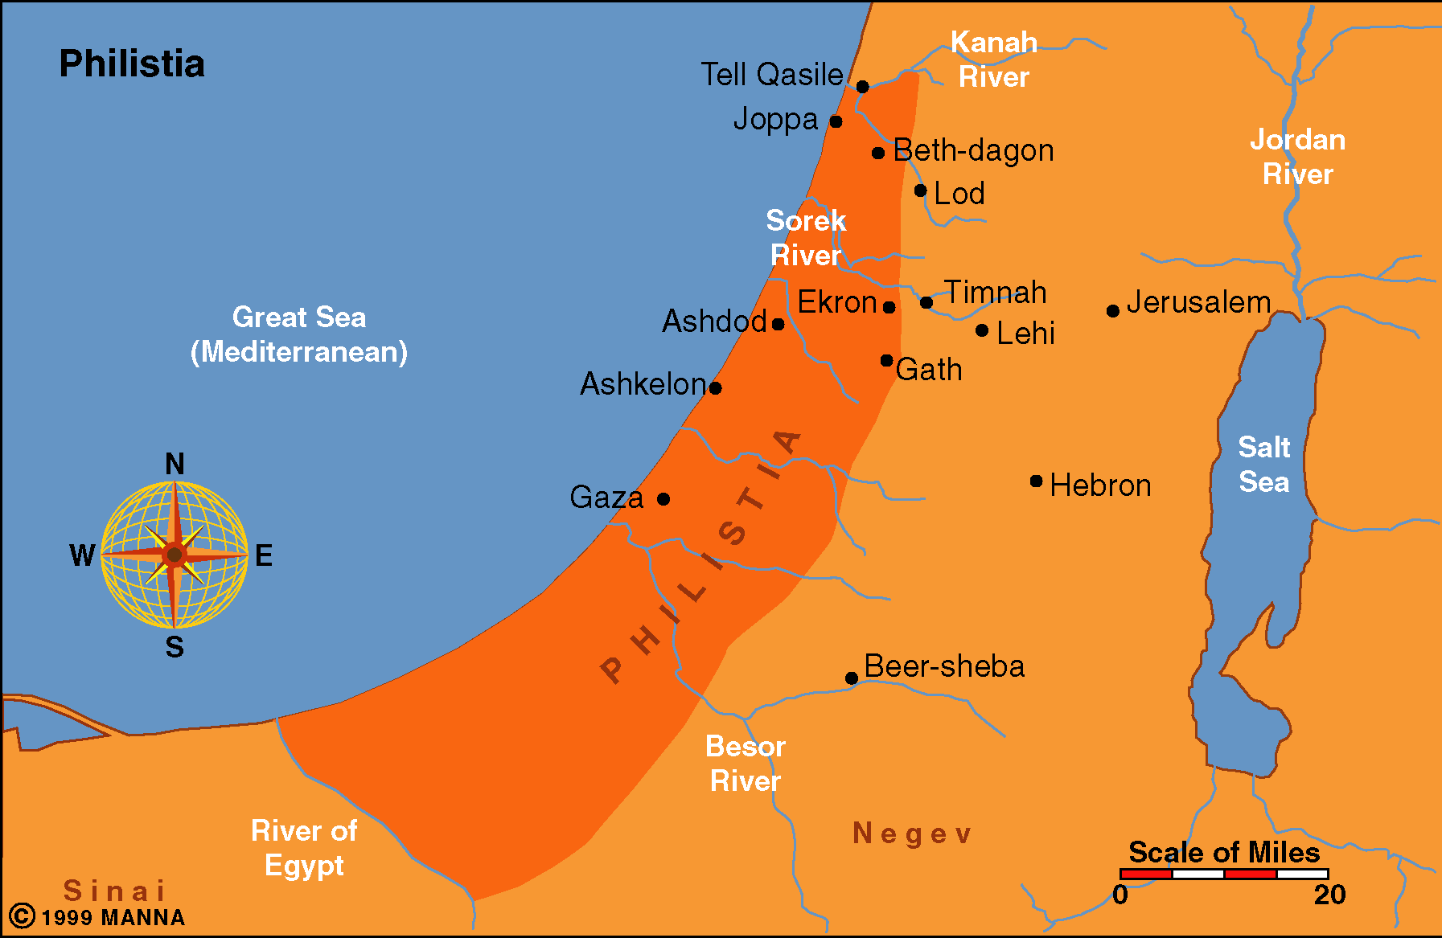

Slide 17
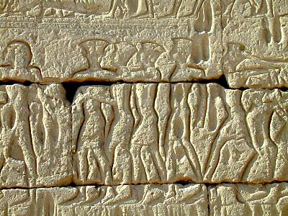
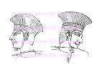
Depictions of the Philistines
In about 1175 B.C. Ramses III successfully stopped the Sea Peoples (including the Philistines) from invading Egypt. This account is recorded on the walls of his mortuary temple. The Philistines are known by their use of feather head dresses, swan decorations, two edged swords, spears, and rounded shields. The majority of the Sea Peoples are clean-shaven, but a few Philistines are depicted with beards.

Slide 18
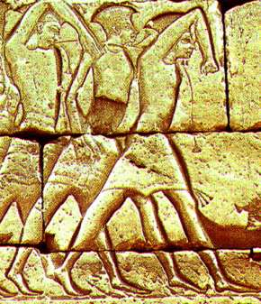
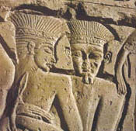
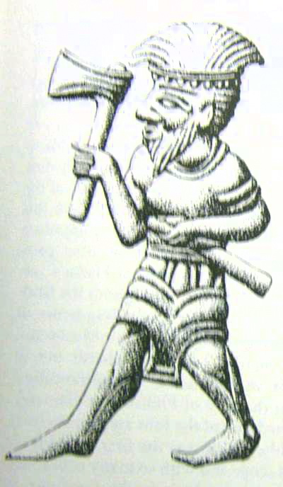
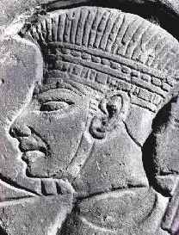
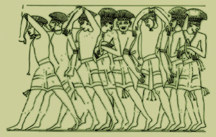

Slide 19
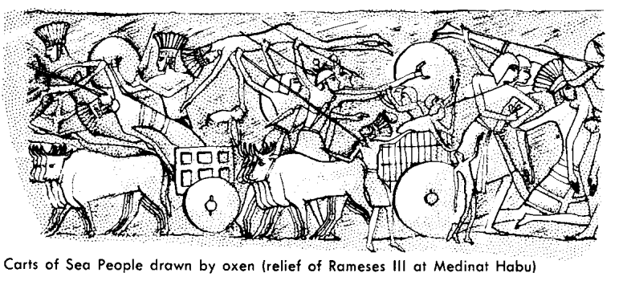
Carts of Sea People drawn by oxen
(relief of Rameses III at Medinat Habu)

Slide 20
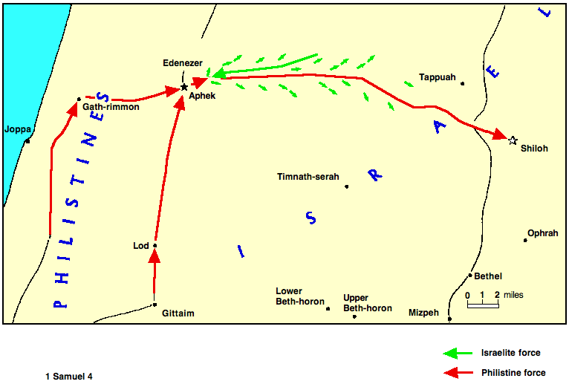

Slide 21
II. The Ark of The Lord 4:1-7:2
A. The ark is taken from Israel 4
1. First battle of Edenezer 4:1-4
Israel defeated by Philistines & lose 4000 men 1-2
b. Israel resolves to battle again & bring the ark of the Lord, with Hophni & Phinehas, the priests, into the camp 3-4

Slide 22
II. The Ark of The Lord 4:1-7:2
A. The ark is taken from Israel 4
Second battles of Ebenezer; Death of Eli's sons, ark taken 4:5-11
They bring the ark into the camp and become foolishly confident 5
At this the Philistines are dismayed 6-9
c. The battle commences; the Israelites again defeated - loss of 30,000 men; Hophni & Phinehas are among the slain; and the Lord’s ark is taken 10-11
3. Death of Eli 4:12-18
4. Sadness in Israel 4:19-22

Slide 23
Lessons 4:1-11
People long for the freedom & prosperity God originally designed
One must first have God’s favor to have true success
Revealed condition of God’s favor- to conform to His will
4. Conforming to God’s will: Exertion & Moral character
5. Striving alone for freedom & blessing ends in final disaster
6. A holy man & religious symbols are not substitutes for righteousness
7. Salvation of the soul is according to God’s law Matt. 11:28, 29; Acts 4:12; 10:43; 1 Cor. 9:25; 2 Tim. 2:5
a. Outward failure remedied by a renewal of spiritual power
b. In times of failure - look to the spiritual condition of God’s servants not new expedients to subdue the world

Slide 24
How God fulfilled His words to Eli
Men adopted conduct different from their usual practice
The Israelites who had despised ceremonies turn to the ark
The superstitious Philistines become determined to die like men
God sometimes does things not anticipated
The ark was used to inspire their enemies to fight harder
We cannot see all of God’s ways - His thoughts are not our thoughts
By the coincidence of unexpected human & divine actions the purposes of God are sometimes accomplished.
The sons of Eli would have been at Shiloh
God rules the lives of men & yet does not violate their free will
c. Confidently belief God’s promises - He can bring about the desired effect
d. Wicked men, whose judgment is delayed, should tremble because judgment comes like a thief in the night

Slide 25
II. The Ark of The Lord 4:1-7:2
A. The ark is taken from Israel 4
3. Death of Eli 4:12-18
4. Sadness in Israel 4:19-22

Slide 26
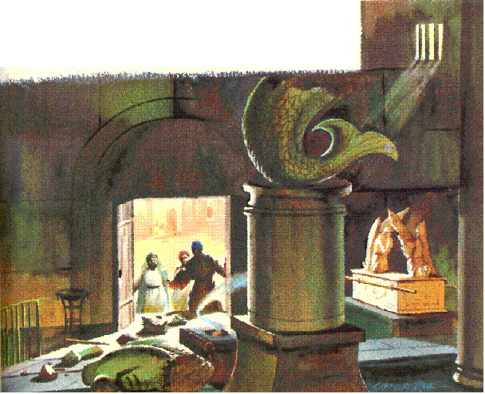
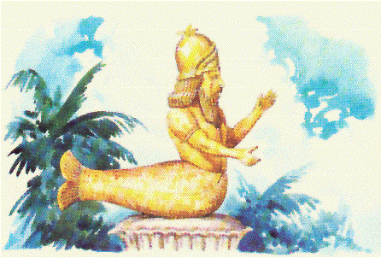
II. The Ark of The Lord 4:1-7:2
B. The ark moves among Philistines 5 Judgment on Philistines
1. The ark in Dagon's house 5:1-5

Slide 27
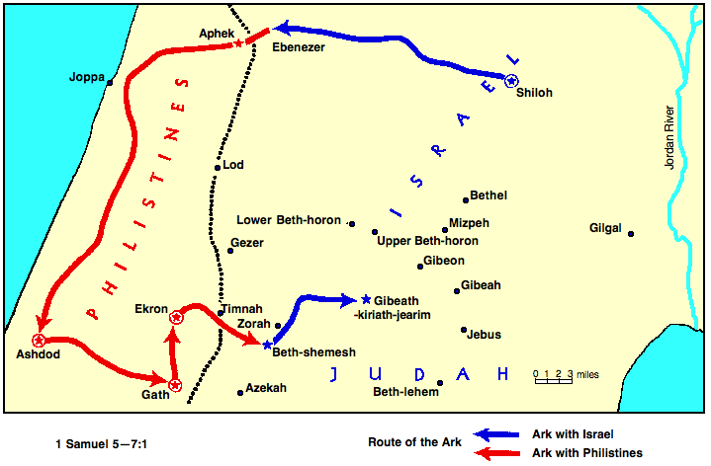

Slide 28
II. The Ark of The Lord 4:1-7:2
B. The ark moves among Philistines 5 Judgment on Philistines
2. The ark in Gath 5:7-9
3. The ark in Ekron 5:10-12

Slide 30
Dagon Broken Before The Ark

Slide 31
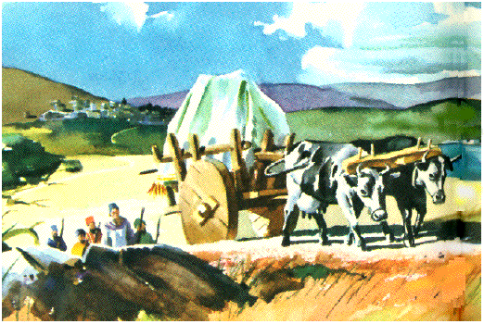
II. The Ark of The Lord 4:1-7:2
C. The ark is returned to Israel 6-7:2
1. The decision to return the ark 6:1-9
2. The ark returned 6:10-18

Slide 32
II. The Ark of The Lord 4:1-7:2
C. The ark is returned to Israel 6-7:2
3. Men of Beth-shemesh smitten 6:19-21
4. The ark in the house of Abinadab 7:1-2

Slide 33
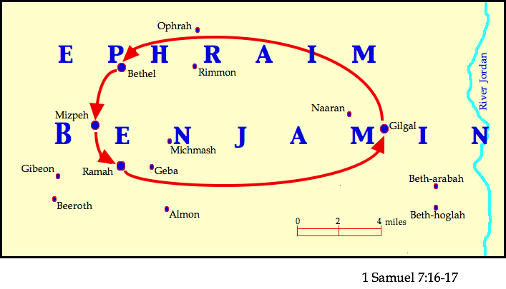

Slide 36
